Slide 1
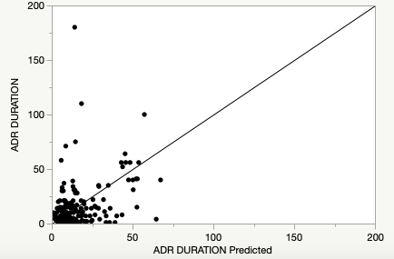
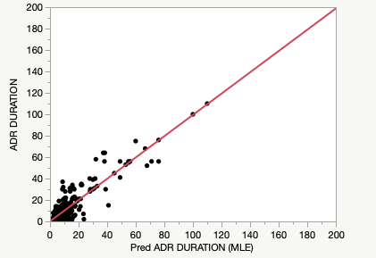
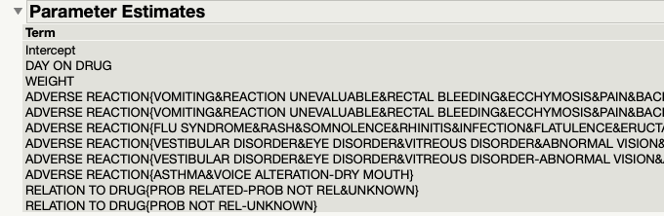
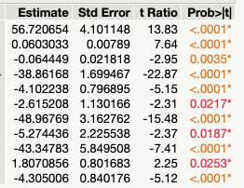
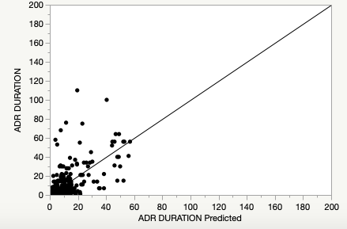
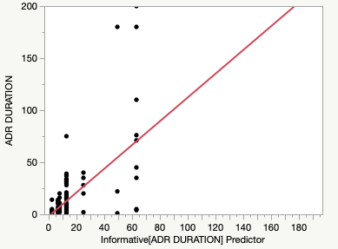
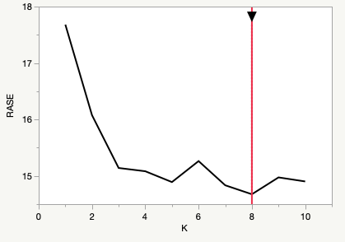
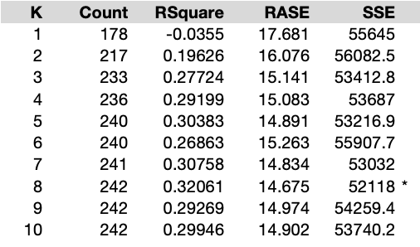
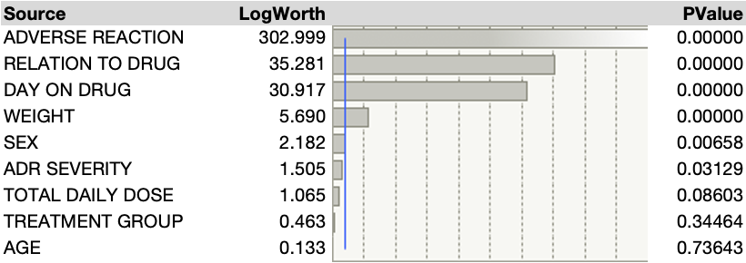
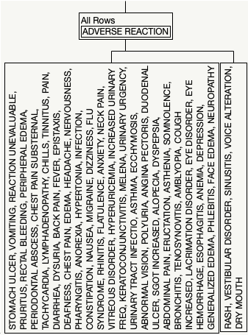
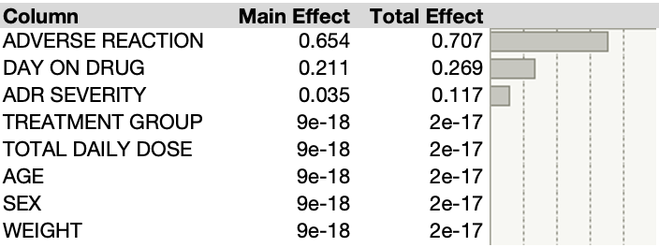
Imputation Strategies for Different Categories of Missing Data
Karthik Chalumuri
Dr. Philip Ramsey
Department of Mathematics and Statistics, University of New Hampshire, Durham, NH 03834
Introduction
Chosen Imputation Methods
Conclusions
Missing data in research can pose a challenge as researchers attempt to publish reliable findings based on the limited available information.
Tools to address missing data exist but are underused and may not address all types of missingness resulting in missing stories and information that can have real-world impacts on system and policy-level decision making (Dziura et al.) .
Missing Completely at Random
Stepwise Regression
Missing at Random
K Nearest Neighbors
Maximum Likelihood Estimation
Missing Not at Random
Partition Predictive Modeling using a Decision Tree with Informative Missing
Predicts response value for a given observation using responses of the observations in that observation’s local neighborhood.
Finds estimates of the treatment differences that maximize the probability of the observed data.
step-by-step iterative construction involving selecting independent variables to be used in a final model. It adds or removes potential explanatory variables in succession and tests for statistical significance after each iteration.
The forward selection approach starts with nothing and adds each new variable incrementally, testing for statistical significance (Hayes).
An algorithm evaluates all features to determine the best feature and the best value to split the data. It considers the missing values as a separate category during the splitting process. It evaluates whether splitting based on the available values or considering the missing values separately would lead to the most informative and discriminative splits. (Kurre).
Missing Completely at Random
Actual by Predicted Plots
Regardless of the percentage missing of the response, “Day on Drug” was shown to be the most important predictor for the response, followed by “Weight.”
The model does not predict the actual values well with clustering and deviations from the line of best fit.
Research Questions:
  How do the imputation strategies for analyzing missing data influence the conclusions drawn on a data set?
  To what extent are these strategies able to tell the stories and predict information of missing data?
Data
Missing at Random
Data consists of 357 survey responses who had an adverse reaction to taking a drug or a placebo.
  Treatment Group: placebo or standard drug
  Total Daily Dose: 0 to 40
  Days on Drug: 0 to 806
  Age: 23 to 81
  Sex: Male (M) = 60 or Female (F) = 297
  Weight: 114 to 331 lbs.
  Adverse Reaction
  Adverse Drug Reaction Severity: mild, moderate, or severe
  Relation to Drug: probably not related, probably related, unknown
  Adverse Drug Reaction Length (Response)
Results
The K = 8 model had the lowest RASE for the validation set and performs the best.
The Maximum Likelihood Estimate “Adverse Reaction” has the greatest total effect and contribution to the variance in the response. The same conclusions are drawn even after adjusting the rates of response for the 4 stacks.
The MLE model does not predict well the true values. There is significant clustering.
The KNN Algorithm performs the best out of all imputation strategies conducted regardless of category.
Missing Completely at Random
Main Categories of Missing Data
Experimented with varying percentages of randomly missing data to replicate a data crash.
(10%, 20%, 40%, 60%)
Parameter Estimates table after modeling a 40% response data loss
Missing Controlled at Random:
  The likelihood of missing data is unrelated to any observed or unobserved variables.
Missing at Random:
  The likelihood of missing data is related to observed variables but not to unobserved variables
Missing Not at Random:
  The likelihood of missing data depends on the unobserved data
Implementation
Missing at Random
Missing Not at Random
The first two nodes in the partition are types of “Adverse Reaction” indicating that it is the most prominent parameter.
The Resampled Inputs shows “Adverse Reaction” has greatest total effect.
This model performs the worst of all tested with distinct patterns and extreme variance.
Implementation
Observed if Males below 60, Males above 60, Females below 60, and Females above 60 each had a unique percentage of not responding.
K Nearest Neighbors Algorithm Response
Maximum Likelihood Estimate effect Summary
Missing Not at Random
References
Implementation
Those with a “mild” ADR Severity classification choose not to report ADR Duration due to a belief that their response is not as accurate compared to those with a “moderate,” or “severe” ADR Severity.
Dziura, James D, et al. “Strategies for Dealing with Missing Data in Clinical Trials: From Design to Analysis.” The Yale Journal of Biology and Medicine, vol. 86, no. 3, 2013, pp. 343–58, www.ncbi.nlm.nih.gov/pmc/articles/PMC3767219/.
Firdose, Tahera. tahere-firdose.medium.com. 30 May 2023. 31 March 2024.
Hayes, Adam. “Stepwise Regression.” Investopedia, 2019, www.investopedia.com/terms/s/stepwise-regression.asp.
King, Caroline, et al. “Addressing Missing Data in Substance Use Research: A Review and Data Justice-Based Approach.” Journal of Addiction Medicine, vol. 14, no. 6, 5 Mar. 2020, pp. 454–456, https://doi.org/10.1097/adm.0000000000000644. Accessed 8 Mar. 2021.
Kurre, Aishwarya. “How Decision Trees Handle Missing Values: A Comprehensive Guide.” Pickl.AI, 16 Aug. 2023, www.pickl.ai/blog/how-decision-trees-handle-missing-values-a-comprehensive-guide/#A_step-by-step_explanation_of_how_decision_trees_handle_missing_values. Accessed 7 Apr. 2024.
Schafer, Joseph L. and John W. Graham. "Missing data: Our view of the state of the art." Psychological Methods 7.2 (2002): 147-177.
“What Are the Best Practices for Handling Missing Data in Your Data Sets?” Www.linkedin.com, www.linkedin.com/advice/3/what-best-practices-handling-missing-data-your-sets. Accessed 4 Apr. 2024.
“What Is the K-Nearest Neighbors Algorithm? | IBM.” Www.ibm.com, www.ibm.com/topics/knn#:~ :text=The%20k%20value% 20in%20the.
Independent Resampled Inputs Summary Report &
Partition Tree for ADR Duration with 1 Split

