Slide 1
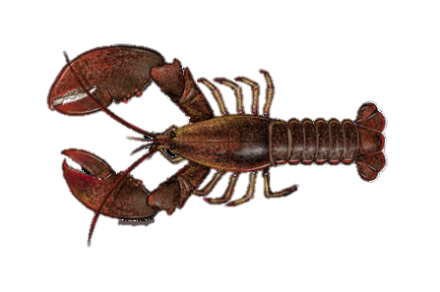
Effects of Ocean Acidification on
Foraging Behavior of Juvenile American Lobsters
(Homarus americanus)
Todd Stelling & Brittany Jellison

Slide 2
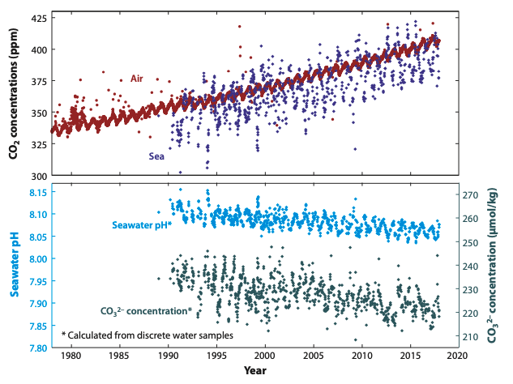
Doney et al. (2020)
Excess atmospheric CO₂ is being absorbed into the oceans,
resulting in altered carbonate chemistry and decreased pH.

Slide 3
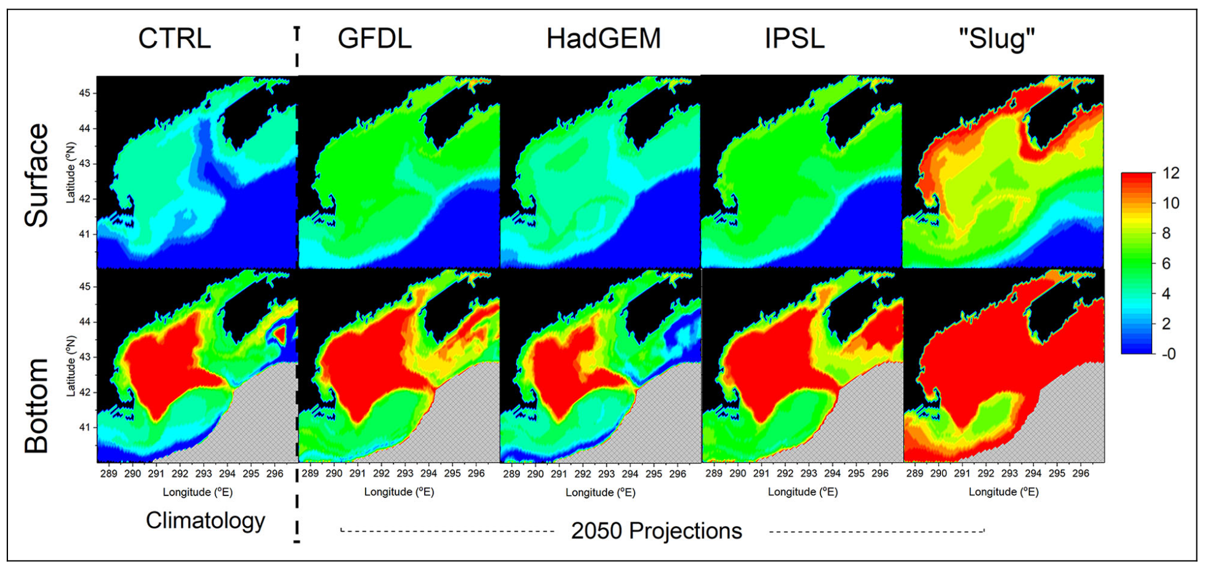
Siedlecki et al. (2021)
The Gulf of Maine has changed rapidly and is forecasted to
continue this rapid change, especially through ocean acidification.

Slide 4
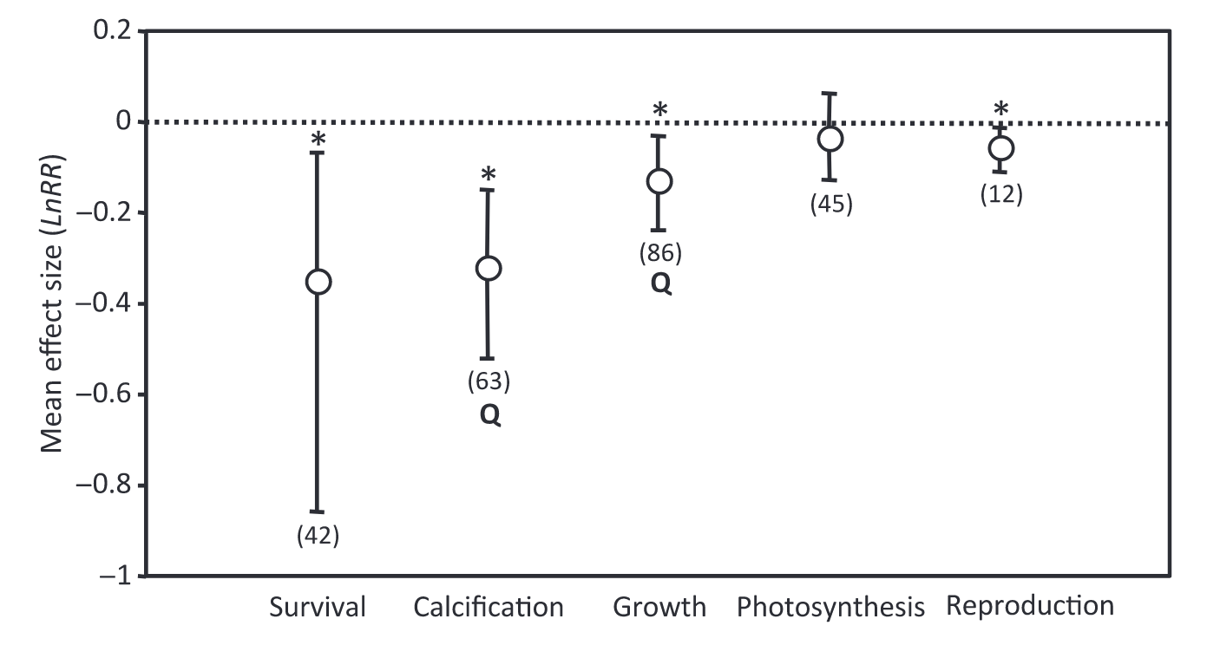
Acidification has a range of physiological and behavioral effects that vary greatly depending on the species and life stage of each individual.
Kroeker et al. (2011)
Observed Behavioral Impacts of OA on Marine Invertebrates
Settlement
Habitat Selection
Anti-predatory Responses
Locomotion
Feeding Patterns
Wang & Wang (2020)

Slide 5
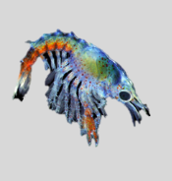
Larval
Lower survival
Decreased time between molts
Altered development
Altered feeding rates
OA
Jesica Waller, UMaine
Juvenile
Increased mortality
Slower development
OA
Studies on the American lobster focus on its larvae. Research on juveniles
primarily focuses on their physiology. More research is needed on the
behavioral impacts of OA on juvenile American lobsters

Slide 6
Research question
What are the effects of OA on the foraging behavior of juvenile American lobsters?

Slide 7
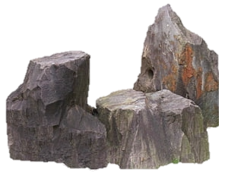
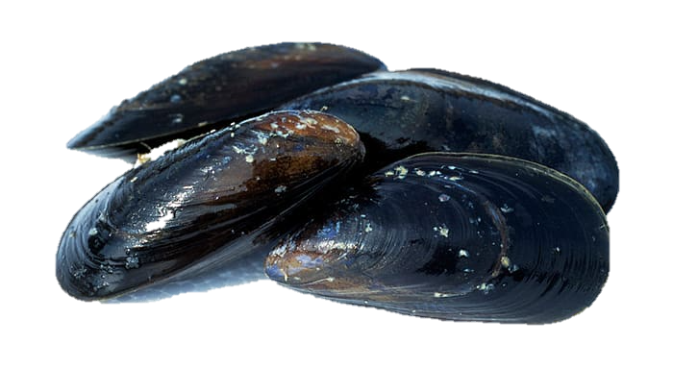
Exposure Period
10 days
- pH
- pH
Juvenile American lobsters were exposed to a pH range between 7.3 and 7.8
- pH
- pH
- pH
- pH
- pH
- pH
- pH
- pH
Without Prey
16 hours
Behavioral Assay
~ 2 days
Experimental Intermission
~ 8 hours
Flow
With Prey
16 hours

Slide 8
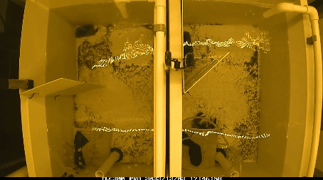
Measured Behaviors via video recordings
1. Time to locate rock
2. Time spent at rock
3. Total # of trips
Each recorded behavior was recorded with and without the presence of prey.

Slide 9
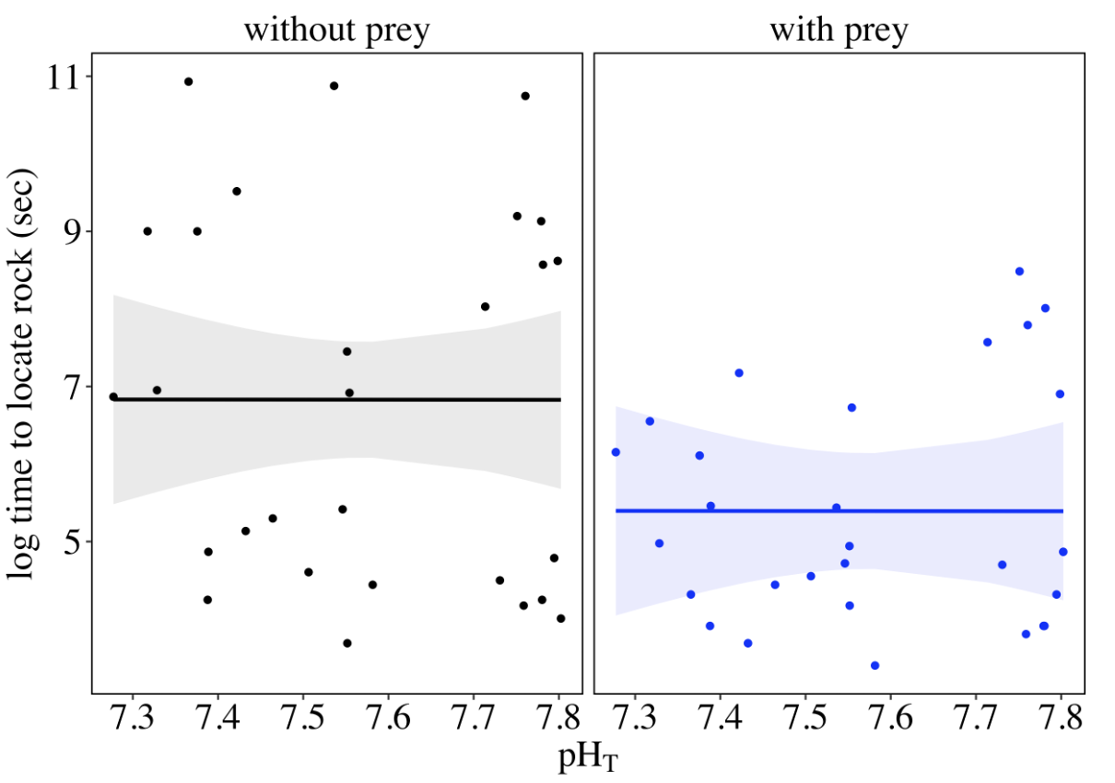
Time to locate Rock
without prey
no pH effect on locomotion
with prey
Found the foraging rock faster – significant effect of prey
No pH effect on time to locate the rock

Slide 10
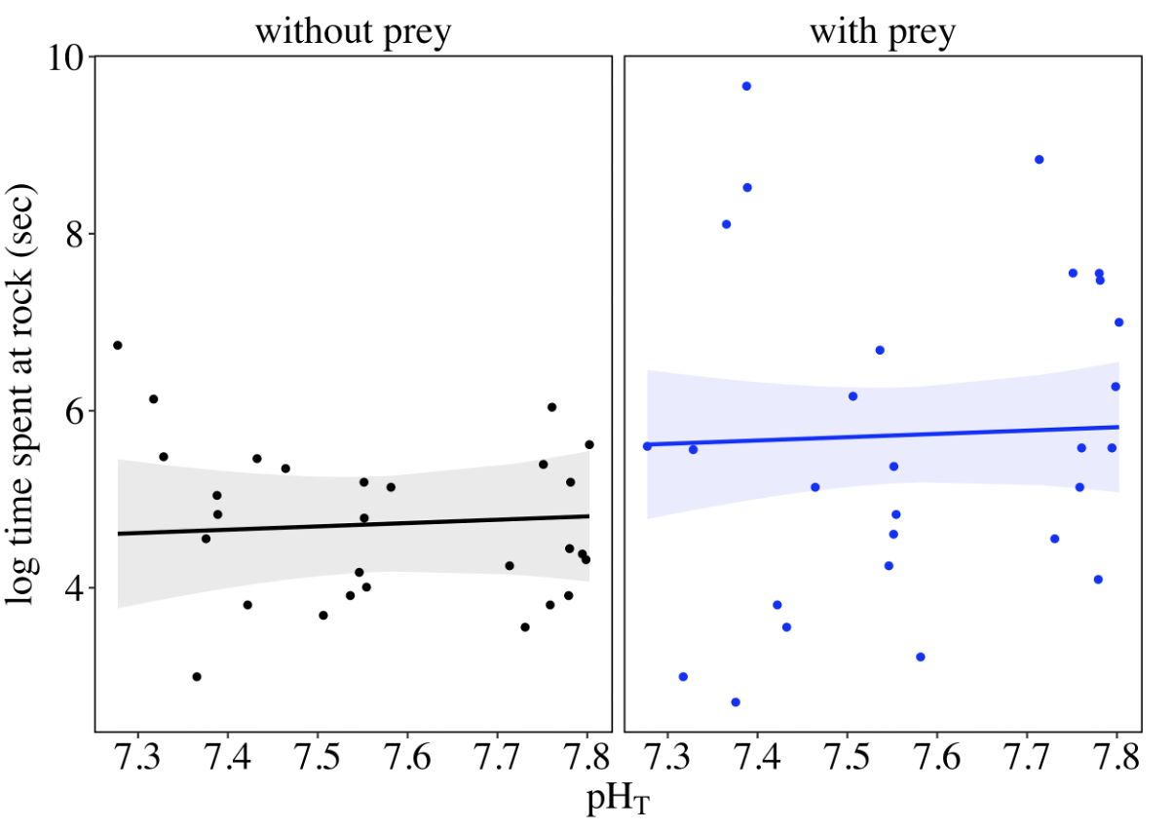
Time spent at rock
without prey
no pH effect on locomotion
with prey
spent more time at rock – significant effect of prey
no pH effect on time spent at rock

Slide 11
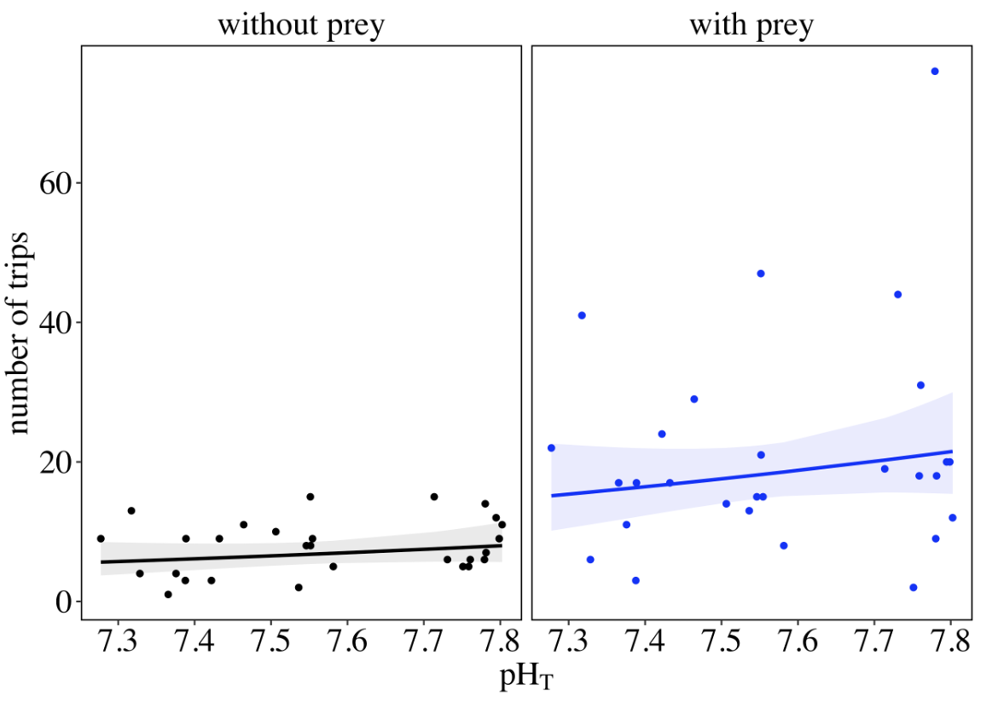
Total # of trips
without prey
no pH effect on locomotion
with prey
took more foraging trips – significant effect of prey
no pH effect on trips taken

Slide 12
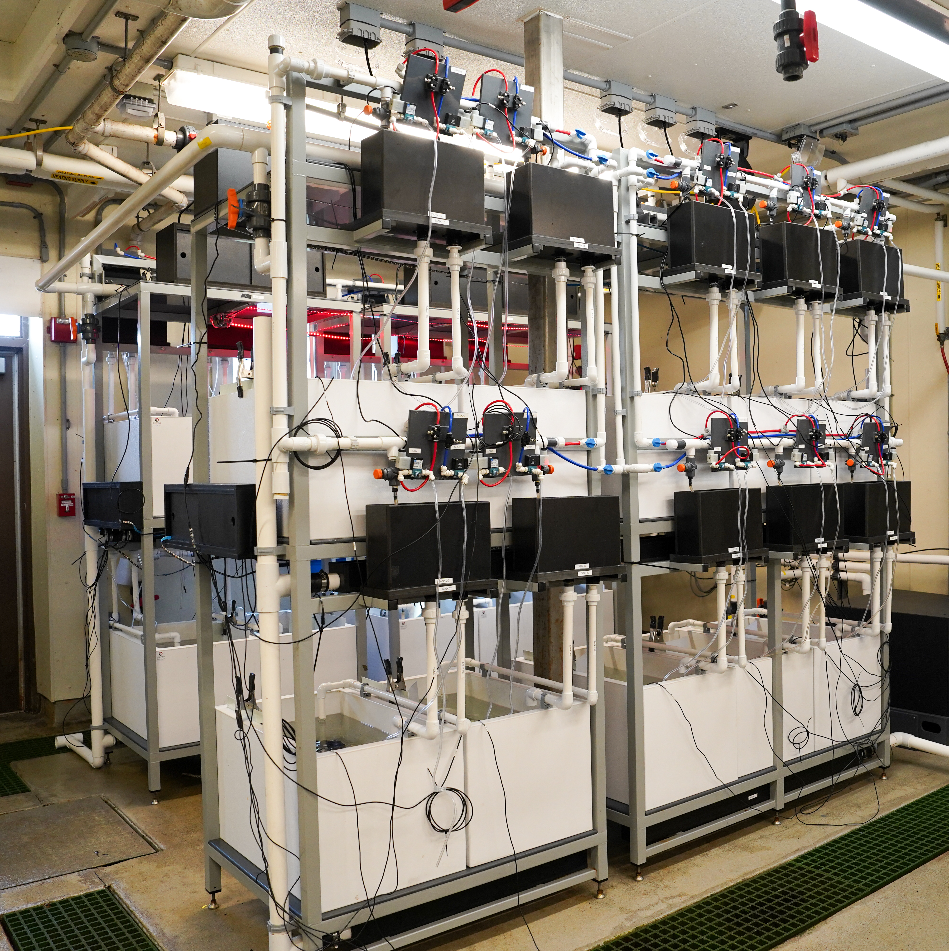
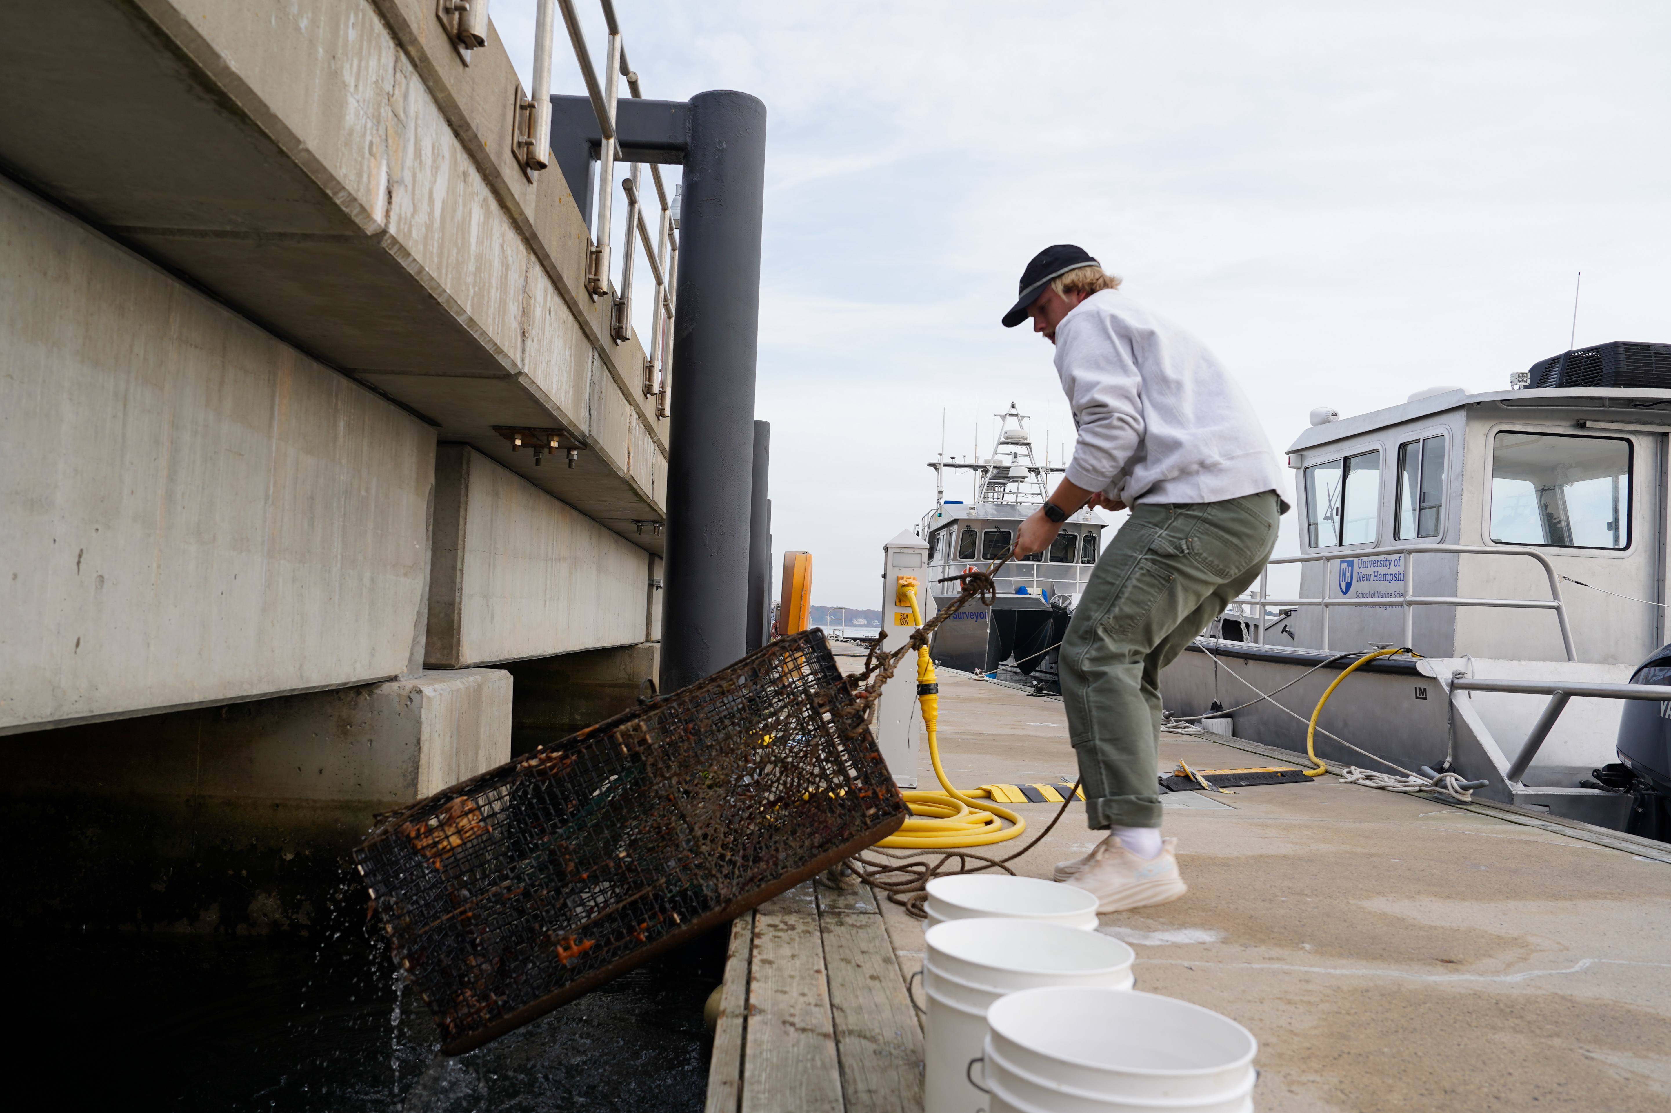
Conclusions
Future work
Juvenile American lobsters: a resilient life stage in a resilient species that show large individual variability
What physiological mechanism can help describe the resiliency seen in the low-pH lobsters?
The intertidal environment is extremely dynamic – exposed to different ranges of pH throughout a day
Did pH affect the time it took for the lobsters to successfully feed?
Resilient enough to sustain normal locomotion and still find food despite continuous exposure.
Alexandra Hatch, UNH
Alexandra Hatch, UNH

Slide 13
Acknowledgements
Ben Gutzler, Jason Goldstein, and Winsor Watson III
Nate Rennels and Franny Lux
Johnny Lamond, Reka Ivanyi, Sophia Roy, & MEFB 503
Kyrie Newby, Michaela Edwards, and Kaitlin Van Volkom

Slide 14
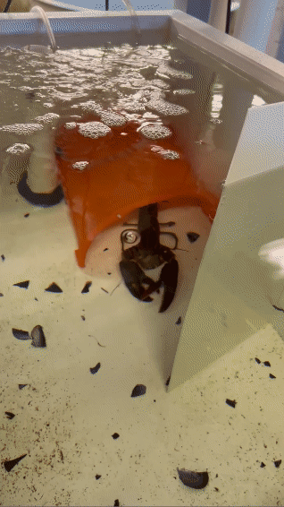
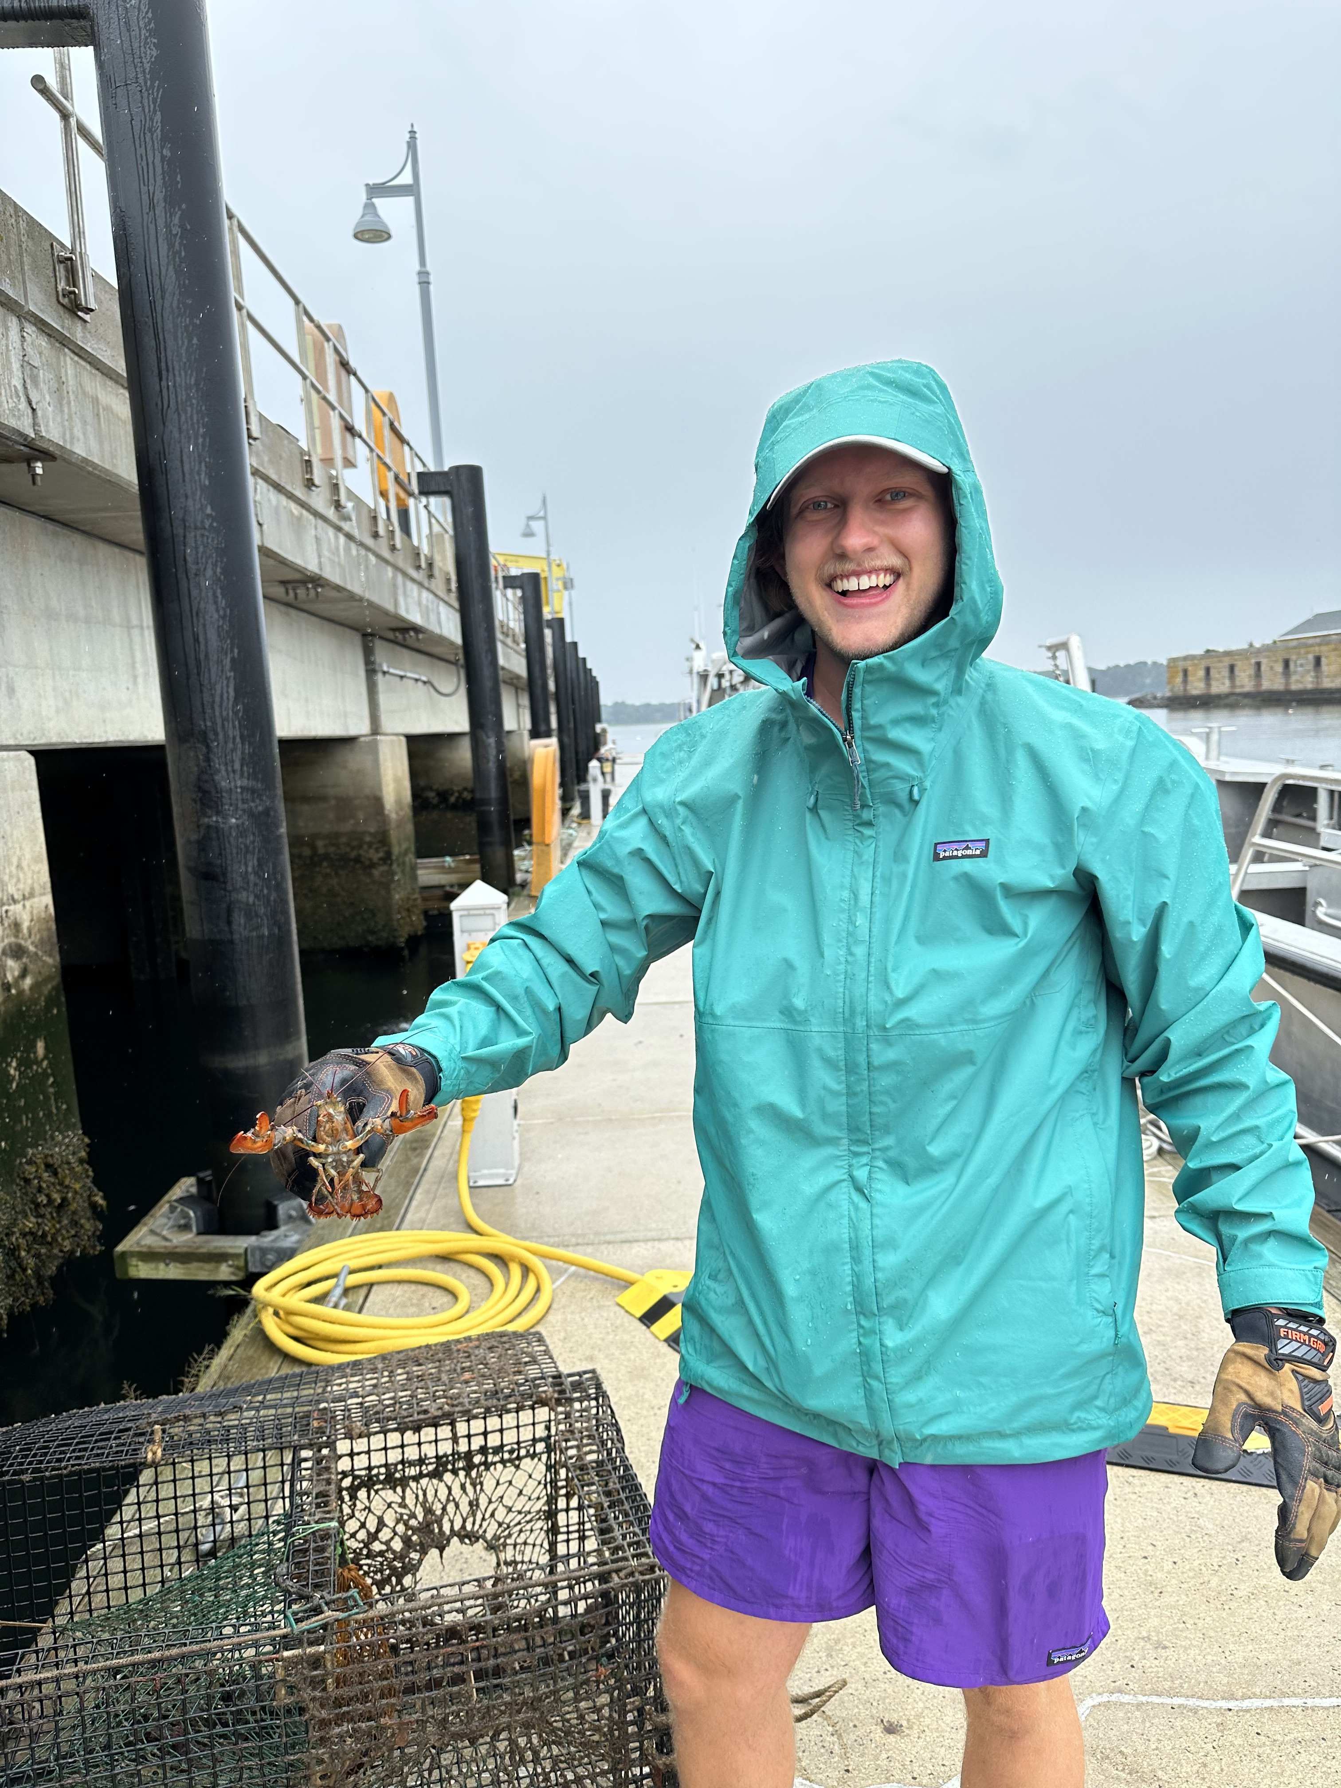
Thank you!

Slide 15
Conclusions
Future work
Juvenile American lobsters: a resilient life stage in a resilient species that show large individual variability
What physiological mechanism can help describe the resiliency seen in the low-pH lobsters?
The intertidal environment is extremely dynamic – exposed to different ranges of pH throughout a day
Did pH affect the time it took for the lobsters to successfully feed?
Resilient enough to sustain normal locomotion and still find food despite continuous exposure.
Alexandra Hatch, UNH
Alexandra Hatch, UNH

