Slide 1

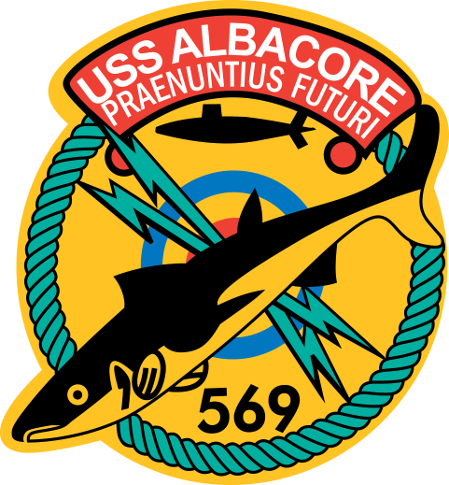

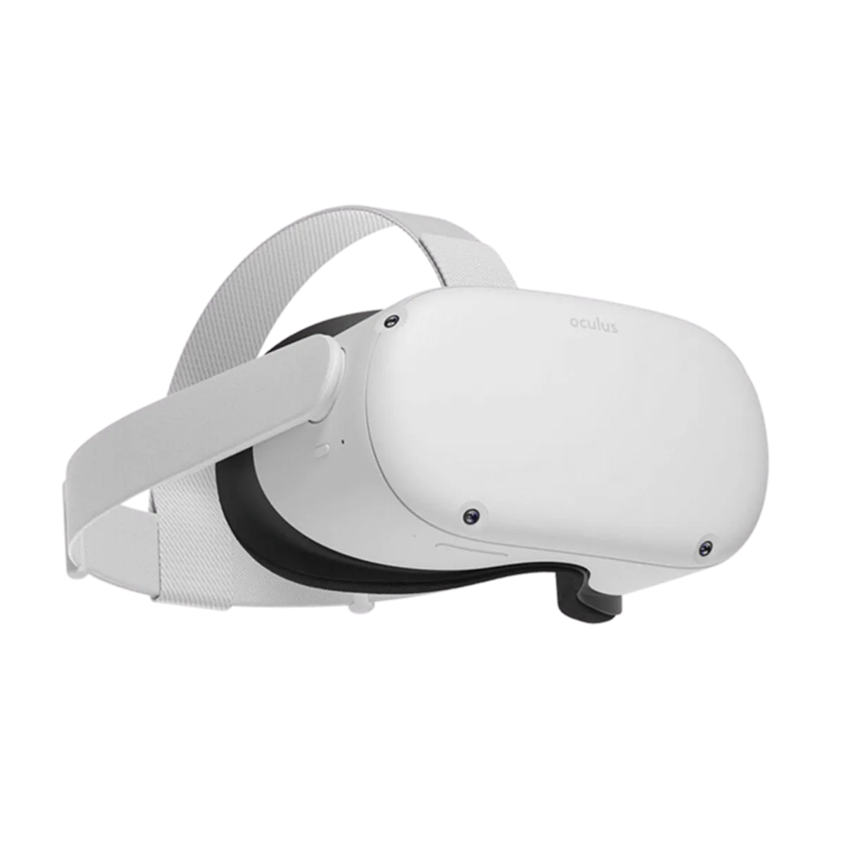
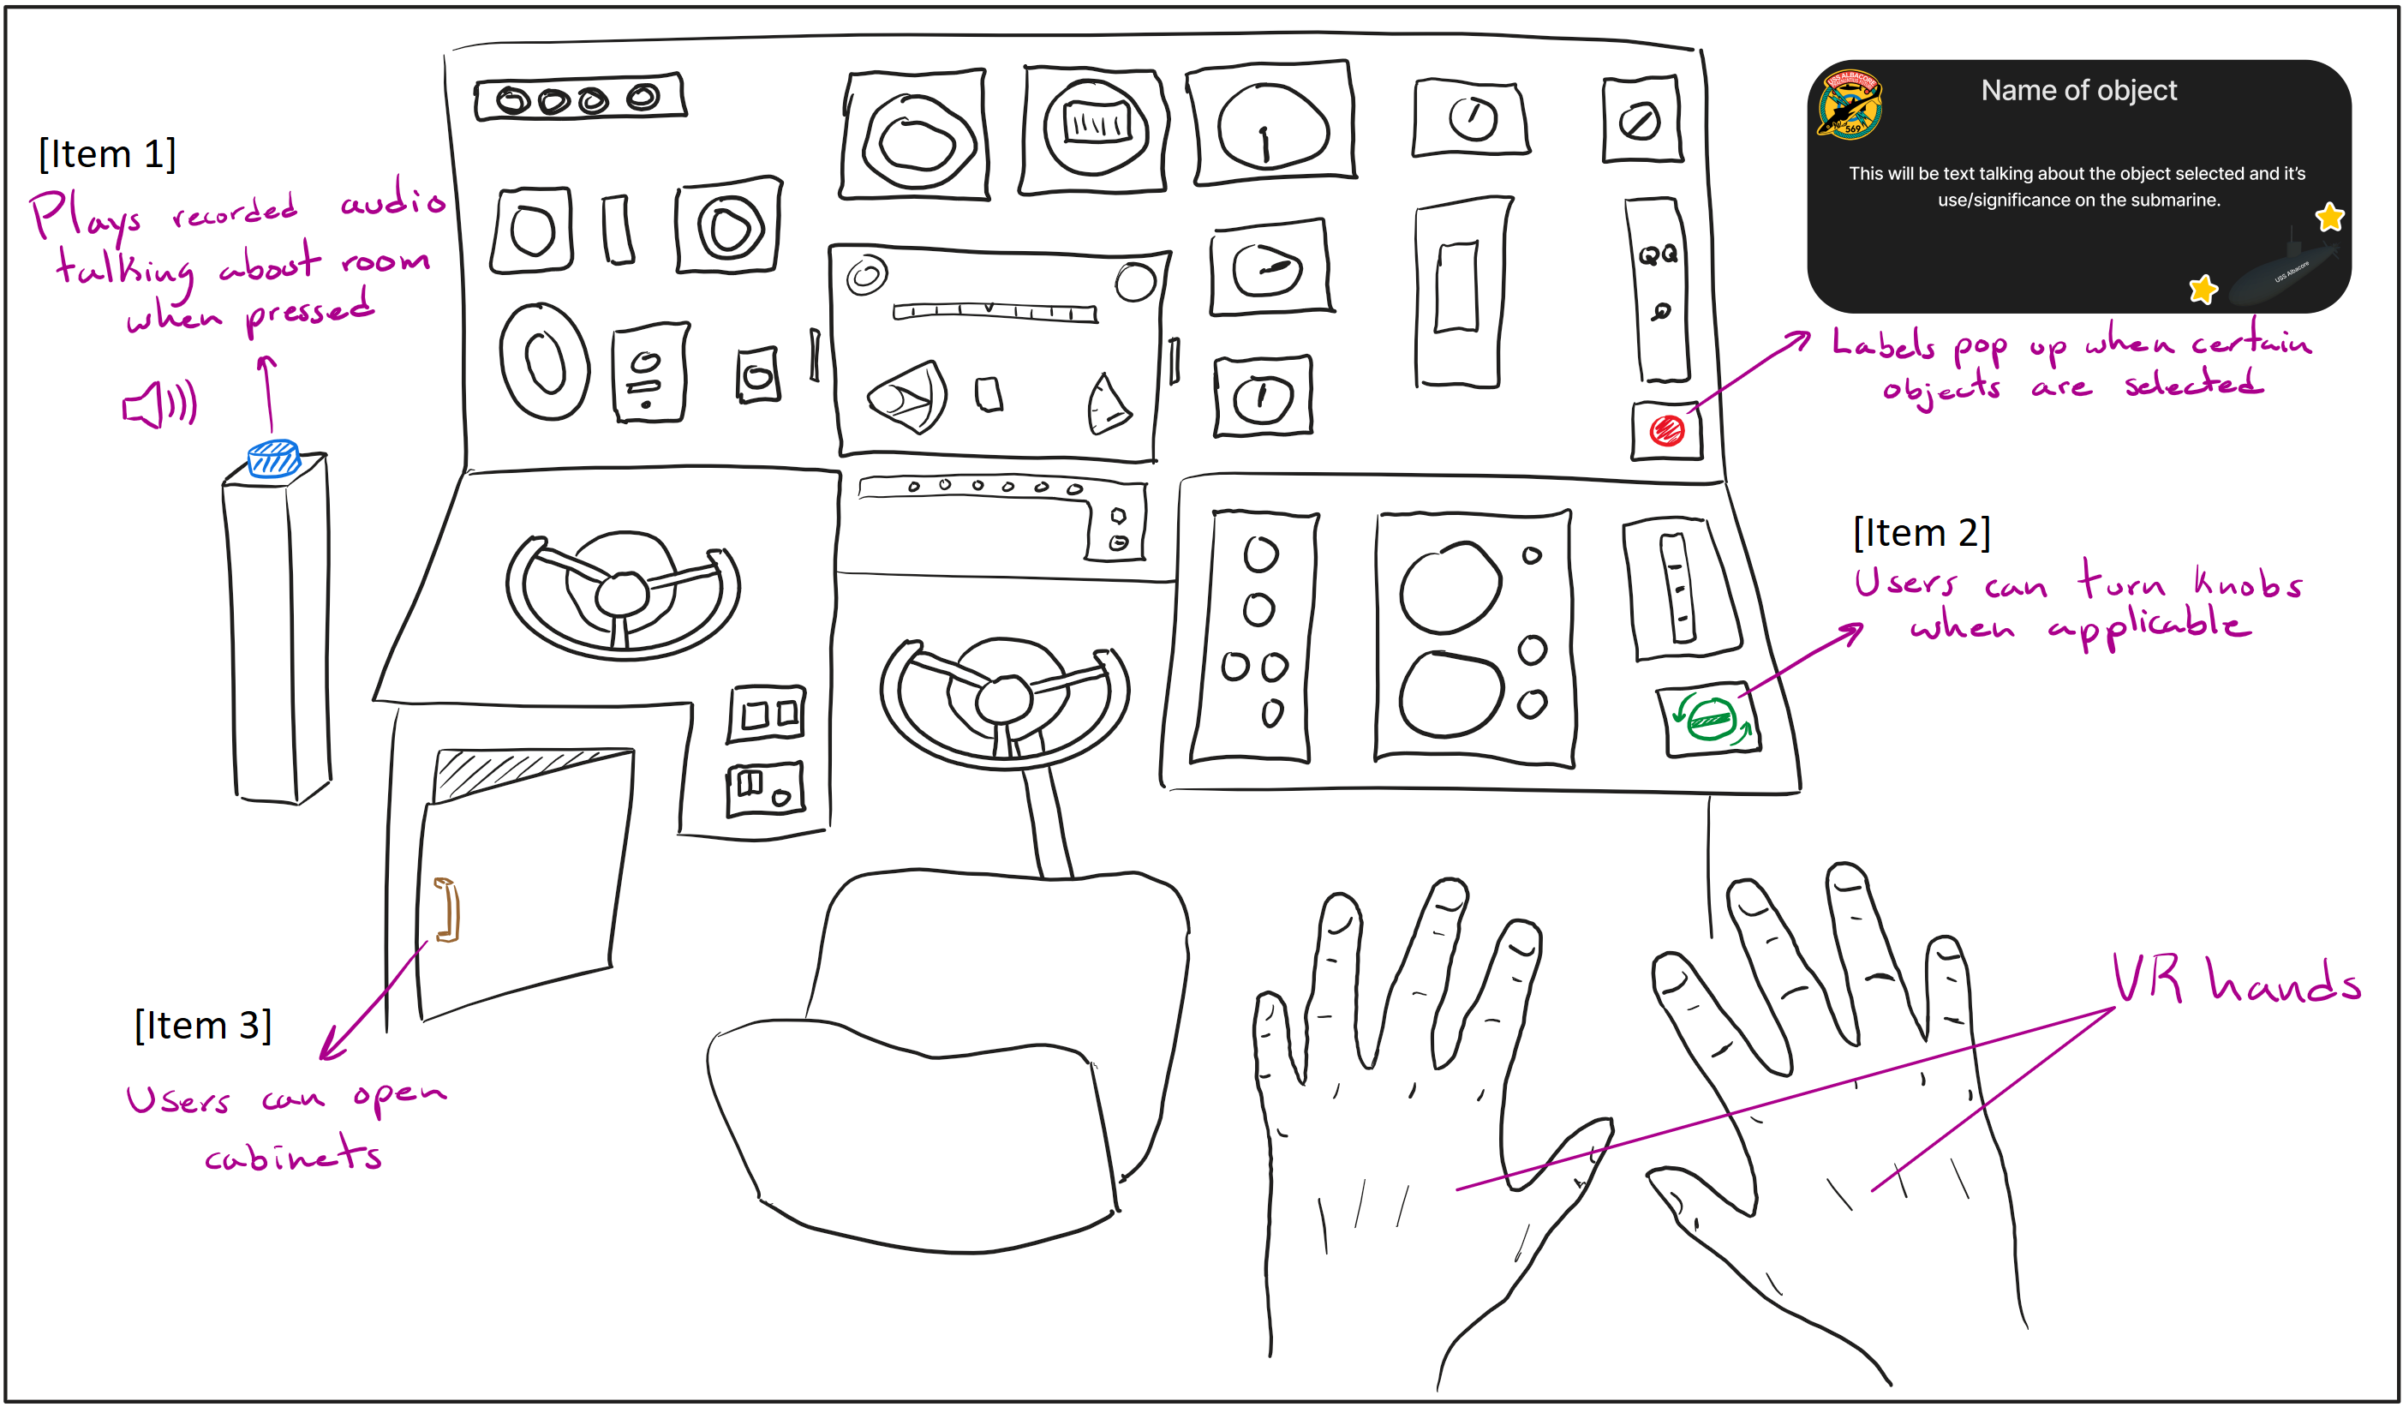
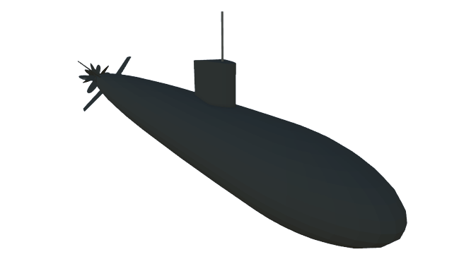
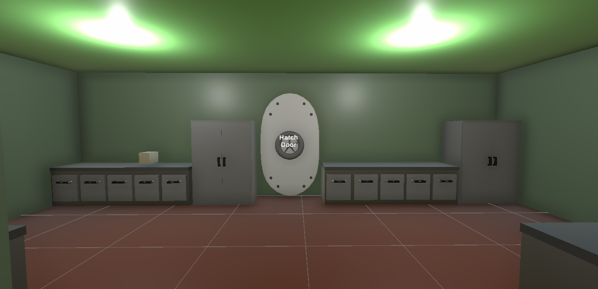
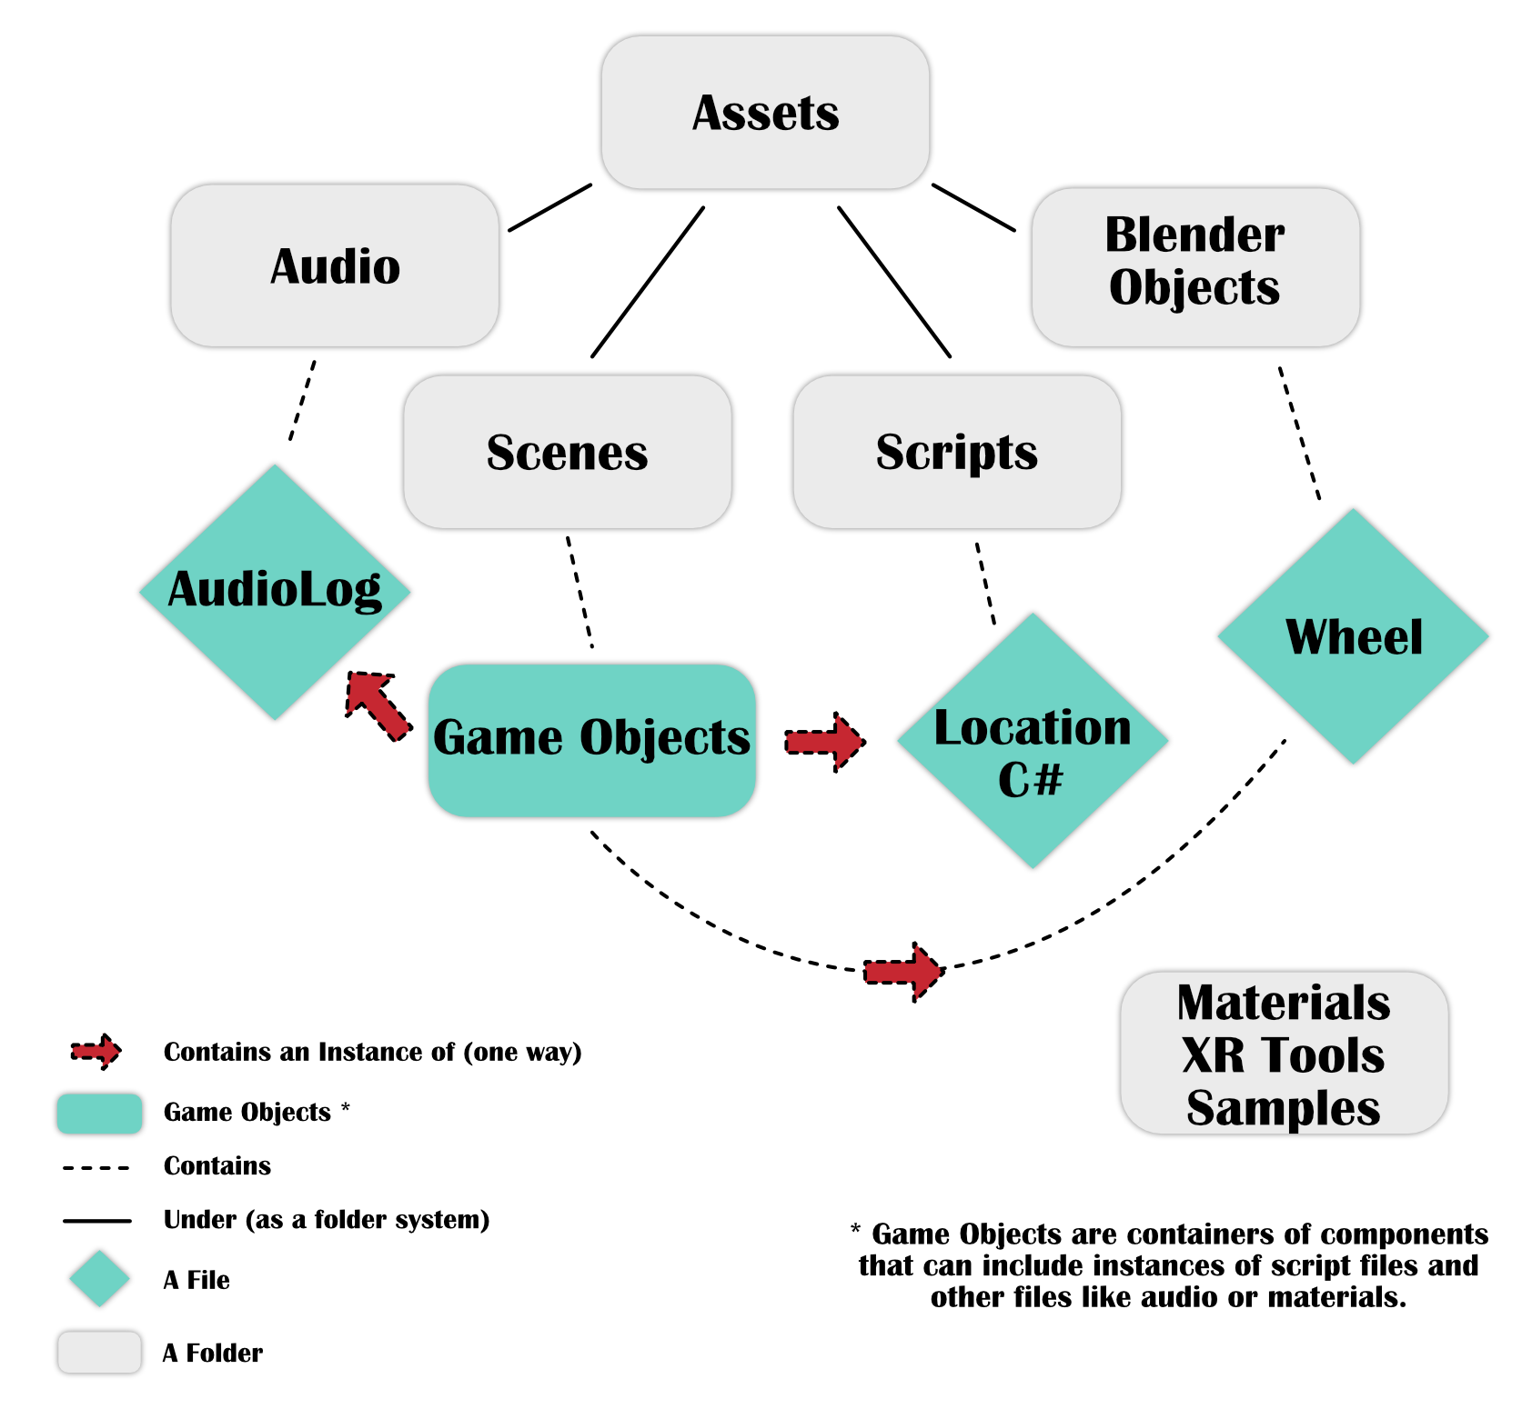
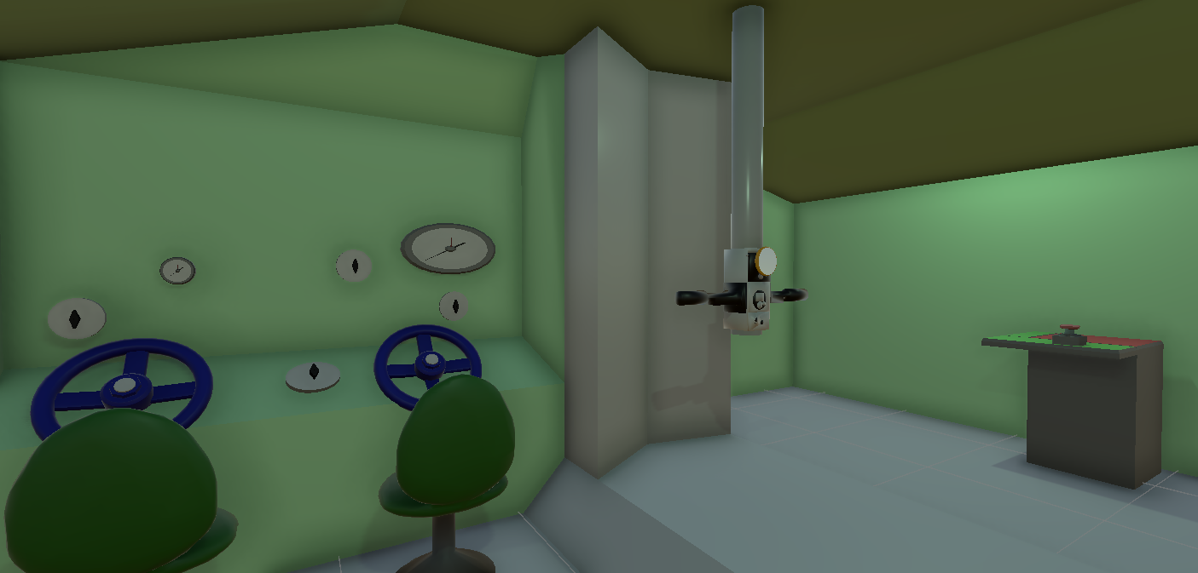
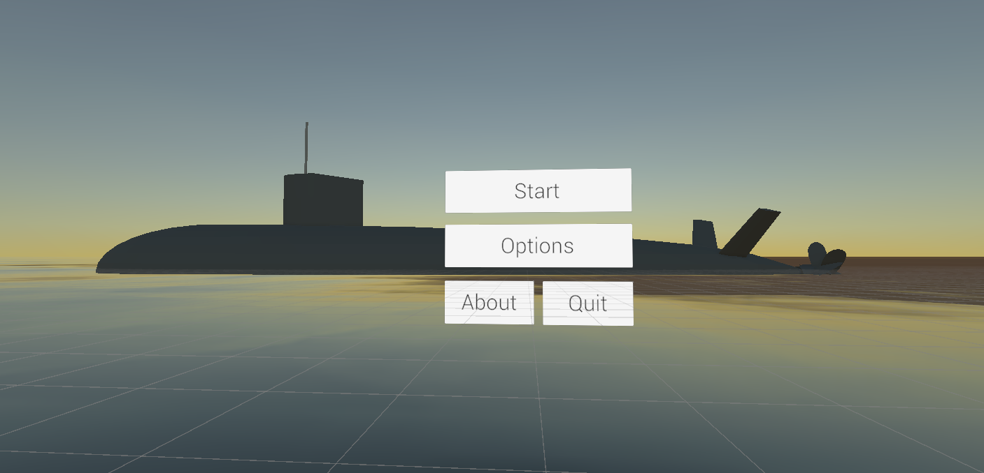
A Virtual Experience at the USS Albacore Museum
Eben Young, Luis Morel, Peter Grieve, Benicio Liu
College of Engineering and Physical Sciences, University of New Hampshire, Durham, NH 03824
Introduction
Requirements
Design
Accessibility is something that lies at the heart of inclusivity, ensuring that individuals of all ages, physical conditions, and limitations can fully participate and enjoy experiences. At The Albacore Museum, they plan to achieve this by the creation of a virtual reality tour of their submarine museum; and that’s what we’re aiming to help with. There are many people who cannot tour the submarine due to the restrictive nature of the design, or who can't move around the tight spaces. The goal of the VR version is to mimic the real submarine but give those individuals the freedom to experience it in their own comfort zone. VR stations will allow them to actively participate in their experience of the Albacore. Our success will be measured by a survey given out after the live demo with a satisfaction score of 8 or higher.
Non- Functional:
The VR experience needs to have more open space than the actual submarine so that claustrophobic users do not become uncomfortable
The scenes in the VR experience must be accurate to the actual submarine
The scenes in the VR experience need to be detailed and immersive
Oculus Quest 2
Functional:
A unique scene for each room on the submarine
Must allow the user to interact with their environment
Must allow the user to move about the scene freely without getting motion sickness
Should contain audio logs that the user accesses by pressing a button
Each of these rooms should have specific and unique interactables
The UI prototype above illustrates the immersive VR experience aboard the Albacore submarine. Users can interact with various objects during the virtual tour, gaining informative insights and facts. Virtual hands facilitate interaction, with labeled objects providing descriptions or facts.
USS Albacore
Implementation
Results
Conclusion
The figure below displays a detailed diagram of project assets, which show that Unity itself manages most of the implementation of Game Objects and Scripts with the Scenes being most of what the user is controlling.
A playable demo at Albacore Park allows users to explore the available rooms including the start menu, kitchen, command room, and bunker with interactable items and audio. This is in service of making our visitors not feel like they are missing the real thing. We will have a playable demo at the Albacore museum and a feedback survey about their experience with a goal of 8 or higher on a 1-10 scale which should show how well we achieve a feeling of the real submarine and show how well we deal with user's issues like comfort.
Year 3 of the Albacore Experience is a big success as many core features have been built and displayed for others to see. With the details in both functional and non-functional aspects such as comfort, readability, intuitive navigation and educational content, the virtual world will be both informative and engaging for visitors who couldn’t access this before. Having 4 rooms to visit in the demo lets users experience the rooms of the submarine without the problems of the real thing. This is verified through the feedback survey. Future work will focus on expanding these rooms with more interactable items and assets, and adding new rooms like the entrance. The core systems being in place allows this extra work be done much quicker and with fewer bottlenecks than before.
Kitchen
Acknowledgments
Command
Room
We’d like to acknowledge our project sponsor Patricia Violette for allowing us to work with her on her vision. We’d also like extend our thanks to our advisor Matthew Plumlee for guiding and supporting. Shoutout to Valem for the excellent VR Unity tutorials.
Submarine

