Slide 1
Calculus I Students’ Understanding of Implicit Differentiation
Supported by NSF IUSE Award No. 2013427. The opinions expressed herein are those of the authors and do not necessarily reflect the views of the NSF.
Meaghan Allen
Advisor: Dr. Orly Buchbinder
UNH GRC April 15, 2024

Slide 2
Context of the Project
STEM Gateways Project
The general structure of the Calculus I course:
Lecture section (~100-180 students) meets three times a week with a faculty member
50-minute Recitation section (~20-25 students) twice a week with a graduate teaching assistant (GTA) and undergraduate learning assistant (LA)
Objective: Improve introductory STEM courses in Biology, Chemistry, Mathematics & Physics

Slide 3
Reform Efforts in Calculus 1 Recitations
Introducing active learning (CBMS, 2016) in recitations.
Inclusion of LAs to support student group work.
Inclusion of six conceptually rich activities (SMMP) that emphasize graphic representations of the calculus concepts.
SMMP – Scientific, Mathematical, Metacognitive Practices
This study is focused on
one SMMP activity and one Exam question on Implicit Differentiation
LA
Graduate TA

Slide 4
Why focus on Implicit Differentiation?
In 2016, Speer and Kung highlighted the lack of research in implicit differentiation.
In response, some researchers characterized student difficulties with this subject (Chu 2019, Kandell 2021).
Others unpacked what is entailed in understanding implicit differentiation (Mirin & Zazkis 2019, Borji & Martinez-Planell 2019, 2020).
Jeppson (2019) and Borji & Martinez-Plannel (2019) created interventions to address student difficulties with implicit differentiation.
Notes:
Chu 2019 -Surveyed 136 first-semester calculus students. Most students’ errors being related to calculus concepts and procedures, rather than prerequisite algebra skills.
Kandeel 2021 - Surveyed 117 Calculus students
Found common algebraic errors were: isolating a common factor, simplifying expressions, dealing with exponents and radicals, isolating y’. Common calculus errors were: chain rule, product rule, differentiating functions
Mirin & Zazkis 2019 - Analyzed what it meant for someone to understand the legitimacy of differentiation both sides of an equation.
Borji & Martinez-Planell 2019, 2020 – Used (APOS) theory to proposed a genetic decomposition of needed tools that may help students understand implicit diff. Small-scale study (14) which found that students’ understanding of implicit differentiation had improved after completing the activities and exercises made with the genetic decomposition in mind.

Slide 5
The Unique Context of Our Study
Focuses on the coordination of the graphical and symbolic meaning of implicit differentiation
Situated within the authentic context of an ongoing Calculus course (as opposed to a post-course survey or small-scale teaching experiments)
Notes:
Our study stands out from previous studies on students’ understanding of implicit differentiation because:

Slide 6
Research question
What aspects of understanding of implicit differentiation can be observed in students’ written responses to an implicit differentiation SMMP activity and the related Exam question?

Slide 7
Methods

Slide 8
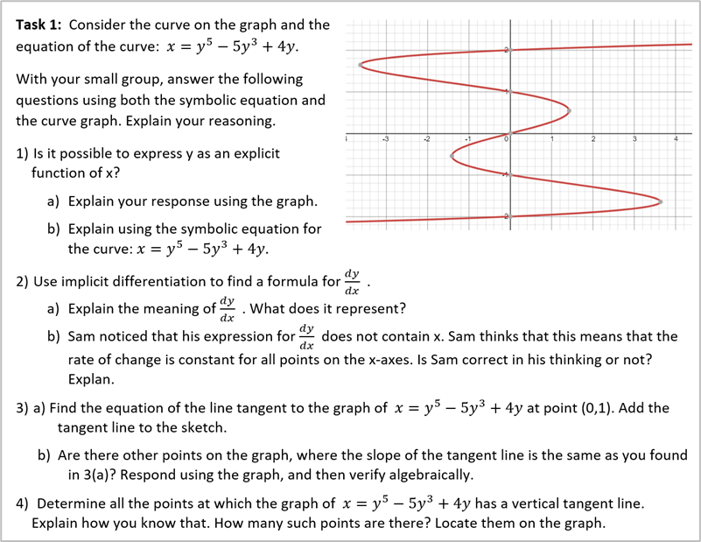
Implicit Differentiation Worksheet (SMMP)
Notes:
DATA COLLECTION
119 participants
Students completed the SMMP activity during one recitation session.
Worked in small groups or individually.
Support from TA & LA, if needed.
At the end of the recitation, students submitted the scanned worksheets to Gradescope.
For the course – student work was graded for completion.
For this study – all data were re-coded

Slide 9
Implicit Differentiation Exam Question (Exam)
Notes:
119 exams collected
Students individually completed the exam.
One exam question was on implicit differentiation and was somewhat similar to the SMMP question.
For the course - the questions were graded for correctness.
For this study – all data were re-coded

Slide 10
Category | Description of Goal | SMMP # | Exam #
Symbolic | Develop the idea of implicit equations in a formula and correctly implement differentiation procedures
Symbolic Implicit Equation and Chain Rule (S_Eq, S_Ch) | Given an equation with variables x and y, one can recognize y as an implicit function of x, and recognize the need for the chain rule in taking the derivative with respect to the implicit independent variable. | 2 | 5a
Symbolic Differentiation (S_Diff) | Can correctly preform procedures for finding $\frac{dy}{dx}$ for implicit equations | 2 | 5a
Symbolic Evaluation (S_Eval) | Can correctly compute the derivative $\frac{dy}{dx}\left(x_{0},y_{0}\right)$ for a point $\left(x_{0},y_{0}\right)$ | 3a, 3b | 5b, 5c
Symbolic Tangent Line (S_Tan) | Can correctly find the equation of a tangent line at a point | 3a | 5b
Graphic | Interpret graphical properties of implicit functions
Graphic Vertical Tangent (G_VT) | Recognize that tangent lines to a graph of implicit equations can be vertical, and at the points of tangency the derivative does not exist | 4 | 5c
Graphic Coordination (G_Cor) | Coordinates graphical and symbolic representations | 2b, 3a, 3b, 4 | 5b, 5c
Implicit Differentiation Knowledge Components
ImDKC
Notes:
Was created/ adapted from Jeppson (2019), Borji & Martinez-Plannel 2019
In the paper, we present all goals. Here we focus only on the 6 ones that were on both the SMMP and exam

Slide 11
Data Analysis
We coded the data using the ImDKC framework
Yes
A student obtained a “Yes” on a goal if their work clearly exhibited attainment of the goal.
No
A student obtained a “No” on a goal if their work clearly showed that they did NOT achieve the goal.
NEE
A student obtained a “NEE” on a goal if their work could not clearly show they did or did not obtain the goal, or if they left the question relating to the goal blank

Slide 12
Coding Decisions
Assigning a single score for multiple problems
We coded each problem separately and then used the following scheme to assign one code to the students’ work overall.
Goals with 2 Questions
G_Cor (4 Questions)
Yes | No | NEE | Outcome
4 | 0 | 0 | Yes
3 | 0 | 1 | Yes
2 | 0 | 2 | Yes
1 | 0 | 3 | NEE
0 | 0 | 4 | No
0 | 1 | 3 | No
0 | 2 | 2 | No
0 | 3 | 1 | No
0 | 4 | 0 | No
Yes | No | NEE | Outcome
2 | 0 | 0 | Yes
1 | 0 | 1 | Yes
0 | 2 | 0 | No
0 | 1 | 1 | No
0 | 0 | 2 | NEE
Notes:
Point out Yes & No is blank
Point out 1 Yes and 3 NEE = NEE
Descriptive statistics conducted on these three codes
4 NEE = No

Slide 13
Results

Slide 14
Research Question
What aspects of understanding of implicit differentiation can be observed in students’ written responses to an implicit differentiation SMMP activity and the related Exam question?

Slide 15
ImDKC Goals Achievement
graphic
symbolic
Notes:
The two graphic goals Graphic Coordination and Graphic Vertical Tangent had the lowest amount of student achievement for both the SMMP and the Exam.
Symbolic Differentiation had the highest achievement on the SMMP
Symbolic Evaluation had the highest achievement on the Exam (and the second highest on the SMMP).
Graphic Coordination had the highest number of No’s on the SMMP by a lot. This was likely due to the fact we decided to code 1 Yes, 3 NEE with a No.
We can notice that the Exam had more No’s than the SMMP. This is probably due to the fact that since the Exam was being graded, there were far fewer questions left blank than the SMMP.

Slide 16
ImDKC Goals Achievement
On SMMP, students did better on symbolic goals (86%) than graphic goals (23%).
graphic
symbolic
Notes:
The two graphic goals Graphic Coordination and Graphic Vertical Tangent had the lowest amount of student achievement for both the SMMP and the Exam.
Symbolic Differentiation had the highest achievement on the SMMP
Symbolic Evaluation had the highest achievement on the Exam (and the second highest on the SMMP).
Graphic Coordination had the highest number of No’s on the SMMP by a lot. This was likely due to the fact we decided to code 1 Yes, 3 NEE with a No.
We can notice that the Exam had more No’s than the SMMP. This is probably due to the fact that since the Exam was being graded, there were far fewer questions left blank than the SMMP.

Slide 17
ImDKC Goals Achievement
On the Exam, students did better on symbolic goals (79%) than graphic goals (58% ).
graphic
symbolic
Notes:
The two graphic goals Graphic Coordination and Graphic Vertical Tangent had the lowest amount of student achievement for both the SMMP and the Exam.
Symbolic Differentiation had the highest achievement on the SMMP
Symbolic Evaluation had the highest achievement on the Exam (and the second highest on the SMMP).
Graphic Coordination had the highest number of No’s on the SMMP by a lot. This was likely due to the fact we decided to code 1 Yes, 3 NEE with a No.
We can notice that the Exam had more No’s than the SMMP. This is probably due to the fact that since the Exam was being graded, there were far fewer questions left blank than the SMMP.

Slide 18
ImDKC Goals Achievement
graphic
symbolic
Notes:
The two graphic goals Graphic Coordination and Graphic Vertical Tangent had the lowest amount of student achievement for both the SMMP and the Exam.
Symbolic Differentiation had the highest achievement on the SMMP
Symbolic Evaluation had the highest achievement on the Exam (and the second highest on the SMMP).
Graphic Coordination had the highest number of No’s on the SMMP by a lot. This was likely due to the fact we decided to code 1 Yes, 3 NEE with a No.
We can notice that the Exam had more No’s than the SMMP. This is probably due to the fact that since the Exam was being graded, there were far fewer questions left blank than the SMMP.

Slide 19
Summary of Results
Students did better on Symbolic Goals, than on Graphic Goals
Students’ most achieved goals were: S_Diff, S_Eval, and S_Tan (applying the derivative formula of implicit differentiation, evaluating derivative at a point and finding the tangent line equation)
Students’ least achieved goals were: G_VT and G_Cor (finding the equations of vertical tangent lines and coordinating graphic and symbolic representations)
Notes:
On the exam, graphic vertical tangent and graphic coordination were very closely related – meaning if a student achieved the goal G_VT on the exam, it was likely that the same student would achieve the goal G_Cor on the exam, and vice versa.
On the Exam, graphic vertical tangent, graphic coordination, symbolic differentiation and symbolic equation and chain rule were closely related to one another. If a student achieved three of these goals, it was likely they would achieve the fourth as well.

Slide 20
Discussion & Conclusions
High success in students’ performance on symbolic goals of the ImDKC is encouraging, especially in light of the literature on students’ difficulties with implicit differentiation.
Low success on graphical goals is alarming since it can be indicative of a low understanding of the meaning of symbolic procedures. It may suggest that the symbolic performance is somewhat mechanical.
Our results illuminate the need for greater teaching attention to the graphical meaning of implicit differentiation (among other Calculus concepts)

Slide 21
Further Research
We also looked at answering the research question: How do students’ performance on the SMMP activity and the Exam question compare across various aspects of implicit differentiation understanding?
To answer this question, we used statistical methods such as Multiple Correspondence Analysis and Logistic Regression

Slide 22
References
Boelkins, M., Austin, D., & Schlicker, S. (2018). Active Calculus 2.1.
Borji, V., & Martínez-Planell, R. (2019). What does ‘y is defined as an implicit function of x’mean?: An application of APOS-ACE. The Journal of Mathematical Behavior, 56, 100739.
Borji, V., & Martínez-Planell, R. (2020). On students’ understanding of implicit differentiation based on APOS theory. Educational Studies in Mathematics, 105(2), 163-179.
Conference Board of the Mathematical Sciences (CBMS). 2016 Active learning in post-secondary mathematics education. https://www.cbmsweb.org/2016/07/active-learning-in-post-secondary-mathematics-education/
Chu, C. G. (2019). Investigation of student understanding of implicit differentiation. The University of Maine.
Cottrill, J. F. (1999). Students’ understanding of the concept of chain rule in first year calculus and the relation to their understanding of composition of functions. (Unpublished doctoral dissertation). Purdue University, West Lafayette, Indiana.
Infante, N. M. E. (2007). Students’ understanding of related rates problems in calculus. (Unpublished doctoral dissertation). Arizona State University, Tempe, AZ.
Jeppson, H. P. (2019). Developing understanding of the chain rule, implicit differentiation, and related rates: Towards a hypothetical learning trajectory rooted in nested multivariation. Unpublished Master’s Thesis. Brigham Young University.
Kandeel, R. A. A. (2021). Learners' common errors in implicit differentiation: An analytical study. Journal of Educational Research and Reviews, 9(7), 198-207.
Lave, J., & Wenger, E. (1991). Situated learning: Legitimate peripheral participation‏. Cambridge University Press.
Martin, T. (2000). Calculus students’ ability to solve geometric related-rates problems. Mathematics Education Research Journal, 12, 74-91.
Mirin, A., & Zazkis, D. (2019). Making implicit differentiation explicit. In A. Weinberg, D. Moore-Russo, H. Soto, & M. Wawro (Eds.), Proceedings of the 22nd Annual Conference on Research in Undergraduate Mathematics Education (pp.792–800). Oklahoma City, OK.
Sfard, A. (2015). Why all this talk about talking classrooms? Theorizing the relation between talking and learning. In Resnick, L. B., Asterhan, C. S. C., & Clarke, S. N. (Eds)., Socializing intelligence through academic talk and dialogue, (pp. 245-253). American Educational Research Association.
Speer, N., & Kung, D. (2016). The complement of RUME: What’s missing from our research? In T. Fukawa-Connelly, N. Infante, M. Wawro, & S. Brown (Eds.), Proceedings of the 19th Annual Conference on Research in Undergraduate Mathematics Education (pp.1288–1295). Pittsburgh, PA.
Stewart, J. (2006). Calculus: Early Transcendentals, 6E. Belmont, CA: Thompson Brooks/Cole.
Vygotsky, L. S. (1978). Mind in society: The development of higher psychological processes. Harvard University Press.
Zandieh, M. (1997). The evolution of student understanding of the derivative. Oregon: Oregon State University Ph. D. Dissertation.

Slide 23
Thank you!

Slide 24
Implicit Differentiation Difficulties
Chu 2019
Surveyed 136 first-semester calculus students.
Found that only about 50% of solutions were correct
Kandeel 2021
Surveyed 117 Calculus students
Most students’ errors being related to calculus concepts and procedures, rather than prerequisite algebra skills
Common algebraic errors were:
isolating a common factor
simplifying expressions
dealing with exponents and radicals
isolating y’
Common calculus errors were:
chain rule
product rule
differentiating functions
These types of errors appeared in 25% - 50% of responses.

Slide 25
Implicit Differentiation Tools
Mirin & Zazkis 2019
Analyzed what it meant for someone to understand the legitimacy of differentiation both sides of an equation.
Borji & Martinez-Planell 2019, 2020
Discussed the learning of implicit differentiation based on Action-Process-Object-Schema (APOS) theory.
Determined that understanding the legitimacy of the operation of differentiation to both sides of an equation is nontrivial.
Proposed a genetic decomposition of needed tools that may help students understand the topic.
Conducted a small-scale study with 14 students and found that students’ understanding of implicit differentiation had improved after completing the activities and exercises made with the genetic decomposition in mind.

Slide 26
Implicit Differentiation Intervention Studies
Borji & Martinez-Plannel 2019, 2020
Jeppson 2019
Rooted in APOS (Action-Process-Object-Schema) theory.
Genetic Decomposition of mental processes involved in learning implicit differentiation.
Emphasis on symbolic-graphic connections.
Intervention: Computer-based activities, class discussions, exercises.
Participants: former Calculus I students.
Rooted in the concept of multivariation.
Hypothetical Learning Trajectory (Simon, 1995) of implicit differentiation.
Emphasis on combining chain rule, related rates and implicit differentiation, and applications.
Teaching experiment with students who have not learned calculus.
Participants: students with no prior calculus knowledge.
Notes:
HLT - a hierarchy of learning stages and goals of students' attaining understanding of these topics.
Rooted in Action-Process-Object-Schema (APOS) theory uses the hypothesis that a person’s mathematical understanding of a topic comes from constructing mental actions, processes and objects, and then organizing them into schemas

Slide 27
Coding Rubric Example
Notes:
For consistency with coding, we created a coding rubric for the SMMP and the Exam which included all possible ways a student could show they attained a goal.

Slide 28
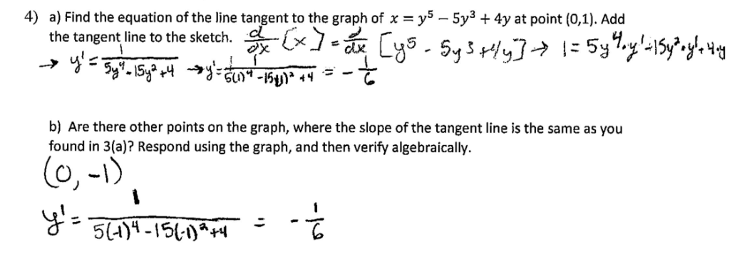
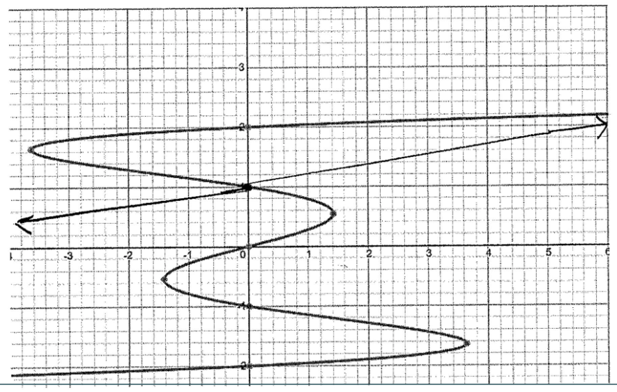
Coding Student Work - Example
3)

Slide 29
Coding Student Work - Example
3)
S_Eval -YES
S_Eval -YES

Slide 30
Coding Student Work - Example
3)
S_Eval -YES
S_Tan -NEE
S_Eval -YES

Slide 31
Coding Student Work - Example
3)
S_Eval -YES
S_Tan -NEE
3a) G_Cor - NO
S_Eval -YES
3b) G_Cor - NEE

Slide 32
Difficulties with G_VT
(a)
Identified the points where the tangent line is vertical and marked them on the graph
Misuse of "local minimums and maximums"
Unclear if student is recognizing the changing of derivative, or if they are recalling prior knowledge of maximums/minimums

Slide 33
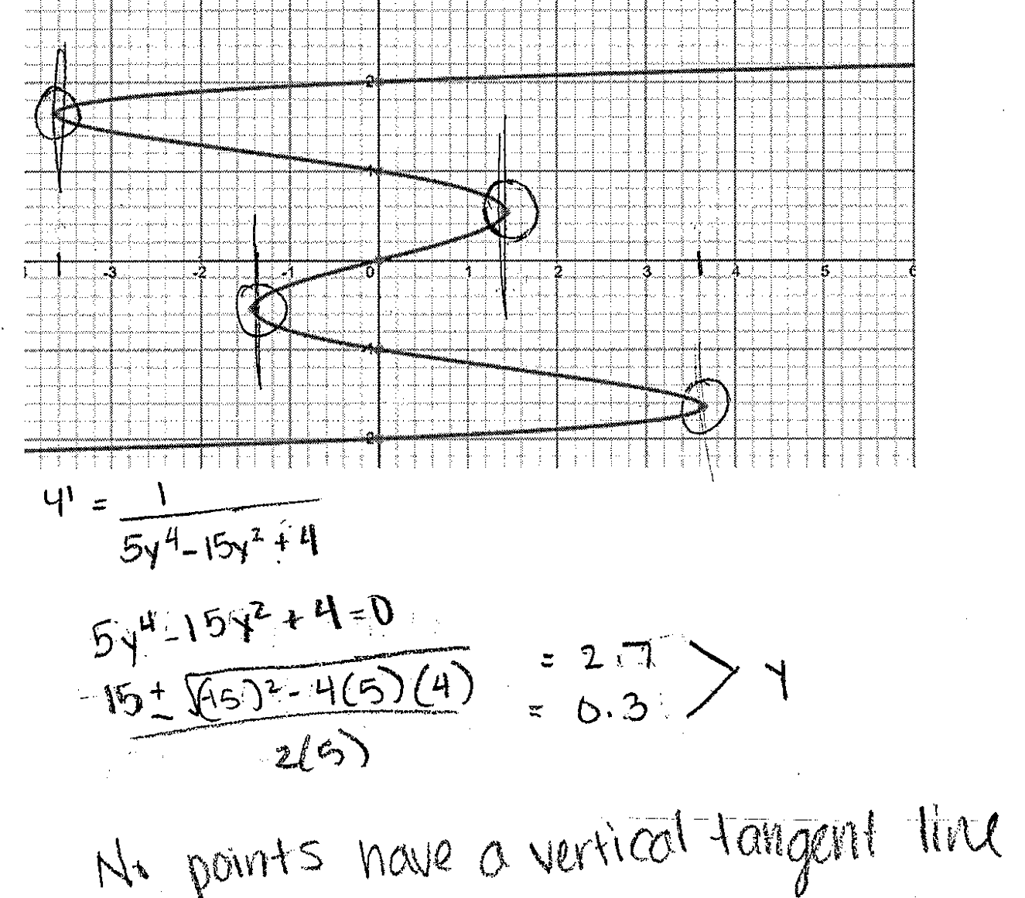
Difficulties with G_VT
(b)
Identified the points where the tangent line is vertical and marked them on the graph
Found $y^{2}$, so should be able to find y-coordinates of the points
Seemingly contradicting conclusion, that there are “no points” with vertical tangent lines
Some confusion on x-coordinates vs. y-coordinates

Slide 34
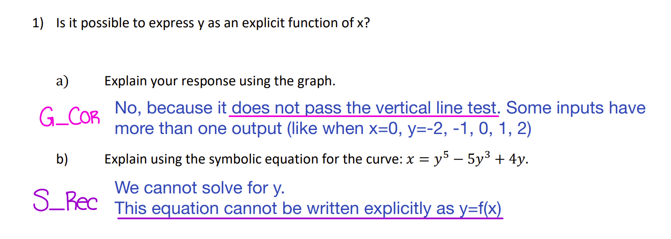
SMMP Rubric

Slide 35
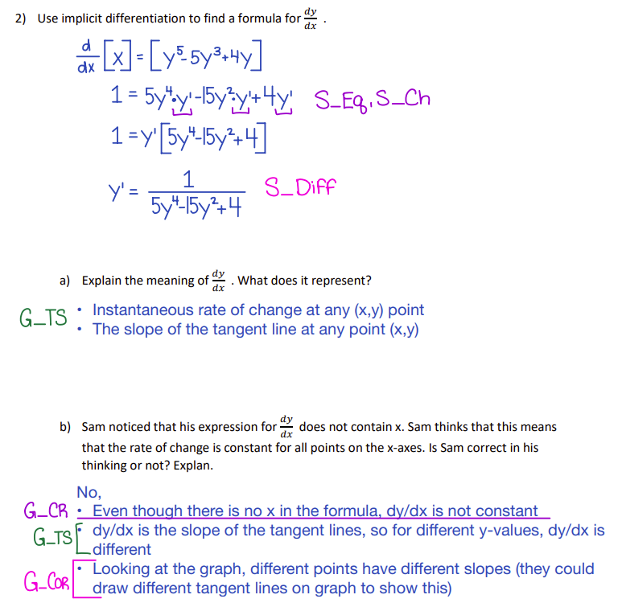
SMMP Rubric

Slide 36
SMMP Rubric
4

Slide 37
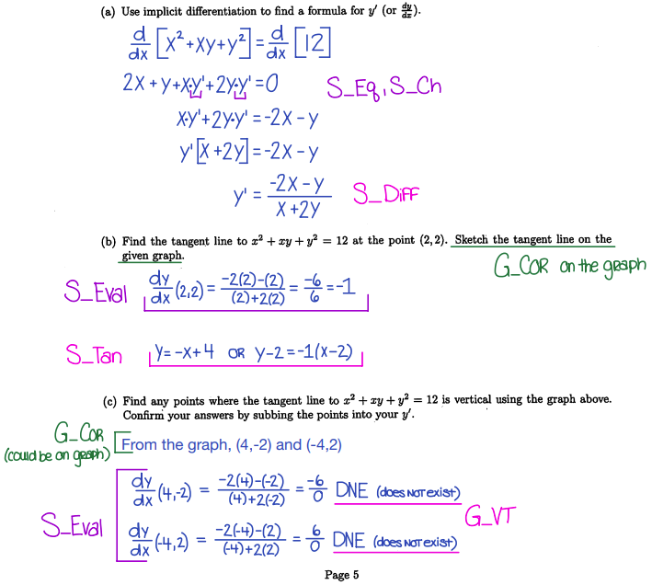
Exam Rubric

