Slide 1


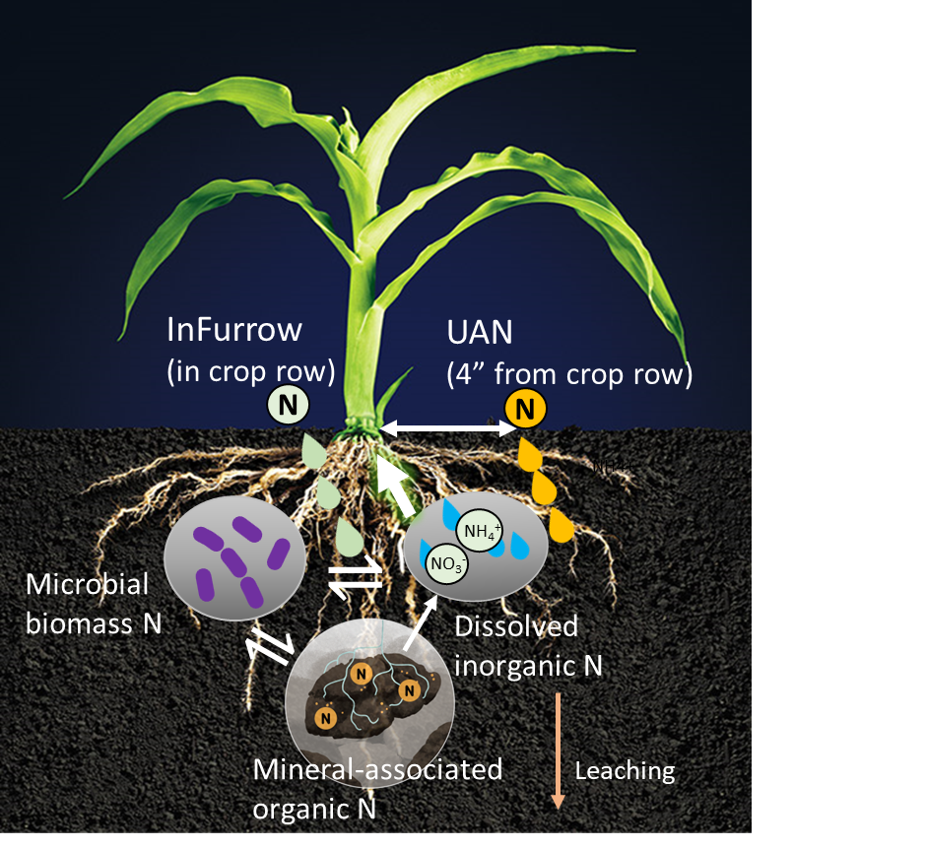
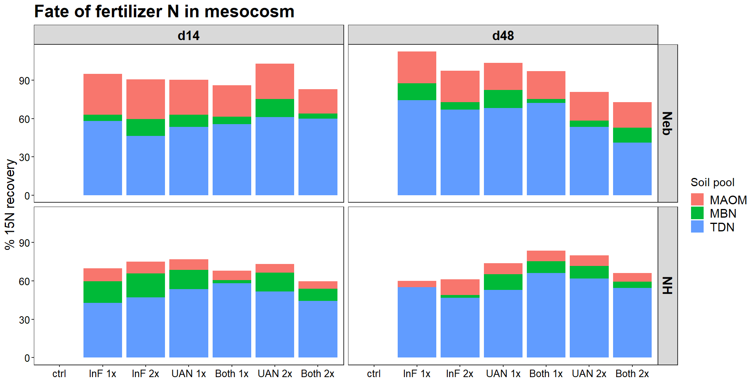
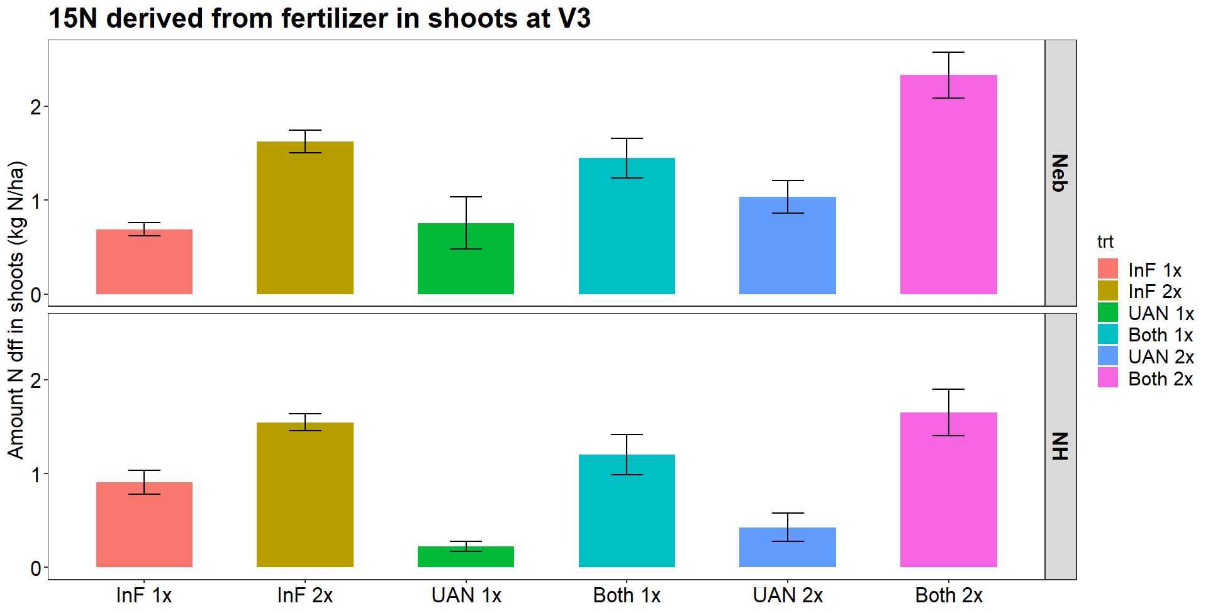
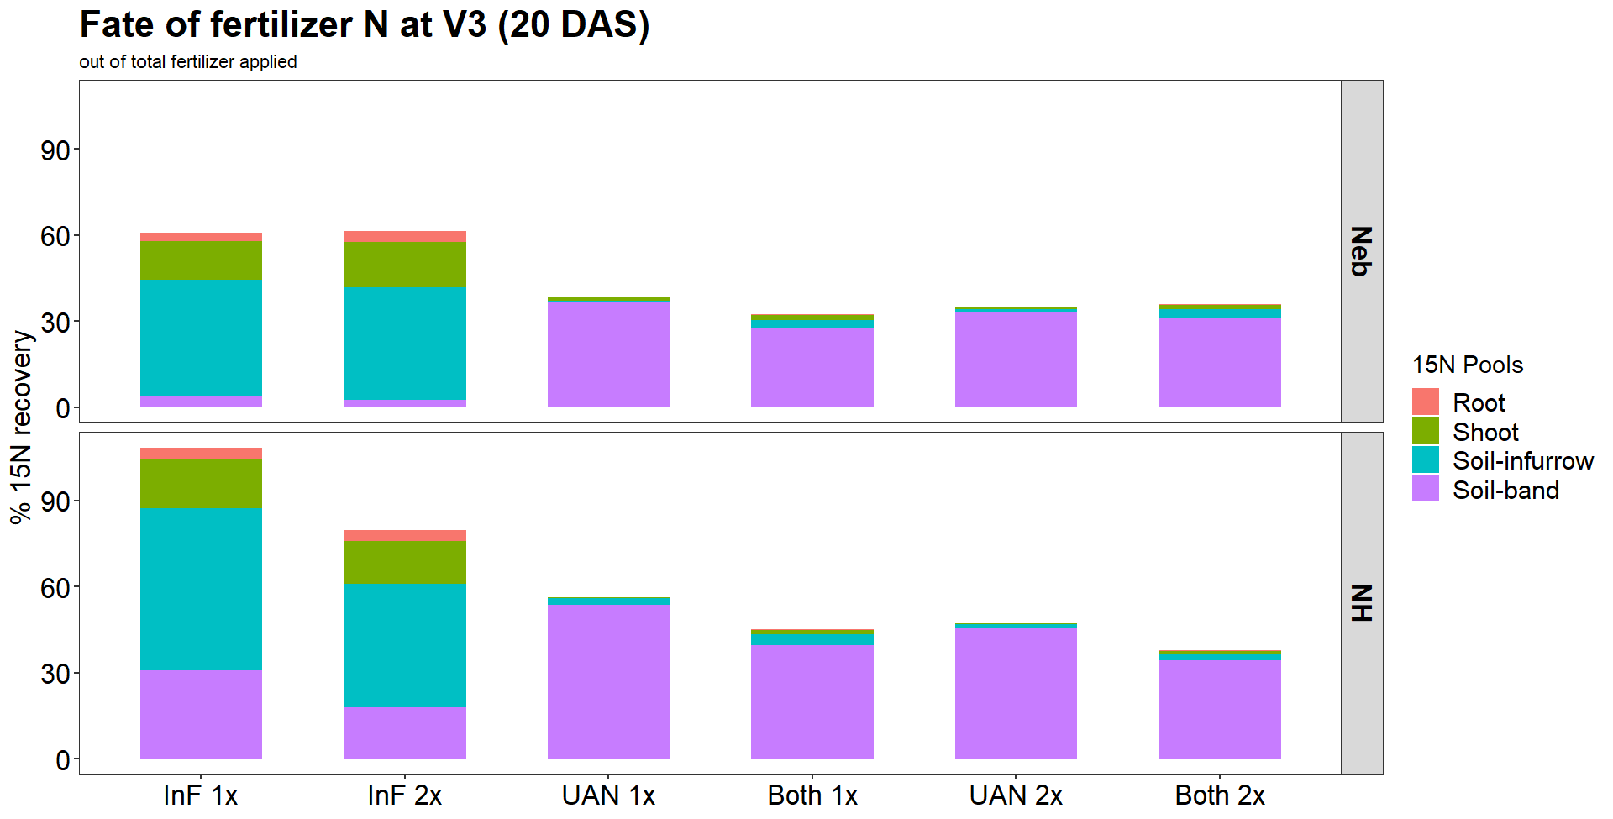
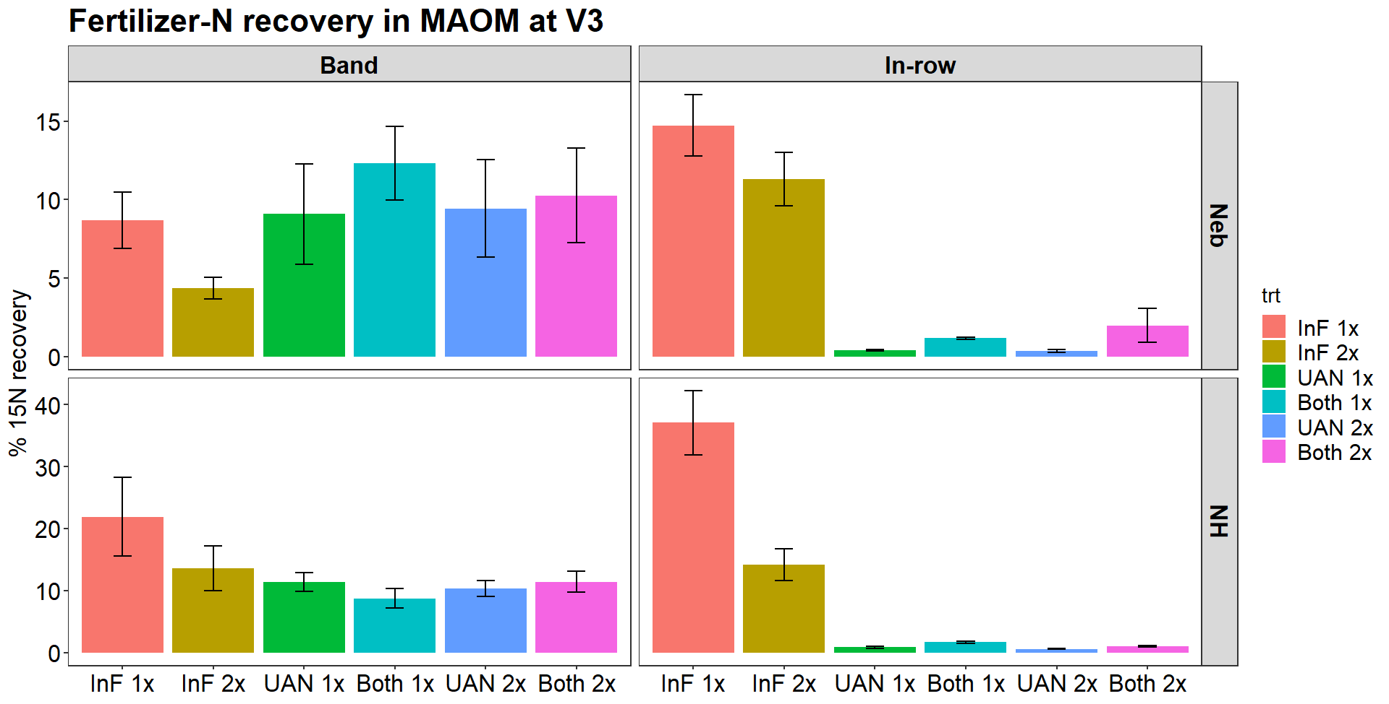
Can starter fertilizers improve plant nitrogen uptake by cycling through microbial and mineral pools?
Manjot Kaur Rekhi¹, Amanda B Daly¹, Brian Gardener², Marty Schmer³, Virginia Jin³, Serita Frey¹, A. Stuart Grandy¹
¹Department of Natural Resources, University of New Hampshire, NH, USA ²Ag Spectrum Company, DeWitt, IA, USA ³USDA-ARS-AMRU Lincoln, NE, USA
Rationale
Key findings
Over 50% of yearly crop nitrogen (N) originates from soil organic matter pool (SOM) but it is unknown how much of SOM-N originates from fertilizers itself.
Inorganic fertilizer applications may cycle through SOM including mineral-associated organic matter (MAOM) and can have implications for fertilizer nitrogen use efficiency.
Fertilizer N was rapidly stored in organic pools
Objectives
In mesocosms, even with high fertilization rates, we found significant fertilizer ¹⁵N recovery in microbial biomass and MAOM pool
Quantify the contribution of N from starter fertilizers into different pools: whole soils, MAOM, total dissolved N (TDN), microbial biomass N (MBN), roots, and shoots at V3 and V6 stage of corn (20 and 38 Days after sowing) using ¹⁵N
Determine the effect of fertilizer type, rate, and placement on crop NUE and storage and cycling in these pools
Small biostimulating fertilizer applications outperformed large UAN applications
Treatment design:
In the field, small applications of starter fertilizer had similar or greater recovery in shoots as well as in MAOM than much higher rates of UAN fertilizer at the V3 stage.
Fert, rate, and placement | InF 1x in-row | InF 2x in-row | UAN 1x band | Both 1x | UAN 2x band | Both 2x
ppm N applied (mesocosm) | 137.5 | 275 | 550 | 687.5 | 1100 | 1375
kg N applied ha⁻¹ (field) | 5 | 10 | 74 | 79 | 148 | 158
“InF” fertilizer (“InFurrow”-commercial fertilizer containing biostimulant; Ag Spectrum, DeWitt, IA, USA) applied in crop row (see fig. 1)
28% UAN applied 4” from crop row (“band”)
“Both” (combination of Inf and UAN) applied in respective rows
Fig. 1. Starter fertilizer applied at seeding in InF and Band position. Corn plant shown for reference, not to scale. Corn photo credit: Jeffrey Marshall
Results and Discussion
A significant proportion of fertilizer recovered in MAOM and microbes!
Out of the total fertilizer-N applied, 47-66% was found in TDN, 5-30% in MAOM, and 5-17% in MBN in both soil mesocosms.
ab
ab
a
Adding biostimulant fertilizer improved N uptake in shoots
Doubling InF fertilizer increased shoot N uptake but doubling UAN alone did not.
Adding InF fertilizer to UAN improved ¹⁵N uptake in shoots.
b
b
b
ab
a
ab
a
bc
b
Fig. 2. Percent ¹⁵N recovery of fertilizer of the amount applied at d14 and 48 in Neb and NH soil incubation in different soil pools.
Fig. 4. The amount of ¹⁵N derived from fertilizer in V3 corn shoots at V3 stage or 20 days after sowing (DAS). Differences significant at p<0.05.
InF fertilizer more efficiently recovered in soil, shoots, and roots
Treatments receiving InF fertilizer had higher N recovery in shoots, roots, and soil than high applications of UAN.
Total fertilizer N recovery in soil system was 60-95% in InF only treatments but just 30-50% in treatments receiving UAN.
a
InF fertilizer more efficient in becoming MAOM
Recovery in MAOM was significantly higher in treatments receiving InF fertilizer in furrow soils compared to much higher N application rates.
We found significant ¹⁵N recovery in MAOM ranging from 0.4% to as high as 37%.
n.s.
a
b
b
b
b
a
a
ab
ab
b
b
ab
b
c
c
c
c
Fig. 3. Average percentage of fertilizer recovered in root, shoot, soil-inf and soil-band at V3 stage or 20 Days after sowing (DAS) in the field experiment.
Fig. 5. Percent ¹⁵N recovery of amount applied in MAOM at V3 stage or 20 Days after sowing (DAS). Differences significant at p<0.05.
Methods
Future directions and acknowledgments
Lab incubation in mesocosms
  6-week incubation using agricultural soils from New Hampshire (NH) and Nebraska (Neb); starter fertilizers injected in mesocosms, 5 replicates each
Soil properties | Neb | NH
Soil type | Silt loam | Sandy loam
OM% | 2.8±0.14 | 4.8±0.2
MAOM:POM% | 85:1 | 51:49
pH | 6.1±0.07 | 5.7±0.04
Cultivation | No-till | Moldboard plow
Lab analysis
Mesocosm experiment: Samples destructively harvested at day 14 (d14) and day 48 (d48)
Field experiment: Soil cores collected from InF and Band positions, and plants harvested at V3 and V6 stages of corn; see Fig 1
Soil fractionation into MAOM (<53 µm) and particulate organic matter (>53 µm)
MBN by chloroform fumigation and extraction
¹⁵N analysis and total C & N of all pools performed on EA-IRMS (Stable Isotope Lab-Cornell)
In process work: assess ¹⁵N in pools from V6 stage
Future research should investigate
how quickly N can be remobilized from these pools
the mechanisms driving mobilization (AMF, enzymes, etc.)
the efficacy of these pools as both short- and longer-term reserves
Field microplot study
  Field study with corn replicated at NH and Neb. Starter fertilizer combinations injected 2 inches deep in the soil, tested V3 and V6 stage of corn
This project is funded by AgSpectrum company, DeWitt, IA, USA. Thanks to Patrick Lemis, James Lin, Jason Reyes, Alice Larson, and Parker Rice for providing lab assistance.
¹⁵N
Each fertilizer spiked with 10 at% ¹⁵NH₄SO₄ to track the movement of fertilizers in various pools

