Slide 1
Avoiding the Pitfalls and Blind Spots of the White Research Lens
Principles for Researchers
Jessica Harter
Mathematics Education Department
Notes:
Extend the desktop and select the correct desktop through Zoom
Thank you everyone for coming to my talk. I am Jessica Harter and I am from the Mathematics Education Department.
My talk is on avoiding the pitfalls and blind spots of the white research lens, principles for researchers

Slide 2
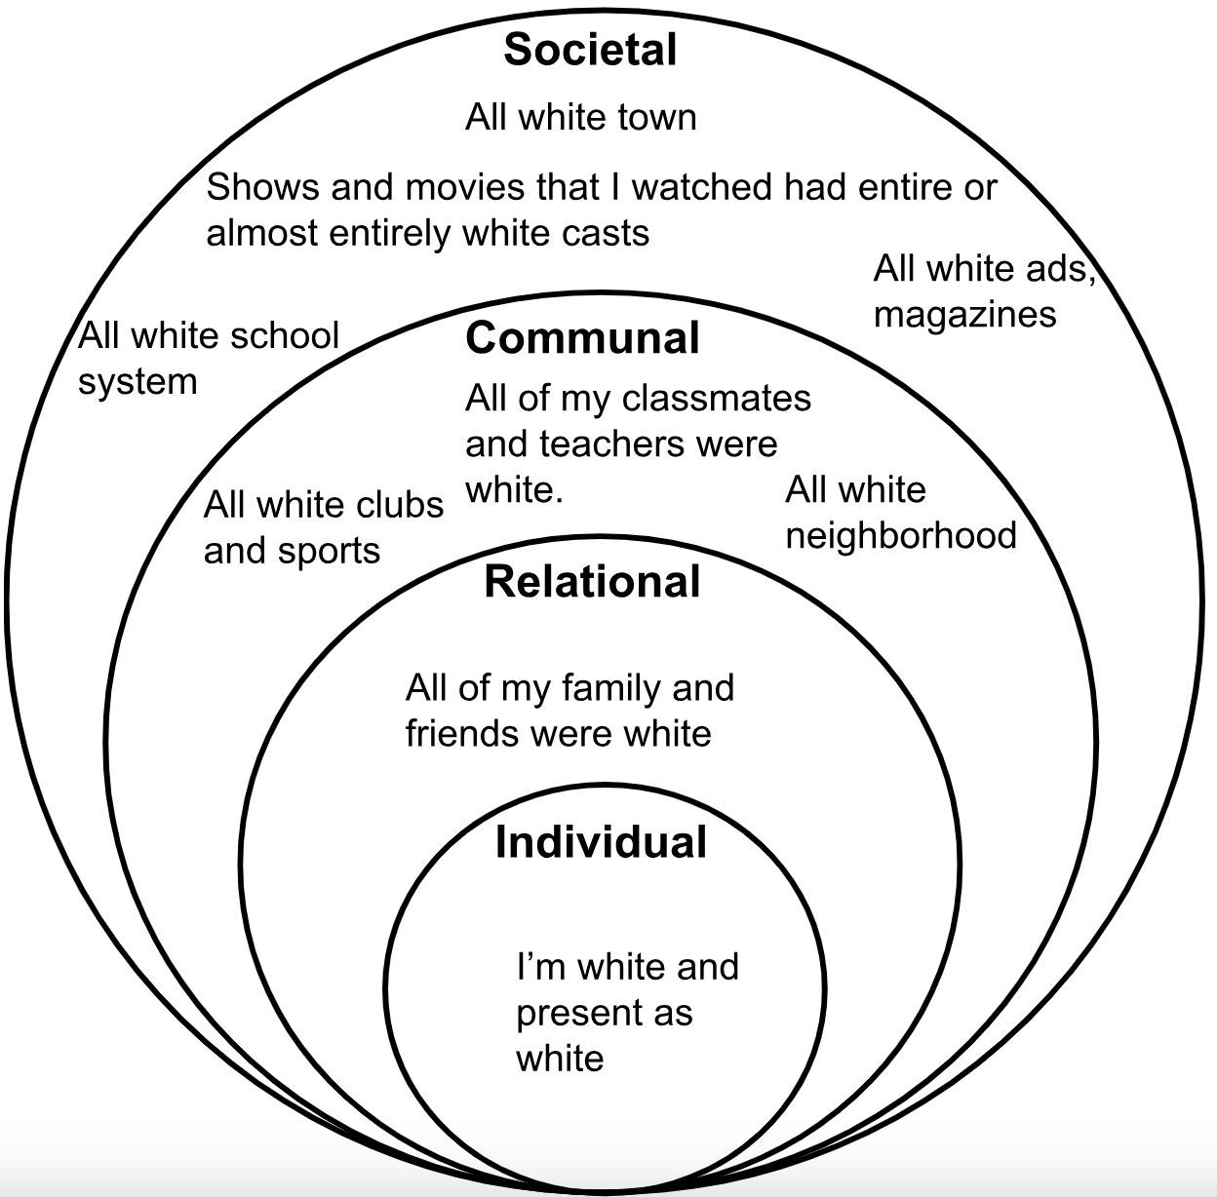
My White
Bubble
Birth-8th grade
Notes:
Throughout my life I have predominantly lived in a White bubble. My friends, family, peers, teachers, neighborhoods, what I watched on TV was all or predominantly white
I was and still am living in a mostly white bubble. CLICK!

Slide 3
My White
Bubble
Birth-8th grade
This is me, in my bubble
Notes:
Bubble is more, ideologies
Since Undergrad I learned more about race and racism, when I started my program at UNH I got to thinking…
This bubble was more than just the people around me, this bubble cultivated and led me to believe in certain ideologies. To believe that America is the land of opportunity and if you worked hard you got accomplish anything you wanted to.

Slide 4
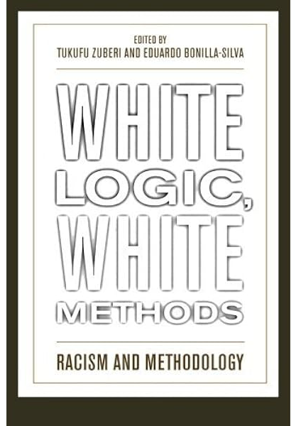
I got to thinking…
Due to the white bubble that I grew up in and the limited interactions I have had with people of color, how does my race affect my research?
Using White Logic, White Methods: Racism and Methodology as my foundation, I came up with principles all scholars should follow when conducting research.
Notes:
Due to the white bubble that I grew up in and the limited interactions I have had with people of color, how does my race affect my research?
I turned to White Logic, White Methods: Racism and Methodology which had 25 contributors with various backgrounds
Used this foundation. I came up with 7 principles categorized into 3 groups

Slide 5
During All Aspects of Research
Principle 1: Race is a Social Construct and Thus Messy
Race is not biological, it is a social construct!
Social construction: process by which people, individually and collectively, negotiate their identities and related interests in an environment of scarce resources.¹
Racial identity isn’t a wholly individual process of self definition.
To the outside world, a person of color does not exist outside their otherness. They are visually put into a racial group and are treated by society according to that categorization.²
(James, 2008)¹ (Bonilla-Silva & Zuberi, 2008)²
Notes:
A social construction is the process by which people, individually and collectively, negotiate their identities and related interests in an environment of scarce resources.
A complicated aspect of Racial identity is that it is not a wholly individual process
Example if someone looks Black…
Me as a white person
To the outside world, a person of color does not exist outside their otherness. They are visually put into a racial group and are treated by society according to that categorization.
Self-identification and society-identification of race
Must be explicit and careful define race and how came up with definition
Another complex aspect of race is that racial identity isn’t a wholly individual process of self-definition
For example: if someone looks Black they will be disadvantaged as a black person in the U.S. regardless of how they self-identify and other individual characteristics they possess besides being black
Similarly, me being white allows me to reap privileges. It doesn’t matter whatever individual characteristics I possess, I am afforded these privileges.
To the outside world, a person of color does not exist outside their otherness. They are visually put into a racial group and are treated by society according to that categorization.
Self-identification of race and society-identification, including researcher-identification) may not agree
And so researchers need to be extremely careful in how they define race and to explicitly state their definition and how they came to such a definition in their work.

Slide 6
During All Aspects of Research
Principle 2: Racism is Structural
Structural racism: refers to the ways in which societies foster racial discrimination through mutually reinforcing systems¹
When researchers do not view racism as structural, racism can be regarded as…
A disease only affecting certain individuals²
A phenomenon that does not have external effects on society and its institutions²
A social problem that needs to be analyzed clinically by separating the good vs bad apples in each race²
We need to question how racism interacts with the structures we are a part of and encounter.
(Bailey, Krieger, Agénor, Graves, Linos, & Bassett, 2017)¹ (Bonilla-Silva & Baiocchi, 2008)²
Notes:
Moving on to principle 2: Racism is structural
Structural racism refers to the totality of ways in which societies foster racial discrimination through mutually reinforcing systems of housing, education, employment, earnings, benefits, credit, media, health care, and criminal justice. These patterns and practices in turn reinforce discriminatory beliefs, values, and distribution of resources.
When we do not view racism as structural, then it can be regarded as…
A disease (problem of those who are afflicted)
An internal phenomenon (ignoring racism’s effect on society and its institutions, absolves institutions and members from reflecting on bias and racist practices)
A social problem to be analyzed clinically (searching for good and bad apples, model minorities)
We must understand that racial inequalities are not the result of an individual’s race, but as a culmination of social interactions that differentiate by race.
So, understanding racism as structural allows us to elevate our understanding of racism from a micro/individual level to the macro/institutional level.
When racism is not veiwed as structural, racism can be regarded as…
A disease only affecting certain individuals
As a phenomenon that does not have external effects on society and its institutions
And as a social problem that needs to be analyzed clinically by separating the good vs bad apples in each race
Seeing racism as a disease lends itself to understanding racism as a problem of those who are afflicted by discrimination and disadvantage and so the responsibility is on the marginalized person to get better. This implies that we only need to fix the racist individuals through education to eradicate the disease, allowing institutional practices to go unexamined and unquestioned which continues structural racism’s reign.
If we view racism as an internal manifestation, that absolves all institutions and members from reflecting on their own biases and racist practices.
Searching for good or bad apples of marginalized groups can lead to model minorities, perpetuating stereotypes, and similarly laying the responsibility on the bad apples to become good apples.
We must understand that racial inequalities are not the result of an individual’s race, but as a culmination of social interactions that differentiate by race.

Slide 7
During All Aspects of Research
Principle 3: Situate your White Audience and Participants in Social and Historical Contexts
White flight of the 1990s resulted in White people having…
Decreased cross-race interactions¹
Indirect knowledge of racial others¹
To rely on and use racial stereotypes¹
(Young Jr, 2008)¹
Notes:
The third principle is to Situate your white audience and participants in social and historical contexts
White flight
More white people now and since the 1990s than in 1960s and prior base their knowledge on media and what they read in academic-based publications
Due to ongoing residential segregation, many white people have limited cross-racial contacts, knowledge is made indirectly
White people tend to lean on stereotypes
In the 1990s white flight began to happen as whites left the inner cities
More white people in the 1990s than in the 1960s based their knowledge of urban, low-income black people on what they saw in the media or what they read in academic-based publications
Given deep, ongoing residential segregation by race, many white people have limited cross-racial contacts and forge their knowledge of racial others indirectly
Therefore, white people tended to lean on stereotypical images of the underclass promoted by prominent researchers to understand black people and their situation

Slide 8
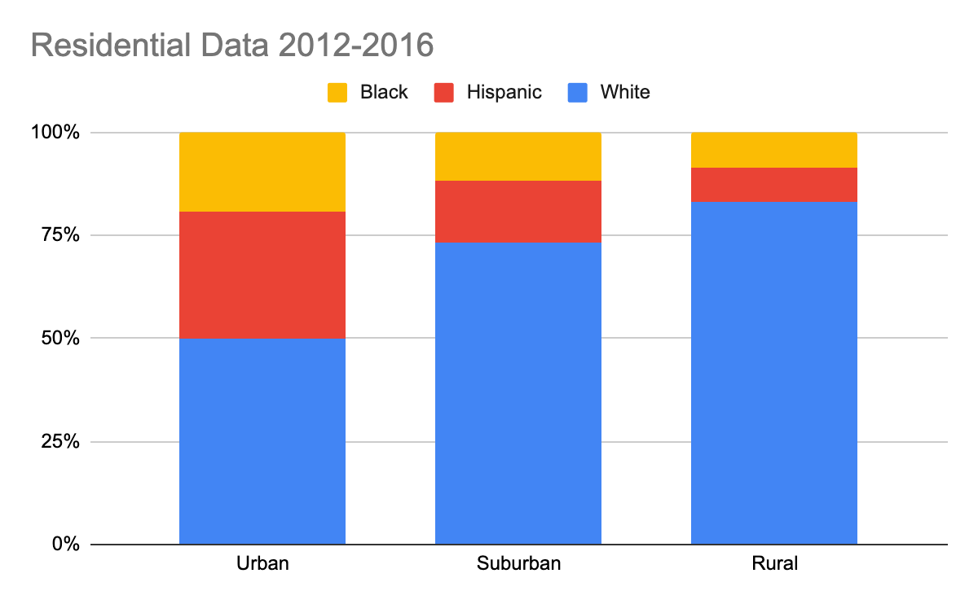
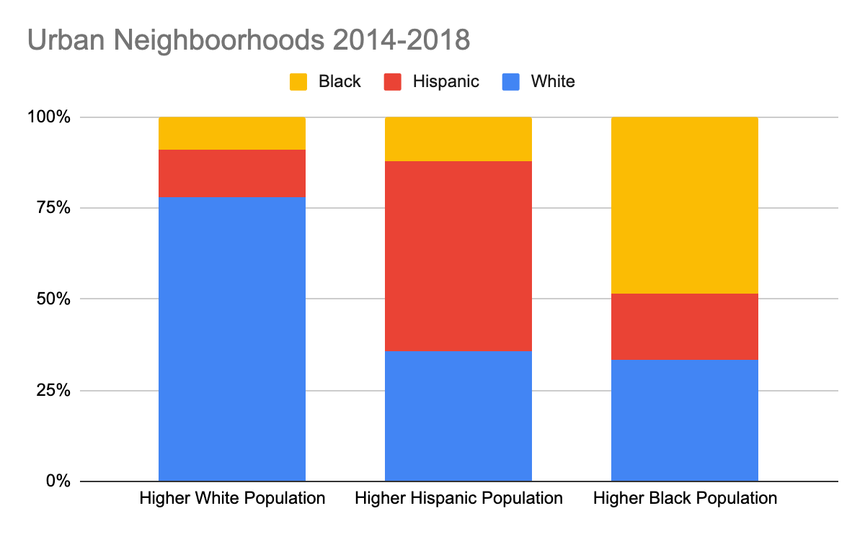
During All Aspects of Research
Principle 3: Situate your White Audience and Participants in Social and Historical Contexts
(Parker et al., 2018; Frey, 2020)
Notes:
Understandable why majority of white people…
Residential data…
It is actually quite understandable why a majority of White people would believe in stereotypes and that we are in a post-racism society.
The majority of white people live in a racially isolated social location which distorts their view of how America operates.
In the graphics you see, the blue represents the white population, red the hispanic population, and yellow the black population
The left graphic depicts residential data between 2012 and 2016, focusing on the White population, urban areas were 44% white,
In the suburbs, 68% were white and In rural areas, 79% white
Frey (2020) took a more micro-level look at urban neighborhoods
Neighborhoods with a higher white population on average were found to be made up of 71% white
Whereas, neighborhoods with higher average Hispanic population were 47% hispanic and 32% white
Neighborhoods with a higher black population, 45% were black and 31% white

Slide 9
During All Aspects of Research
Principle 4: Researcher Positionality Effects Research
Need to recognize our positionality and how it affects our research
There is a lack of recognized researcher positionality which can promote color-blind racism¹
Reflect on where you come from and your experiences
(Goar, 2008)¹
Notes:
Principle 4: Researcher positionality Effects Research
We must recognize our positionality and how it affects our research at all levels.
Goar contends that there is a lack of recognized researcher positionality which can promote color-blind racism.
We must reflect on where we come from, our experiences or lack of experiences in order to uncover biases and blind spots in our research.

Slide 10
During All Aspects of Research
Principle 4: Researcher Positionality Effects Research
Social location impacts what a researcher sees or does not see.¹
The White lens tends to reproduce the racial order.²
Race affects the way participants and researchers perceive social phenomena¹
(Gallagher, 2008)¹ (Bonilla-Silva & Zuberi, 2008)²
Notes:
A white researcher has most likely grown up and continues to live, work, and socialize in a predominantly white bubble. The influence of social location on a researcher impacts what a researcher sees or does not see and this impacts every aspect of the research process.
The white lens provides a particular set of knowledge and experiences which in turn tends to reproduce the racial order

Slide 11
When Developing and Executing your Research Project
Principle 5: Methods and Analysis are not Objective
Many researchers believe that methods and analysis are objective¹
That methods can be applied impartially¹
Try to make the case using the objectivity of mathematics¹
Results of applied mathematics should not be considered value-free, neutral, objective mathematical proofs.¹
(Bonilla-Silva & Zuberi, 2008)¹
Notes:
Moving on to the next group: When developing and executing your research project
The 5th principle is that Methods and analysis are not objective
Many researchers believe that methods are objective research tools that do not depend on race, gender, or class and that these methods can be applied impartially regardless of the researcher’s racial background.
Many who believe this try to make the case it is because the foundation of social sciences and the statistical methods employed by the field is objective mathematics.
Yes, mathematics in its pure form is objective. Definitions and theorems are what they are and knowledge logically follows. However, when we apply theorems to the real world and/or when imperfect people (we all are) are involved at any level, what results is not objective.

Slide 12
When Developing and Executing your Research Project
Principle 5: Methods and Analysis are not Objective
30 Million Word Gap conducted by Hart and Risley (1995)
Concluded that children from affluent families were exposed to 30 million more words than children from families on welfare
Affluent sample: 90% White, Welfare sample: 100% Black
White parents were performing for the White researchers; whereas, Black parents purposefully spoke less
Researchers have recreated the study and found that the gap is about 4 million word by the age of four.
Notes:
We can look to Hart and Risley’s (1995) “30 Million Word Gap” as an example.
Their sampling and data collection led them to inaccurate findings and perpetuating stereotypes about parents of color.
Hart and Risley reported that by the age of 3 children from affluent families were exposed to 30 million more words than children from families living on welfare. 90% of the affluent families in there sample were white, and 100% of the welfare families sample were black. So the conversation turned into that there’s a 30 million word gap between white children and black children by age 3.
Later research suggested that the white parents were more likely to perform for the researchers and speak more than they would have normally; whereas, the parents of color were more likely to not talk as much because of the fear of saying something wrong. In addition, it was found that the gap is around 4 million words by the age of four between Low SES and High SES children instead of 30 million by 3 between children of color and white children

Slide 13
When Developing and Executing your Research Project
Principle 6: Race is not a Cause
Treating race as a cause morphs “a Black student who gets poor grades” into “because he is Black, he gets poor grades”
Race can only describe associations which then indicate racial stratification¹
(Allen et al., 2008)¹
Notes:
Principle 6: Race is not a cause
When we discuss and analyze race in research, we need to be careful how we treat race as a variable.
The race of a student for instance is an attribute, a description of the student. Treating race as an attribute we may state that I have a black student who gets poor grades.
If race is viewed as a cause, this implies it is because he is black that the student is getting poor grades.
Treating race as cause is treating it as fixed and not dynamic, it doesn’t provide the historical and social contexts needed.
And so, race can only describe associations which are indications of racial stratification
For instance, it is not because the student is black that he has poor grades, it may be due to school and residential segregation, an example of racial stratification, and thus his school does not have the resources necessary for him to do well.

Slide 14
When Writing and Presenting your Research
Principle 7: Consider Social and Historical Contexts
“It is not a question of how a person’s race causes disadvantage and discrimination. The real issue is the way society responds to an individual’s racial identification. The question has more to do with society itself, not the innate makeup of individuals.”
-Bonilla-Silva & Zuberi, 2008, p.12
Notes:
The last group in when writing and presenting your research
Principle 7 is to consider social and historical contexts
As Bonilla-Silva and Zuberi states
“It is not a question of how a person’s race causes disadvantage and discrimination. The real issue is the way society responds to an individual’s racial identification. The question has more to do with society itself, not the innate makeup of individual’s.”
Researchers tend to write about race in a way that puts the responsibility of discrimination and disadvantage on those who are being discriminated against instead of the systems in society that allows the discrimination to exist in the first place.

Slide 15
When Writing and Presenting your Research
Principle 7: Consider Social and Historical Contexts
Be cognizant of what is happening at the time your study is being conducted
Explore and understand what events have led to current conditions¹
Look for and at patterns of opportunity and disadvantage
Understand and make explicit that race is not fixed and that it morphs based on social and historical contexts
(James, 2008)¹
Notes:
We must be cognizant of what is happening at the time our study is being conducted and what events led to current conditions, including looking for and at patterns of opportunity and disadvantage.
And when writing and presenting your research we should acknowledge that race is not fixed and that it morphs based on social and historical contexts.

Slide 16
In Conclusion…
Racial Stratification
Analysis and conclusions of Racialized data
Racialized data
Notes:
The ultimate goal would be to destroy racial stratification which would allow the equal distribution of rights and privileges; however, in order to do this we must use racialized census, survey, and other social data.
The danger is that the analysis used and conclusions drawn from utilizing racialized data may further preserve racial stratification.
In order to deracialize data, we must deracialize the social circumstances that originally created race and continue to perpetuate racial inequality.

Slide 17
We must reflect.
Do we reinforce the cycle?
Or do we try to break it?
Racial Stratification
Analysis and conclusions of Racialized data
Racialized data
Notes:
Everything that we do, say, interpret, investigate are filtered, are initiated through how we view and understand the world.
So, it is important for me, for all of us to reflect on our race-bubbles and to accept that what we know about the world is not necessarily a fact, that what we interpret and perceive can be vastly different from what others interpret and perceive.
Due to our position of researchers or future researchers, I believe it is our duty to be reflective, to follow these seven principles so in that way we can challenge racist structures causing disparities and not reinforce them.
We must work towards seeing the realities of phenomena with fewer pitfalls and fewer blind spots.
Thank you!

Slide 18
References
Allen, W. R., Suh, S.A., González, G., & Yang, J. (2008). Qui bono? Explaining- or defending- winners and
losers in the competition for educational achievement. In T. Zuberi & E. Bonilla-Silva (Eds.), White logic, white methods: Racism and methodology (pp. 190-208). Rowman & Littlefield Publishers, Inc.
Bailey, Z. D., Krieger, N., Agénor, M., Graves, J., Linos, N., & Bassett, M. T. (2017). Structural racism and health inequities in
the USA: evidence and interventions. The lancet, 389(10077), 1453-1463.
Bonilla-Silva, E., & Baiocch, G. (2008). Anything but racism: How sociologists limit the significance of
racism. In T. Zuberi & E. Bonilla-Silva (Eds.), White logic, white methods: Racism and methodology (pp. 123-135).
Rowman & Littlefield Publishers, Inc.
Bonilla-Silva, E., & Zuberi, T. (2008). Toward a definition of white logic and white methods. In T. Zuberi & E. Bonilla-Silva (Eds.),
White logic, white methods: Racism and methodology (pp. 9-30). Rowman & Littlefield Publishers, Inc.
Crenshaw, K. (Host). (2019, November 14). What slavery engendered: An intersectional look at 1619 (6) [Audio podcast
episode]. In Intersectionality Matters.
Crenshaw, K. (Host). (2021, May 14). Black women’s health through the twin pandemics (37) [Audio podcast episode]. In
Intersectionality Matters.
Frey, W. H. (2020, March 23). Even as Metropolitan Areas Diversify, White Americans still Live in Mostly White Neighborhoods.
The Brookings Institution.
https://www.brookings.edu/research/even-as-metropolitan-areas-diversify-White-americans-still-live-in-mostly-White-neig
hborhoods/.

Slide 19
References
Gallagher, C. A. (2008). “The End of Racism” as the new doxa: New strategies for researching race. In T. Zuberi & E.
Bonilla-Silva (Eds.), White logic, white methods: Racism and methodology (pp. 145-158). Rowman & Littlefield
Publishers, Inc.
Goar, C. (2008). Experiments in black and white: Power and privilege in experimental methodology. In T. Zuberi & E.
Bonilla-Silva (Eds.), White logic, white methods: Racism and methodology (pp. 136-144). Rowman & Littlefield
Publishers, Inc.
Hart, B., & Risley, T.R. (1995). Meaningful Differences in the Everyday Experience of Young American Children.
Paul H. Brookes Publishing.
James, A. (2008). Making sense of race and racial classification. In T. Zuberi & E. Bonilla-Silva (Eds.), White logic, white
methods: Racism and methodology (pp. 32-44). Rowman & Littlefield Publishers, Inc.
Khalfani, A.K., Zuberi, T, Bah, S, & Lehohla, P.J. (2008). Race and population statistics in South Africa. In T. Zuberi & E.
Bonilla-Silva (Eds.), White logic, white methods: Racism and methodology (pp. 58-83). Rowman & Littlefield Publishers,
Inc.
Maniam, S. (2016, July 18). Sharp differences over who is hurt, helped by their race. Pew Research Center.
https://www.pewresearch.org/short-reads/2016/07/18/sharp-differences-over-who-is-hurt-helped-by-their-race/
Marks, C. (2008). Methodologically eliminating race and racism. In T. Zuberi & E. Bonilla-Silva (Eds.), White logic, white
methods: Racism and methodology (pp. 45-58). Rowman & Littlefield Publishers, Inc.
Mazzuca, J. (2004, July 13). For Most Americans, Friendship is Colorblind. Gallup.
https://news.gallup.com/poll/12349/most-americans-friendship-colorblind.aspx.
McIntosh, P. (1989). White Privilege: Unpacking the Invisible Knapsack. Peace and Freedom.
Morawski, J. (1997). White experimenters, white blood, and other white conditions: Locating the psychologist’s race. In M. Fine,
L. Weis, L. Powell, & L. Mun Wong (Eds.), Off White: Readings on Race, Power, and Society (pp. 215-231). Routledge.

Slide 20
References
Oliphant, B. (2017, September 28). View about whether whites benefit from societal advantages split sharply along racial and
partisan lines. Pew Research Center.
https://www.pewresearch.org/short-reads/2017/09/28/views-about-whether-whites-benefit-from-societal-advantages-split-
sharply-along-racial-and-partisan-lines/
Parker, K., Menasce Horowitz, J., Brown, A., Fry, R., Cohn, D., & Igielnik, R. (2018, May 22). 1. Demographic and
Economic Trends in Urban, Suburban, and Rural Communities. Pew Research Center.
https://www.pewresearch.org/social-trends/2018/05/22/demographic-and-economic-trends-in-urban-suburban-and-rural-
communities/.
Pew Research Center. (2016, June 27). On views of race and inequality, Blacks and Whites are worlds apart. Pew Research
Center.
https://www.pewresearch.org/social-trends/2016/06/27/on-views-of-race-and-inequality-blacks-and-whites-are-wor
lds-apart/
TEDx Talks. (2019, November). The social implications of race [Video]. YouTube.
https://www.youtube.com/watch?v=a4jPGhN5TCM&t=547s
Young Jr., A. A. (2008). White ethnographers on the experiences of African American men: Then and now. In T. Zuberi & E.
Bonilla-Silva (Eds.), White logic, white methods: Racism and methodology (pp. 159-177). Rowman & Littlefield
Publishers, Inc.

Slide 21
Questions?
Thank you!

