Slide 1
A proposal for modeling elasmobranch populations
PhD in Marine Biology
Graduate Research Conference Presentation
Chapter 1:
Modeling of a large pelagic fish population in Cocos Island, Costa Rica
Presented by MSc. Miguel de Jesús Gómez-García
Gomez-Garcia, M. de J., Furey, N., Moll, R., White, E.R.

Slide 2


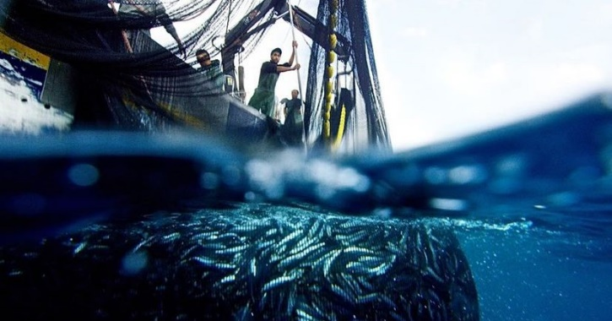
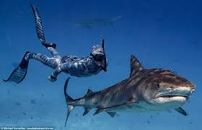
Marine Ecology
Study and understanding of the sea
Ecosystems. Populations. Species.
Marine resource management
Manage fisheries
Understand ecological and biological processes
Improve tourism

Slide 3
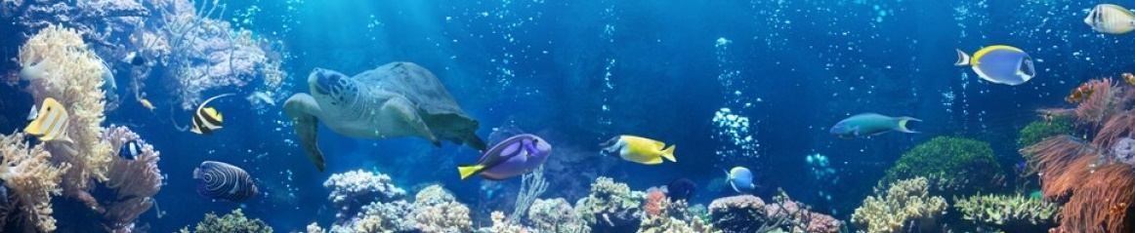


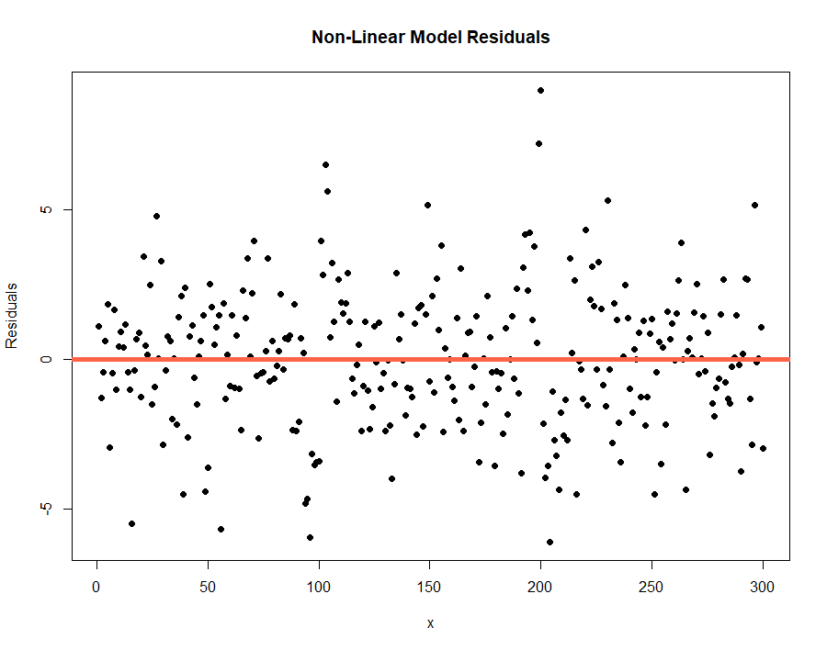
Ecological models
What causes x on species y?
?
Understanding data
Make predictions
Evaluate trends
Notes:
Konrad Lorenz

Slide 4
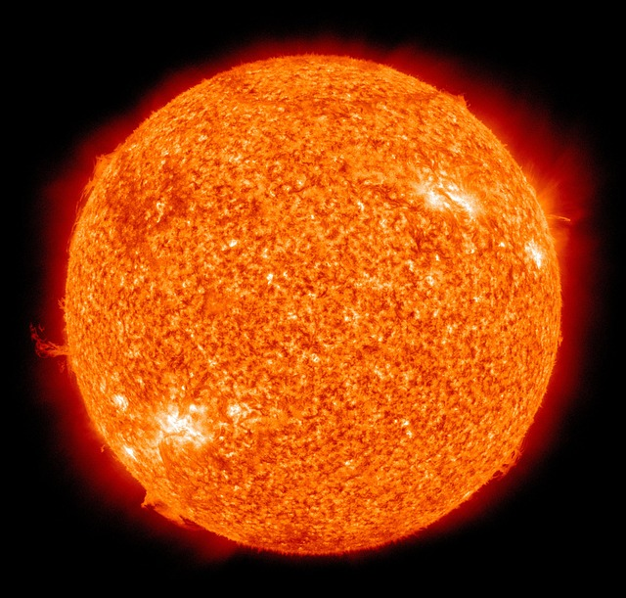
Building model
Large scale process

Slide 5
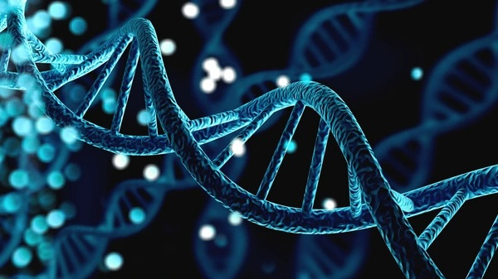
Building model
Small scale process

Slide 6

Somewhere in between
Somewhere in between lies the truth
Or at least something useful

Slide 7
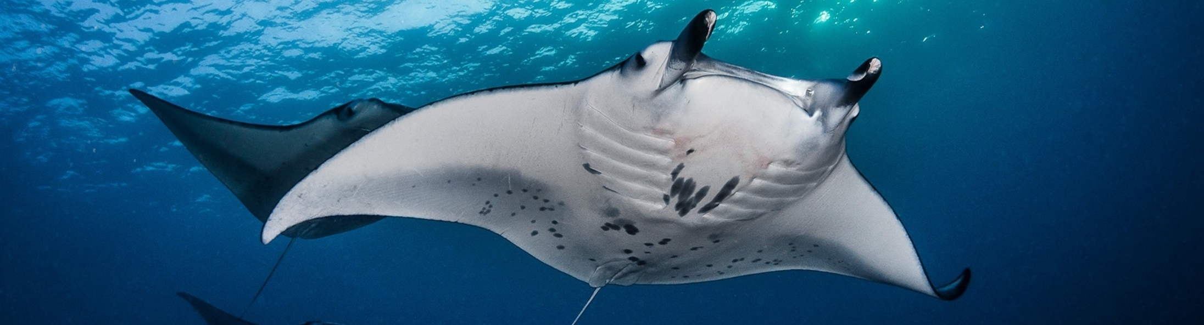
Informing Models
Reality:
Informed, thought model:
Uninformed, model:

Slide 8
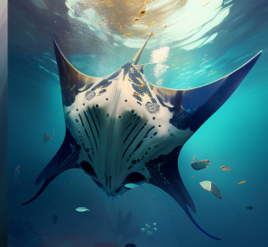
Informing Models
Reality:
Informed, thought model:
Uninformed, model:

Slide 9
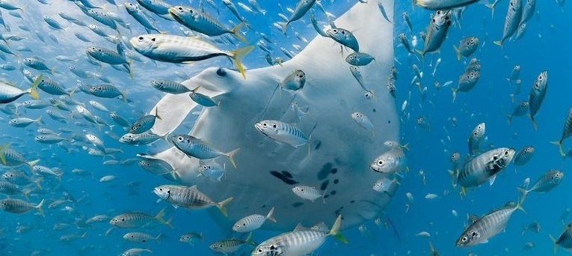
Dissertation Goal
The main objective of this dissertation will be to apply modern methodological techniques for the modeling of marine ecological systems at different scales of interaction

Slide 10

Chapters
Chapters, organized from the most general to the most particular ecological study cases, will explore advantages, applications, and challenges for these methods

Slide 11

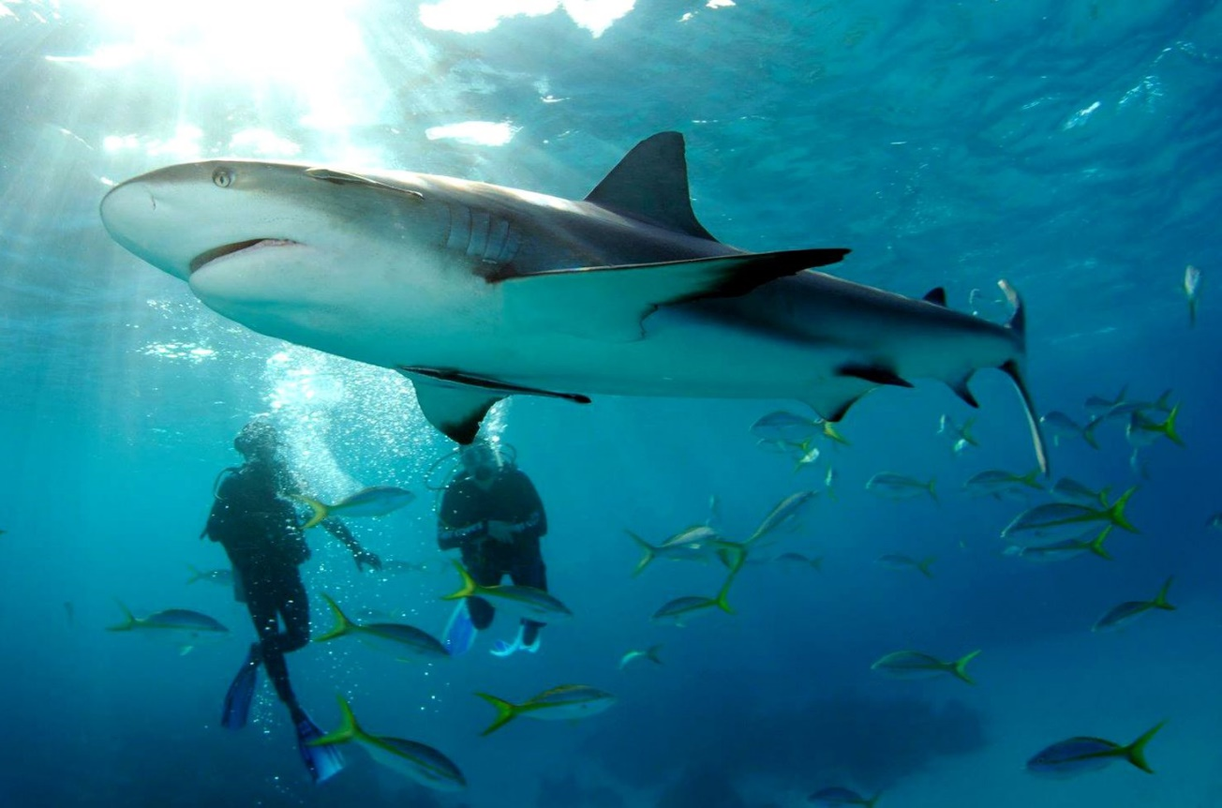
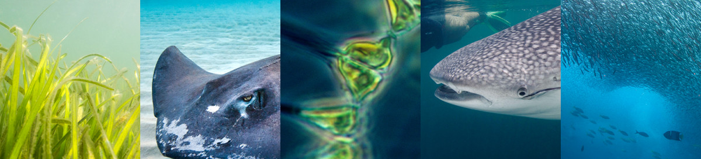
Elasmobranchs
Diversity and conservation
Tourism
Ecosystem regulation

Slide 12
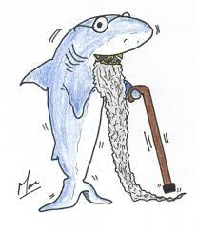
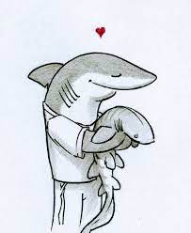
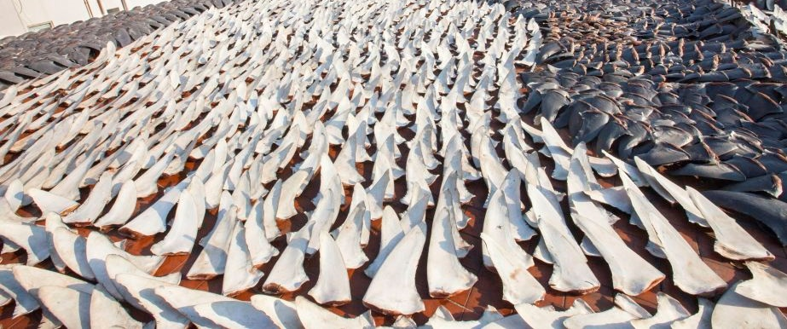
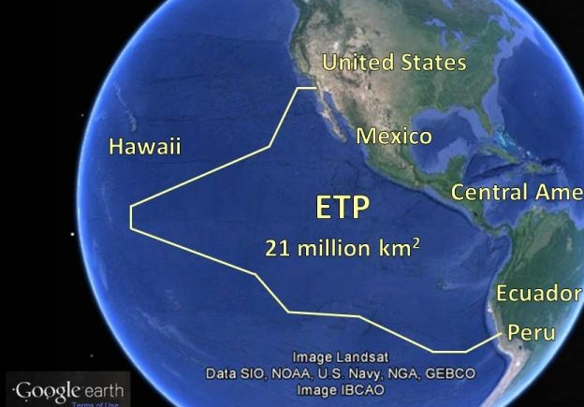
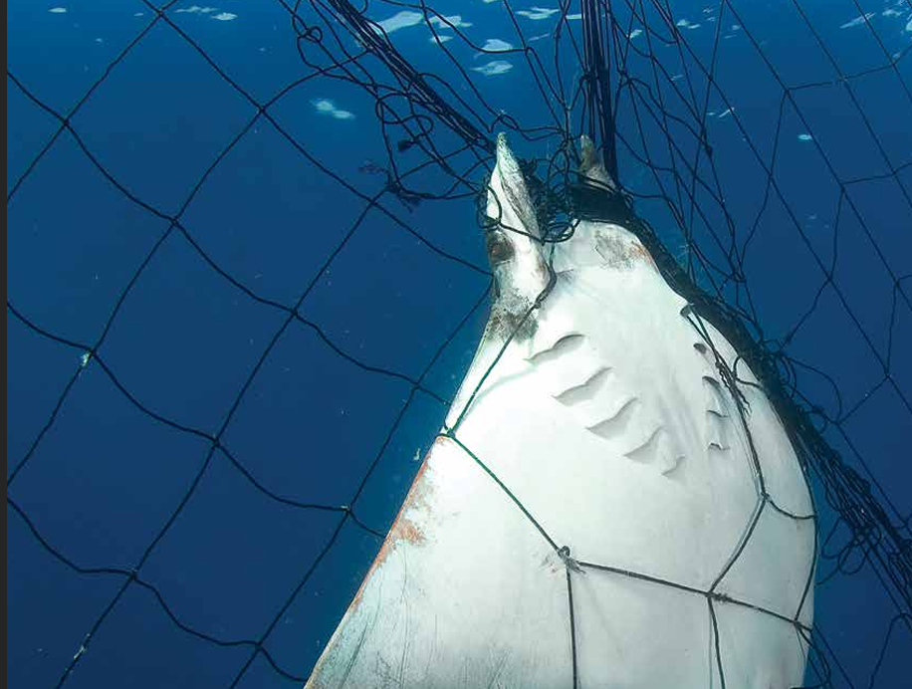
Challenges
Overfishing
Life history
Distribution
Bycatch

Slide 13
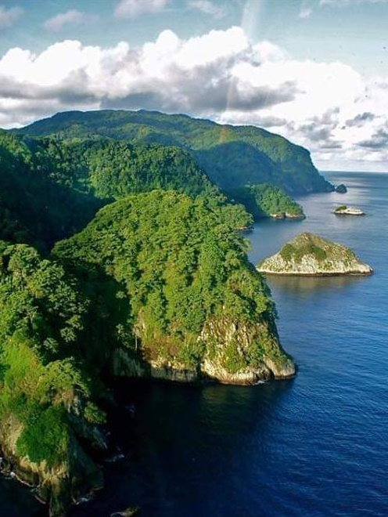
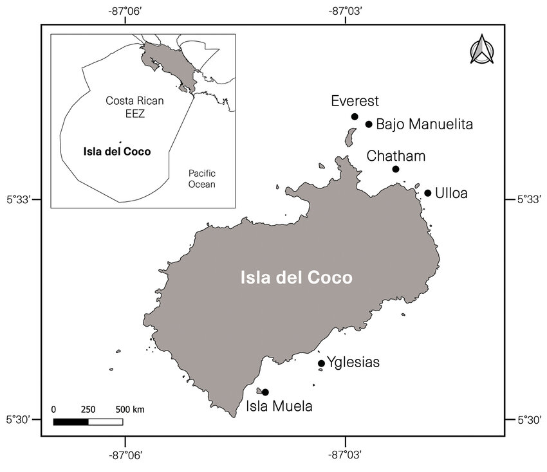
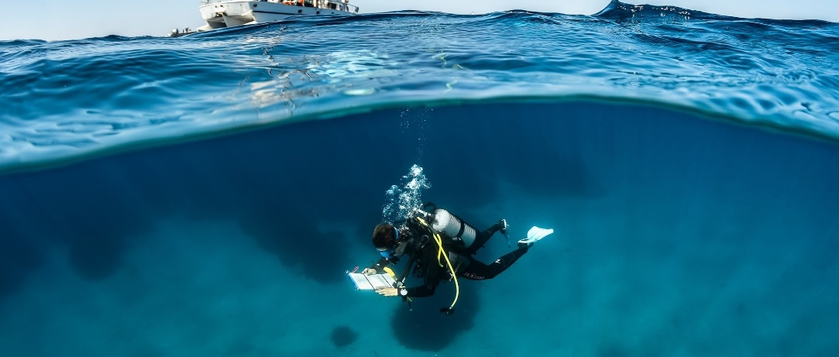
Chapter one: Elasmobranch Marine Ecosystem
Cocos Island, Costa Rica (500 km off)
World Heritage Site
Data from 1993-2019
Breedy et al., 2001
Information from SCUBA surveys 7 species of elasmobranchs

Slide 14
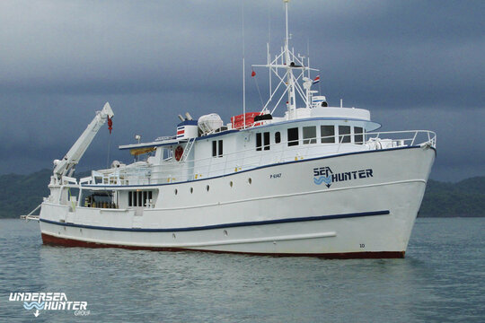
Chapter one: Elasmobranch Marine Ecosystem
Data collected by the Undersea Hunter Group. Tourism, research and diving.
Conservation. Management. Forecast.

Slide 15
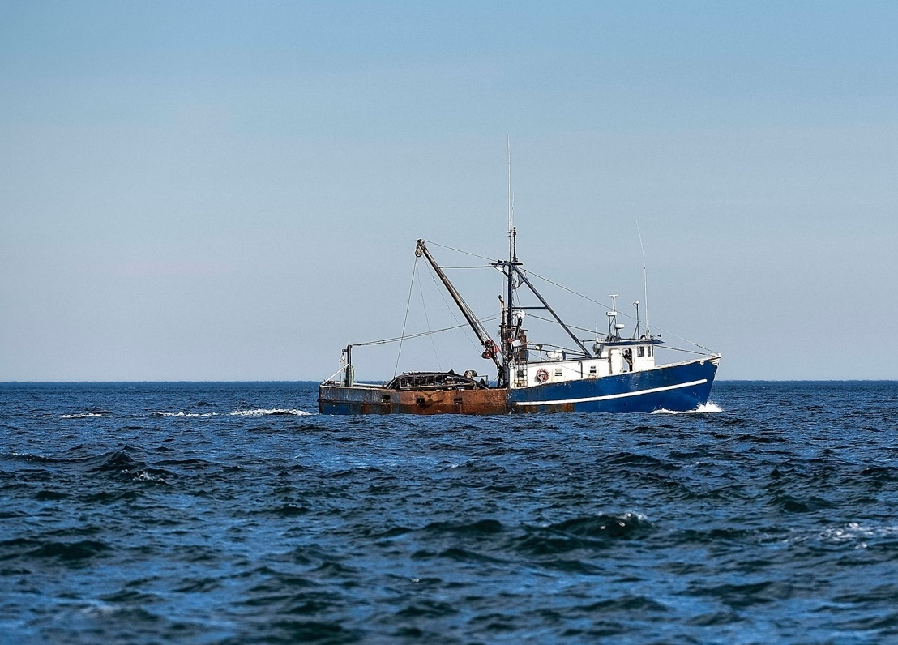
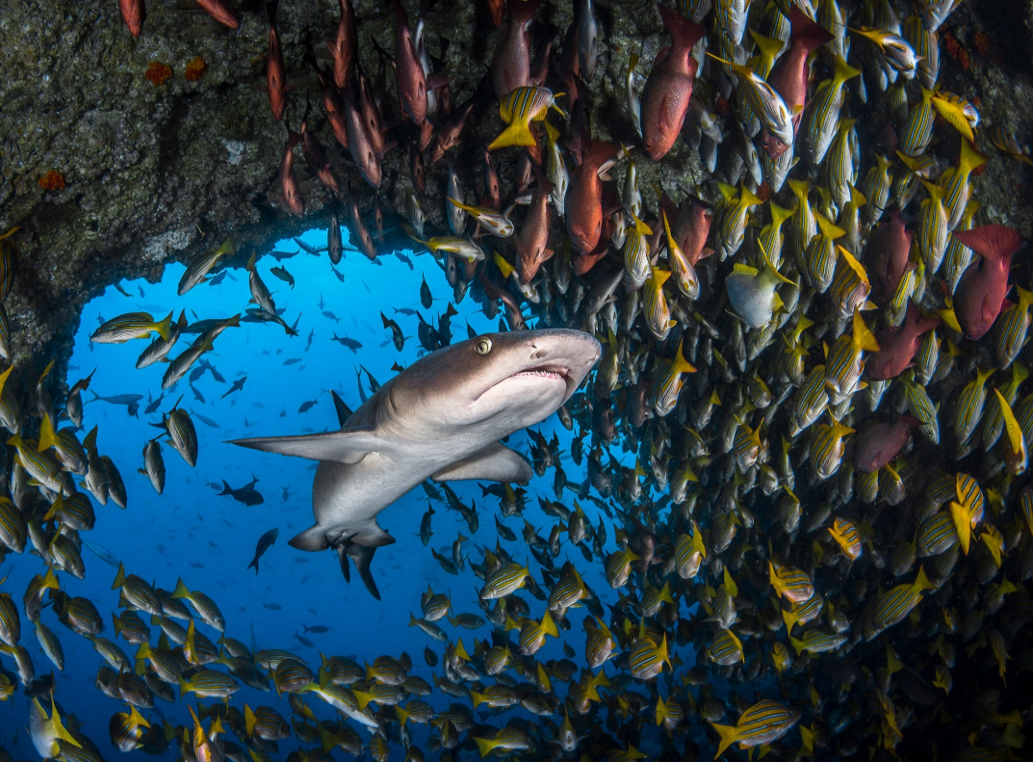
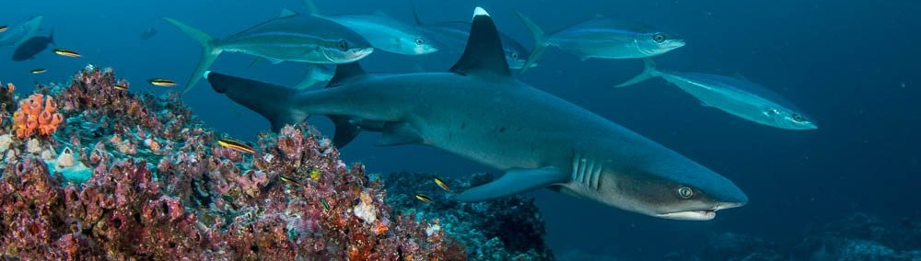
Previous work
González-Andrés et al., 2020
Osgood et al. , 2021
Illegal fishing and extreme events
White et al., 2015
González-Andrés et al., 2021
Saltzman et al. , 2023
GAMs and Mixed models to understand environmental preferences

Slide 16
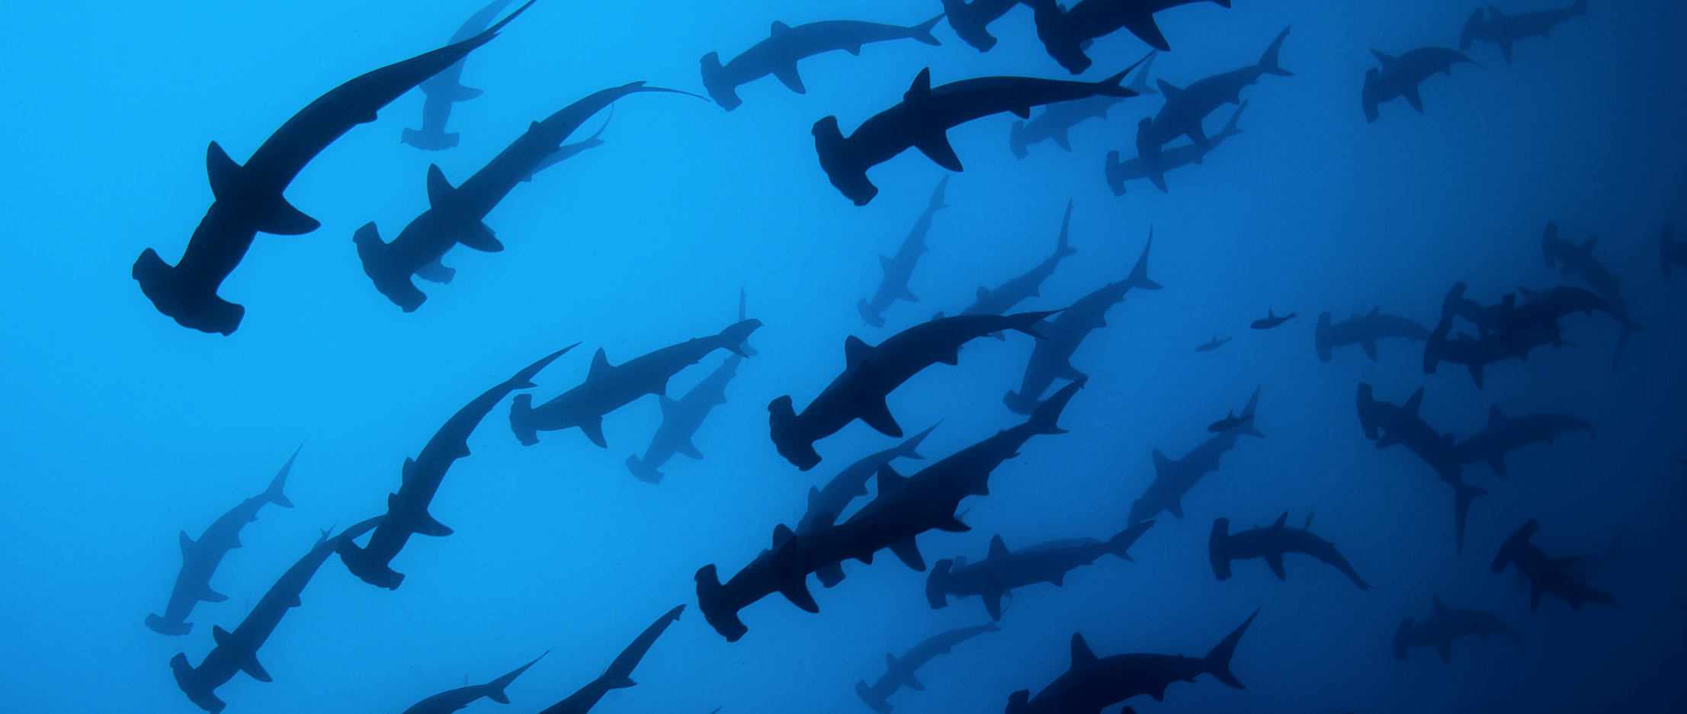
Knowledge Gaps
Studies solely focused on environmental variables. Lack of understanding of demographic processes and the effect of life history. Effect of inter species interactions, differential response to environment and natural and fishing mortality

Slide 17
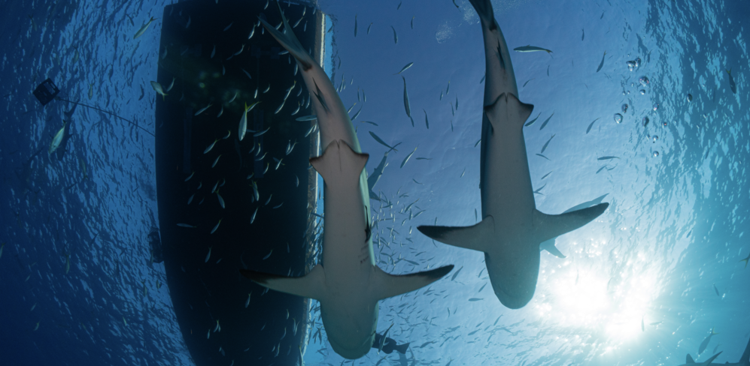
Objectives
Find variables and parameters important for abundance and richness. Evaluate effect on demographic and life history parameters. Test useful models for species abundance and trend prediction.

Slide 18
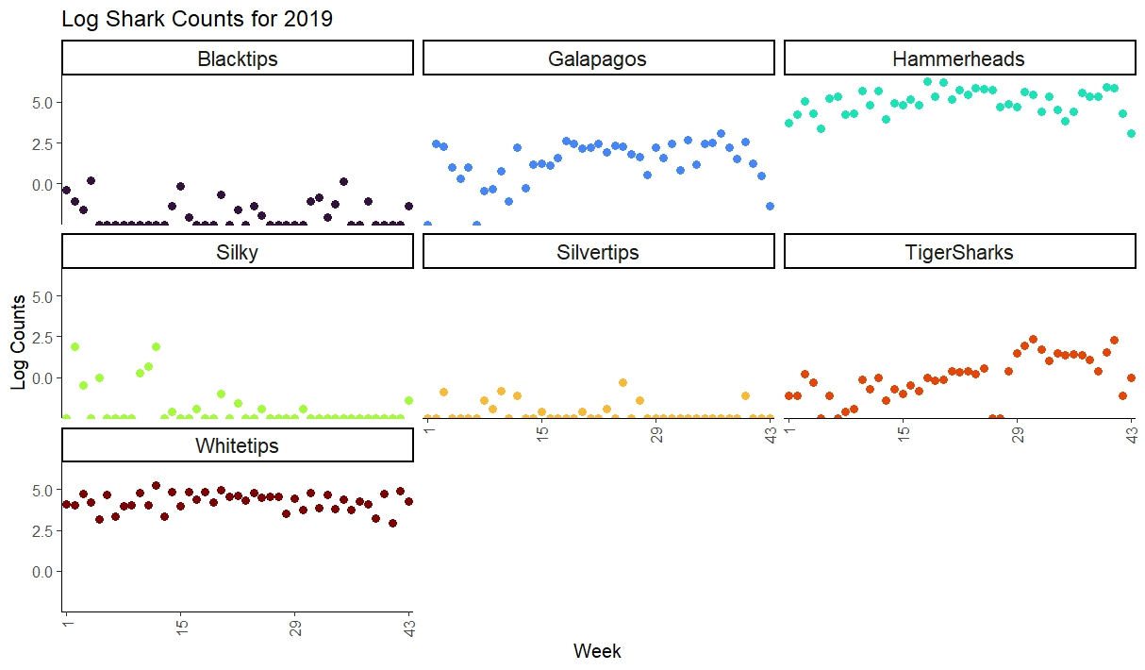
Data and results: Abundances
Log transformed species abundances for visualization. Only Shark species included in the model

Slide 19
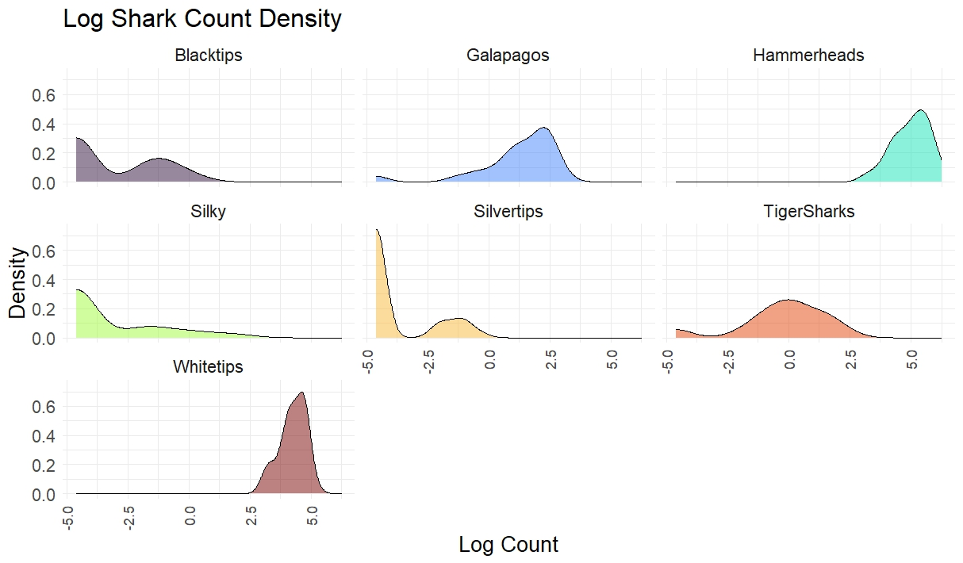
Data and results: Density
Notice different patterns are apparent

Slide 20
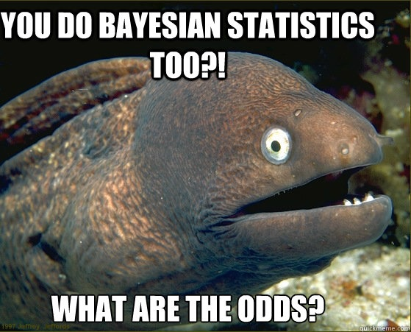
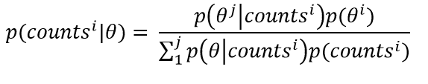



Bayesian model construction
Proposed model:
Simple, starting model

Slide 21
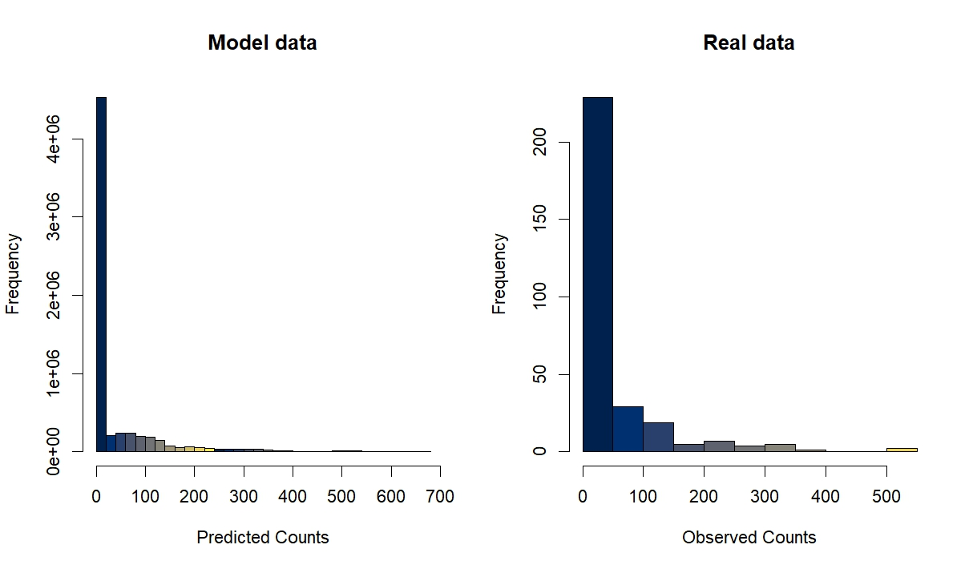
Results: Hierarchical Bayesian Model
Bayesian regression. Hierarchical model assuming negative binomial distribution of shark counts, random slope for each species

Slide 22
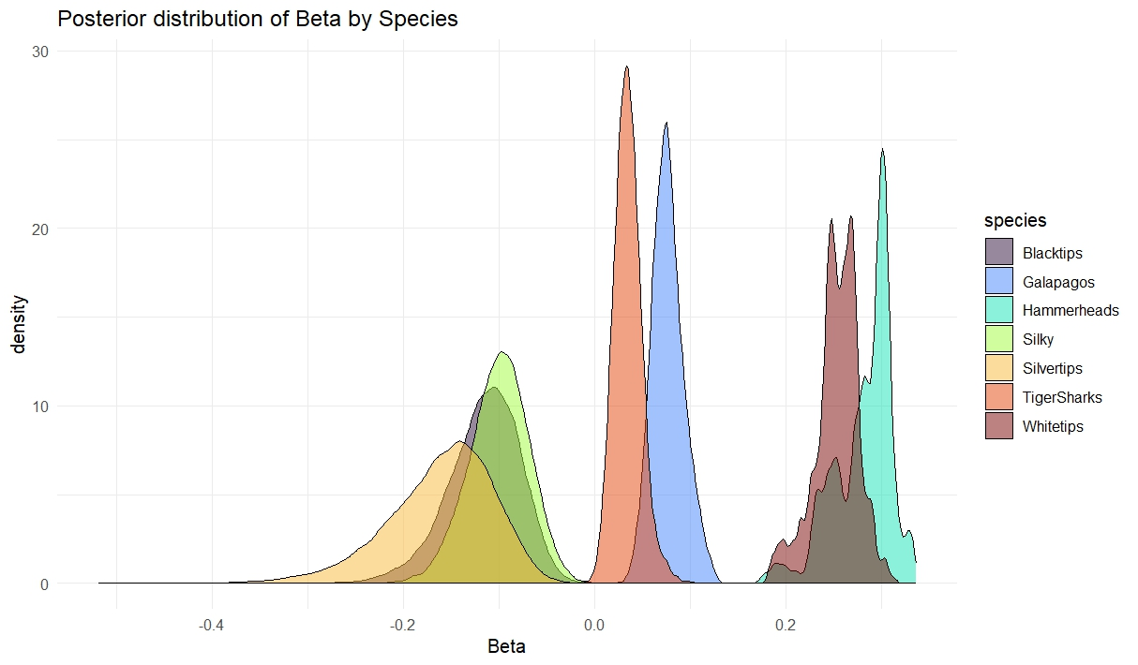
Highlights
Posterior distribution of parameters

Slide 23
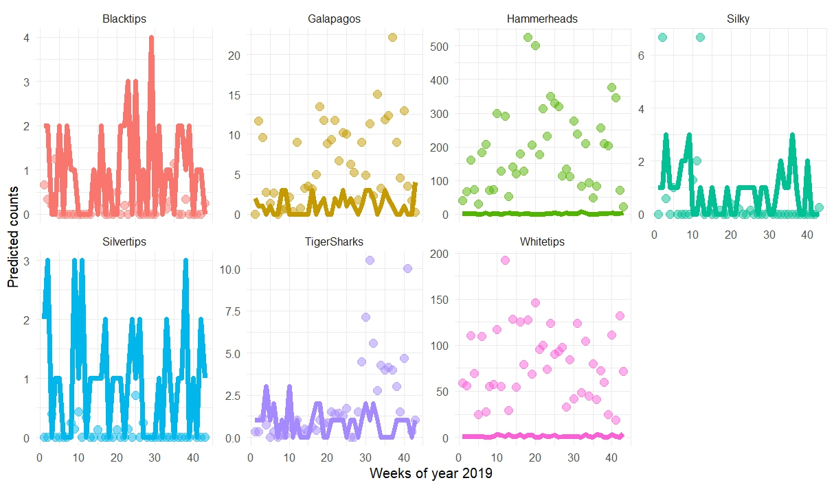
Highlights
Making predictions from our model
How good is the model looking?

Slide 24
Next steps
Still a work in progress!
Testing additional parameters. Input different combinations of priors. Implementing informed distributions e species. Incorporating life history traits.

Slide 25
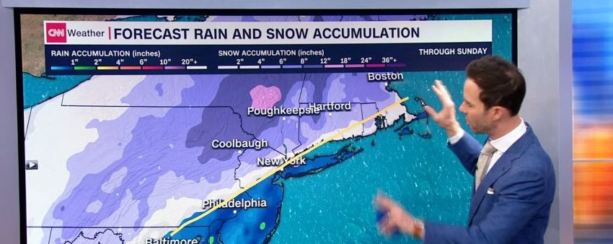

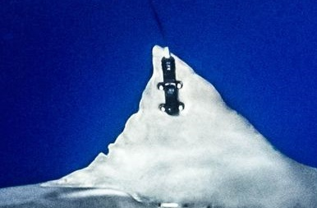

Future Work
SHARK AND RAY
Corroborate predictions with remote sensing
Collaboration with Management and stakeholders

Slide 26
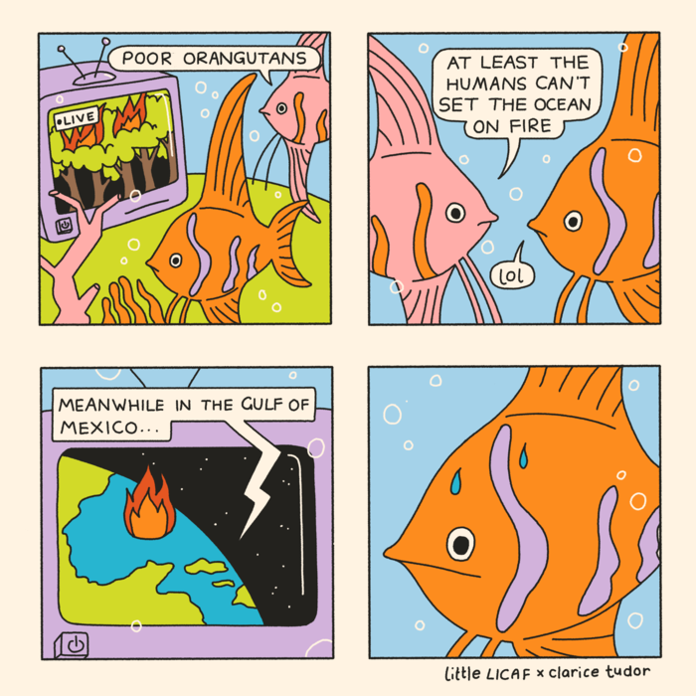
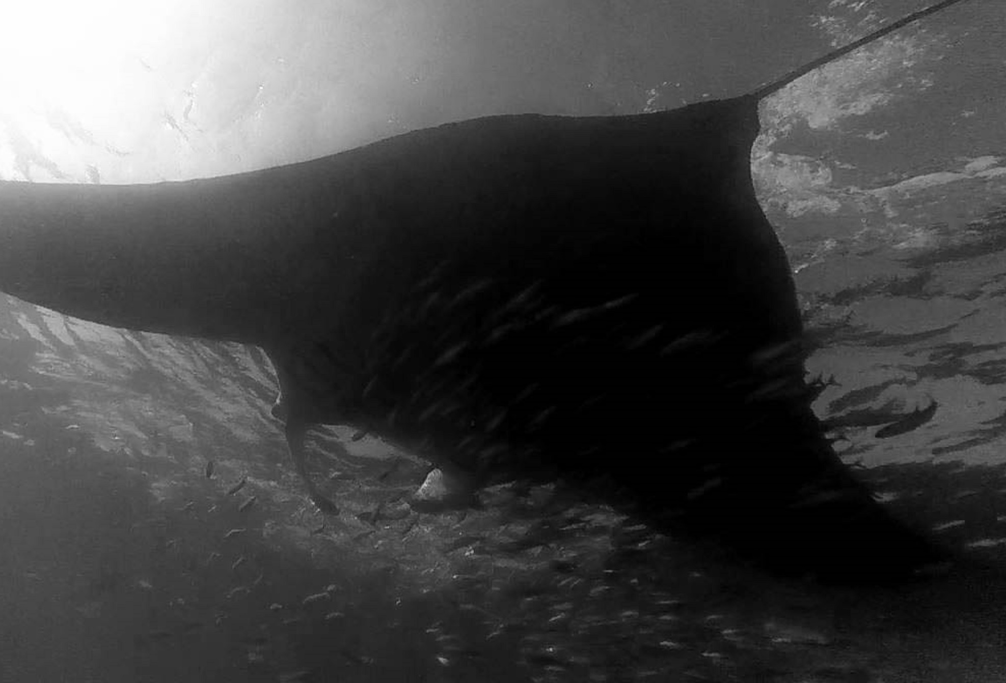
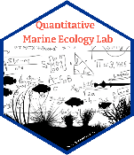



Thanks for your attention!

