Slide 1
Simulation Studies of a Mitomembrane Targeting Bioconjugated Peptide
Son Nguyen
4th year PhD Candidate, Department of Chemistry
Advisors: Dr. Roy Planalp and Dr. Harish Vashisth
UNH Graduate Research Conference 2024
University of New Hampshire, Durham

Slide 2
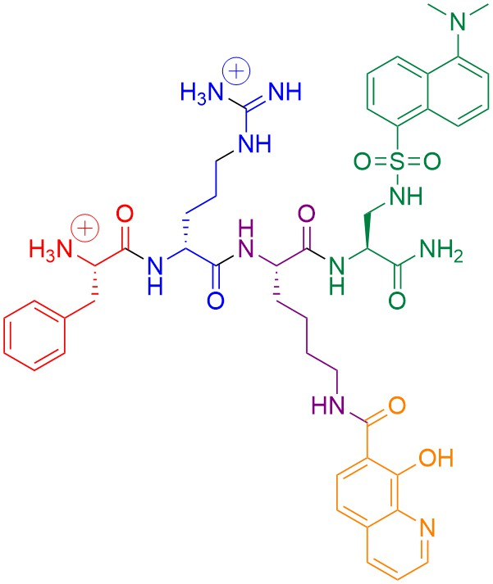
Objectives
Dansyl (fluorophore)
Creating a mitochondria-targeting probe and inhibit Fenton chemistry.
Understanding probe and mitochondrial membrane interaction.
F-r-K(8HQ)-Dap(dansyl)-NH₂
8-hydroxyquinoline (iron chelator)
Abbate, V.; et al. Biochemical Journal 2015, 469 (3), 357–366.

Slide 3
Iron Regulation is Essential to Biological Functions
Iron plays a role in:
DNA synthesis and repair
Gas transport
Cellular respiration
Programmed cell death
Iron dysregulation can promote reactive oxygen species (ROS) production.
The Fenton reaction:
$${Fe}^{2+}+ H_{2}O_{2}→ {Fe}^{3+}+{OH}^{−}+OH∙$$
Torti, S. V.; et al. Annual Review of Nutrition 2018, 38 (1), 97–125.

Slide 4
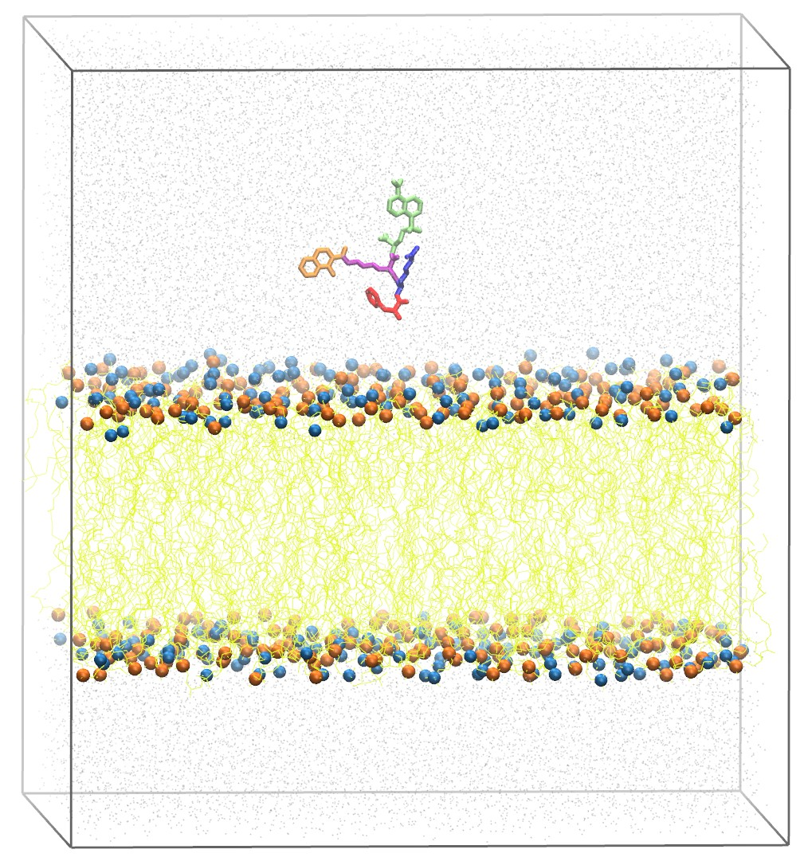
All-Atom Molecular Dynamics (MD) Simulation
Solving Newton’s equation of motion
$F=ma$
Trajectory
Timestep: 2 fs
High-performance computing
~120,000 atoms
S1: Phe towards membrane
S2: (D)-Arg towards membrane
S3: 8HQ towards membrane
S4: Dansyl towards membrane
Created in Biorender.com

Slide 5
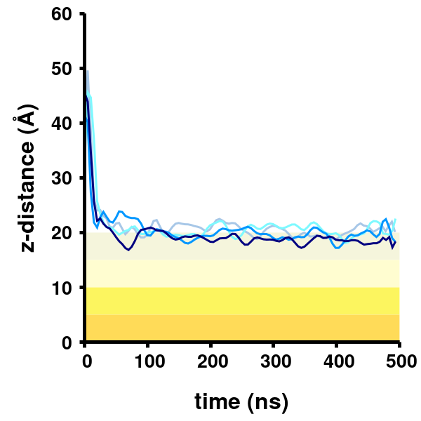
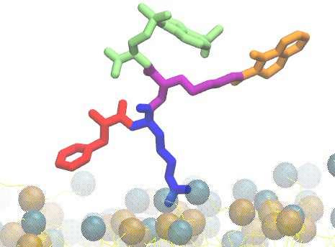
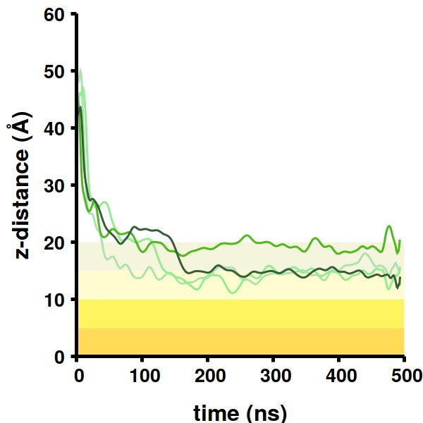
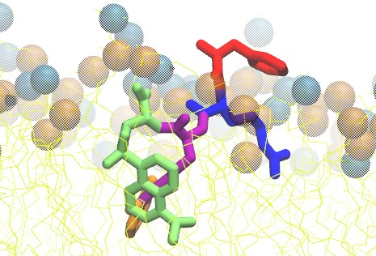
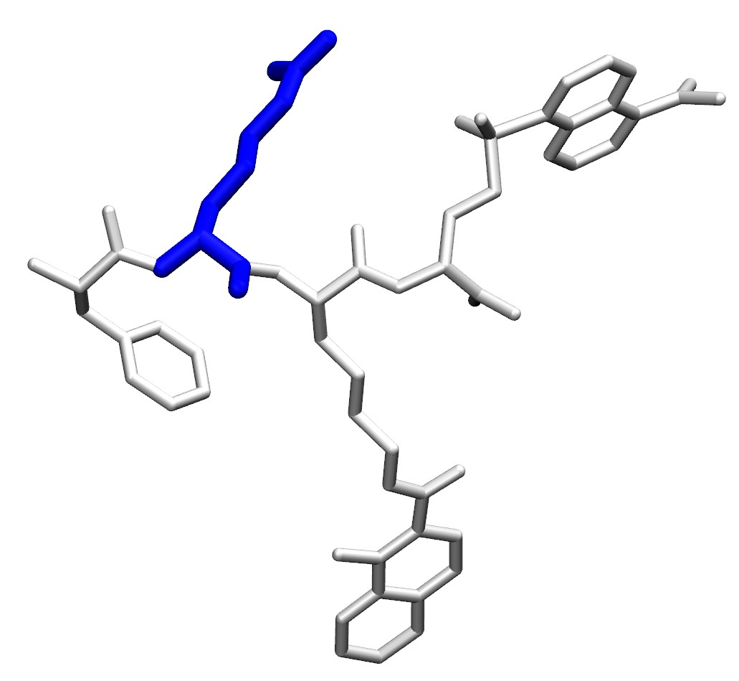
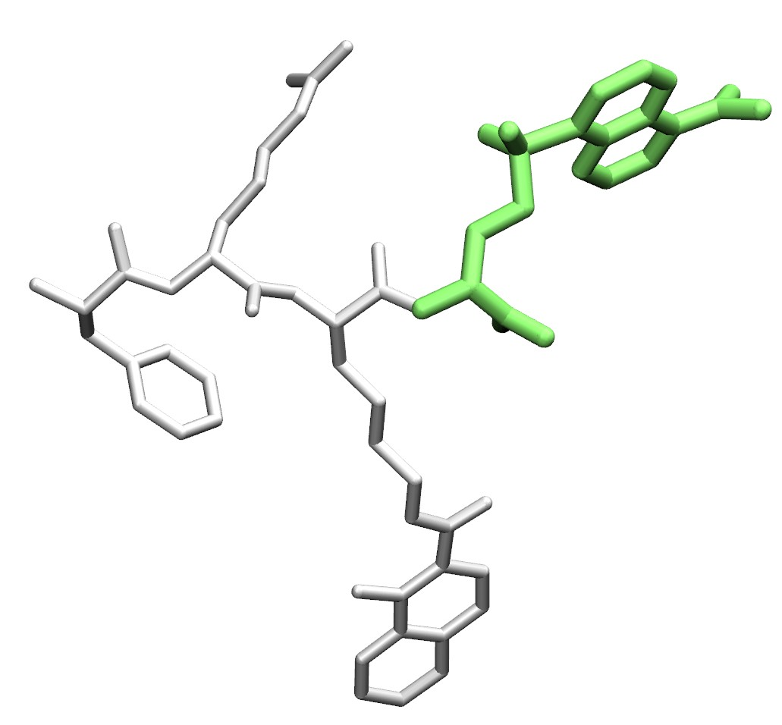
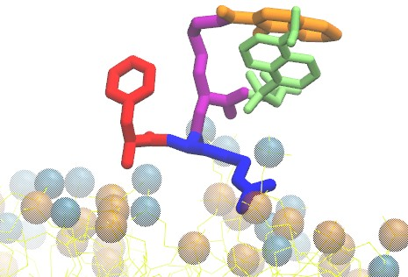
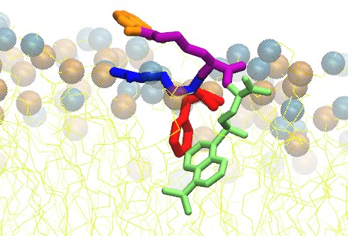
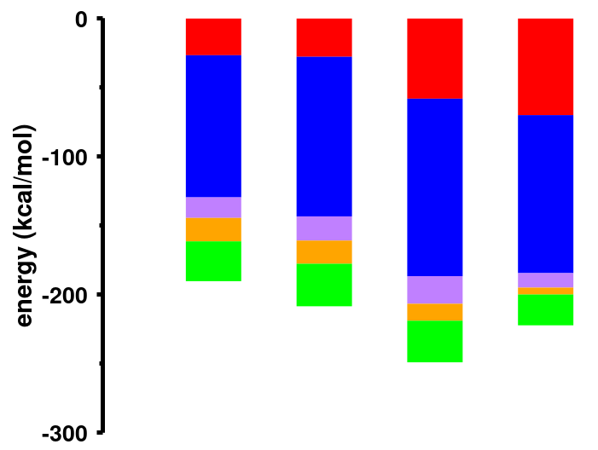
Spontaneous Peptide and Membrane Interactions
S1
S2
S3
S4
S1
S2
S3
S4
S1
S2
S3
S4
(D)-Arg binds to the membrane surface.
Aromatic side chains have higher affinity toward membrane core.
Phe (D)-Arg Lys 8HQ Dansyl
Nguyen, S. V.; et al. Bioconjugate Chem. 2024, ‌35 (3), 371-380.

Slide 6
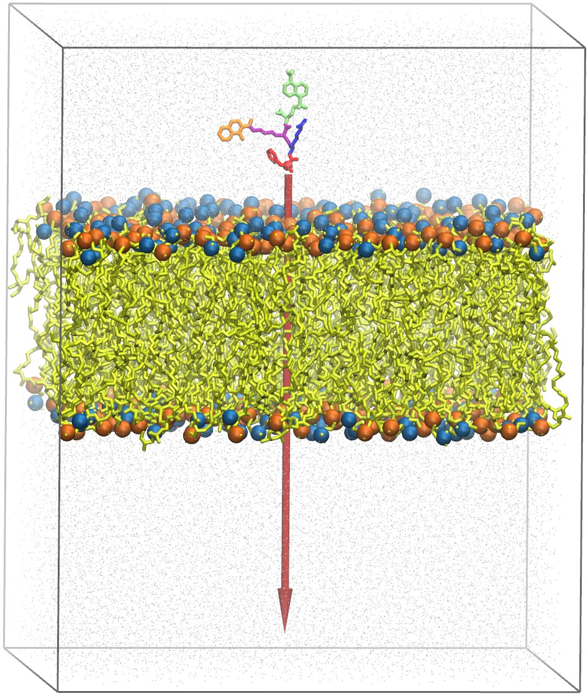
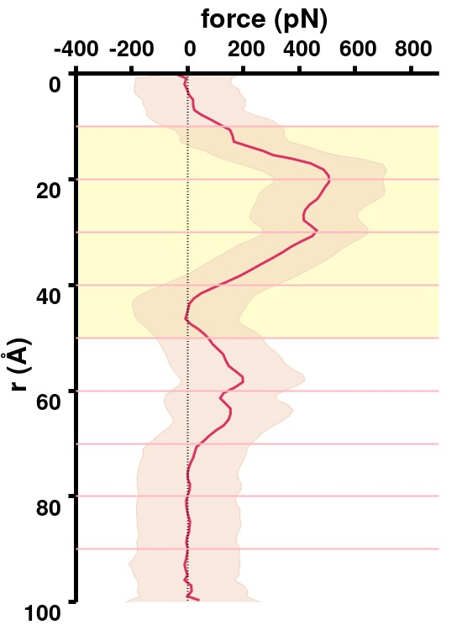
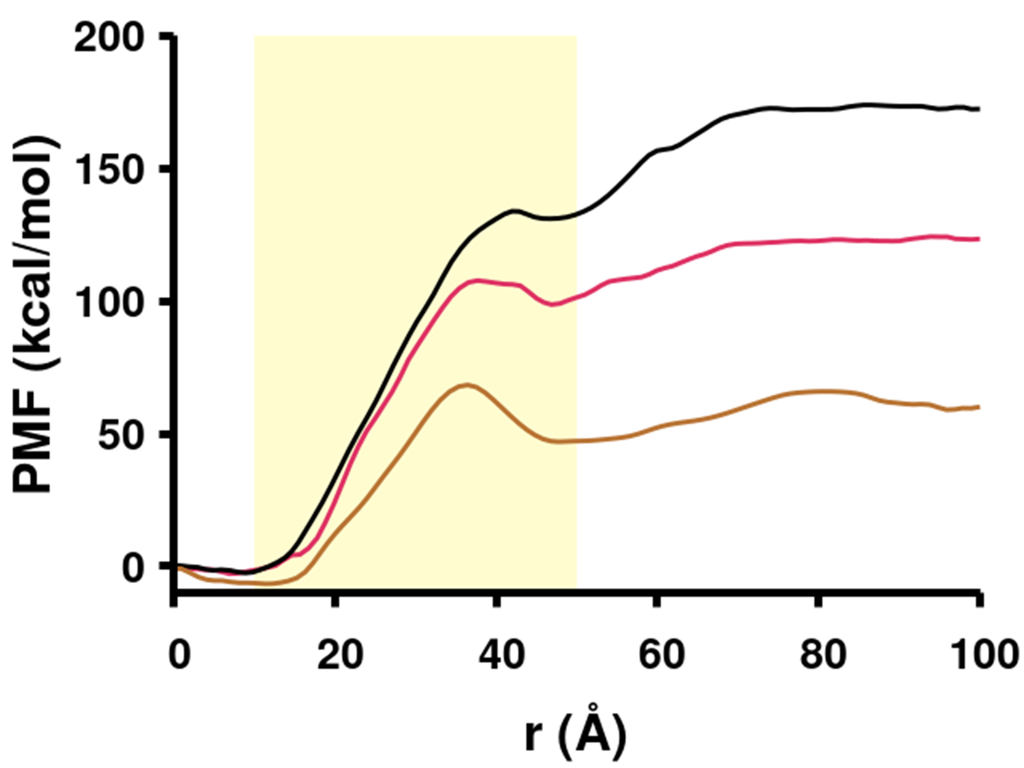
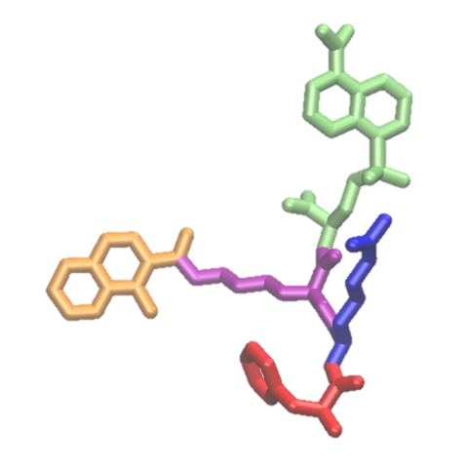
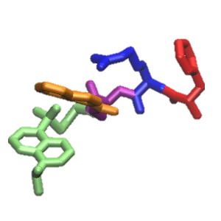
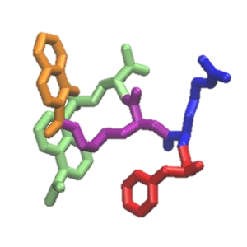
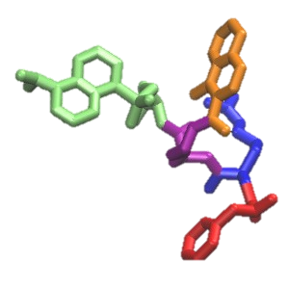
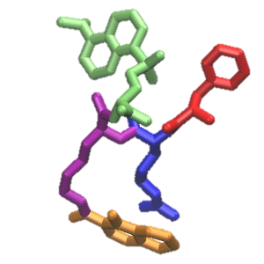
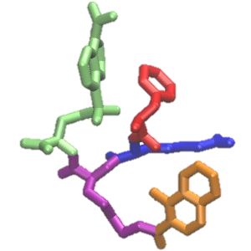
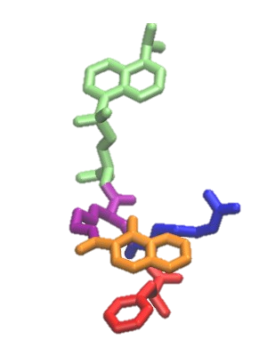
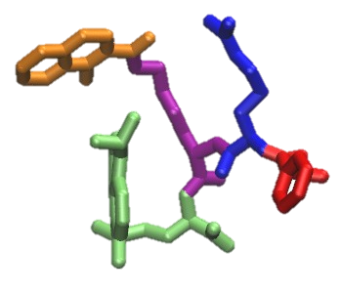
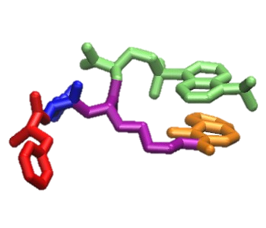
Mechanism of Peptide Translocation Across Membrane
2 Å/ns
0.5 Å/ns
0.1 Å/ns
r (Å)
0
10
20
30
40
50
60
70
90
0.1 Å/ns
The energy barrier decreases with lower pulling velocities.
Nguyen, S. V.; et al. Bioconjugate Chem. 2024, ‌35 (3), 371-380.

Slide 7
Conclusions
Acknowledgements
Peptide spontaneously diffuses to the membrane.
Electrostatic interactions guide localization.
Hydrophobic interactions guide membrane penetration.
Translocation energy barrier decreases with reduced velocities.
Dr. Roy Planalp and group members
Dr. Harish Vashisth and group members
Dr. Suzy Torti and group members
NIH R35GM138217 and R01 CA188025
NSF OIA-1757371
Premise HPC at UNH
Notes:
Combine with ack

