Slide 1
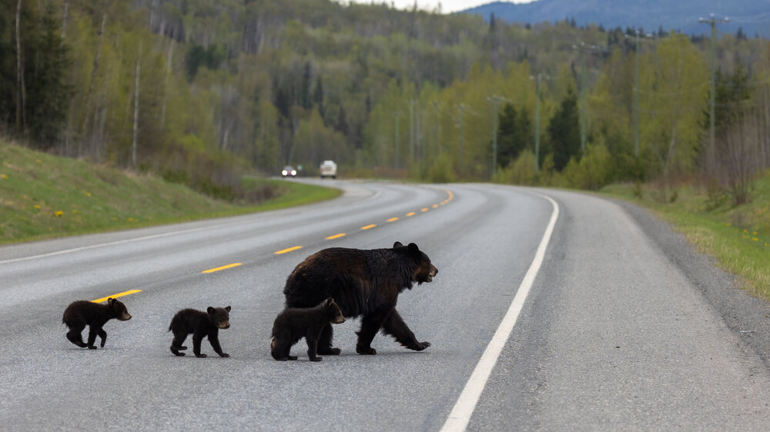

Whiskers on the windshield
An assessment of wildlife connectivity and vehicle collisions across New Hampshire
Clara R. Dawson, Amy M. Villamagna,
Rebecca A. Martin, Remington J. Moll
Photo credit: Liam Brennan

Slide 2
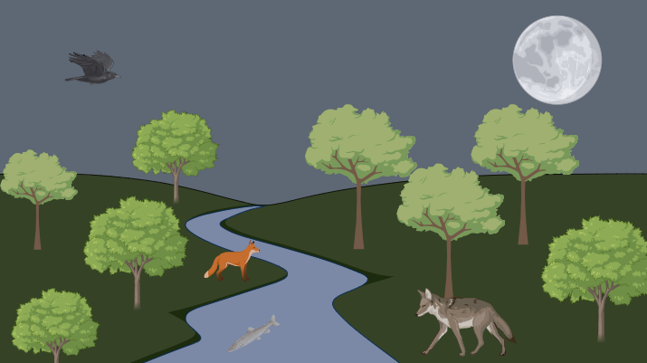
Wildlife Connectivity
Image created with 2024 Biorender.com https://app.biorender.com/illustrations/65dce076181a3c9162ee4e08

Slide 3
Wildlife Connectivity
Ability to move freely
Importance:
-forage
-establish territory
-connect gene flow
All species differ

Slide 4
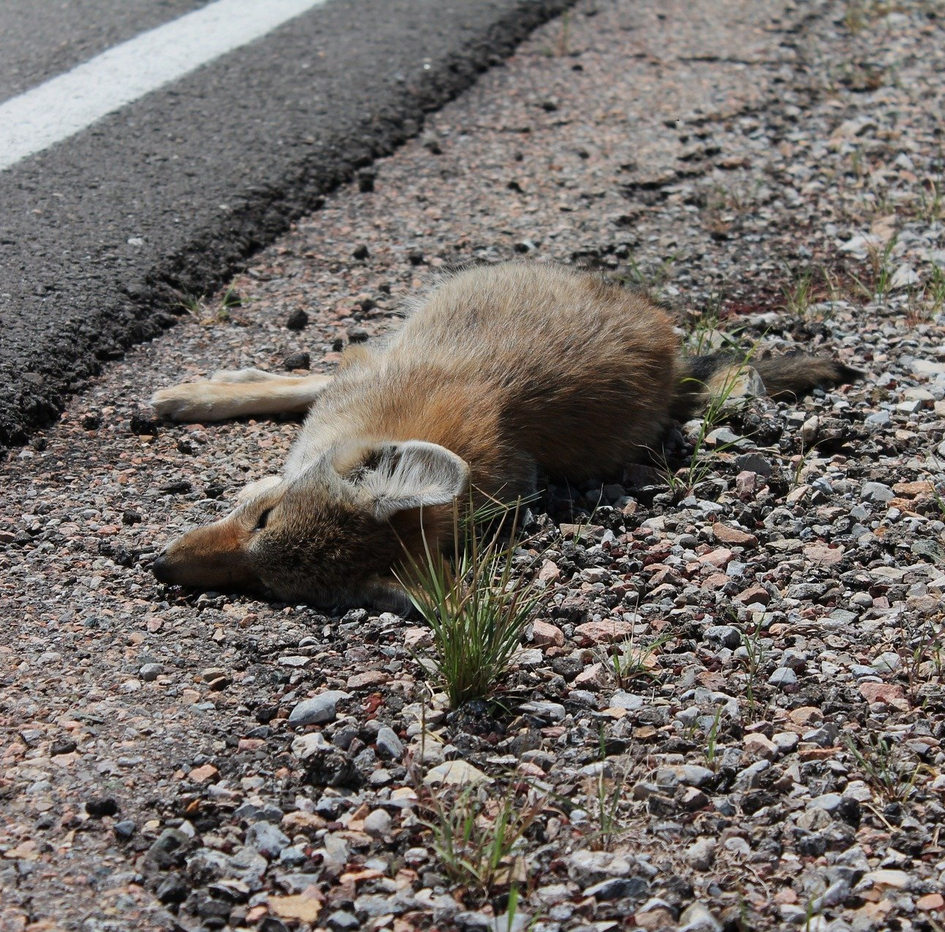
Wildlife-Vehicle Collisions
Economic
1-2 million collisions in USA annually
  Large species
Estimated $8 billion in damage (A. Villamagna, 2022)
Environmental
1 million vertebrates killed daily
  5.5 million globally per day
  2 billion globally per year (D. Jenson, 2021)
Local extinctions
roadkill.jpg (1920×1280) (b-cdn.net)
Notes:
Avg deer collision cost: $8000; Avg moose collision cost: $30,000
Globally, there are 5.5 million vertebrate animals killed daily- over 2 billion annually

Slide 5
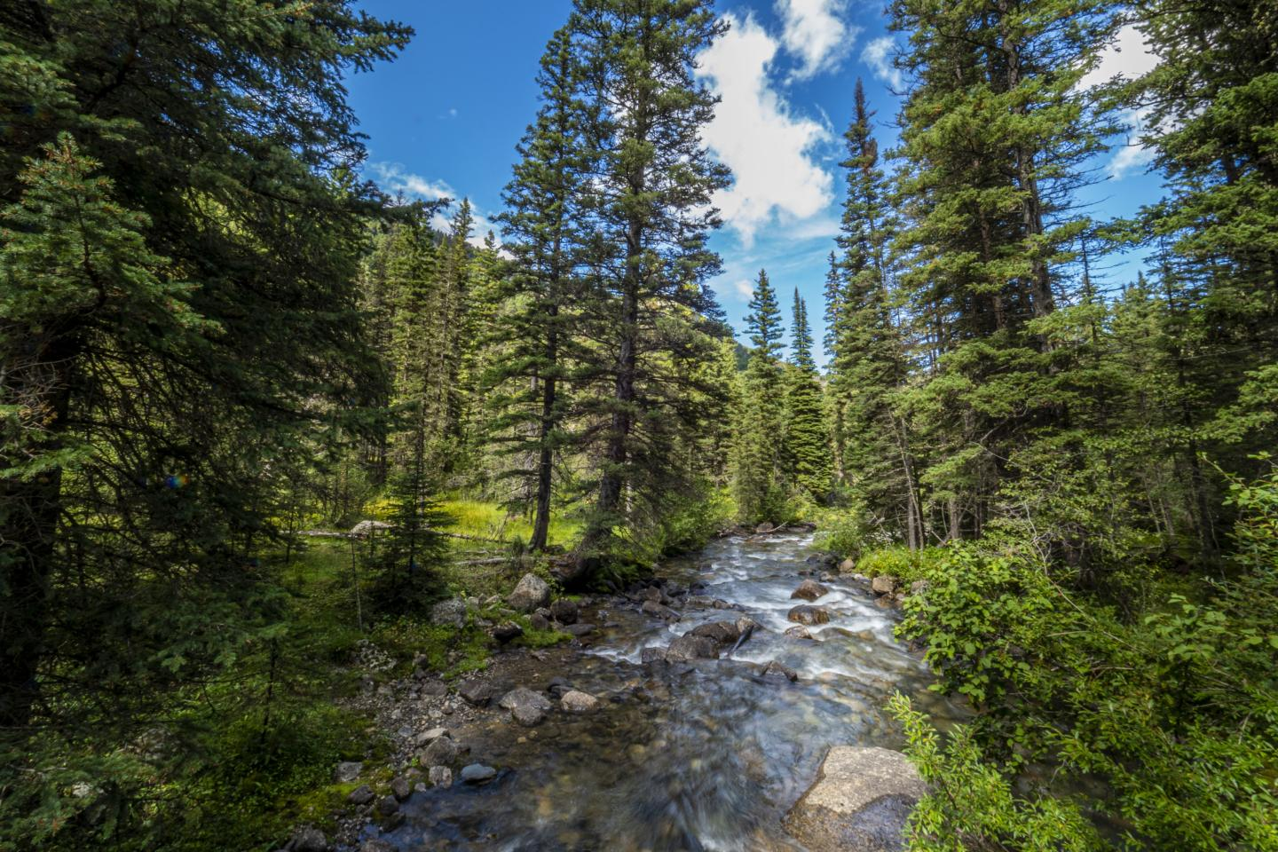
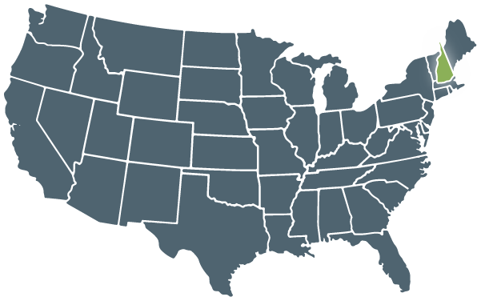

New Hampshire as a
Study System
USDA Forest Service
Ecosystem vs Urbanization
Diversity of habitats
>80% forested
Variety of species
Boston connection via 1-95
Population increase
Urban sprawl in SE
Cordell & Cordell. 2024

Slide 6
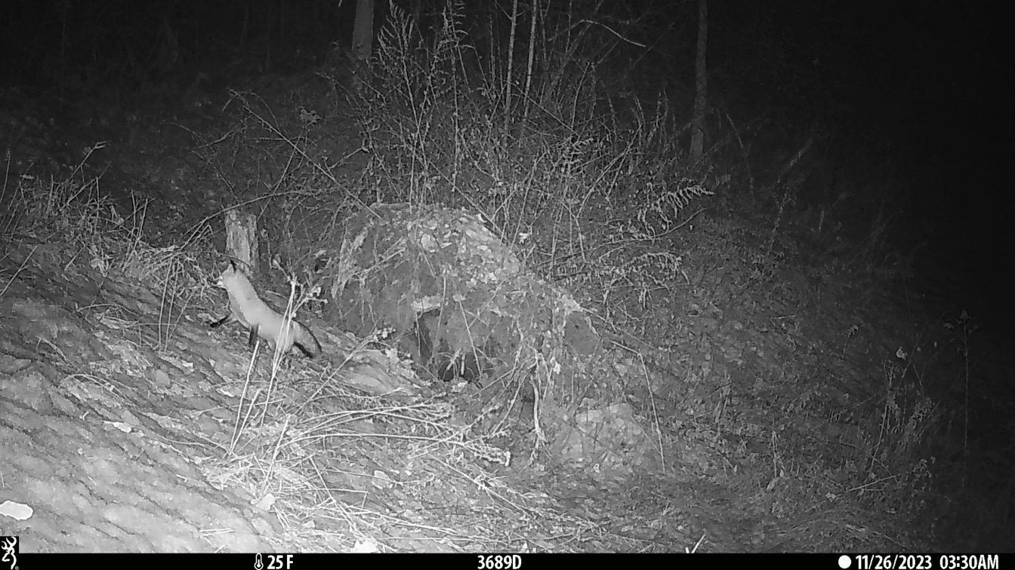
Research Questions

Slide 7
Research Questions
How does habitat connectivity influence wildlife-vehicle collisions (WVCs)?
Can species-specific connectivity maps serve as indicators of WVC hotspots?
Notes:
Speak a bit more to the first question (reasoning of why)

Slide 8


Slide 9
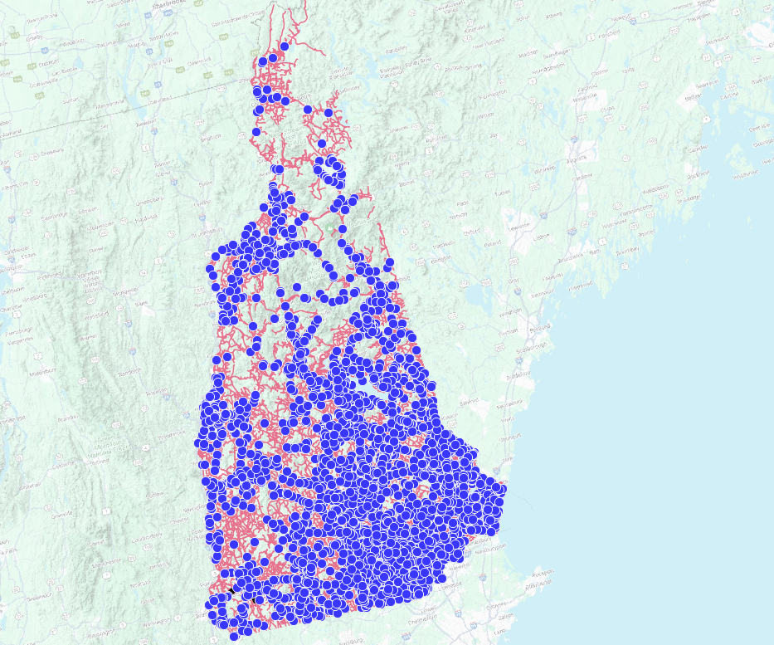
NH Department of Transportation
Collision data from police reports
2015-2019 focal years
>6,000 recorded collisions
Basemap: Google Terrain (QGIS)

Slide 10
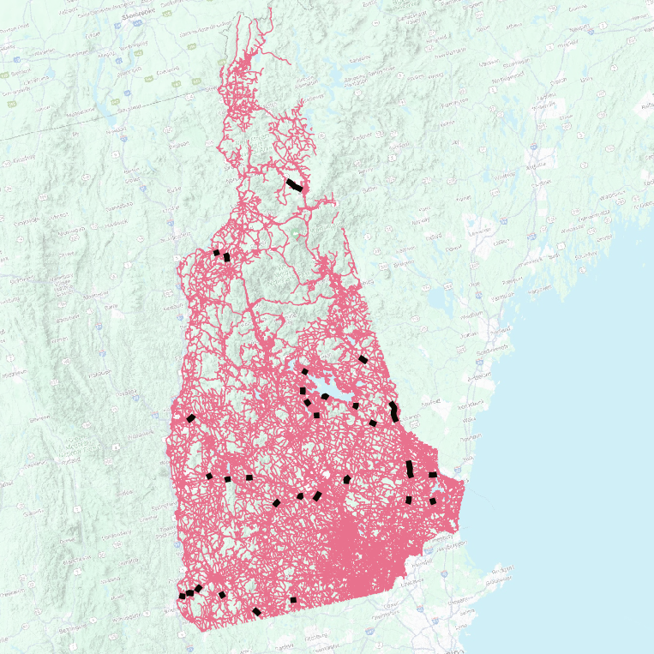
Collision hotspots
Basemap: Google Terrain (QGIS)
Basemap: Google Terrain (QGIS)
Wildlife-vehicle collisions
Hotspots
Notes:
Mention Amy Villamagna as a collaborator

Slide 11
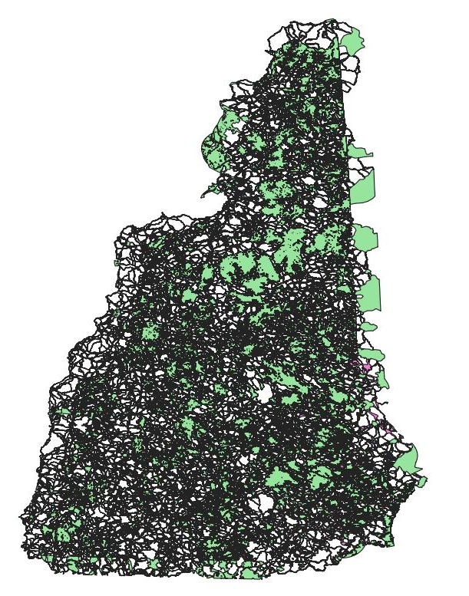
NH Fish & Game
NHFG connectivity model
16 focal species
4 landscape factors in cost-surface
  (Land cover, distance to roads, distance to riparian areas, slope)
Resistance scores were assigned to each class (1-10)
NH Connectivity Model, NH Fish & Game. 2021
Notes:
This figure is a representation of all the data made available from the connectivity model. All the black lines are different wildlife corridors, and the green and pink blocks are wildlife habitat blocks. Won’t get too much into them.

Slide 12
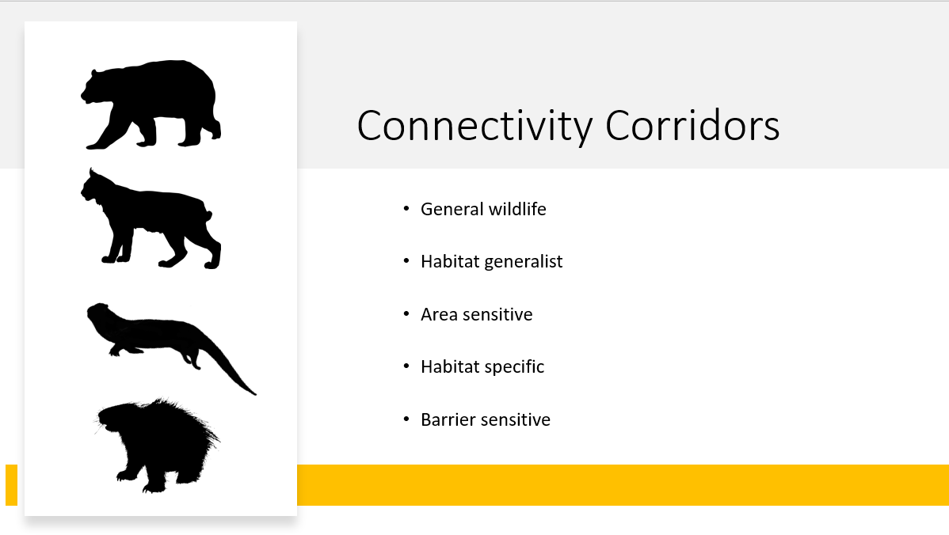
General wildlife
Habitat generalist
Area-sensitive
Habitat specialist
Barrier-sensitive
Silhouettes from Phylopic.com: Tracy Heath (black bear), Margot Michand (bobcat), Jose Infante (otter), T. Michael Keesey (porcupine)

Slide 13
General wildlife
Habitat generalist
Area-sensitive
Habitat specialist
Barrier-sensitive
Notes:
a species that can live in a wide variety of environmental conditions and can utilize a variety of different resources.

Slide 14
General wildlife
Habitat generalist
Area-sensitive
Habitat specialist
Barrier-sensitive
Notes:
species that require large habitat sizes

Slide 15
General wildlife
Habitat generalist
Area-sensitive
Habitat specialist
Barrier-sensitive
Notes:
a species that can live only in a narrow range of environmental conditions or has a limited diet

Slide 16
General wildlife
Habitat generalist
Area-sensitive
Habitat specialist
Barrier-sensitive
Notes:
species that are specifically sensitive to roads or other anthropogenic barriers in the landscape due to their specific habitat preferences.

Slide 17
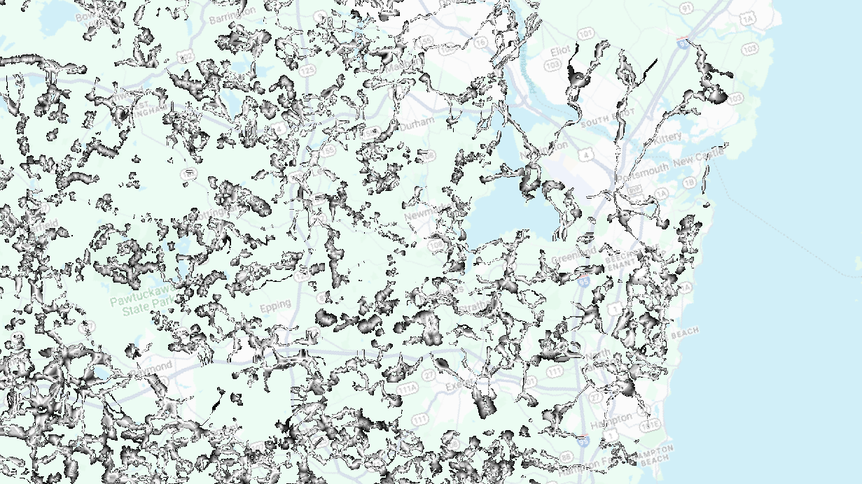


Basemap: Google Road (QGIS)

Slide 18
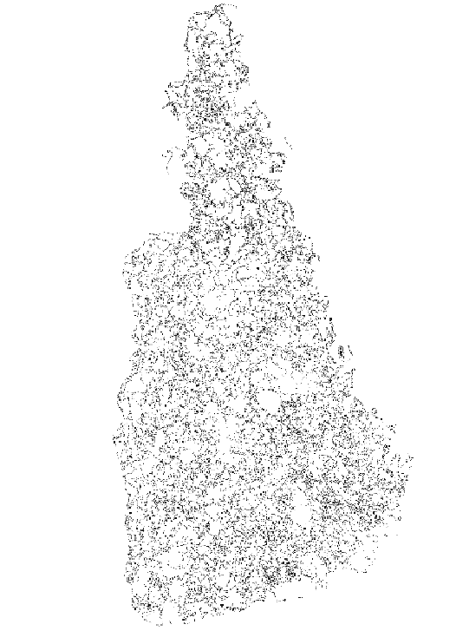
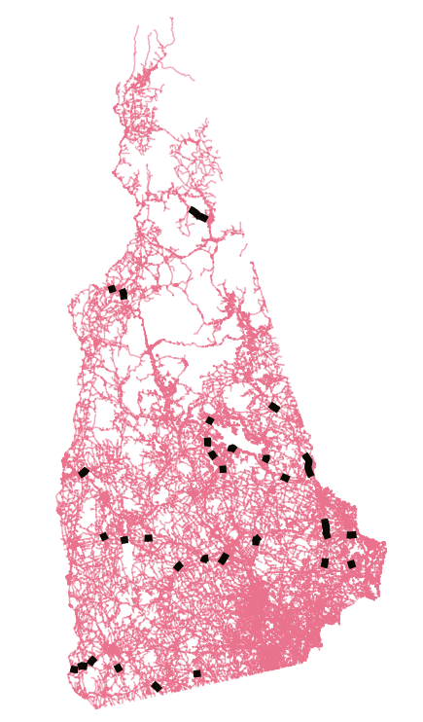
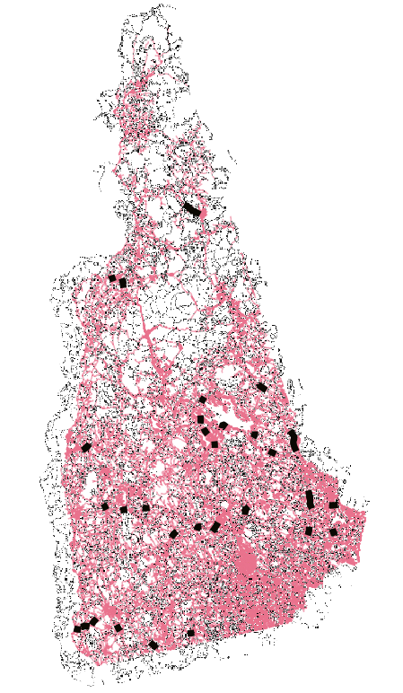
NH Fish & Game, 2021
NH Granit, 2024
Combination of both previous maps

Slide 19
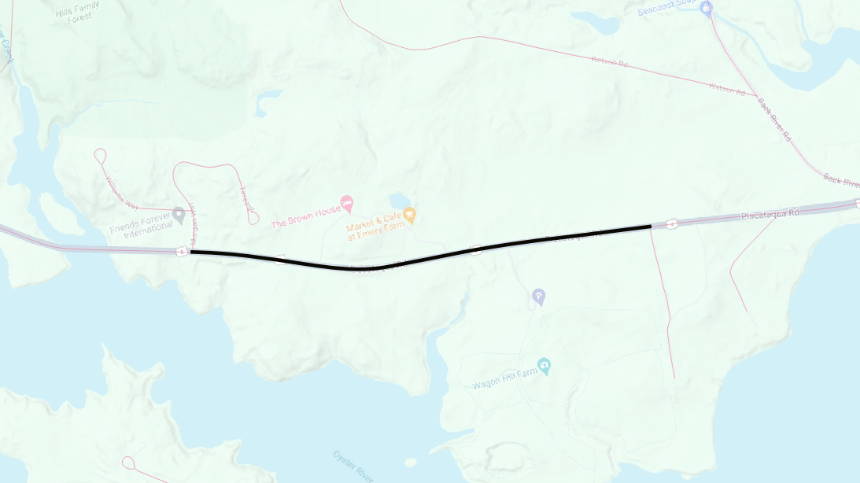
Methodology
Basemap: Google Terrain (QGIS)

Slide 20
Methodology
Hotspot
Basemap: Google Terrain (QGIS)

Slide 21
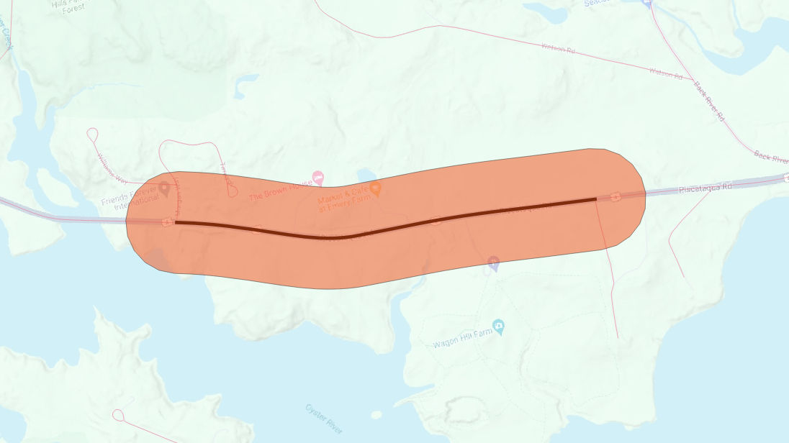
Methodology
Hotspot
150m Buffer
Basemap: Google Terrain (QGIS)

Slide 22
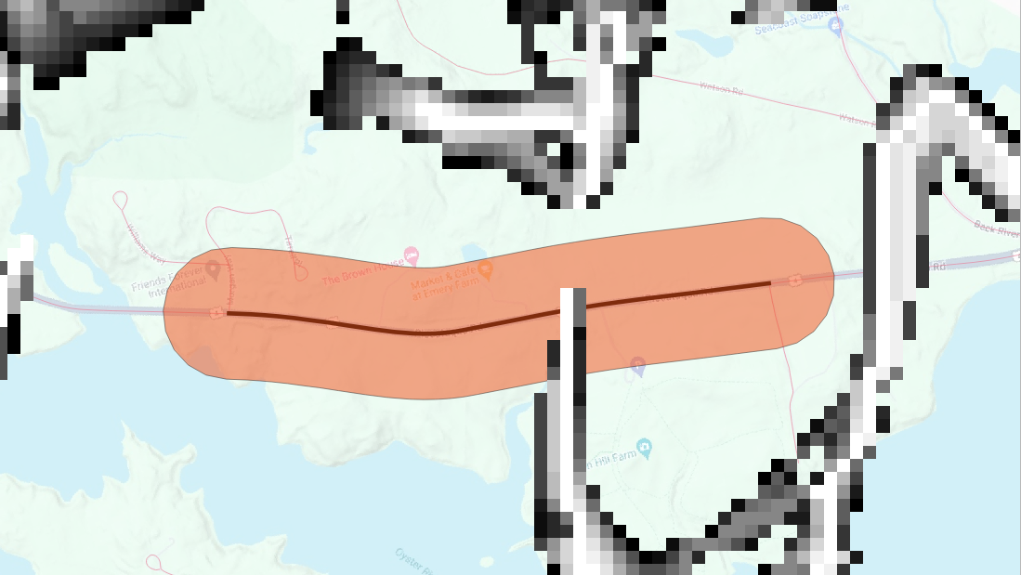
Methodology
Hotspot
150m Buffer
Bobcat Corridor
Basemap: Google Terrain (QGIS)

Slide 23
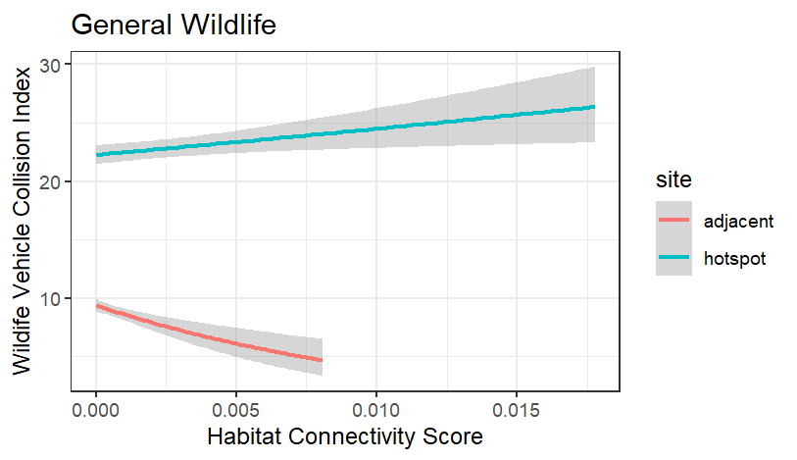
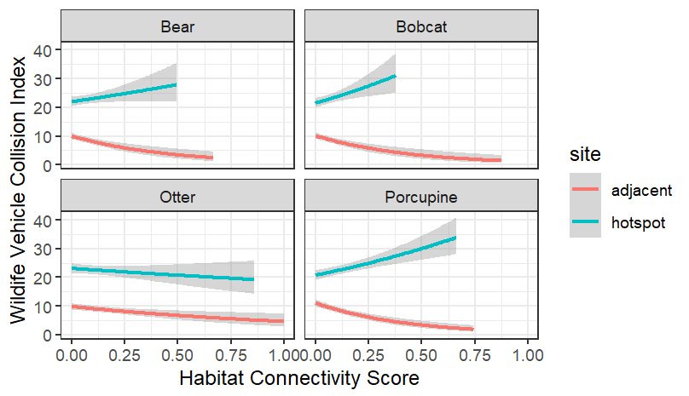
Preliminary Corridor Analyses

Slide 24
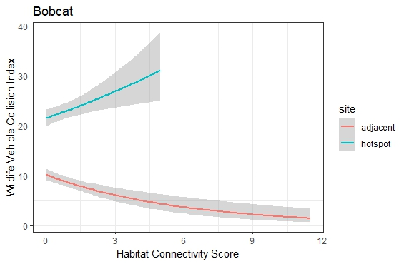
Preliminary Corridor Analyses

Slide 25
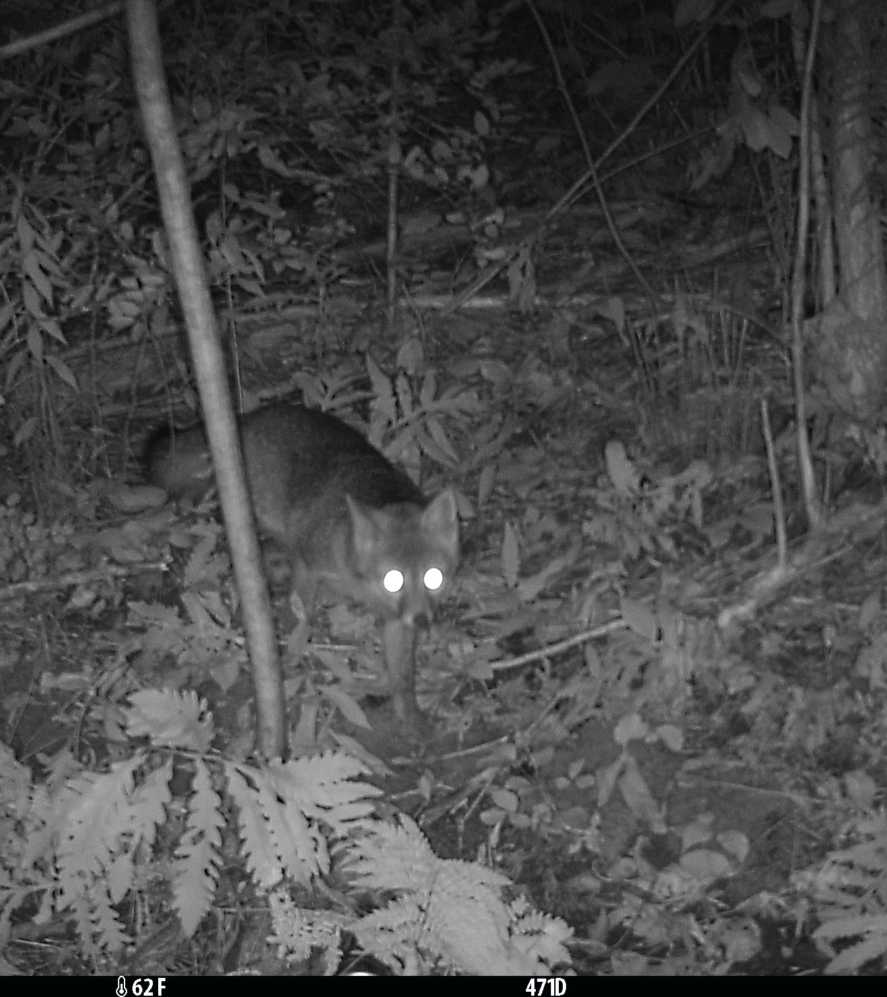
Next Steps
Finalize methodology
  Add adjacent sites
  Random sites?
Determine best fit of model/analyses
  Poisson regression in JAGS

Slide 26
Research Goals
Ground truth wildlife use of hotspots
  Trail cameras at field sites
Inform WVC mitigation
Improve wildlife connectivity

Slide 27




Acknowledgements
Committee Members: Remington Moll, Ph.D., Amy Villamagna, Ph.D., Fikirte Erda, Ph.D.
Technicians: Shelby Normand, Mikayla Shubert
Lab Members: Andrew Butler, Mairi Poisson, Taylor Readyhough, Lily Hall, Sarah Richard, Frank Shinost
Additional Affiliates: Rebecca Martin, Senior Environmental Manager, NH DOT
Katie Callahan, GIS Coordinator, NHFG

Slide 28
References
Images
Biorender.com. 2024
Black bear family: Liam Brennan B.C.'s wildlife bridges narrowest in western North America, finds study - Pique Newsmagazine
New Hampshire forest: usda.gov 48762466961_650b626b28_o.jpg (1440×960) (usda.gov)
PhyloPic.com; Silhouettes. Black bear- Tracy Heath, bobcat- Margot Michand, otter- Jose Infante, porcupine- T. Michael Keesey
Roadkill: b-cdn.net roadkill.jpg (1920×1280) (b-cdn.net)
USA map: https://cordellcordell.com/wp-content/uploads/2021/11/NewHampshire_Mobile-1.png
USDA Forest Service. 2022. Forests of New Hampshire, 2021. Resource Update FS-371. Madison, WI: U.S. Department of Agriculture, Forest Service. 2p
Jensen, Derrick; Keith, Lierre; Wilbert, Max (2021). Bright Green Lies: How the Environmental Movement Lost Its Way and What We Can Do About It. Monkfish Book Publishing. pp. 346–347. ISBN 978-1948626392.
New Hampshire Fish and Game. 2021. NH Connectivity Model. NHWildlifeCorridors_bySpecies.zip. (n.d.). . https://www.dropbox.com/s/zjp1wrh1ublkaa5/NHWildlifeCorridors_bySpecies.zip?dl=0.
NH GRANIT: https://granit.unh.edu/
Villamagna, A., Kim, H., LaFlamme, E., Boyer, O., DeBisscho, S. 2022. Plymouth State University Story Map in Service to the NH Department of Transportation; Wildlife-Vehicle Collisions (WVCs) in New Hampshire (arcgis.com)

Slide 29
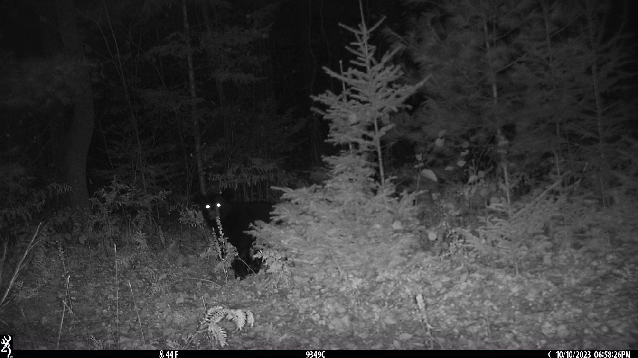
Questions?

Slide 30
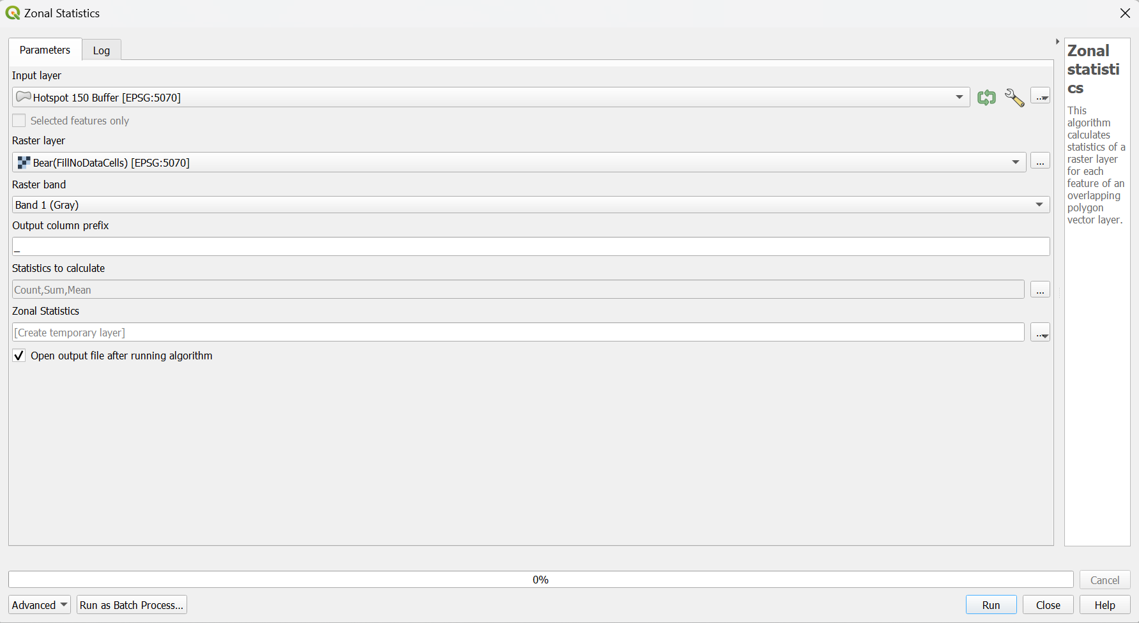

Slide 31
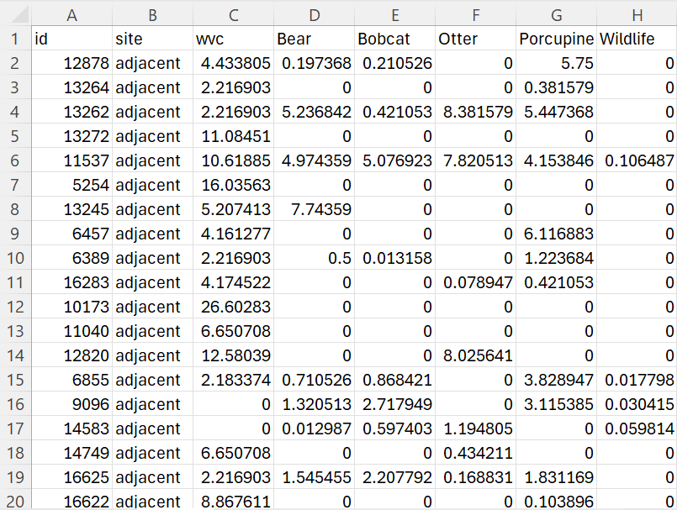

Slide 32
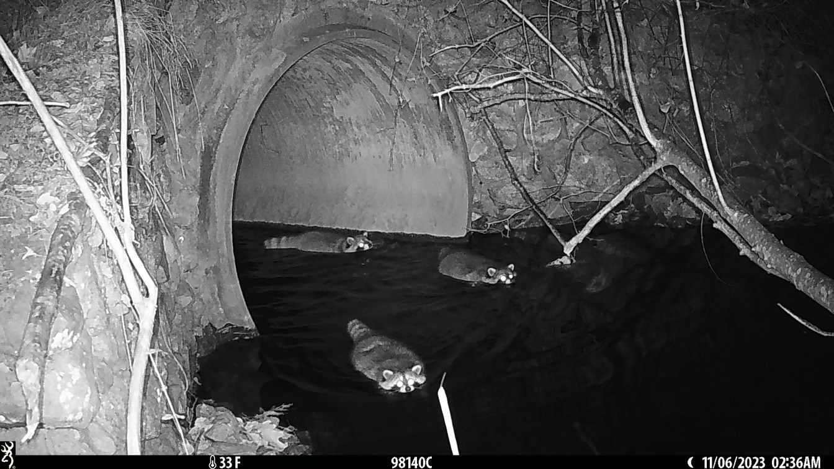
Wildlife Crossings
Chapter Two

Slide 33
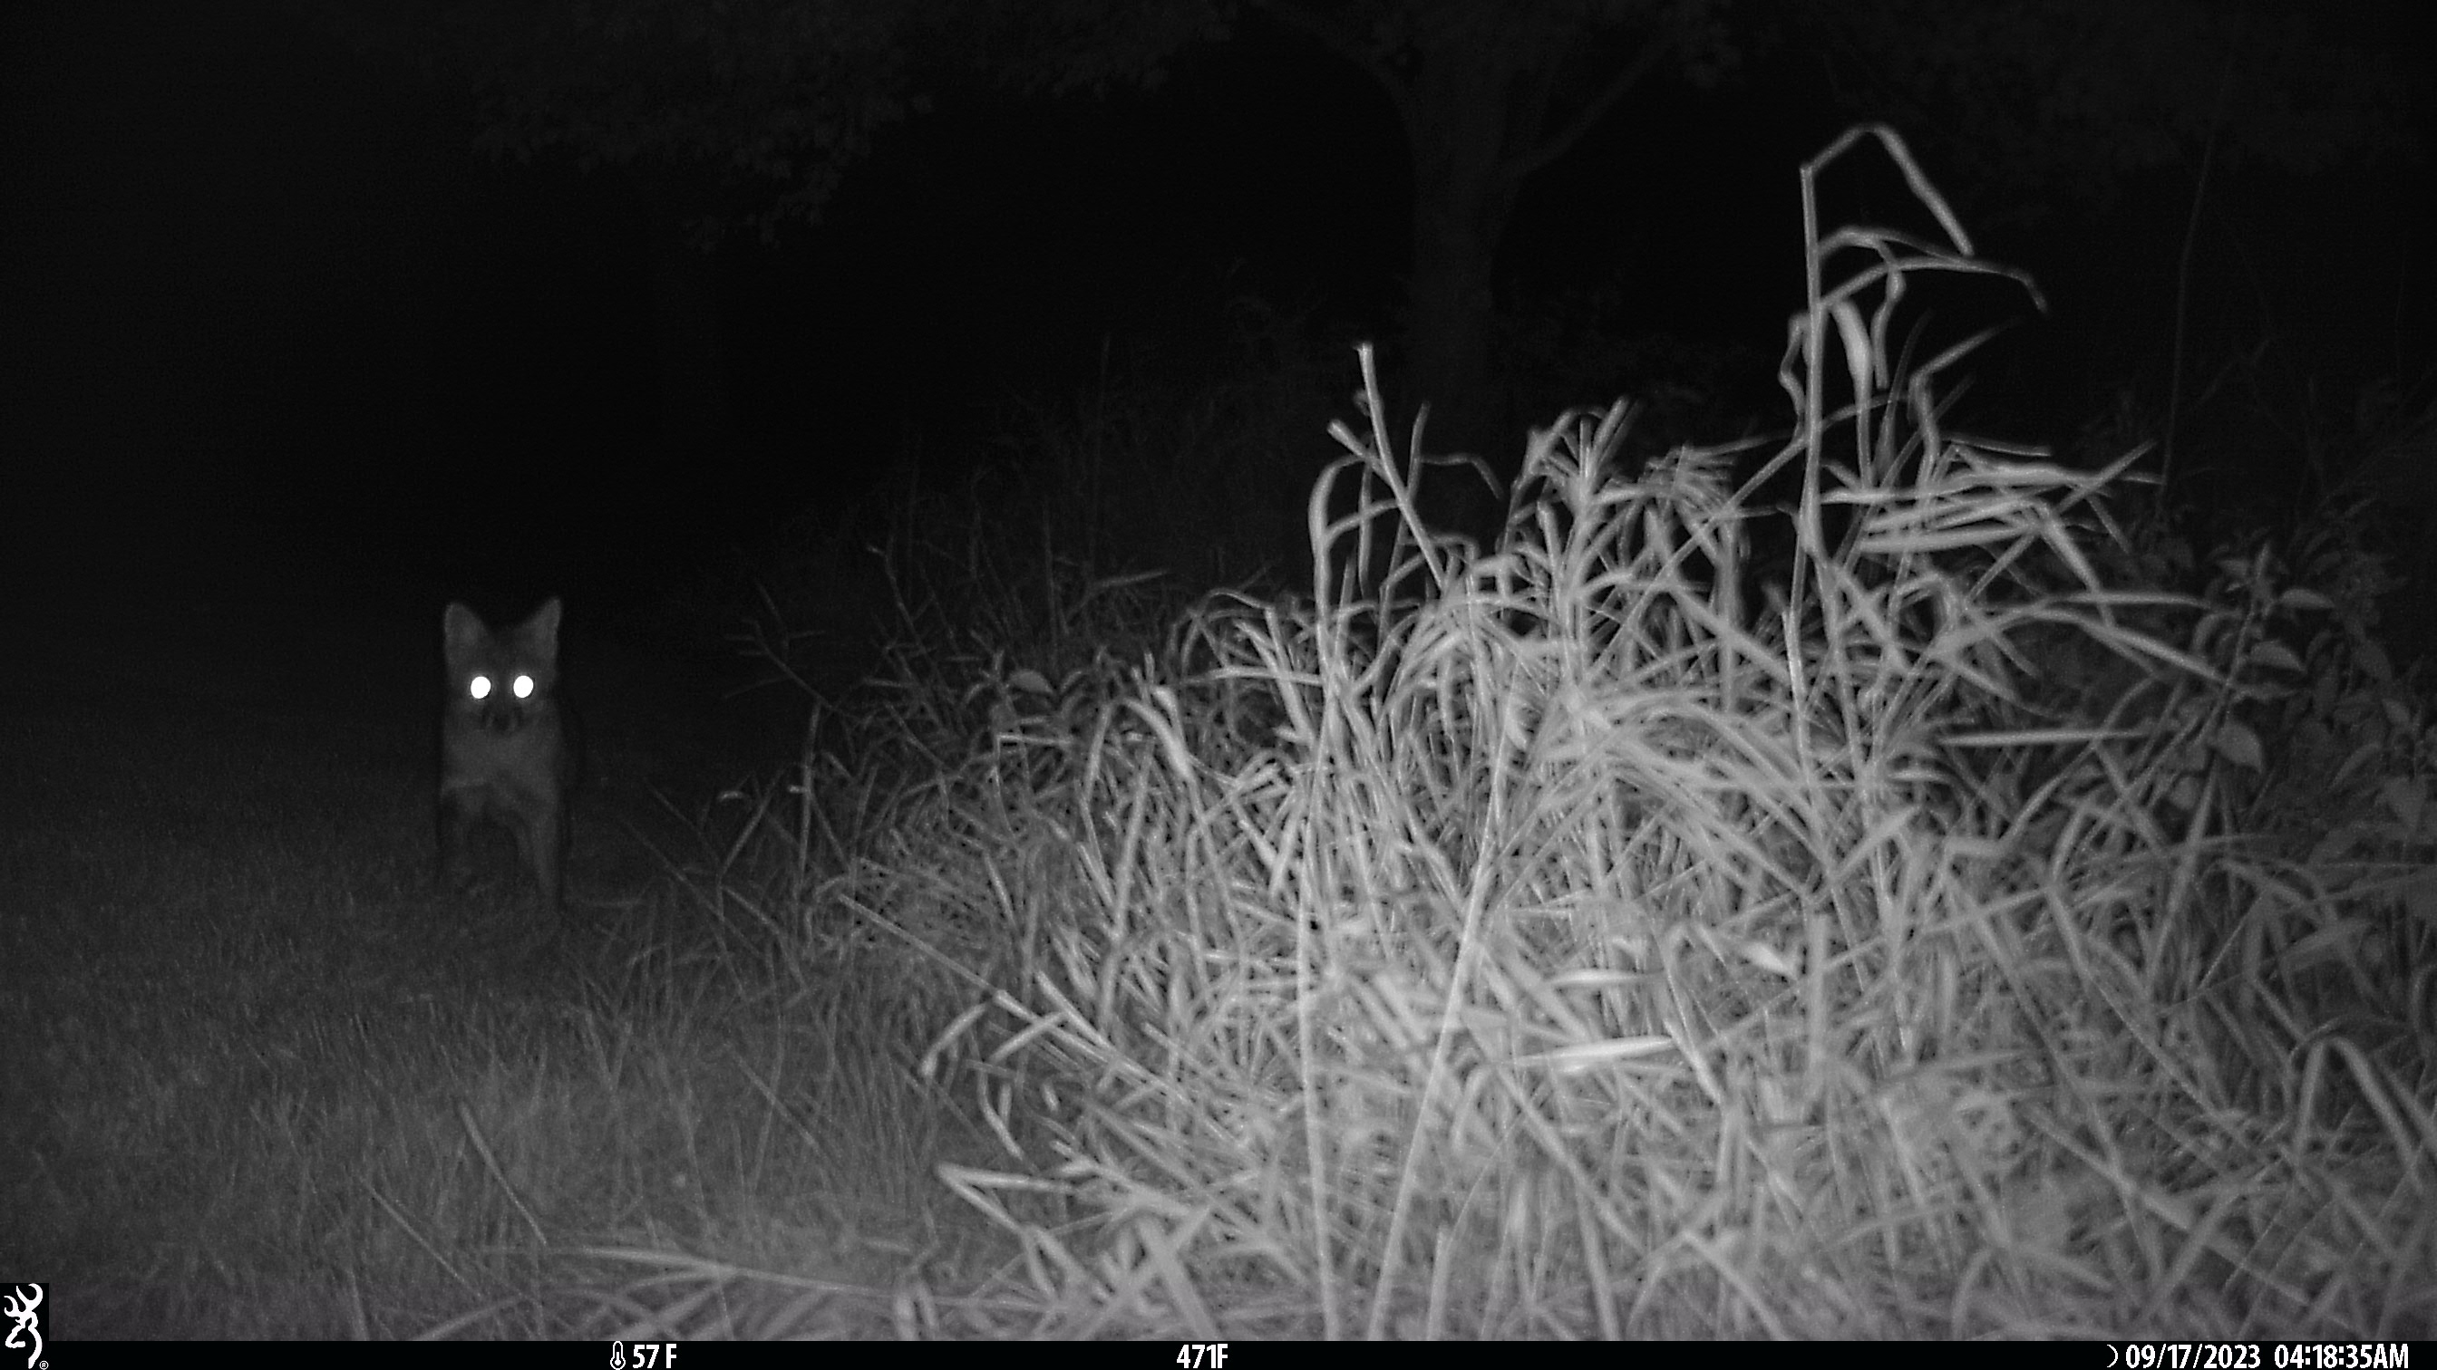
Data from the Field
(so far)

Slide 34
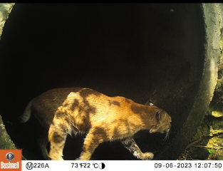
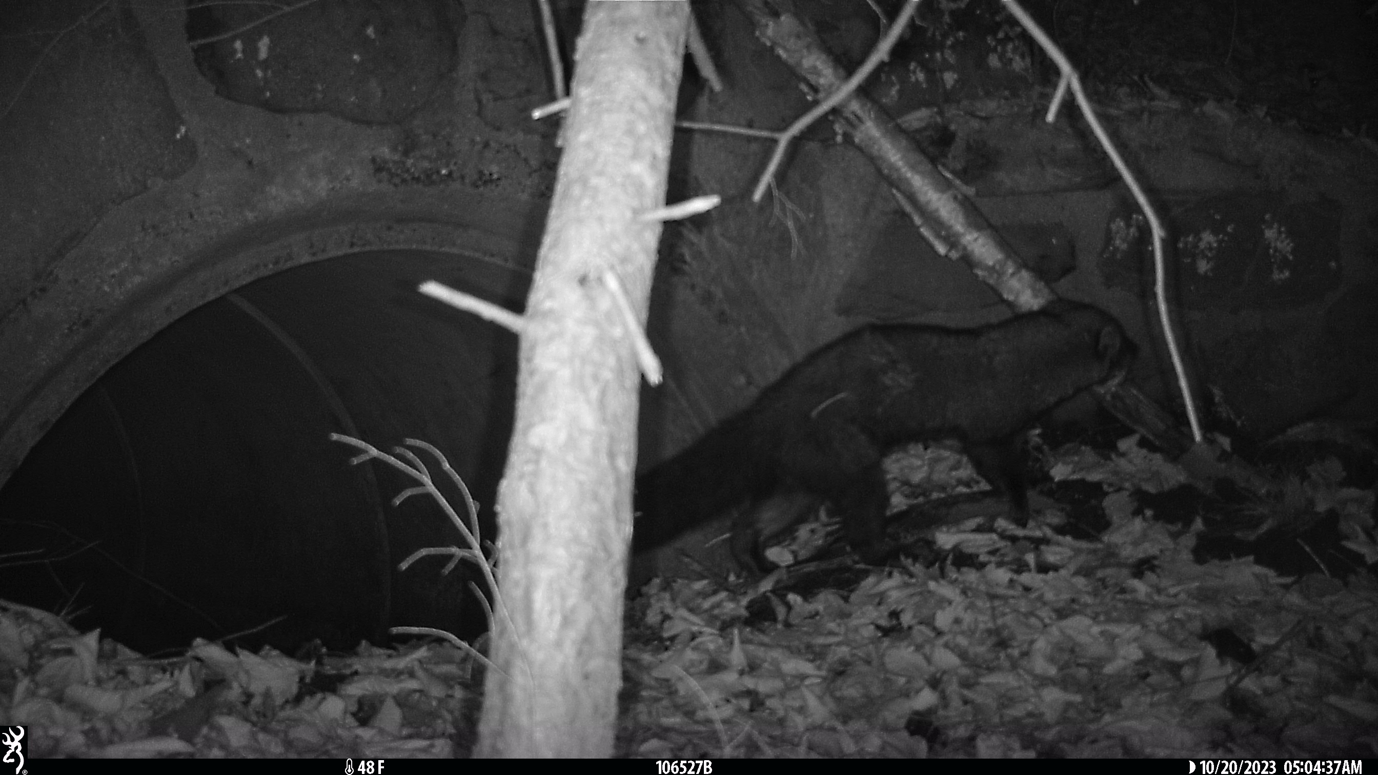
Culvert Cams

Slide 35
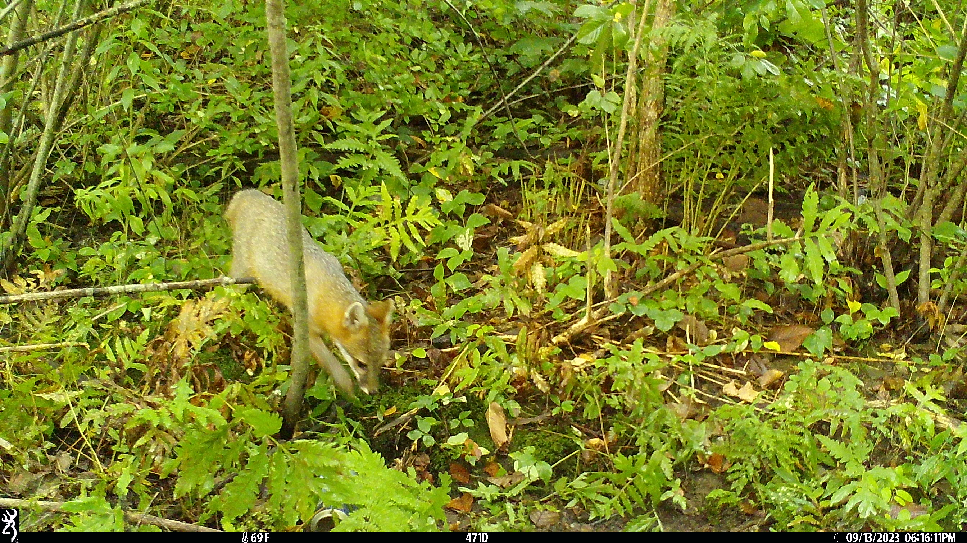
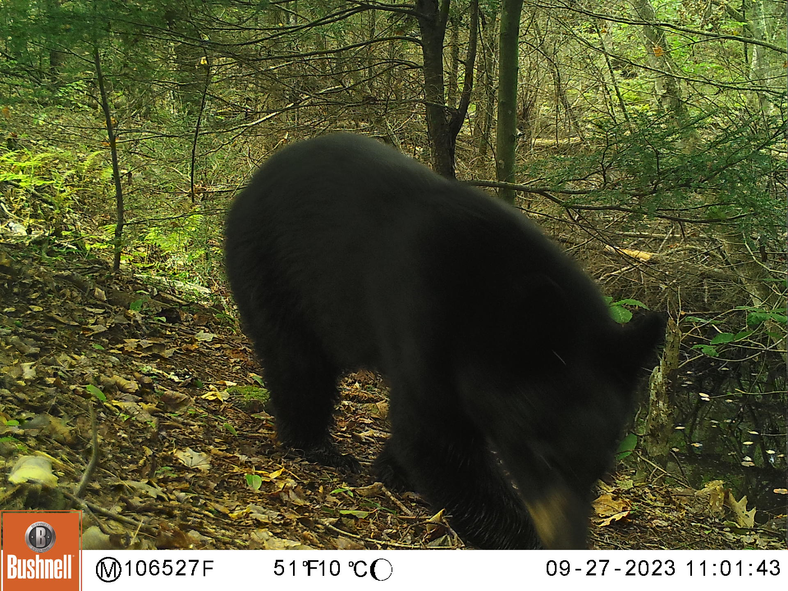
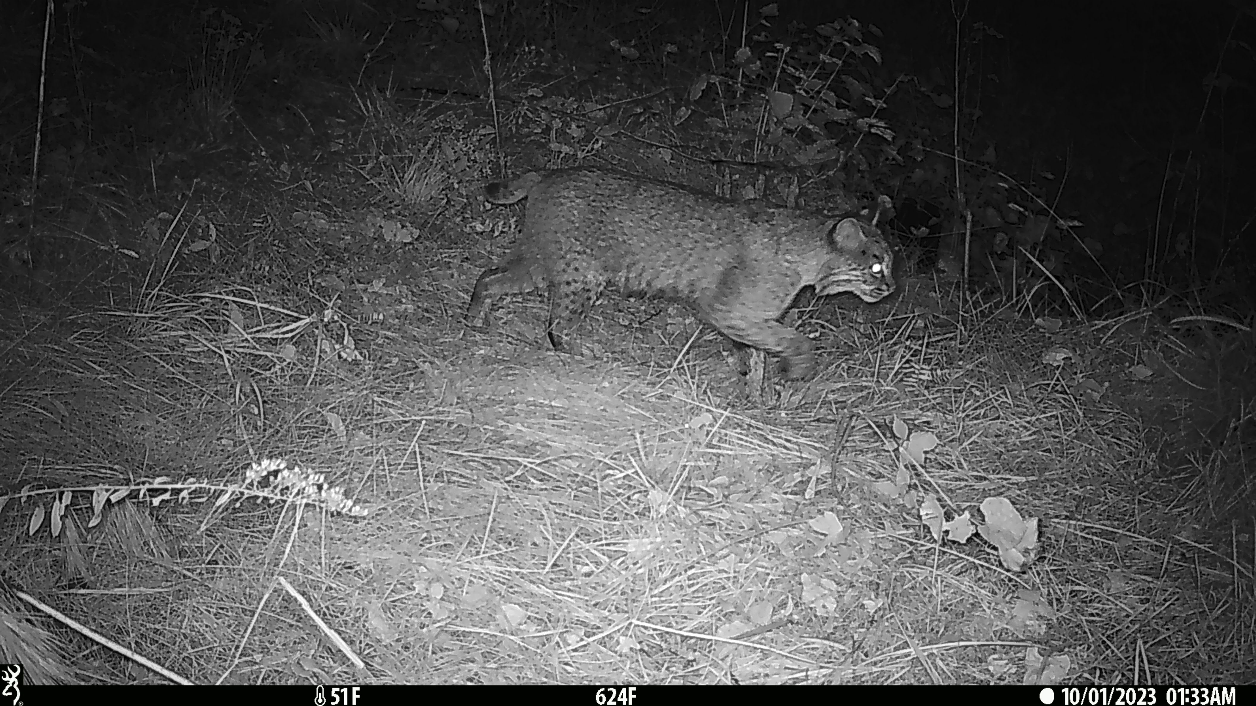
Area Cams

Slide 36
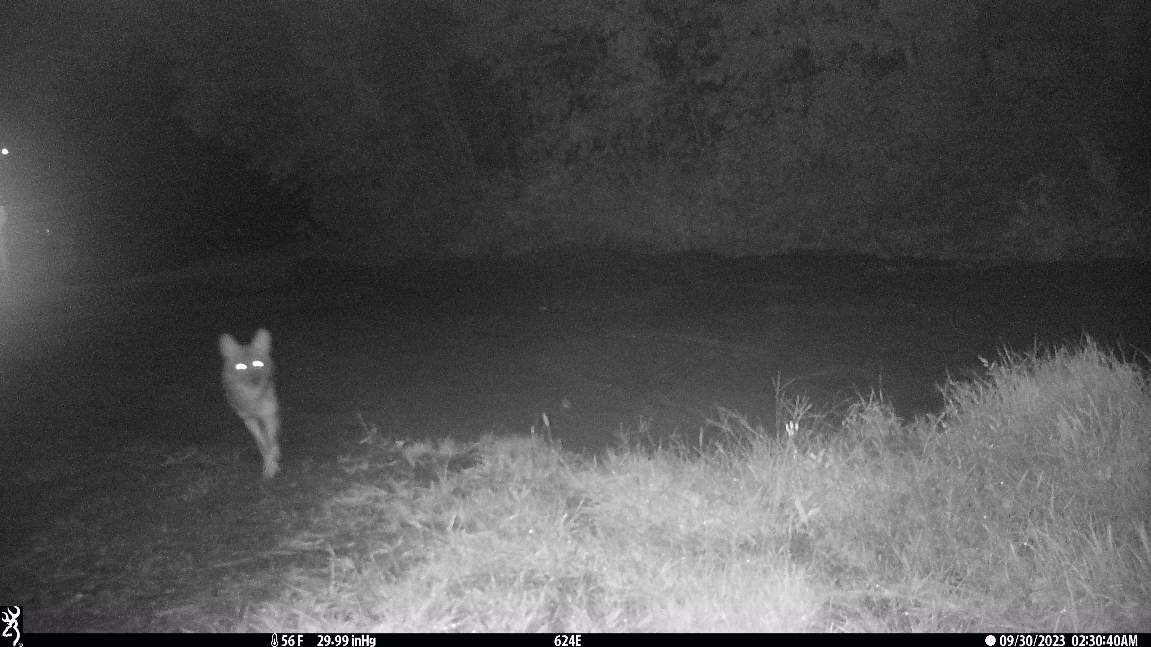
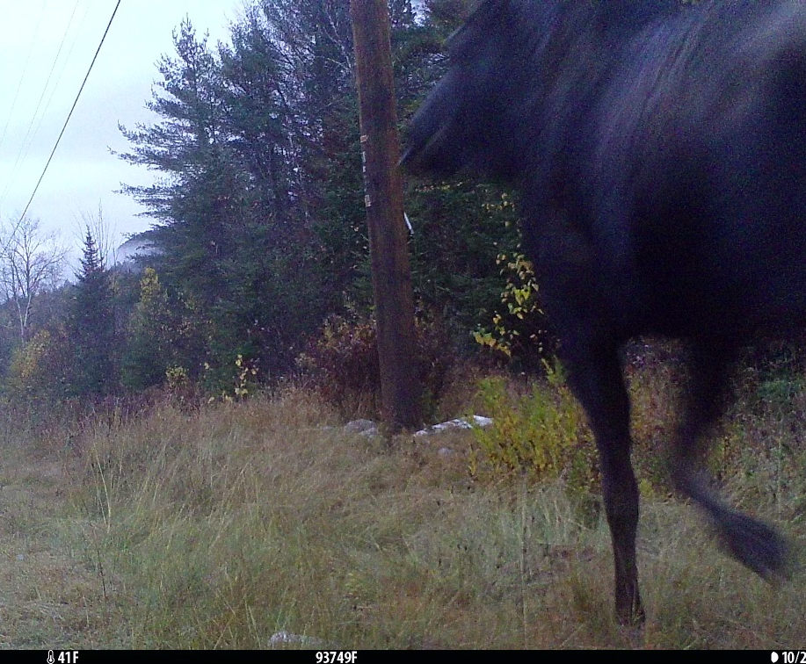
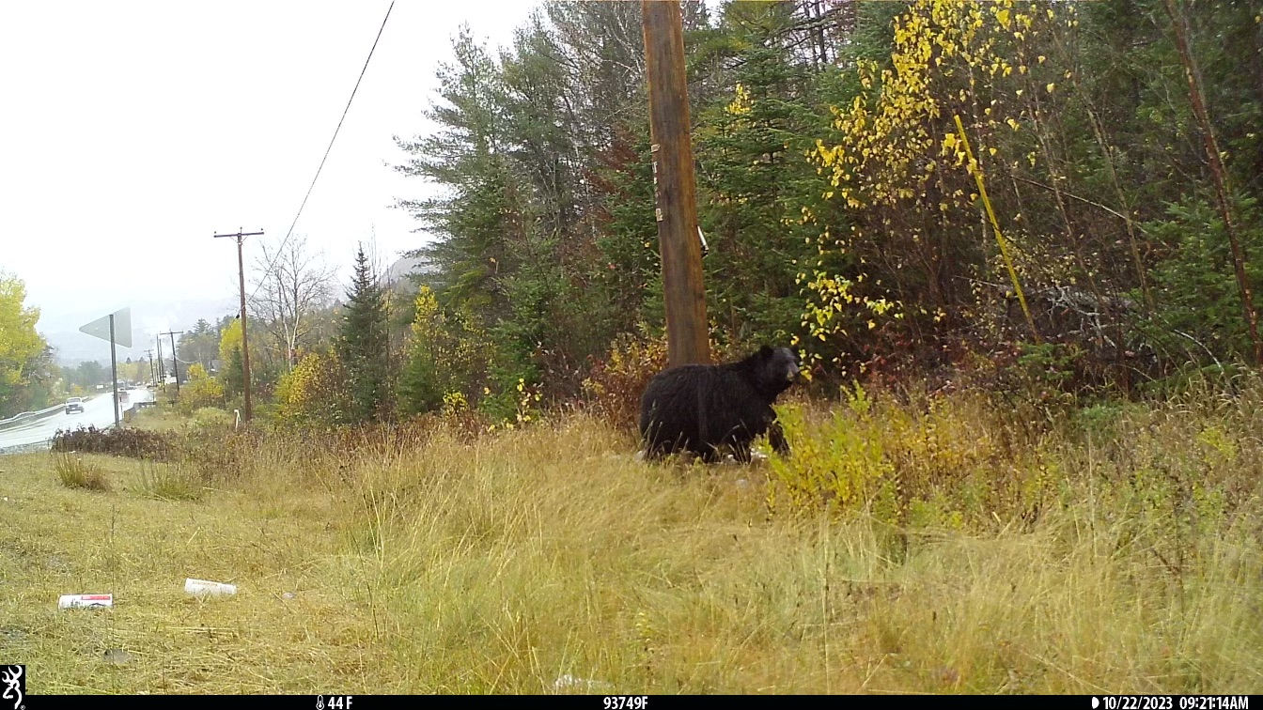
Roadside Cams

Slide 37
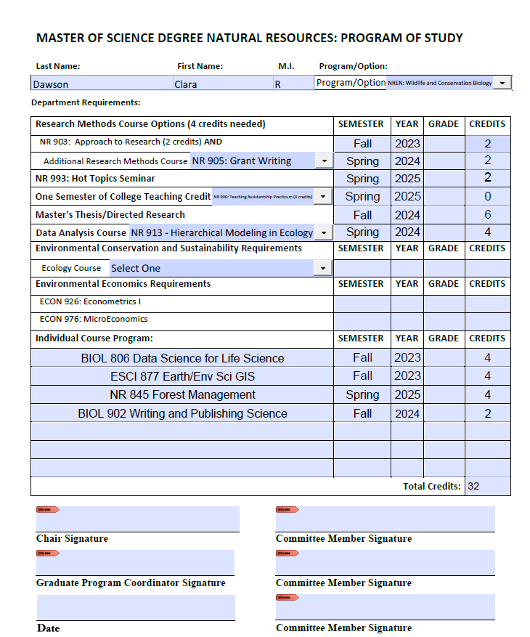
Program of Study

Slide 38
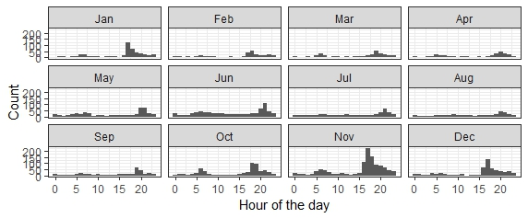
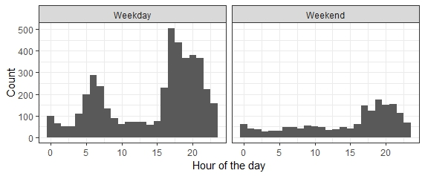
Roadkill Results

Slide 39
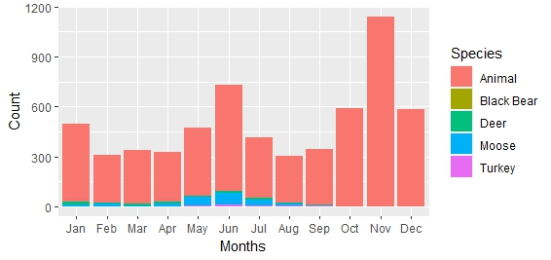
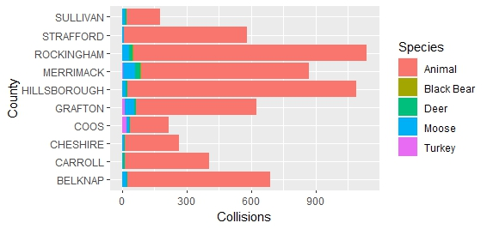
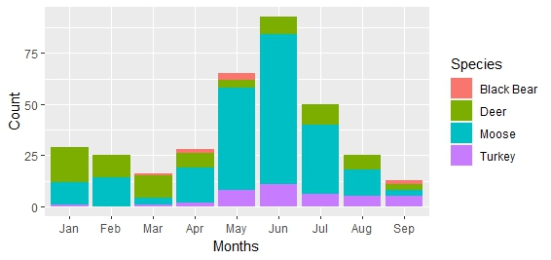

Slide 40
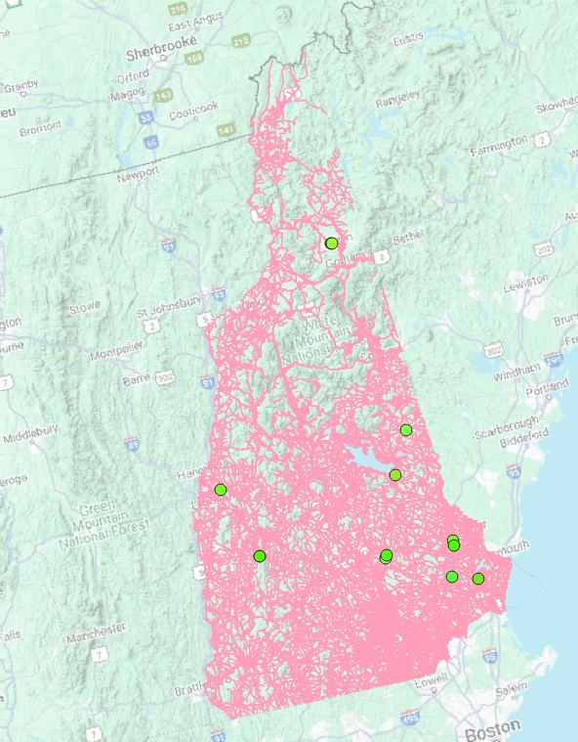
Field Design
12 hot spots monitored
10 “top priority”
Multi-camera deployment
Culverts, bridges

Slide 41
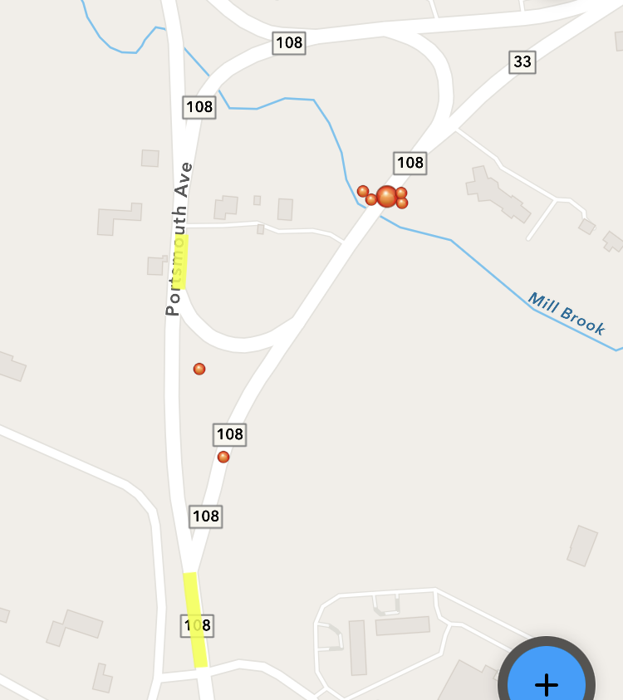

Slide 42
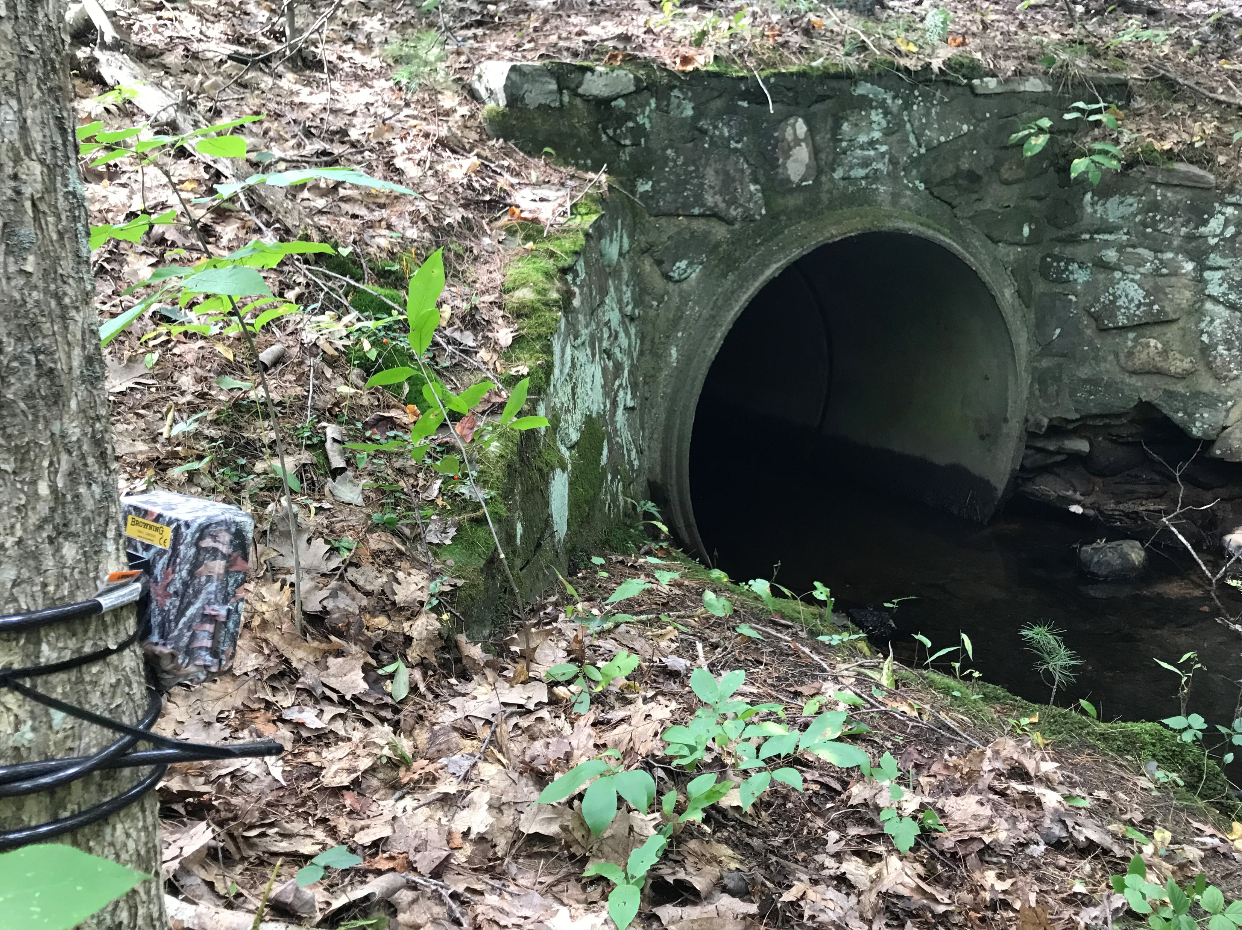
Methods

Slide 43
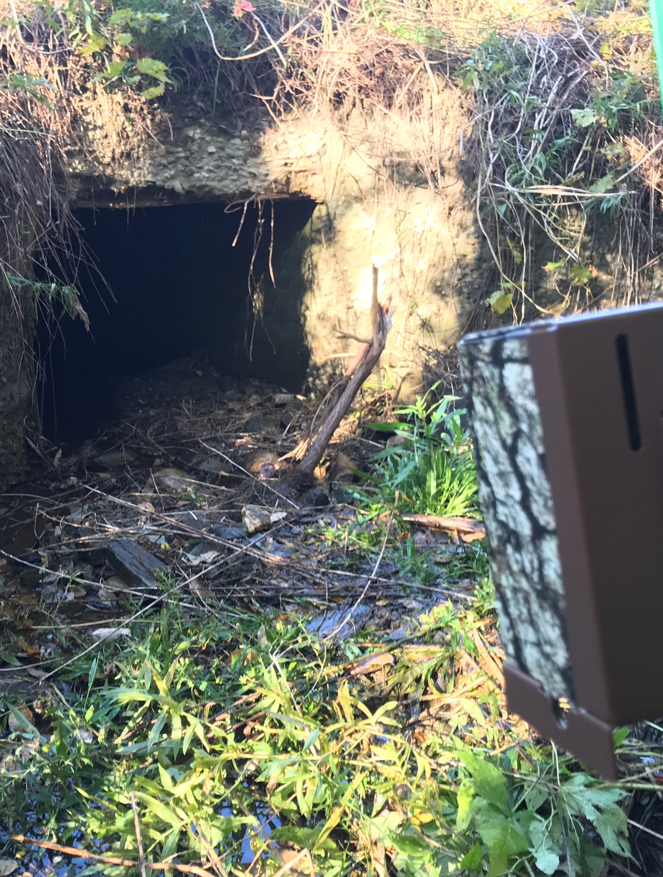
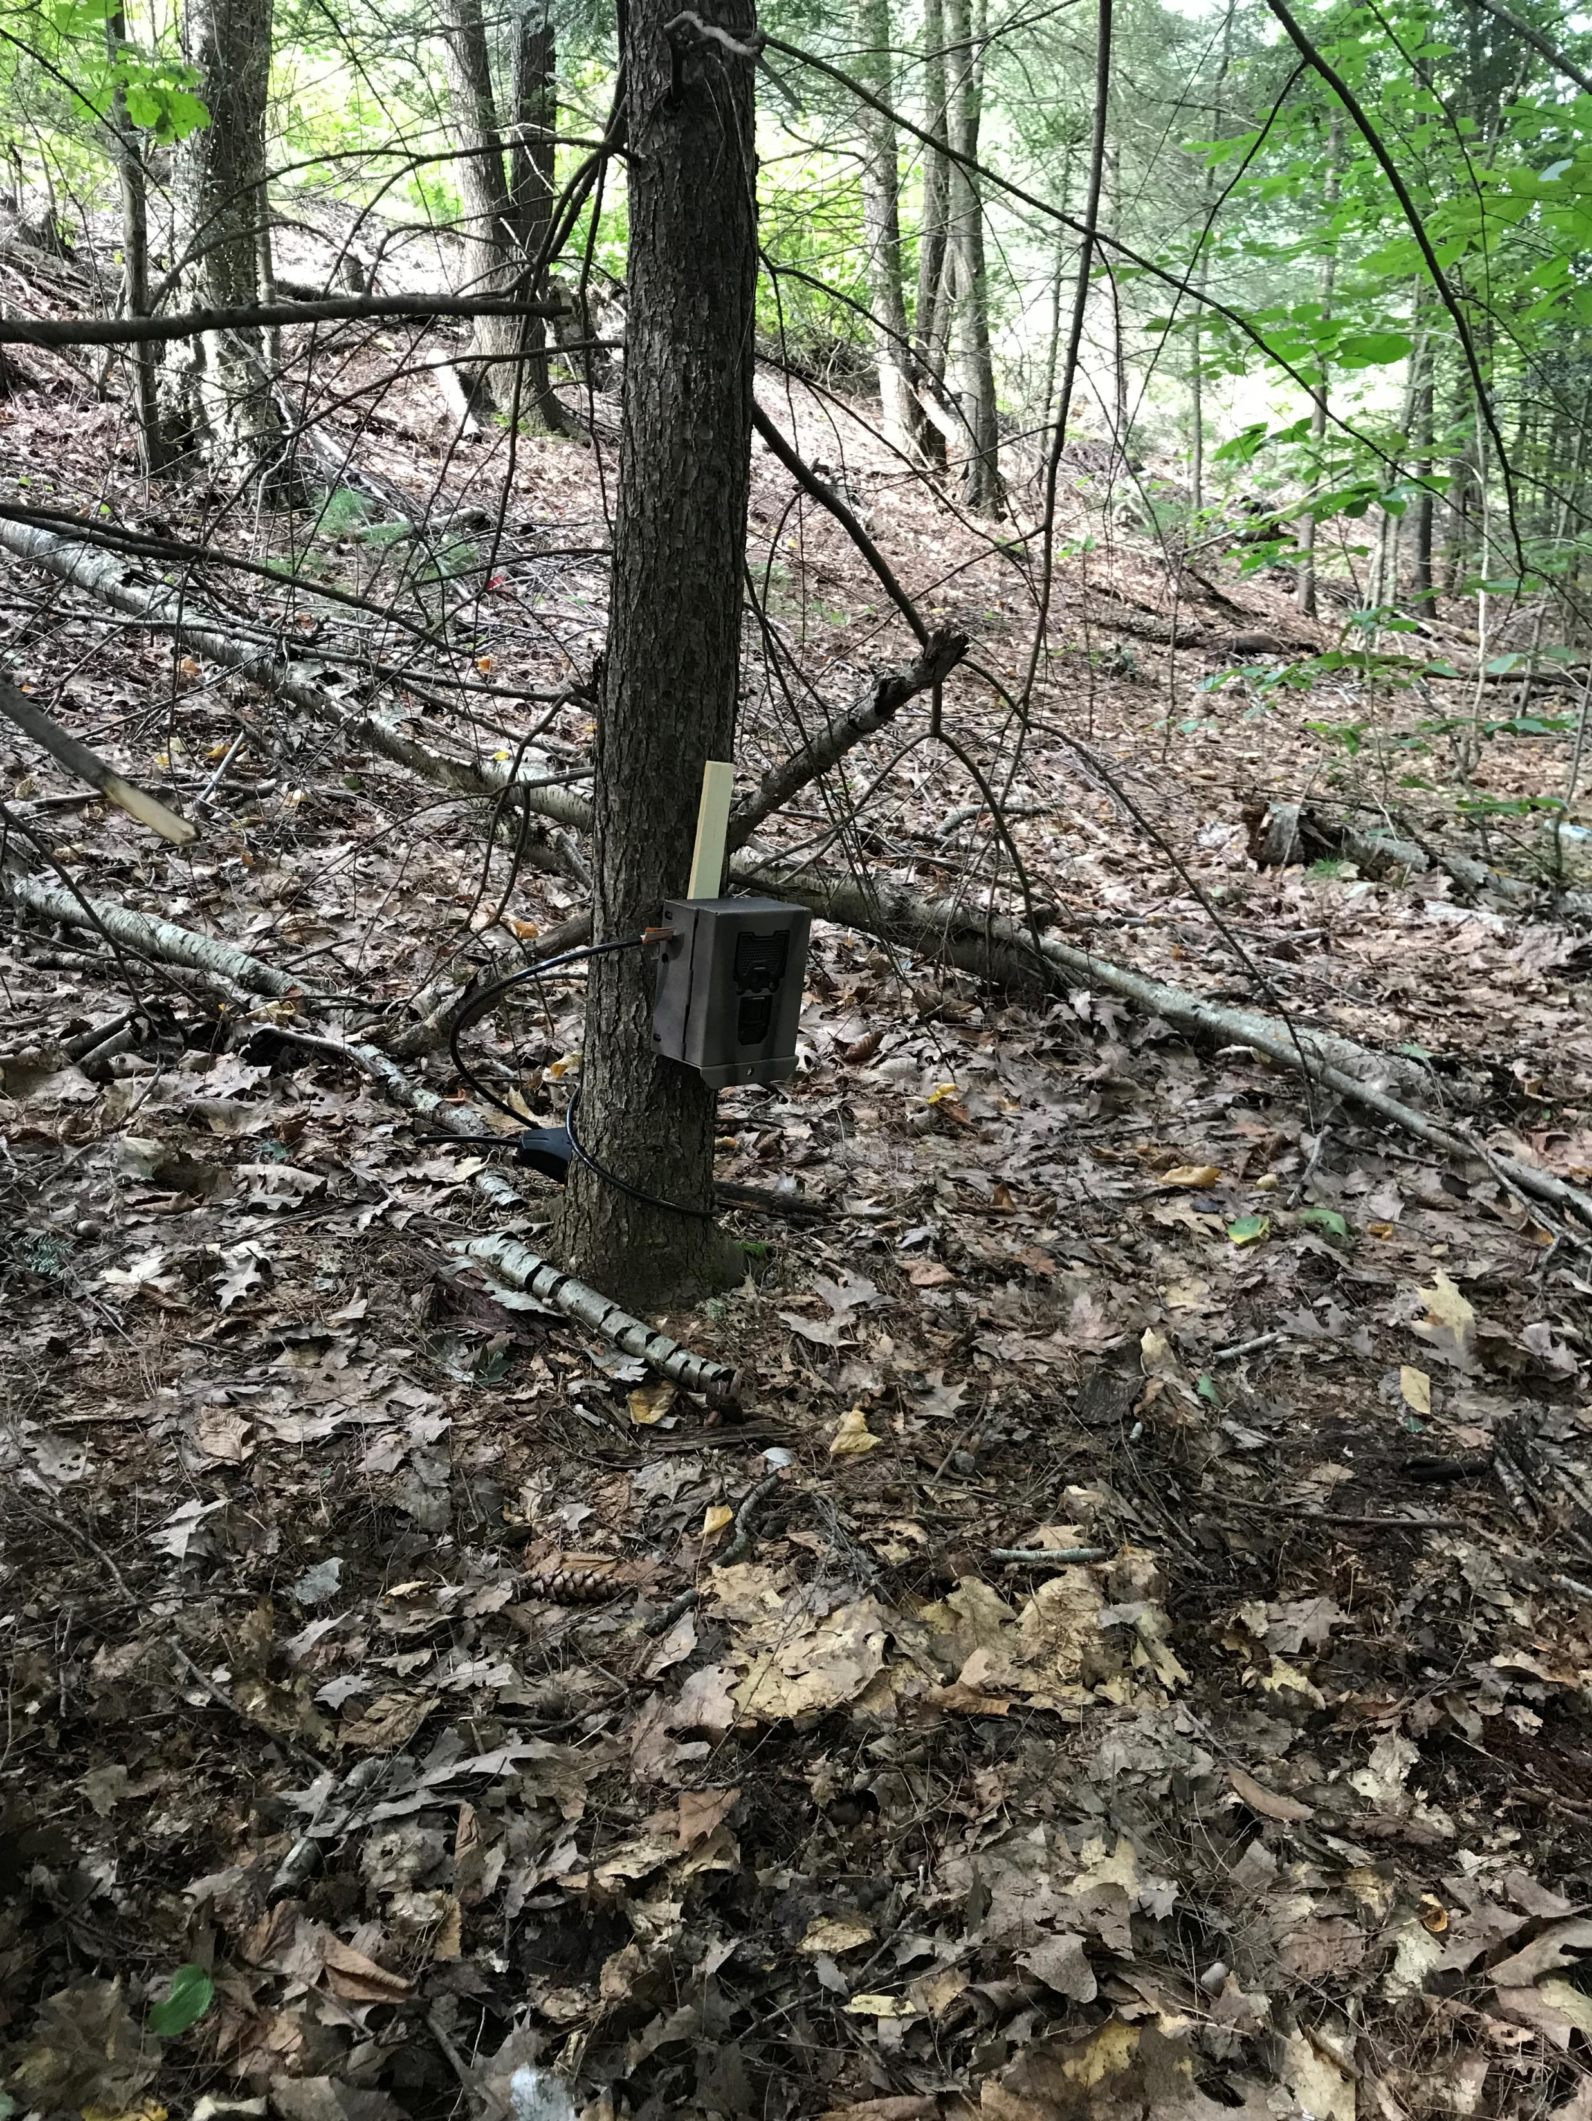
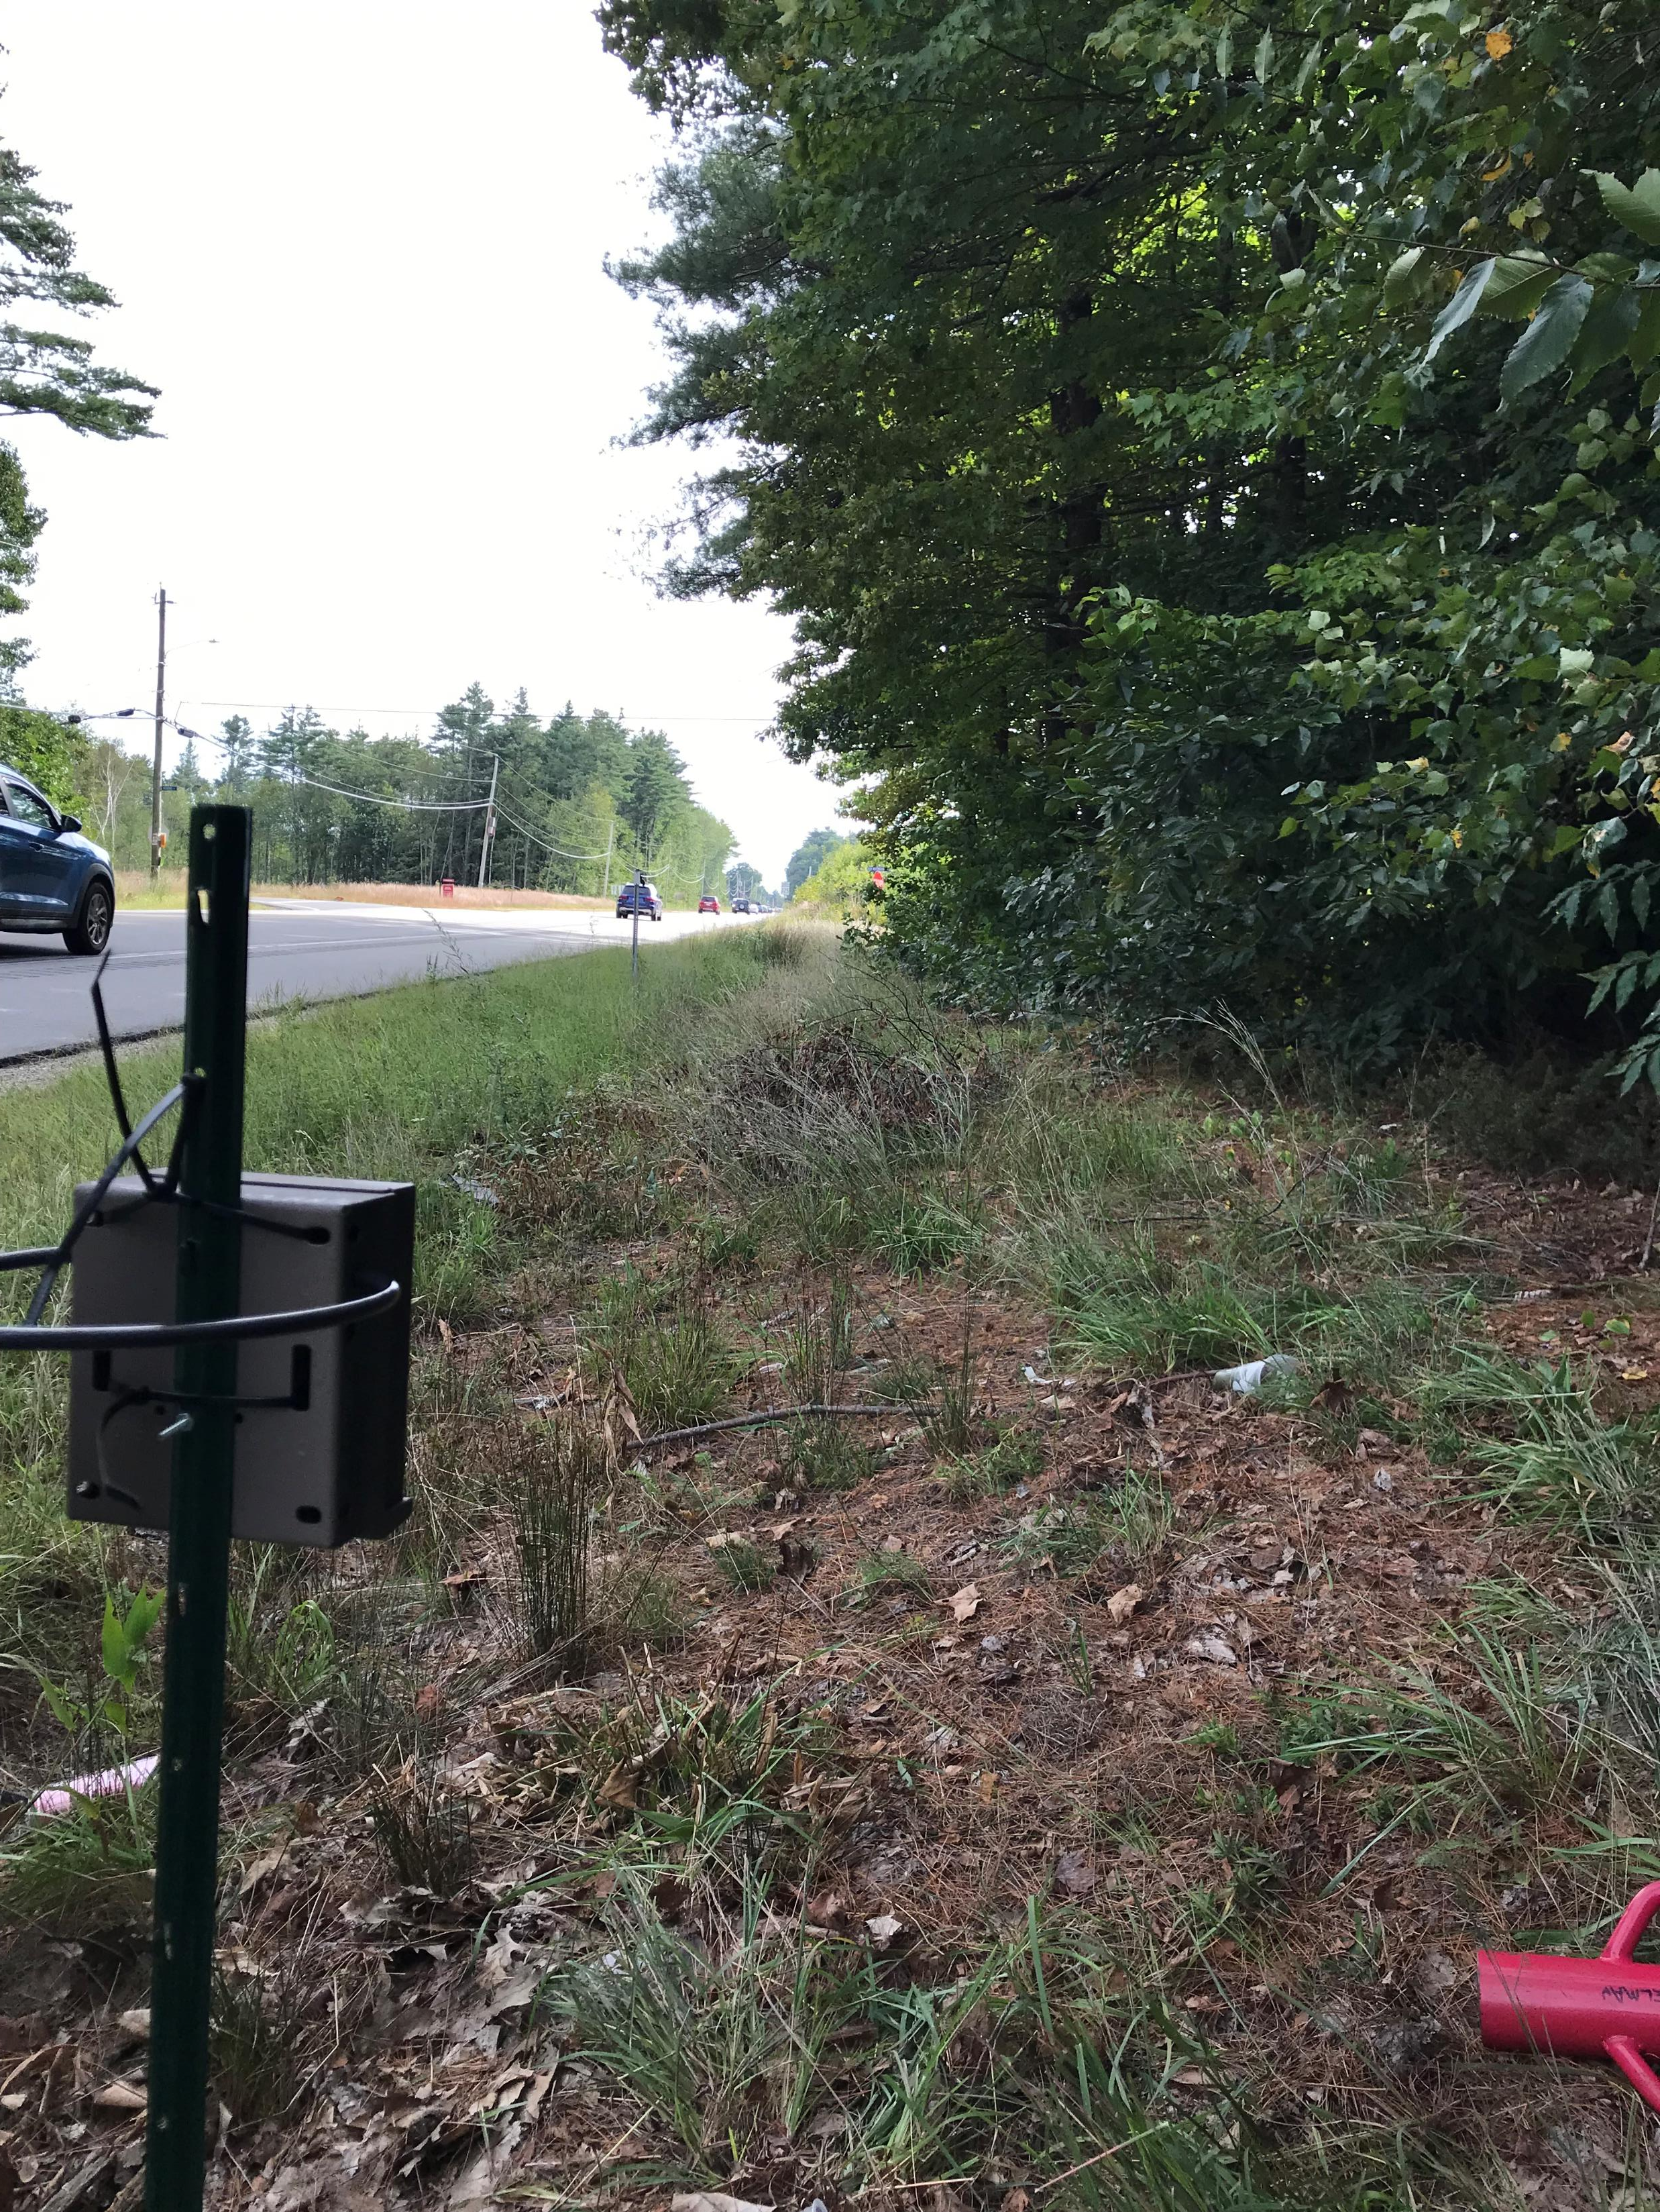
Cams in the Field
Culvert Cam
Area Cam
Roadside Cam

Slide 45
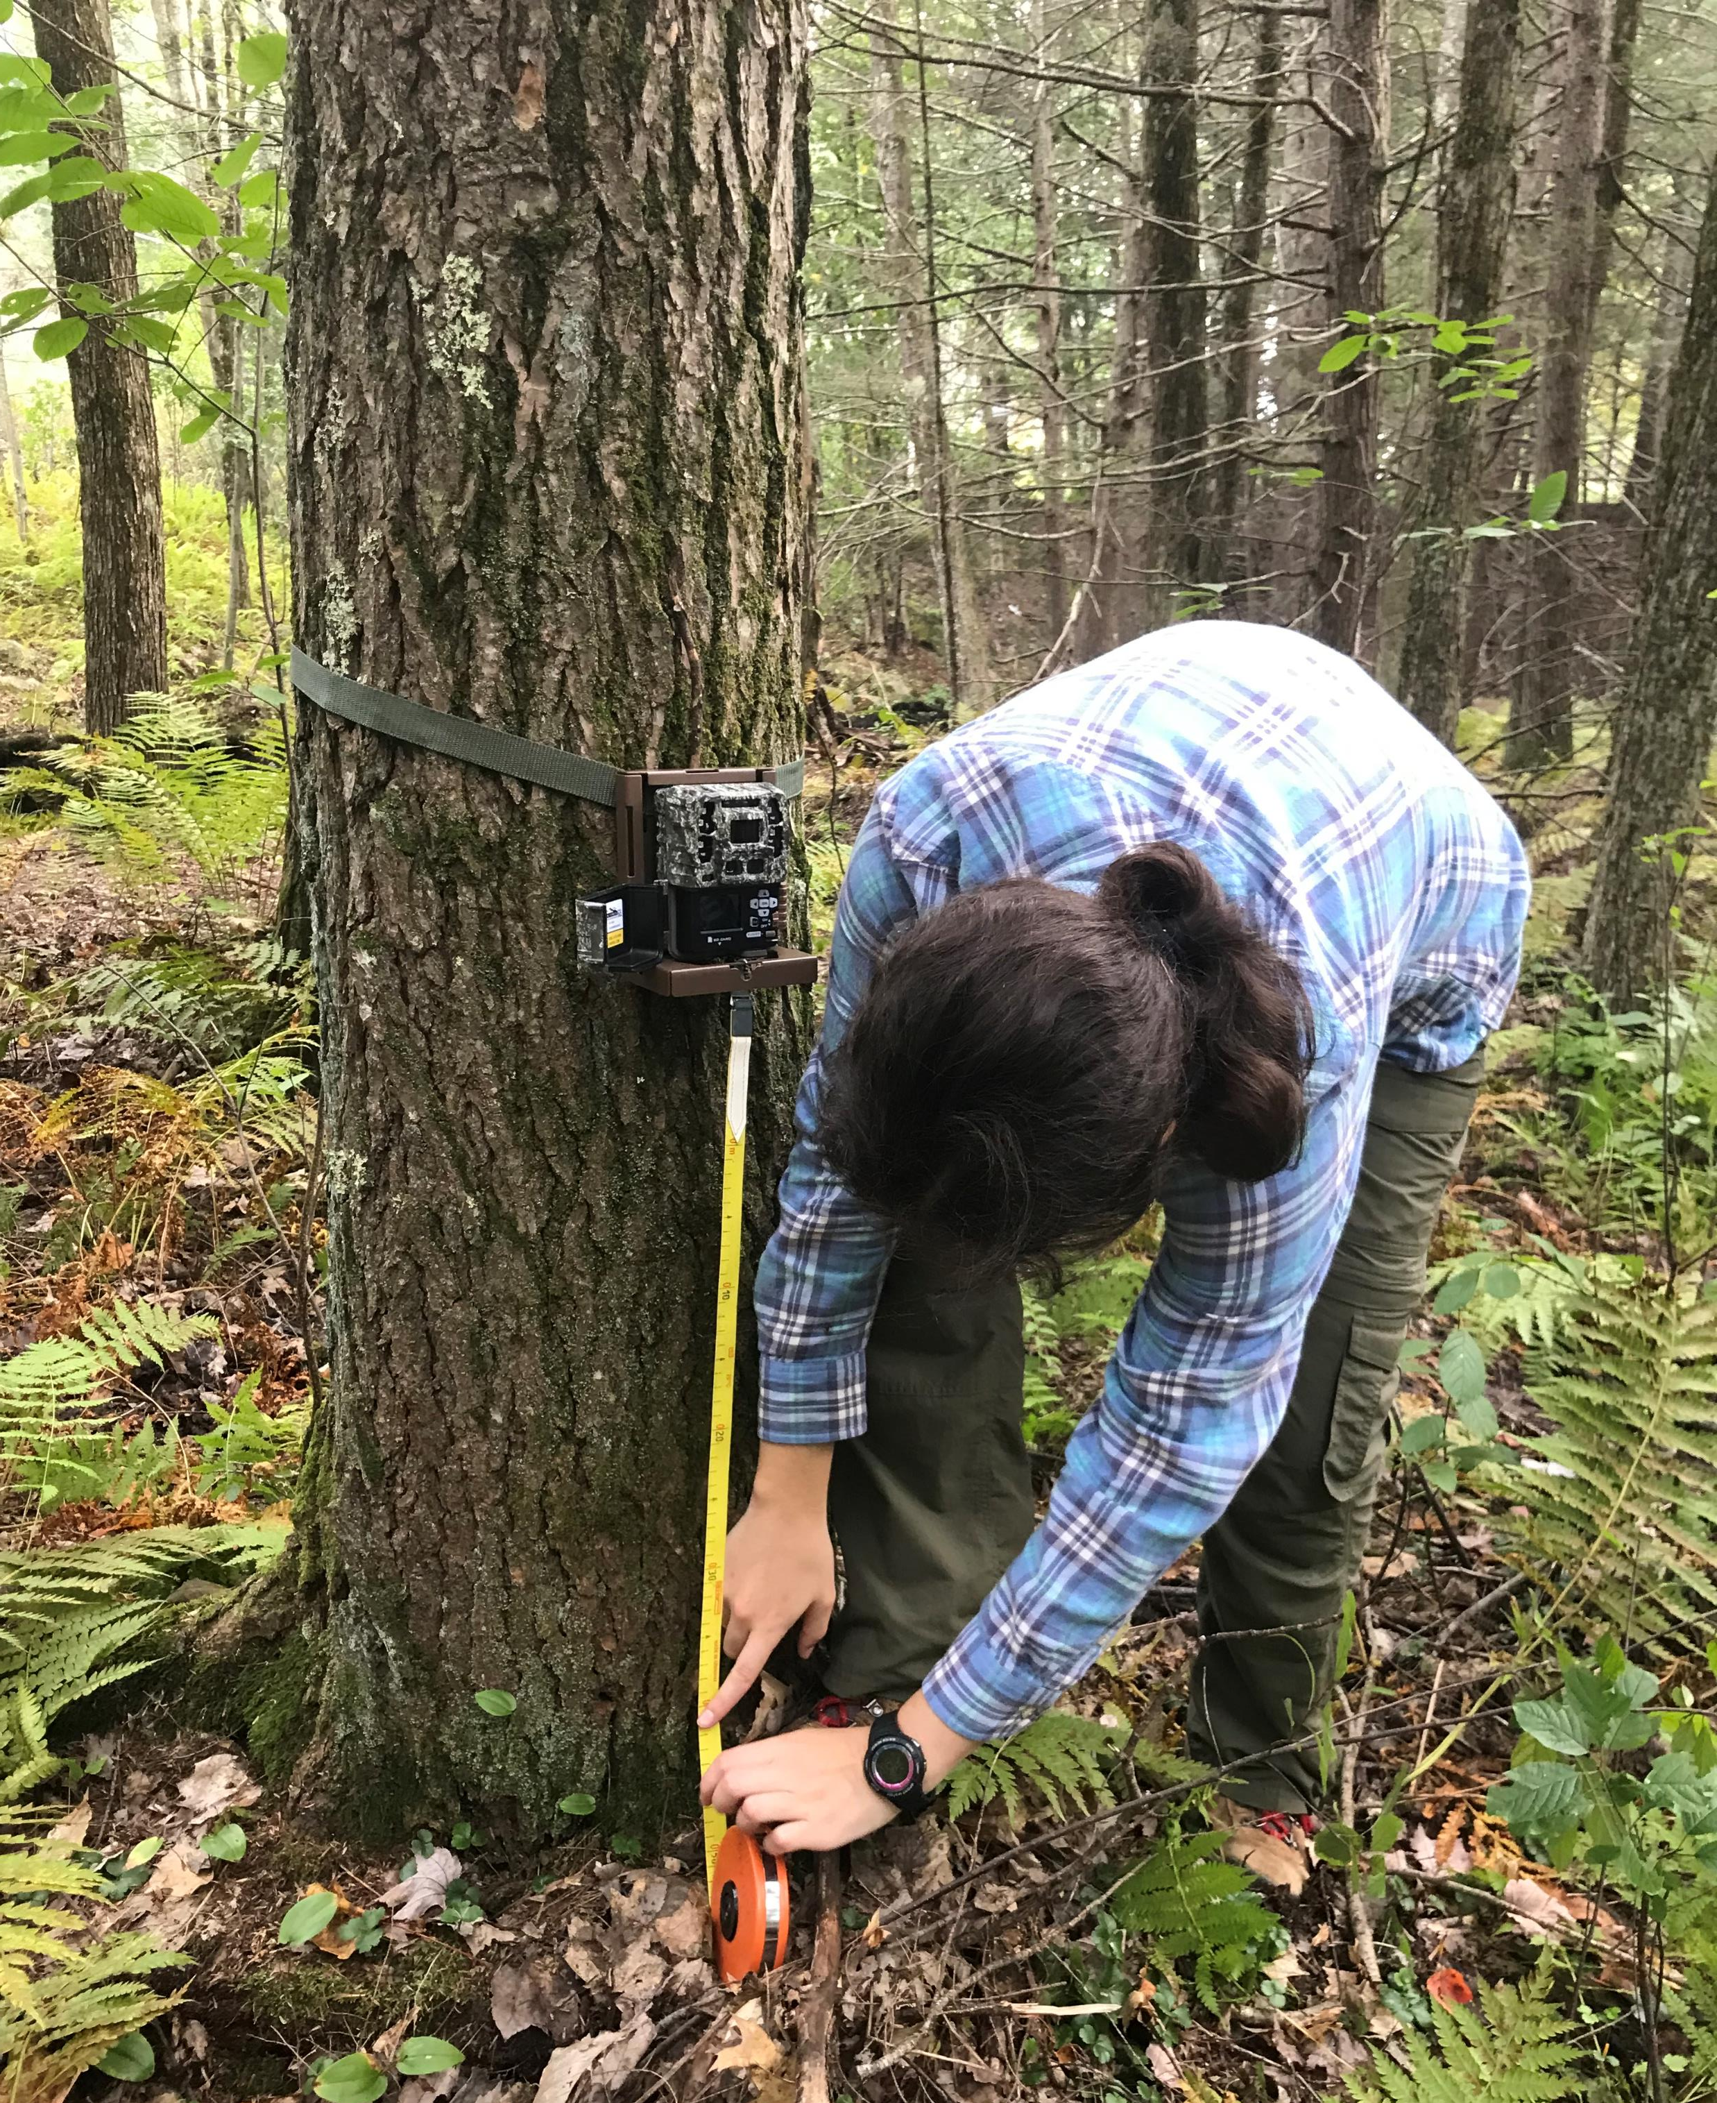
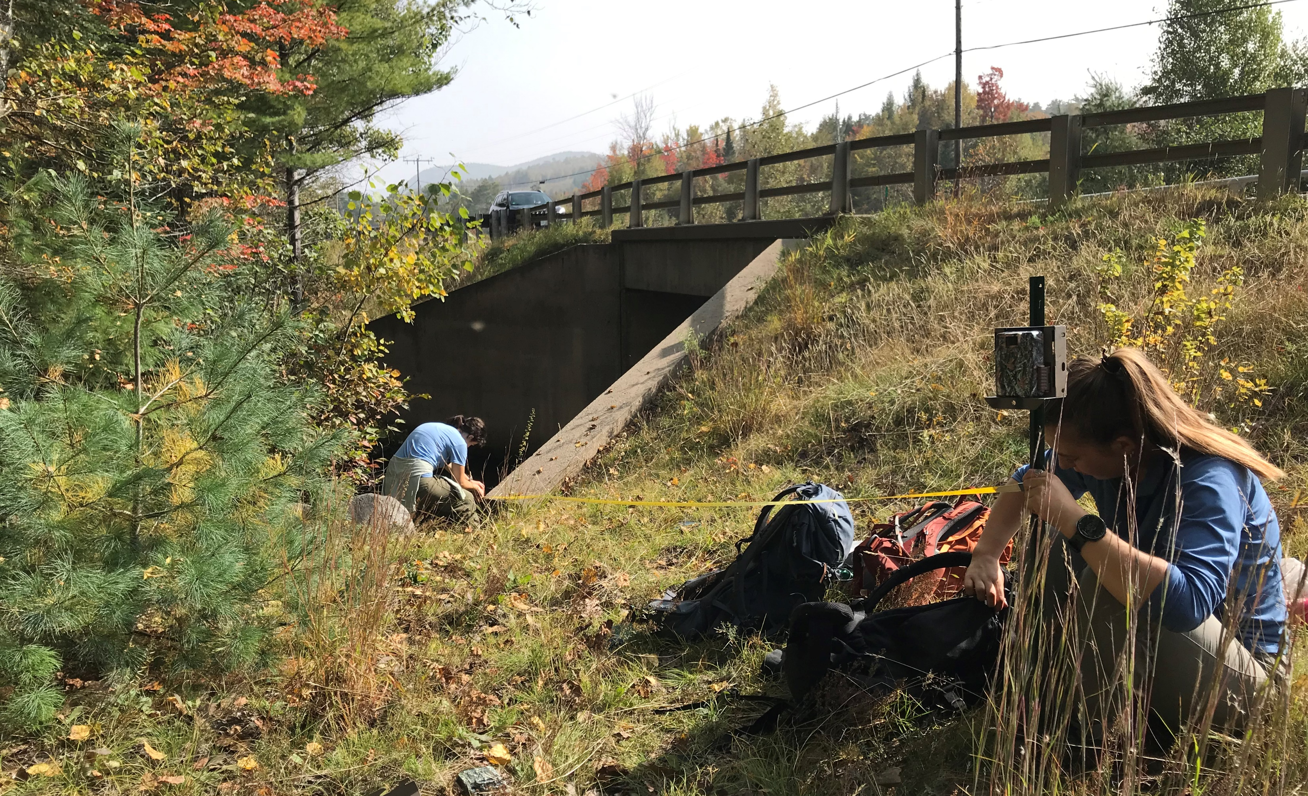
Deployment
Placement
Measurements
Field Checks

Slide 46
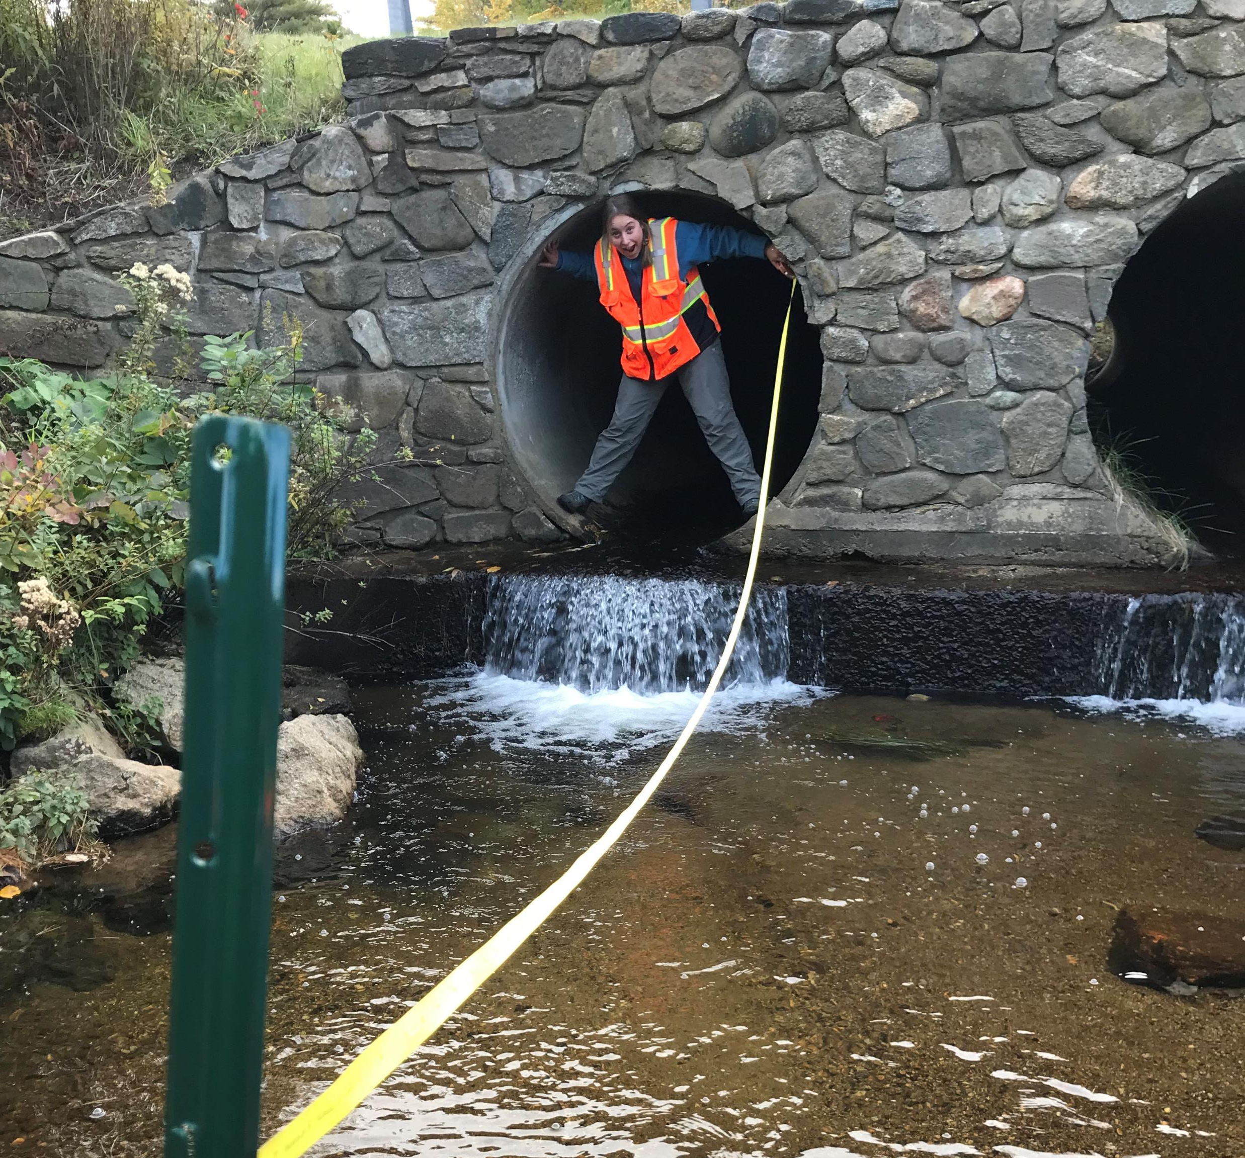
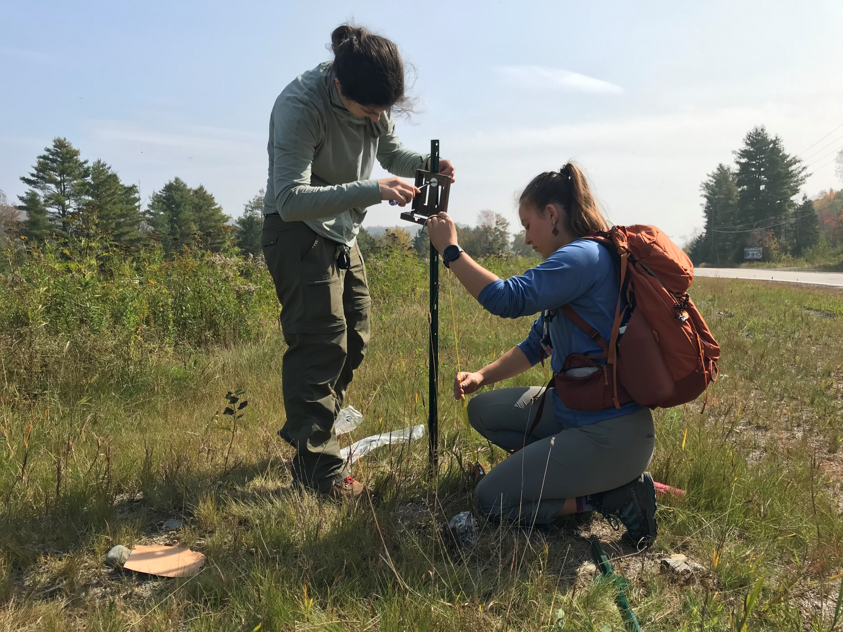


Slide 47



Bobcat Corridors
Porcupine Corridors
Black Bear Corridors
Otter Corridors

Slide 48
Wildlife Connectivity
Chapter One

