Slide 1

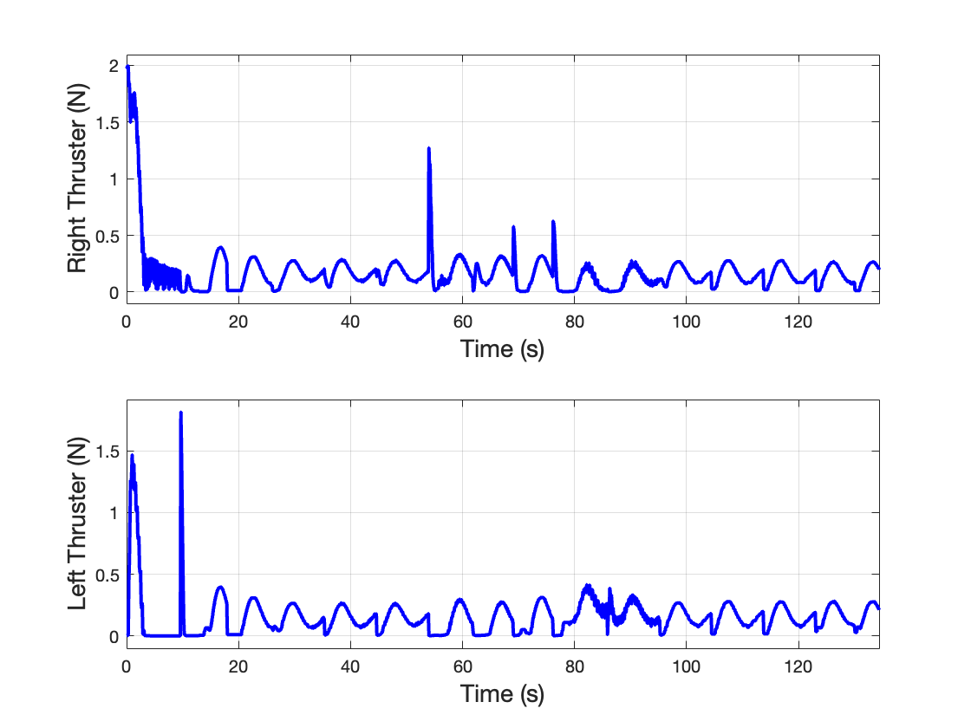
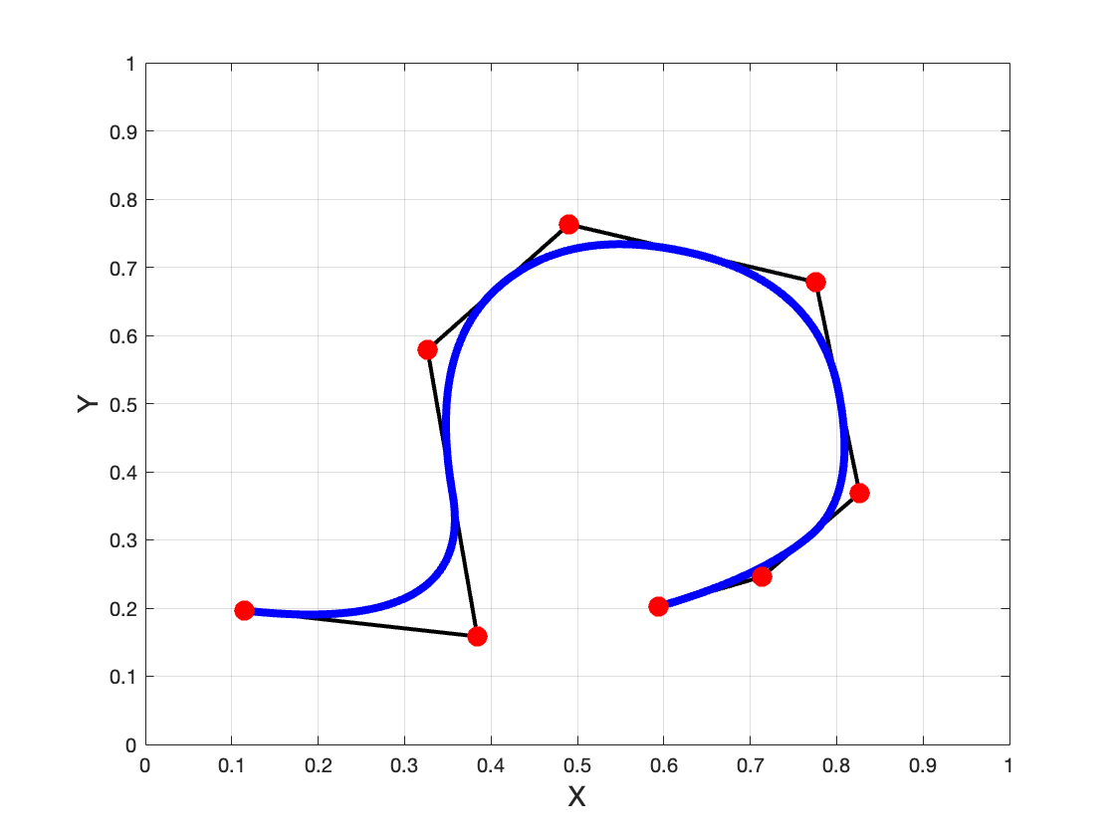
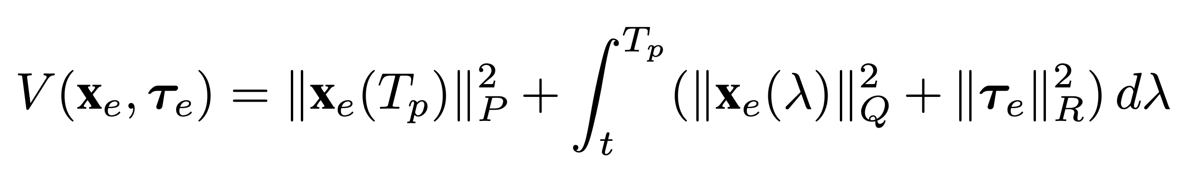
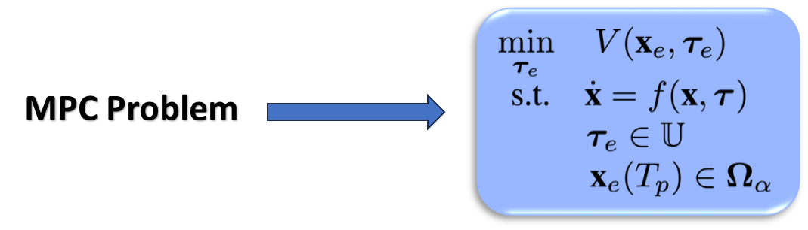
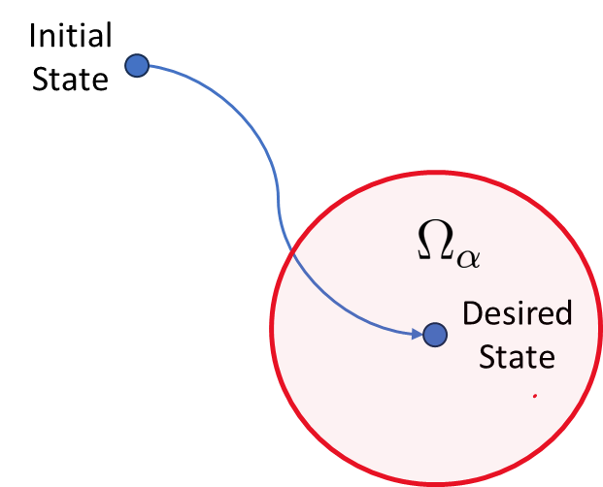
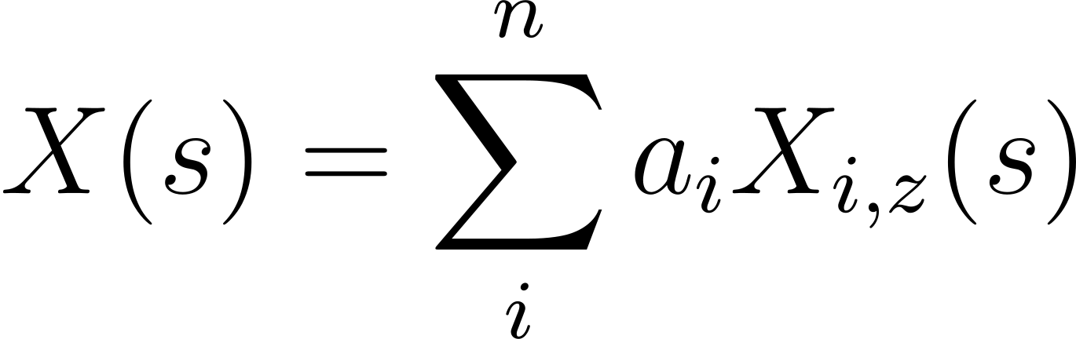
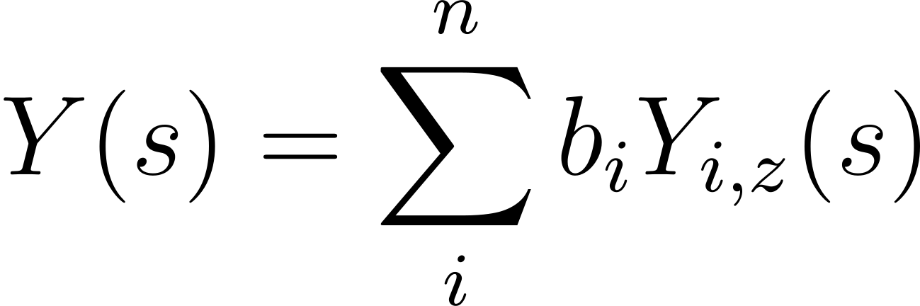
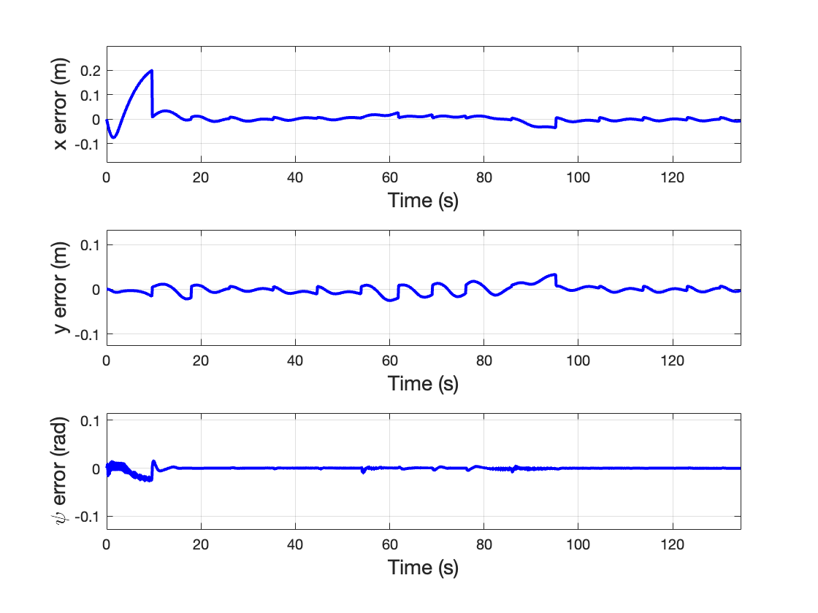
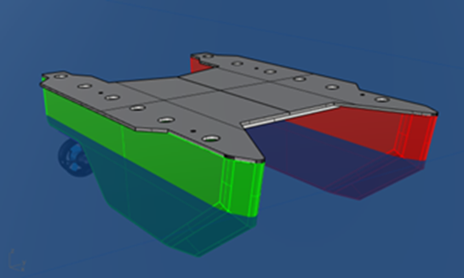
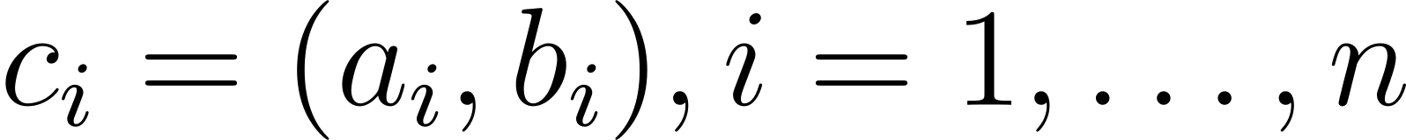
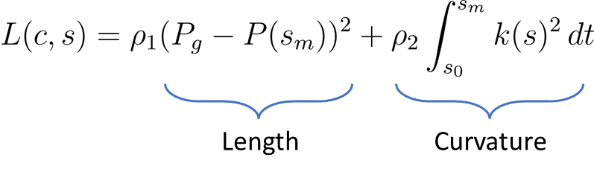
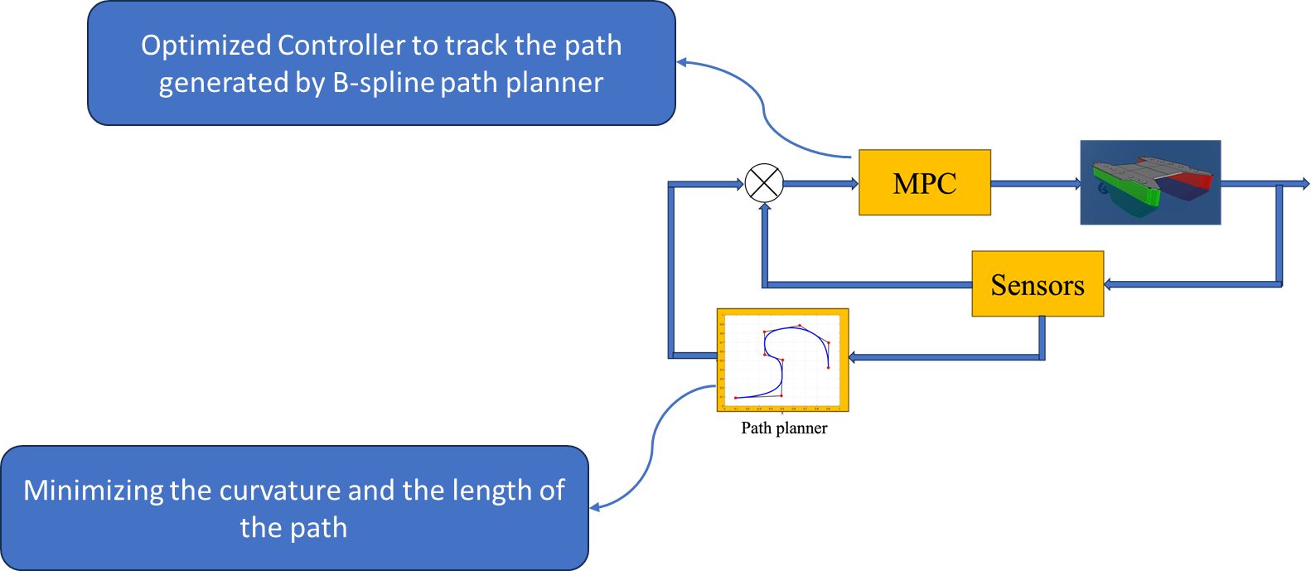
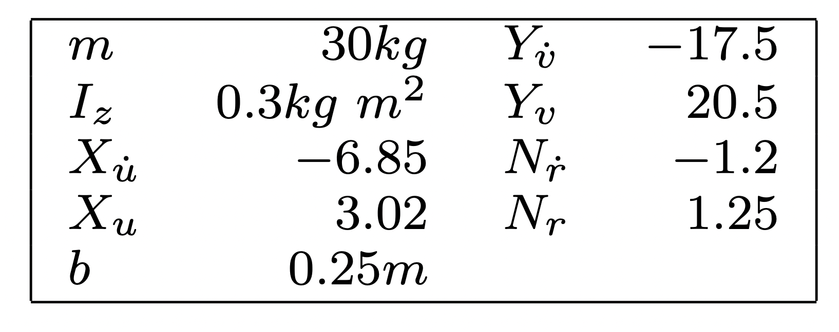
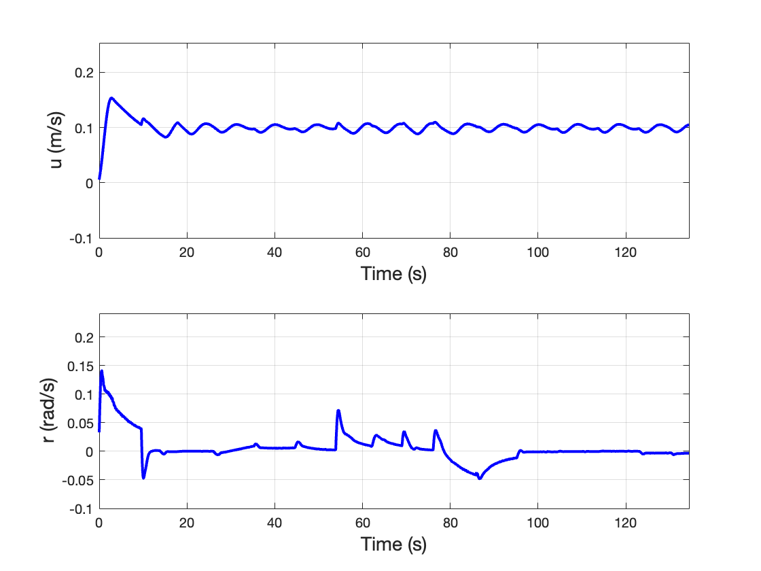
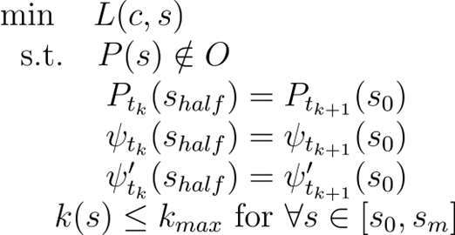
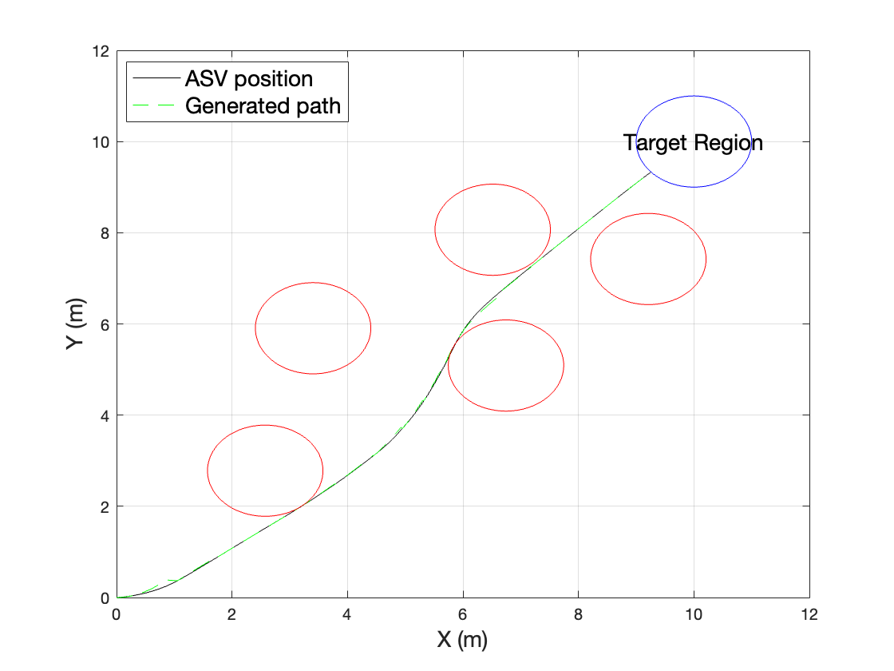
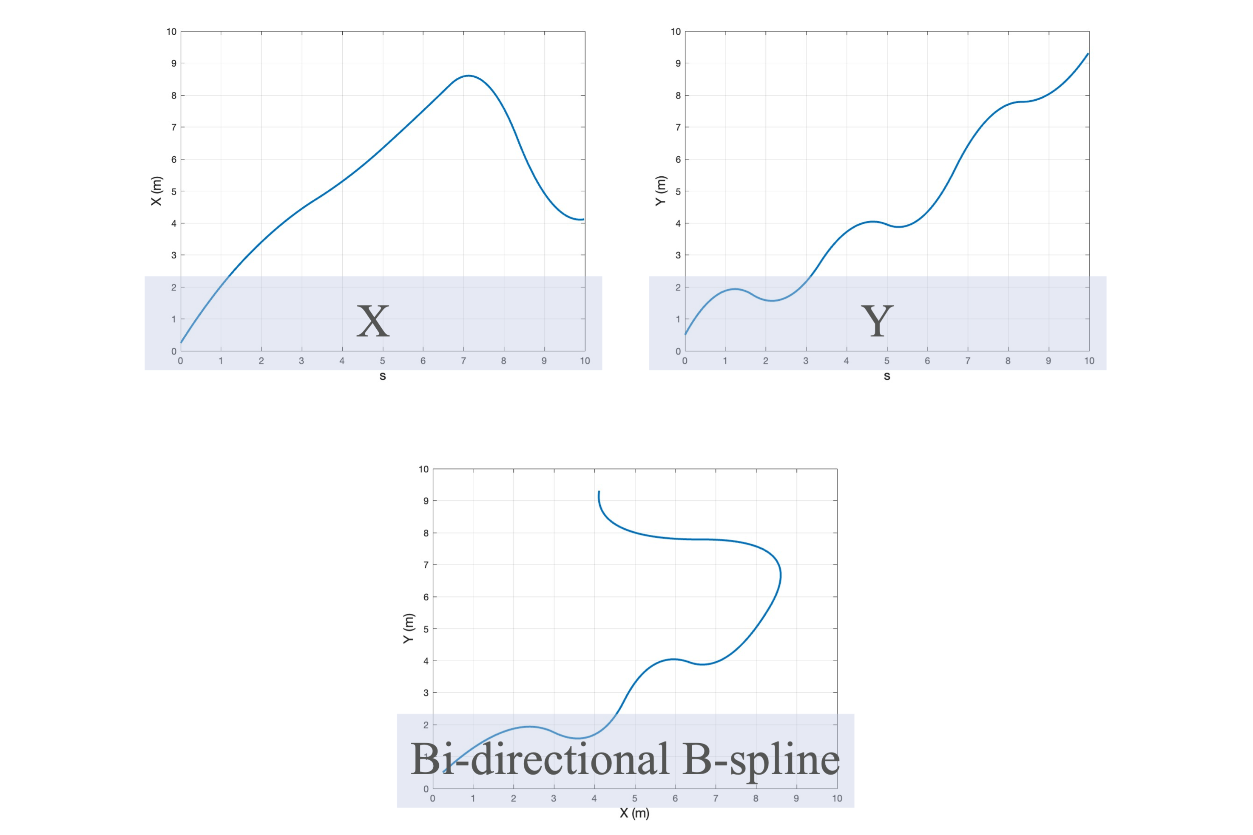
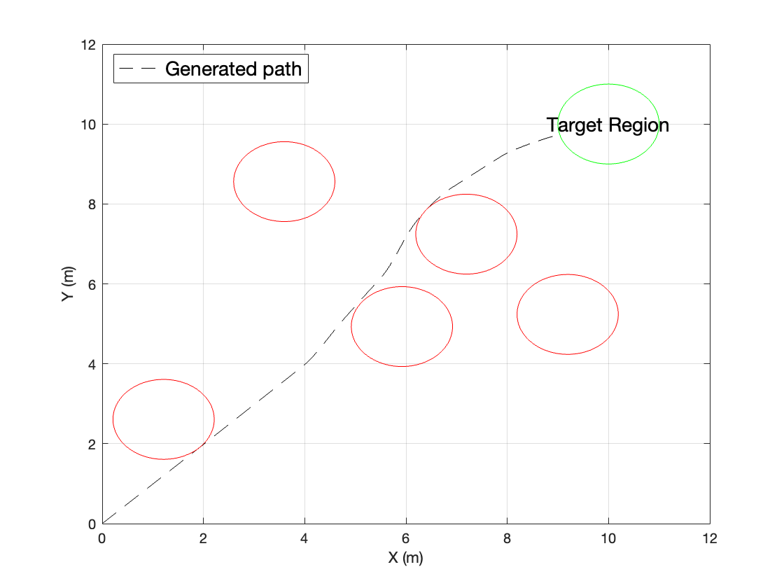
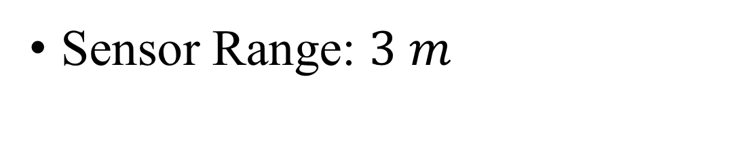
Optimized Path Planning and Control for Autonomous Surface Vehicles using B-Splines and Nonlinear Model Predictive Control
Graduate Research Conference
Shahab Shokouhi, Bingxian Mu, May-Win Thein
Importance of the Study
Control Design and Stability Analysis
Minimum Curvature Path
The utilization of minimum curvature paths in our study ensures that Autonomous Surface Vehicles (ASVs) can navigate smoothly through complex environments, addressing challenges related to path curvature and increasing their overall maneuverability.
Optimized Control Effort
In our study, the integration of Nonlinear Model Predictive Control (NMPC) enhances the performance and stability of Autonomous Surface Vehicles (ASVs), enabling precise path tracking and better management of thruster constraints.
The overall shape of the B-spline is controlled by control points.
More control points result in more flexibility, but more complexity of the optimization problem.
The constrained optimization problem to calculate the input is characterized as:
Fig. 7. Thrusters Force
Fig. 3. B-spline and Control Points
To address both curvature and target tracking, a two-part cost function is introduced:
Fig. 5. Region of Attraction
Fig. 1. ASV 3D Model
Simulation Results
Model Parameters
Fig. 8. Positional Errors
To avoid obstacles and maintain the continuity of the path, the following constrained optimization problem is presented:
Sensor Range: $3 m$
Obstacles are randomly distributed such that the existence of solution is guaranteed.
Fig. 2. Integrated Controller and Path Planner
B-splines and their structure
Fig. 9. Surge and Yaw Velocities
Two individual B-splines are combined to create a bi-directional B-spline.
Fig. 6. Integrated Controller and Path Planner Results
Fig. 4. Path Planner Results

