Slide 1
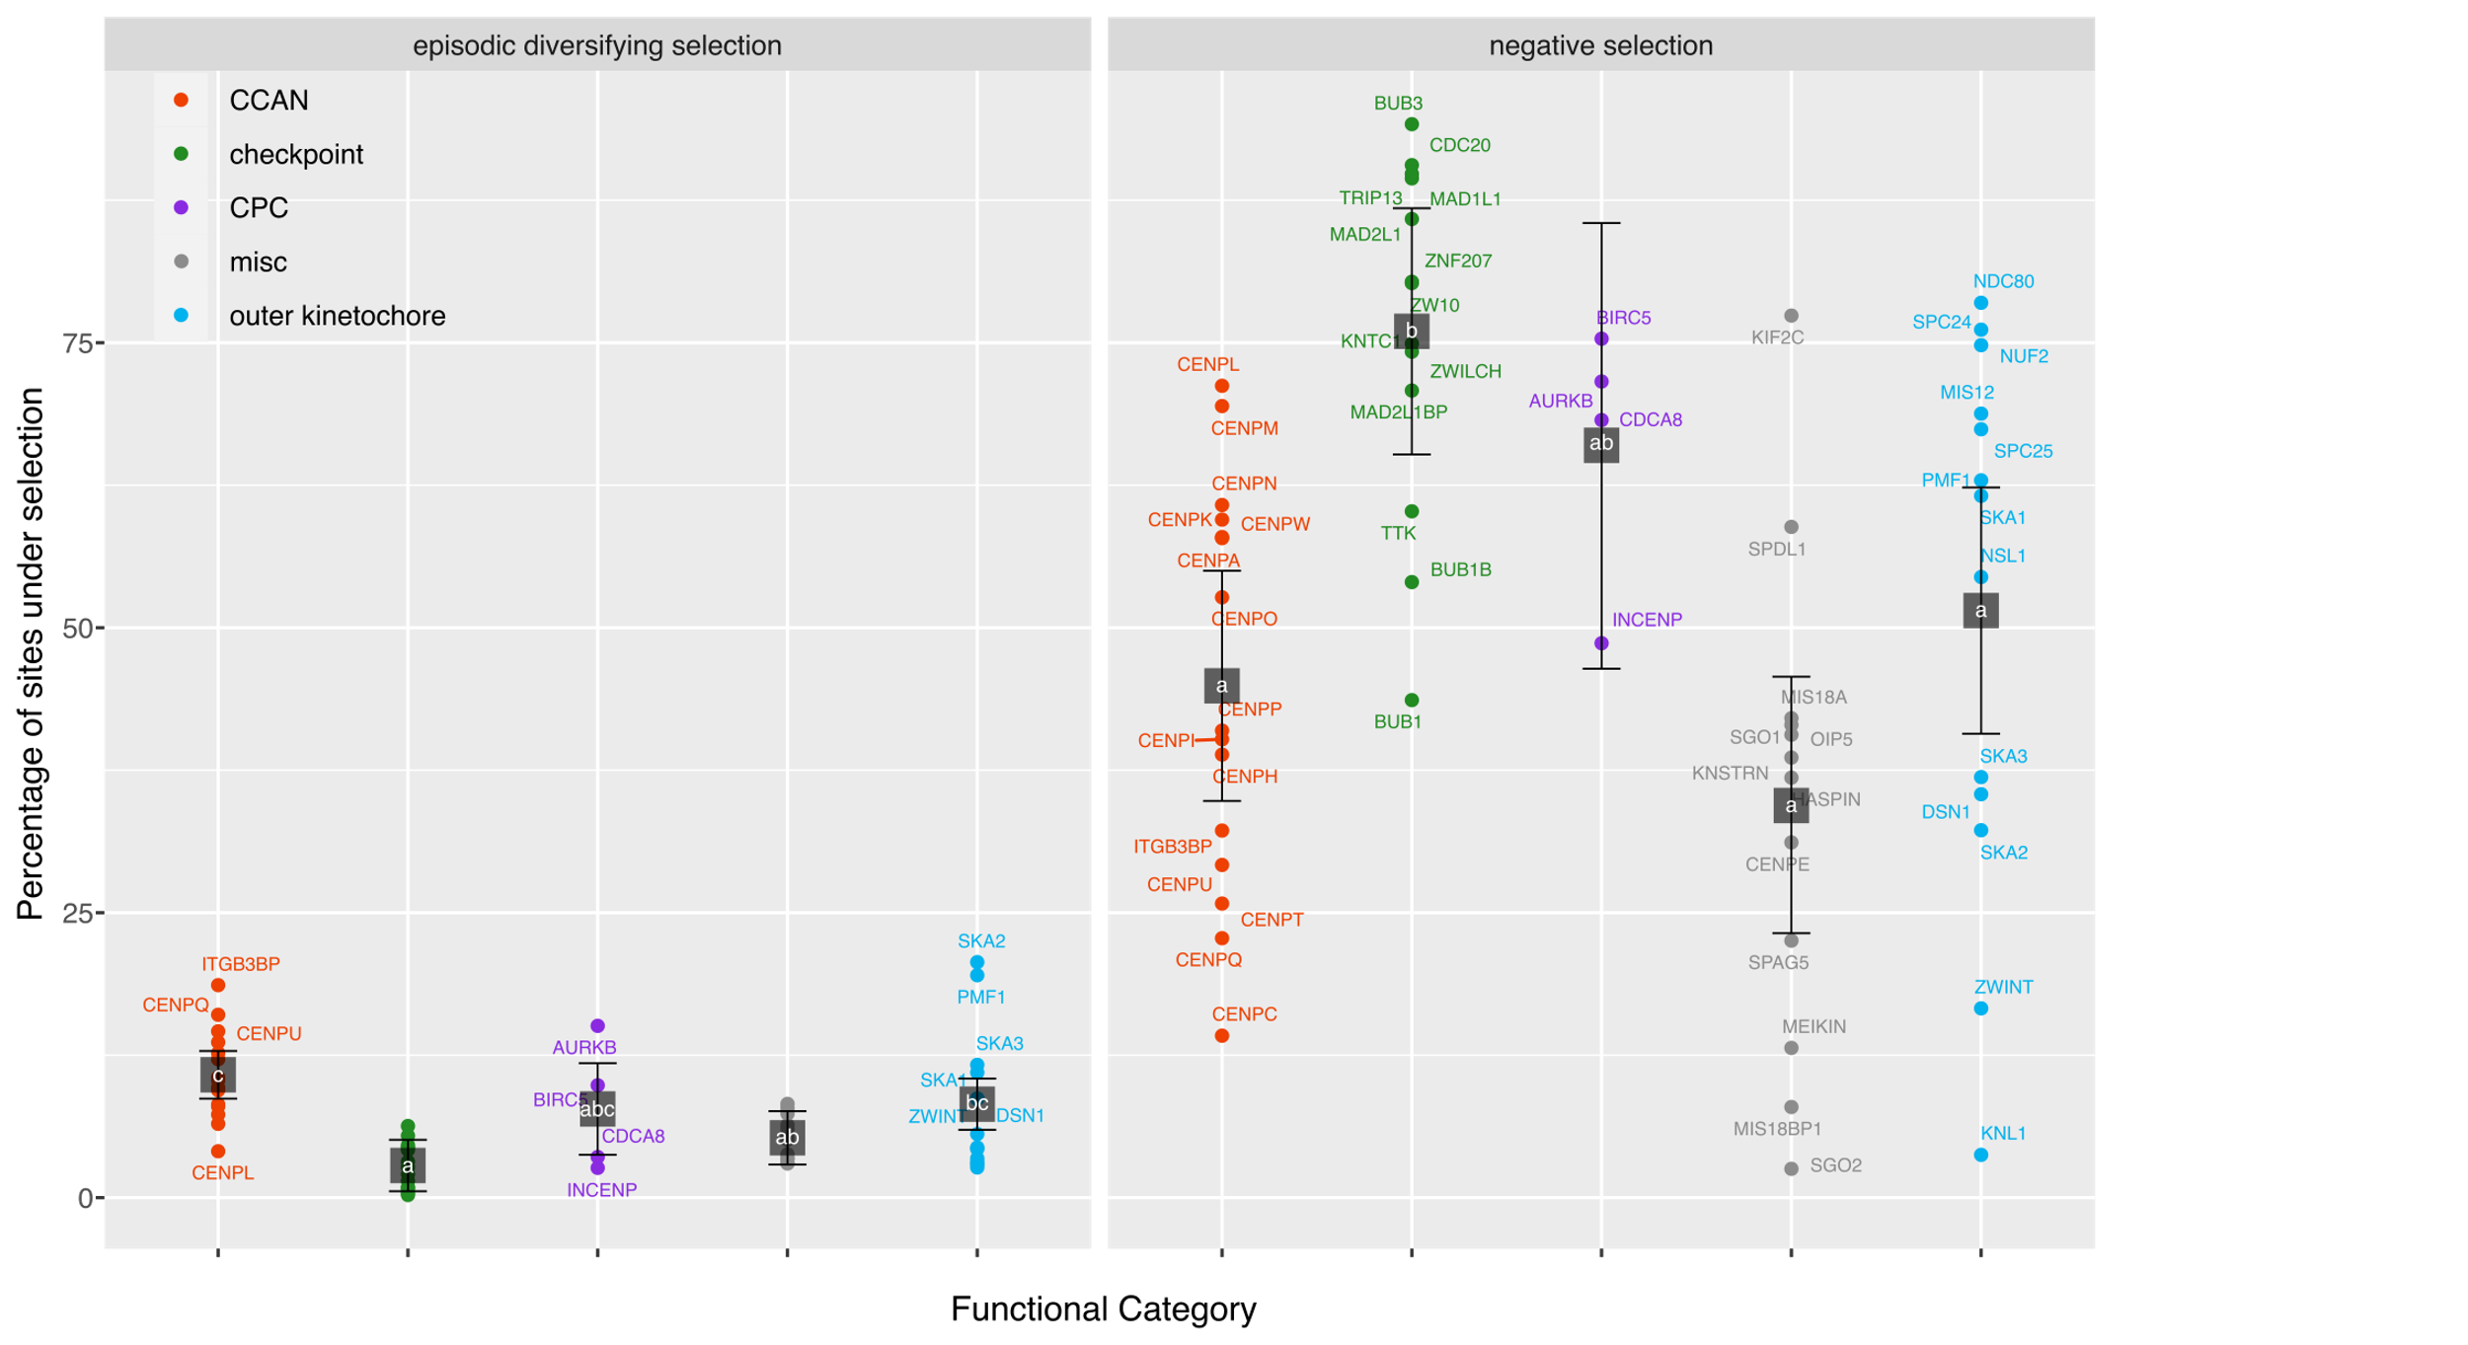
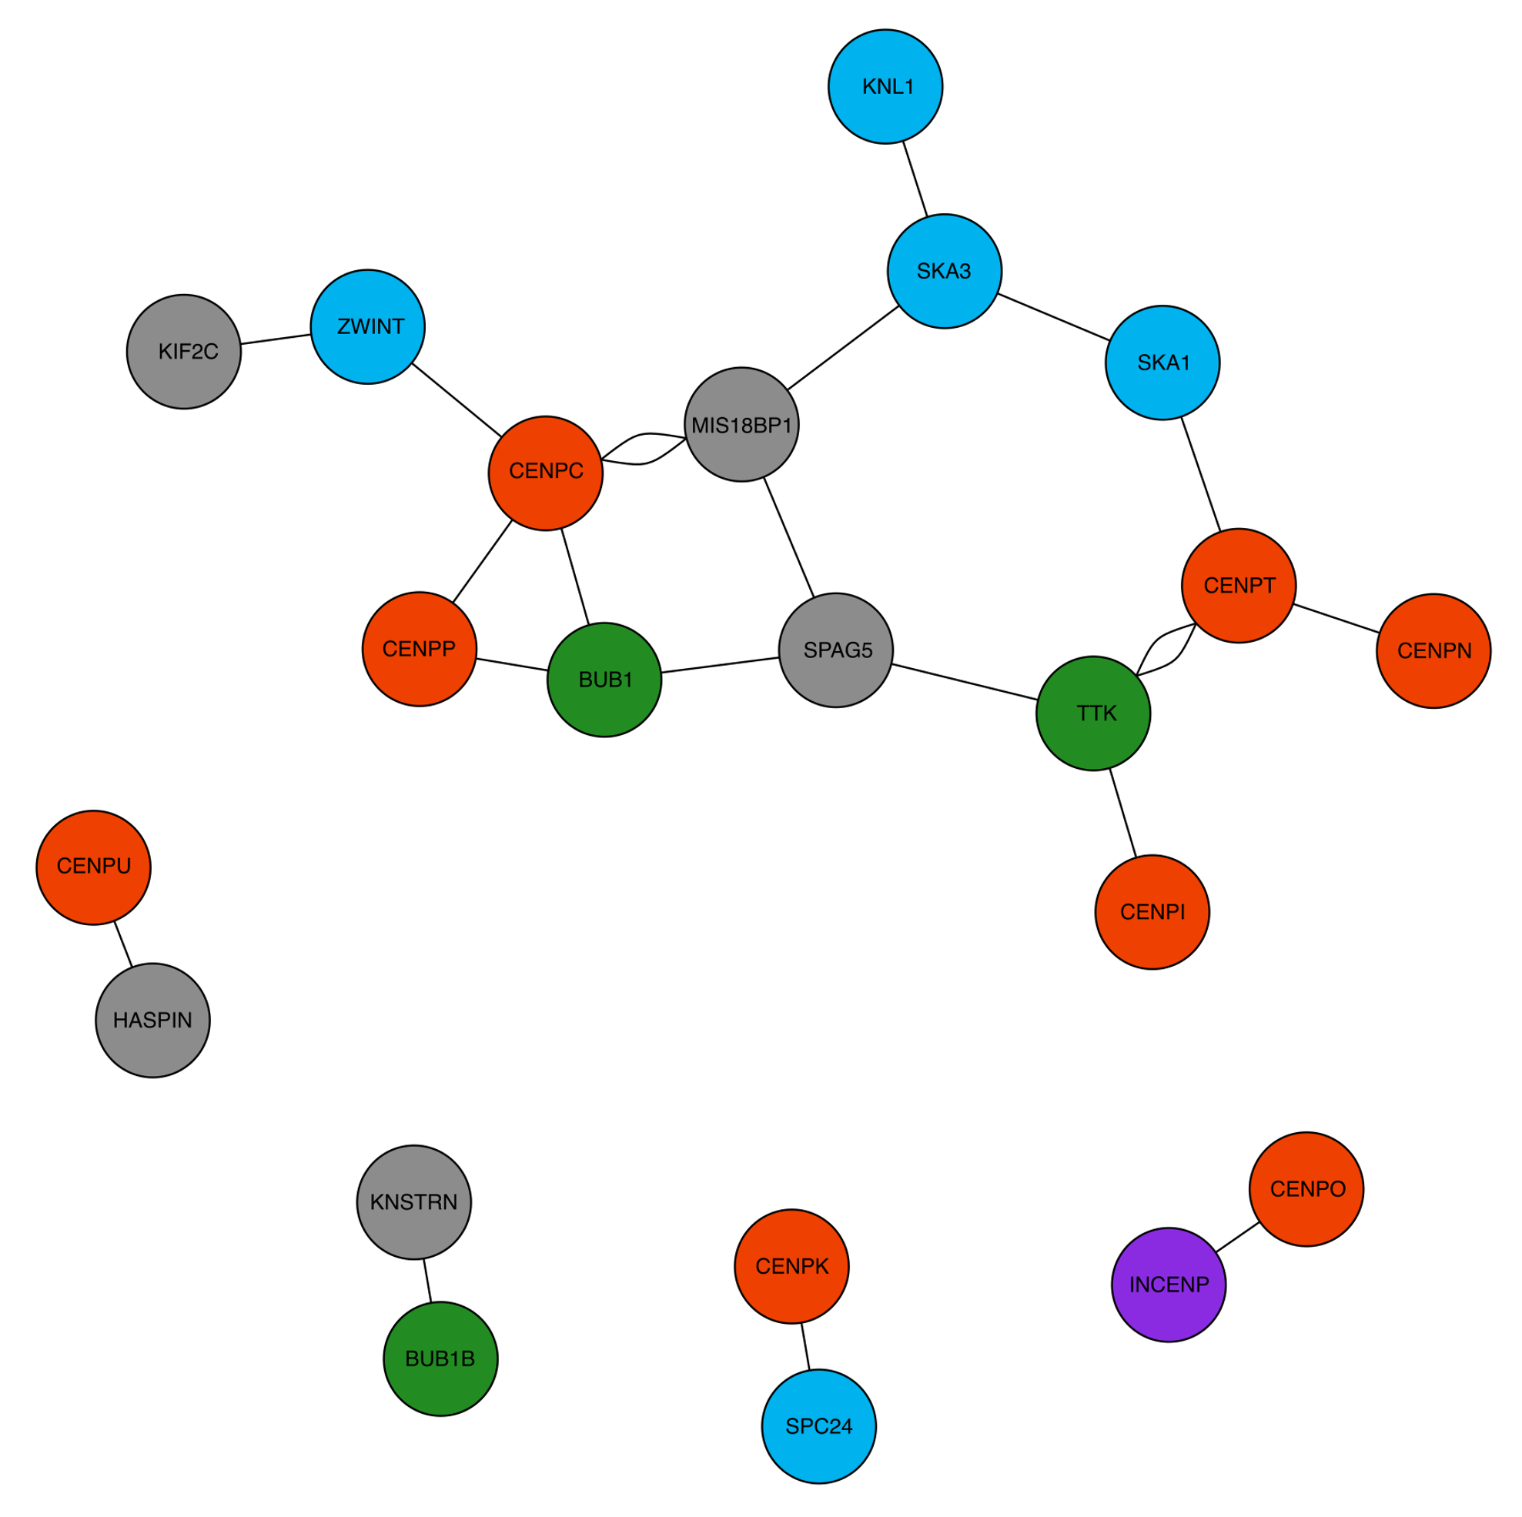
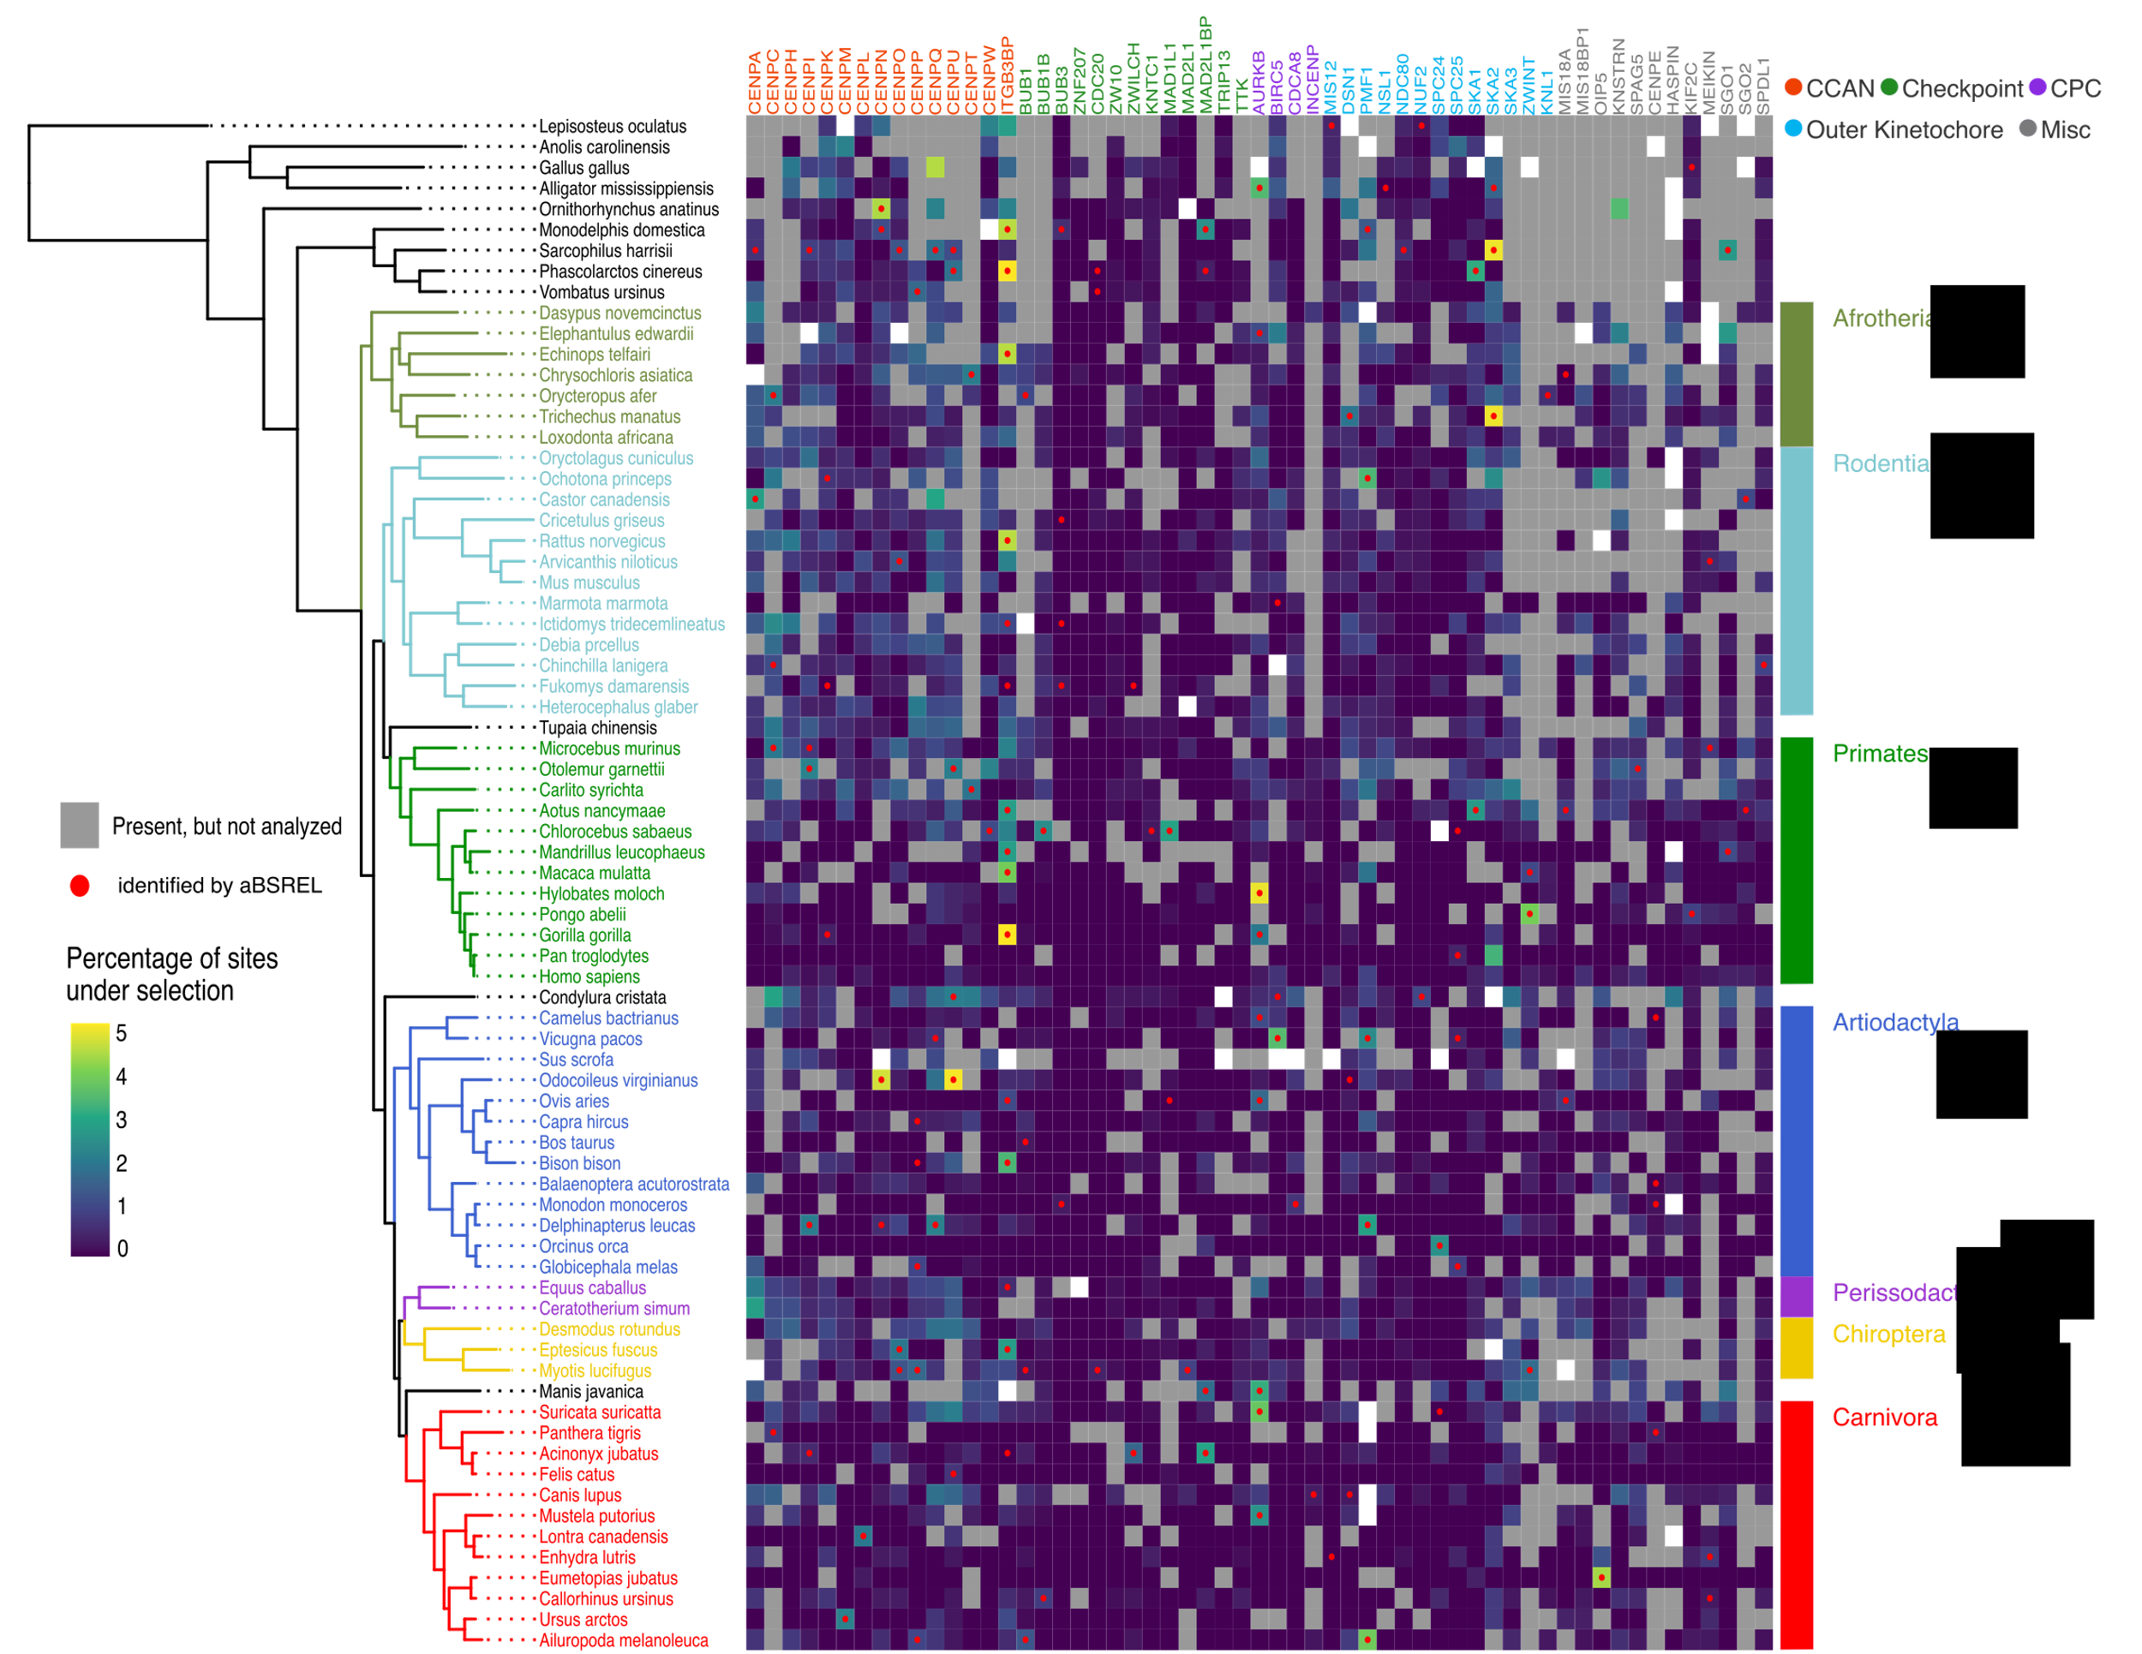
Structural constraints and drivers of molecular evolution in a macromolecular complex; the kinetochore
Hannah Paré¹, Alexandra Nguyen², Iain Cheeseman ², David Plachetzki¹
1. University of New Hampshire, Durham, NH, USA 2. Whitehead Institute for Biomedical Research, Cambridge, MA, USA
Introduction
57 genes were surveyed in this study representing five functional categories
2. CCAN and outer kinetochore genes evolve rapidly, while checkpoint genes experience significantly more negative selection
How does a macromolecular complex, encoded by >100 loci, experience both high rates of diversifying selection and essential functional conservation?
The kinetochore mediates the attachment of the chromosome to the microtubules during cell division
Malfunction can lead to cancer¹⁻³, growth disorders^{4,5} and mental health issues¹
Evolutionary theory would suggest that the kinetochore should be subject to strong negative selection, reflective of its critical functional importance
However, while function is conserved across eukaryotes, the individual components that make up the structure evolve rapidly^{6,7}
Figure 1. The Constitutive Centromere-Associated Network (CCAN) assembles on centromeric DNA to form the foundation for kinetochore assembly. The outer kinetochore facilitates the attachment to the microtubules. Sub-complexes within the CCAN and outer kinetochore are circled. The Chromosomal Passenger Complex (CPC) regulates chromosome alignment and segregation, while checkpoint proteins monitor the process of cell division for errors in kinetochore-microtubule attachments. Proteins that did not fit into any one of these modules were classified as “miscellaneous”.
Objective
Figure 3. Percentage of sites under selection within each gene grouped according to their functional characterization. Black squares represent the mean (least squares) for each functional category with the error bars highlighting the 95% confidence interval. Letters are significance groupings according to a Tukey all pair-wise comparison at alpha = 0.05.
Investigate the evolutionary dynamics of the kinetochore and develop a model for the study of the evolutionary principles governing macro-molecular protein complexes
Main Findings
3. Sites in CENP-C, CENP-T, MIS18BP1 and TTK show corresponding trends in evolution with other genes among species
1. CCAN and outer kinetochore genes from afrotherians have significantly more sites under selection when compared to carnivores.
Workflow
Figure 4. Network diagram of corresponding sites. Edges represent a pair of sites between two proteins (nodes) for which the same group of three or more species are evolving under episodic diversifying selection. The color scheme corresponds to the functional groupings as described in Figure 1.
Genomic sequences for 70 mammalian species & 4 outgroups
OrthoFinder⁸
JPred⁹
Align and edit sequences for 57 kinetochore genes
4. Positive selection is enriched in protein regions predicted to be unstructured and depleted in helices, sheets, and coils
IQ-TREE¹⁰
References/Acknowledgments
Selection analyses (HyPhy¹¹)
Identify sites under episodic diversifying selection
Identify branches under episodic diversifying selection
Identify sites under pervasive positive and negative selection
We would like to acknowledge Lindy McKee and Stephen Mrenna for help with running the bioinformatic workflow and Dr. Sabrina Pankey for help with statistical analysis. This work was supported by the National Science Foundation under the grant number 2029868 and the Graduate School at the University of New Hampshire in collaboration with the Whitehead Institute for Biomedical Research.
References: [1] Xie, M. & Bu, Y. (2019). Genes and Diseases 6(1): 25-30 [2] Jiang, J. et al. (2020). Exp Cell Res. 395(1): 112181 [3] Lee, C. et al. (2014). Nat Genet. 46(10): 1060-1062 [4] Carvalhal, S. et al. (2022). Sci Adv. 8(3): eabk0114 [5] Hung, C. et al. (2017). PLoS One 12(12): e0189324 [6] Pontremoli, C. et al. (2021). Mol Ecol. 30(6): 1505-1515 [7] Drinnenberg, I. et al. (2016). Trends Cell Biol. 26(7): 498-510 [8] Emms, D. & Kelly, S. (2015). Genome Biol. 16(1): 157 [9] Drozdetskiy, A. et al. (2015). Nucleic Acids Res. 43(W1): W389-W394 [10] Nguyen, L. et al. (2015). Mol Biol Evol. 32(1): 268-274 [11] Kosakovsky, S. et al. (2020). Mol Biol Evol. 37(1): 295-299 [12] Smith, M. et al. (2015). Mol Biol Evol. 32(5): 1342-1353
Figure 2. Lineage-specific comparison of the degree of episodic diversifying selection within each of the 57 kinetochore genes analyzed. The heatmap displays the percentage of sites under selection in a gene (column) for a particular species (row). Red dots are branches that were identified as being under selection according to aBSREL¹². Gray tiles highlight sequences that were present in the genome but were not analyzed for evidence of episodic selection; white tiles are genes that were not present in the genome of that species.
Notes:
feel free to change background colors & text boxes and use sections for difference purposes!

