Slide 1

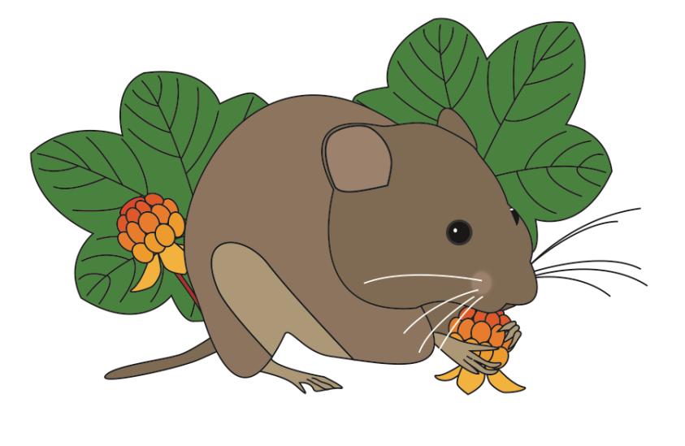
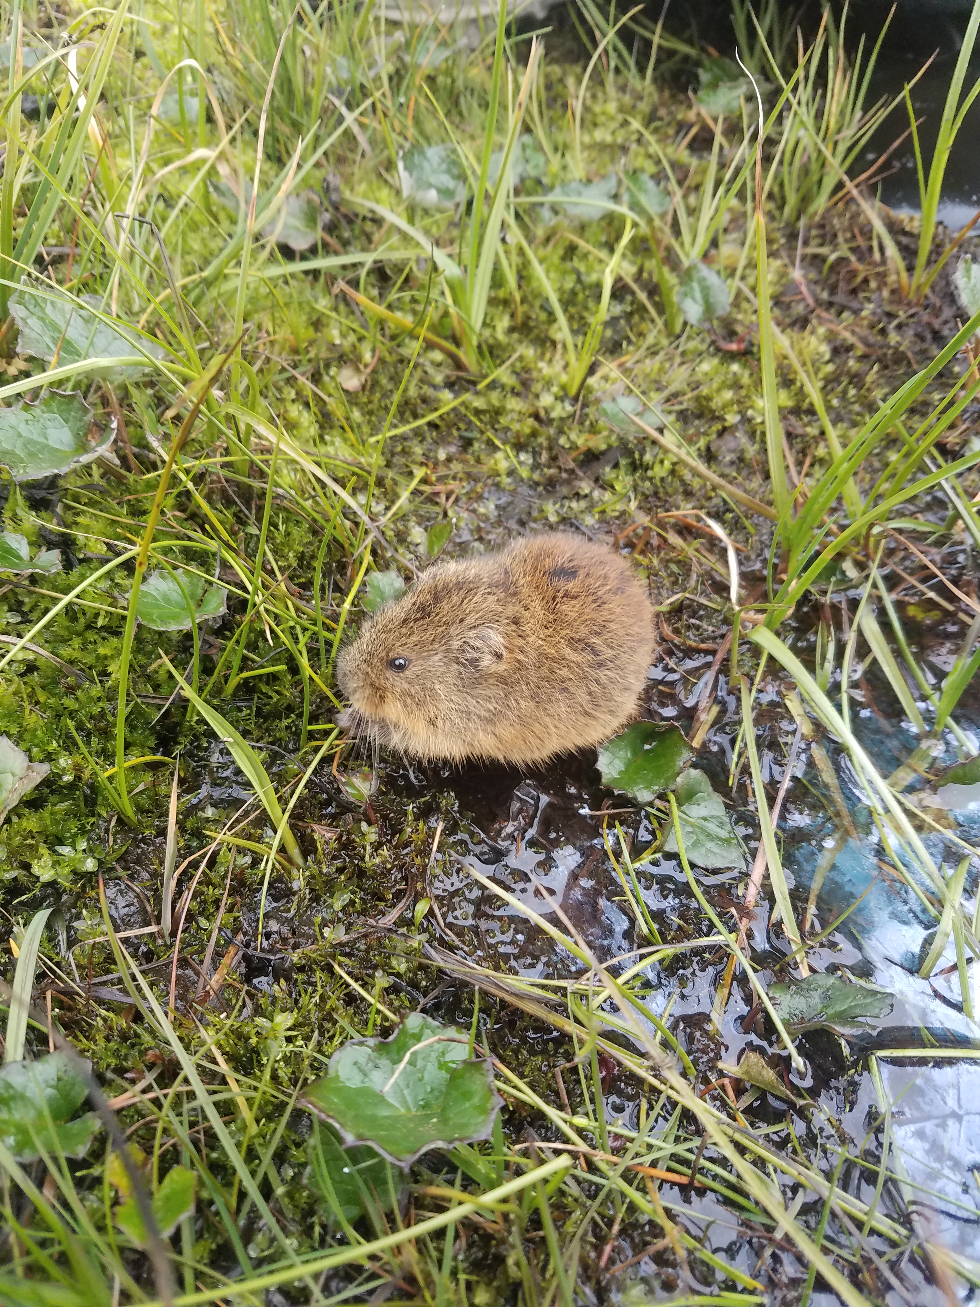
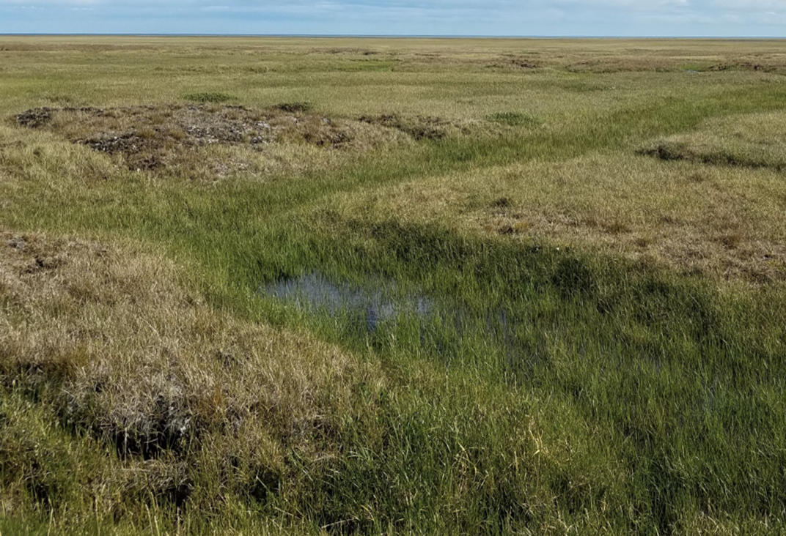
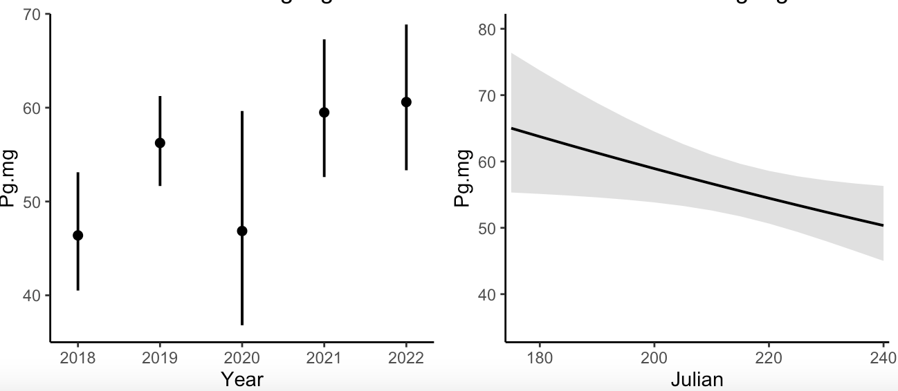
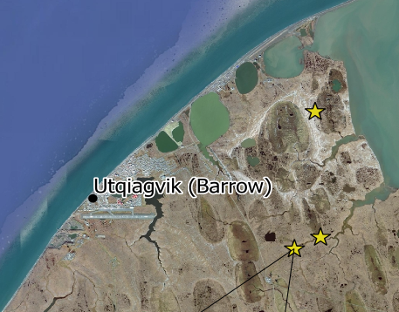
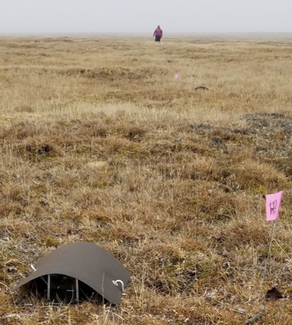
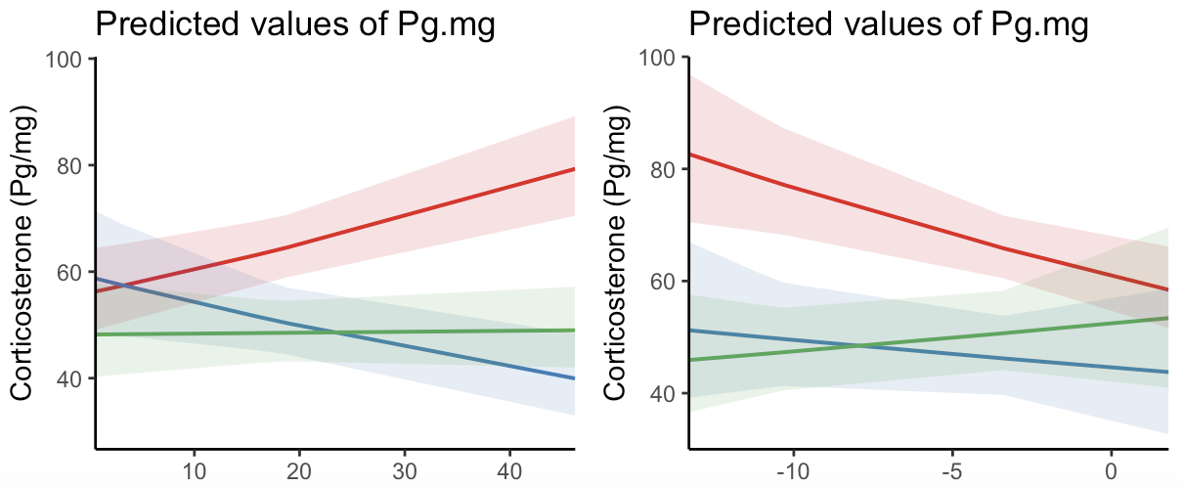
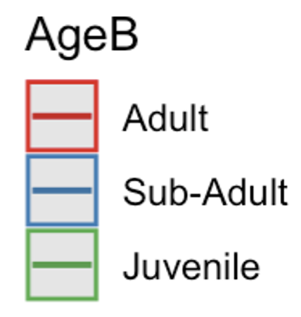
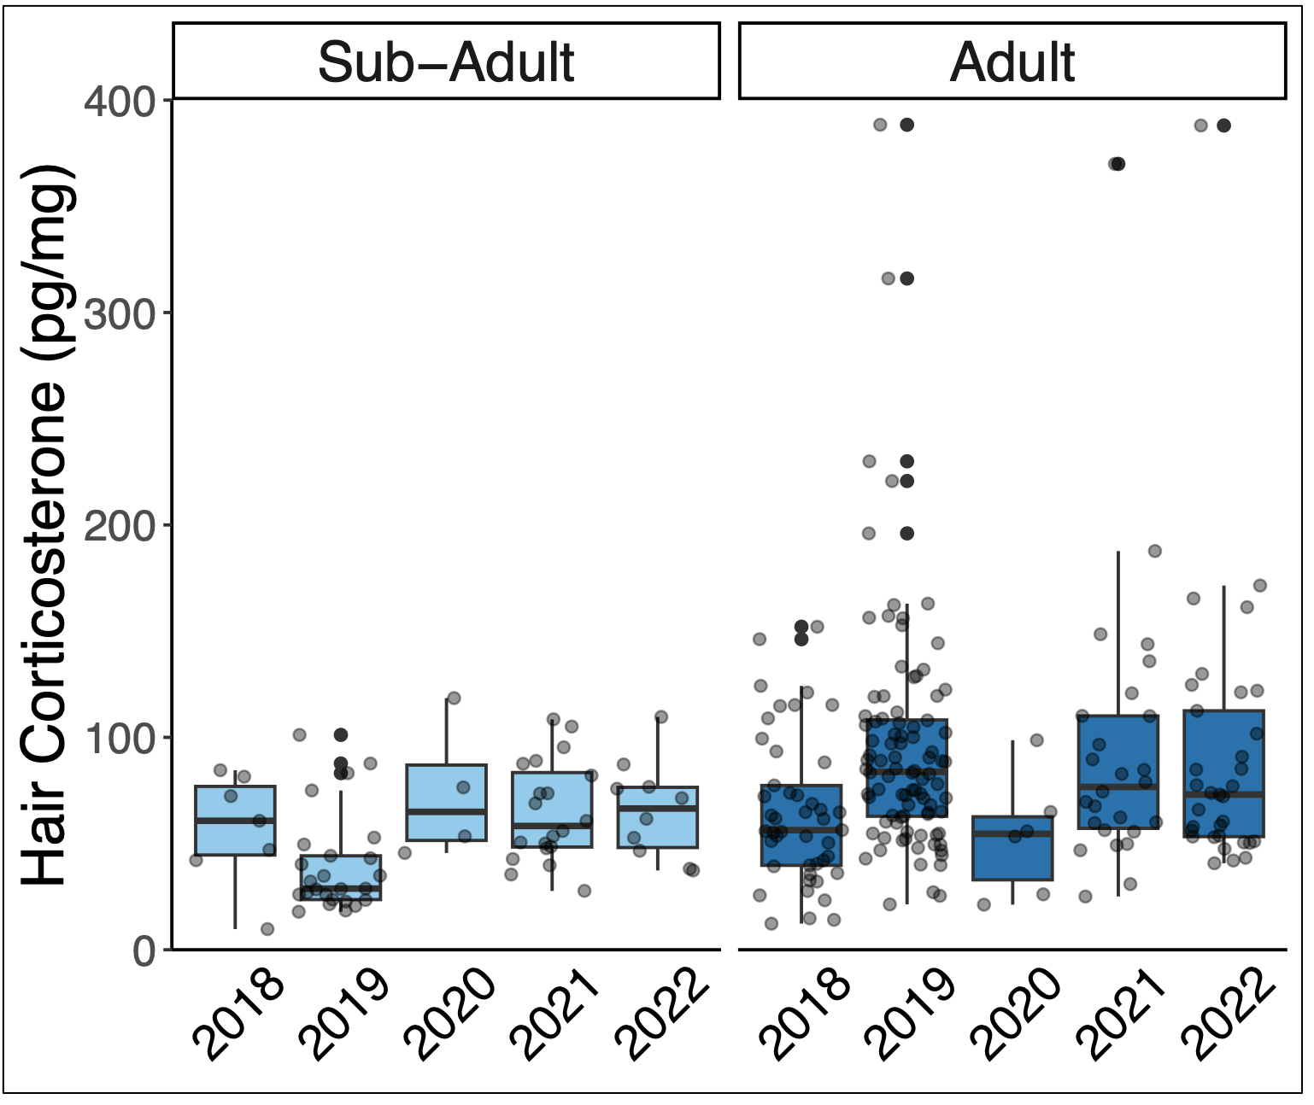
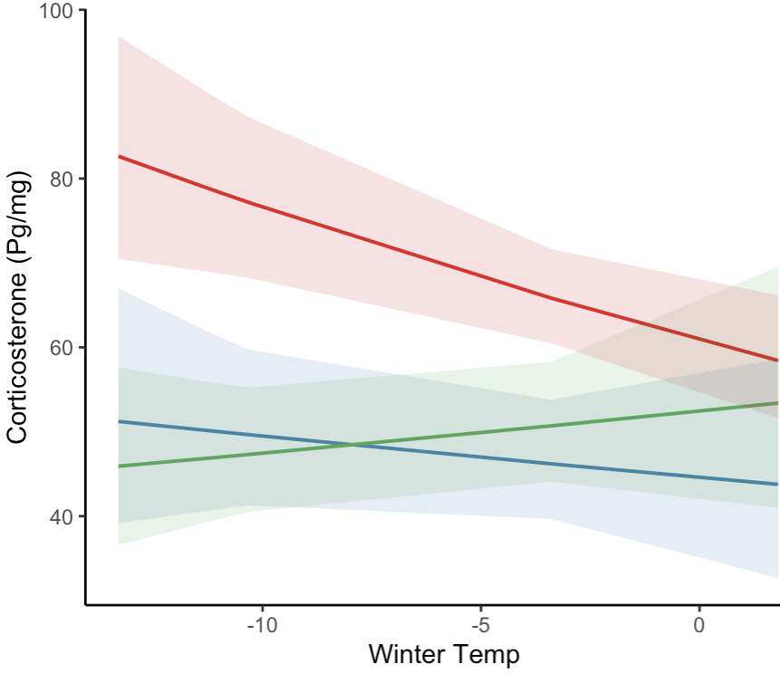
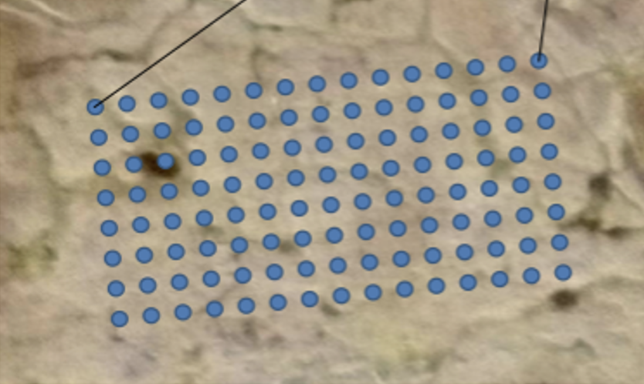
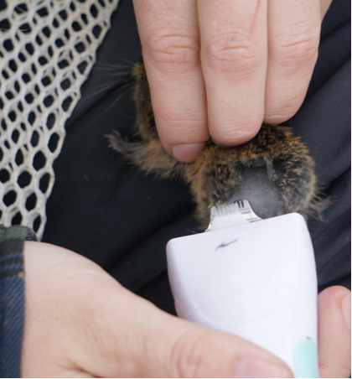
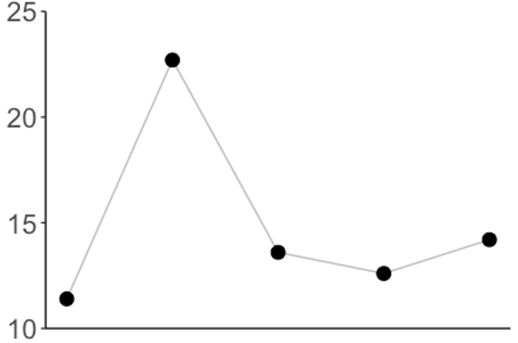
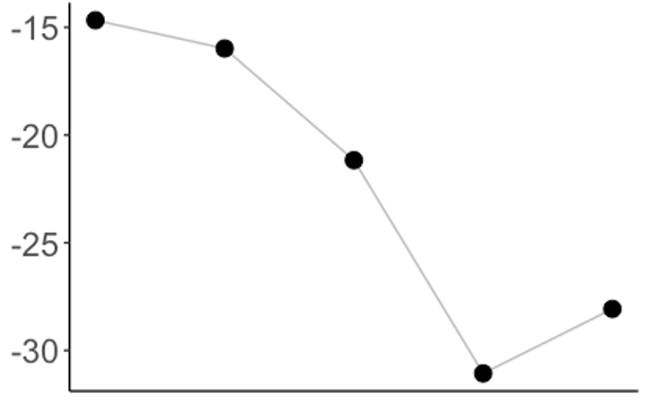
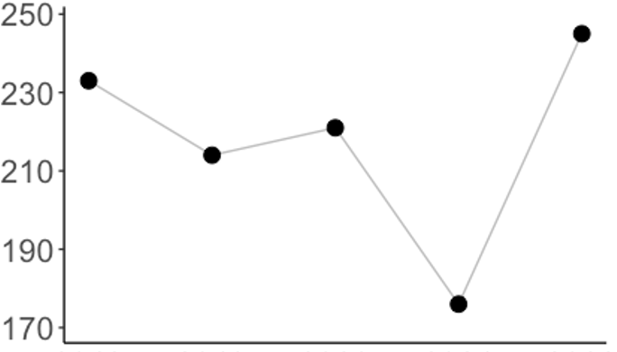
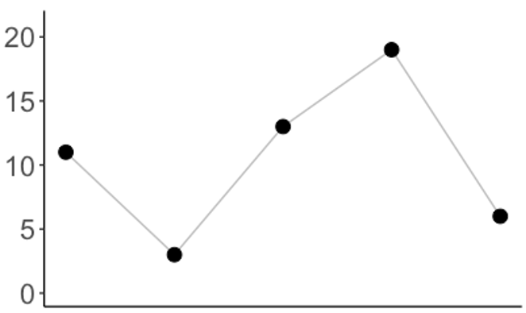
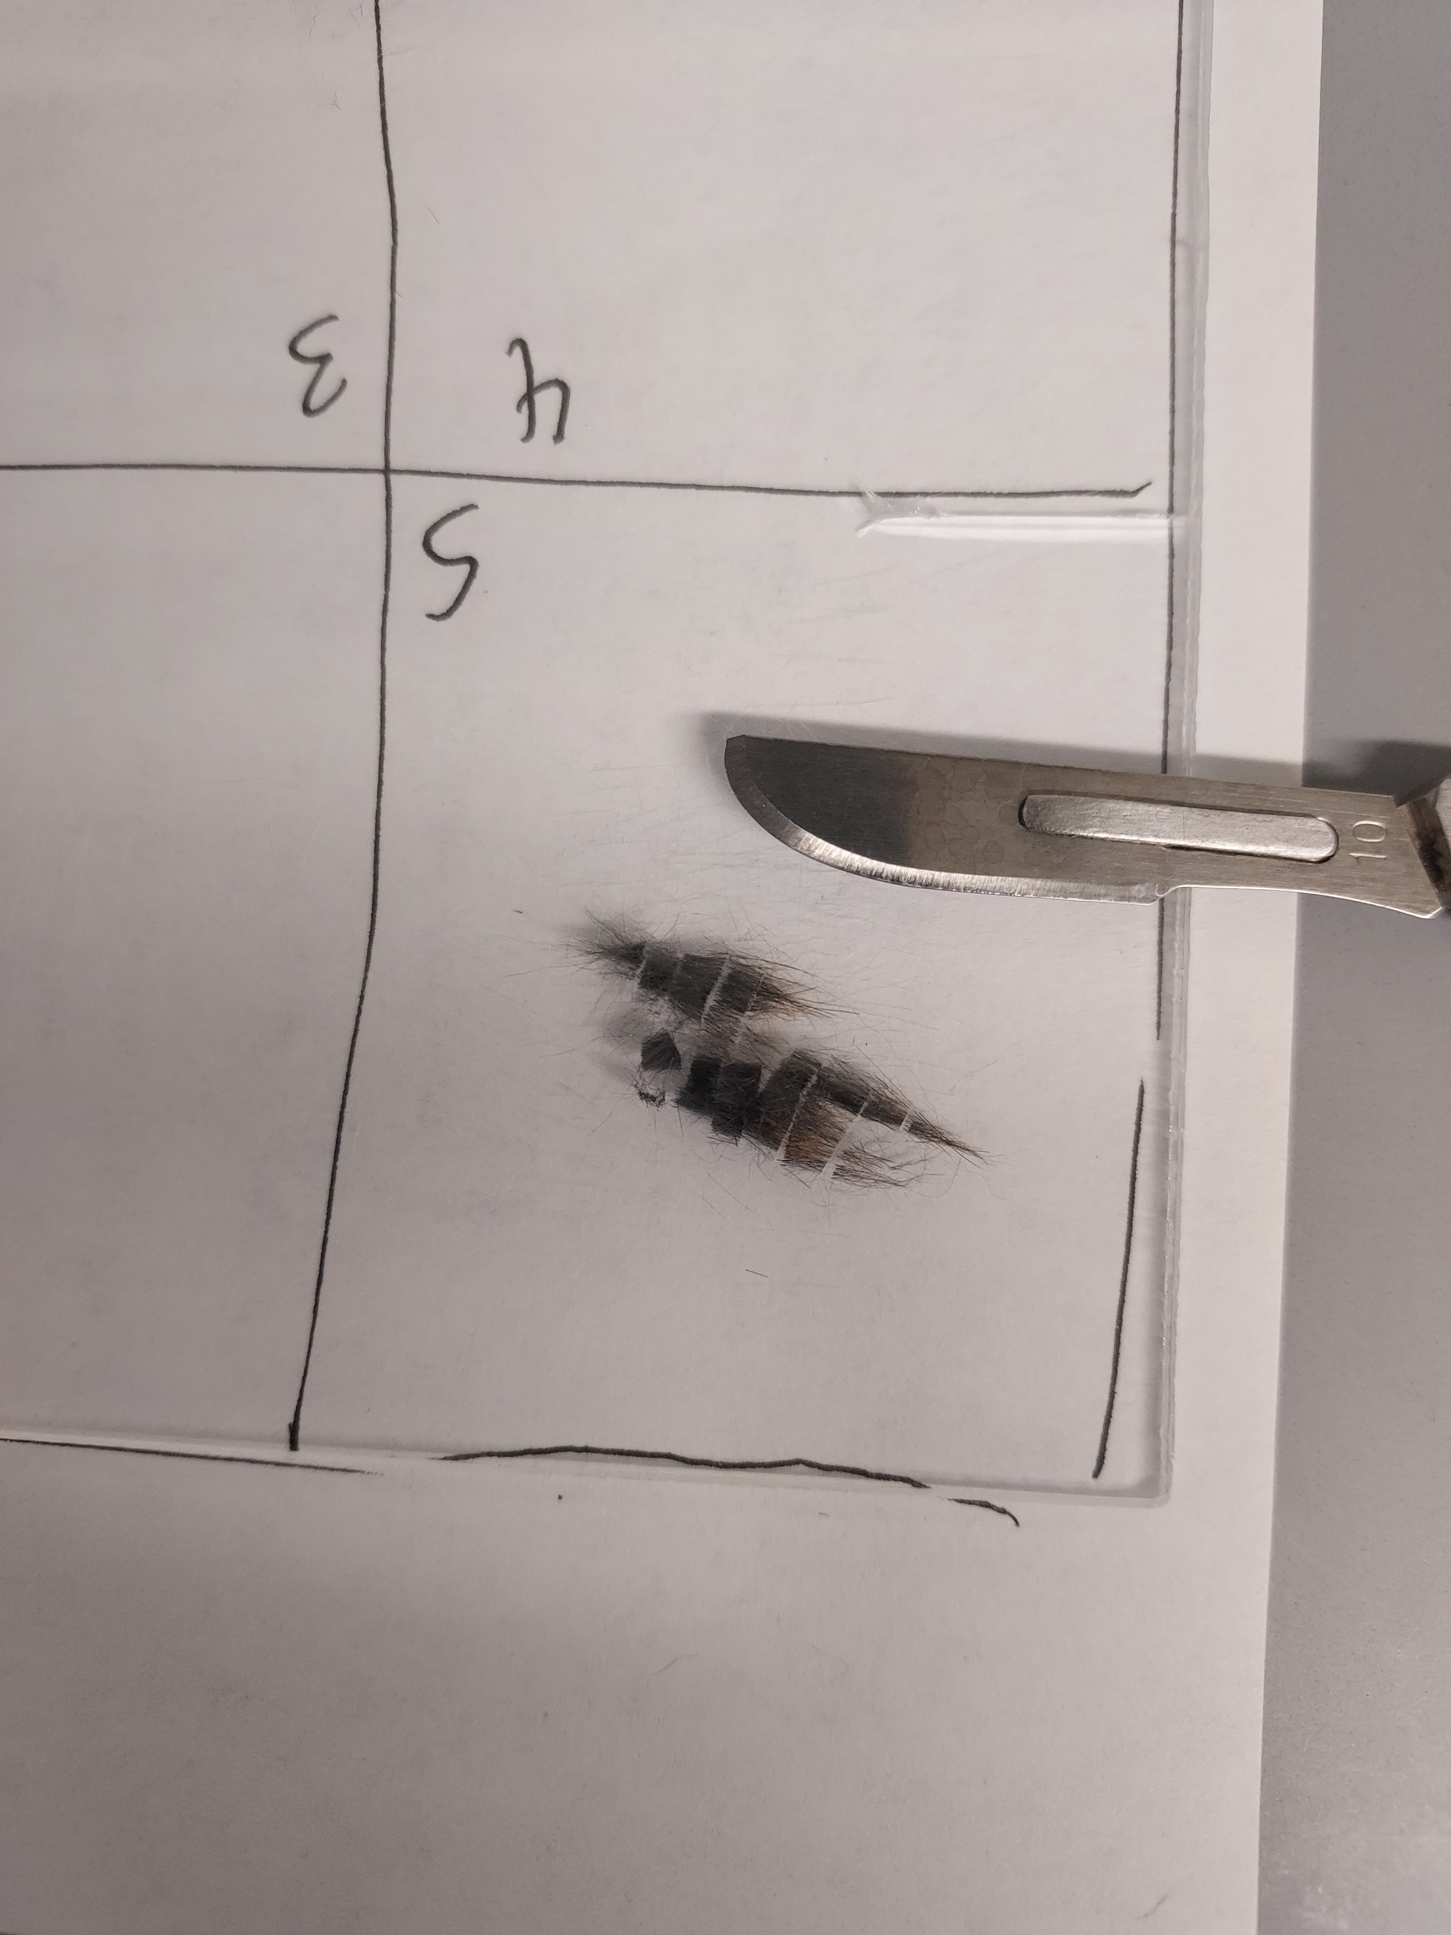
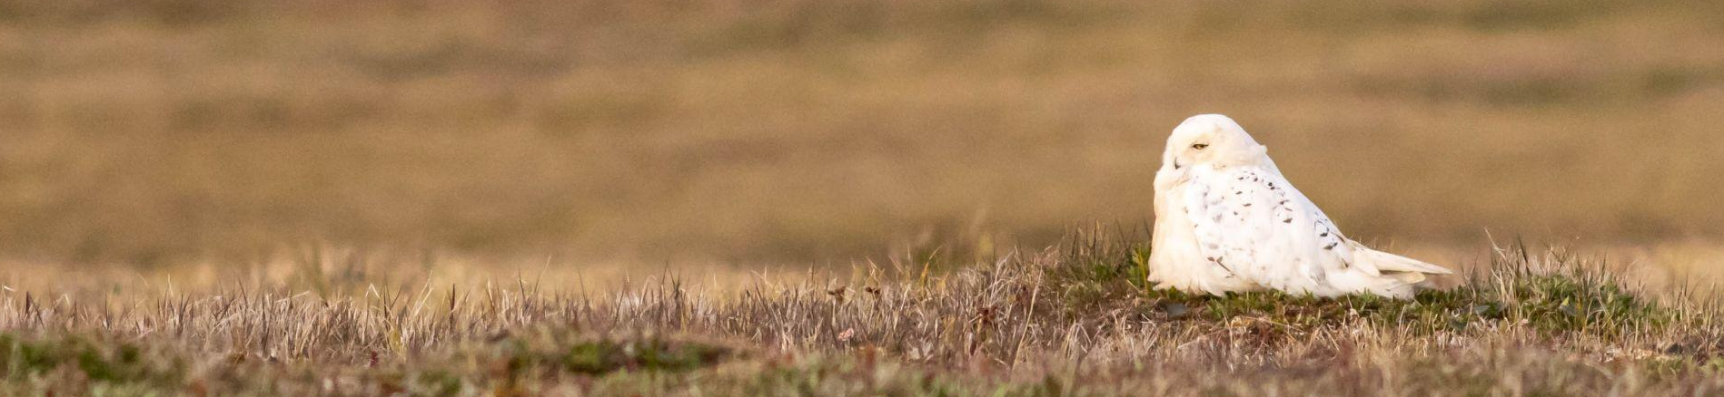
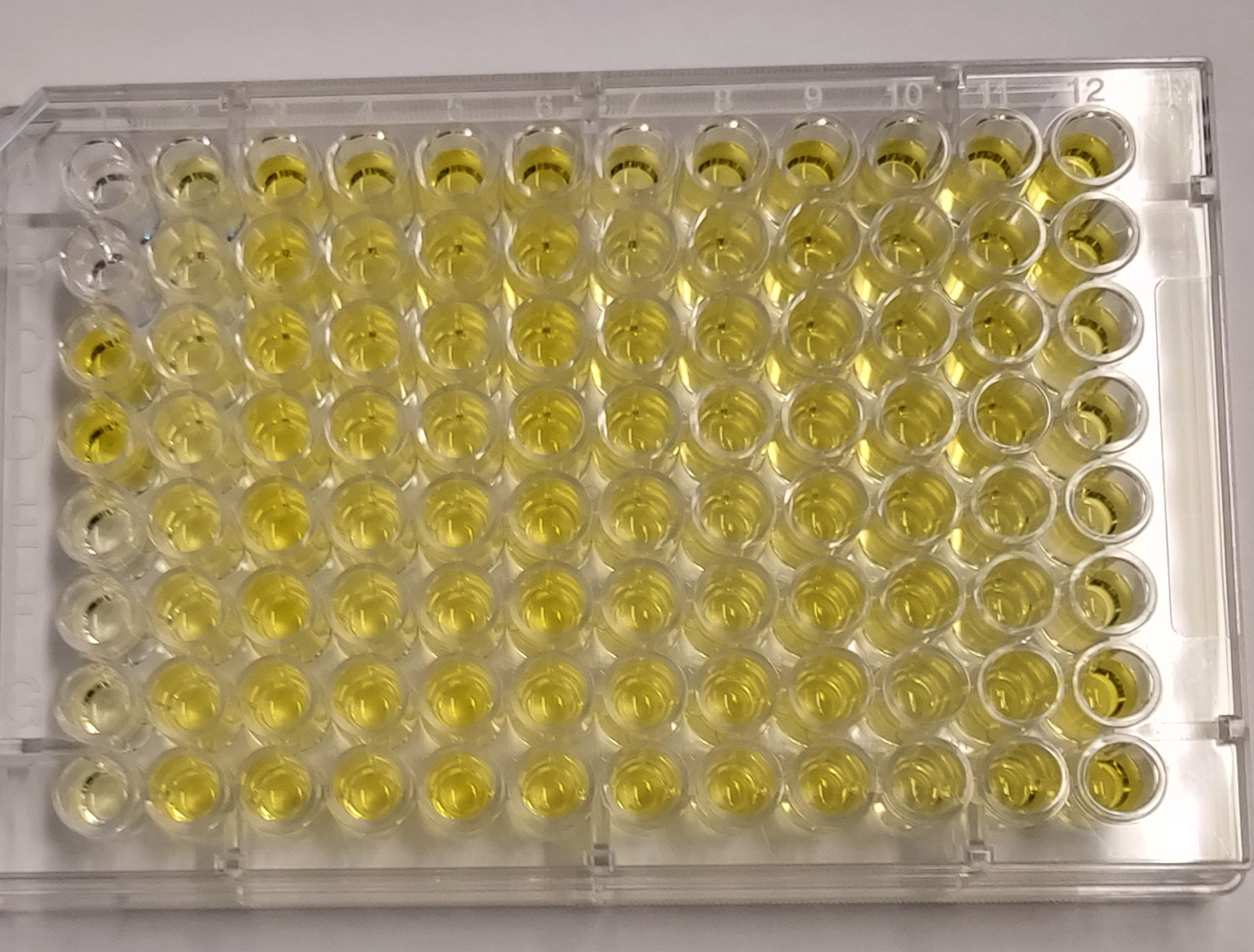
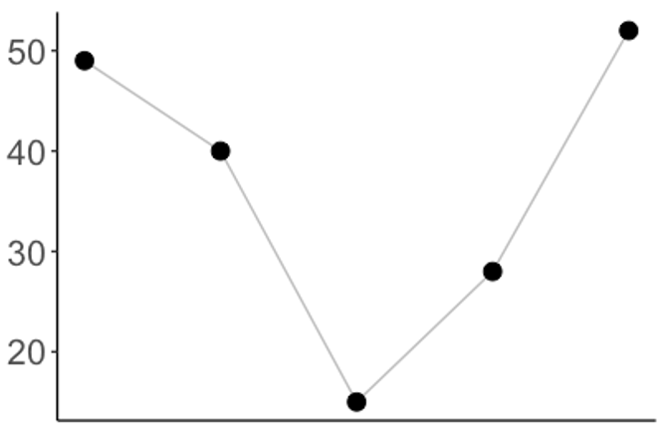
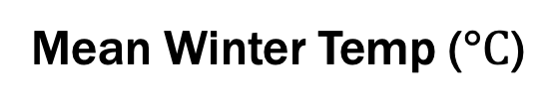
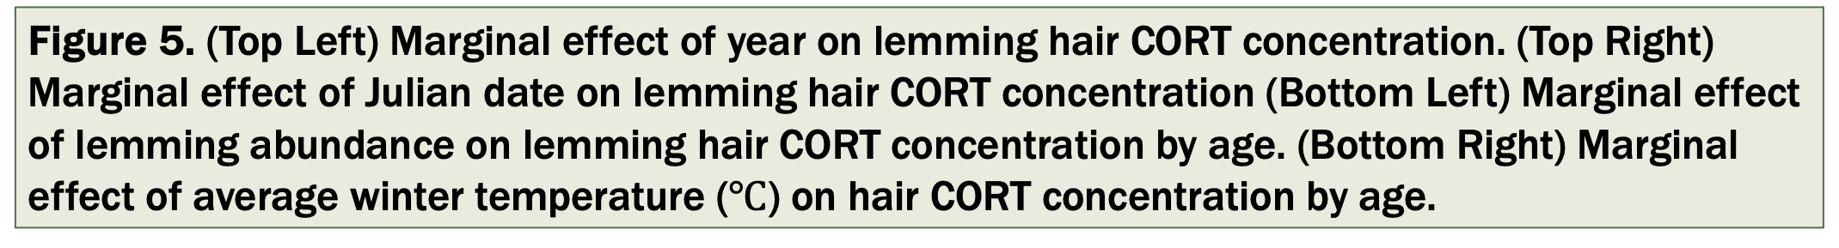
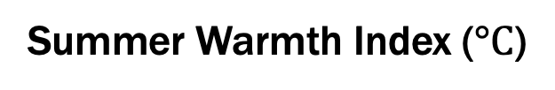
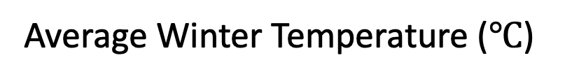
Intrinsic and extrinsic drivers of brown lemming
stress hormone levels in Utqiaġvik, Alaska
Jess Steketee¹, Michael Sheriff², Thomas Foxall³ and Rebecca J. Rowe¹
1. Natural Resources and the Environment, University of New Hampshire 2. Biology, University of Massachusetts Dartmouth. 3. Biological Sciences, University of New Hampshire
  Introduction
  Arctic rodents exhibit dramatic 3–5 year cyclic fluctuations in density.
  The relative drivers of these fluctuations remain unclear with multiple proposed drivers, both extrinsic (food quality and quantity, predation, and weather) and intrinsic (behavior, genetics and stress response).
  Our research examines corticosterone levels as an intrinsic driver of population cycles. Chronic stress can impact fitness and dampen population growth resulting in multiple low years after each peak.
  Using brown lemming hair samples collected over 5 years, we ask:
  How do biological factors (age, sex, reproductive status) influence lemming stress hormone levels?
  Do lemming stress hormone levels reflect population phase, abundance or
  environmental conditions?
Results – Phase, Abundance & Environmental variables
Hair CORT levels were lower in the decline phase & did not appear to be linked to population phase
Julian date had a weak but significant negative effect on hair CORT (p = 0.03)
Abundance and Summer Warmth Index were highly correlated; both increased hair CORT levels (p=0.001)
Winter temperature was negatively associated with hair CORT (p = 0.02)
No effect of predator index or snow variables on hair CORT concentration
p = 0.06
p = 0.03
Figure 2: (Left) Brown lemming (Lemmus trimucronatus) in Utqiaġvik AK. (Right) High centered polygonal tundra characteristic of the coastal plain.
p = 0.09
Results –Effects of Age, Sex & Reproductive Status on Hair CORT
Brown lemming abundance varied substantially over 5 years, suggesting a full population cycle occurred. Seasonally, abundance increased from early to late summer.
  Intrinsic Effects
Hair CORT was greater in females than males (p=0.001)
Hair CORT increased with age (p<0.001)
Reproductive status increased hair CORT of breeding males (p = 0.003) but not of females
Corticosterone (Pg/mg)
Corticosterone (Pg/mg)
Year
Julian Date
Use different colors; not orange/pink,
not green
Not blue (dark blue = okay)
Corticosterone (Pg/mg)
Corticosterone (Pg/mg)
Peak?
Peak
Peak?
Average Landscape Abundance
Average Winter Temperature ($℃$)
Figure 1. (Left) Map of three mark-recapture grids with 120 traps ea. in Utqiaġvik (formerly Barrow), Alaska. (Right) Photo of trapping grid; Sherman trap under tar paper roof for cover.
Figure 5. (Top Left) Marginal effect of year on lemming hair CORT concentration. (Top Right) Marginal effect of Julian date on lemming hair CORT concentration (Bottom Left) Marginal effect of lemming abundance on lemming hair CORT concentration by age. (Bottom Right) Marginal effect of average winter temperature ($℃$) on hair CORT concentration by age.
  Methods
  Mark-Recapture Surveys
  3 grids surveyed late June (at snowmelt) and late August 2018 – 2022
  Estimated abundance with zero-augmented Bayesian closed population models
  Collaboration with the Owl Research Institute
  Annual Snowy Owl counts (as a predator index)
  Provided additional hair samples from long term study
  Weather Data
  NOAA weather station & NEON snow camera data to characterize environmental conditions
  Examined correlations & reduced variables
  Corticosterone Analysis
  Washed, cut & extracted 3.5 mg hair over 24 hrs, dried & stored at -80 before reconstituting in buffer
  Arbor Assays corticosterone enzyme immunoassay kits
  Statistical Analyses
  Mixed effects models, multiple linear regression models, and Tukey post hoc tests
Figure 3. (Left) Brown lemming abundance from 2018-2022, in early and late summer with 95% credible intervals. (Right) Brown lemming hair corticosterone concentration in adults and sub-adults 2018-2022. Boxplots represent median, 25th-75th interquartile range and whiskers are 1.5*IQR.
Summer Warmth Index ($°C$)
Mean Winter Temp ($°C$)
Duration of Snow Cover
Autumn Harshness Index
Conclusions
Multiple factors influence lemming lemming stress hormone levels (e.g., season, age, sex, reproductive status). Despite the positive influence of lemming abundance on hair corticosterone levels, our results suggest that changes in stress hormone levels may not be an intrinsic driver of lemming population cycles.
Next Steps
Examine hair corticosterone levels across multiple historical population cycles
Challenges
Limited sample size during crash phase & only 1 population cycle examined
Snowy owl abundance may not be representative of total predator pressure
2018 2019 2020 2021 2022
2018 2019 2020 2021 2022
2018 2019 2020 2021 2022
2018 2019 2020 2021 2022
Figure 4. Extrinsic variables: Top: (Left) Annual sum of monthly air temperatures above 0°C . (Middle Left) Average winter (Dec-Feb) air temperature. (Middle Right) Number of days snow depth > 30 cm. (Right) Days air temperature reached (6°C ) prior to subnivean formation. Bottom: Abundance of snowy owls by year from ORI.
Snowy Owl Abundance
Acknowledgements
This work is funded by NSF Polar Programs, Arctic System Science (1603777), a Grant-in-Aid from the American Society of Mammalogists, and the UNH NRESS Program. Many thanks to numerous field technicians and Team Vole collaborators, Ukpeaġvik Iñupiat Corporation, Battelle Arctic Research Operations, Owl Research Institute (ORI) and the Museum of Vertebrate Zoology.
2018 2019 2020 2021 2022
Earl Johnson

