Slide 1
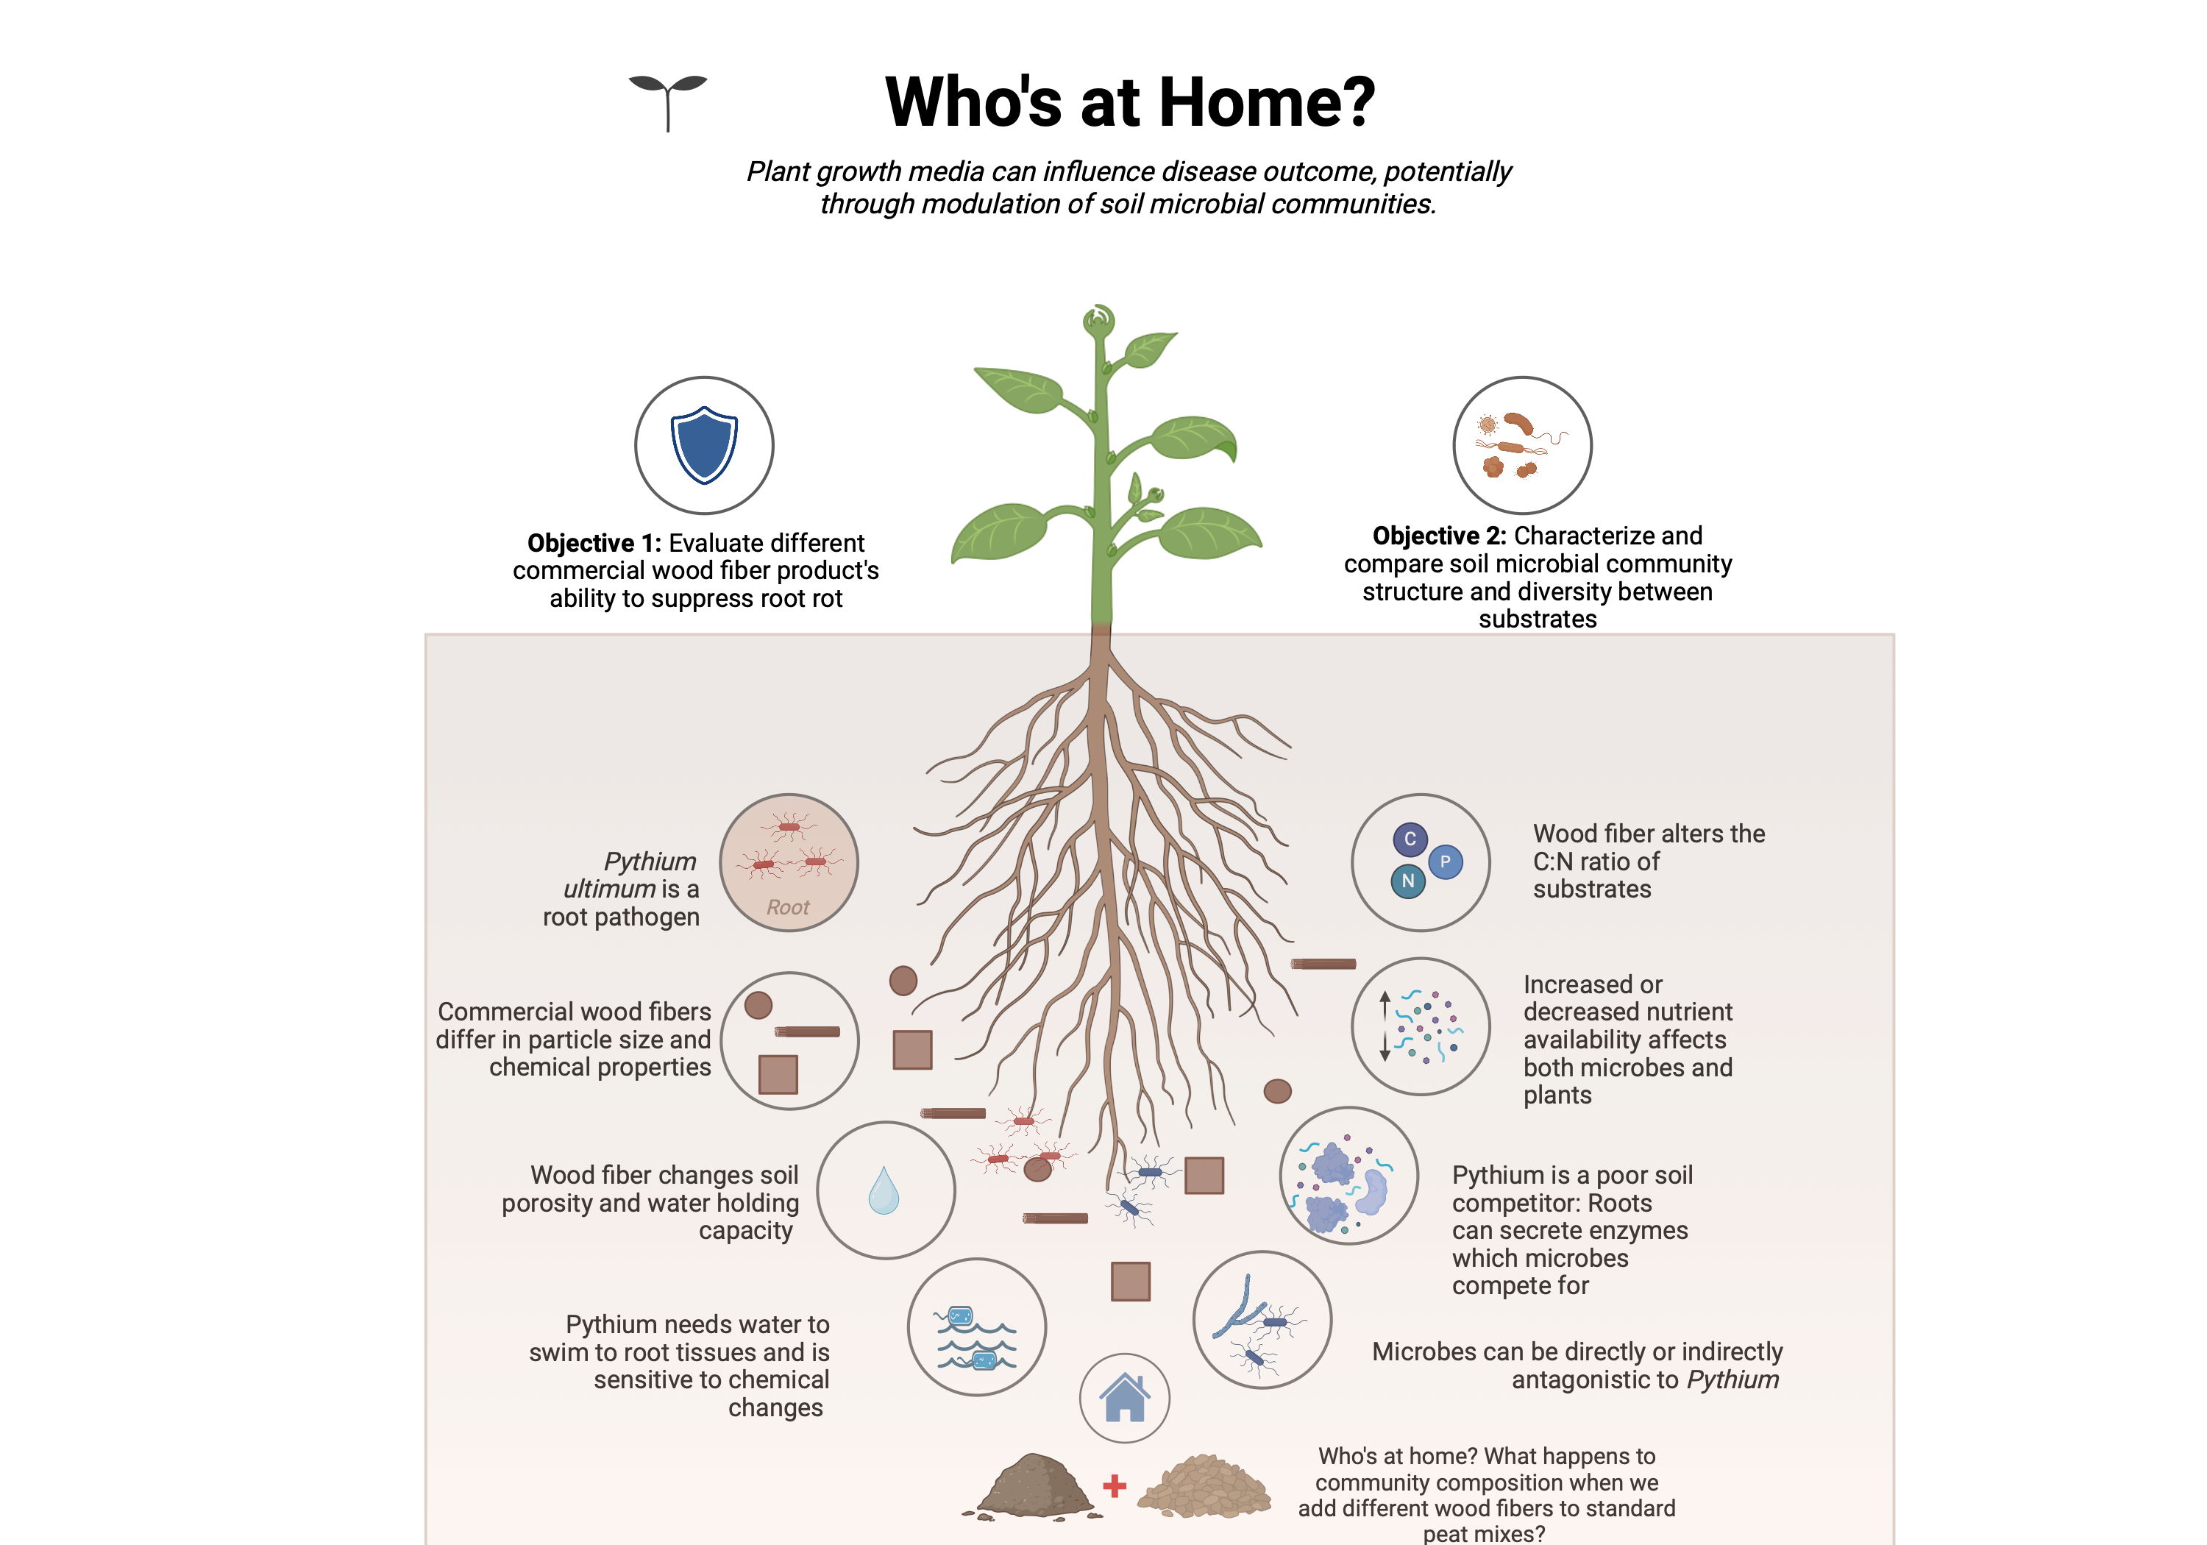
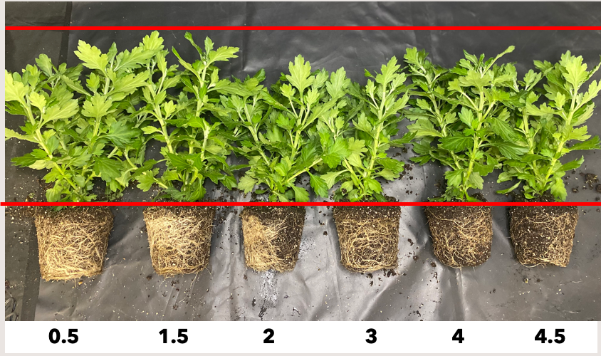
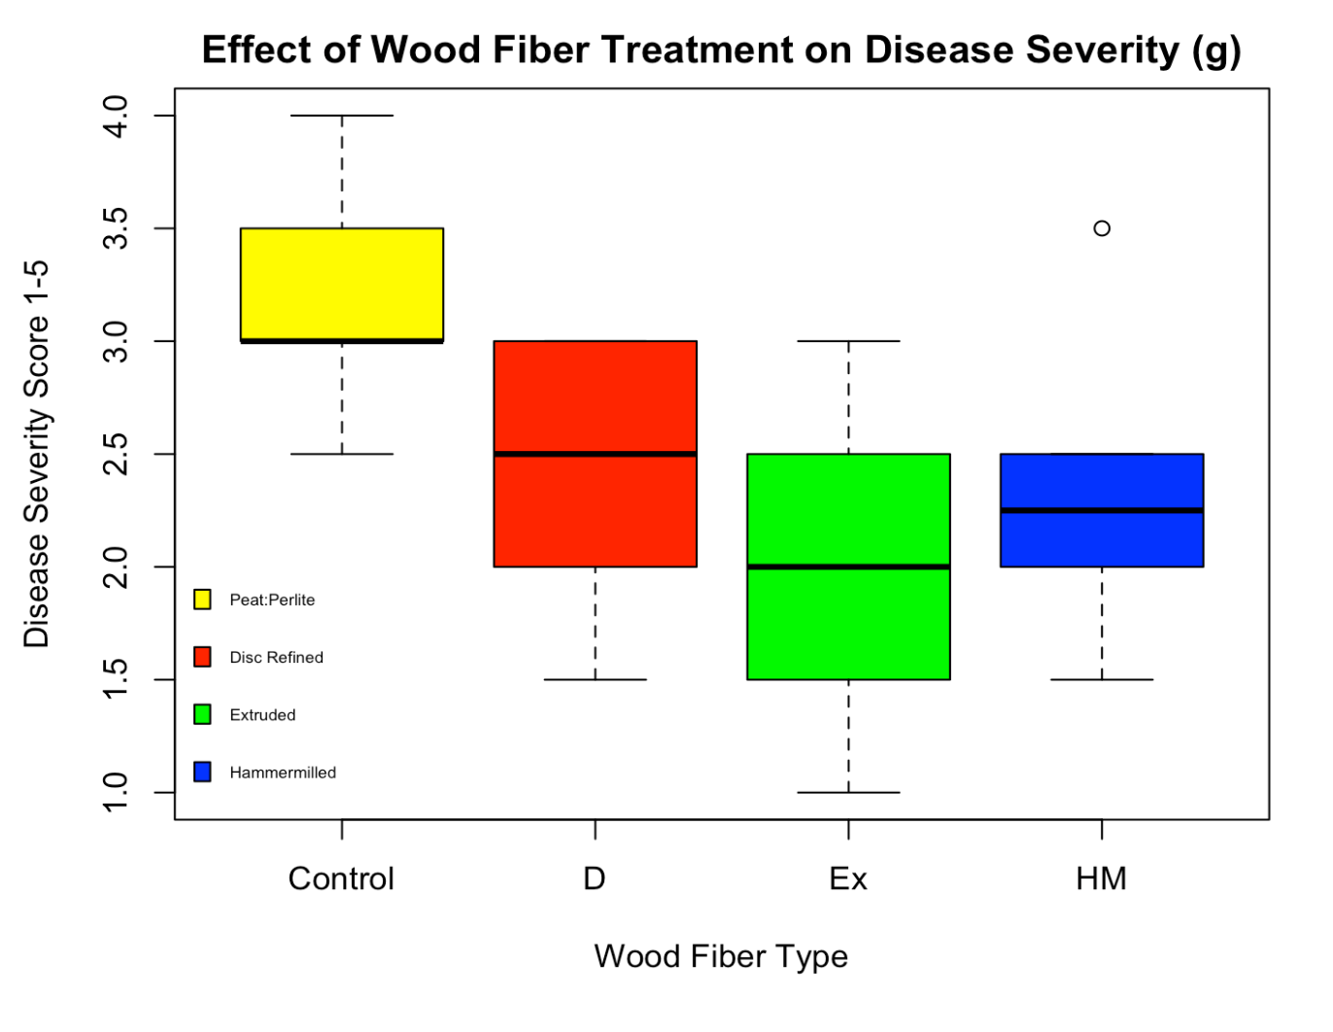
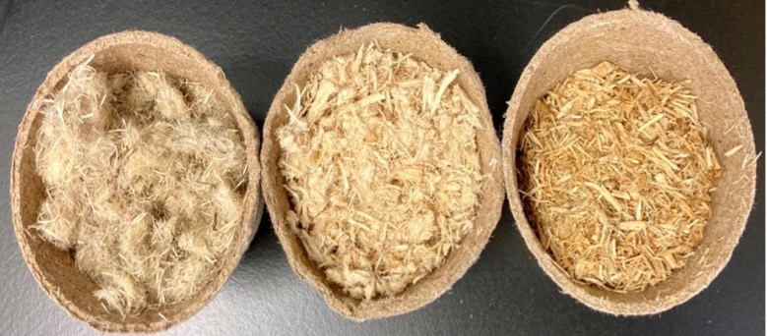
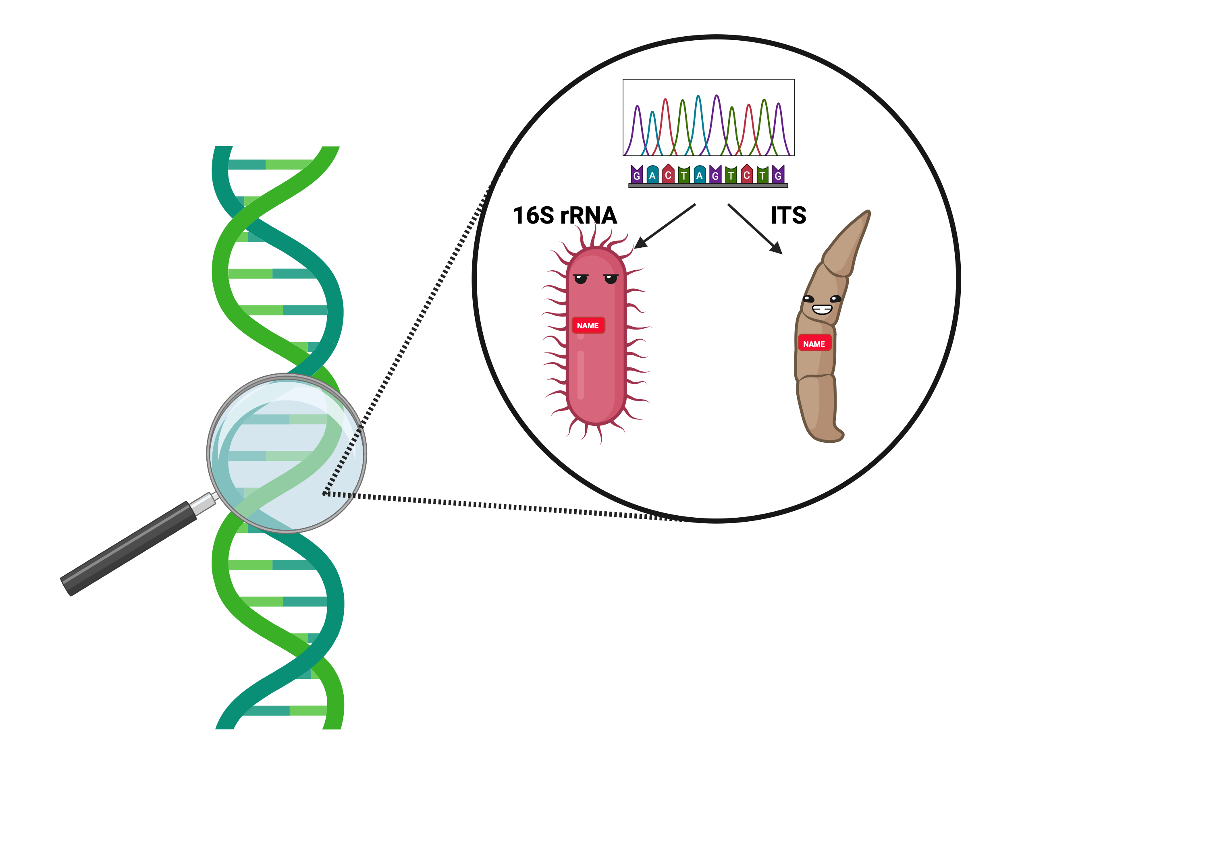
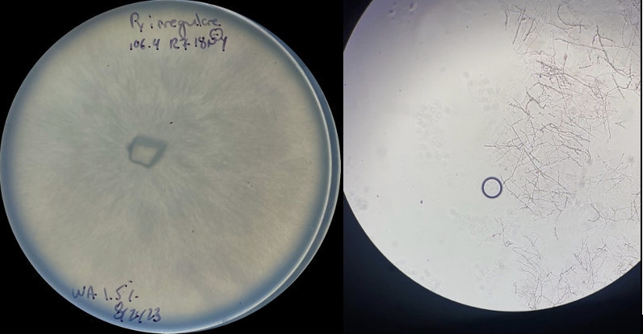
THE ROLE OF THE MICROBIOME IN THE NATURAL SUPPRESSION OF PYTHIUM-ROOT ROT IN WOOD-FIBER SUBSTRATES
Isabella Borrero, University of New Hampshire
Masters in Agricultural Sciences
Hypothesis:
Plants grown in amended substrates will have less severe root rot
WF amendments change the microbial composition of the rhizosphere, helping to suppress disease
Methods
Background
X 4 blocks X 3 replicates
Most greenhouse growers produce plants using soilless substrates.
Wood Fiber is On The Rise
Shortages in peat
Increased interest in wood fiber
Plants grown in WF substrates had less disease when inoculated with Rhizoctonia Solani
Disease Rating Scale
Preliminary Results
D Ex HM
Pythium Ultimum: The Universal Killer
Casual pathogen of root rot
Wide host range
Limited management strategies
Up Next
Acknowledgements
Community composition analysis via amplicon sequencing; 16S for bacteria and ITS for fungi
MacFarland Research Greenhouse; Committee Members: Dr. Anissa Poleatewich, Dr. Anna O’Brien, Dr. Brian Jackson, Dr. Maria Carlota Dao ; O’Brien Lab Members; Poleatewich Lab Members; Funding Sources: NHAES Hatch Project

