Slide 1
A Lack of Belongingness on an Outdoor Orientation Program
Dr. Brent Bell, Trevor Guilmette & Katriana Kivari
University of New Hampshire
Jorich Horner Kalamazoo College
Notes:
Brent

Slide 2
Literature review
Baumiester & Leary (1995) a sense of belongingness is a core motivation
Friendships (humans have a need for affectively pleasing and temporally stable relationships). Friendships are personally supportive communities (Takasaki, 2017)
When humans do not develop a sense of belonging the evidence shows negative impacts including diminished cognition, loneliness, depression, poor health outcomes, and a major decrease in happiness (Baumiester & Leary, 1995)
Development of belongingness (new friendships) is vitally important in transition (Weiss, 1971)
Notes:
Brent Lit Review

Slide 3

Our Study
Outdoor Orientation Programs are small, peer led outdoor adventure programs meant to create a social support among transition students.
The Outdoor Orientation Benchmarking Survey (TOOBS).
A small group of >1% each year remark that they did not have a sense of belongingness
Notes:
Katie

Slide 4
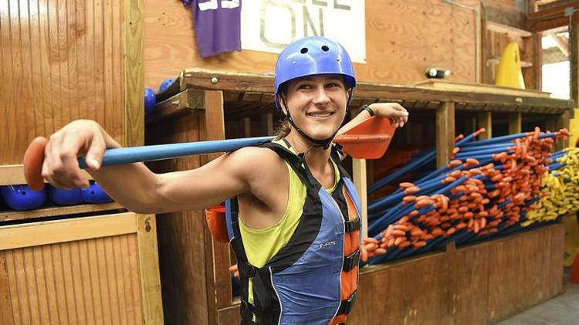
Methods
Participants from TOOBS
Interviews of participants reporting low belongingness
Utilized a General Qualitative Method
Transcribed interviews, created codes
Weekly data discussions
Explored theories and tested them to with returns to the data.
Made a PowerPoint for CEO
Notes:
Trevor

Slide 5
Models of Not Belonging
1. Generalized vs. Isolated Sense of Not Belonging (Clegg, 2006)
2. Are violations Bridgeable or Unbridgeable Belongingness (Aanstoos, 1987)
Varying degrees of ambivalence
Consistent, generalized lack of SOB internalized by the individual.
Isolated, short-term lack of belongingness
I am left out and I want to be included
I am left out and I don’t care
Notes:
Brent

Slide 6
Combining Clegg (2006) and Aanstoos (1987)
 | Bridgeable (Aanstoos, 1987) | Unbridgeable (Aanstoos, 1987)
Isolated (Clegg, 2006) | A lack of a sense of belonging is a rare occurrence. Open to joining group in the future. | A lack of a sense of belonging is a rare occurrence. Closed to joining or interacting with the group in the future
Generalized (Clegg, 2006) | A lack of a sense of belonging is a common occurrence. Open to joining group in the future | A lack of a sense of belonging is a common occurrence. Closed to joining or interacting with the group in the future
Notes:
Trevor

Slide 7
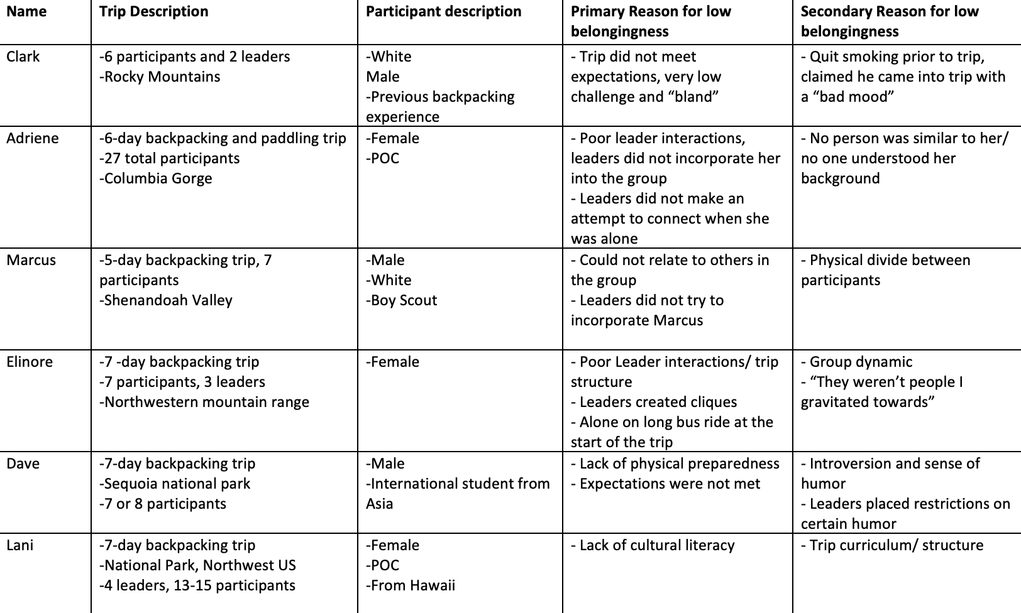
Results
Notes:
Katriana ---CLARK, Trevor Elinore, BRENT –ADRIENE the RAFTER and LANI Hawaii

Slide 8
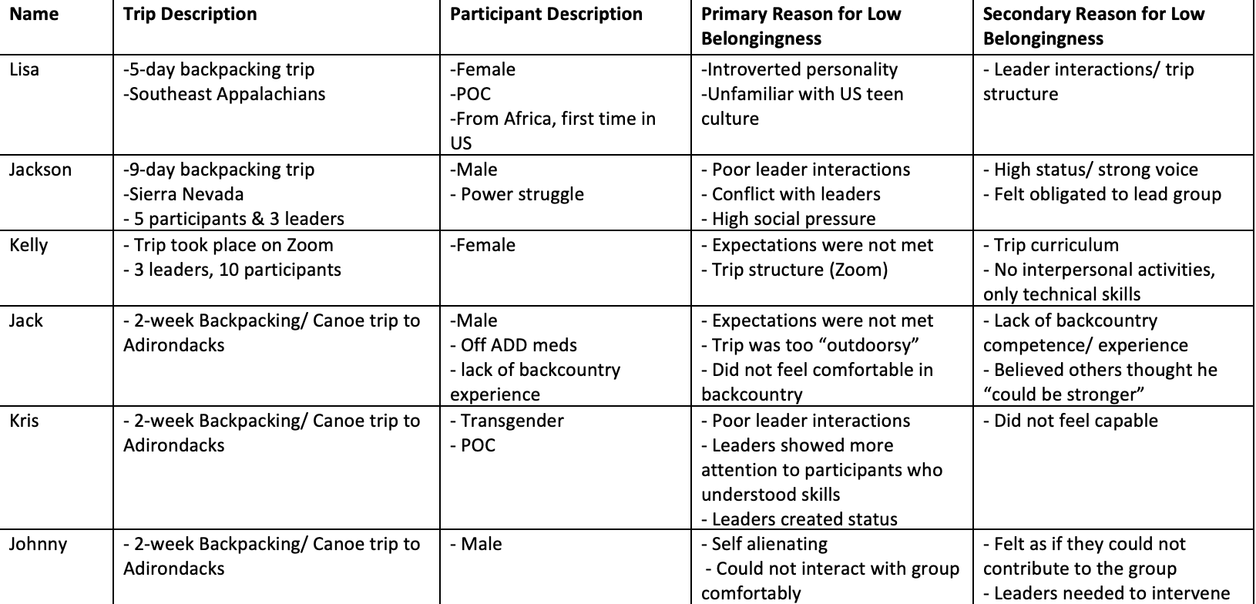
Results

Slide 9
Belongingness Assessment Model (BAM)
 | Bridgeable | Unbridgeable
Isolated | Adriene, Lani, Jackson Kelly, Kris | Elinore (Bus)
Generalized | Marcus, Johnny Lisa, Dave, Jack | Clark (smoker)
Notes:
Katriana and Trevor

Slide 10
What does this mean?
Most of the interviewees took a position that was bridgeable and isolated. A lack of belongingness to a group was rare and they hoped to create belongingness, even with a group that had not successfully included them.
It is likely that some Leader interventions would impact and may quickly resolve the lack of belongingness of bridgeable/isolated.
Some participants may be unable to develop a sense of belonging due to an impenetrable personality or a desire to hold grudges.
All participants are narrating some type of story to explain how this occurred. These stories have the potential to create false beliefs.
Notes:
All share one big pont

Slide 11
 | Bridgeable | Unbridgeable
Isolated | A lack of a sense of belonging is a rare occurrence. Open to joining the group in the future Potential Intervention: This is the most easily correctable lack of belongingness situation because the person wants to bridge the issues preventing belongingness and the person expects to belong. Activities that evaluate the group contract, build trust, allow for honest sharing are likely to help correct a lack of belongingness. | Lacking a sense of belonging is a rare occurrence, but the person is not open to joining or interacting with the group in the future. Potential Intervention: This person will likely interpret the experience as entering “the wrong group” or being stuck with “people not like me.” Potential interventions can focus on a need to understand other perspectives and using activities that help understanding differences.
Generalized | A generalized lack of belonging means this is a common occurrence and the person is open to joining the group. Potential Intervention: This is a person who is willing to belong, but for some reason does not have a history of belonging. The group will need to extend effort into building trust and understanding. A person with a generalized lack of belongingness may present with some off-putting behavior that may need to be discussed. | A lack of a sense of belonging is a common occurrence. Is not open to joining or interacting with the group in the future Potential Intervention: This person likely hopes for the trip to end and will invest energy in trying to belong somewhere else. Leader discussions with the participant could focus on what it would take to move from unbridgeable to a bridgeable position.

Slide 12
Questions
Contact: Brent.Bell@unh.edu
Thank you to the outdoor orientation programs who participate in The Outdoor Orientation Benchmarking Survey (TOOBS).

