Slide 1
Time Variant Particle Swarm Optimization (TVPSO) for Autonomous Extraterrestrial Rescue and Recovery
Authors: Kyle Sanders and May-Win Thein

Slide 2
Outline
Problem
Particle Swarm Optimization
Time Variant PSO
Simulation Framework
Simulation Results
Conclusion/Future Work

Slide 3
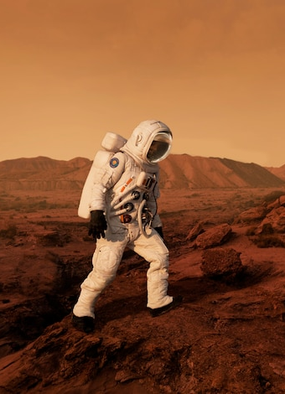
Problem
Lost source (i.e., hardware and personnel) on extraterrestrial surfaces
Personnel or resources
Stationary
Dynamic
Assumptions
Source
Within a bounded search area
Emits measurable signal
Search particle - Faster than dynamic source
Global communication between particles

Slide 4
Particle Swarm Optimization
Stochastic optimization technique
Swarm communication improves swarm knowledge
Distributed decentralized robotic assets
Distributed global communication

Slide 5
Particle Swarm Optimization
Initialize parameters
Local/Global Best Comparison
PSO Calculation
Sample signal function
Convergence
Iterate
$$v\left(k+1\right)=χv\left(k\right)+χc_{1}r_{1}\left(l_{best}−x(k)\right)+χc_{2}r_{2}\left(g_{best}−x(k)\right)$$
Inertial Component
Local Component
Global Component
$$x\left(k+1\right)=x\left(k\right)+v(k)$$

Slide 6
PSO Performance Weaknesses
Performance degradation with dynamic sources
Possible false positive results
Particle convergence to a static point (i.e., does not follow dynamic source)

Slide 7
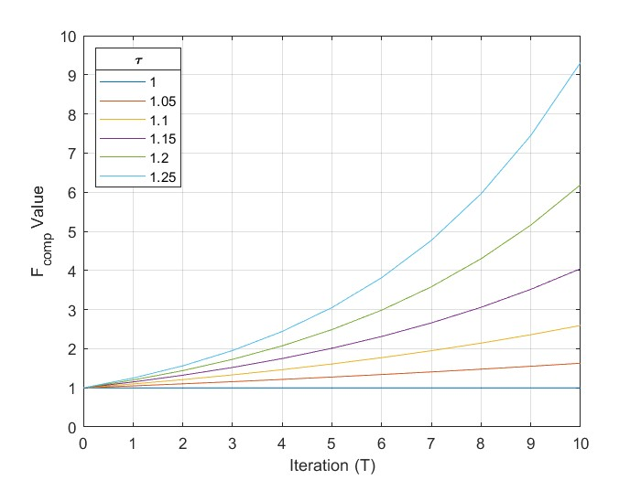
Time Variant PSO (TVPSO)
New information is more valuable than older information
Time constriction $τ$ acts as a weighting factor for “best” comparisons
Rate of “forgetting” controlled by $τ$

Slide 8
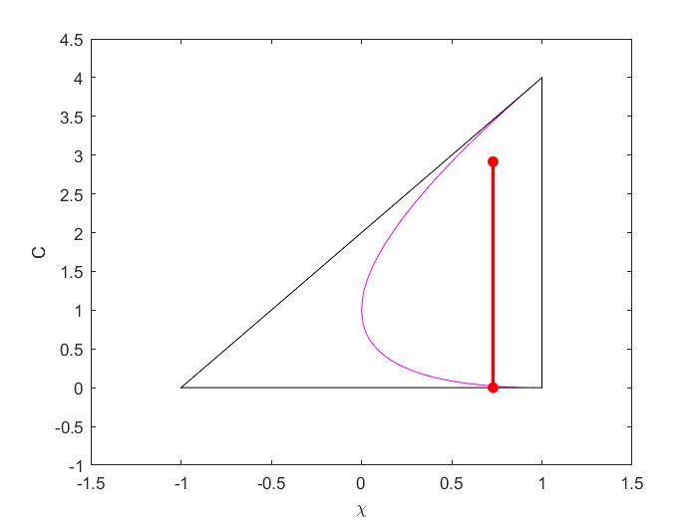
Time Variant PSO (TVPSO)
Eigenvalue Stability Zone
Eigenvalue stability shown for decoupled swarm dynamics
$$C=χc_{1}r_{1}+χc_{2}r_{2}$$

Slide 9
Time Variant PSO (TVPSO)
Classical PSO
Iteration | Sensor Reading | $$F_{best}$$
1 | 4 | 4
2 | 5 | 5
3 | 2 | 5
4 | 3 | 5
5 | 4 | 5
New Comparison Logic:
If the reading is more optimal than $F_{comp}$
$F_{comp}\left(T\right)=F_{best}(T)=F_{sensor}(T)$
If the reading is worse than $F_{comp}$
$F_{comp}\left(T\right)=F_{comp}\left(T−1\right)∗τ$
$F_{best}\left(T\right)=F_{best}(T−1)$
TVPSO
Iteration | Sensor Reading | $$F_{comp}$$ | $$F_{best}$$
1 | 4 | 4 | 4
2 | 5 | 5 | 5
3 | 2 | 4 | 5
4 | 3 | 3.2 | 5
5 | 4 | 4 | 4

Slide 10
TVPSO Sample Application

Slide 11
Simulation (Source Path)
Static
$$\begin{matrix}x=C_{x} \\ y=C_{y}\end{matrix}$$
Linear Motion
$$\begin{matrix}x=C_{x}t \\ y=C_{y}t\end{matrix}$$
Random Path
$$\begin{matrix}v(t+1)=v(t)+δ \\ δ∈N(μ=0,σ=0.5)\end{matrix}$$

Slide 12
Simulation (Source Signal)
Sphere
$$f\left(\vec{x}\right)=\sum_{i=1}^{d}{{\vec{x}}_{i}^{2}}$$
Best-case scenario
Rastrigin
$$f\left(\vec{x}\right)=10d+\sum_{i=1}^{d}{{\vec{x}}_{i}^{2}−10cos⁡(2π{\vec{x}}_{i})}$$
Gaussian
$$f\left(\vec{x}\right)=100\left[1−\exp\left(−\sum_{i=1}^{d}{\frac{{\vec{x}}_{i}^{2}}{2σ_{i}^{2}}}\right)\right]$$
Simulates signal decay with increased distance
Simulates local sensor noise

Slide 13
Simulation Results
Single particle convergence within $r_{conv}$
Multi-particle (i.e., ≥3) convergence within $r_{conv}$
Monte-Carlo: 10,000 runs per path-function pair
$r_{conv}=5m$
Search Space: $500m x 500m$
Notes:
Monte carlo simulation with 10,000 runs per scenario combination in a 500m x 500m search area and a 5m r_conv

Slide 14
Simulation Results
Search duration for successful multi-particle convergence
Monte-Carlo: 10,000 runs per path-function pair
$r_{conv}=5m$
Search Space: $500m x 500m$
Notes:
Slight increase in search duration

Slide 15
Conclusions
Advantages
Significant efficacy increase in cases considered
Challenges
Slight increase in search time
Simple implementation
Minimal logistic infrastructure (i.e., decentralized communication)
Bots are significantly faster than the source

Slide 16
Future Work
Implementation on experimental testbed
Leverage of traversal time for additional sensor engagement
Evaluation against wider array of source functions

Slide 17
Thank you!

