Slide 1

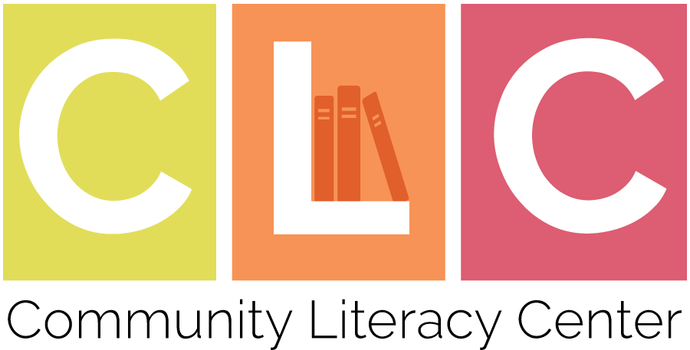
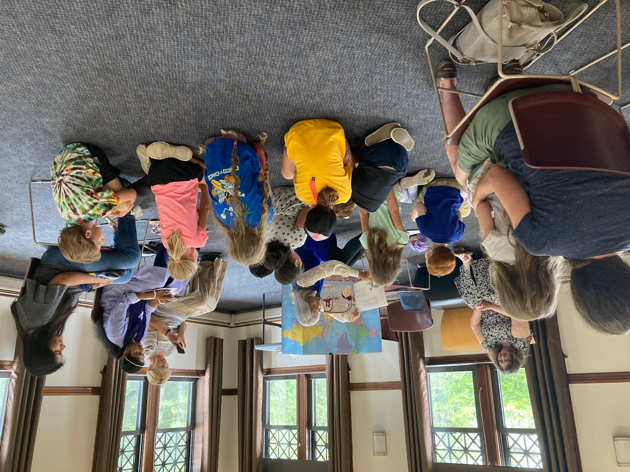
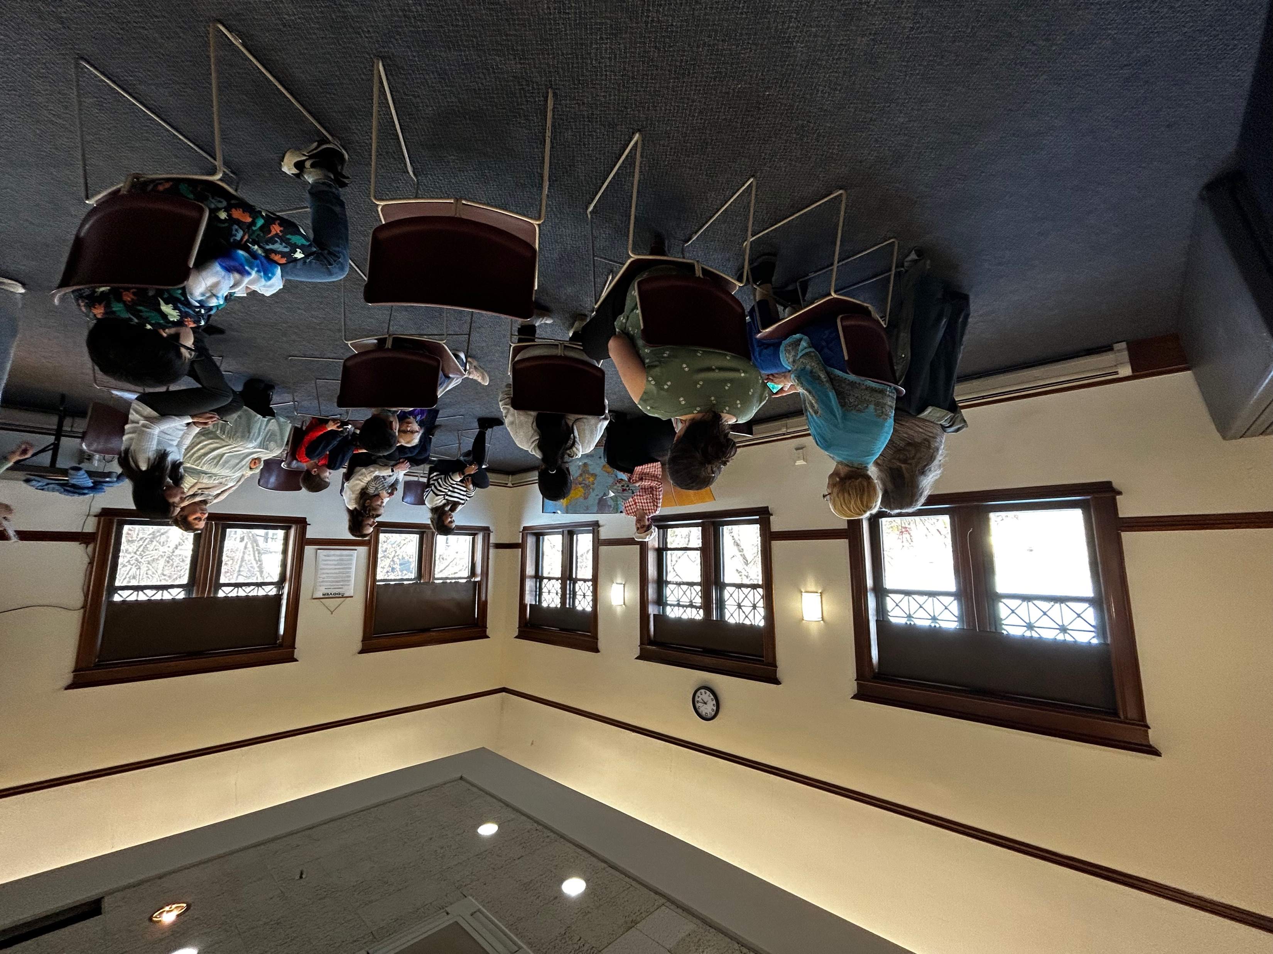
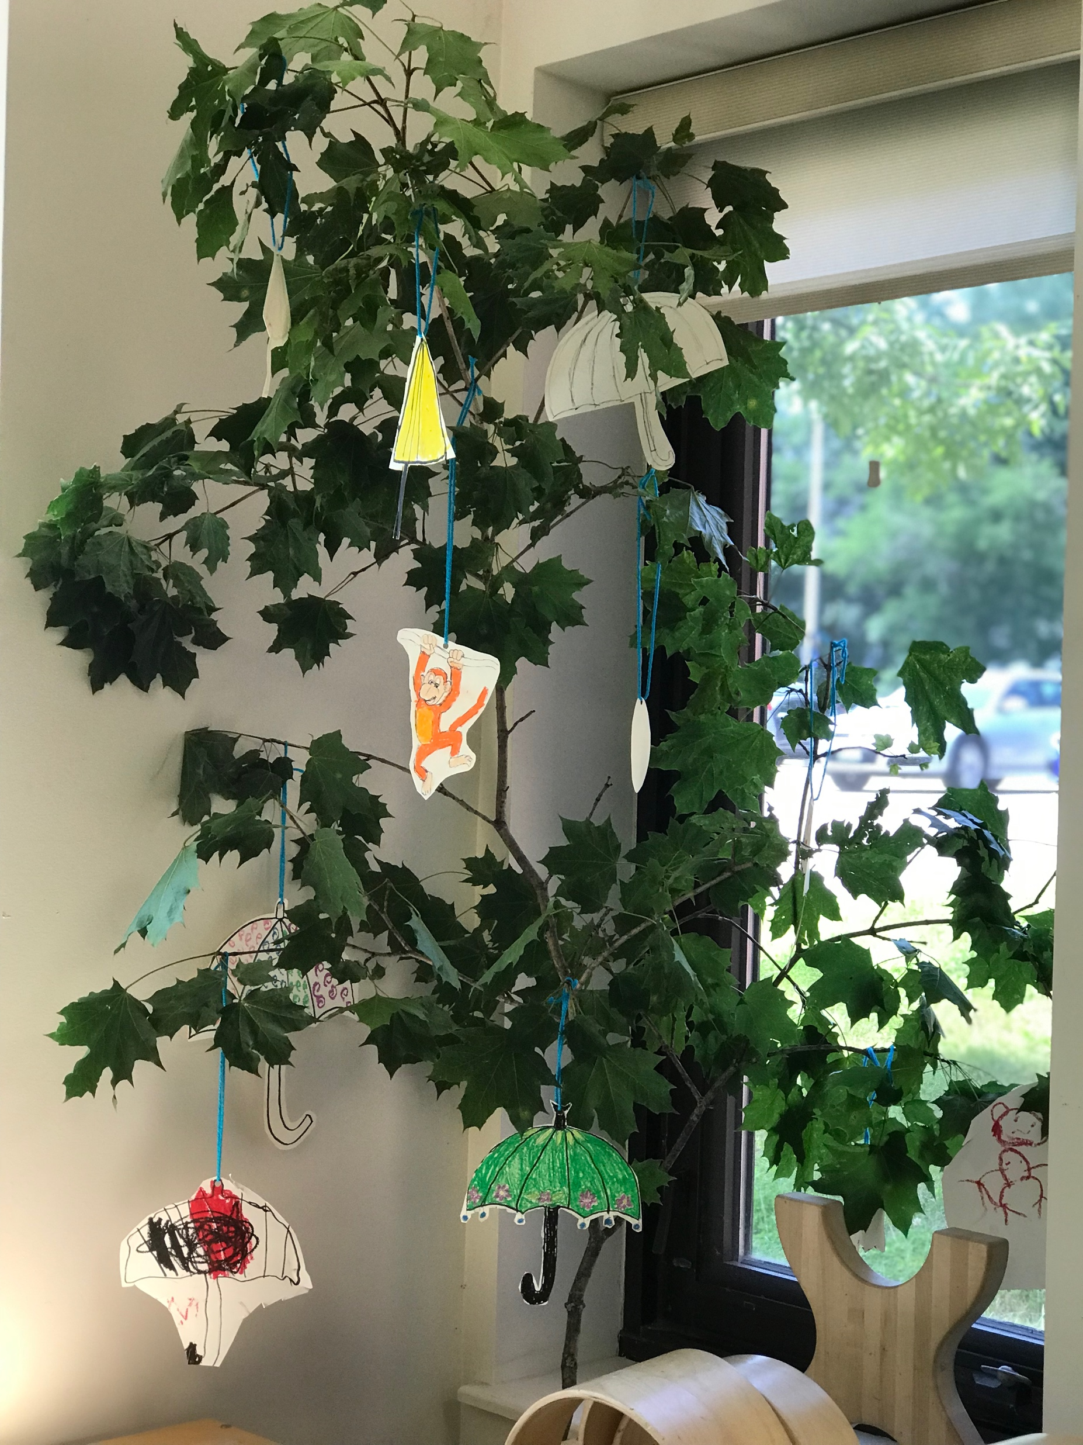
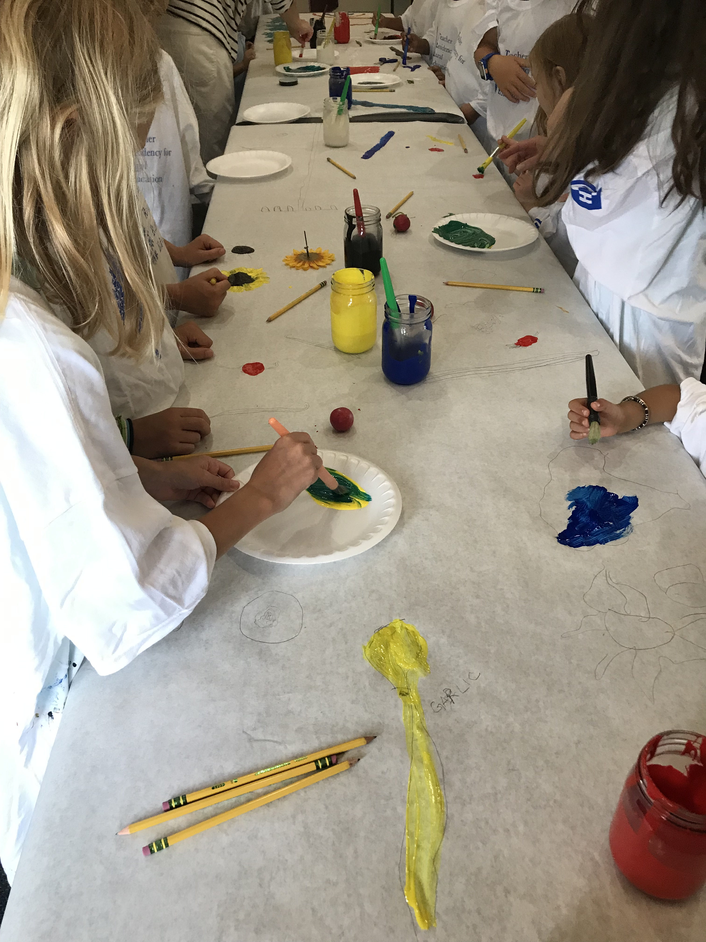
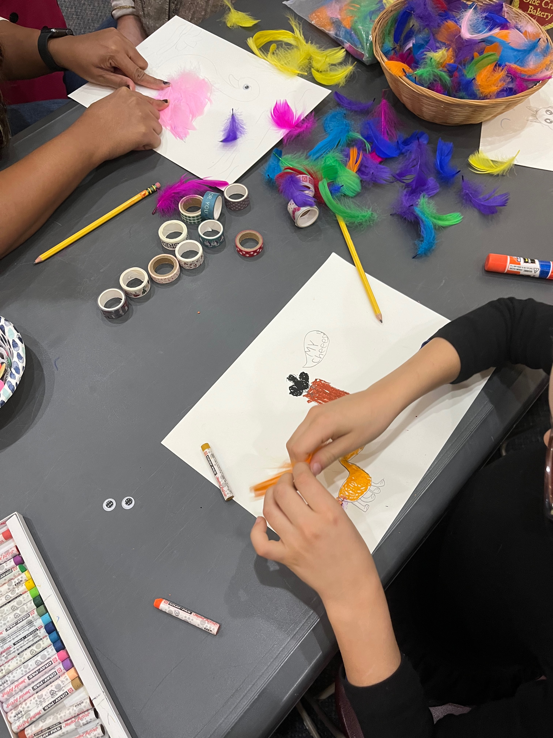
Working Toward Equitable Partnership for a Multilingual Book Club
Emilie Coppinger & Dr. Bethany Silva
Education Department | University of New Hampshire | Durham | NH
Context
Multilingual Book Club
Findings
Multilingual Book Club is a community program where children and their families engage in and celebrate culturally relevant ways of interacting with books. The program’s goal is to highlight languages that are present but not often recognized within our region’s English-dominant communities. We (1) support multilingual individuals in preparing read-alouds (2) enact a multilingual book club that engages with literature in ways that are culturally relevant.
Multilingual Read-alouds
On-going, structured support for read-aloud preparation
Readers identified cultural literacy practices after their read-aloud
Children’s responses were encouraging, and readers wished more multilingual children attended
Lessons Learned
Structuring our partnership to promote shared ownership
The potential of enacting an equitable partnership stance
Problem of Practice
Methods
Multilingual literacy experiences support community-building, respect the legitimacy of multiple languages, and embrace diverse ways of engaging in literate practices. Although there is a national call for more books in classrooms that are written by diverse authors and feature diverse characters, taking up that call within predominantly white spaces, both in and out of school, requires developing resources and support. Enacting critical literacy practices in predominantly white, monolingual contexts requires partnership development to ensure equitable literacy engagement. Partnerships that leverage the expertise and intentions of multilingual community-members are crucial to developing and sustaining an equitable project.
Acknowledgements
Study Context | Six Book Club sessions, each session featuring a different language
Data Sources and Participants | 49 exit surveys - book club attendees Three 60-minute interviews - book club readers
Inductive Analysis (Miles et al., 2014) | Coding Round 1: Identifying places that discussed ‘lessons learned’ Identification of themes Consensus of definitions Coding Round 2: Coding for themes
Peer Debriefing (Lincoln & Guba, 1985) | Five sessions where researchers reviewed aspects of the inquiry to make researchers’ understandings explicit.
Thank you, Dover Adult Learning Center and Dover Public Library, for being remarkable partners in this work!
References
Dahlen, S. P. (2020). “We need diverse books”: Diversity, activism, and children’s literature. In Literary Cultures and Twenty-First-Century Childhoods (pp. 83-108). Palgrave Macmillan.
Diamond, J. B. (2021). Racial equity and research practice partnerships 2.0: A critical reflection. William T. Grant Foundation.
García, O., & Kleifgen, J. A. (2019). Translanguaging and literacies. Reading Research Quarterly, 55(4), 553-571.
González, N., Moll, L. C., & Amanti, C. (Eds.). (2006). Funds of knowledge: Theorizing practices in households, communities, and classrooms. Routledge.
Han, M., Van Duinen, D. V., & Weng, A. (2021). Interactive Read‐Alouds as Translanguaging Spaces. The Reading Teacher, 75(3), 389-394.
Kelly, L., & Bolanos, C. (2020). From Outreach to Translanguaging: Developing a Bilingual Storytime. Children and Libraries, 18(3), 28-34.
Lincoln, Y. S., & Guba, E. G. (1985). Naturalistic inquiry. Sage.
Miles, M. B., Huberman, A. M., & Saldaña, J. (2014). Qualitative data analysis: A methods sourcebook (3rd ed.). Sage.
Oyewole, K. A., Karn, S. K., Classen, J., & Yurkofsky, M. M. (2022). Equitable research-practice partnerships: A multilevel reimagining. The Assembly, 5, 40-59.
Street, B. V. (1984). Literacy in theory and practice (Vol. 9). Cambridge University Press.
Silva, B., Hambacher, E. L., & Wharton-McDonald, R. (2021). Justice through Practice: Inquiry on the Development of Preservice Teachers’ Teaching for Social Justice. Journal of Practitioner Research, 6(2), 4.
sTAMD Simulations
…More Multilingual Book Club
Process Art Projects
Theoretical Perspectives
Critical Literacies & Translanguaging (Garcia & Kleifgan, 2019; Street, 1984)
Funds of Knowledge (González et al., 2006)
RPPs (Diamond, 2021)
Equitable RPPs (Oyewole et al., 2022)

