Slide 1




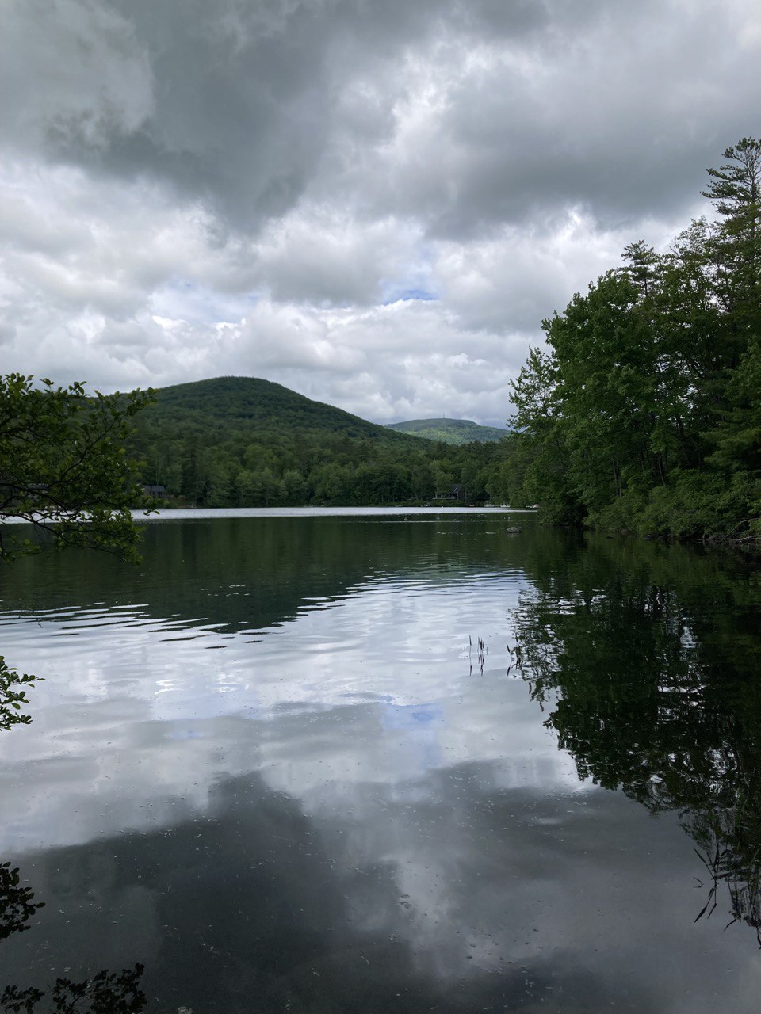
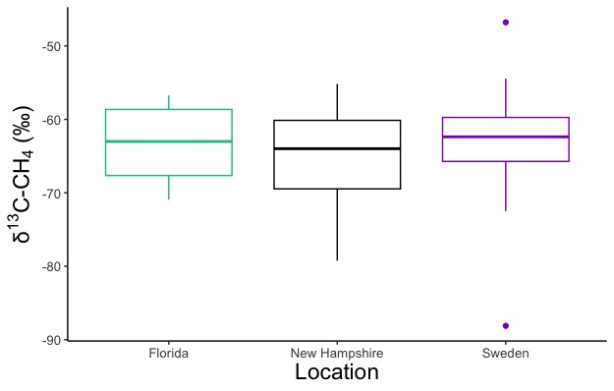
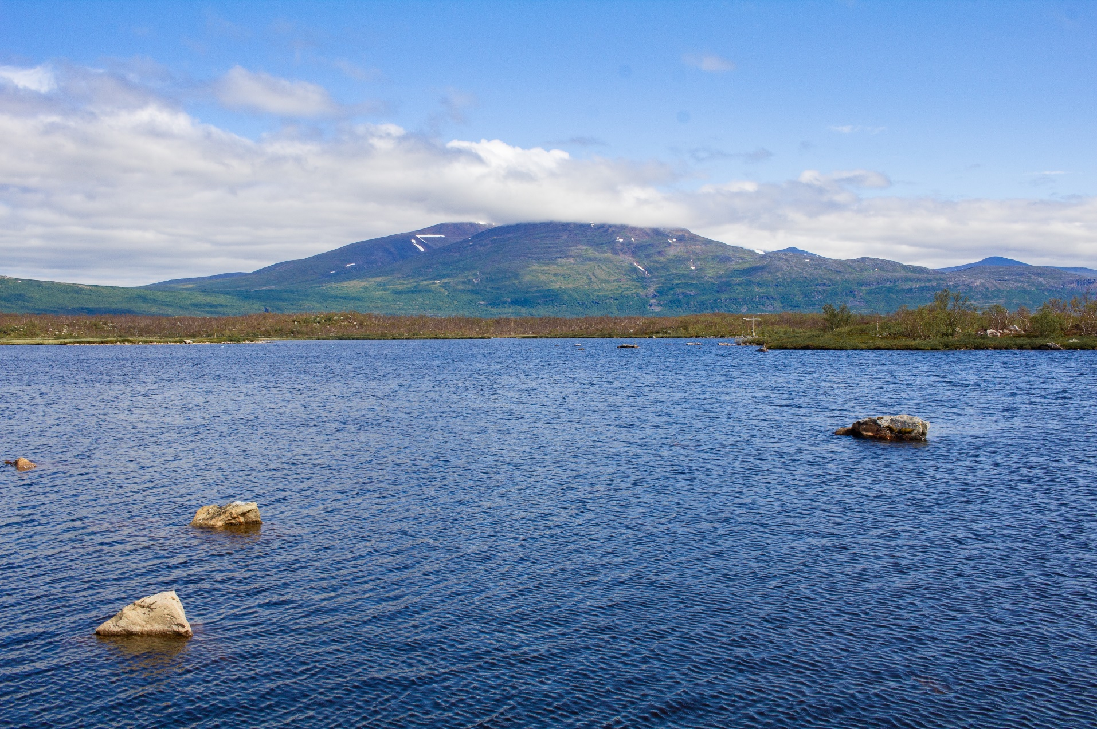
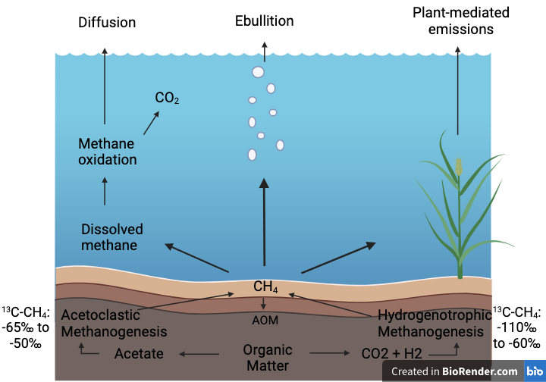
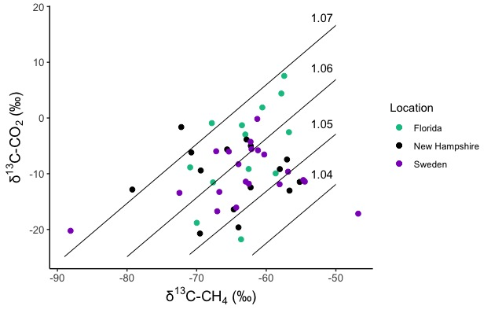
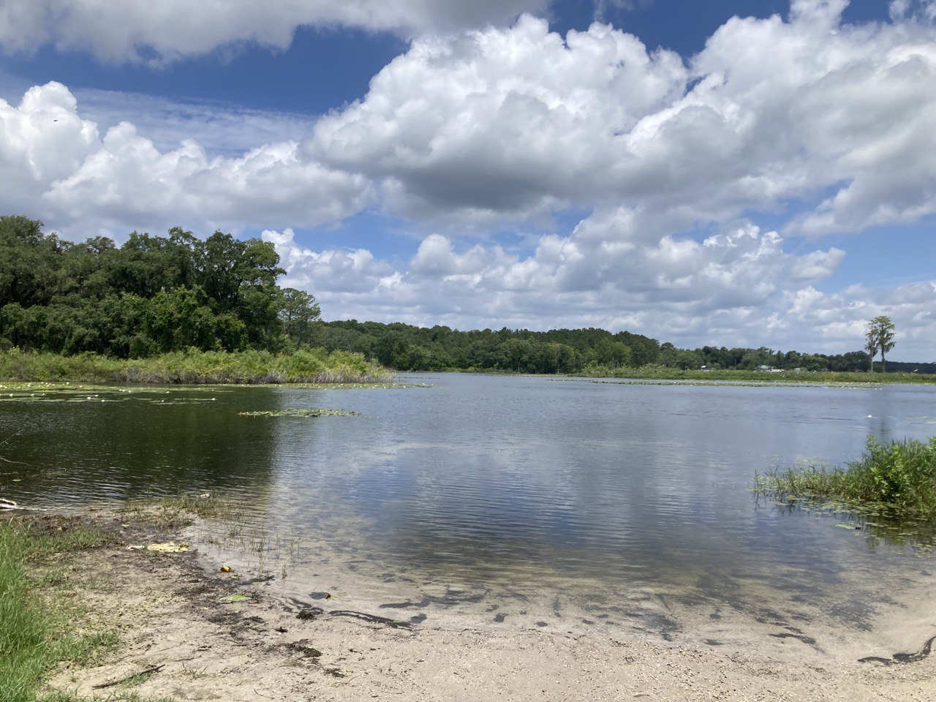
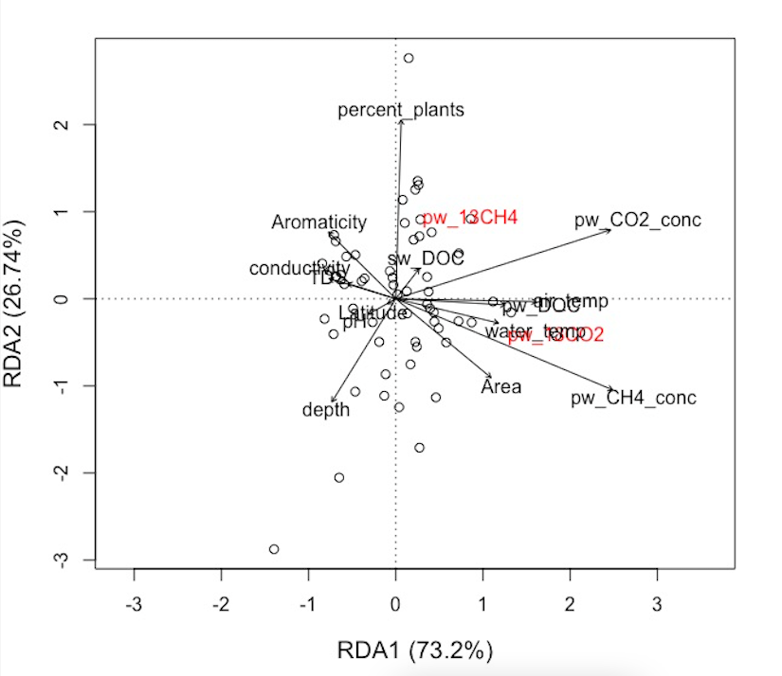
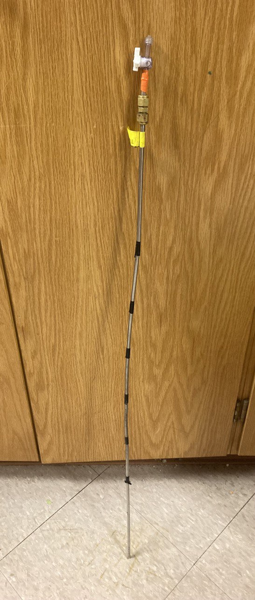
Email: theresareynolds14@gmail.com
Abstract ID: B21K - 2097
Isotopic Signatures from Lake Sediments, Plants, and Methane Bubbles: A Latitudinal Study of Lake Sediment Methane and Organic Carbon
Theresa Reynolds, Megan Wimsatt, McKenzie A. Kuhn, Cheristy P. Jones, and Ruth K. Varner
Earth Sciences Research Center, Institute for the Study of Earth, Oceans, and Space, University of New Hampshire (UNH)
Background
Study Sites
Results
Question: Does methane isotopic composition vary latitudinally? If so what controls the variability?
Methane (CH₄), a potent greenhouse gas, has been increasing in the atmosphere.¹ CH₄ emissions from lakes are estimated to account for 9-24% of total CH₄ emissions.²
CH₄ isotopes are used to distinguish methane from different sources and develop a global CH₄ budget.³ Distinguishing sources helps to constrain where atmospheric CH₄ comes from.
Figure 4: Boxplot of the porewater ¹³C-CH₄ average for each latitude. A one-way ANOVA was run, and it was concluded that there is no significant difference between the latitudes (p = 0.74).
Pc: T. Reynolds
New Hampshire, USA
43.19N, 71.57W
Abisko, Sweden
68.21N, 18.49E
Figure 5: ¹³C-CH₄ and ¹³C-CO₂ values in the porewater at each latitude are displayed. Lines are labeled with their corresponding αC values, the fractionation factor for C, and can estimate dominant methanogenesis pathways.⁴
Pc: T. Reynolds
Figure 6: A Redundancy Analysis (RDA) with the ¹³C-CH₄ and ¹³C-CO₂ in the porewater as the response variables and the other parameters such as aromaticity and conductivity as the explanatory variables. This RDA was determined to be significant (p= 0.001).
Figure 1: The different ways in which CH₄ can be produced and emitted from a lake to the atmosphere.
Florida, USA
30.29N, 38.50W
Methods
Pc: T. Reynolds
Sampled about 20 lakes at each latitude.
Methane
Stirred sediments and caught bubbles in a bubble trap
Collected CH₄ from porewater with a sipper
CH_{4,} CO₂ concentrations and their carbon-13 (¹³C) isotopes analyzed at FSU via gas chromatography – Isotope Ratio Mass Spectrometry (GC-IRMS)
Sediments and Vegetation
Collected sediments and vegetation nearby
Will be analyzed for ¹³C via Isotope Ratio Mass Spectrometry (IRMS)
Water Quality Analysis
Took water samples to test for various parameters, including dissolved organic carbon (DOC)
Analyzed in the Water Quality Analysis lab at UNH
Figure 3: Map of the 3 locations (Florida, New Hampshire, and Sweden) where lakes were sampled.
Conclusions
Conclusions: We found no significant differences in ¹³C-CH₄ across the latitudinal locations and no evidence of different methanogenesis pathways, but there may be other impacts to ¹³C-CH₄ that were not measured. Our findings suggest that ¹³C-CH₄ cannot be used to distinguish lake methane sources from the different latitudes and lake types in this study.
Future work: Sediment and vegetation samples will be analyzed via IRMS for ¹³C. Ebullition samples will be analyzed for ¹³C via a Quantum Cascade Laser and compared to the sediment and vegetation ¹³C.
References and Acknowledgements
1. Lan, X.,et al. (2023), https://doi.org/10.15138/P8XG-AA10; 2. Saunois, M. et al. (2019). 10.5194/essd-2019-128. ;
3. Quay, P.D. et al. (1991). doi:10.1029/91GB00003 ; 4. Whiticar M.J. et al. (1986) https://doi.org/10.1016/0016-7037(86)90346-7
I would like to thank the Trace Gas Biogeochemistry group for their support. I would also like to thank my field work volunteers, Donnamarie Giglio and Johnny Murta. Additionally, I would like to thank the Water Quality Analysis Lab at UNH, the Stable Isotope lab at UNH, Dr. Jeff Chanton’s lab at FSU, and Dr. Kelly Wrighton’s lab at CSU for their help in running my samples. I am also thankful to Dr. Flororencia Fahnestock, Apryl Perry,Dr. Katharine Duderstadt, and Dr. Matthew Vadeboncoeur for their advice and assistance in my project. I would like to thank the Swedish Polar Research Secretariat and SITES for the support of the work done at the Abisko Scientific Research Station. SITES is supported by the Swedish Research Council. This work was done on the land of the Sámi (Sweden), the Pennacook, Abenaki, and Wabanaki (New Hampshire), and the Ais, Apalachee, Calusa, Timucua, Tobago as well as the Seminole Tribe of Florida and the Miccosukee Tribes of Indians of Florida. Thanks to the UNH Earth Sciences Department, Department of Energy (DE-SC0023456), Heising-Simons Foundation (#2022-4087), and the EMERGE Biological Integration Institute (DBI-2022070) for my funding.
Pc: T. Reynolds
Figure 2: A sipper; used to collect porewater.

