Slide 1
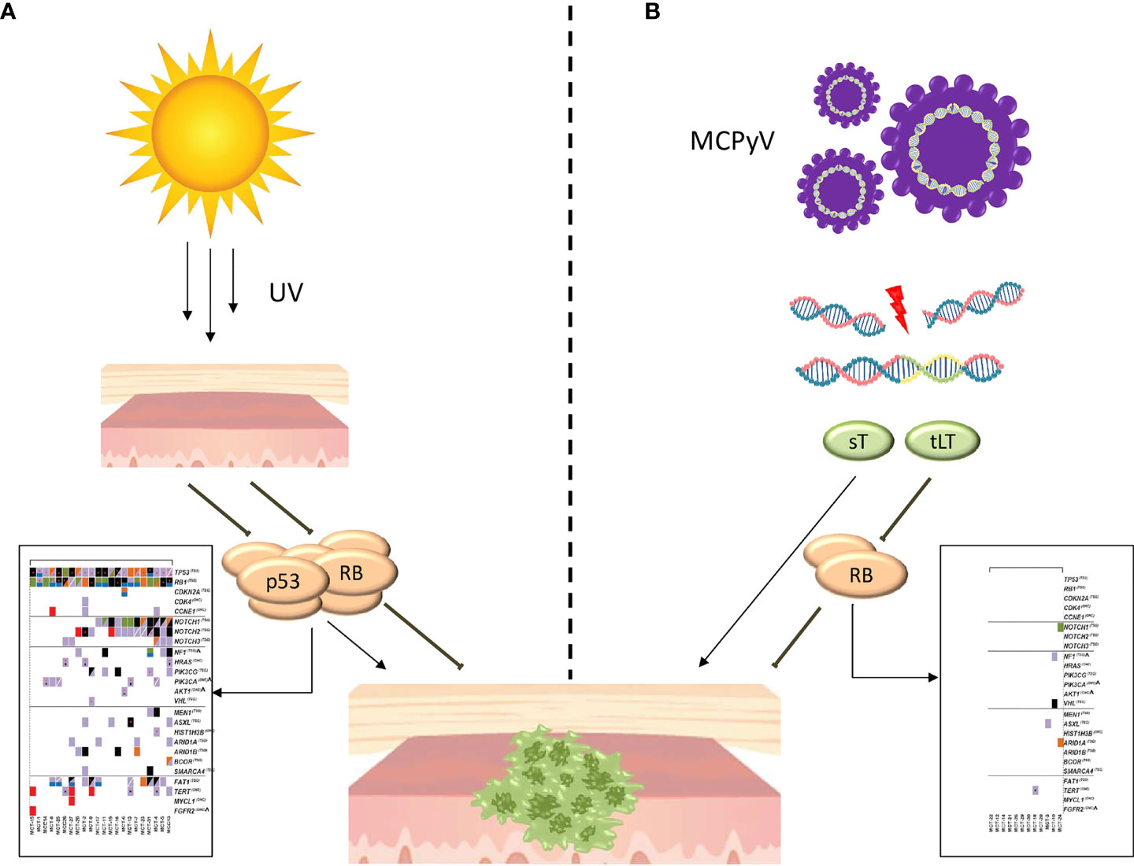
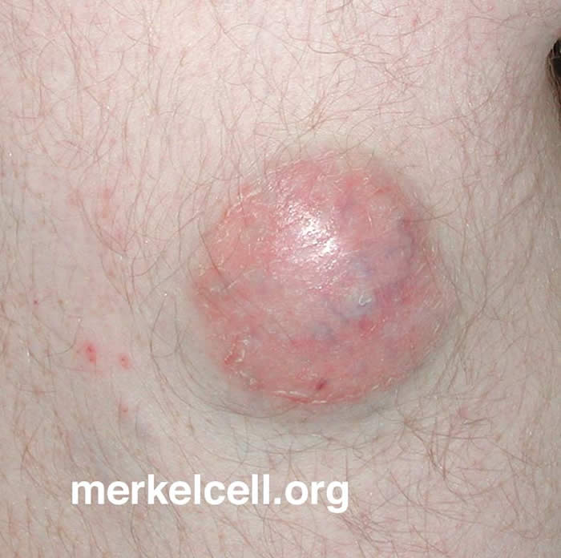
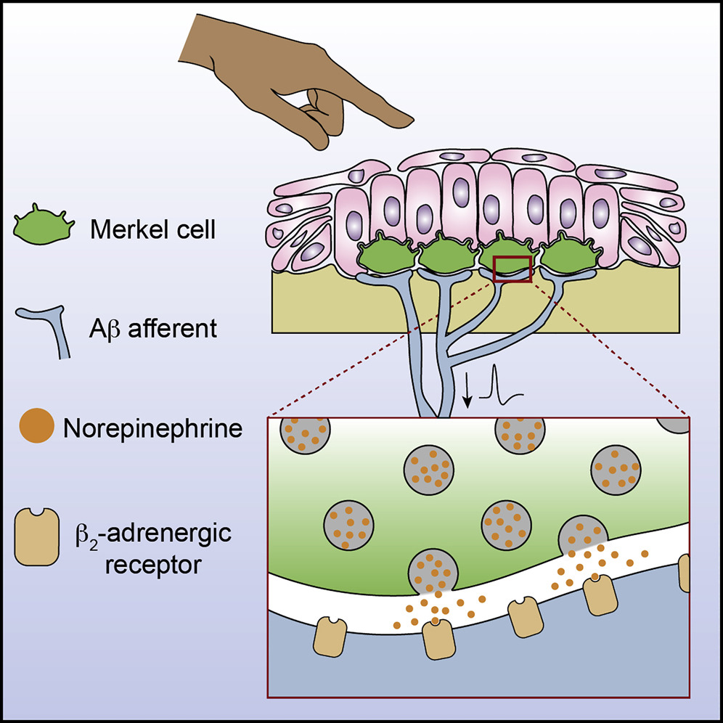
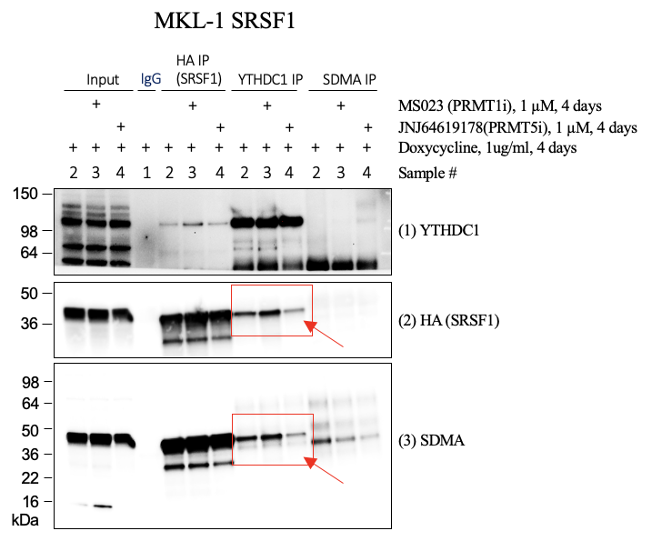
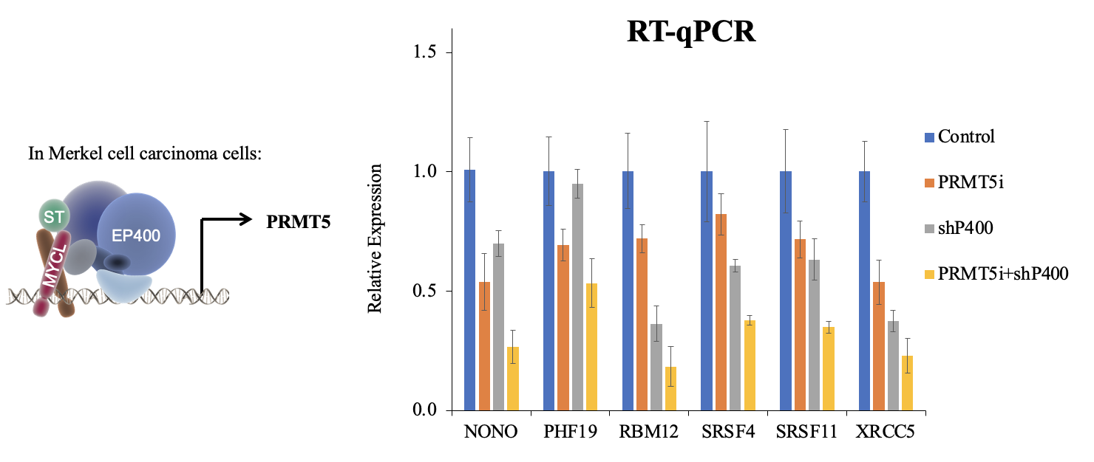
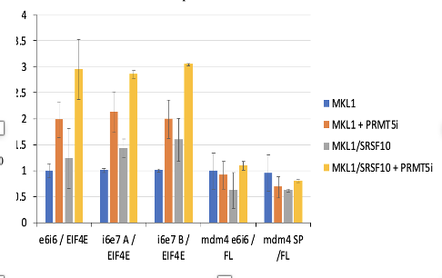
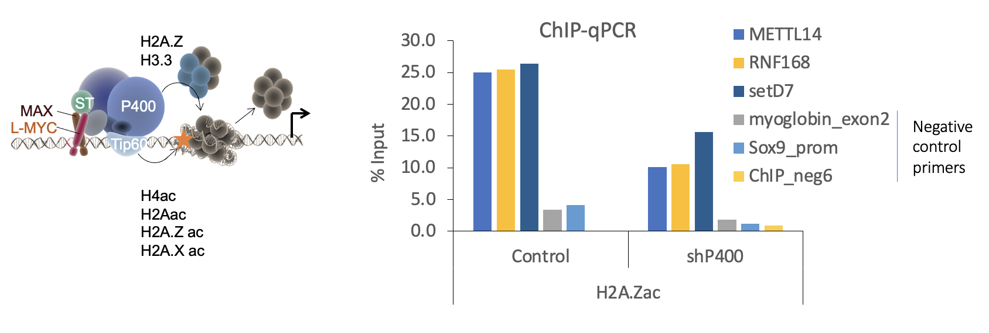
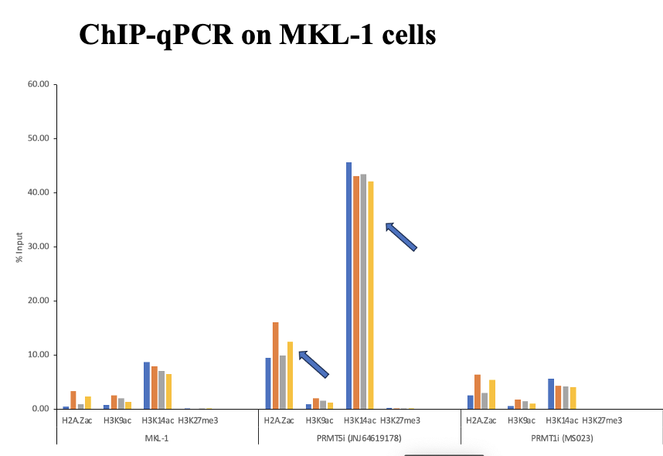
Understanding the Epigenetic Role of PRMT5 Inhibitors in RNA Binding Proteins and Histones Involved in Merkel Cell Carcinoma Tumorigenesis Devya Gurung and Jingwei Cheng Department of Molecular, Cellular and Biomedical Sciences at University of New Hampshire, Durham, NH 03824
Introduction
MCC Pathways
Results
Merkel cell carcinoma (MCC) is a rare but aggressive form of skin cancer with a 30% mortality rate. It occurs due to the integration of Merkel cell polyomavirus (MCPyV) in the human genome, and excessive exposure to sunlight or ultraviolet light (UV) which leads to UV-induced DNA damage. Many factors are involved in the development of cancer, such as protein arginine methyltransferase 5 (PRMT5) which plays a significant role in controlling the oncogenic process, and therapy response. Therefore, I aim to investigate the roles of PRMT5-mediated epigenetic modifications of RNA binding proteins (RBPs) and histones using Merkel cells.
When treated with PRMT1i, it increased levels of SRSF1 proteins Co-Ip by YTHDC1.
PRMT5i decreased the binding affinity.
Thus, PRMT5-mediated SDMA modification of SRSF1 promotes YTHDC1 & SRSF1 interaction.
Fig 1. MCC Virus Positive vs. Virus Negative pathways
Virus-induced cellular network perturbations may mimic disease-causing mutations. Epigenetic deregulation and DNA mutations converge to the same oncogenic pathways.
Fig 2 & 3. Merkel Cells and its sensory pathways
Merkel cells communicate with sensory neurons via β2-adrenergic receptors which allows us to feel sensation via touch.
Fig 7. Ip-WB on MKL-1 SRSF1
RT-qPCR Data
Conclusion
Objectives
Goal 1. Investigate the role of PRMT5 -mediated methylation of RNA binding proteins in protein-RNA interactions.
Goal 2: Examine the roles of PRMT5 -mediated epigenetic modifications of histones using MCC cell lines.
Hypothesis: PRMT5 promotes MCC tumorigenesis by methylating RBPs and histones.
Fig 8. Small T- Antigen LMYC activating Ep400 (SLaP) Complex with Histones
This study validated H2A.Zac as a good marker.
H2A. Z are involved in acetylation and are located at promoter regions.
RT-qPCR experiment showed that constitutive expression of SRSF10 in MKL-1 cells can further increase detained intron levels in addition to PRMT5i.
Fig 4. P400 knockdown & PRMT5 inhibition show synergistic down-regulation in a subset of genes such as NONO, PHF19, RBM12, SRS4, SRSF11 and XRCC5.
Fig 5. RT-qPCR show constitutive expression of SRSF10 in MKL-1 cells show increase detained intron levels of EIF4E, which is a translation initiation factor.
Methodology
Why PRMT5?
Lentiviral transfection & transduction was performed to generate stable MKL-1 cell lines overexpressing SRSF proteins. Then, we performed following assays to measure the effects of our PRMT5 treatment on MKL-1 cells.
Cell viability: Test cell sensitivity with inhibitors.
Immunoprecipitations (IP)-Western Blots: Detect protein-protein interactions.
Chip-qPCR: Chromatin DNA was extracted. Performed ChIP-qPCR to analyze histone modifications at the promoter regions of genes associated with neuroendocrine cell differentiation.
RT-qPCR: extracted genomic DNA and reverse transcribed. It was used to understand transcription sites and study gene expression.
PRMT5 is a downstream target gene of the ST-MYCL-EP400 complex.
PRMT5 is a Major type II arginine methyltransferase group.
It mediates symmetric dimethylarginine (SDMA) marks on histones and RNA binding proteins (RBPs).
PRMT5 also plays a crucial role in gene regulation, cell development, splicing, chromatin regulation, and DNA damage response.
Acknowledgements
This research was supported by an Institutional Development Award (IDeA) from the National Institute of General Medical Sciences of the NIH under grant number P20GM113131.
References
Shailesh H., Zakaria Z. Z., Baiocchi R., Sif S. Protein arginine methyltransferase 5 (PRMT5) dysregulation in cancer. Oncotarget. 2018; 9: 36705-36718.
https://merkelcell.org
https://www.frontiersin.org/journals/oncology/articles/10.3389/fonc.2021.739006/full
Tanda, E et al., Merkel Cell Carcinoma: An Immunotherapy Fairy-Tale?. Frontiers in oncology, (2021), 11, 739006. https://doi.org/10.3389/fonc.2021.739006
Hoffman, B et al., Merkel Cells Activate Sensory Neural Pathways through Adrenergic Synapses. Neuron, 100(6), 1401–1413.e6.
Fig 6. ChIP-qPCR studied at promoter regions. PRMT5 inhibitor may increase acetylated histone H2A.Z levels at the promoter regions of genes. PRMT5 can inhibit histone acetyl transferase activity of p400 (H2A.z).

