Slide 1
Flaw type and build orientation dependent creep strength of 316L stainless steel fabricated via laser powder bed fusion
Nemanja Kljestan
University of New Hampshire
1
Notes:
Enter speaker notes here.

Slide 2
Motivation
2
Notes:
Enter speaker notes here.

Slide 3
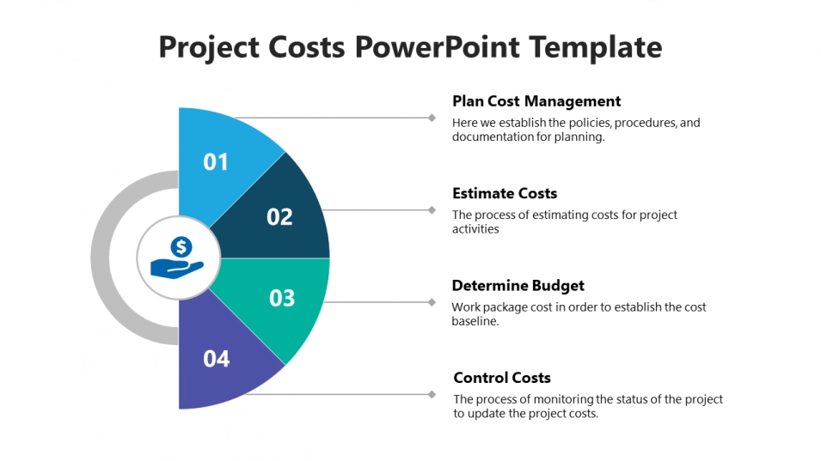
Motivation
Reduced material waste due to AM process
Customization and Rapid Prototyping
Benefits
Small-scale production cost effectiveness
Design Freedom
3
Notes:
Enter speaker notes here.

Slide 4
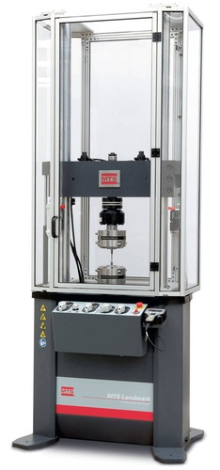
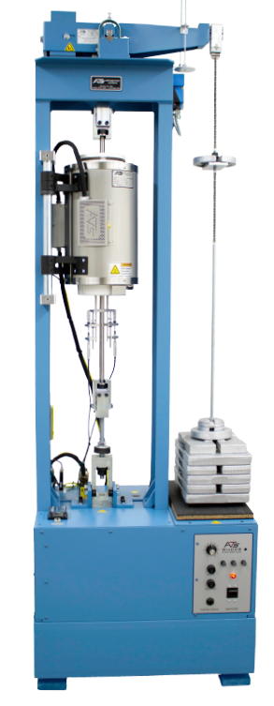
Machinery and specimens
Tensile tests
Creep tests
Creep Specimen
4
Notes:
Enter speaker notes here.

Slide 5
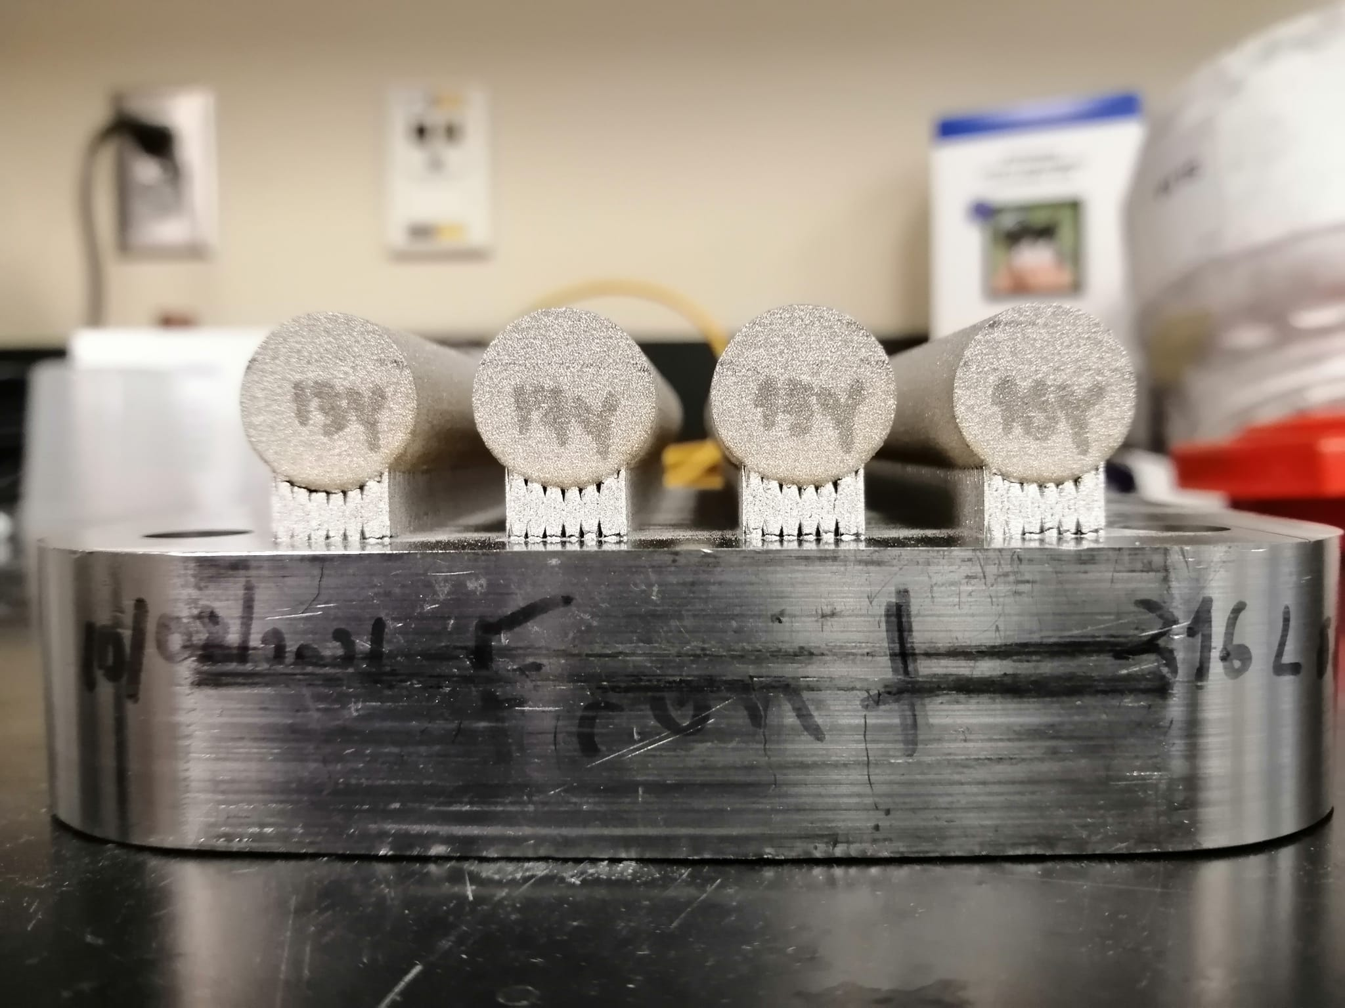
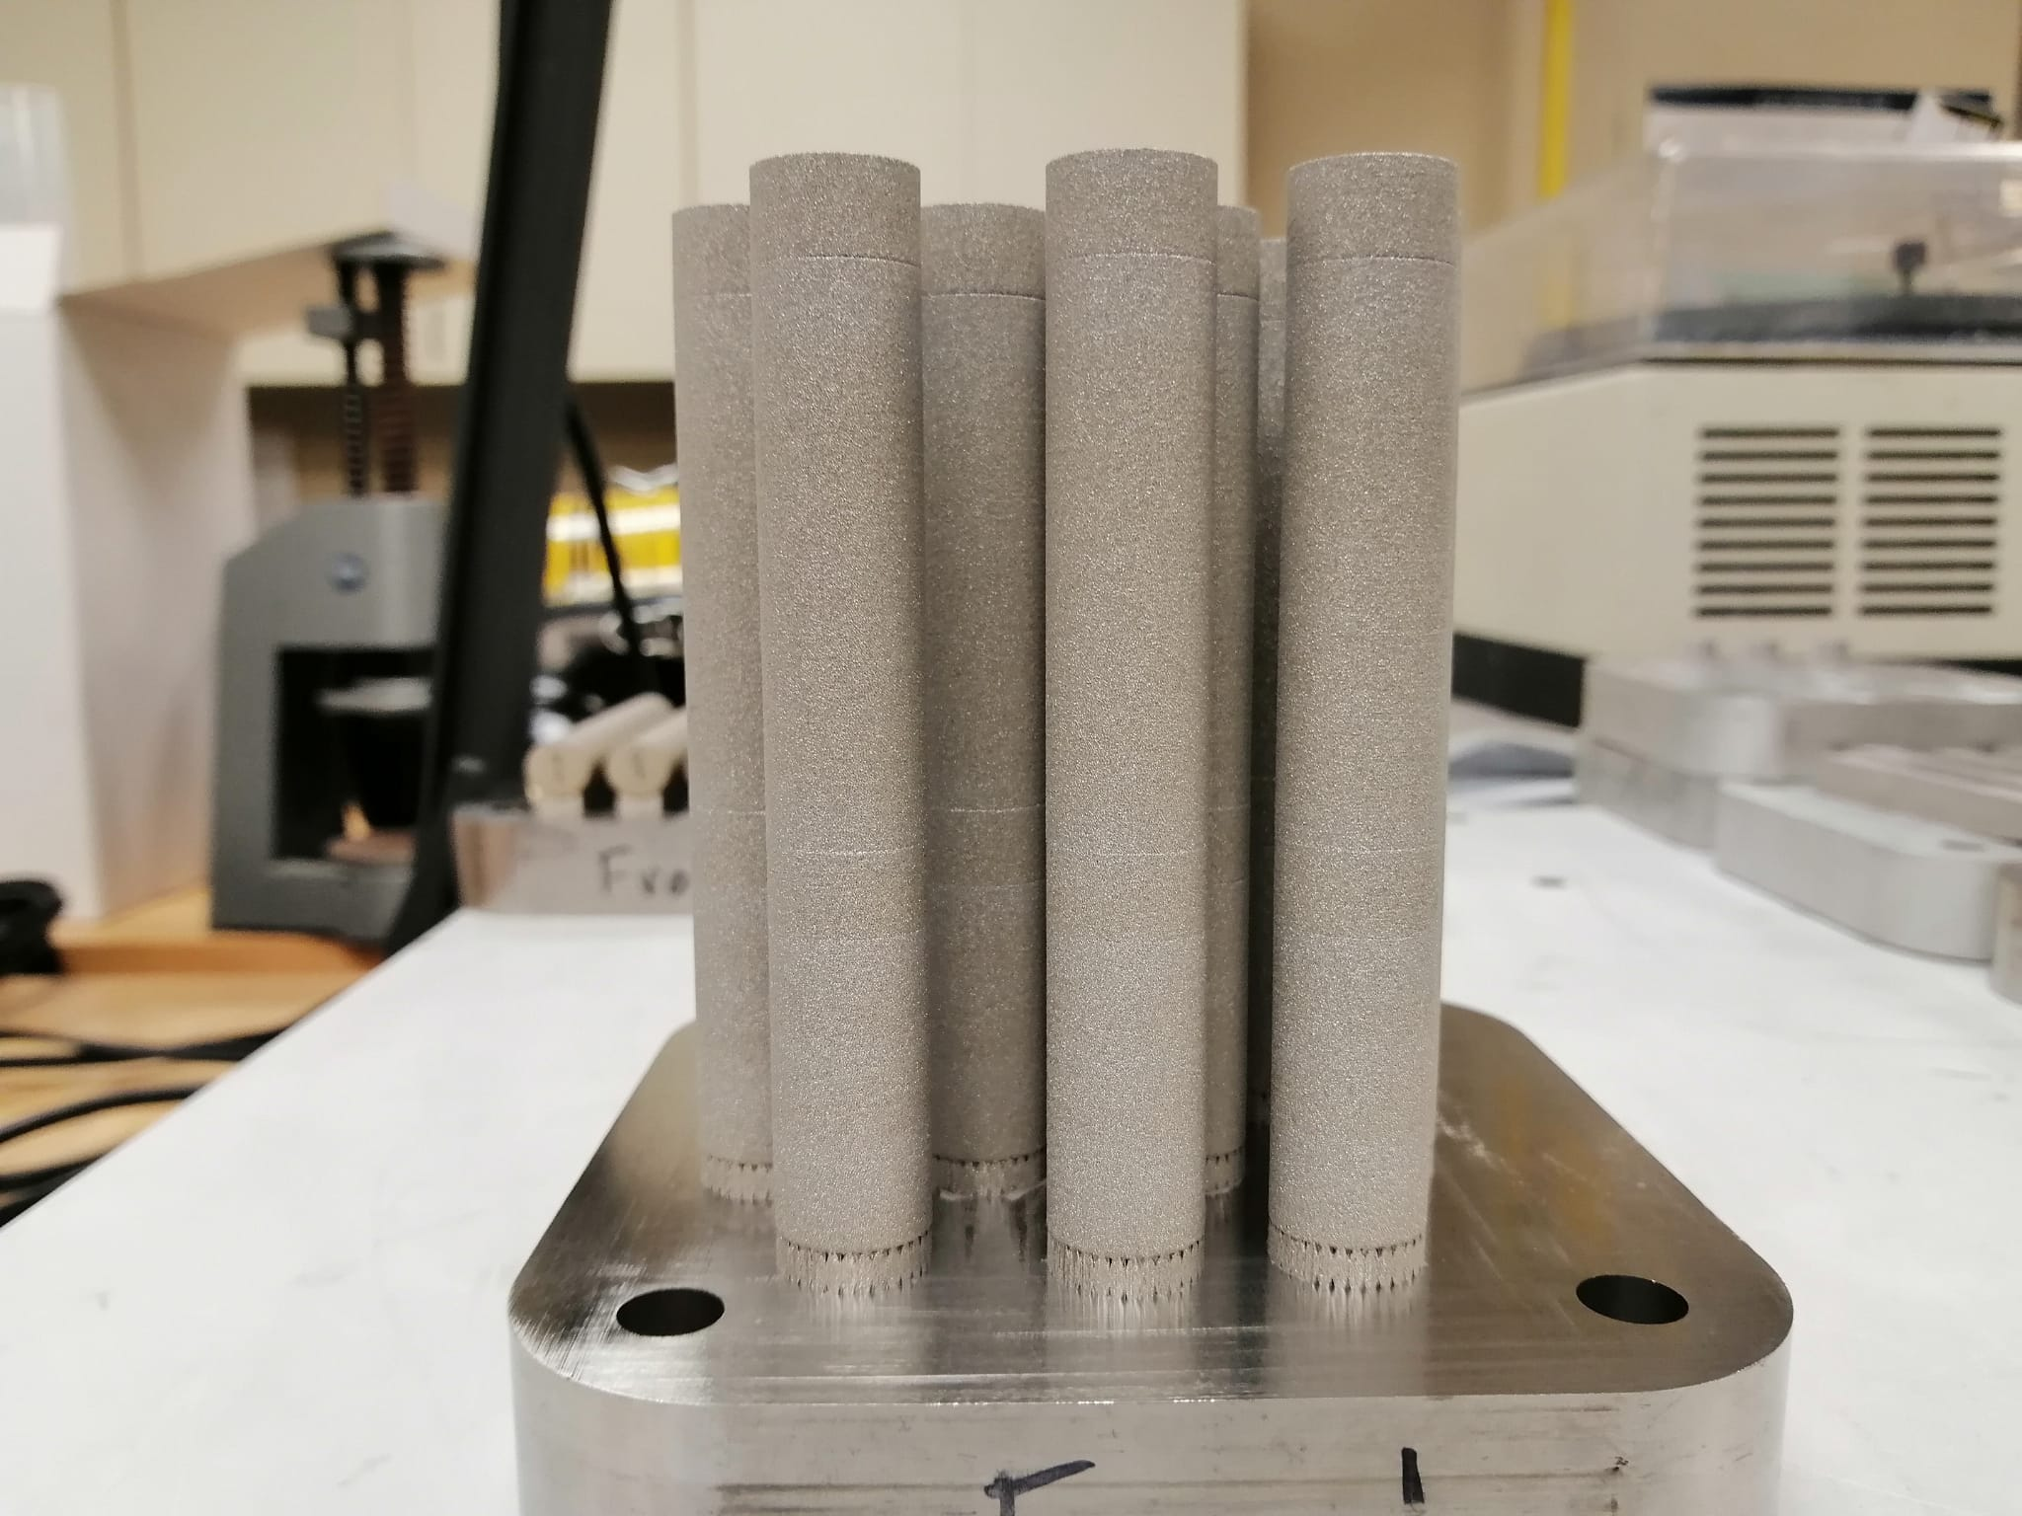
Manufacturing
Horizontal (Y direction)
Vertical (Z direction)
Processing parameters:
Fully Dense (FD) samples
200 W, 800 mm/s, 0.03 mm, 0.12 mm
Keyhole (KH) samples
200 W, 400 mm/s, 0.03 mm, 0.12 mm
Lack of Fusion (LoF) samples
200 W, 1500 mm/s, 0.03 mm, 0.12 mm
5
Notes:
Enter speaker notes here.

Slide 6
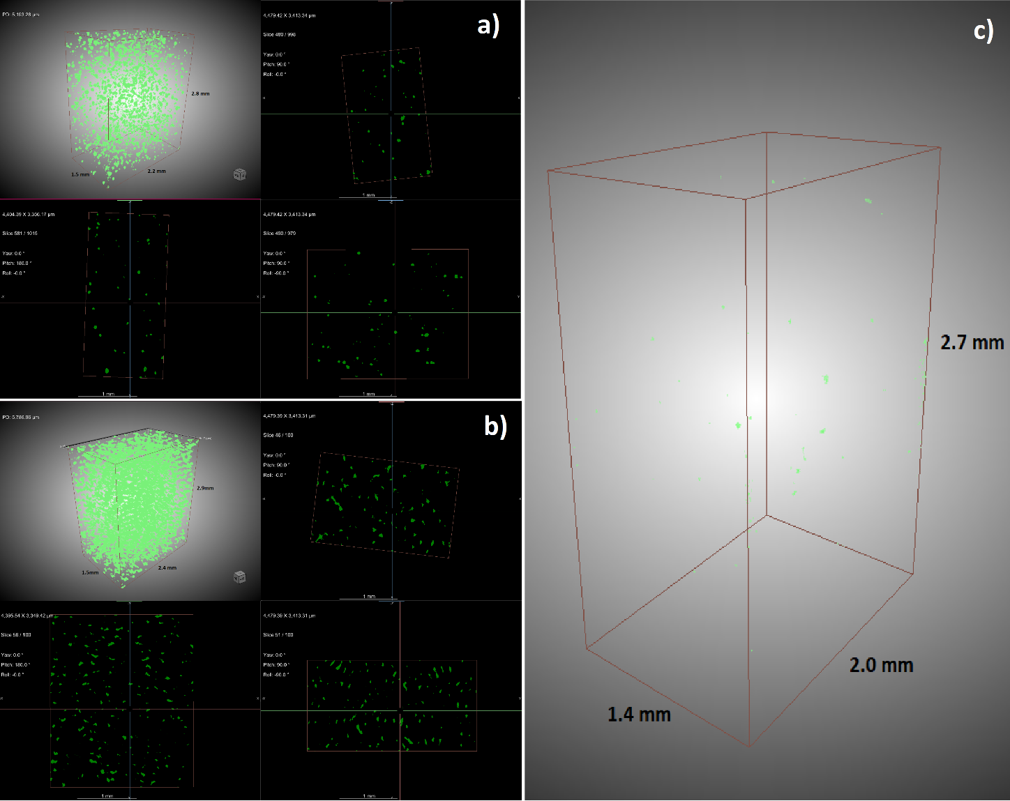
Characterization
μXCT visual representation of voids in material showing:
a) Keyhole Z
b) Lack of Fusion Z
d) Fully Dense Z material
6
Notes:
Enter speaker notes here.

Slide 7
Characterization
Fully Dense Z
Keyhole Z
Fully Dense Y
Lack of Fusion Z
7
Notes:
Enter speaker notes here.

Slide 8
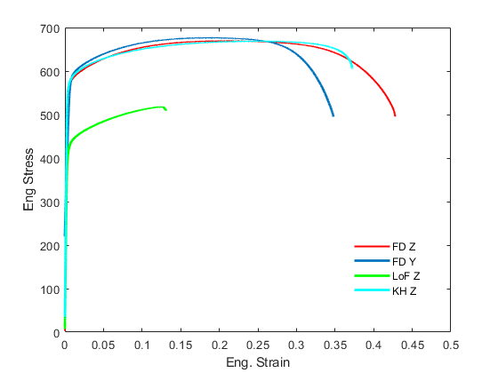
Tensile behavior
Name | YS, MPa (0.2% offset) | UTS, MPa | Eng. Strain at UTS | Eng. Strain at Fracture
FD Z | 576.0 | 670.2 | 0.2096 | 0.4279
FD Y | 597.5 | 676.7 | 0.1816 | 0.3407
LoF Z | 436.3 | 518.5 | 0.1268 | 0.1307
KH Z | 583.6 | 668.4 | 0.2693 | 0.3721
8
Notes:
Enter speaker notes here.

Slide 9
Creep
Creep strain vs run time
9
Notes:
Enter speaker notes here.

Slide 10
Creep
Fits for secondary creep with implemented threshold stress to MBD equation
10
Notes:
Enter speaker notes here.

Slide 11
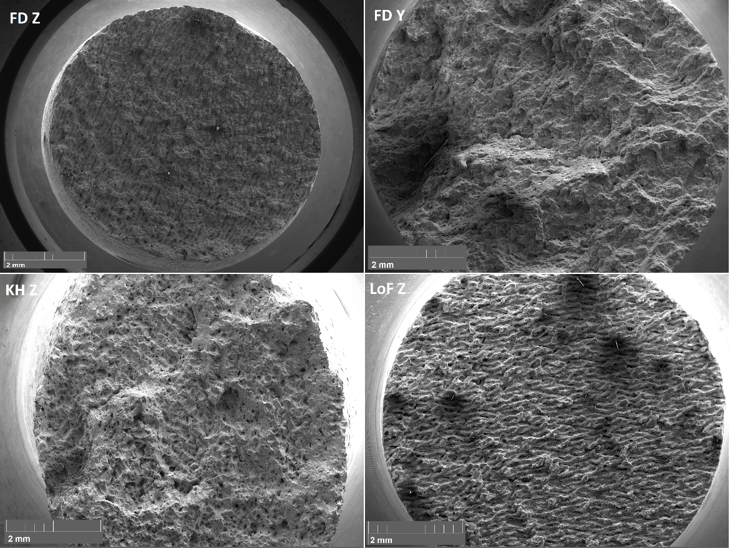
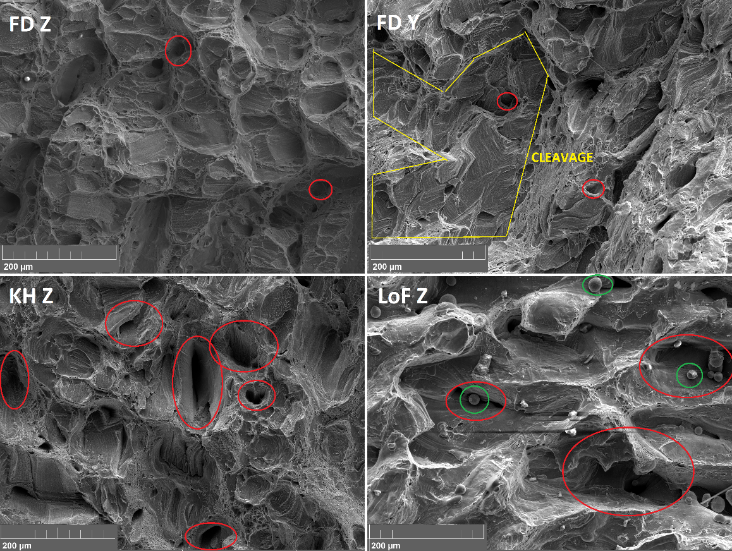
Fractography
Low magnification SEM images
High magnification SEM images
11
Notes:
Enter speaker notes here.

Slide 12
Conclusions
The creep strength of 316L stainless steel is affected by the build direction and the presence of flaws
The incorporation of threshold stress into the creep equation was necessary to reduce the stress exponent and activation energy values
Vertically built FD Z samples outperform the horizontally built FD Y samples
The activation energy values consistently decrease with increasing temperature across all material categories
The stress exponent values suggest dislocation climb as the main creep mechanism
12
Notes:
Enter speaker notes here.

Slide 13
Notes:
Enter speaker notes here.

