Slide 1
Opportunities for Instrumental Genesis in Mathematics Lessons
Catherine Dennis and Orly Buchbinder

Slide 2

Motivation
Digital technology is making advancements every day
  Technological tools are increasingly being integrated into classrooms.
As students interact with a technological tool, the tool gradually becomes an instrument supporting students’ mathematical thinking. This process is called instrumental genesis.
Instrumental genesis has been a useful construct to describe the process of learning mathematics with technology.
(Artigue, 2002; Buteau et al., 2020; Drijvers et al., 2010; Trouche, 2004) (Trouche & Drijvers, 2010)
Notes:
-Tech in classrooms a lot
-loose definition of instrumental genesis
-this is a construct we use in math ed research

Slide 3
Motivation
There has been a significant societal transition to student-oriented device use.
Past research has been centered around teacher influence on instrumental genesis
Want to explore how students influence each other’s instrumental genesis.
(Artigue, 2002; Buteau et al., 2020; Drijvers et al., 2010; Trouche, 2004) (Trouche & Drijvers, 2010)
Notes:
-societal transition to student-oriented device use
-teacher influence in past
-want to explore student influene

Slide 4
Instrumental Genesis
Artefact: An object (physical, e.g., a calculator or abstract, e.g., a quadratic formula) that can be turned into an instrument for use or learning of mathematics.
Instrument: An artefact becomes and instrument when the individual has psychological schemes for the object.
Instrumental Genesis: The process of users (usually students) turning an artefact into an instrument for use in mathematics.
(Artigue, 2002; Drijvers et al., 2010; Trouche, 2004)
Notes:
Use examples

Slide 5

Instrumental Orchestration
Instrumental Orchestration: The contexts and organized activities that support instrumental genesis, usually conducted by teacher.
Didactical configuration: The settings and artefacts available for the lesson.
Exploitation Modes: The lesson plan and flow to support instrumental genesis.
  Didactical Performance: The ad hoc decisions made during the lessons. Students and teachers can play a role in didactical performance.
(Clark-Wilson et al., 2020) (Drijvers et al., 2010; Trouche, 2004) (Drijvers et al., 2010)
Notes:
Instrumental orchestration was termed for teacher influence on instrumental genesis
Didactical configuration examples: room setup, technology available
Exploitation modes: planned lesson for instrumental genesis
Didactical performance: ad hoc – everyone can play a role.

Slide 6
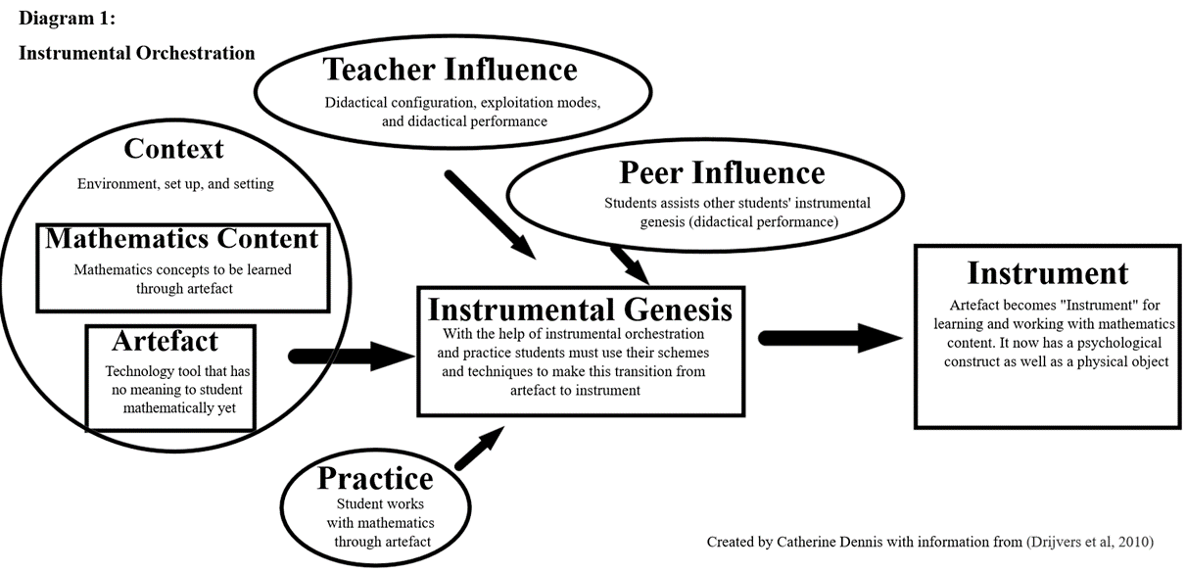
Instrumental Genesis Process
Based on Drijvers et al., 2010
Notes:
A visual of instrumental genesis process- explain left to right flow and influences along the way

Slide 7
Research Questions
What are the didactical configurations (the setting and the artefacts) for each lesson?
2. How do teachers enact instrumental orchestration in various modes of discourse?
3. How do peers influence each other’s instrumental genesis?
We seek to make a theoretical contribution by extending the existing frameworks of instrumental genesis and instrumental orchestration by examining these processes:
In varied didactical configurations and
Within multiple modes of discourse.
Notes:
In this research we used three freely available online videos for analysis
Read research questions
We want to make a theoretical contribution to instrumental genesis theory by examining process in varied didactical configurations and within multiple modes of discourse.

Slide 8
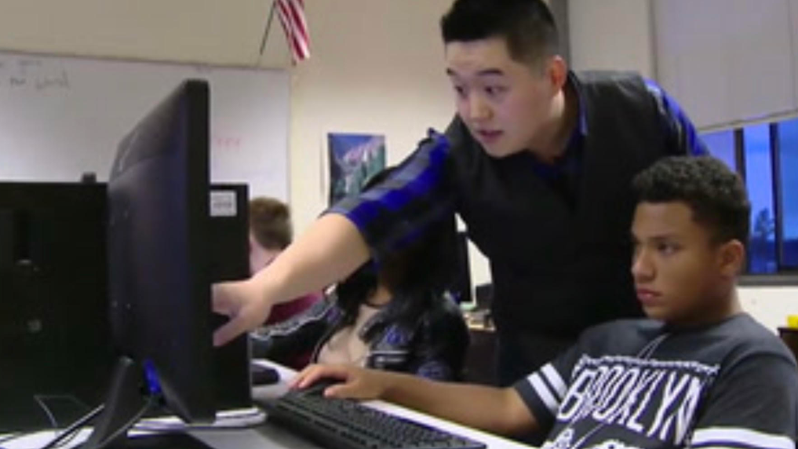
Methods
Data sources
Video recordings of three mathematics lessons using computer graphing software (Desmos). Videos include classroom observations and some teacher interviews.
Each class appears to have about 20-25 students
Data analysis
Transcriptions of all three lessons.
Notes taken for both
Lessons coded using the Drijvers et al. (2010) codes as well as new codes.
Codes displayed in raw number and percentage
Notes:
We used freely available online video.
Goal was to choose a variety of lessons.

Slide 9
Video Lessons and Participants
Lesson 1: Group Work Heavy: Modeling with Polynomials
Algebra 2 2016/2017 School year.
Amy Burke Instructor: Thirteen years teaching experience
Students model polynomials using Desmos. They work in groups of 4-5 students and share Chromebooks.
Video is approximately 20 minutes and primarily moves amongst groups
Lesson 2: Teacher-student interactions Heavy
High School Algebra class in Washington
Mr. Kwon has two years of teaching experience
Students use code.org and Desmos to complete a lesson about rate of change and rockets.1 to 1 desktops are used.
Video is approximately 10 minutes and jumps between teacher interview and students-teacher conversations
Lesson 3: Online Lecture
Zoom Algebra 1 lesson for performing arts school in Philadelphia, PA
Tracy Saltz has thirteen years of teaching experience
Video is about 4 minutes jumps between teacher interview and teacher lesson
Tracy uses Desmos during this lesson
Notes:
Lesson 1: Group work heavy – students modeling polynomials with Desmos on chromebooks in groups
Lesson 2: Teacher-student interaction heavy – students using code.org and Desmos on 1-1 desktops to complete lesson about rate of change and rockets.
Lesson 3: Online lecture – teacher uses Desmos during lesson. Students interact within program but not verbally.

Slide 10
Research questions and analytic techniques
What are the didactical configurations (the setting and the artefacts) for each lesson?
2. How do teachers enact instrumental orchestration in various modes of discourse?
3. How do peers influence each other’s instrumental genesis?
1. Didactical Configurations were established through videos, transcripts, and notes taken.
2 & 3. Starting with Drijvers et al. (2010) Instrumental Orchestration Types we coded each line for the instances of instrumental orchestration. We additionally found new arising categories for influence on instrumental genesis. Some quotes fell under more than one category and were counted twice.
Notes:
1 – videos, transcripts, and notes taken
2-line by line coding for instrumental orchestration. We also found new arising categories for influences on instrumental genesis

Slide 11

Drijvers et al. (2010) Instrumental Orchestration Types
Teacher-centered orchestration
Technical-demo
  The demonstration of tool techniques by the teacher
  Important aspect of technology-rich teaching
Explain-the-screen
  Whole-class explanation by the teacher guided by what happens on the computer screen
Link-screen-board
  Emphasizing the relationship between what happens in the technological environment and how this is represented in conventional mathematics
Notes:
What are the existing types of instrumental orchestration? Both teacher-centered and student-centered.
Explain these 3

Slide 12

Drijvers et al. (2010) Instrumental Orchestration Types
Student-centered orchestration
Discuss-the-screen
  A whole-class discussion about what happens on the computer screen
  Enhancing collective instrumental genesis
Spot-and-show
  Using students’ work in a whole classroom discussion
Sherpa-at-work
  Sherpa-student uses the technology to present work or to carry out actions the teacher requests

Slide 13
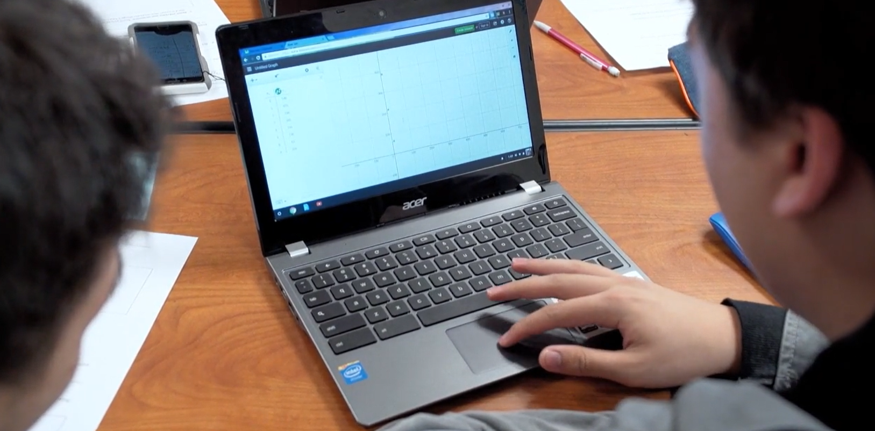
Findings Lesson 1 - Didactical Configuration
Lesson context “Cutting corners” activity
  Volume optimization problem. Students build physical models of boxes by cutting corners and folding a piece of paper and calculating the volume. Then find the maximum volume by fitting a polynomial function through all data points.
Classroom organization
  Students are seating in groups of 4-5, with desks facing each other.
  Group members have roles (e.g., a facilitator keeps the group moving forward).
Resources Available
  Each group works with 2 Chromebooks.
  Technology tool: Desmos
  Cutting corners worksheet, paper and writing utensils.

Slide 14
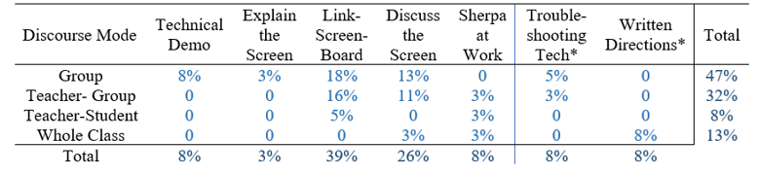
Findings Lesson 1 – Modes of discourse and influence on instrumental genesis
Novel categories of influence on instrumental genesis
Four discourse modes. Group (student-to student) and Teacher-group being most prevalent.
The modal categories of influence on instrumental genesis
Notes:
There were 38 transcript lines that contained evidence of influence on instrumental genesis.

Slide 15


Findings Lesson 1 - New categories of influence on instrumental genesis
Troubleshooting Technology
In a few instances students/teacher ran into technology issues they had to troubleshoot using their knowledge of mathematics and technology. For example, one group got a scatter plot with all points on the y axis. Based on their knowledge of the coordinate points and graphs they knew something must be wrong. They worked together to fix the technological issue using multiple routes.
Written Directions
Teacher gave technology directions in written form on the worksheets. For example, “Use the regression feature to find a function that models the data” (Cutting Corners Worksheet)
Notes:
Written directions: Some of the worksheets Mrs. Burke gave provided written directions for students to make links between mathematics and the Desmos software. For example, “Use your model to find the maximum volume of the box.”
Mrs. Burke and the students had to use their knowledge of both technology and mathematics to troubleshoot technological issues that arose. For example, when one group was creating a scatterplot in Desmos their graph showed all points on the y-axis (Figure 1). They questioned, “why is it like that?”, knowing something must be wrong, and worked together to fix the technological issue.

Slide 16
Findings Lesson 2 - Didactical Configuration
Lesson context “Rocket launch” activity
  Students watched a Desmos animation of a rocket launch and adjusted parameters to get the rocket go at different speeds and heights. Then, used Code.org to match the code that animates the rocket to a mathematical representation of its movement.
Classroom organization
  Students seat in rows of computer desks facing the front of the room.
Resources Available
  Individual desktop computers
  Technology tool: Desmos and Coge.org

Slide 17
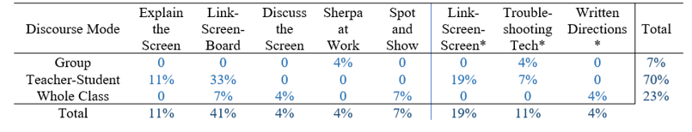
Findings Lesson 2 – Modes of discourse and influence on instrumental genesis
Only three discourse modes. No Teacher-group interaction, since students mostly worked individually.
The modal category of influence on instrumental genesis
Novel categories of influence on instrumental genesis
Notes:
There were 27 transcript lines that were coded for influencing student’s instrumental genesis.
Five out of six original instrumental orchestration categories (all except technical-demo) were detected.

Slide 18


Findings Lesson 2: New categories of influence on instrumental genesis
Link-Screen-Screen
Students were using two windows Desmos and Code.org to link their model rocket and velocity to the mathematics they were doing.
Troubleshooting Technology
In a few instances students/teacher ran into technology issues they had to troubleshoot using their knowledge of mathematics and technology.
Written Directions
Teacher gave technology directions in written form of written text on front board.

Slide 19
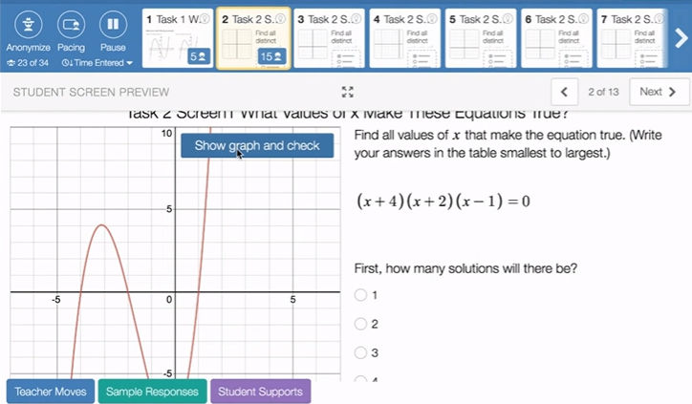
Findings Lesson 3 - Didactical Configuration
Lesson context: Finding roots of polynomials
Classroom organization
  Online lesson (via Zoom) in Desmos classroom.
  Teacher has access to students’ screens.
  Anonymous sharing of student work
Resources Available
  Desmos classroom
  Screen sharing available to students

Slide 20
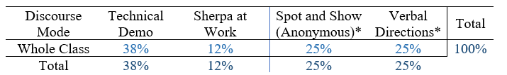
Findings Lesson 3 – Modes of discourse and influence on instrumental genesis
A single discourse mode.
The modal category of influence on instrumental genesis
Novel categories of influence on instrumental genesis
Notes:
This lesson only had whole class discourse and contained 8 influences on instrumental genesis.
Only one original category of instrumental geneses was observed – technical demo.
Two

Slide 21


Lesson 3 New Categories
Verbal Directions
Teacher gave verbal directions for students about Desmos, e.g., “Can you all make your way to screen 2 with me now?”
Anonymous Spot-and-Show
Teacher showed anonymized student work and responses to discuss with the whole class.

Slide 22
Summary and Discussion
RQ1: What are the didactical configurations (the setting and the artefacts) for each lesson?
Different didactical configurations afford different instrumental orchestrations and different supports for instrumental genesis.
All lessons used Desmos in some form.
All lessons involved rich mathematical tasks with multiple representations.
Group work with shared laptops.
Students sitting in rows with individual computers.
Teacher-led remote lesson via Zoom.
Significant student-to-student interactions.
Limited to none student-to-student communication

Slide 23
Summary and Discussion
RQ2: How do teachers enact instrumental orchestration in various modes of discourse?
RQ3: How do peers influence each other’s instrumental genesis?
Drijvers et al’s (2010) categories of instrumental orchestration can be observed in other configurations than a whole class, and can be applied to a variety of communication styles:
  Group
  Whole Class
  Teacher-Student
  Teacher-Group
New categories of influence on instrumental genesis emerged
  Written / Verbal directions
  Link-Screen-Screen
  Troubleshooting Technology
  Anonymous Spot-and-Show
Notes:
The categories of teachers’ instrumental orchestration continue to be available to them. But in addition, there are new categories on student influence on instrumental orchestration.

Slide 24
Methodological limitations vs. affordances
Small number of videos
Online videos are selective and often heavily edited (short clips instead of a whole lesson)
No control over the camera movement or choice of captured object (doesn’t stay with a single group).
Our analysis cannot be used to characterize lessons.
Online video is freely available
Access to a variety of educational settings, grade-levels, technological tools.
Focuses on “significant” classroom events (e.g., no home-work check, test returns, discipline problems…)
Students knowing that they are being recorded tend to focus on the mathematical task at hand.
Access to supplementary materials, like lesson plans, transcripts and teacher interviews.

Slide 25

Implications
Students increasingly become comfortable with digital technology and can support each others’ instrumental genesis.
Teachers can influence the types of communications in class and influence students’ instrumental genesis by choosing certain didactical configurations in their lessons.
Current and novice teachers, and teacher educators can use the categories of influence on instrumental genesis to structure and assess mathematics instruction.
Researchers can use the extended framework of Influence on Instrumental Genesis to analyze technology-rich mathematics instruction.
Methodologically, our study presents a proof of concept of the utility of using publicly available video of teaching and learning with technology to study instrumental genesis.

Slide 26
References
Artigue, M. (2002). Learning mathematics in a CAS environment: The genesis of a reflection about instrumentation and the dialectics between technical and conceptual work. International Journal of Computers for Mathematical Learning, 7, 245–274.
Drijvers, P., Doorman, M., Boon, P., Reed, H., & Gravemeijer, K. (2010). The teacher and the tool: Instrumental orchestrations in the technology-rich mathematics classroom. Educational Studies in mathematics, 75(2), 213-234.
Maschietto, M., & Trouche, L. (2010). Mathematics learning and tools from theoretical, historical and practical points of view: The productive notion of mathematics laboratories. ZDM, 42, 33–47.
Trouche, L. (2004). Managing the complexity of human/machine interactions in computerized learning environments: Guiding students’ command process through instrumental orchestrations. International Journal of Computers for mathematical learning, 9(3), 281-307.
Trouche, L., & Drijvers, P. (2010). Handheld technology for mathematics education: Flashback into the future. ZDM, 42(7), 667-681.
Buteau, C., Muller, E., Rodriguez, M. S., Gueudet, G., Mgombelo, J., & Sacristán, A. I. (2020). Instrumental orchestration of using programming for mathematics investigations. Mathematics Education in the Digital Age (MEDA), 443.

Slide 27

Thank you!
Catherine Dennis
catherine.dennis@unh.edu
Orly Buchbinder
orly.buchbinder@unh.edu

Slide 28
Overview
Motivation
Research Questions
Framework: Instrumental Genesis and Orchestration
Drijvers et al. instrumental orchestration categories
Methods
Descriptions of learning contexts/data
Analytic Framework
Key findings
Conclusion/Discussion
Implications for Education

Slide 29
Summary and Discussion
RQ2: How do teachers enact instrumental orchestration in various modes of discourse?
Different lesson styles contribute to different types of communication
Group
Whole Class
Teacher-Student
Teacher-Group
Whole class instrumental orchestration categories (Drijvers et al., 2010) can be applied to the above communication styles. Additionally, more categories for instrumental genesis emerged
Directions
Link-Screen-Screen
Troubleshooting Technology
Anonymous Spot-and-Show

Slide 30
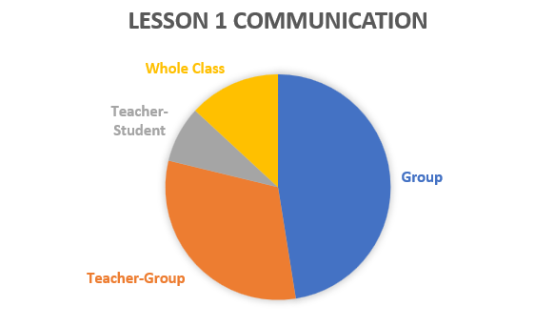
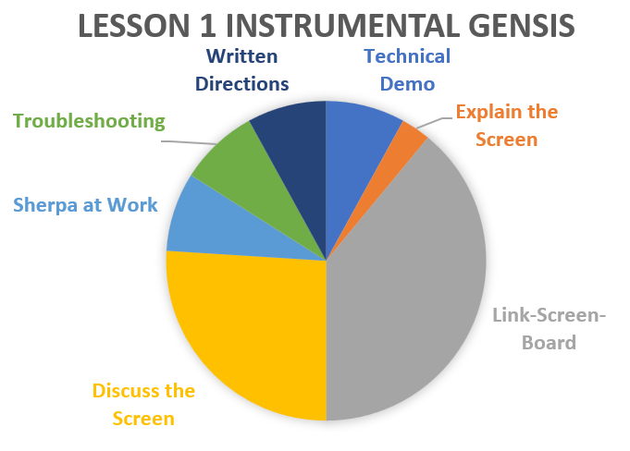
Key Findings: Lesson 1

Slide 31
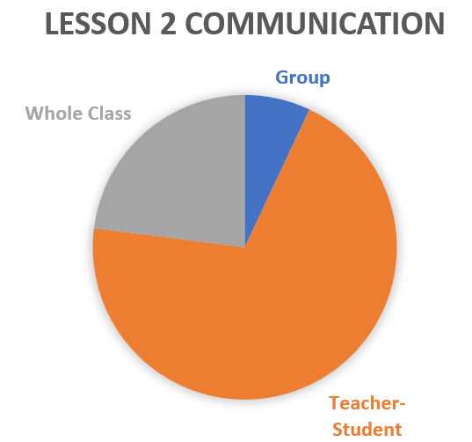
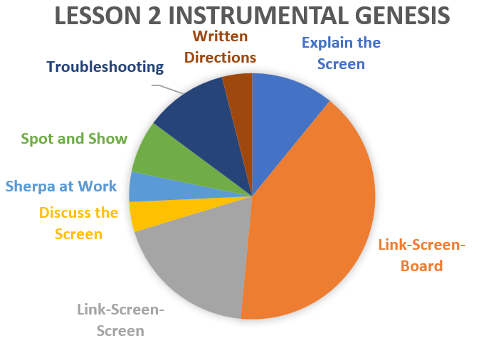
Key Findings: Lesson 2

Slide 32
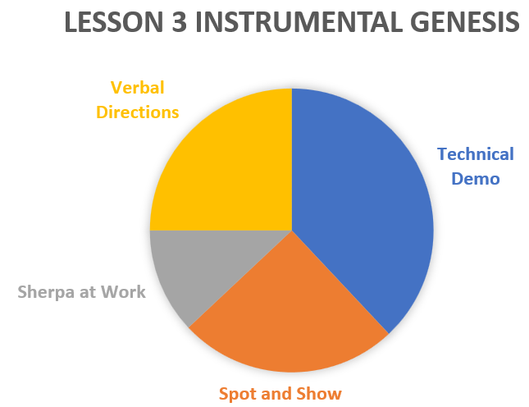
Key Findings: Lesson 3

