Slide 1


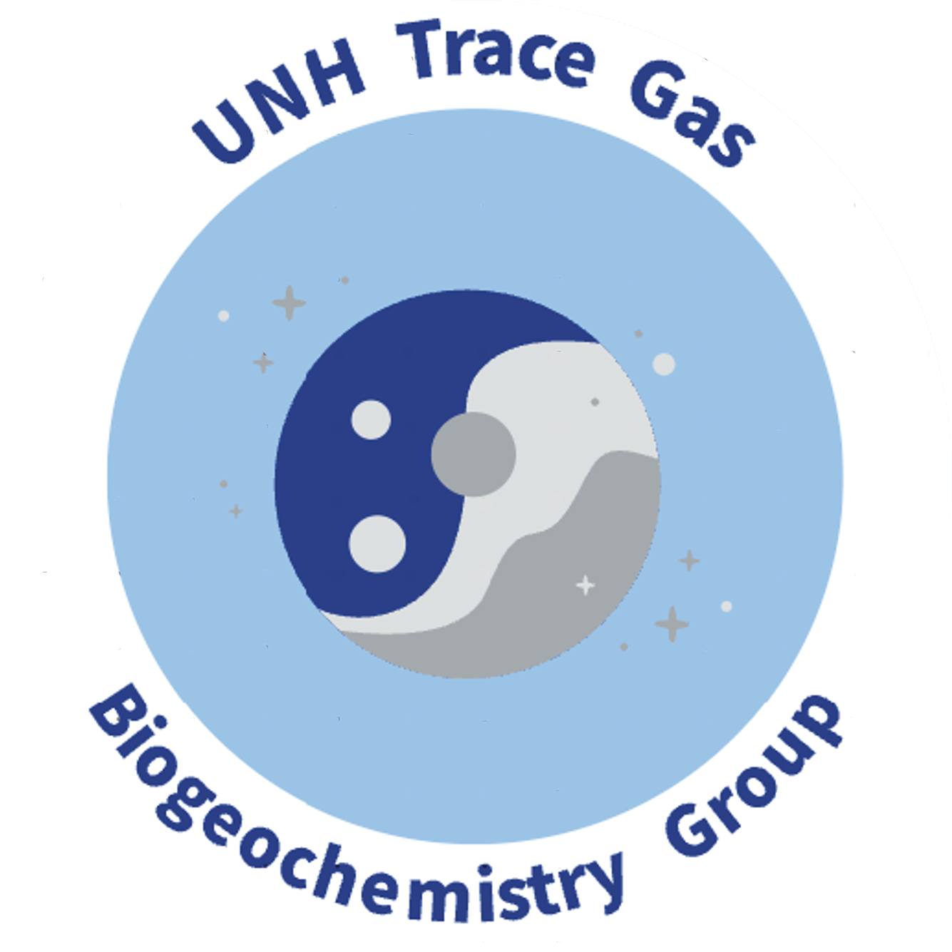

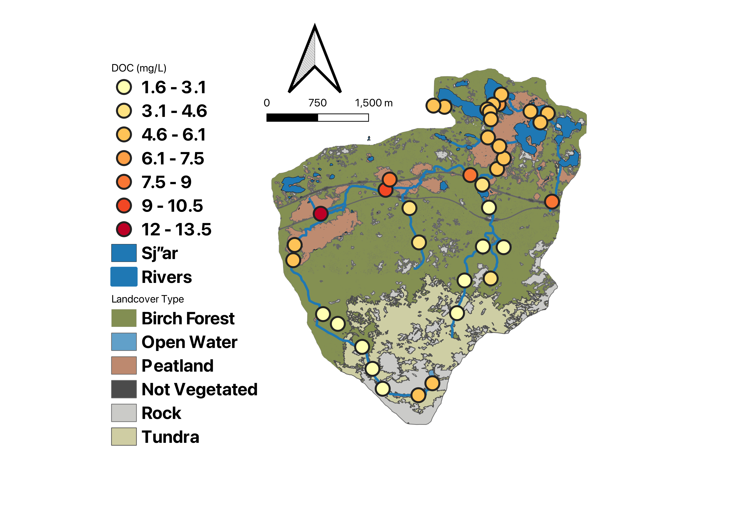
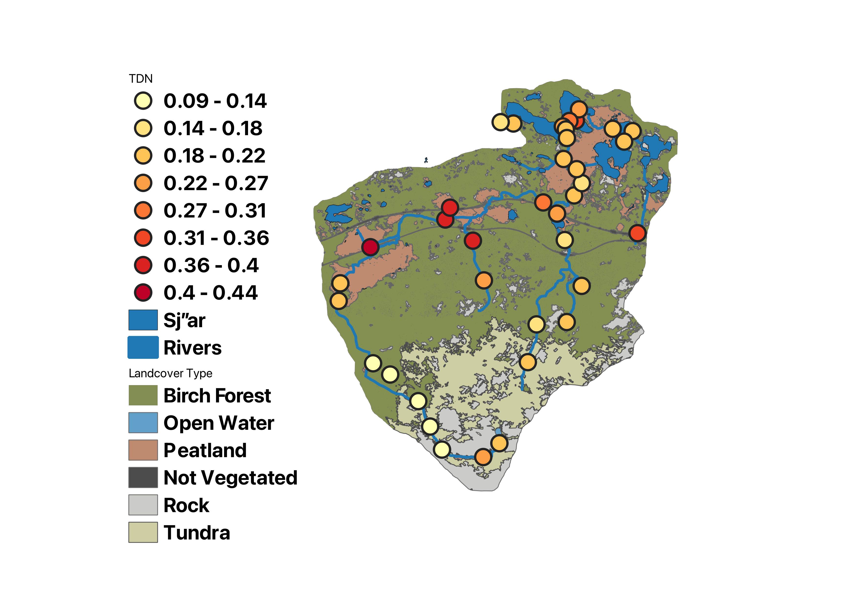
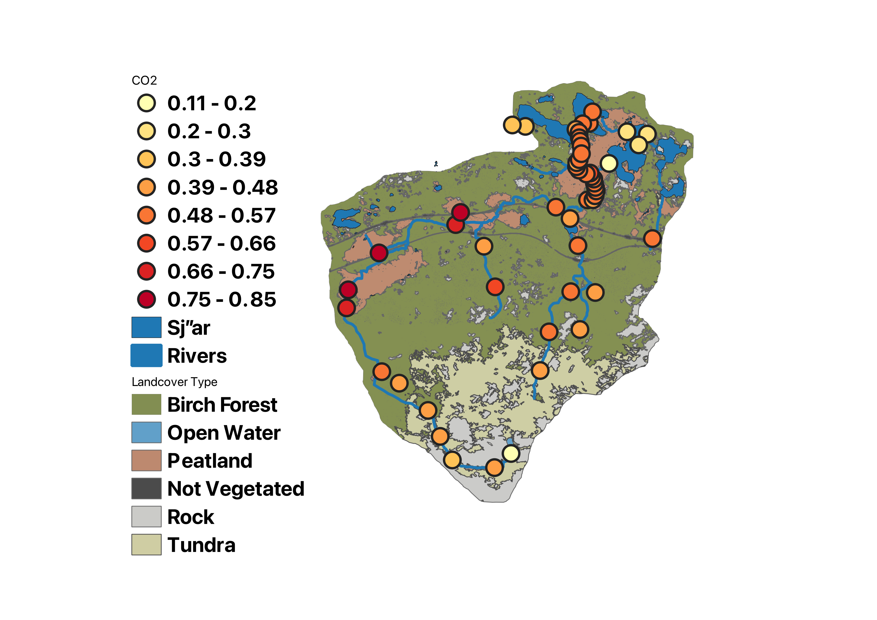
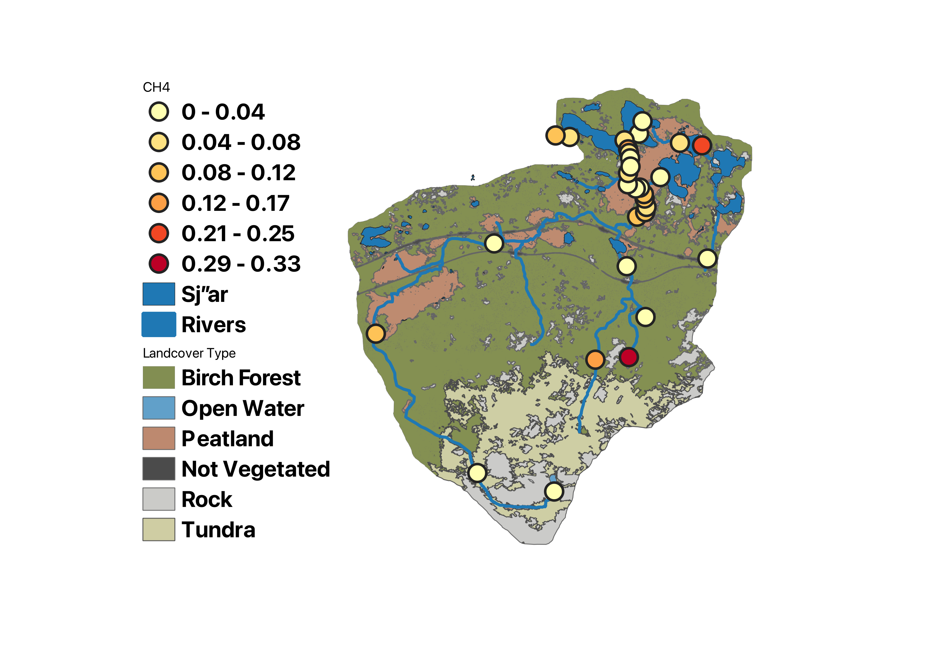
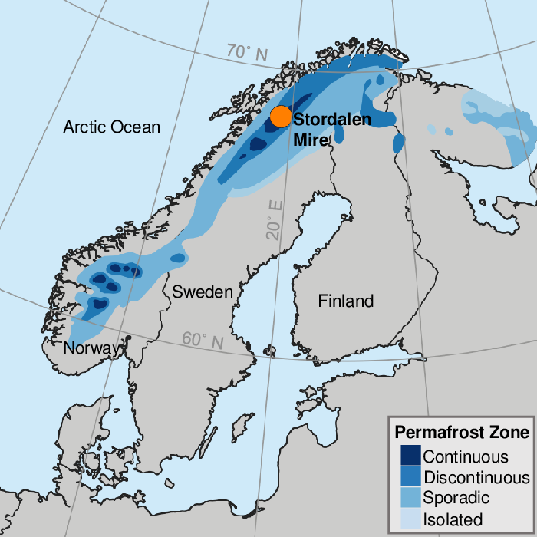
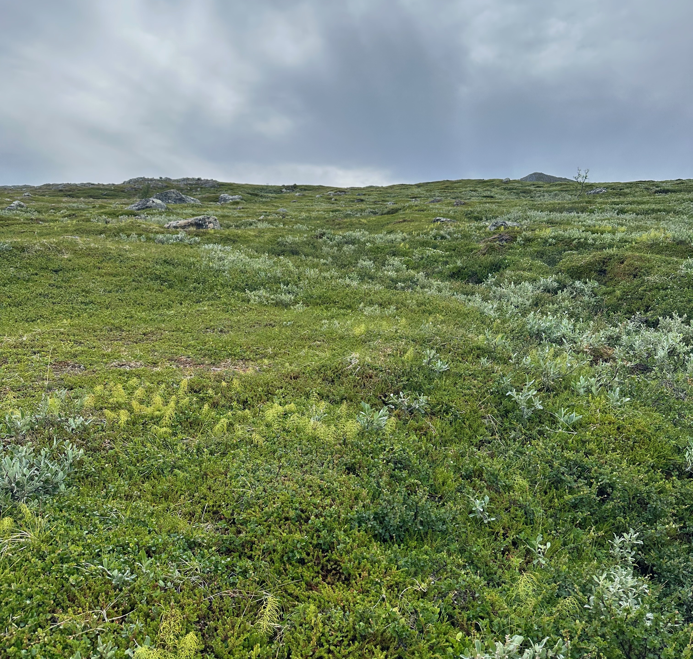
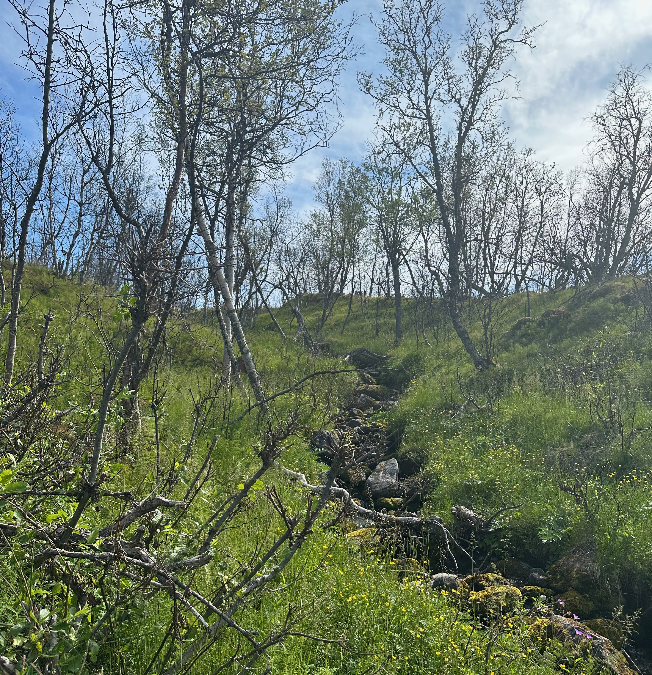
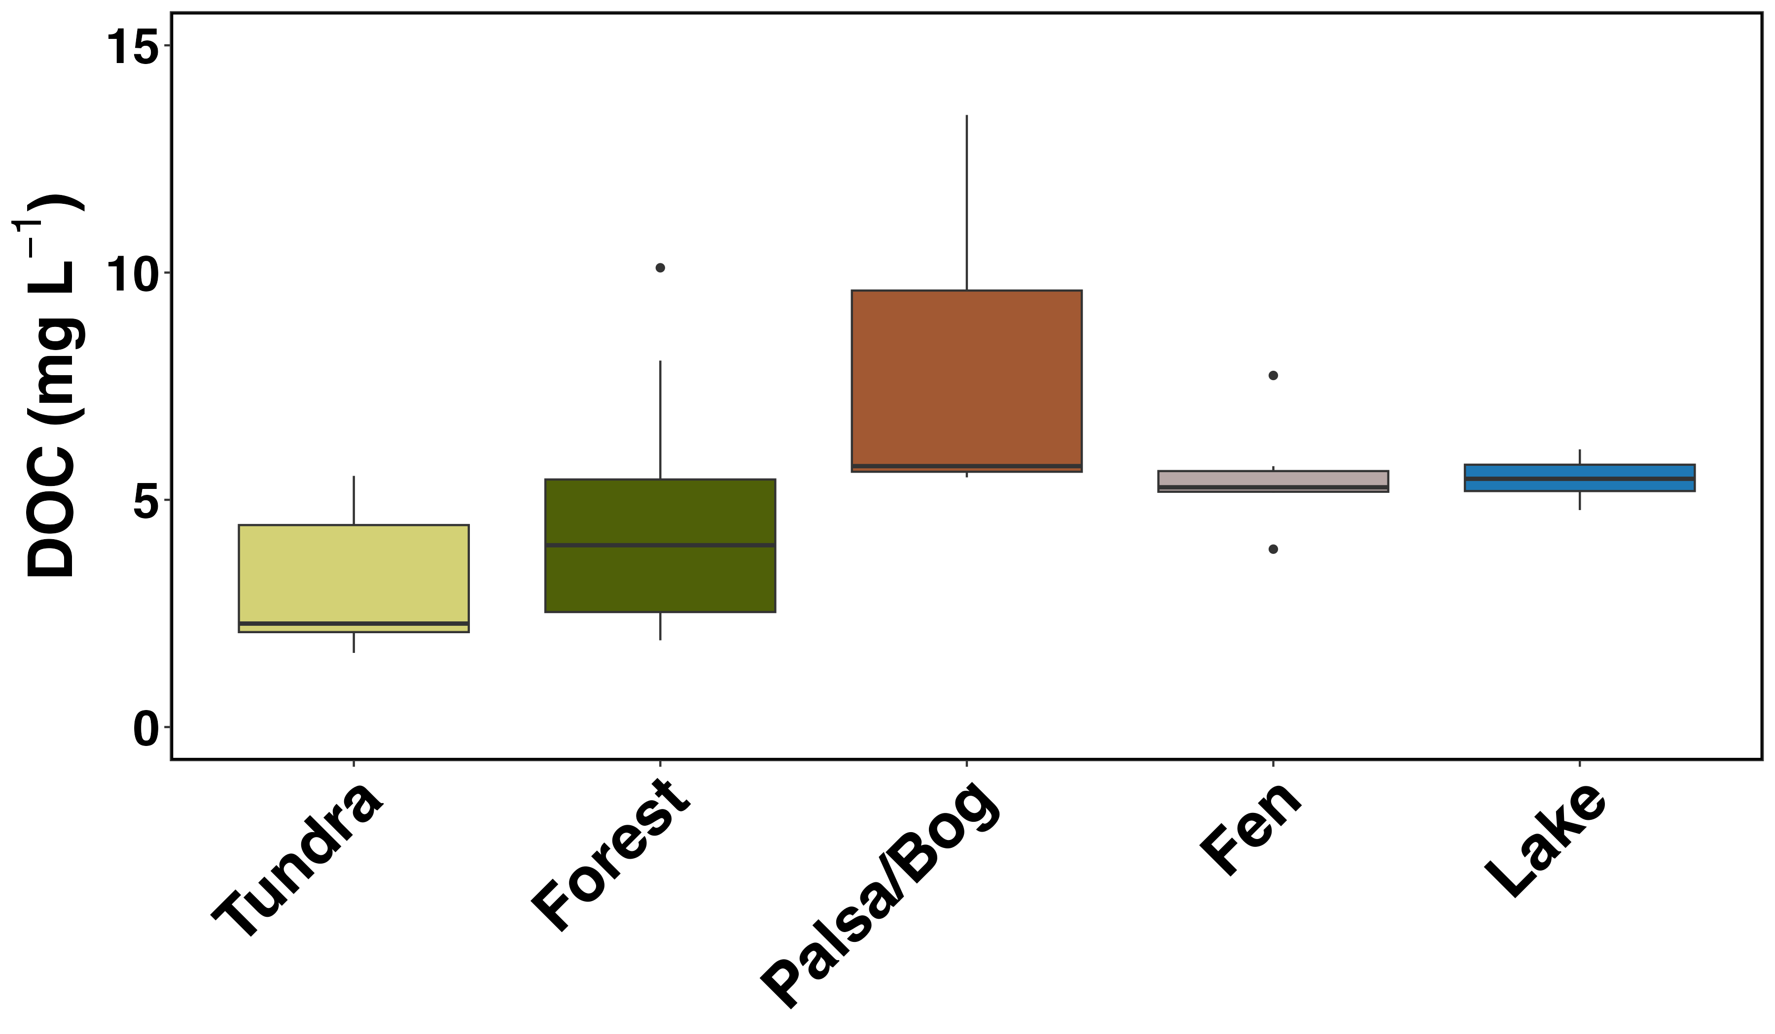
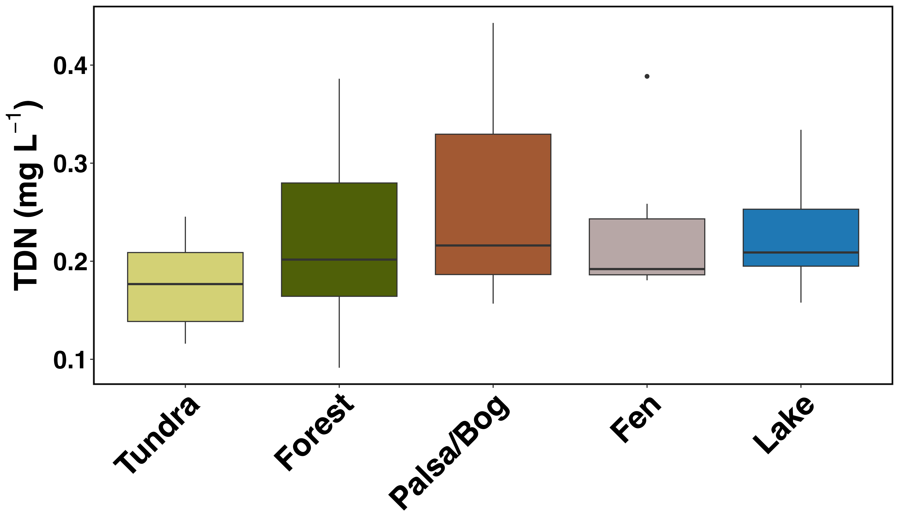
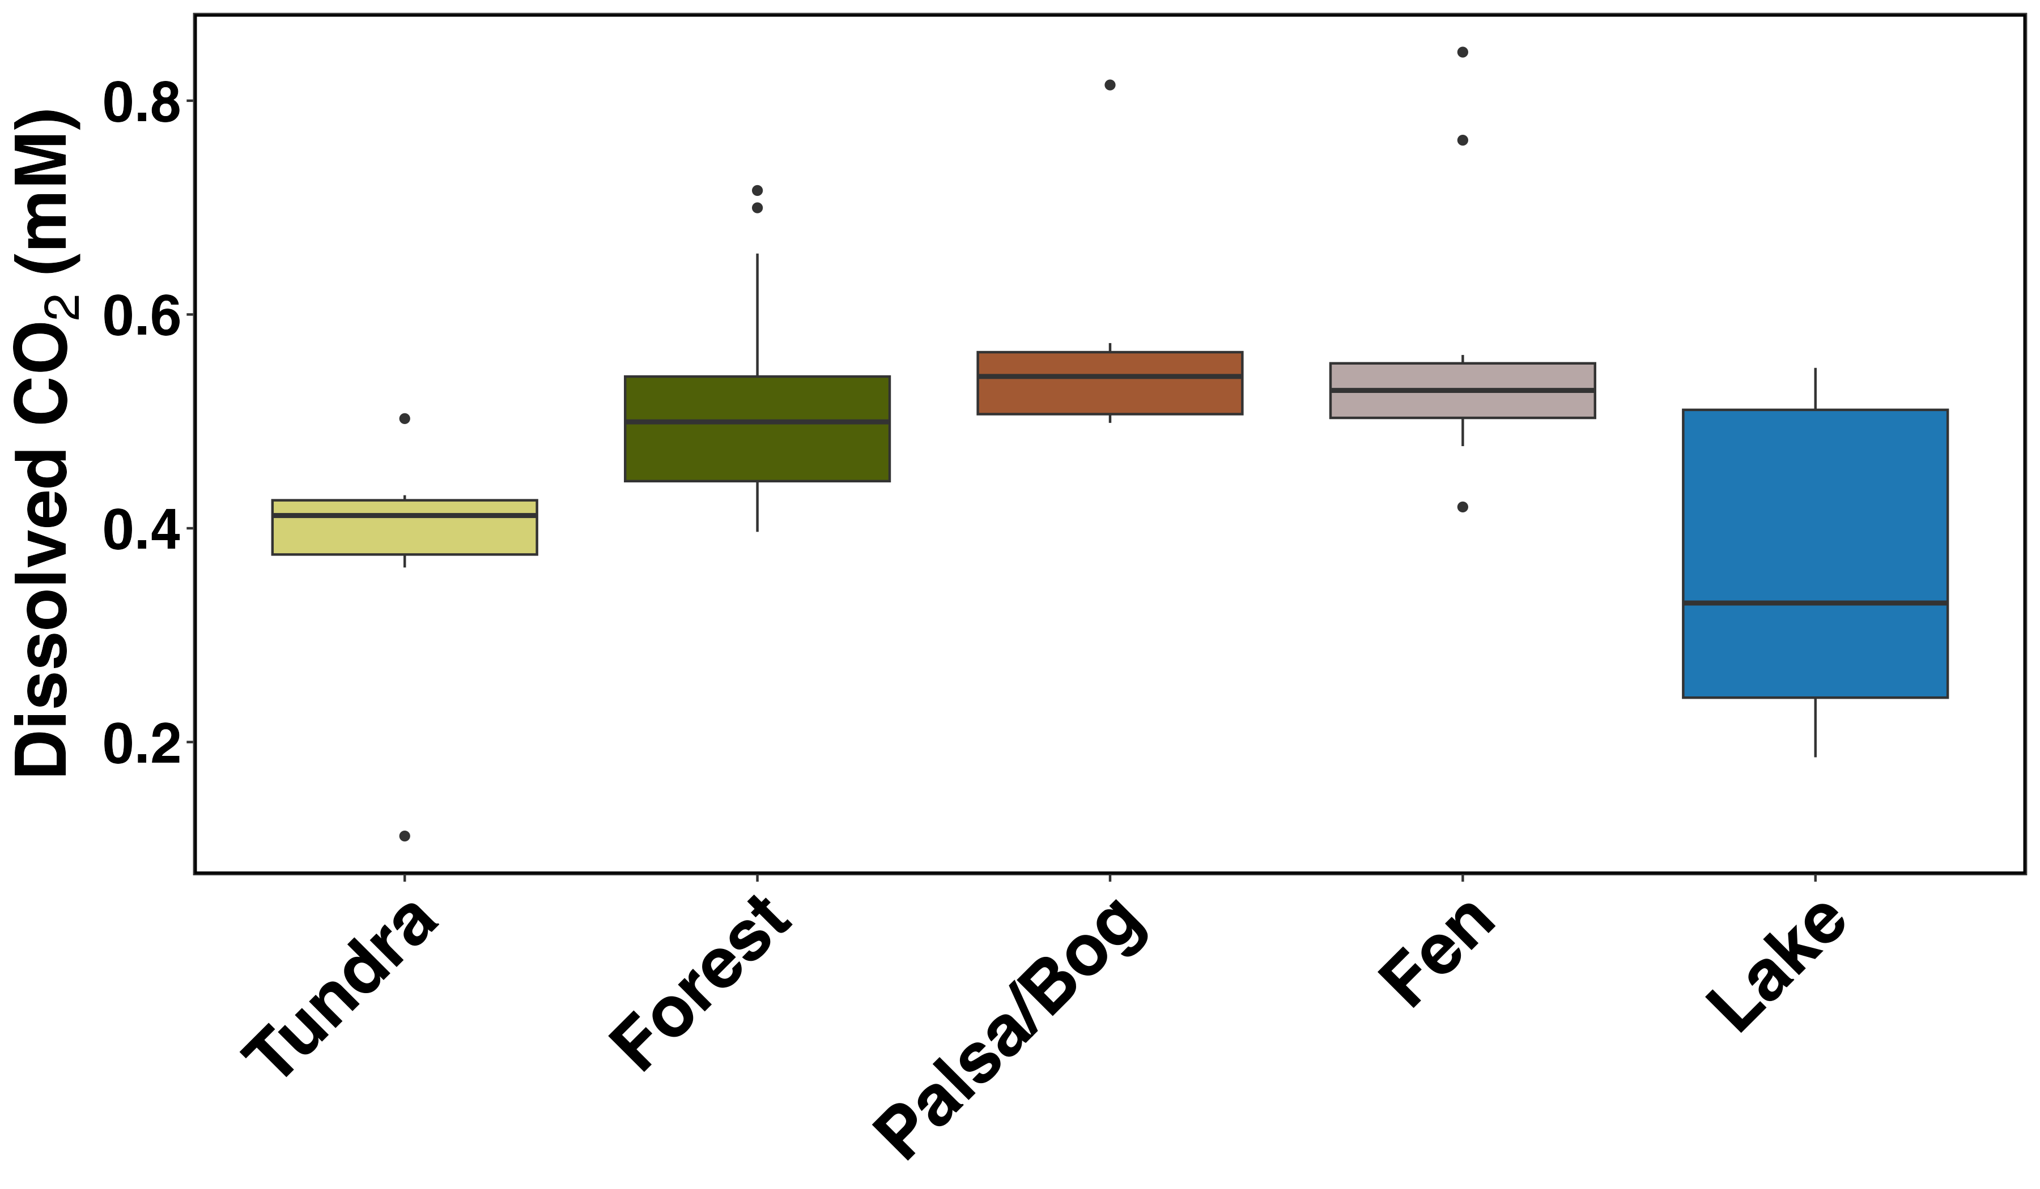
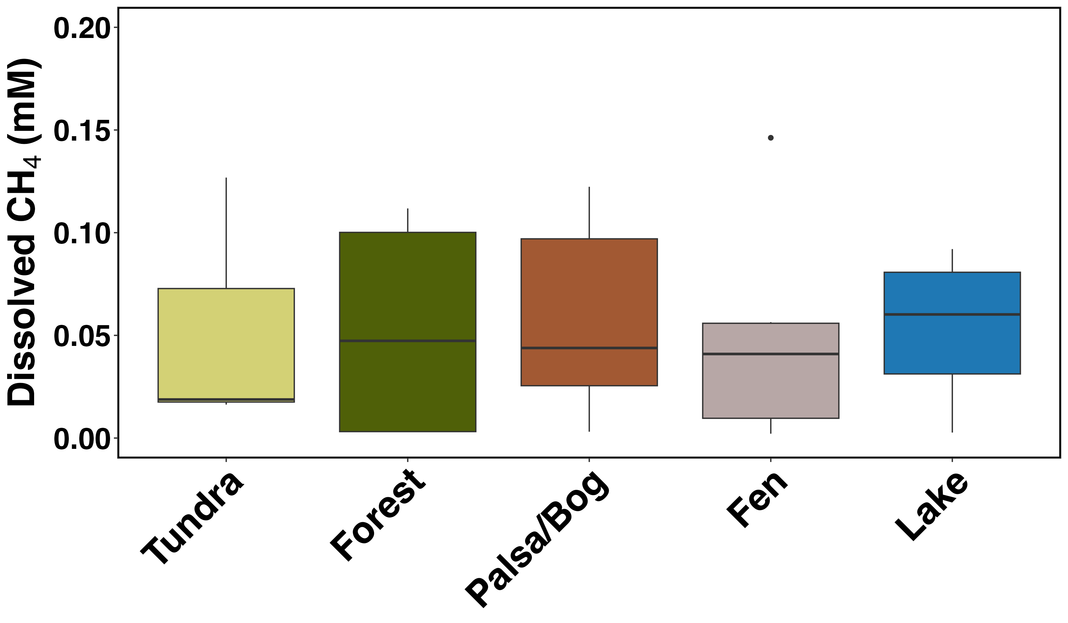
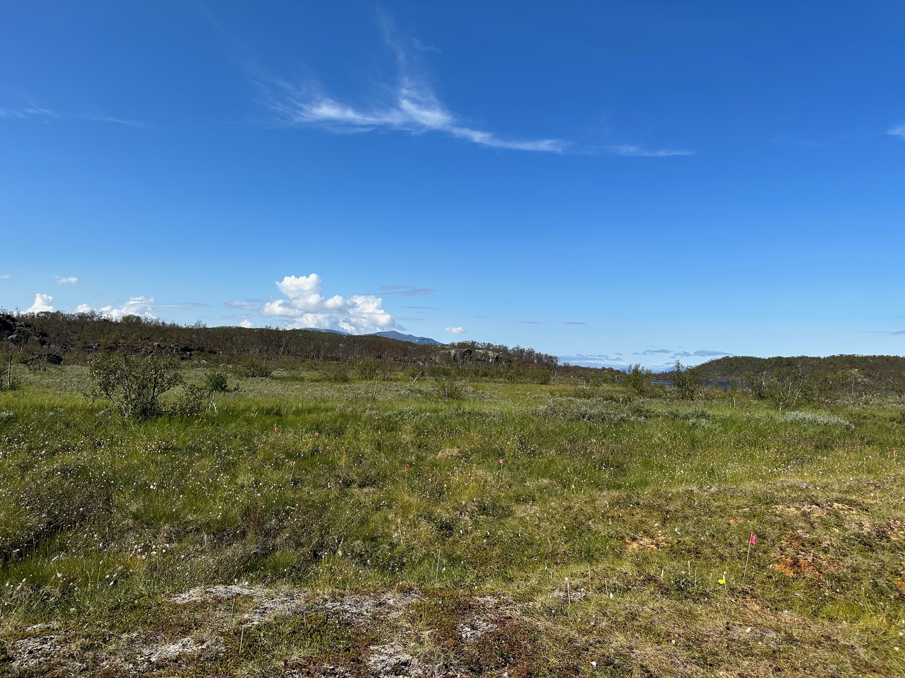
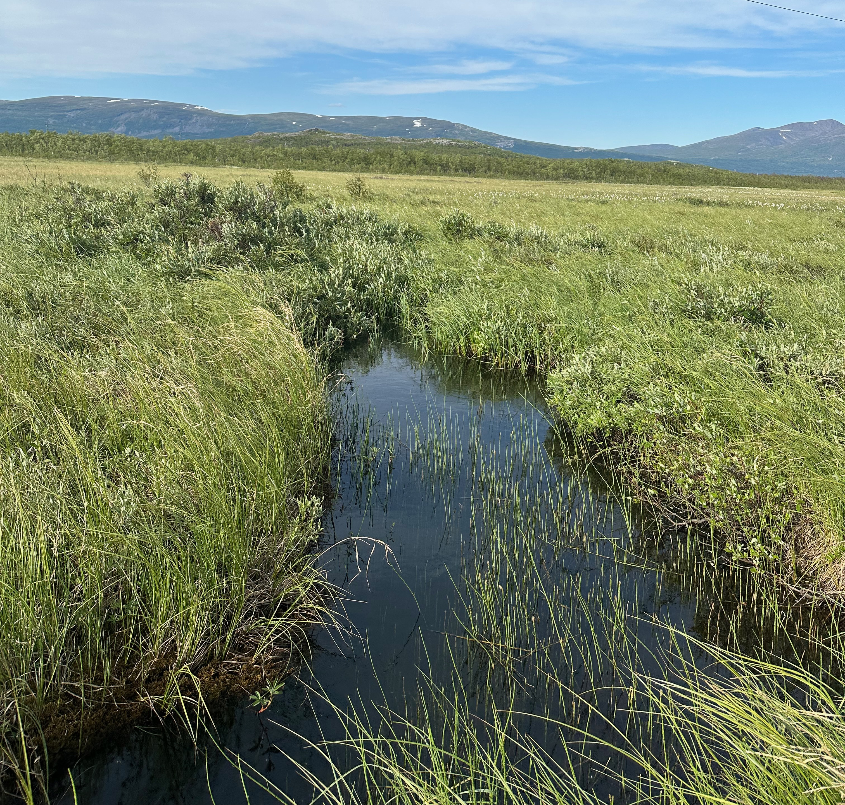
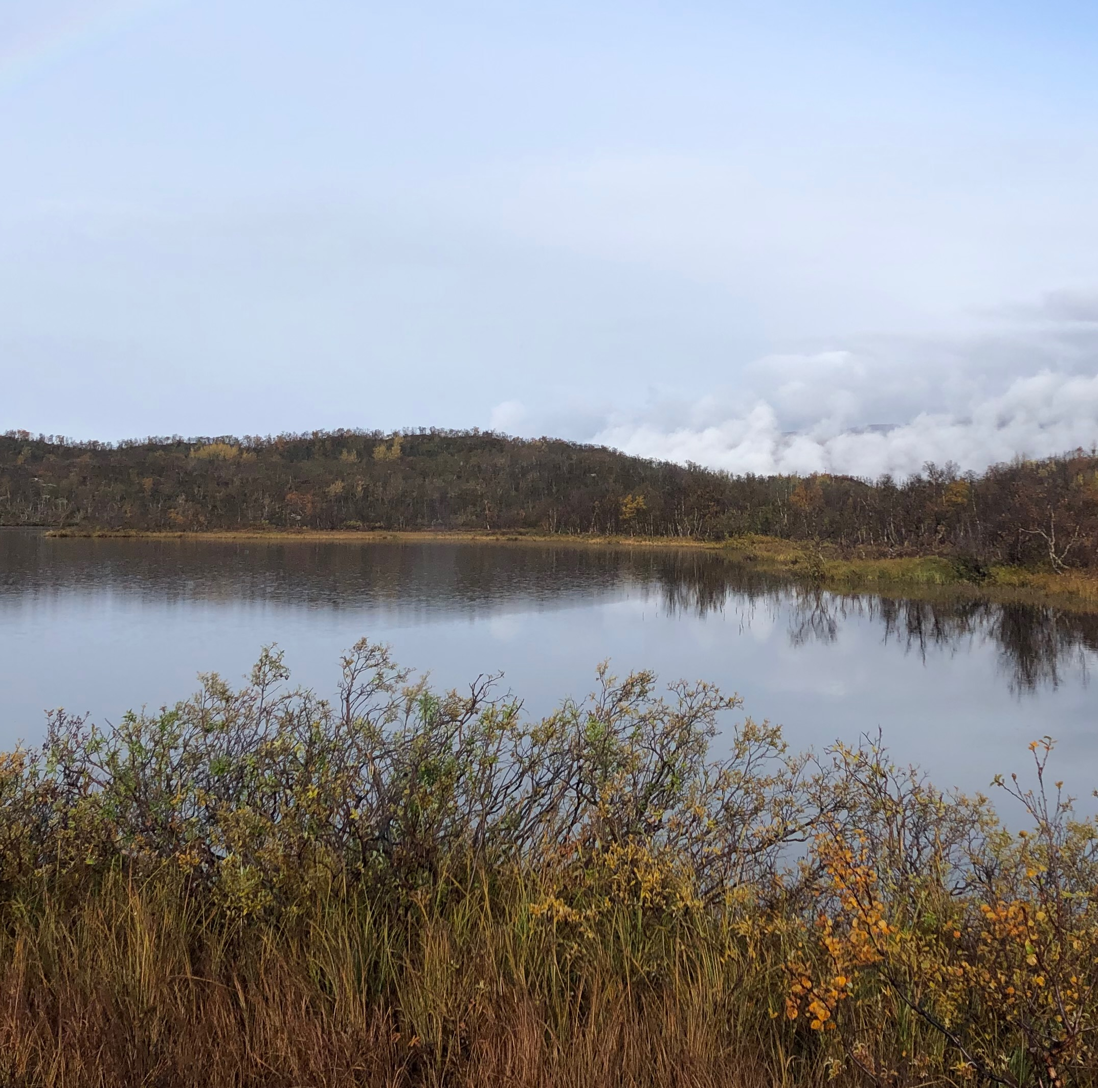
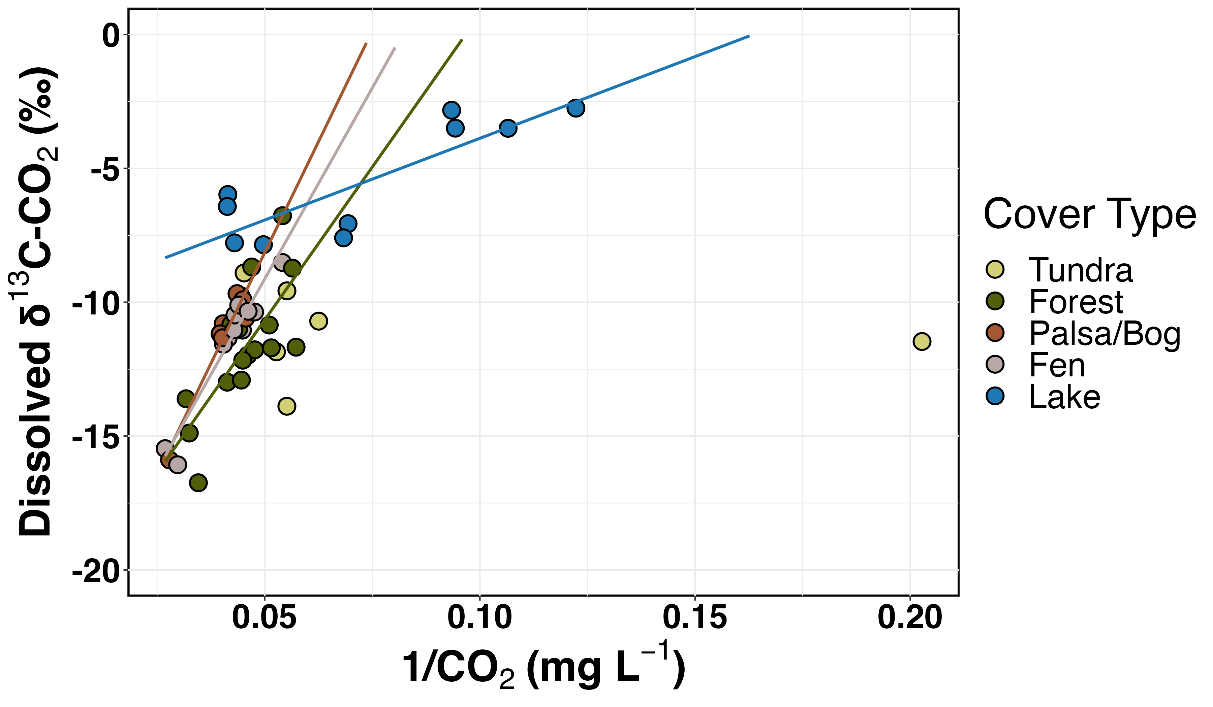
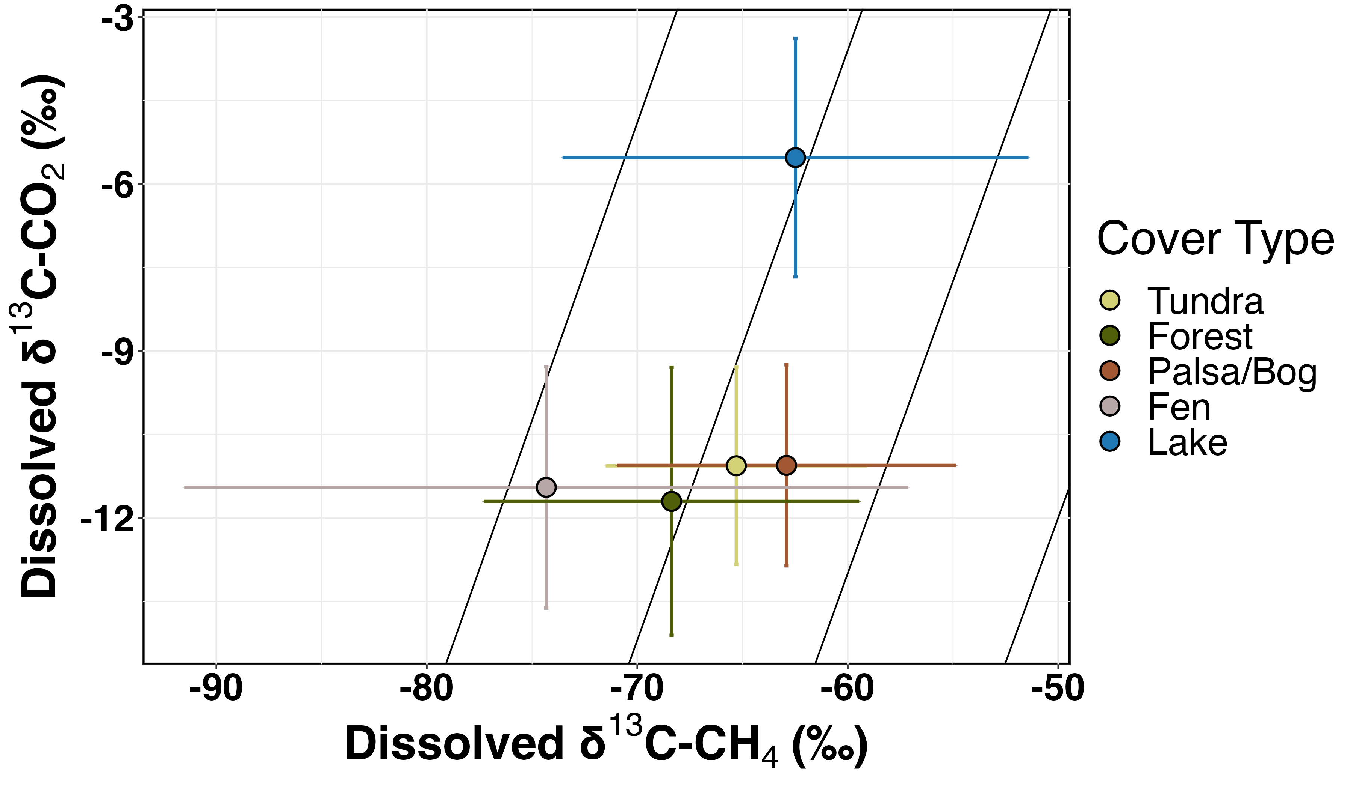
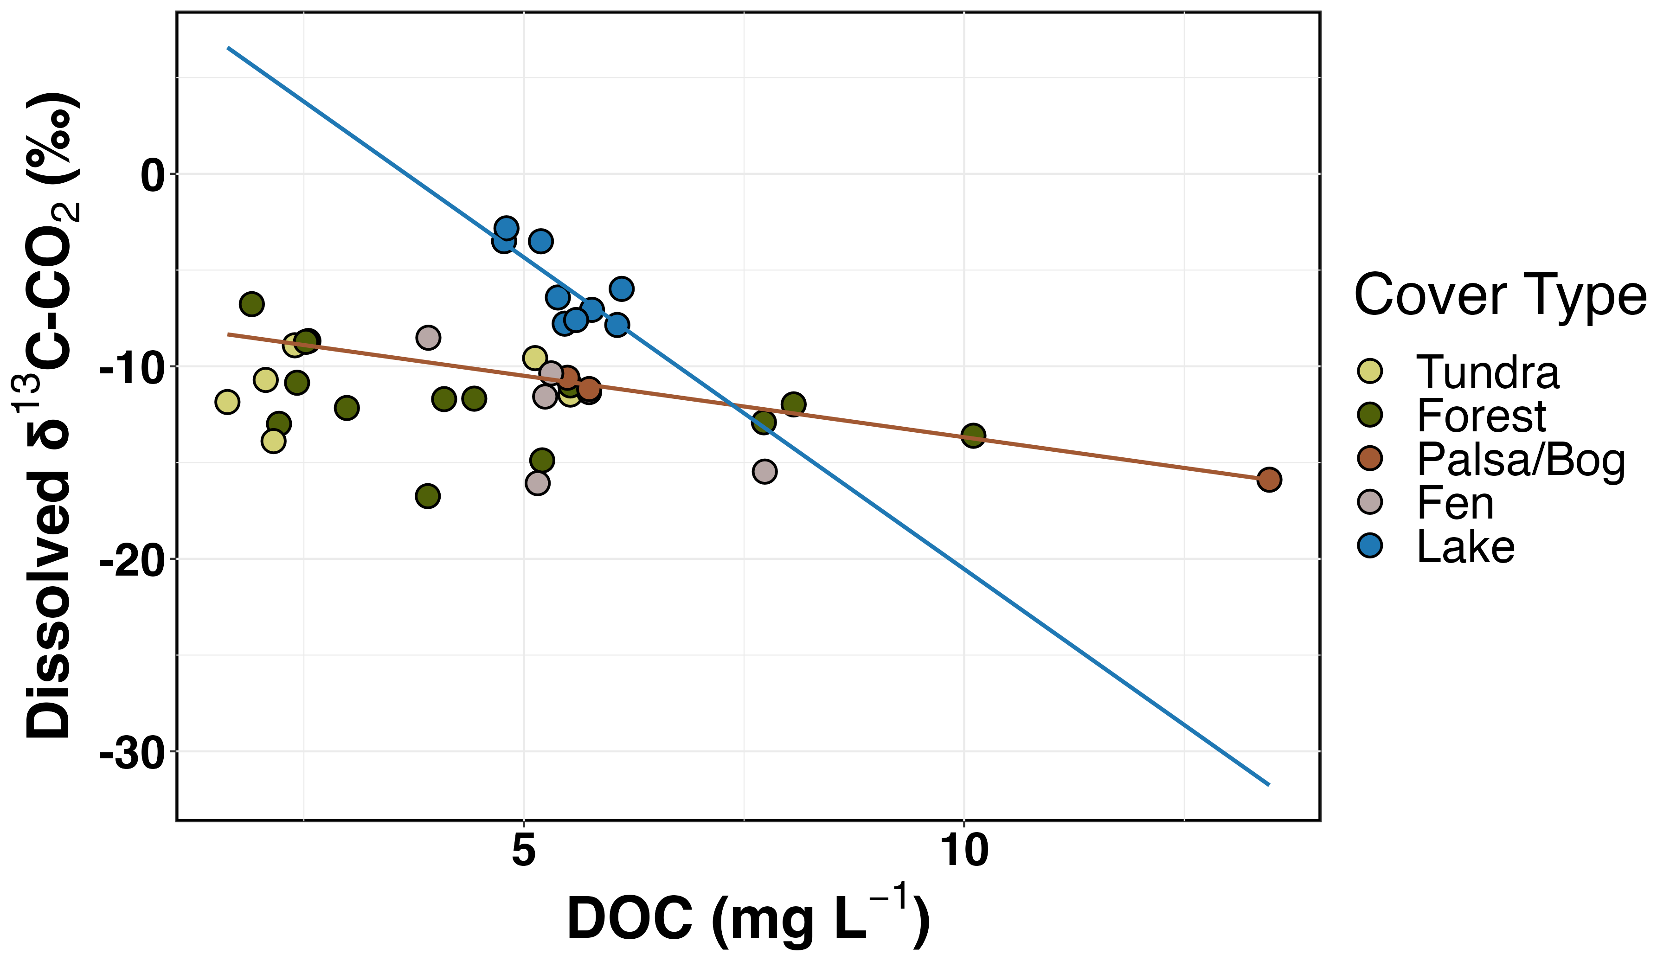
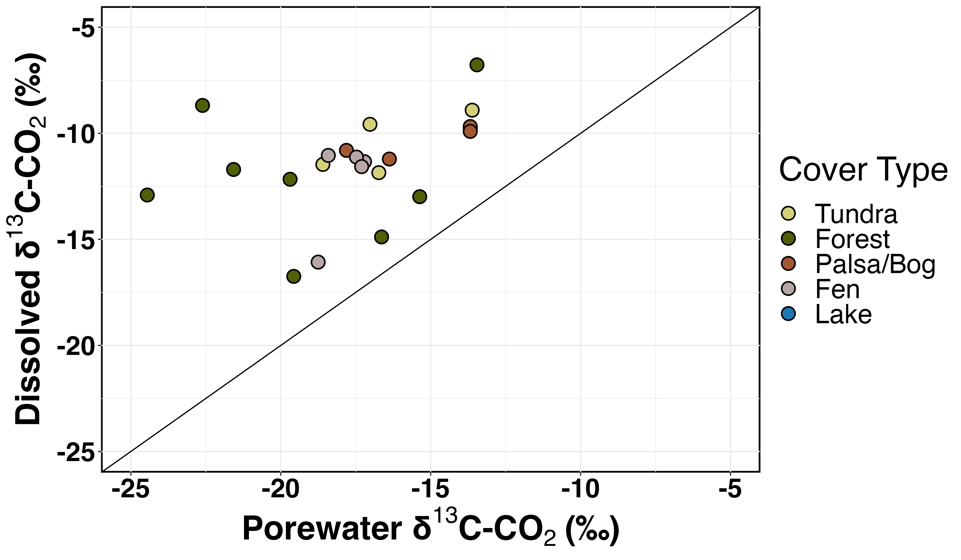
Spatial Variability of Carbon Fluxes in a Subarctic Catchment
AGU 2023: B41G- 2534
cheristy.jones@unh.edu
@cheristy.jones
Cheristy P. Jones¹, McKenzie A. Kuhn¹, Lyreshka Castro-Morales¹, M. Florencia Fahnestock¹, Elijah Atley², Josibel Pardo¹, Helen Sears¹, Jeff Chanton³, Ruth K. Varner¹
¹University of New Hampshire, ²Delaware State University, ³Florida State University
How does carbon quantity change throughout the catchment? What are the sources of this carbon?
In-stream DOC and CO₂ Concentrations are Highest in Palsa/Bog Reaches
Fig. 1. In-stream concentrations of a) DOC (mg L⁻¹), b) TDN (mg L⁻¹), c) CO₂ (mM), and d) CH₄ (mM) overlayed on a cover type map of the Stordalen Mire Catchment^{3,4}. Point color indicates concentration, with yellow noting lower concentrations and red noting higher concentrations. Fens and palsa/bogs are a subset of the peatland classification.
a)
DOC (mg L⁻¹)
b)
c)
d)
TDN (mg L⁻¹)
pCO₂ (mM)
pCH₄ (mM)
Arctic flow paths are shifting…
…which can move highly labile carbon (C) into streams, potentially increasing CO₂ and CH₄ emissions^{1,2}. Understanding the spatial variability and controls of these fluxes will be crucial for scaling C emissions and modeling transformations.
Sampling in Stordalen Mire Catchment
Cover Type
c
Flow
ab
bc
b
b
ac
a
bc
bc
a
Map: McKenzie Kuhn
Tundra
Birch Forest
Fig. 2. In-stream a) DOC (mg L⁻¹), b) TDN (mg L⁻¹), c) pCO₂ (mM), and d) pCH₄ (mM) concentrations across dominant stream reach cover types. Different letters indicate statistical significance (p<0.05).
Evasion is a Strong Control of CO₂ Concentrations
b)
Palsa/Bog
Fen
Lake
a)
R² = 0.52
α= 1.07
Sampled surface water and hillslope porewater July 12-18, 2023 for: dissolved organic carbon (DOC), dissolved CO₂ (pCO₂), dissolved CH₄ (pCH₄), dissolved δ¹³C-CO₂ and δ¹³C-CH₄
Palsas: permafrost peat mounds, bogs: peatlands without groundwater inputs, fens: peatlands with groundwater inputs
R² = 0.91
Oxidation
R² = 0.92
R² = 0.68
α= 1.06
α= 1.05
Main Conclusion
DOC and CO₂ concentrations are highest in palsa/bog reaches, driven by evasion and more biogenic sources. Increasing DOC concentrations from shifting flow paths could shift the fate of C and the magnitude of CO₂ emissions in Arctic catchments.
α= 1.04
Fig. 3. a) Keeling plot showing the relationship between in-stream dissolved δ¹³C-CO₂ (‰) and 1/CO₂ (mg L ⁻¹) Linear regressions drawn and noted for significant relationships (p<0.05). A positive relationship indicates evasion as a strong control of CO₂ concentrations⁴. b) in-stream dissolved δ¹³C-CO₂ (‰) and in-stream dissolved δ¹³C-CH₄ (‰). More negative δ¹³C-CO₂ and more positive δ¹³C-CH₄ could indicate oxidation. Point color indicates color type.
Biogenic Sourcing in Lakes and Palsa/Bogs
b)
a)
R² = 0.99
1:1
R² = 0.55
R² = 0.70
Acknowledgments
Our fieldwork occurs on the unceded homeland of the Sámi Peoples (Sápmi). I acknowledge this not only in thanks to the Indigenous communities who have held a relationship with this land for generations, but also in recognition of the historical and ongoing legacy of colonialism. LAND BACK. We would like to thank Apryl Perry and Samantha Bosman for technical support as well as Nathalie Triches, Bianca Cilento, and everyone who hiked up the mountain with us.
Funding: the Department of Energy (DE-SC0023456), the EMERGE BII (NSF-DBI 2022070), the Swedish Polar Research Secretariat and SITES for the support of the work done at the Abisko Scientific Research Station (SRC 4.3-2021-00164), the University of New Hampshire CEPS First Year PhD Fellowship and the CARPE NRT Fellowship (NSF #2125868).
References: 1. Frey, K. E., et al. (2005).Geophys. Res Letters. 2. Vonk, J.E., et al. (2015). Biogeosci. 3. Tang, J., et al. (2015). Biogeosci. 4. Mzobe, P., et al. (2020). Geophys. Res. Biogeosci. 4. Venkiteswaran, J.J., et al. (2014). PLOS. 5. Campeau, A., et al (2017). Sci. Reports. 6. Campeau, A., et al (2018). JGR.
Fig. 4. a) Relationship between in-stream dissolved δ¹³C-CO₂ (‰) and DOC (mg L ⁻¹). Linear regressions drawn and noted for significant relationships (p<0.05). A strong correlation indicates biogenic sources (i.e, soil CO₂, organic matter) are important for CO₂ concentrations⁵. b) Relationship between in-stream dissolved δ¹³C-CO₂ (‰) and hillslope porewater δ¹³C-CO₂ (‰). Significant relationships are noted. Values near the 1:1 line indicates terrestrially derived CO₂⁶. Point color indicates dominant cover type.

