Slide 1
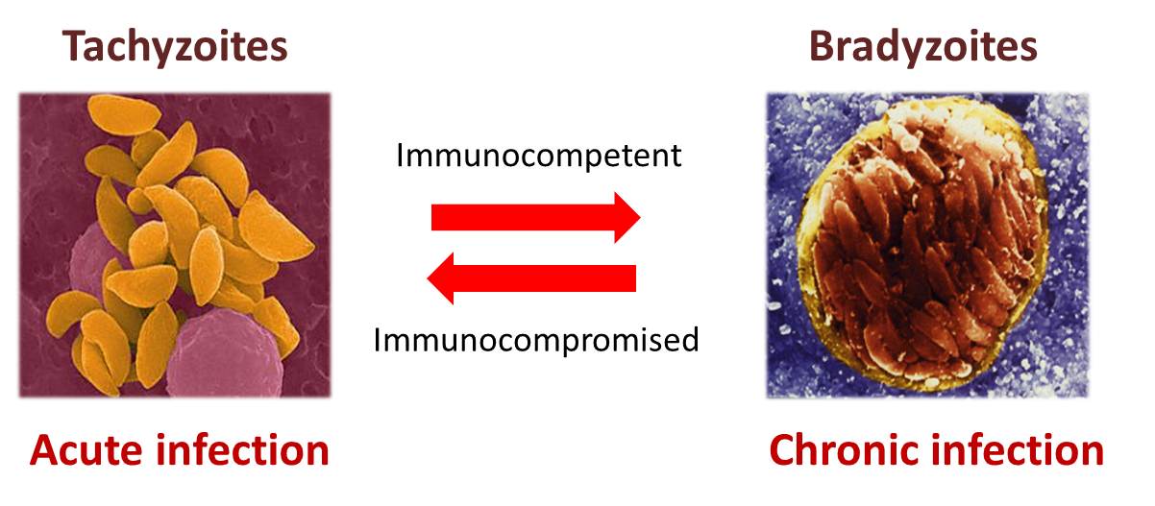
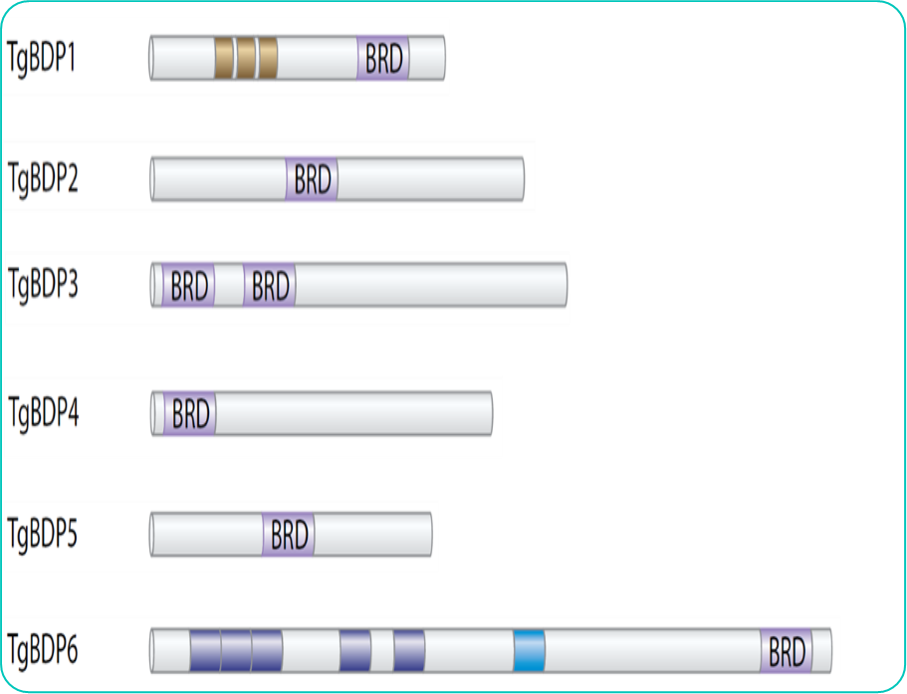
Identifying the biological function of Toxoplasma gondii bromodomain protein 5 Julia Heffernan, Dr. Krista Fleck, and Dr. Vicki Jeffers Department of MCBS, University of New Hampshire
Toxoplasma gondii
Hypothesis: TgBDP5 contributes to the gene regulation
of the differentiation between tachyzoites and bradyzoites
Approximately one third of the world population is infected with Toxoplasma gondii. The protozoan parasite is the third leading cause of foodborne disease deaths in the U.S.
What impact does the loss of TgBDP5 have on viability?
There are two distinct phases of the disease, the acute phase caused by the tachyzoites and the chronic form caused by bradyzoites. The key to the parasite’s success is their ability to differentiate between the tachyzoite and the bradyzoite form of the parasite.
All the mechanisms behind the differentiation have yet to be identified but histone acetylation is likely to contribute to this switch.
Parental
Knockout
A knockout was generated to look for a defect in the lytic cycle. No difference was seen between the parental and knockout strains in the replication of tachyzoites.
Bromodomain Proteins
Gel imaging confirming the knockout of TgBDP5 at the 5’UTR and 3’UTR..
What is the biological function of TgBDP5?
Histone acetylation is an essential part of gene regulation in Toxoplasma.
Bromodomain proteins bind acetyl-lysine residues on histone tails and link acetylated histones to the protein complexes that regulate transcription.
There are six parasite specific bromodomain proteins in Toxoplasma. They are essential for the parasite’s survival but their function is unknown.
3xHA endogenous tag
Confirm nuclear localization using Immunofluorescence
Identify bromodomain complexes using co-immunoprecipitation
Determine genes regulated through chromatin immunoprecipitation
Toxoplasma parasite-specific bromodomain protein
What impact does the loss of TgBDP5 have on
the parasite’s response to stress
Knockout Parasite
Transcriptomic analysis
Identify genes upregulated
Stress parasites with alkaline pH to promote upregulation of bradyzoite markers
Toxoplasma gondii bromodomain protein 5 (TgBDP5) is conserved in coccidia parasites. This suggests that it is involved in a parasite specific pathway like differentiation or bradyzoite maintenance.
References
Jeffers, V., Yang, C., Huang, S. & Sullivan, W. J. Bromodomains in Protozoan Parasites: Evolution, Function, and Opportunities for Drug Development. Microbiol. Mol. Biol. Rev. MMBR 81, (2017).

