Slide 1

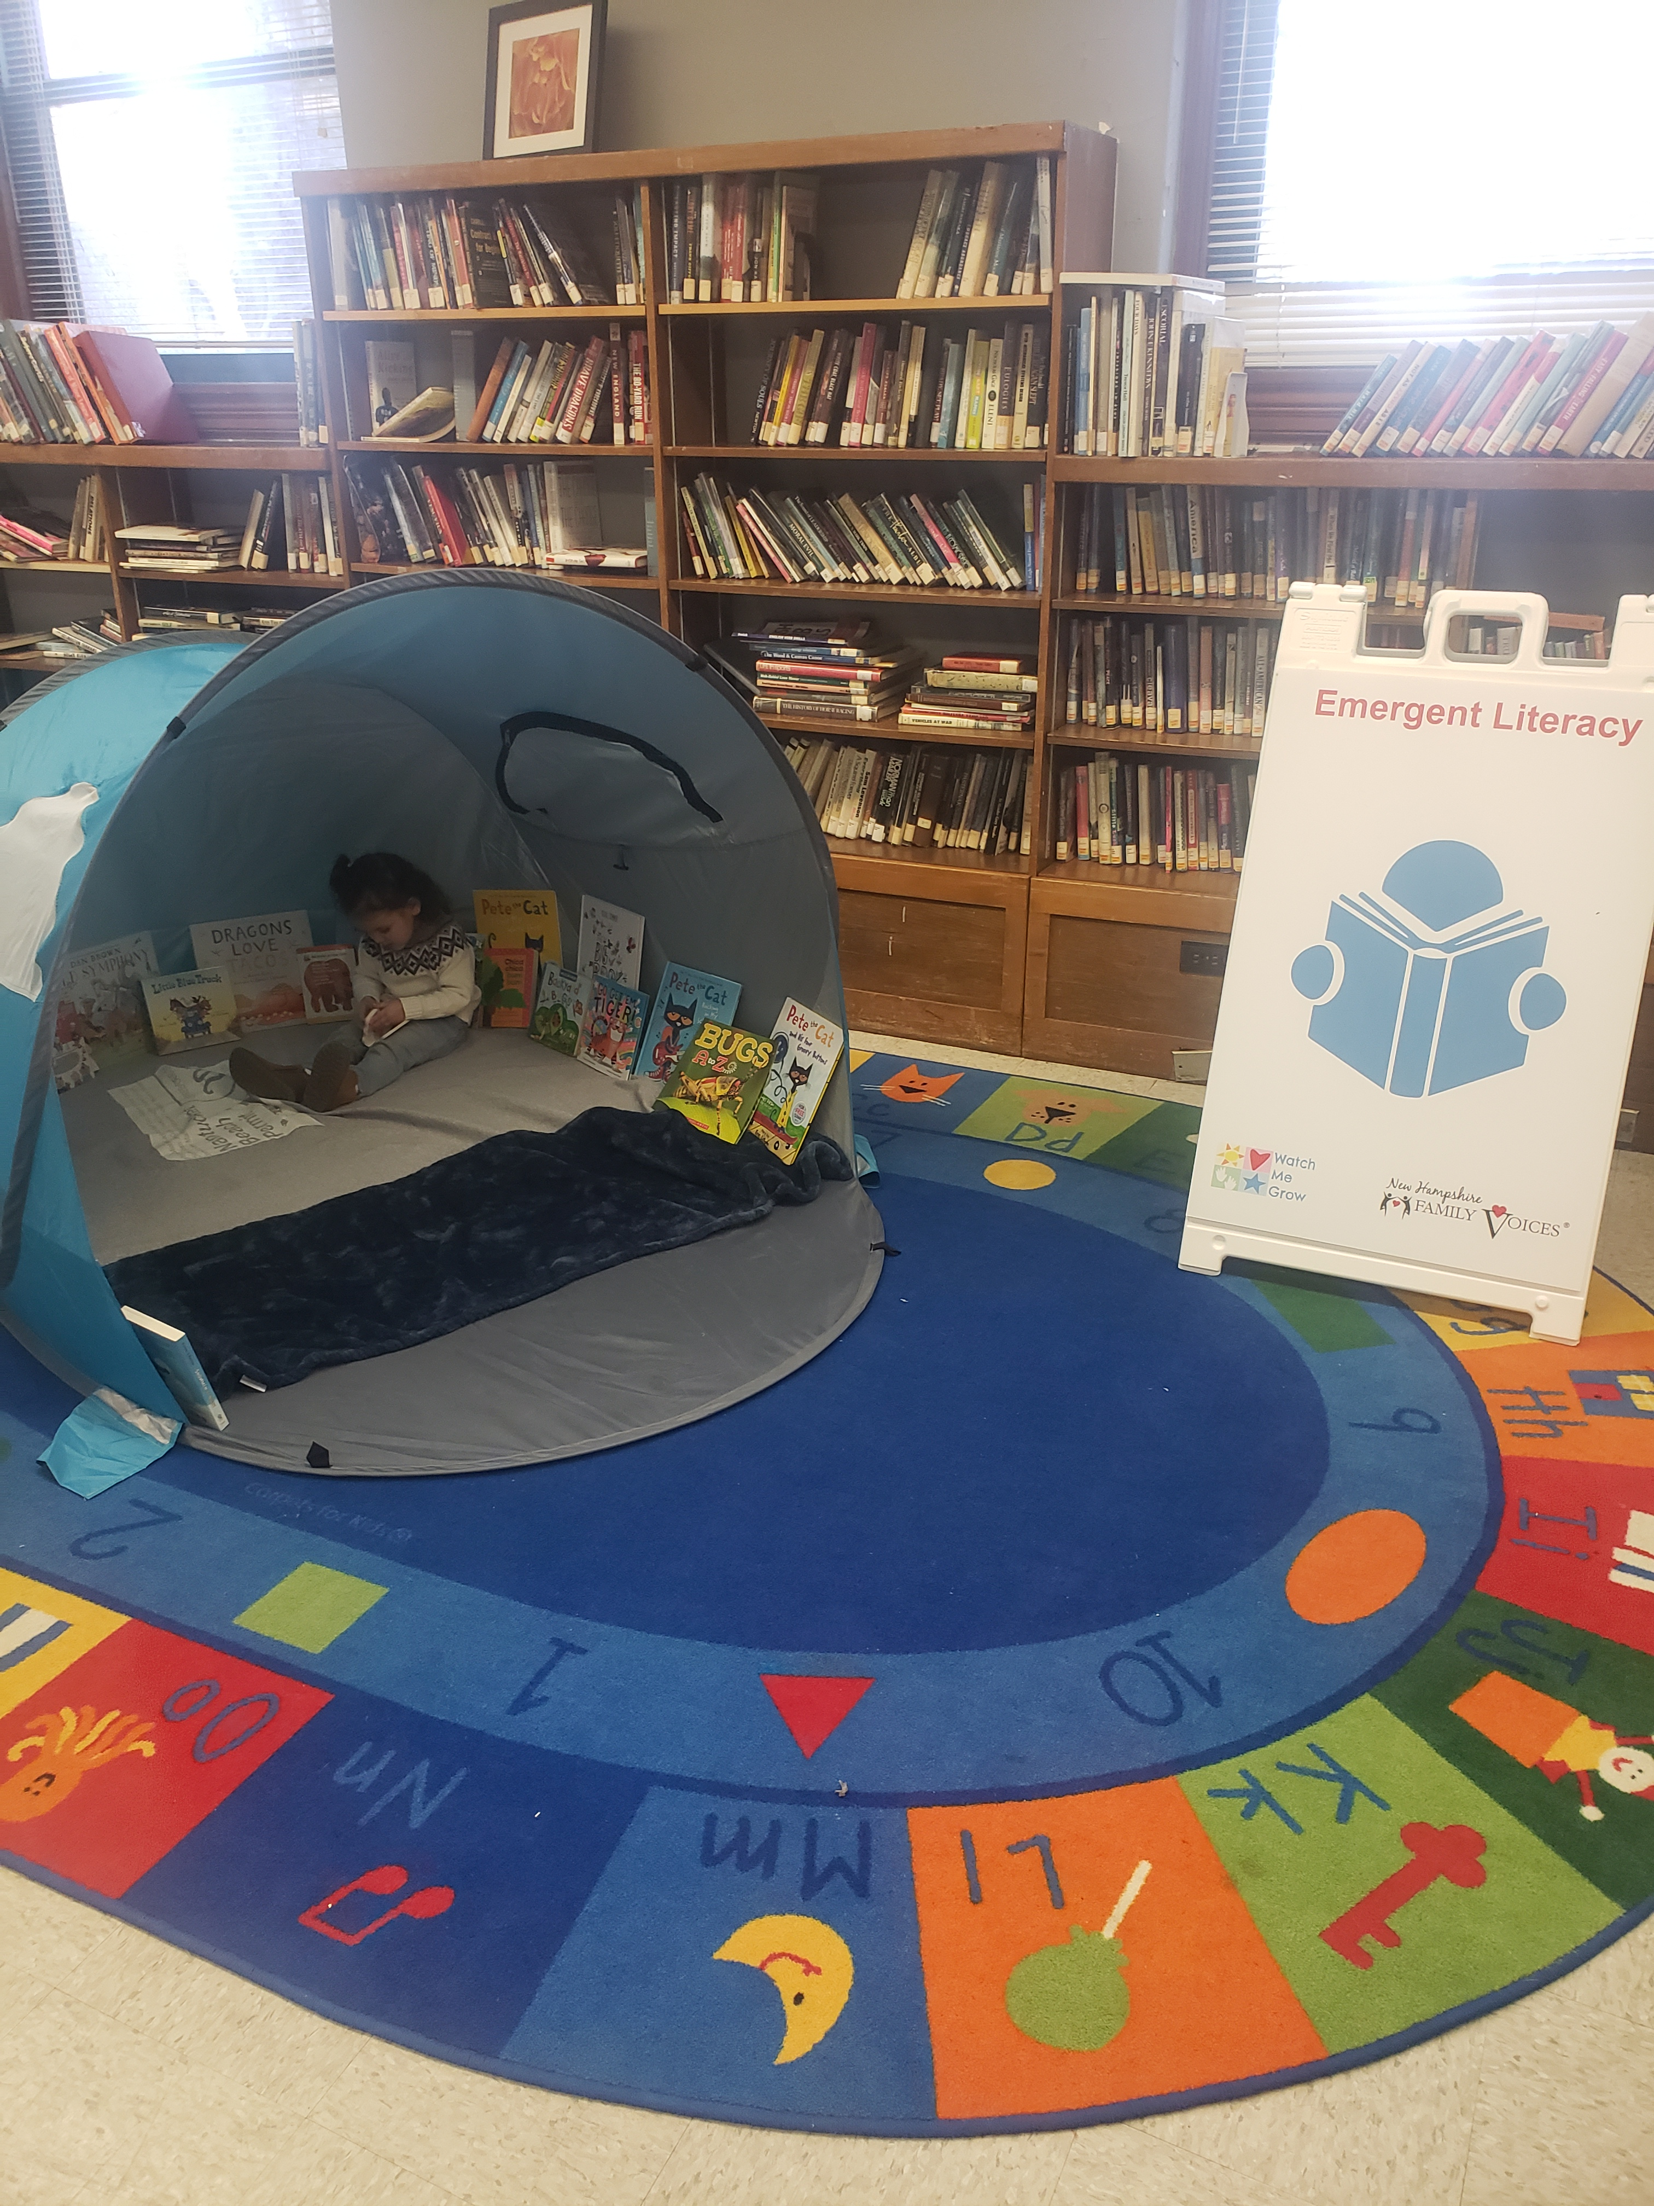



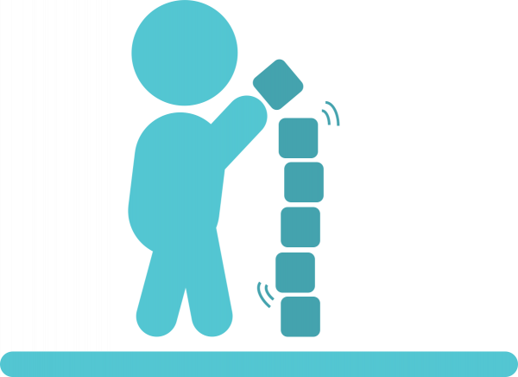
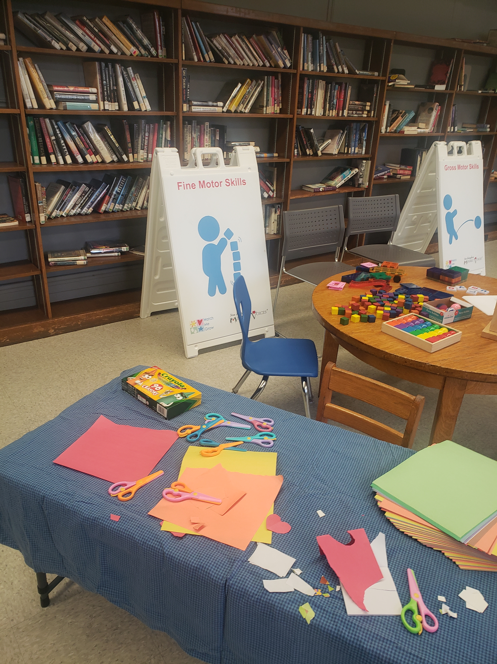

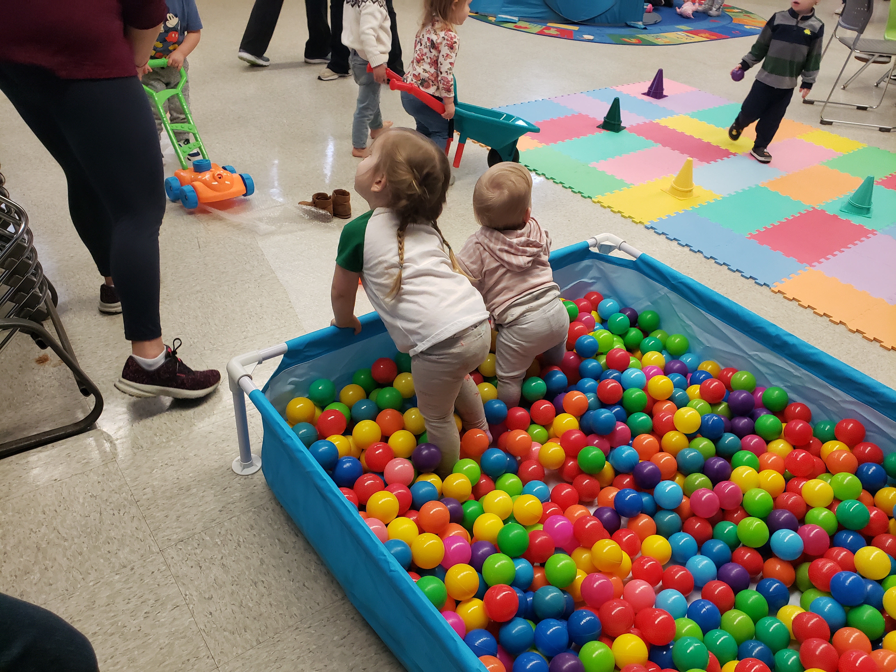
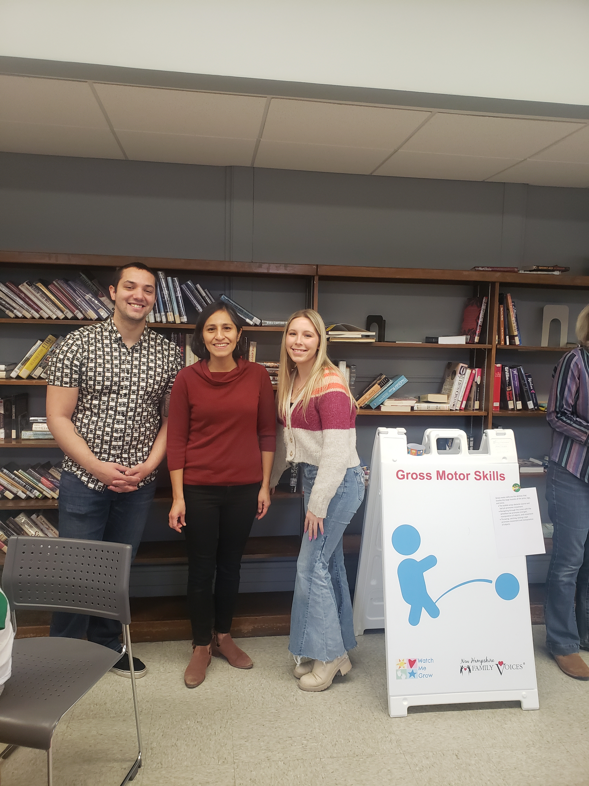
Watch Me Grow: A Books, Blocks, and Balls Event
Dimitri Santos
B.S. Nutrition: Dietetics
Background
CHART NAME
Summary
Watch me grow is the developmental screening, information, monitoring, and referral system in NH for families with children ages 0-5.The developmental questionnaires used are the Ages and Stages Questionnaire (ASQ-3) and Ages and Stages Questionnaire Social-Emotional (ASQ:SE-2) New Hampshire Family Voices (NHFV) provides free support and referral services to families caring for children with special health care needs through family centered care and family professional partnerships. Books, Blocks, and Balls (BBB) is an interactive parent event where families with young children are provided with an entertaining venue to receive information about developmental screenings, child development, and community resources.
For the first BBB event ever done by NHFV, it went fairly well; the set up was easy with several volunteers
The children utilized all of the activity stations and had an enjoyable time
All parents received screening materials and resources were available
The books station consisted of a book tent with a variety of developmentally appropriate content and a storyteller.
Description of Project
A BBB event is an opportunity for parent education, community engagement, and to help detect developmental delay. Books encourages emergent literacy skills, blocks strengthen math and fine motor skills, and balls encourage gross motor development. These are the steps to create a BBB event:
Takeaways and Next Steps
Watch Me Grow: BBB event is an easily replicated experience where families can increase their understanding of child development, what they can do to support it, and where they can go to access resources.
Focusing on advertising and giving ample notice are two key components to bring in a larger audience
More BBB events will be held in the future and activities can be changed based on the venue and participation rates
Determine Community Partners
Determine Date and Venue
The blocks station had ½ inch blocks, magna tiles, an abacus, and arts and crafts materials.
Determine Activity Stations and Create a Map of Event
Create a List of Supplies for Activities, Resource Tables, and Misc. Items
Recruit Volunteers and Assign Jobs
Gather and Transport Materials
The balls station had a ball pit, several balls of different sizes to throw or kick, and an obstacle course made of bubble wrap with a wheel barrow.
Set-up, Run Event. And Clean Up

