Slide 1



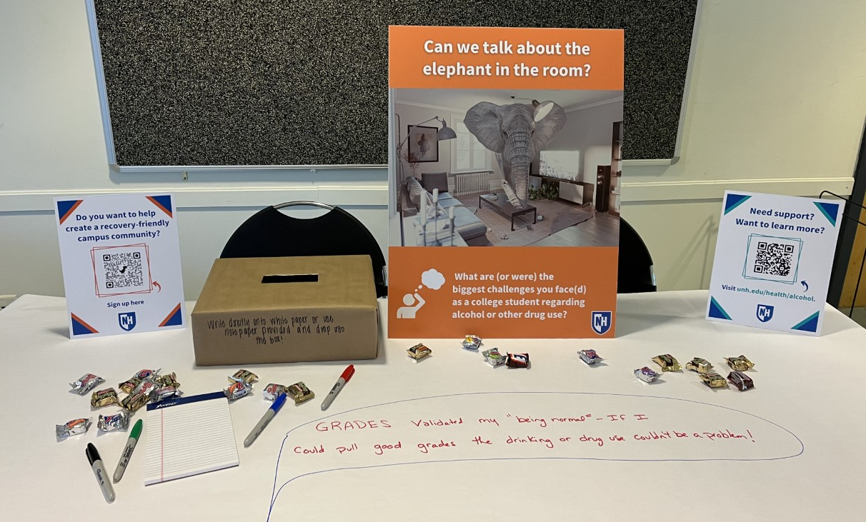




SUBSTANCE USE DISORDER AND DISABILTY
Samantha Barb, Master of Social Work Student; Heidi Cloutier, MSW
Institute on Disability at the University of New Hampshire
The Institute on Disability (IOD)
The Elephant in the Room Project
Addressing Comorbidities & Intersections
The IOD leads UNH in establishing strong accessibility policies informed by research and emerging evidence- based practice. The IOD’s mission is to “promote full access, equal opportunities, and participation for all persons by strengthening communities and advancing policy and systems change, promising practices, education, and research”.
The Elephant in the Room
Project, a community collaboration
initiative led by the SRCC Work Group, gathered qualitative data on student experiences relating to substance use & recovery.
Individuals with Neurodevelopmental Disabilities, namely Autism Spectrum Disorder (ASD) and Attention Deficit Hyperactivity Disorder (ADHD) display high risk factors for Substance Use Disorder (SUD) comorbidities (Butwicka et al., 2017).
This comorbidity is tied to the following factors that may increase risk of an SUD:
Individuals may self-medicate to cope with the sensory issues, social anxieties, and difficulty with executive functioning and self-regulation associated with ADHD and ASD
The common use of stimulants prescribed to individuals with ADHD can be habit forming and result in reliance on and abuse of the substance
(Butwicka et al., 2017)
Amongst the diverse collection of programs supported by the IOD is a Supportive Recovery Campus Community (SRCC), which is UNH’s initiative to develop a Collegiate Recovery Community built on the principles of inclusion and resilience. Fifteen additional UNH programs involved in the initiative, including Student Life and Health & Wellness.
Disability and Substance Use Disorder in NH
Example of a table setup for the project
Substance Use Disorder Classified as a Disability: Changing the Narrative
The results revealed and expressed need for support for students struggling with SUD’s, including peer support opportunities and addressing stigma on the UNH campus.
"Drug addiction, including an addiction to opioids, is a disability under Section 504 of the Rehabilitation Act, the Americans with Disabilities Act, and Section 1557 of the Affordable Care Act, when the drug addiction substantially limits a major life activity” (US DHHS, 2018)
Considering your disciplinary perspective, do you believe Substance Use Disorder is considered a Disability?
Let’s discuss!
1 in 8 NH residents has a disability
Over 100,000 people in NH are reported to be in need of treatment for a Substance Use Disorder (IOD, 2021)
UNH Students’ Definitions of Recovery:
Of that 100,000, only
4-6% receive necessary.
treatment (IOD, 2021)
“Recovery is acceptance. You can change your past mistakes.”
“Recovery is
holding on to what I know I'll lose if I don’t succeed.”
References
Roughly 20% of college students nationally meet the criteria of Alcohol Use Disorder, meaning​ approximately 2756 UNH students may need recovery support (American College Health Association, 2021)
American College Health Association. (2021). Reference Group Executive Summary, Fall 2021 [Data set]. https://www.acha.org/NCHA/ACHA-NCHA_Data/Publications_and_Reports/NCHA/Data/Reports_ACHA-NCHAIII.aspx
Butwicka, A., Långström, N., Larsson, H., Lundström, S., Serlachius, E., Almqvist, C., Frisén, L., & Lichtenstein, P. (2017). Increased risk for substance use-related problems in autism spectrum disorders: A population-based cohort study. Journal of Autism and Developmental Disorders, 47(1), 80–89. https://doi.org/10.1007/s10803-016-2914-2
Department of Health and Human Services. (2018). Drug Addiction and Federal Disability Rights Laws Fact Sheet. https://www.hhs.gov/sites/default/files/drug-addiction-and-federal-disability-rights-laws-fact-sheet.pdf
Institute on Disability. (2021). Facts & Figures: The 2021 Report on Disability in New Hampshire. https://iod.unh.edu/research/new-hampshire-disability-statistics
Notes:
Sam-
I would love to see something about the partnerships at UNH to establish the SRCC.
you may also want to check out some of these resources:
NH statistics: ( source: National Center for
Drug Abuse Statistics https://drugabusestatistics.org/teen-drug-use/#new-Hampshire)
Teenagers in New Hampshire are 27.56% more likely to have used drugs in the last month than the average American teen.
64,000 adults aged 18- to 25-years-old used drugs in the last month.
18- to 25-year-olds in New Hampshire are 24.35% more likely to use drugs than the average American in the same age group.
DRUG ADDICTION AND FEDERAL DISABILITY RIGHTS LAWS: https://www.hhs.gov/sites/default/files/drug-addiction-aand-federal-disability-rights-laws-fact-sheet.pdf
To protect people with addiction from discrimination, the Justice Dept. turns to a long-overlooked tool: the ADA: https://www.statnews.com/2022/06/22/to-protect-people-with-addiction-from-discrimination-the-justice-dept-turns-to-a-long-overlooked-tool-the-ada/
Discrimination Against Patients With Substance Use Disorders Remains Prevalent And Harmful: The Case For 42 CFR Part 2: https://www.healthaffairs.org/do/10.1377/forefront.20170413.059618/

