Slide 1
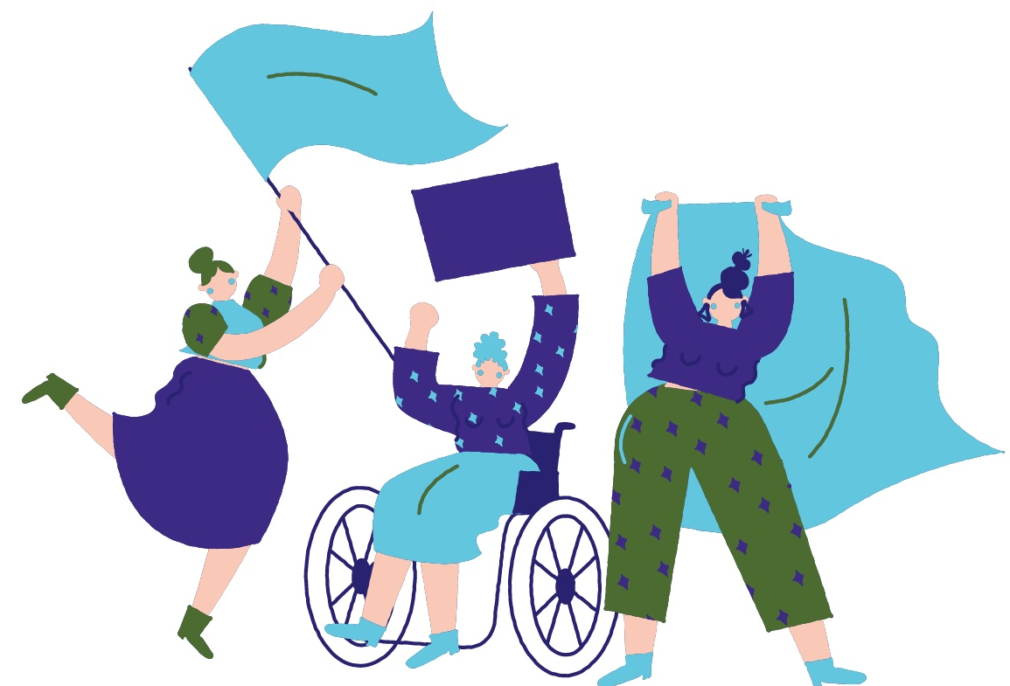
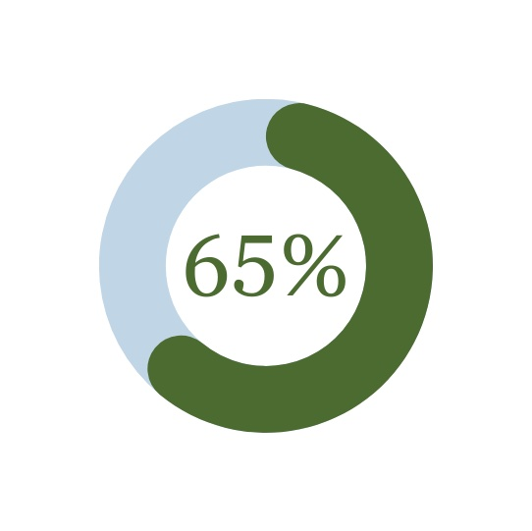
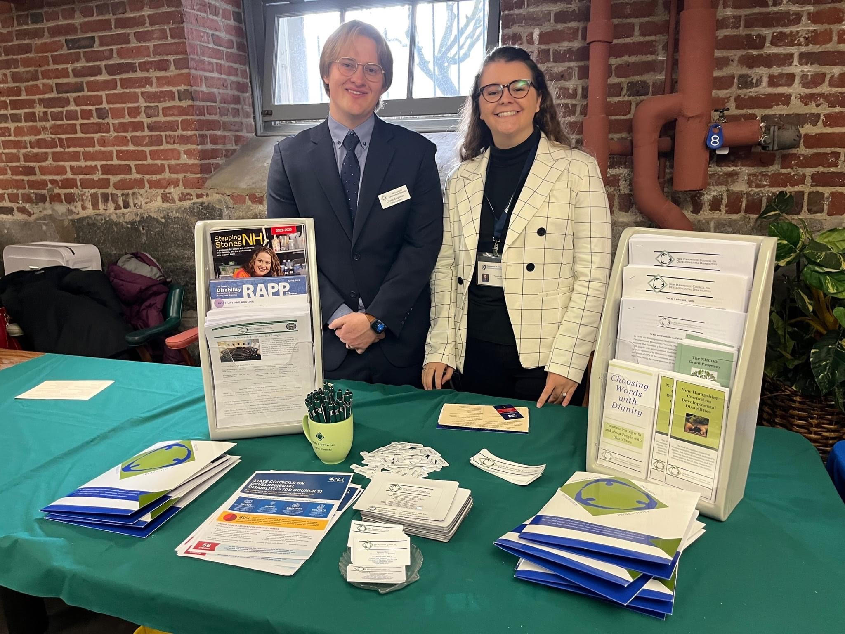
Reducing Barriers to Civic Engagement for People with Disabilities
Victoria Muñoz
MSW Student, University of New Hampshire
Introduction
Barriers to Civic Engagement
Moving Forward
The New Hampshire Council on Developmental Disabilities is a federally- funded state agency that supports public policies and initiatives that remove barriers and promote opportunities in all areas of life for people with disabilities.
The DD Council engages in advocacy, capacity building, and systemic change activities consistent with the purpose of the federal Developmental Disabilities Assistance and Bill of Rights Act (DD Act). My LEND leadership placement was focused on the New Hampshire policy process.
People with disabilities were quoted as experiencing participation in American democracy as fragmented, inaccessible, and ableist (Ho et al, 2020, NCL, 2022).
We need to put “nothing about us, without us” into practice by involving people with disabilities in every aspect of civic engagement!
“As a disabled person, I face stereotypes and bigotry about people with disabilities. My credibility is always in question. No one presumes my competence.” (Ho et al, 2020).
Conceptualizing the Issue
This includes empowering voices, electing people with disabilities to represent us, prioritizing policies that affect people with disabilities, and much more.
In a study by Brandeis University and the Lurie Institute for Disability Policy, researchers set out to understand the barriers that people with disabilities face (Ho et al, 2022).
New Hampshire Legislation
Two relevant bills introduced in the 2023 session.
SB 250: Relative to remote participation in government meetings.
HB 308: Relative to a quorum for meetings open to the public to include remote presence.
New Hampshire is an outlier in this region. Massachusetts, Vermont, and Maine have passed laws since the COVID-19 pandemic allowing for remote and hybrid participation in government meetings in an effort to increase access and engagement.
65% strongly agreed that it is important to have leaders in government who identify as having disabilities (Ho et al, 2020).
26% people in the US experience a disability (CDC, 2019).
“Those who have disabilities, those who have young children, elderly citizens, and those who can’t drive at night or in the snow have all shared with me how important remote access is to them”, Representative Alexis Simpson (D) from Exeter, NH (Dewitt, 2022).
The DD Council is leading initiatives with a focus on dignity, cultural diversity, equal opportunity, and full participation for ALL people with developmental disabilities.
57% of respondents report experiencing barriers to civic engagement (Ho et al, 2020).
Photo from the NH Disability Organizations Meet and Greet at the State House Cafeteria in February 2023. This event was for legislators to learn about how policy can impact the lives of people with disabilities.
References
Centers for Disease Control. (2019). Disability Impacts All of Us. https://www.cdc.gov/ncbddd/disabilityandhealth/infographic-disability-impacts-all.html
Dewitt, E. (2022, January 31). NH lawmakers take on the next remote access political debate: local government. NHPR.
Ho, S., Easton, S., Mitra, M. (2020). Civic Engagement and People with Disabilities: A Way Forward through Cross-Movement Building. The Lurie Institute for Disability Policy, Brandeis University/New York, NY: Ford Foundation Civic Engagement and Government Program.
National Civic League. (2022). Making Civic Engagement Easier for People with Disabilities. https://www.nationalcivicleague.org/making-civic-engagement-easier-for-people-with-disabilities/
New Hampshire Council on Developmental Disabilities. (2021). 5 Year Plan: What’s next for the DD Council. https://www.nhcdd.nh.gov/sites/g/files/ehbemt411/files/inline-documents/sonh/5-year-plan.pdf
More than 20% of respondents report that inaccessibility is a barrier to civic engagement (Ho et al, 2020; NCL, 2022).
Representing the DD Council: Chase Eagleson, Policy Assistant and Victoria Muñoz, LEND Trainee

