Slide 1
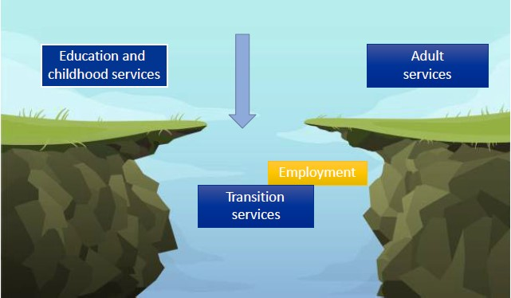
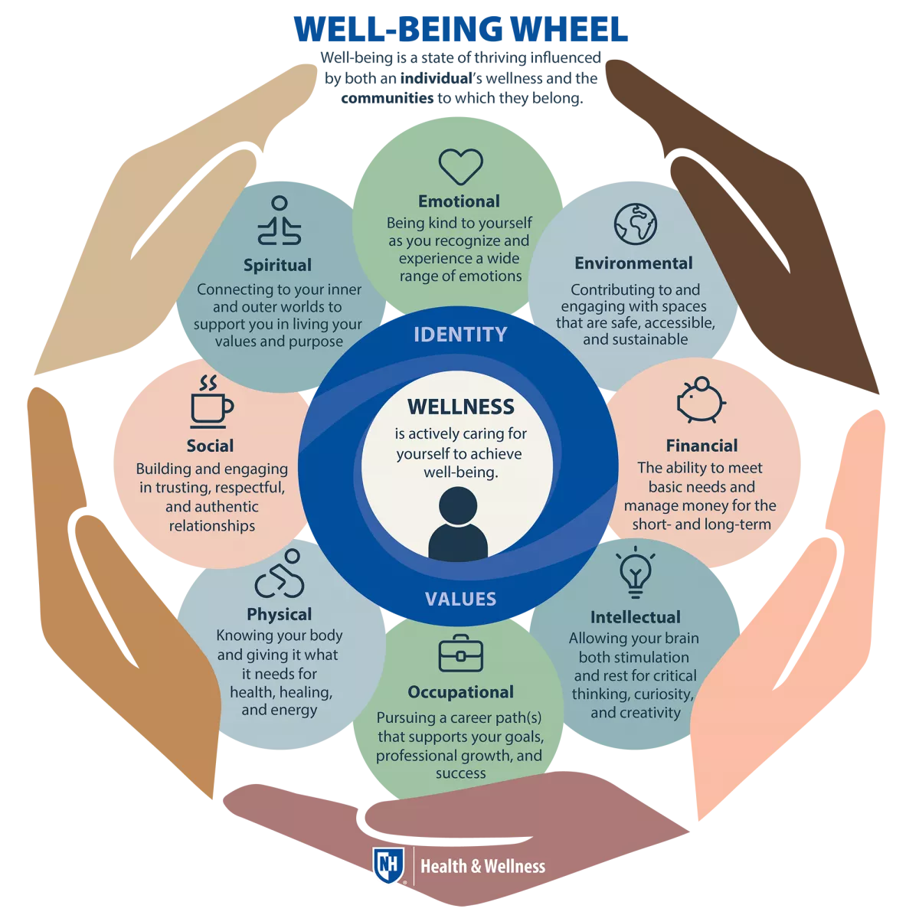
Person-Centered Planning Through Bridges
Sarah Hewitt
NH-ME LEND, Institute on Disability, University of New Hampshire
Bridges Training Series
Bridges Person-Centered Planning Curriculum
Academic and Assistive Technology:
Incorporates PCP through self-identification of personal assistive technology needs and development of self-advocacy skills. Students learn about software and platforms used in college and professional settings as well as tools to support reading, writing, note-taking, and executive function skills (e.g., planning, organizing, problem-solving).
Setting & Realizing Goals Using Person-Centered Planning
Guides students through the PCP process as a strategy for goal setting. In this course, students identify goals in the areas of work, education, leisure, health and wellness, education, and life skills. Students explore their strengths, the important people in their lives, and strategies needed to help achieve their goals. The PCP process fosters collaborative, leadership, communication, and self-advocacy skills.
Healthy and Social Aspects of Life
Next Steps in Person Centered Planning
Students use PCP to define and set goals related to health and wellness as an adult. Students also receive information about accessing wellness and nutritional resources. All areas of wellness are targeted for goal creation including emotional, environmental, financial, intellectual, occupational, physical, social and spiritual domains.
Focuses on career exploration including job trainings, how to present yourself to an employer, entering the workforce, leaving a job, career advancement, changing careers, using supports, and mapping their next steps. The goal is for students to demonstrate the PCP process through goal setting and self-advocacy to identify personal and community resources available to create a PCP plan and career goals.
The Bridges Training Series is a transition program aimed at young adults ages 18-24 with an intellectual disability and/or those who receive services under the Individuals with Disabilities Education Act. The series is an online college and career training program focused on higher education, independent living, and careers offered through the Institute on Disability at the University of New Hampshire. The trainings provide opportunities for students to reflect on who they are, what they want their future to look like, learn about resources available outside of high school, and to connect with other young adults.
Image adapted from Kelly Nye-Lengerman
Person-Centered Planning
Leadership Activities
Person-Centered Planning (PCP) is a problem-solving process used to support people with disabilities in receiving the things they want and need to be successful by putting them at the center of the planning process. The individual identifies the important people in their lives to empower them in identifying and planning their own goals and supports, including developing a plan of how to achieve them.
Steps of PCP Goals of PCP
Facilitated small group discussions in Bridges classes.
Assessed assignments, collected attendance, monitored chats, recordings, and assignments.
Participated in Bridges team meetings and information sessions.
1. Develop a history of important people and events
2. Describe the quality of life (community participation and presence)
3. Personal preferences/vision for the future
Increase community presence
Increase community participation
Increase choice, respect, and competence
Develop personal relationships
Increase control over one’s life
Develop skills to achieve goals
Held meetings with Leadership partner.
Conducted independent research on transition topics and services.
Available as a resource to Bridges students for questions or support.
References
(Holburn et al., 2007)
Holburn, S., Gordon, A., & Vietze, P. M. (2007). Person-Centered Planning Made Easy: The Picture Method. Paul H. Brookes Pub.
Nye-Lengerman, K., personal communication, March 31, 2023.
Unknown Author. (n.d.). Person-Centered Planning. National Parent Center on Transition and Employment. Retrieved April 16, 2023, from https://www.pacer.org/transition/learning-center/independent-community-living/person-centered.asp
(pacer.org, 2023)
Images courtesy of UNH Bridges Program and UNH Health and Wellness

