Slide 1
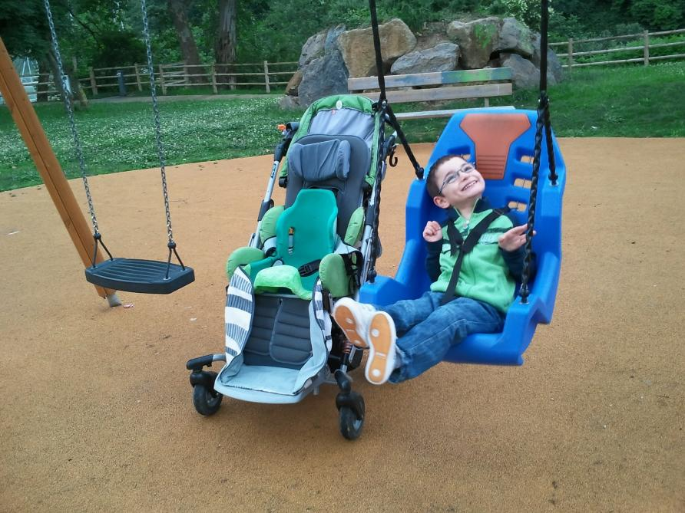
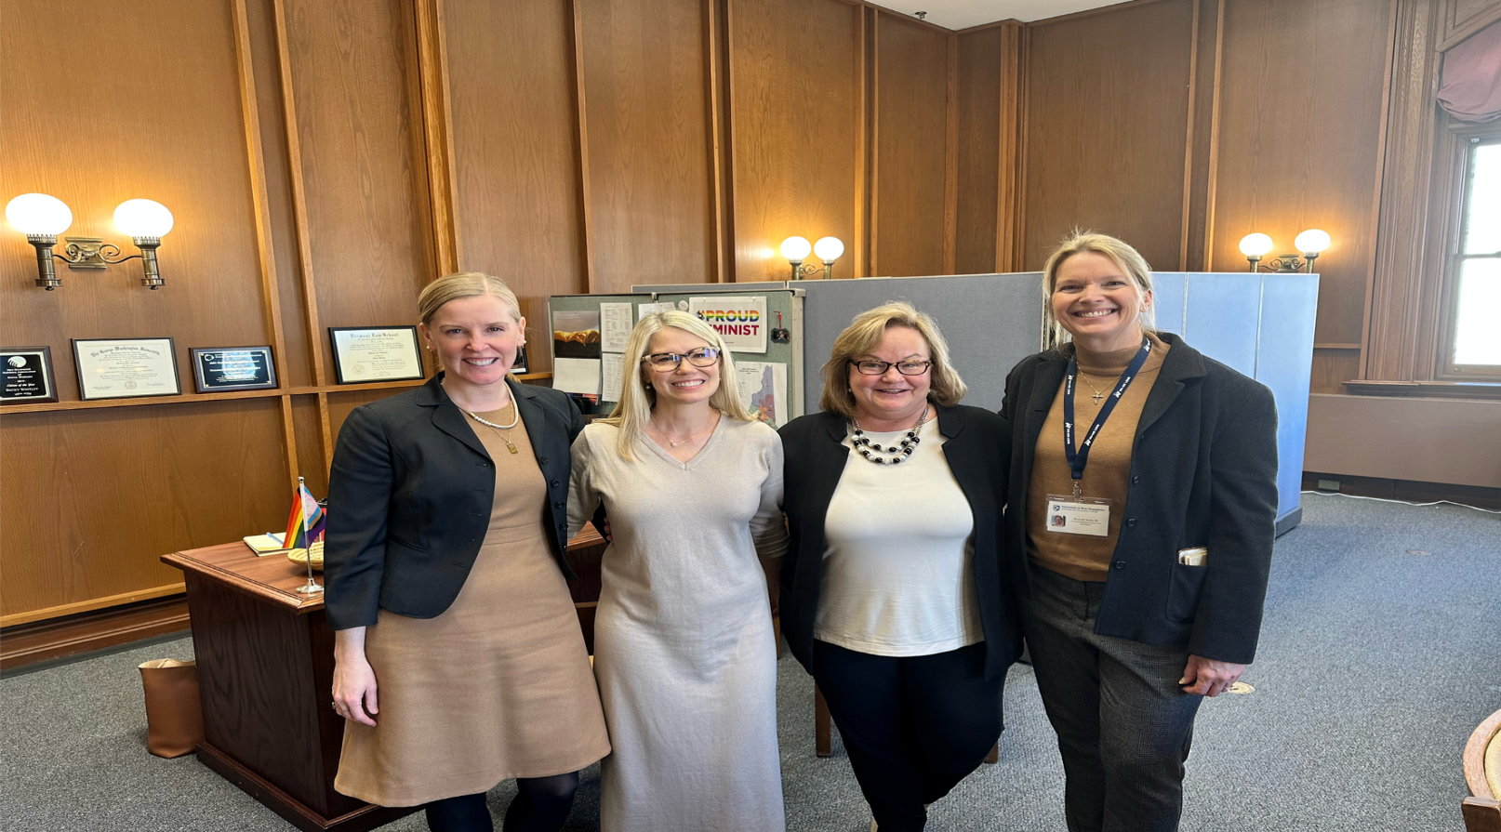
Pathway to Advocacy for People with Disabilities
Rachelle Smith, B.S., Communication Sciences and Disorders Trainee
NH-ME LEND, Institute on Disability, University of New Hampshire
Introduction
Pathway to Advocacy
Taking Action & Expected Outcomes [4]
Individuals with disabilities have been fighting for their right to live full, independent, and inclusive lives since the 1800’s. This group had no legal protection against discrimination until 1990 when the Americans with Disabilities Act (ADA) was enacted. While this was a step in the right direction, further policy action is required to win equal rights for individuals with disabilities. HB467-FN is a bill proposed in the State of New Hampshire to ensure accessibility to children with disabilities in public playgrounds. Many state and local policymakers desire expert consultation from medical professionals to inform their understanding on the societal impacts possible through this bill. This poster presents the work done with Jennifer Bertrand and others at Community Crossroads in systematically supporting HB467-FN throughout the policy cycle. Multiple opportunities exist to advocate for this (and similar) bills in the future and the reader is encouraged to participate in this process moving forward.
HB467-FN Relative to Public Playground Accessibility
Actions [4a]
Conducted 1-to-1 Meetings with NH State House Representatives
Registered in Support of HB 467-FN
Submitted Written Testimony for HB 467-FN
Submitted a Letter to the Editor Informing the Public of HB 467-FN
Expected Outcomes [4b]
Increased Public Awareness of Importance of Accessibility
HB467-FN Passes Making All Public Playgrounds Accessible to All Individuals
Learning the System through Policy Partners at Community Crossroads [2]
Getting involved!
Get Informed about Bills that Benefit Individuals with Disabilities
by Visiting https://www.nh.gov/index.htm
Register Your Support or Opposition of a Bill Online at
https://www.gencourt.state.nh.us/
Email a Letter of Testimony in Favor or in Opposition of a Bill to the Committee
Write a Letter to the Editor of Your Local Newspaper to Inform the Public of a Bill
Provide Oral Testimony to Support or Oppose a Bill in Person at a Public Hearing
Make a connection,
Make your voice heard,
Make a change in the lives of individuals with disabilities
Accomplished through relationship building, conducting one-to-one interviews, community organizing, communication, persuasion, issue framing, power and the ability to act, etc.
Events [2a]
Participated in the Community Partnership Candidate Event
Attended Legislative Liaison Meetings
Attended Public Policy Outreach Meeting
Attended a Brain Injury Committee Meeting
Toured the State House
Voted in the Local Elections
Watched Governor Sununu’s Budget Address
Advocating for Change [3]
Understand the NH Legislative Process
Initiate And Build Relationships With Legislators
Provide Legislative Testimony
Stay Informed
Identify and Vote on Key Issues That are Important to You
Engage in Public Outreach Efforts
Build and Expand Networks
Vote in Local, State and National Elections
References
The General Court of New Hampshire. (n.d.). Retrieved March 3, 2023, from
https://www.gencourt.state.nh.us
Disability History: The Disability Rights Movement (U.S. National Park
Service). (n.d.). Retrieved February 25, 2023, from https://www.nps.gov/articles/disabilityhistoryrightsmovement.htm
NH.gov—The Official Web Site of New Hampshire State Government. (n.d.).
Retrieved February 25, 2023, from https://www.nh.gov/index.htm
Policy Partners. (n.d.). Community Crossroads. Retrieved February 25, 2023,
from https://communitycrossroadsnh.org/advocacy/policy-partners/
How a Bill Becomes a Law | New Hampshire Almanac | NH.gov. (n.d.). Retrieved March 3,
2023, from https://www.nh.gov/almanac/bills.htm
NH State Senator Becky Whitley, Jennifer Bertrand, Senator Suzanne Prentiss and me at the State House

