Slide 1
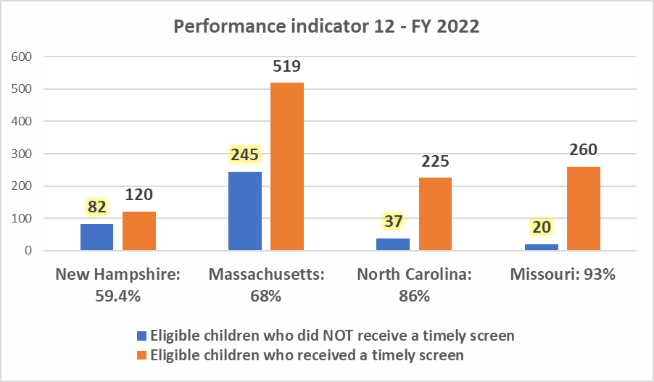
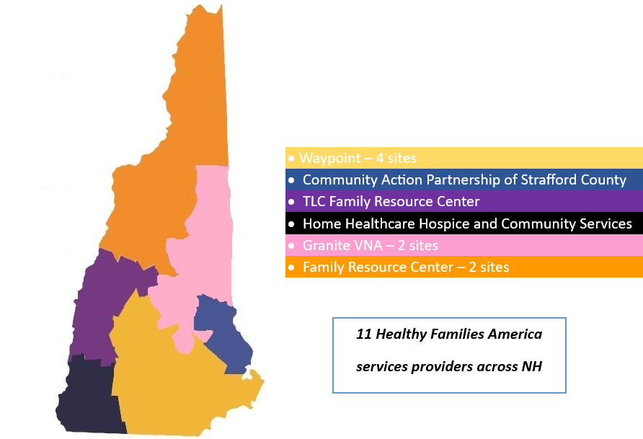
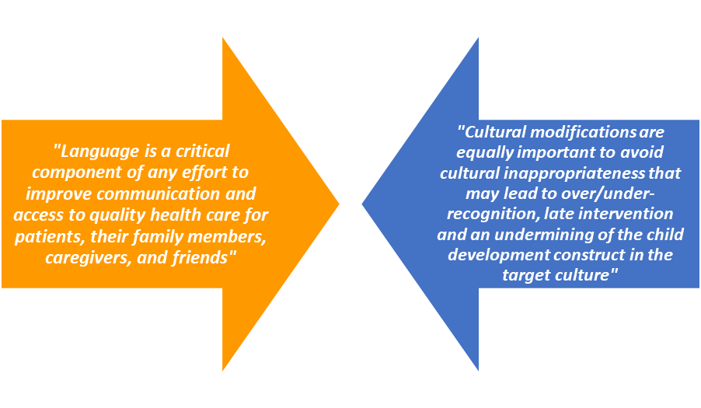
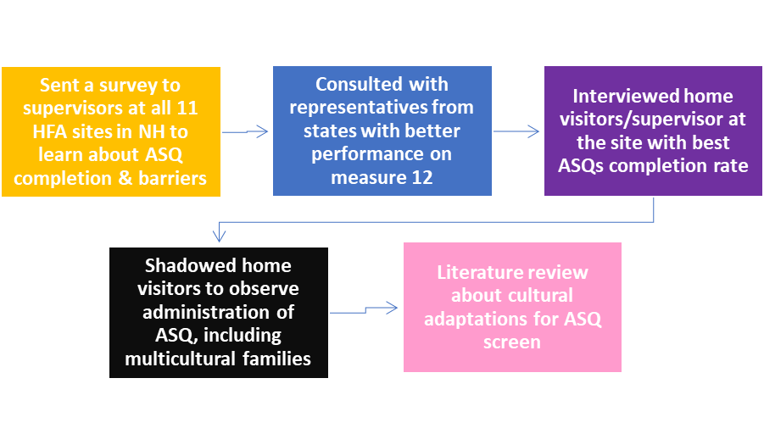
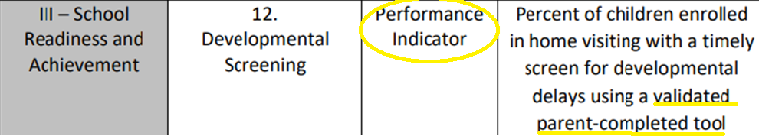
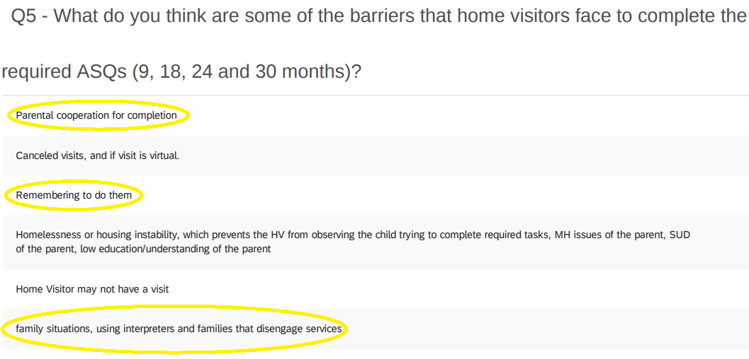
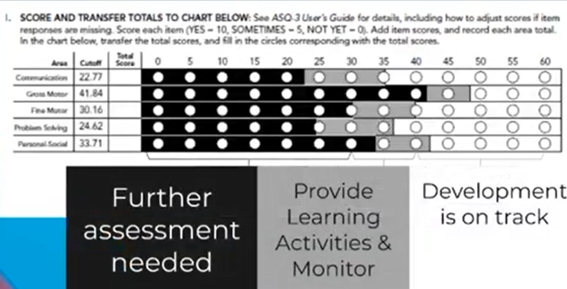
Maximizing Opportunities: Increasing timely developmental screenings during home visits
Lisseth Milkovits, B.A., Communication Sciences and Disorders Graduate Student, 2022-23 NH-ME LEND trainee
Introduction
Only 59.4% of children enrolled in an HFA program had a timely developmental screen in NH
Findings
Partnering organization:
Maternal and Child Health Visiting Program
This program administers the Maternal Infant Early Childhood Home Visiting (MIECHV) federal grant and oversees the implementation of Healthy Families America (HFA) in NH. HFA is an evidence-based home visiting model that provides support to parents during and after pregnancy, until their child turns three.
Barriers:
Not screening as soon as the window opens for each specific age range
Staff turnover
Unfamiliarity with cultural adaptations to effectively assess developmental skill
Language access: Unreliable interpreting services available for immigrant families
MIECHV program grantees are required to collect data and report their performance measures to demonstrate improvement in the services provided to participating families in at least four of six benchmark areas.
There are 19 performance measures included in this annual report that are categorized as performance indicators or systems outcomes.
Performance indicators ARE directly linked to interventions provided by home visitors and, as such, are more sensitive to change by home visitors’ actions.
Project Activities
Project
Summary of strategies implemented by other states to increase timely developmental screenings
Recommendations to ameliorate language accessibility
Creation of visuals to support caregiver’s comprehension of questions asked in ASQ
Reflections about validity and reliability of translations of ASQ as well as the need for cultural adaptation of this tool
Objective: Learn how to improve performance measure 12
References
In NH, the validated tool used is the Ages and Stages Questionnaire, Third Edition (ASQ-3). Grantees are required to administer this screening as a minimum at the age intervals of 9, 18, 24 and 30 months to all age eligible children participating in the program.
MIECHV Data & Continuous Quality Improvement. MCHB. (n.d.). Retrieved April 16, 2023, from https://mchb.hrsa.gov/programs-impact/programs/home-visiting/miechv-data-continuous-quality-improvement
U.S. Department of Health and Human Services. (2022, August 31). Language access in clear communication. National Institutes of Health. Retrieved April 21, 2023, from https://www.nih.gov/institutes-nih/nih-office-director/office-communications-public-liaison/clear-communication/language-access-clear-communication
Rousseau, M., Dionne, C., Savard, R. T., Schonhaut, L., & Londono, M. (2021). Translation and cultural adaptation of the ages and stages questionnaires (ASQ) worldwide: A scoping review. Journal of Developmental & Behavioral Pediatrics, 42(6), 490–501. https://doi.org/10.1097/dbp.0000000000000940

