Slide 1
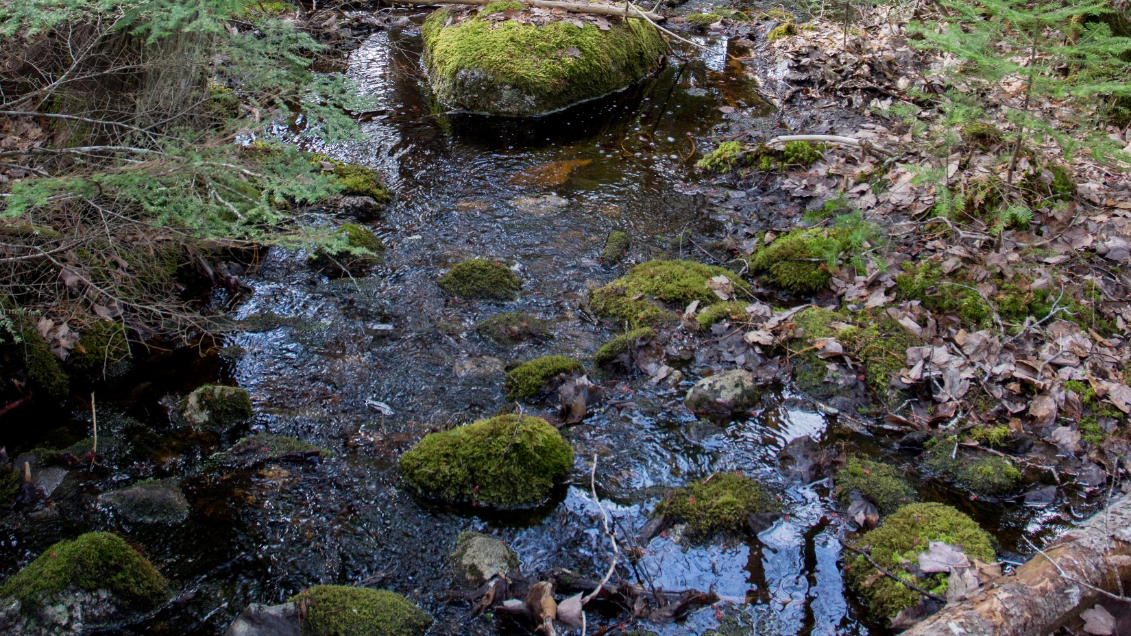

Assessing DON’s ecological duality through in-situ manipulation of organic solutes
Katherine X. Pérez Rivera
NREN Master’s student
GRC Spring 2020
Notes:
Hello everyone! My name is Katherine Xiomara Pérez Rivera. I am a second year master’s student in the Department of Natural Resources and the environment. Today, I’ll be talking about some of the research I have been conducting as part of my thesis work. My research focuses on understanding the dynamics of dissolved organic matter in freshwater ecosystems, specifically looking at the role of Dissolved organic nitrogen in streams.

Slide 2
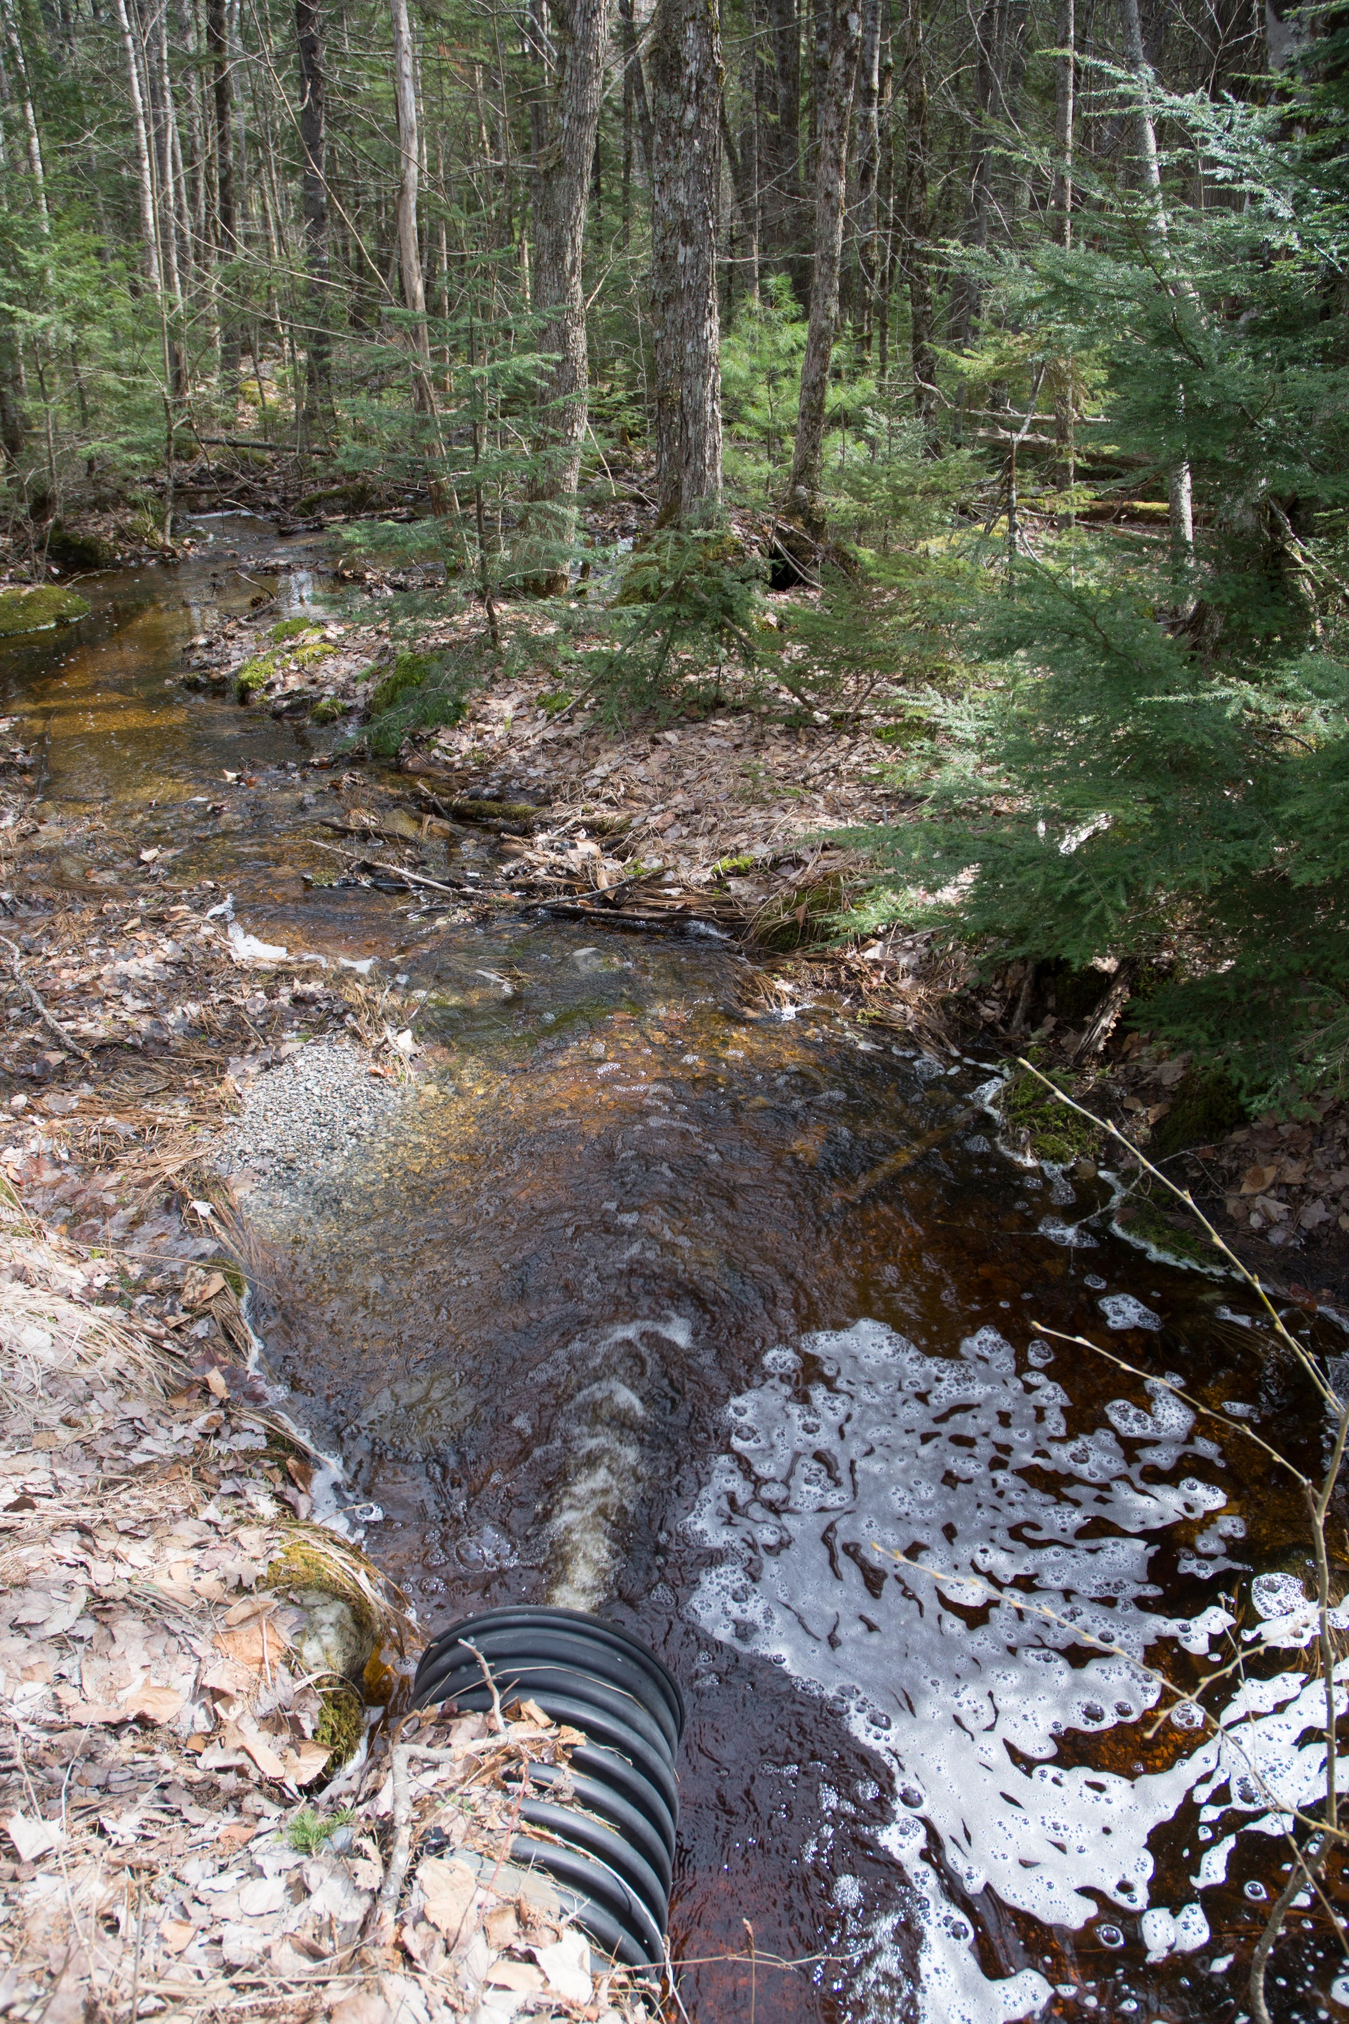
Dissolved organic matter (DOM)
Major link between terrestrial and aquatic ecosystems
Influences cycling and distribution of energy and nutrients
Understudied aspect of DOM: ecological and biogeochemical controls of DON concentrations
runoff
leaching
leaf matter
Notes:
Dissolved organic matter (DOM) serves as the major link between aquatic and terrestrial ecosystems. Inputs from the surrounding landscape (e.g. runoff, leaching from the soil, leaf matter, etc.) Inputs from the surrounding landscape influence the concentration of solutes as well as ecological processes that take place within freshwater ecosystems. Which influences the cycling and distribution of energy and nutrients. An important but understudied aspect of DOM are the ecological and biogeochemical controls on dissolved organic nitrogen (DON).

Slide 3
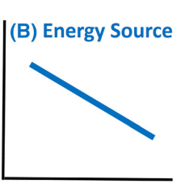
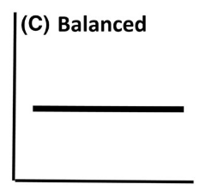
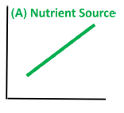


DON’s ecological duality
If DON is a major N source under low NO₃⁻ , then we expect [DON] to increase with the addition of NO₃⁻ (net DON production).
If DON is used as an energy source, [DON] are expected to decrease with the addition of NO₃⁻ (the added solute is likely to stimulate demand for additional carbon, increasing DON consumption).
DON (mg/L)
NO₃⁻ (mg/L)
NO₃⁻ (mg/L)
NO₃⁻ (mg/L)
(Wymore et al., 2015)
Notes:
DON serves as a major constituent of the DOM pool in freshwater ecosystems. Previous work shows that DON in streams can be consumed or produced by microbial processes, however, the factors that control DON concentrations are poorly understood. Because DON is made up of such a wide range of individual organic compounds (amino acids, proteins, nucleic acids, etc.) that it is virtually impossible to predict its behavior and ecological significance by tracing the fate of a specific individual compound instead, the whole DON pool must be considered in any assessment of its reactivity.
Here we have the on-going hypothesis that highlights DON’s duality. This is in a setting where the concentration of an inorganic form of nitrogen is being manipulated. Here we have the manipulation of nitrate and the response of DON to it. It is expected that if DON is a major source of N under low nitrate, [DON] will increase with the addition of NO3, resulting in net DON production (this means that DON will be use a source of N by microbial communities).
However, if DON is being used as energy, it is expected that [DON] will decrease with the addition of NO3. Because adding NO3 can stimulate a demand for energy (additional C), resulting in an increase of DON consumption.
And we do not see a response when manipulating NO3 we said that is balanced and therefore, DON does not show a response to the manipulated solute.

Slide 4
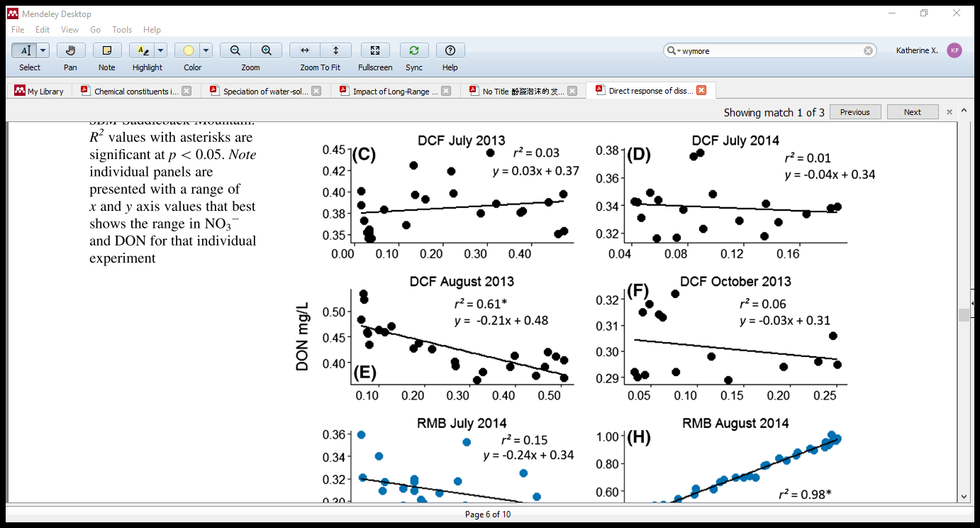
DON responses to NO₃⁻ manipulations
r² = 0.98*
r² = 0.27*
DON (mg/L)
r² = 0.15
r² = 0.66*
Under low NO₃⁻ DON is primarily used as a N source.
NO₃ - N (mg/L)
(Wymore et al. 2015)
Notes:
This hypothesis has been tested. And this is the evidence that supports the release hypothesis

Slide 5
Research question and hypothesis
How does the ambient pool of DON respond to changing availability of energy?
Whole stream manipulations of acetate are expected to stimulate nitrogen uptake from the ambient DON pool (DON concentrations decrease).

Slide 6
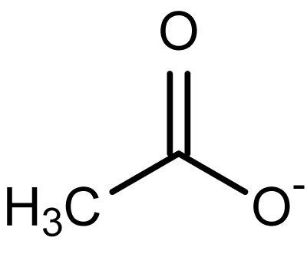
Labile DOM
Acetate
Found in freshwater ecosystems at very low concentrations. This is often as a result of release from stream algae.
(Kaplan and Newbold, 2003)
(Johnson and Tank, 2009)
Notes:
Solutes that are easily assimilated. Found at very low concentrations. Acetate allows to get at the energic role of DON, because is an easily assimilated Carbon/ energy source that consists of an organic acid that has one carbon atom attached to a carboxyl group. Glycine on the other hand has both nitrogen and carbon in its structure and By studying acetate we can inform on the energetic role of DON.

Slide 7
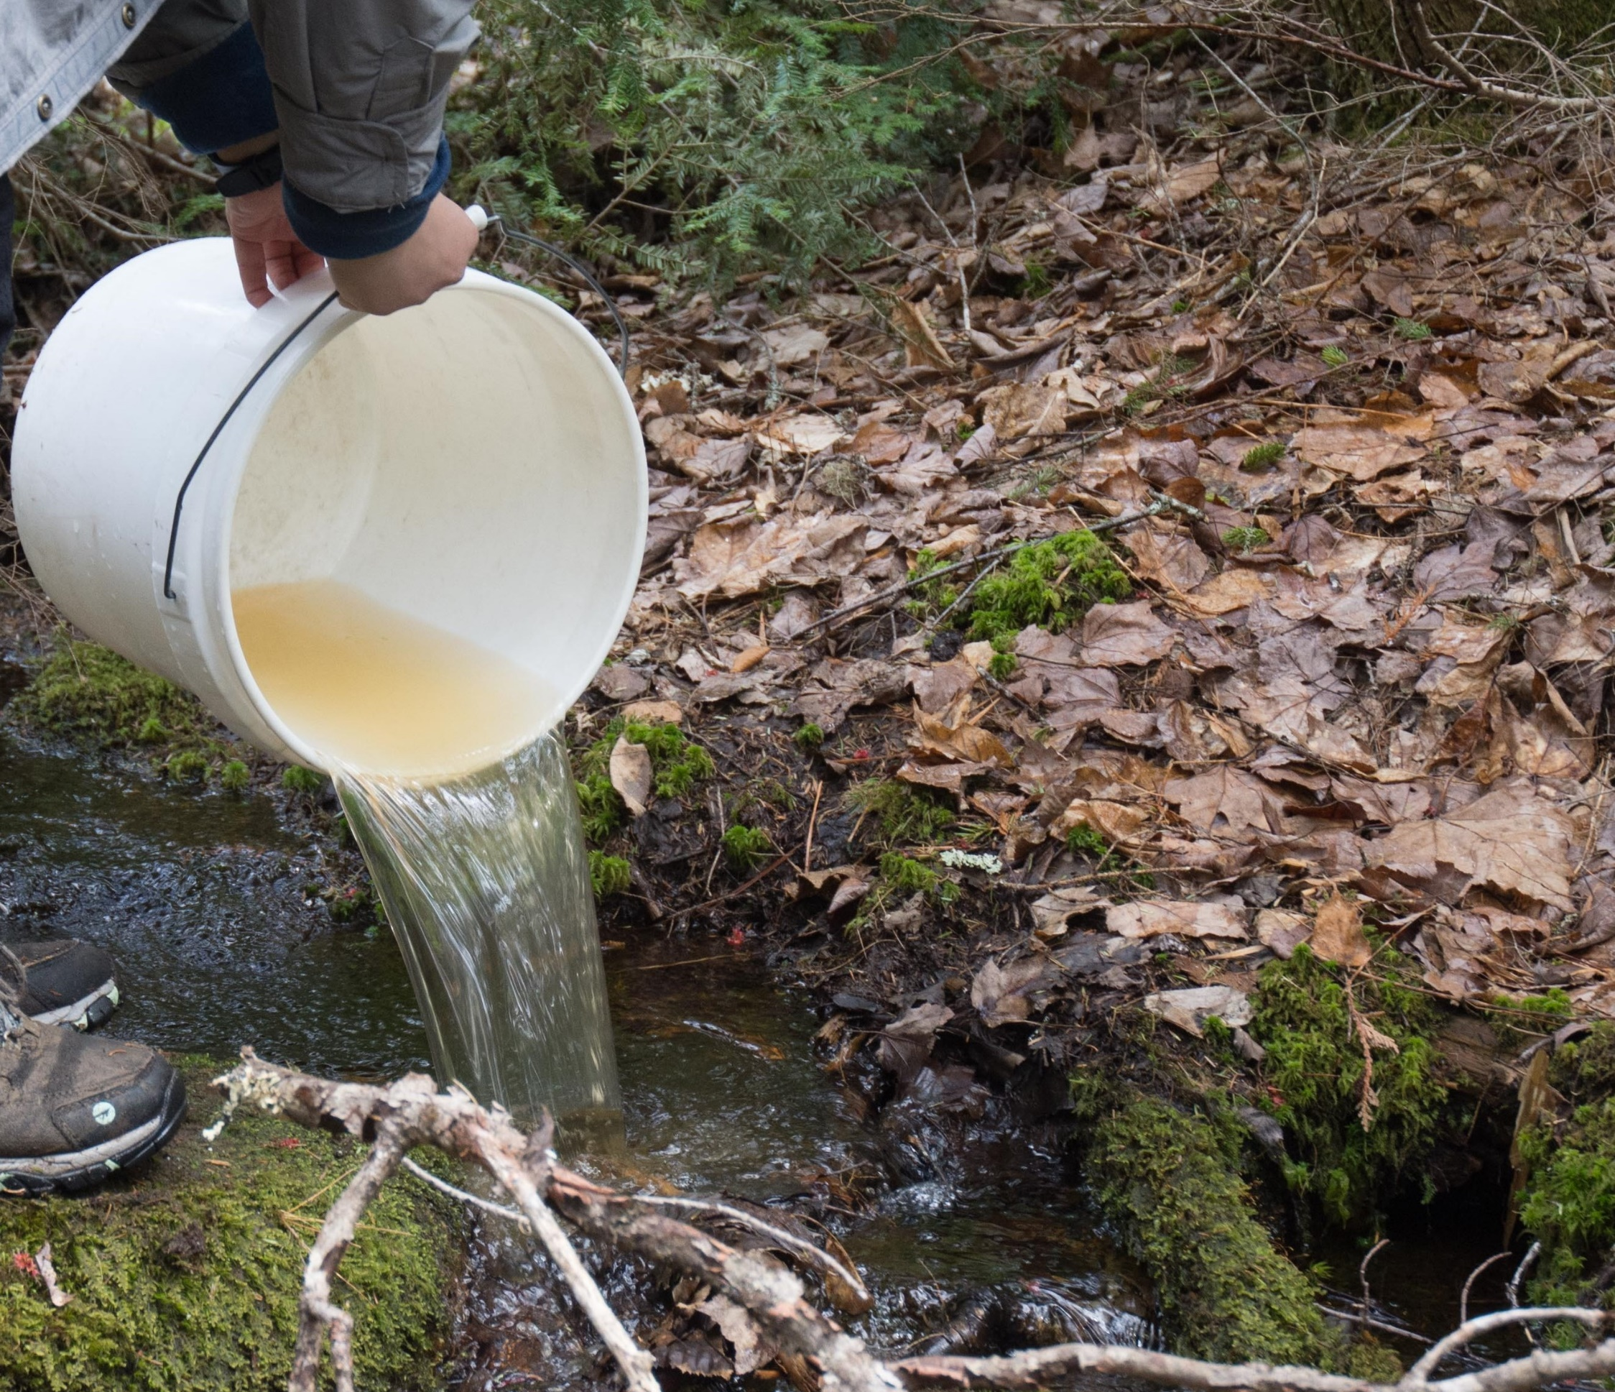
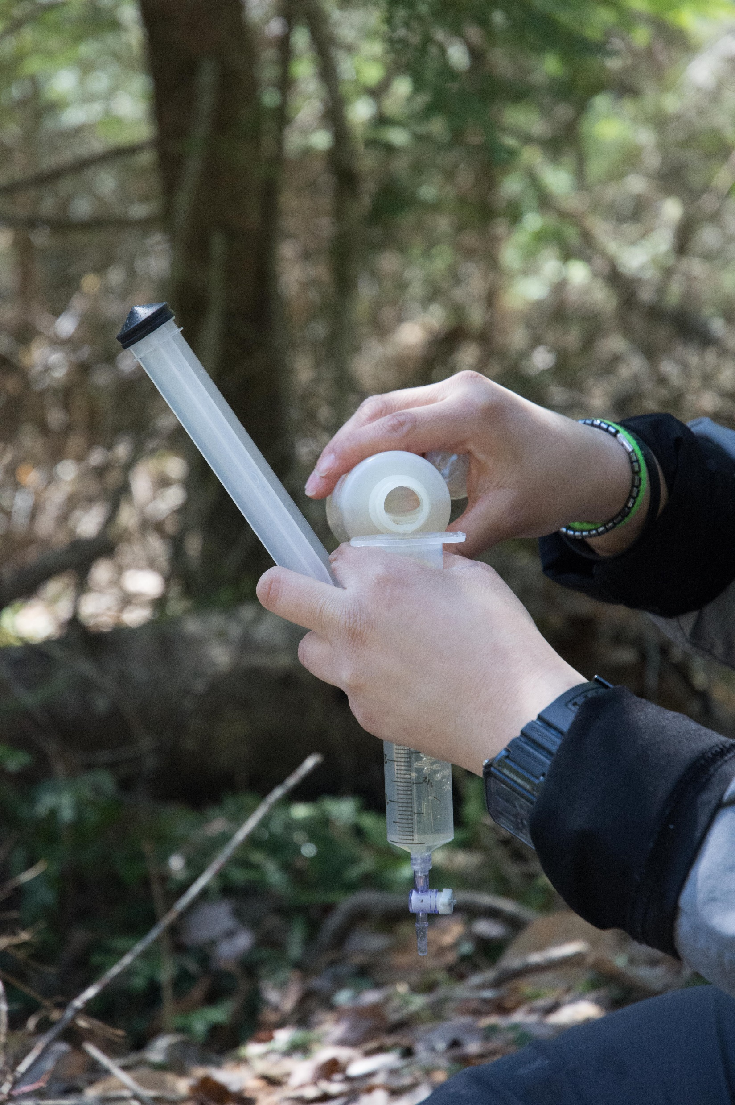
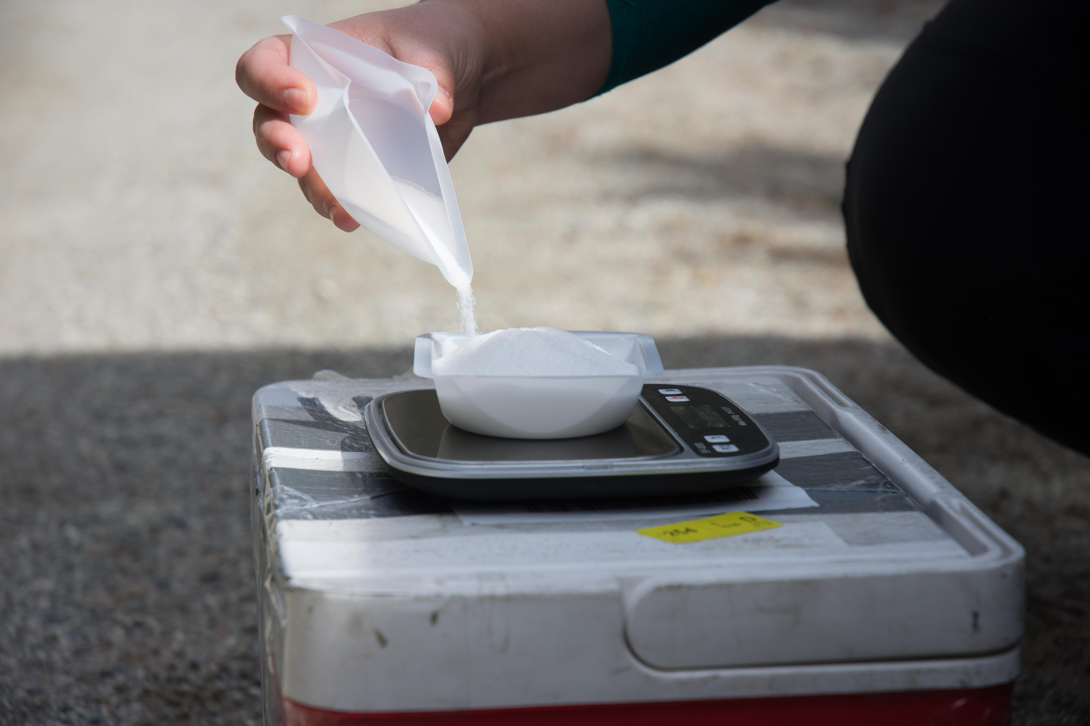

Field-based manipulations
Field-based manipulations of labile DOC (acetate)
Quantify changes in concentration of DON and DOC to added solutes
Reach Length (m)
upstream
A. Herreid
Solutes:
Acetate
Conservative Tracer:
NaCl
A. Herreid
Modified from (Covino et al 2010)
downstream
Notes:
Manipulations were conducted at the study sites using TASCC a method that consists on elevating the background concentration of the solute of interests (glycine and acetate) along with a conservative tracer (NaCl). The solution is added at the upstream section of the experimental reach and samples are collected at the downstream site. The arrival of the solution is detected through the changes in conductivity using a conductivity probe. Samples are collected through the BTC which includes rising limb, peak and falling, limb. After samples are collected and analyzed the changes in the concentration of DOC and DON to the added solutes (glycine and acetate) are quantified.

Slide 8
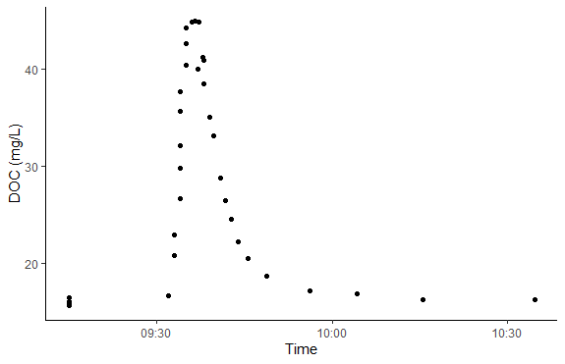
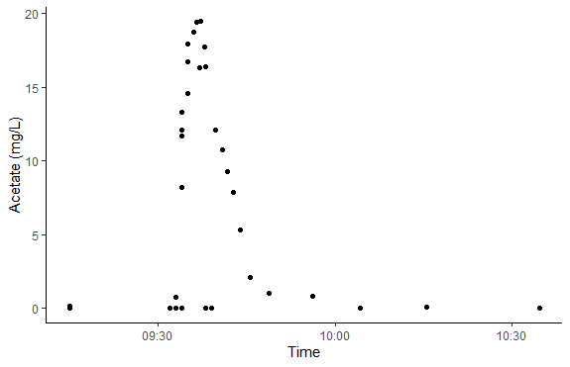
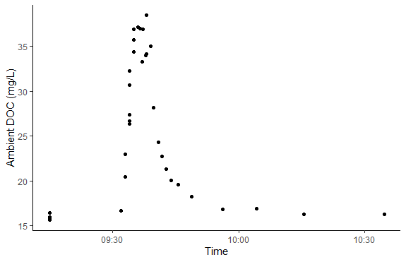
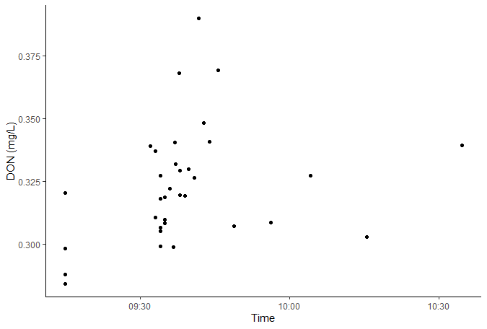
Time Series-Solutes
A
B
C
D
Notes:
CRB
So, here we have some preliminary results for some of the manipulations I have conducted. The four figures we are looking at show the changes in the concentration of the solutes of interest throughout time.

Slide 9
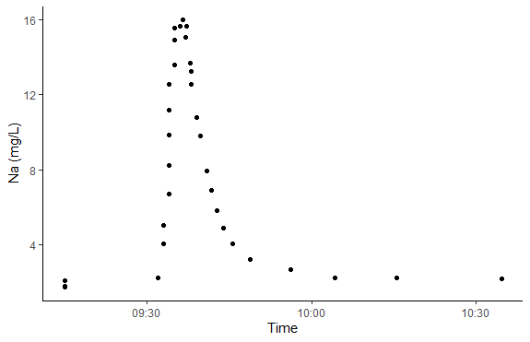
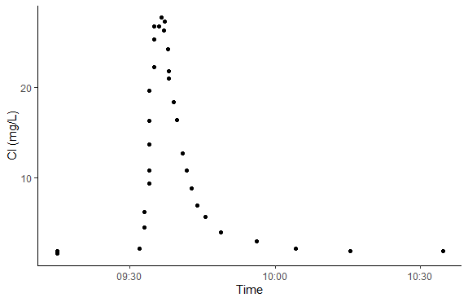
Time Series-Tracers
Notes:
And here we have the time series for the tracers that were added along with the acetate. We that sodium chloride follow the BTC and that is exactly what it was expected.

Slide 10
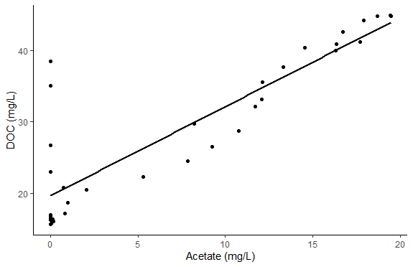
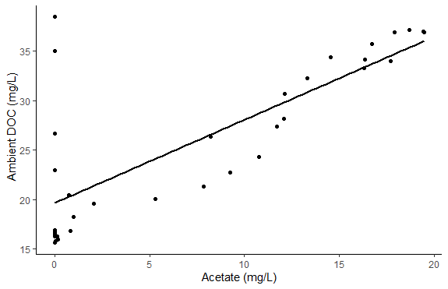
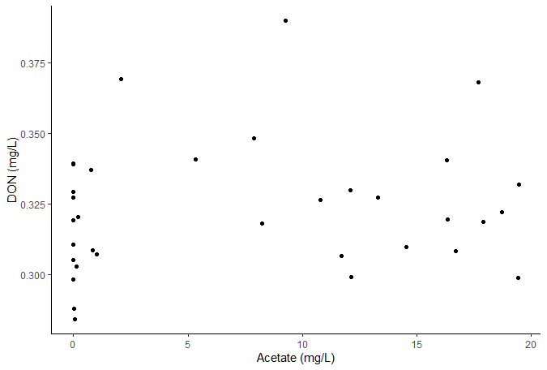
CRB- Responses
A
B
R² = 0.7591
p-value: 1.249e-11
R² = 0.5859
p-value: 8.127e-8
C
Notes:
So, now getting at the

Slide 11
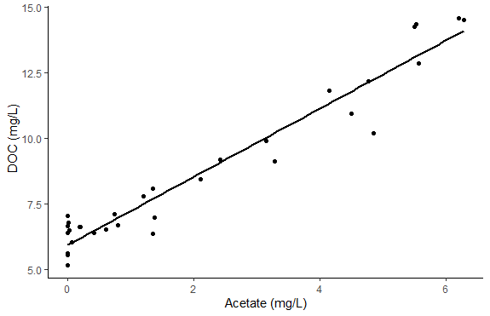
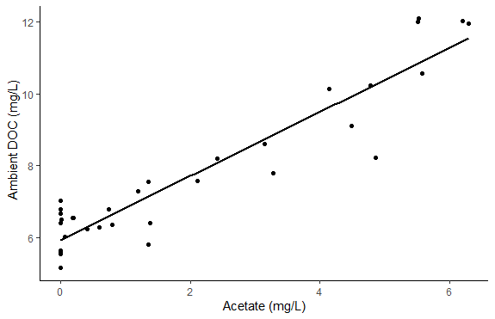
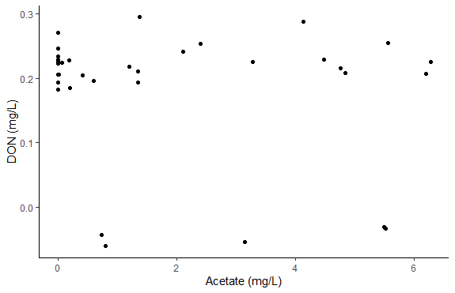
DCF- Responses
R²= 0.9396
p-value < 2.2e-16
R²= 0.8799
p-value < 2.2e-16

Slide 12
Summary
Changes in the concentration of solutes throughout time follow the BTC
Acetate manipulations stimulate DOC release, causing Ambient DOC concentrations to increase
DON does not show a response to the added acetate

Slide 13

Thank You!

