Slide 1
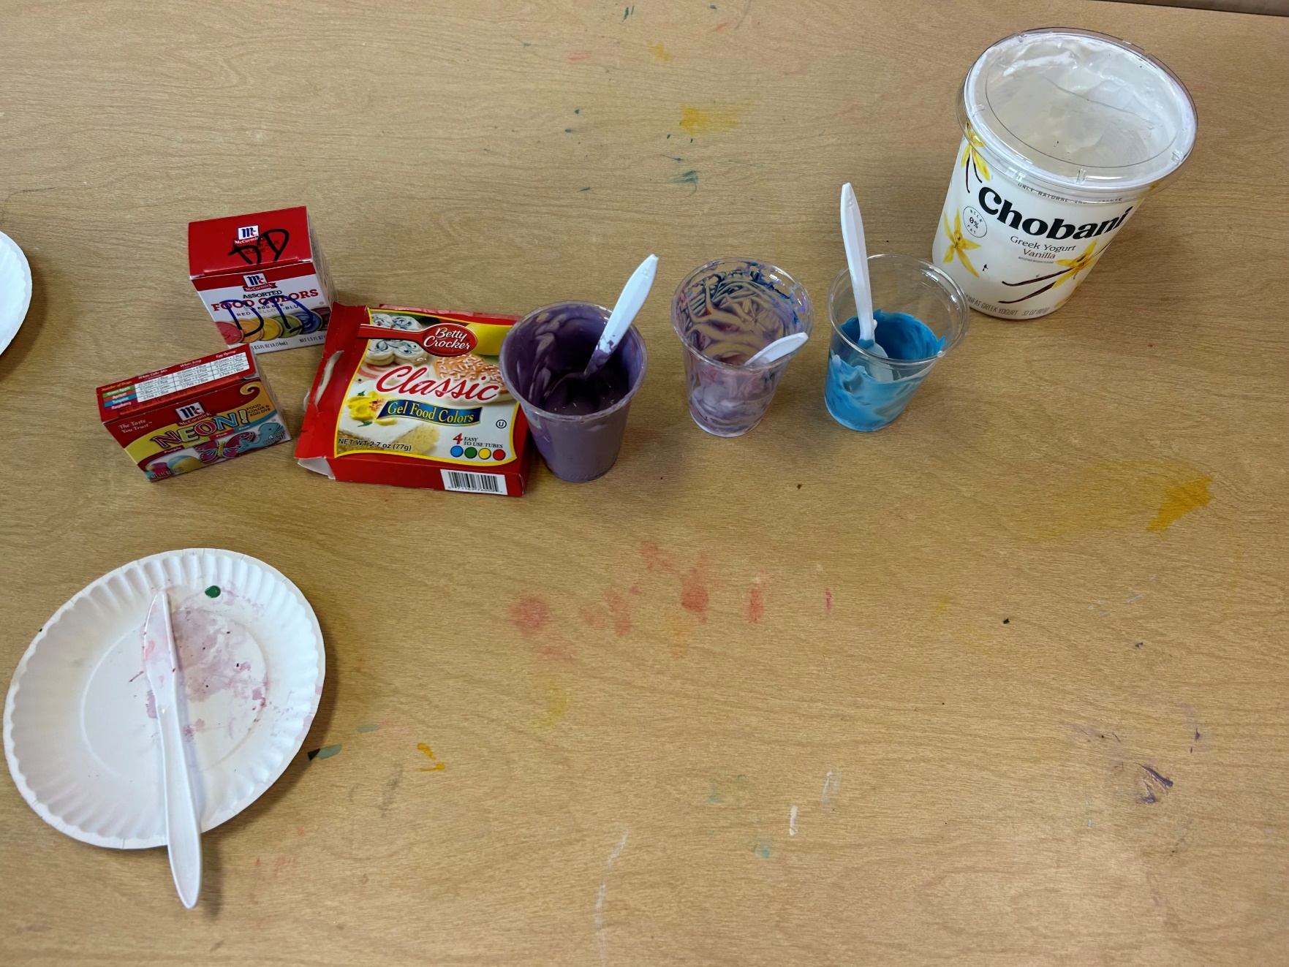
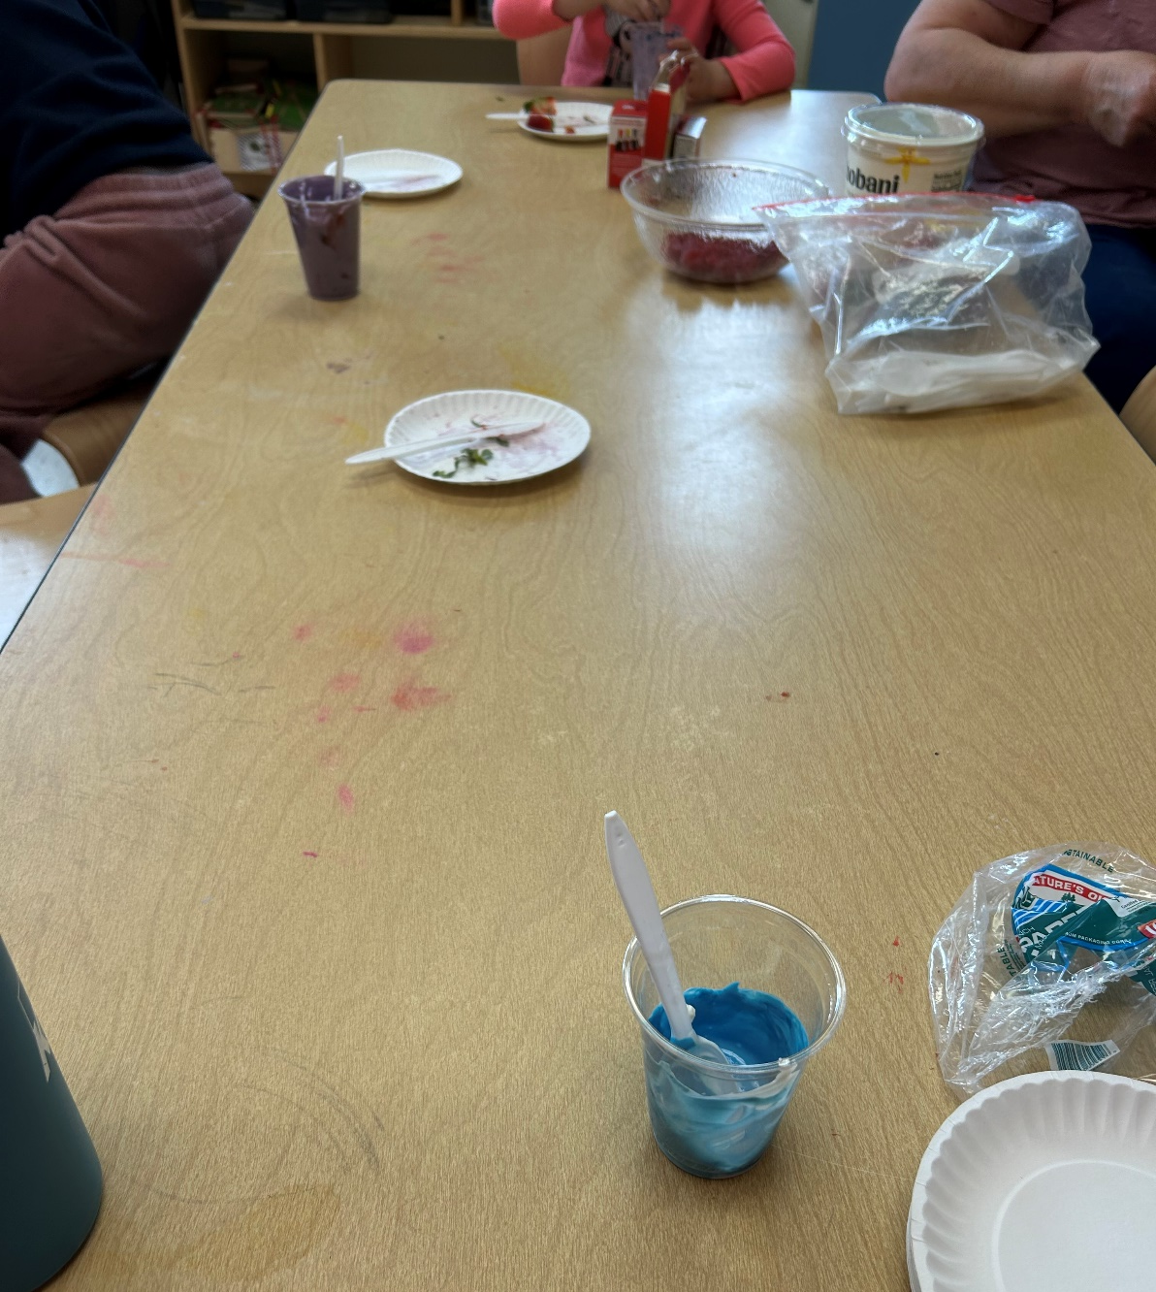
Choice Making in Preschool Aged Kids
Sarah Belhumeur
Institute on Disability at the University of New Hampshire
Intro to Methods
Methods are focused on smaller activities that will plant the seed for bigger concepts, with a focus on:
Dignity of Risk: the right of a person to make an informed choice to engage in experiences meaningful to him/her and which are necessary for personal growth and development Natural Consequences: Things that happen in response to a child’s behavior without parental involvement. Imposed by nature, society, or another person. (Natural & Logical Consequences: Natural Consequences, n.d.)
Results
Introduction
Dignity of Risk
Natural Consequence
Kids were excited to be given the choice of food coloring – they felt empowered when their yogurt turned the color they chose
The kids especially loved seeing the natural consequence of what happens when they mix the two colors they chose – this turned into an unexpected mini lesson on colors
The kids were excited about the natural consequence of their tongue turning different colors
The kids loved participating in this activity and seemed to respond well to the teachable moments of choice making
Supported decision-making (SDM) was passed in New Hampshire on August 10, 2021 (signed SB 134), which establishes SDM as a statutorily-recognized alternative to guardianship for adults with disabilities and their families.
SDM allows a person with disabilities to make their own decisions. It is an alternative to guardianship.
A person using supported decision-making identifies what types of decisions they want help with, as well as whom they trust to help them understand, make, and communicate those decisions.
Through a written supportive decision-making agreement, the person with disabilities legally designates which supporters will help them make which decisions. (Bhattarai, 2021)
Methods
Colorful Choices
The objective of this activity is to have kids make low-stake choices in an age appropriate, creative, engaging manner
Kids get a clear cup with a spoon full of vanilla Greek yogurt
They get the choice between red, yellow or blue food coloring to add to their cup of yogurt
Kids get the opportunity to mix the food coloring into the white yogurt before getting one more spoon of yogurt on top of their newly colorful yogurt
They again get to chose one more color, and mix it in with the rest of the yogurt in their cup
Supported Decision Making Related to Preschool Age Children
(Calling it “Choice Making” with 3-5 year olds)
As children develop, they will be able to participate in increasingly complex decision-making. Talking with children about what they think and responding to what matters to them will give children a sense of ownership over the decisions that they have contributed to.
Including children in choice making around planning, setting goals and choosing supports helps them learn how to take the lead as they get older and become more independent. This will also help others to respect and encourage their active role in key decisions that affect their life. (Comms, 2019)
Choice Making gives children skills that build independence, increase their self-esteem, and grow confidence in their own abilities.
If we want children to make their own choices, we have an obligation to help them and give them the resources, but not make the decision for them
Conclusions
When starting choice making at a young age, it plants the seed for future, bigger decisions and paves a path for supported decision making in scenarios such as employment, medical and living.
There are natural consequences to decisions, but consequences aren’t always negative/bad
i.e the natural consequence of choosing red and blue food coloring in the yogurt activity is purple yogurt and a purple tongue
References
Lipstein, E. A., Lindly, O. J., Anixt, J. S., Britto, M. T., & Zuckerman, K. E. (2015). Shared Decision Making in the Care of Children with Developmental and Behavioral Disorders. Maternal and Child Health Journal, 20(3), 665–673. https://doi.org/10.1007/s10995-015-1866-z
Decision-Making Examples in Different Scenarios | Harappa Education. (2020, September 11). Harappa.education. https://harappa.education/harappa-diaries/decision-making-examples/
Supported Decision-Making Can Benefit Children with Special Needs and Family Caregivers | Supported Decision Making. (n.d.). Supporteddecisionmaking.org. http://supporteddecisionmaking.org/blogs/guest-blogger/supported-decision-making-can-benefit-children-special-needs-and-family
About Supported Decision-Making. (n.d.). Supported Decision-Making. https://supporteddecisions.org/about-supported-decision-making/
Bhattarai, D. (2021, February 26). Supported Decision-Making. DRCNH. https://drcnh.org/issue-highlight/supported-decision-making/
The Value of Dignity of Risk - Direct Support Professionals Orientation - Virginia Commonwealth University. (n.d.). Dsporientation.partnership.vcu.edu. Retrieved April 1, 2023, from https://dsporientation.partnership.vcu.edu/section-i/the-value-of-dignity-of-risk/#:~:text=The%20concept%20of%20dignity%20of

