Slide 1
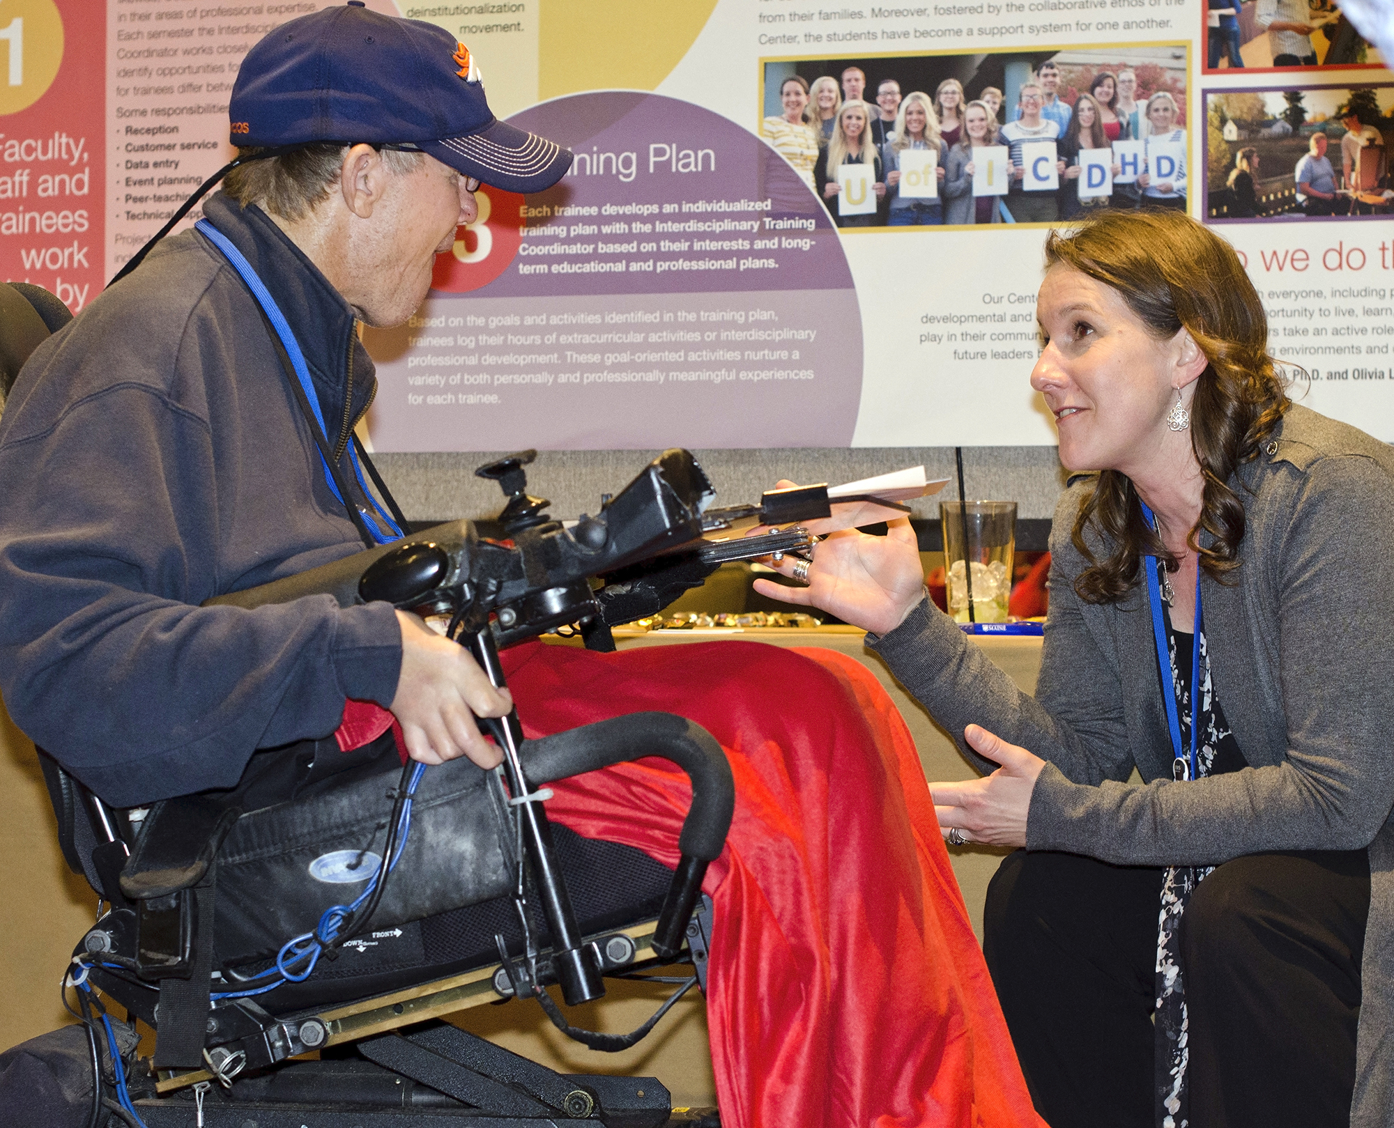
Adults With Intellectual and Developmental Disabilities (IDD) as Role Models to Youth with IDD
Abbott Philson
Institute on Disability at the University of New Hampshire
Introduction – Why Research Peer Mentoring ?
Discoveries
There are not a lot of opportunities for formal peer mentoring for youth with disabilities.
Opportunity for more peer mentoring training in the state of Maine.
Three of the 4 interviewees reported offering informal peer mentoring.
All Maine Parent Federation staff are either parents or family members of people with disabilities.
The Community Advisory Committee (CAC) partners with the University of Maine Center for Community Inclusion and Disability Studies, to advise, plan and implement the activities of the Center. The CAC is comprised of a majority of individuals with developmental disabilities.
New Mainers Public Health Initiative directly serves the needs of immigrant and refugee youth, including developing their independence.
This research project was to understand peer mentoring with people with disabilities. Peer mentoring by someone with a disability is important because:
During peer mentoring there is a connection with young people with disabilities.
During my clinical placement I experienced young people with disabilities approaching with interest-they wanted to know another person with a disability.
Chance to be a role model, support growth and development of youth with disabilities.
Sharing personal success and challenges can support youth to know how to proceed when things happen to them.
Who Were the Partners Interviewed?
Maine Parent Federation
Methods
Step 1: Identified organizations that do mentoring.
Step 2: Created interview questions.
Step 3: Invited organizations to a zoom interview, scheduled times/days, sent interview questions.
Step 4: Conducted interviews.
Step 5: Created notes, and analyzed data.
Opportunities
Youth with disabilities find me approachable, sought me out for conversation.
In 2016/2017 there was a movement across the nation to get the young voice involved at parent centers.
LEND experience created opportunity for mentoring as a paid job.
Interview Questions
What is Peer Mentoring with Youth with Disabilities?
What resources and support do you have for young people (including those with disabilities) transitioning to adulthood?
What resources do you have to support families of youth (including those with disabilities) who are transitioning to adulthood?
What are the biggest challenges that youth (including those with disabilities) identify?
Do you have a mentoring program or offering for youth (including those with disabilities)? If you do, what happens in that program?
Do you provide an opportunity for people to be trained as mentors?
Do you connect youth (including those with disabilities) to adults with disabilities?
Do you connect youth (including those with disabilities) and their families to social opportunities as they are moving into adulthood?
A mentor is a person who through support, counsel, friendship, reinforcement and constructive example helps another person, usually a young person, to reach his or her work and life goals. Mentoring relationships provide valuable support to young people, especially those with disabilities, by offering not only academic and career guidance, but also effective role models for leadership, interpersonal and problem-solving skills.
Mentoring relationships may take different forms:
Peer Mentoring: A person close in age to his or her mentee may act as a sounding board for ideas and plans and provide guidance in an informal manner.
Office of Disability Employment Policy. Cultivating leadership: mentoring youth with disabilities. Retrieved from: https://www.dol.gov/agencies/odep/program-areas/individuals/youth/mentoring-youth-with-disabilities

