Slide 1
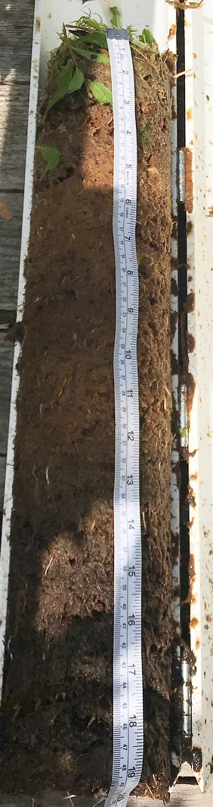
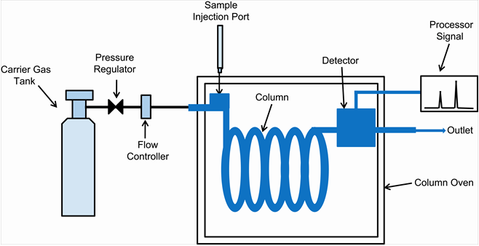
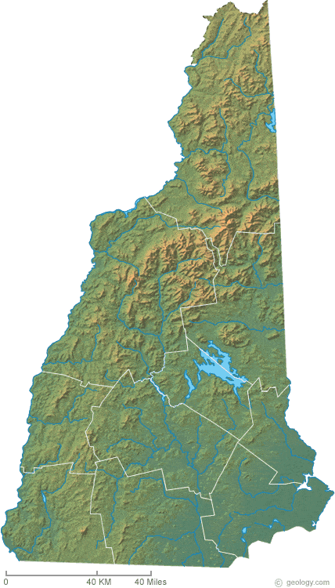

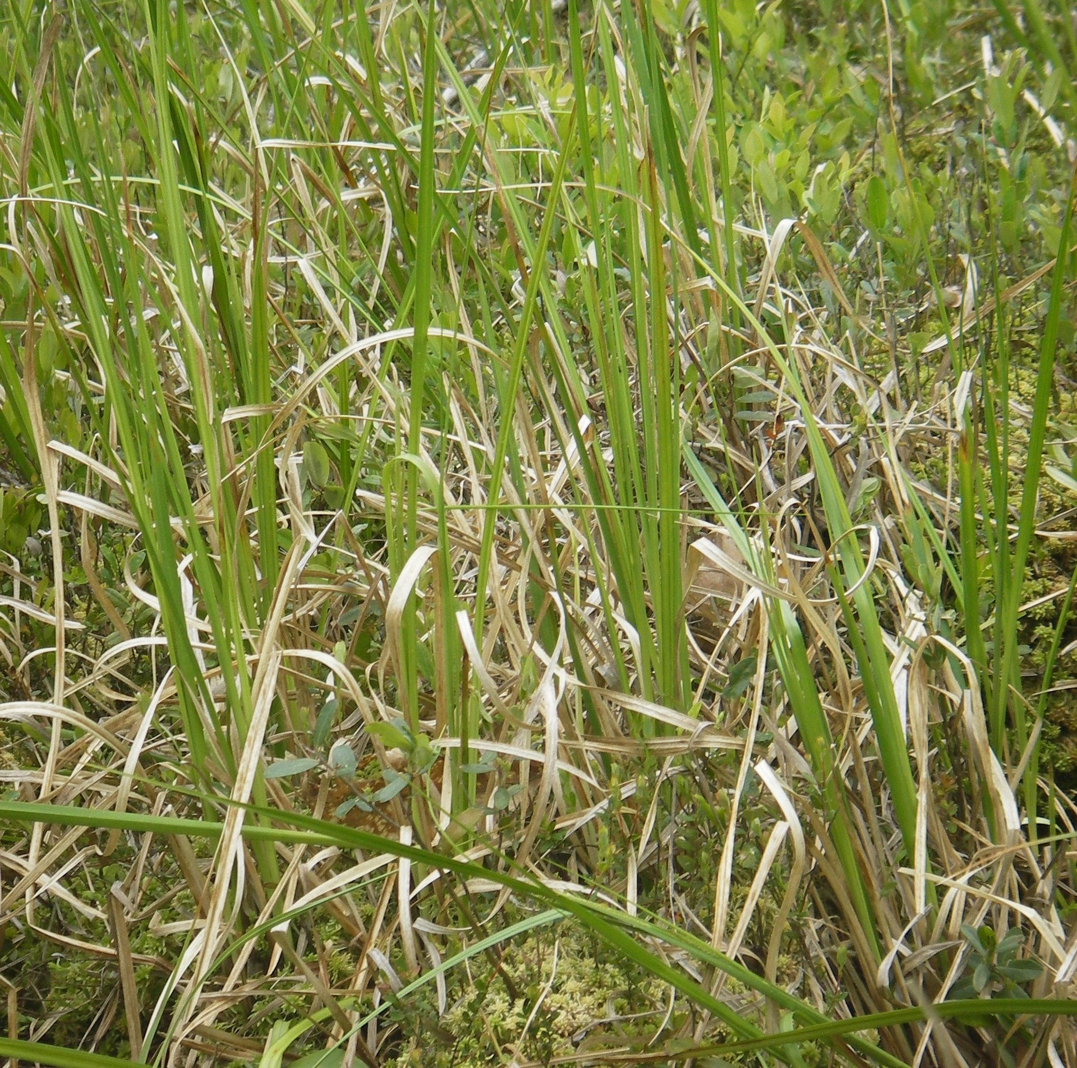
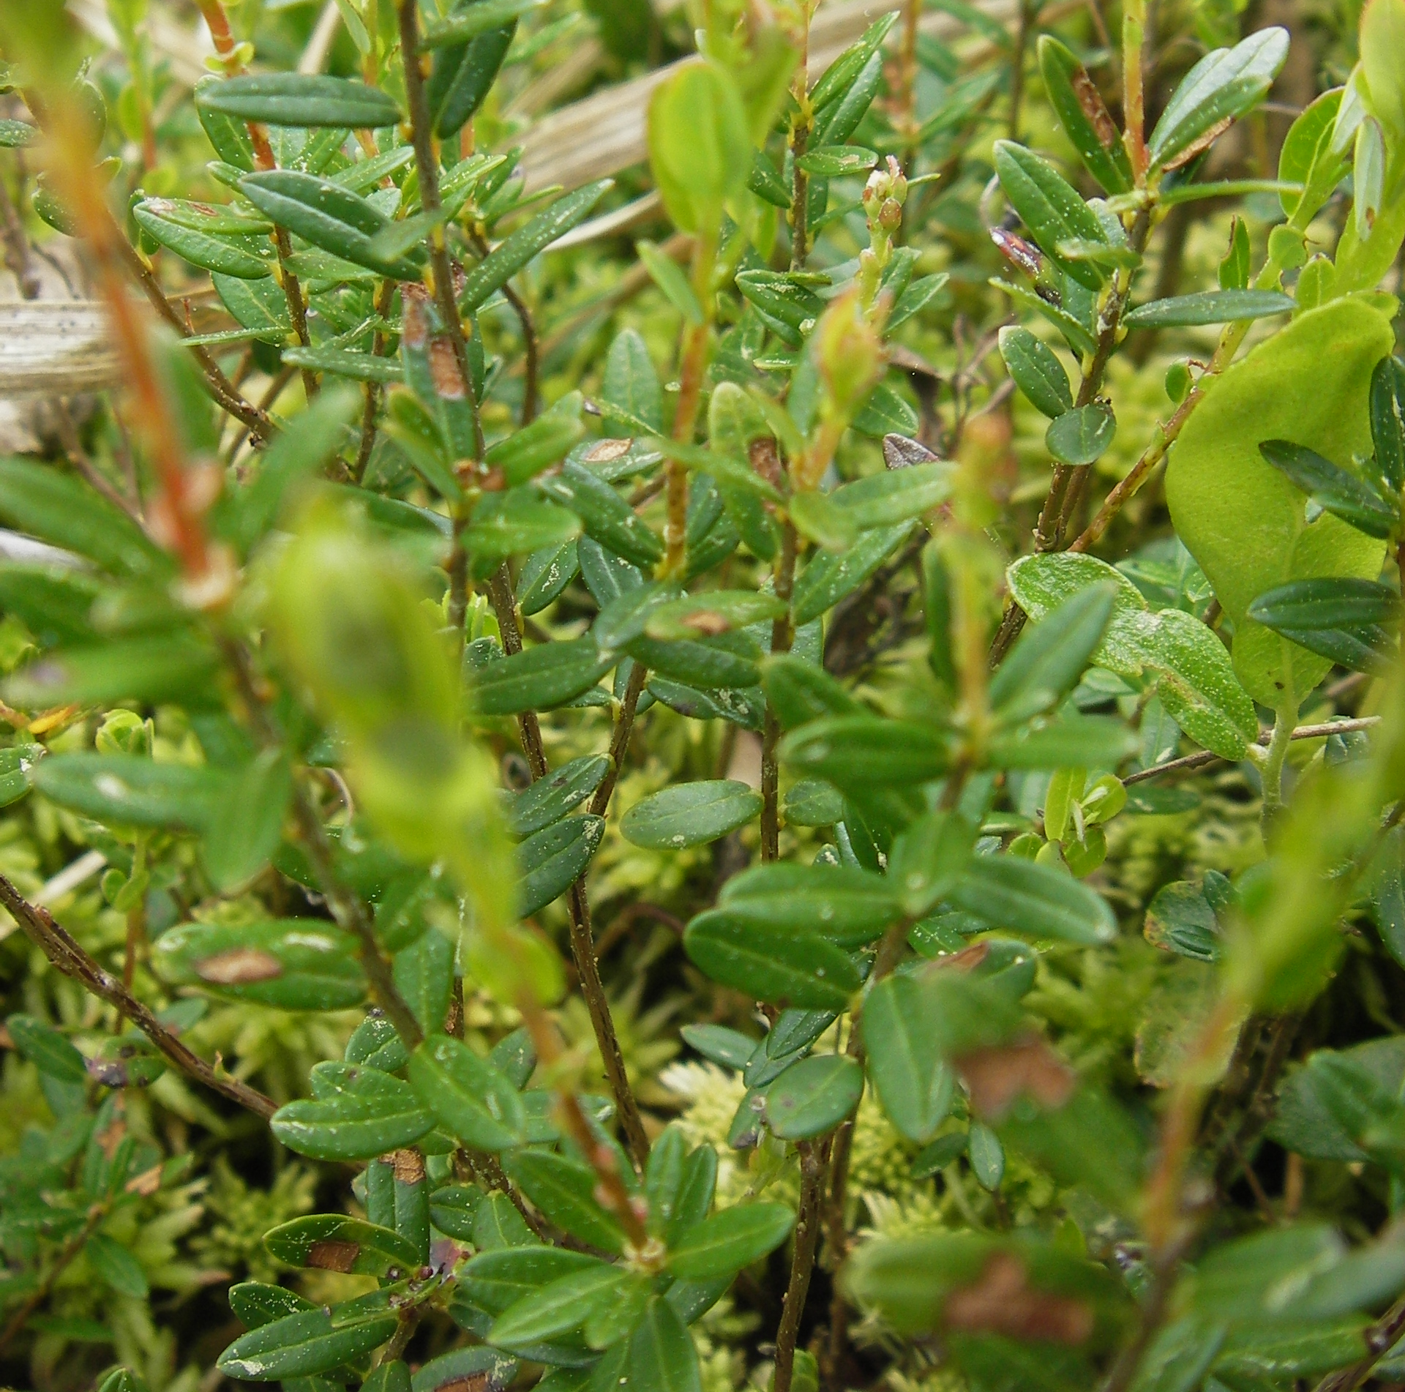
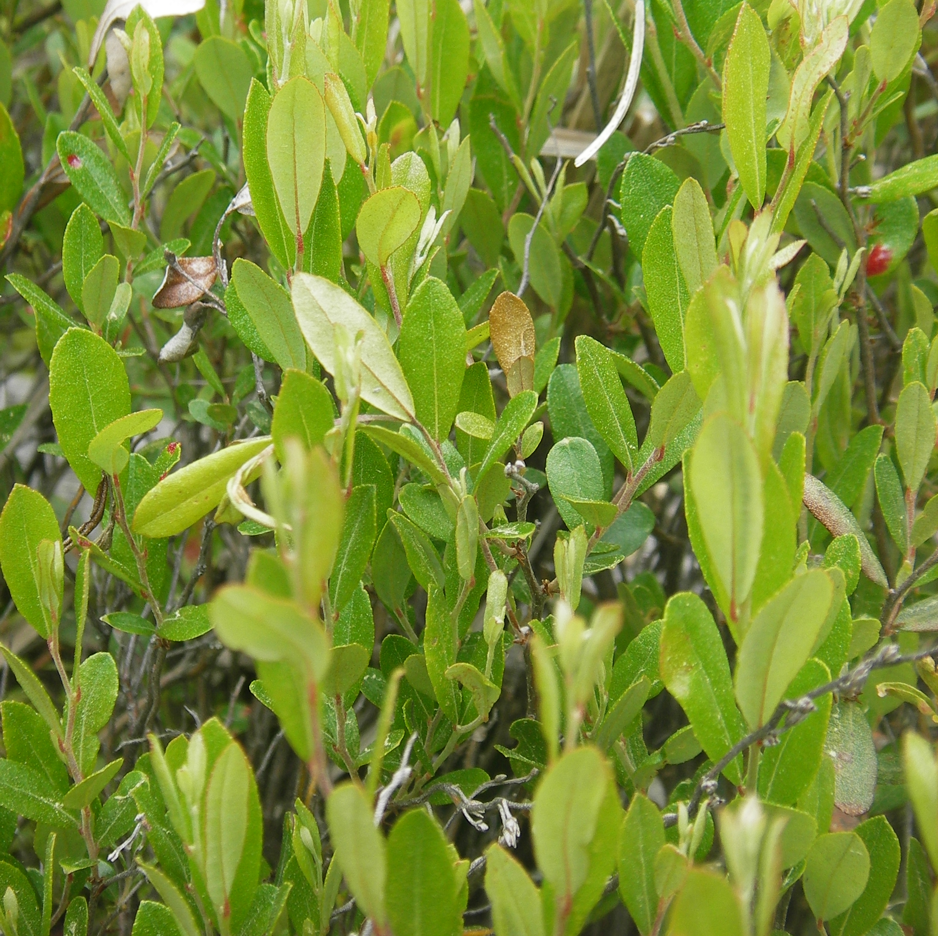



Examining the Impact of Shrub Encroachment on Methane Production and Consumption in Northern Peatlands
Clarice R. Perryman^{1,2*}, Jessica G. Ernakovich³, Ruth K. Varner^{1,2}
¹Department of Earth Sciences, University of New Hampshire, Durham, USA, *crp1006@wildcats.unh.edu, ²Institute for the Study of Earth, Oceans, and Space, University of New Hampshire, Durham, USA
³Department of Natural Resources and the Environment, University of New Hampshire, Durham, USA
Background:
Increasing temperatures and drought frequency promote shrub encroachment in peatlands^{1,2}
Shrub encroachment may increase the vulnerability of peatland carbon³
Peatlands are a globally significant source of methane⁴ (CH₄) emissions and the effect of shrub encroachment on CH₄ cycling is uncertain
We assessed CH₄ production and consumption and the abundance of methanogens (producers) and methanotrophs (consumers) in an New Hampshire peatland experiencing shrub encroachment
Methods:
Aerobic and
anaerobic incubations
Measure CH₄
on GC-FID
Change in CH₄
over time
Cores collected from 3 vegetation types and subsampled at 10, 30, and 60 cm
CH₄ concentration
16s rRNA amplicon sequencing
time
Sequence QC, clustering, and ID⁶
Microbial community composition
Fig. 1. Aerial image of Sallie’s Fen taken in October 2014 using UAS and approximate location.Images courtesy of Michael Palace (palace@guero.sr.unh.edu) and geology.com.
Study Site:
Sallie’s Fen (43° 12.5’ N, 71° 3.5’ W) is a 1.7 ha fen in Barrington, NH (Fig. 1)
Growing season CH₄ emissions range from 8.7 to 3833.1 mg CH₄ m⁻² d⁻¹ and vary with vegetation and climate⁵
Vegetation Types:
Hummock (n = 3): Vaccinium oxycoccos (bog cranberry), Sphagnum magellanicum (moss)
Lawn (n = 3): Carex rostrata (sedge), S. magellanicum
Shrubby Lawn (n = 2): Chamaedaphne calyculata (leatherleaf), S. magellanicum
Photos by G. Noyce.
C. rostrata
sedge
V. oxycoccos
bog cranberry
C. calyculata
leatherleaf
Depth has a stronger influence on methane-cycling microbes than vegetation cover in a peatland experiencing shrub encroachment.
@ClaricePerryman
@UNH_GasLab
Key point 1: Depth strongly affects the community composition of
methanotrophs and methanogens
Key point 2: Vegetation affects rates of CH₄ consumption and production, but not abundance of methanotrophs and methanogens
(a)
(d)
(f)
CH₄ consumption (d) varies by vegetation (χ2 = 9.25, p = 0.009) and depth (χ2 = 6.5, p = 0.038), relative abundance of methanotrophs (f) varies only by depth (χ2 = 10.73, p = 0.005)
CH₄ production (g) varies by vegetation (χ2 = 5.95, p = 0.05), relative abundance of methanogens (h) varies by depth (χ2 = 14.1, p < 0.001)
Forthcoming stable isotope analysis of dissolved CH₄ may resolve current discrepancies, as isotopes better approximate in situ activity of methanogens and methanotrophs
Relative Abundance
(b)
(g)
(h)
hummock
cores A, B, C
lawn
cores A, B, C
shrubby lawn cores A + B
Methanotrophs are more abundant than
methanogens across vegetation and depth (a)
Methanogen abundance increases with depth (a)
CH₄ cycling community does not differ by vegetation (b), but does differ significantly by depth (c)
(c)
References:
¹Heijmans et al. (2013), Global Change Biology
²Weltzin et al. (2003), Global Change Biology
³Luca et al. (2013), Nature Climate Change
⁴Turetsky et al. (2014), Global Change Biology
⁵Treat et al. (2007), Journal of Geophysical Research
⁶Boylen et al. (2019), Nature Biotechnology
Acknowledgements: This work was supported by the the NSF GRFP [Grant No. DGE145027] , the USDA Forest Service Northern Research Station Climate Change Program, and the U.S. Department of Energy Joint Genome Institute Community Science Program [Proposal ID 1445]. The work conducted by the U.S. Department of Energy Joint Genome Institute, a DOE Office of Science User Facility, is supported by the Office of Science of the U.S. Department of Energy under Contract No. DE-AC02– 05CH11231. Thanks to Jack Dibb and Sallie Whitlow for allowing access to Sallie’s Fen and the UNH Hamel Center for Undergraduate Research for funding field assistants Madelaine Juffras and Mike Zampini.

