Slide 1




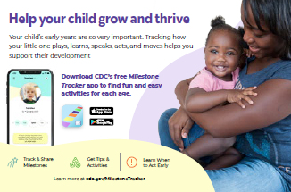
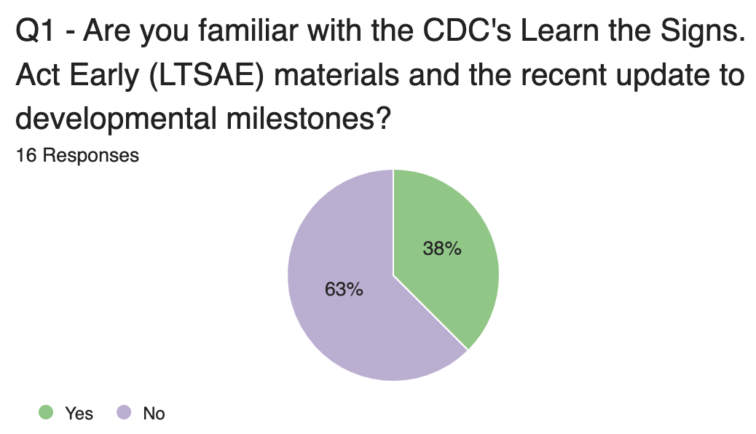
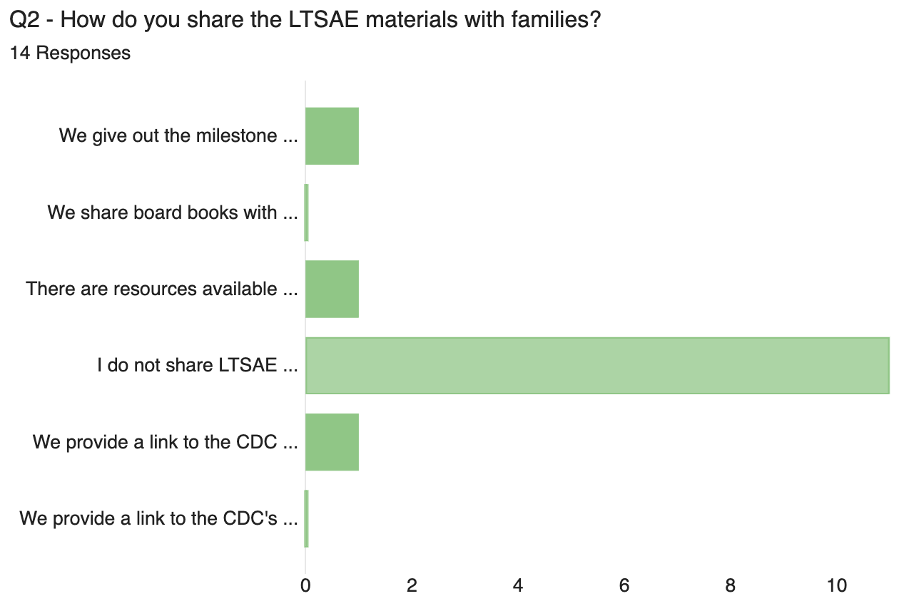
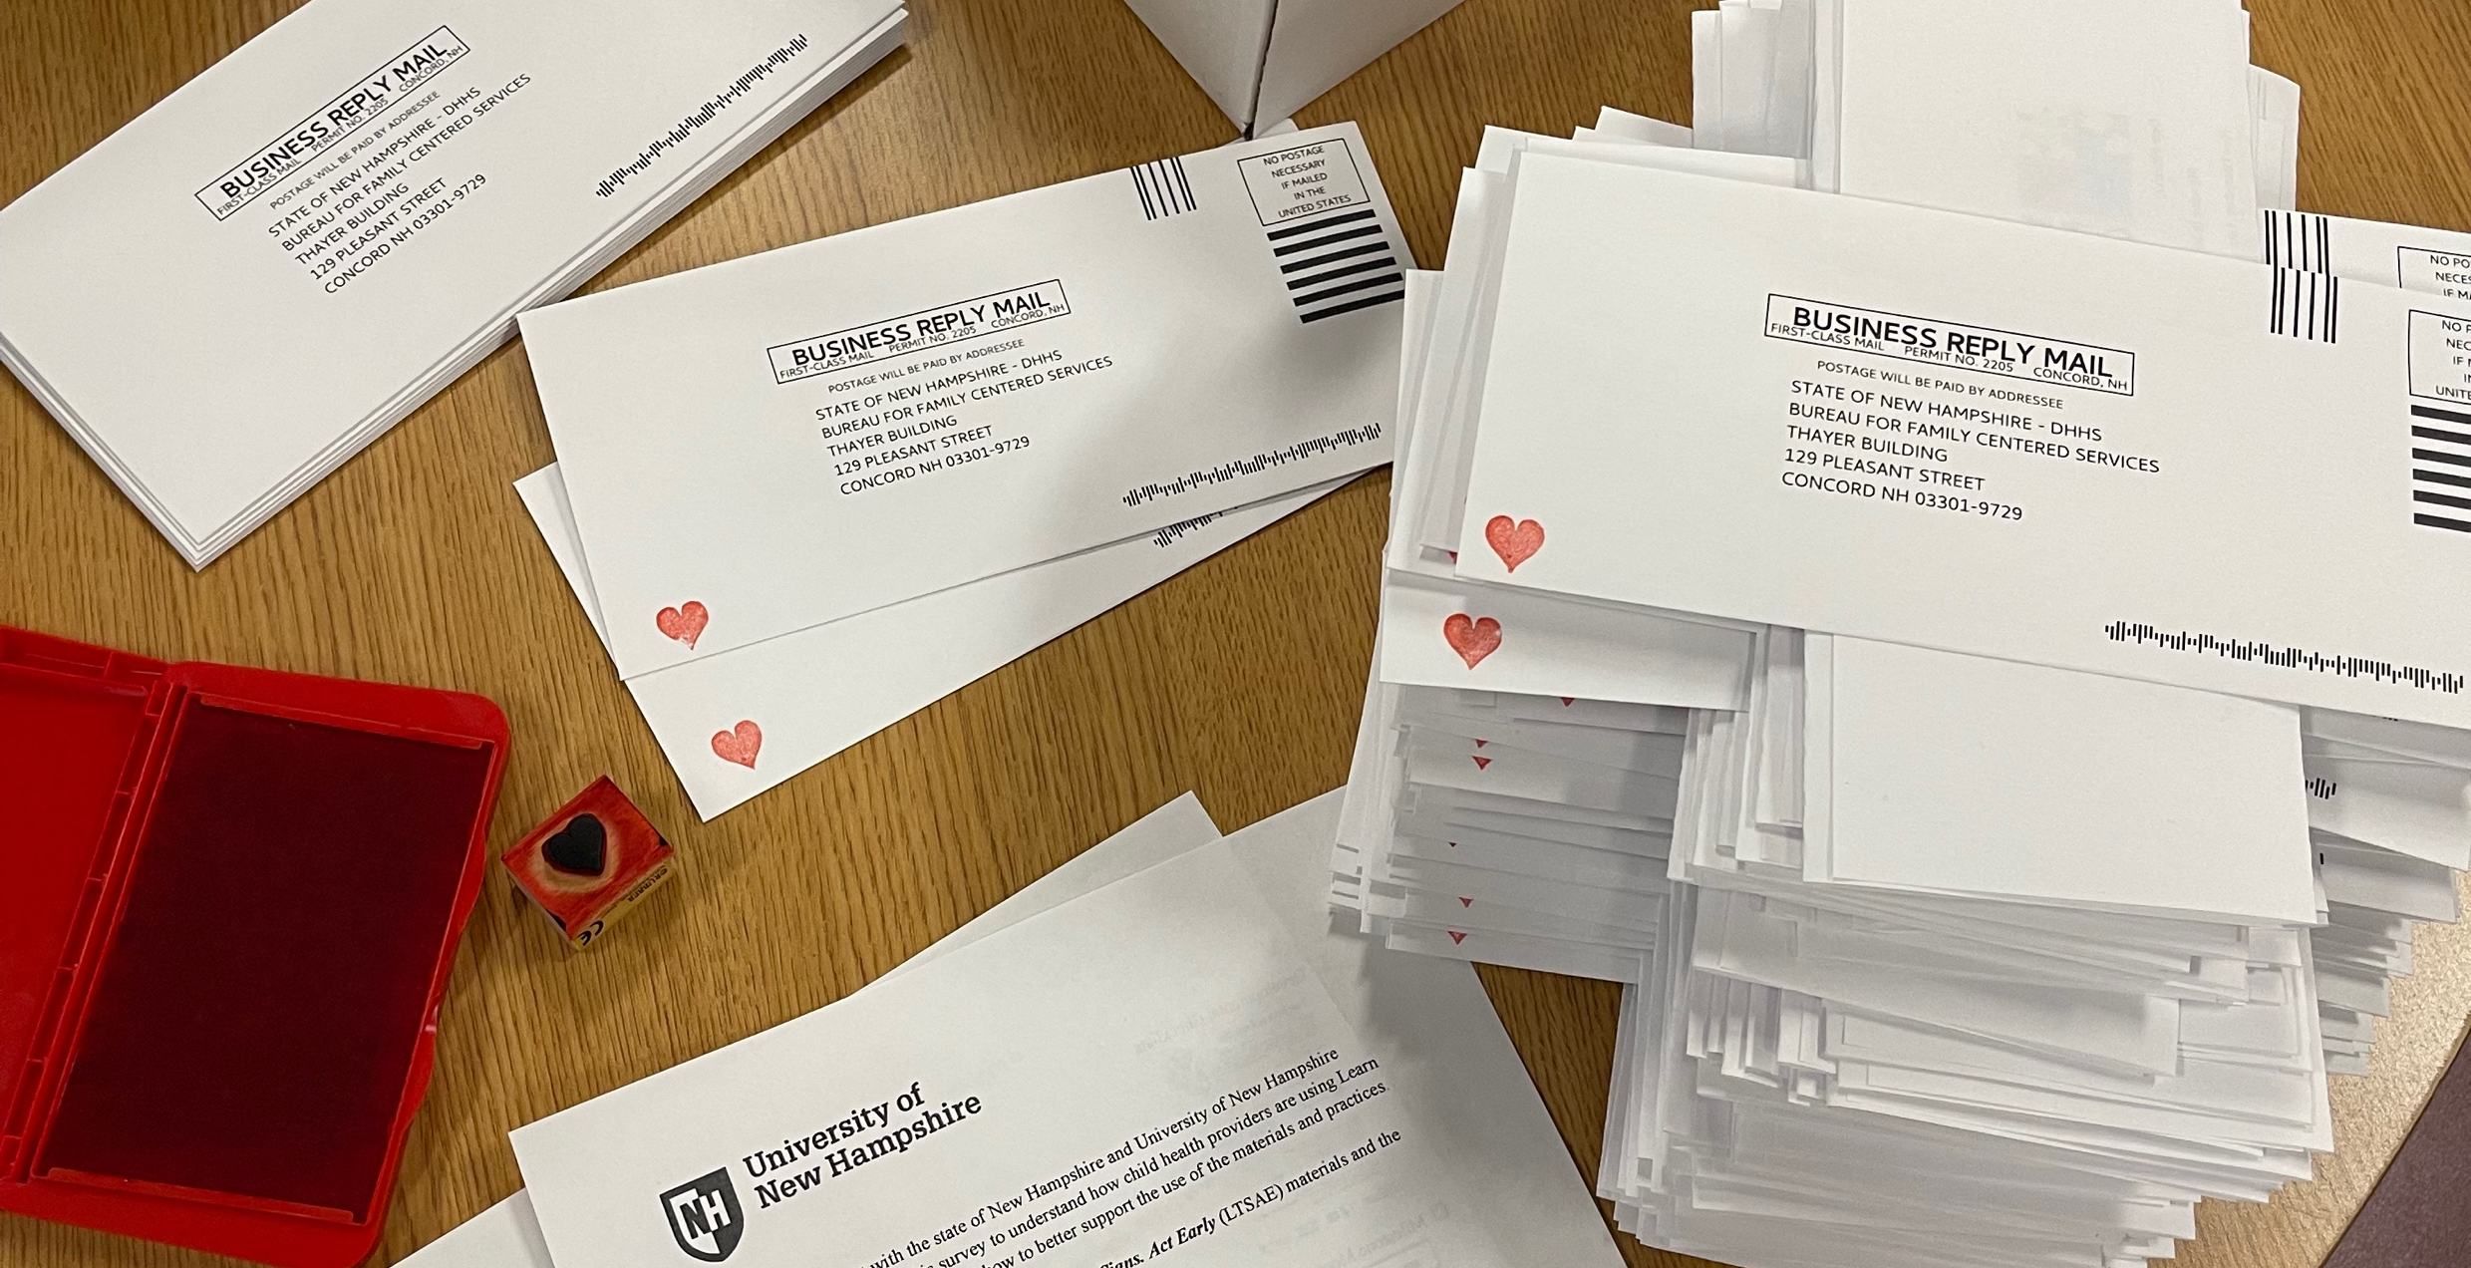
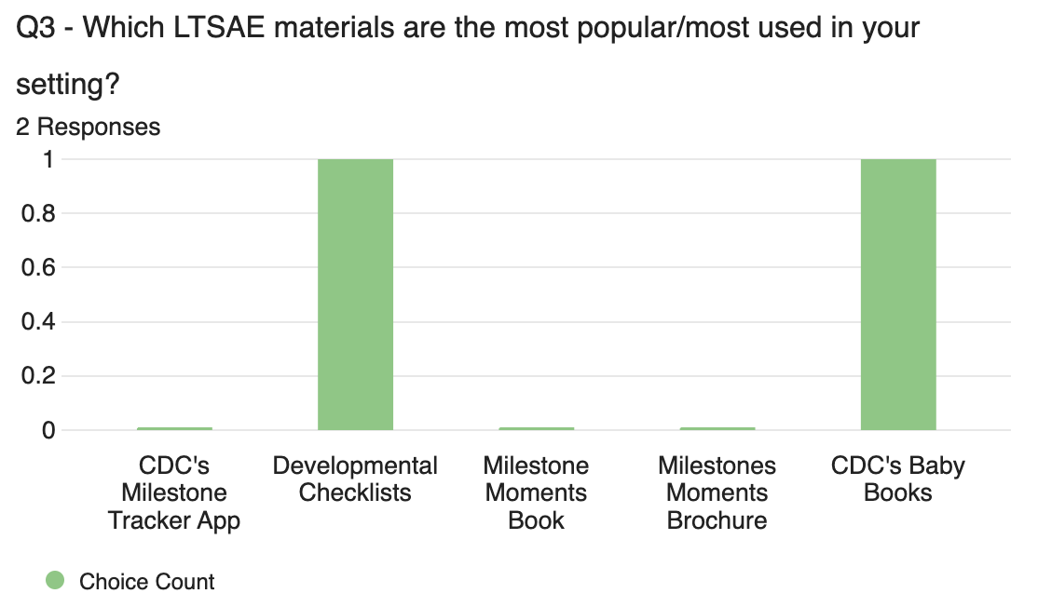
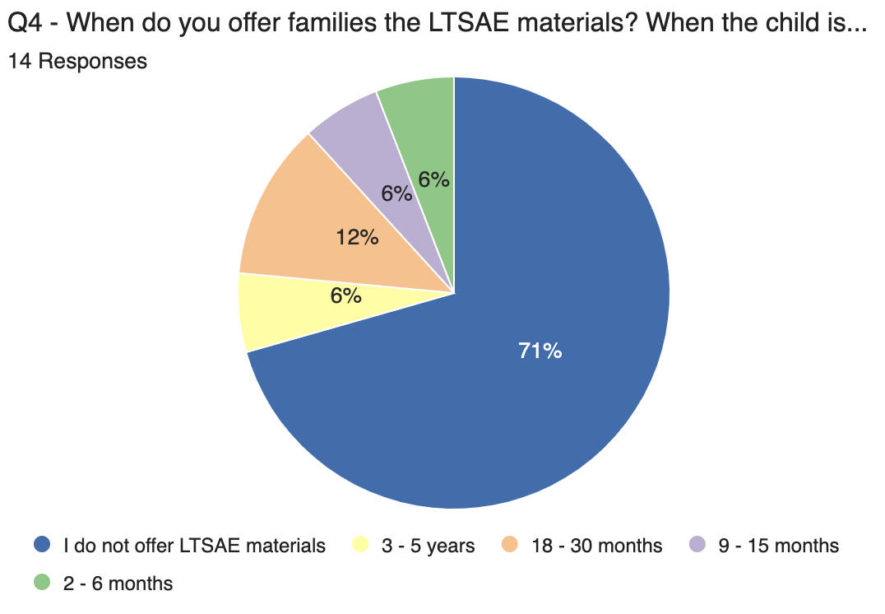
The Importance of Family Engaged Developmental Monitoring
Julia Forcillo, B.S. Occupational Science
Institute on Disability at the University of New Hampshire
Background
Family-Engaged Developmental Monitoring
Families are the expert on their child’s development
Watch Me Grow (WMG)
NH developmental screening, monitoring, information, and referral system
Information is gathered to inform a holistic approach to the child’s development
Developmental progress and needs are discussed over time
Supports early identification of children who may need developmental supports and services
Learn the Signs. Act Early (LTSAE)
Program that aims to improve early identification of children with autism and other developmental disabilities so children and families can get the services and supports they need
New Hampshire Family Voices (NHFV)
Provides free, confidential services to families and professionals caring for children with chronic conditions and/or disabilities
Data Collection and Analysis
Conclusion
Are you familiar with the CDC’s Learn the Signs. Act Early (LTSAE) materials and the recent update to developmental milestones?
How do you share LTSAE materials with families?
When do you offer families the LTSAE materials?
Which LTSAE materials are the most popular/most used in your setting?
Survey Questions
About 100 child health providers in the state of NH received a letter, including a description of the project and a paper survey. Out of the 100 letters sent, we received 16 responses resulting in a 16% response rate. We received 6 visits to the online Qualtrics survey from the NH AAP Newsletter but no qualitative responses, therefore they are not included in the data.
The results of this survey indicate:
63% of respondents were not familiar with LTSAE materials.
71% of responders do not share LTSAE materials with their families.
12% of responders use LTSAE materials in their setting.
Project Activities
LTSAE materials provide caregivers and professional’s with knowledge about a child’s developmental milestones in comparison to “typically developing” children. These materials can help a professional determine if a child needs a screening or referral to therapy (OT, SLP, PT).
Results
Create survey for child health providers
Send out survey in the NH AAP Newsletter
Create Provider Distribution List
Send out Distribution Letter to 100 child health providers
Create gross motor, fine motor, and sensory regulation posters
Analyze survey results
Take-Aways and Next Steps
It is time-consuming and challenging finding updated and accurate child health provider information
It is important to continue in this research to:
Understand why LTSAE materials are not being utilized
What other developmental materials may be used instead
How to more effectively reach child health providers in gaining better response rate in the future
WMG and LTSAE materials provide families with knowledge on the important of developmental milestones and resources to monitor their child’s development
References
https://helpmegrownational.org/resources/coordinated-and-integrated-data-systems-for-early-identification-project-information-materials/
https://nhfv.org/watch-me-grow-nh-ages-0-5/
https://www.cdc.gov/ncbddd/actearly/index.html
https://nhfv.org/who-we-are/mission-and-vision/
Above. Survey and provider letter mailing.
Notes:
FEDM: an intentional partnership of families and providers working together to highlight a child’s developmental progress and identify opportunities for support and education for positive outcomes
LTSAE:
Health education campaign
Act Early Initiative
Research and evaluation
NH AAP: New Hampshire Chapter American Academy of Pediatrics
Resources
https://helpmegrownational.org/resources/coordinated-and-integrated-data-systems-for-early-identification-project-information-materials/
https://nhfv.org/watch-me-grow-nh-ages-0-5/
https://www.cdc.gov/ncbddd/actearly/index.html
https://nhfv.org/who-we-are/mission-and-vision/

Slide 2
Poster Accessibility Tips
Institute on Disability/UCED at UNH
About this Template…
This template contains 6 layouts to choose from, each designed to meet or exceed basic accessibility standards.
To View/Add Layouts and Edit the Master…
To view/add different layouts from the master slide deck, select the dropdown arrow under “new slide” in your home ribbon then select the layout you wish to use.
To view and edit the master slides go to View> Slide Master.
To add this as a template on your computer go to File>Save as> change file type to “powerpoint template” and save.
Fonts
We recommend using Sans-Serif fonts that are large enough to be read from 5-10 feet away. Sizes may vary depending on the viewing distance and amount of text.
Title: Use at least 72-point font or larger for poster titles. This template uses 125 point (ideal is 158).
Section Titles: Use at least 46 to 56-point font for section titles. This template uses 60 point-font.
Block Text/Body: Use at least 24-36. This template uses 40 point font for body text.
Colors
Select a high contrast color scheme. Check your contrast with WebAIM contrast checker.
Graphics and Images
Caption or title all images and graphics. Include alt text if you plan to share this digitally (template already includes alt text for background graphics.
Language
The first rule of plain language is: write for your audience. Use language your audience understands and feels comfortable with. Take your audience’s current level of knowledge into account.
Note. Many individuals who are blind or visually impaired rely on electronic versions of slides or posters in order to access the content. You may be asked to upload a version of your slides or poster before a conference. Please speak with someone if you need assistance preparing an accessible PDF or plain text version of your poster.

Slide 3
TITLE of Poster
Authors
NH-ME LEND, Institute on Disability, University of New Hampshire
Introduction
Data Analysis
Conclusions
Add content here
CHART NAME
Add content here
Methods
Add content here
CHART NAME
SUBHEADING
Add content here
References
Results
Add content here
Add content here

Slide 4
TITLE of Poster
Authors
NH-ME LEND, Institute on Disability, University of New Hampshire
Introduction
Data Analysis
Conclusions
Add content here
Add content here
Add content here
Methods
Add content here
SUBHEADING
Add content here
References
Results
Add content here
Add content here

