Slide 1

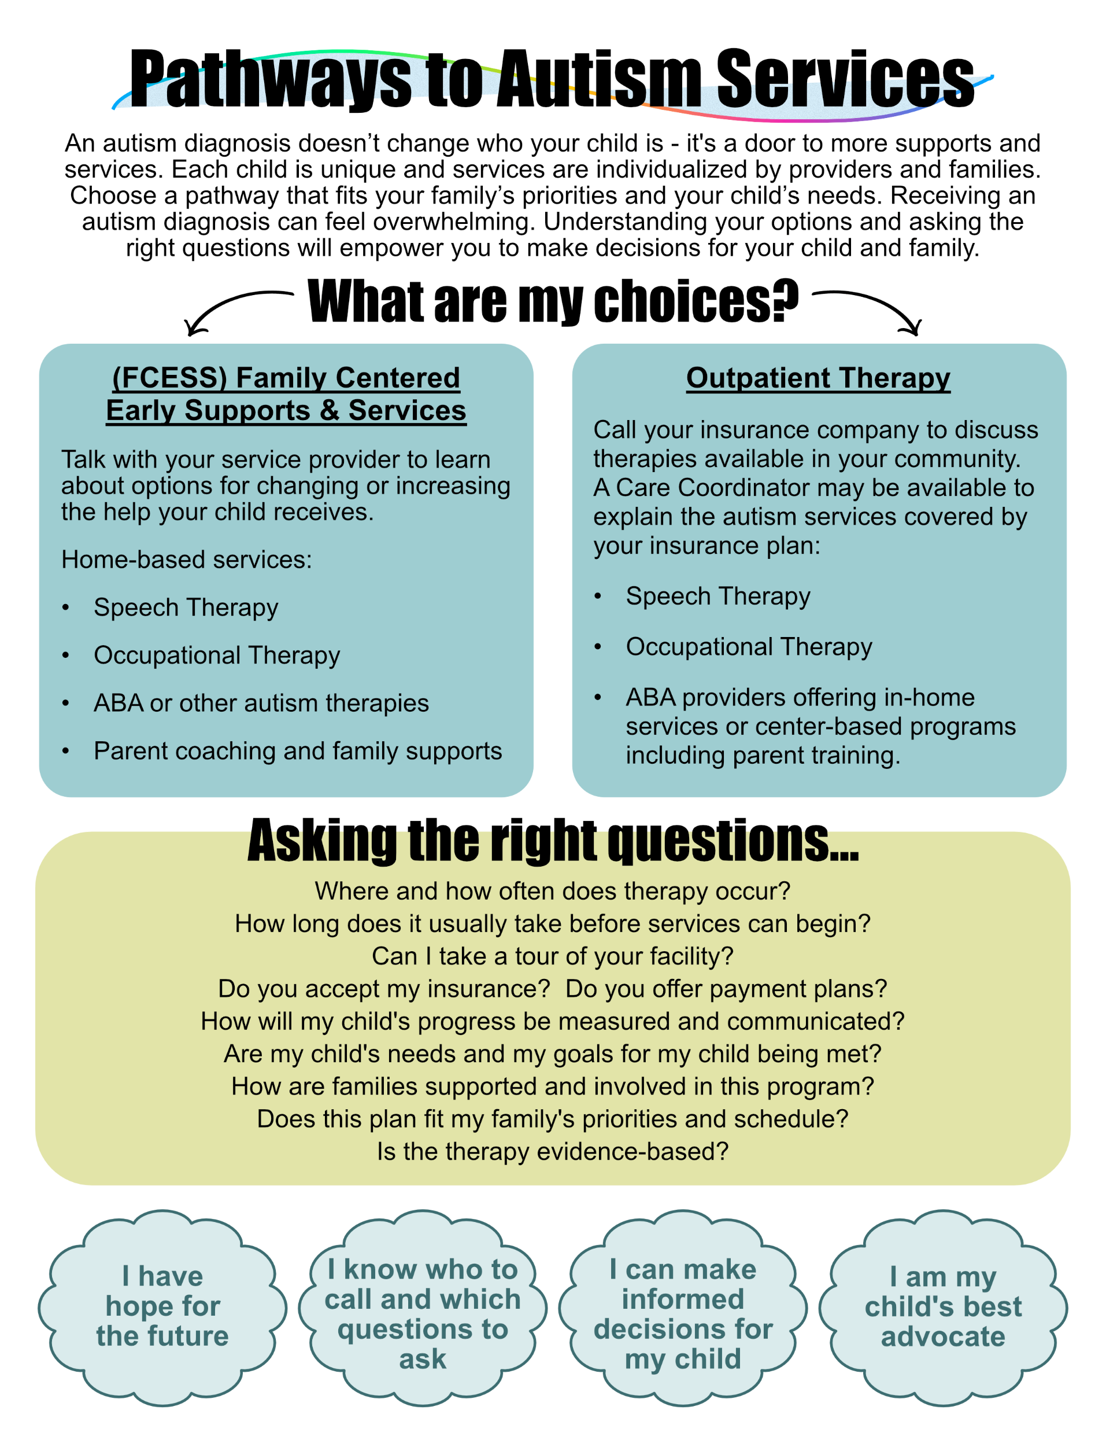
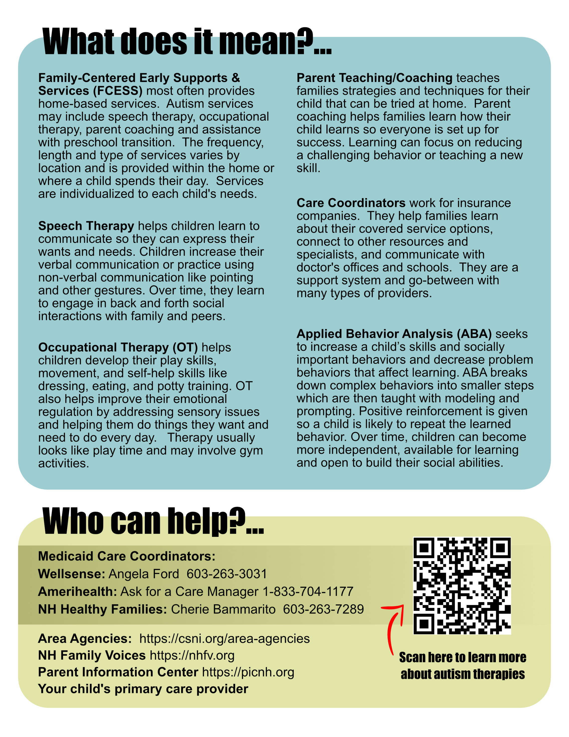
Empowering Families to Choose a Pathway to Services
After an Autism Diagnosis
Micaela Demeter, B.S. Nutrition & Dietetics, Family Discipline
BACKGROUND:
Amoskeag Health is a 501c (3) nonprofit, federally
qualified health center in Manchester, NH. Their mission is
to improve the health and well-being of their patients and the
communities they serve by providing exceptional physical and mental health care and social services that are accessible to all. Their high quality, comprehensive health care is designed specifically for low-income and underserved populations experiencing significant barriers to care.
The Child Development Clinic (CDC), administered by Amoskeag Health, is one of four NH statewide Title V programs for Children with Special Health Care Needs which is supported by the NH Department of Health and Human Services (NH DHHS), Bureau of Family Centered Services.
The CDC provides interdisciplinary, developmental evaluation for children through age six. Clinic teams provide family centered, culturally competent care with a goal to assist families in making informed decisions regarding medical, developmental and educational needs of their child. Many children are evaluated and diagnosed with autism spectrum disorder.
This research process revealed several project parameters which were considered when creating the infographic:
The Child Development
Clinic serves
families from
across the
state.
English
proficiency and literacy levels
vary among
families.
Services can
greatly differ depending on the city or town of residence.
Families are
often concerned
about talking, sleeping,
behavior and toileting.
Services
are determined
by insurance co., school districts
& Area
Agencies.
The clinic coordinator
has limited time to support families
after a
diagnosis.
Everyone is exhausted at
the conclusion
of each
appointment.
Services
may be delayed
due to waitlists
and insurance
approval
timelines.
This simple visual explains common autism service options
Two versions were developed for 0-3 years and preschool age
The infographic supports visual learners
Families are given clear first and next steps for decision making
Allows families to explore additional information after their diagnosis meeting ends
The clinic team can offer a more supportive, higher-quality sendoff
Instills confidence and purpose at an otherwise challenging time
PROJECT GOAL
Create an infographic for the Child Development Clinic that provides information about autism services and empowers families to ask the right questions and choose a pathway that matches their priorities and needs.
ACTIVITIES:
Reviewed online autism resources
Observed 7 clinic evaluations and diagnosis discussions
Received infographic feedback from the clinic team
FUTURE STEPS:
Review infographic with clinic and community providers
Consider testing the infographic during clinic evaluations
  Follow up with clinic families in 3-6 months
Adjust wording as needed when systems change
Review for accessibility and plain language
Translate into other languages
CONCLUSIONS:
The pathway to choosing next steps after an autism diagnosis looks different for each family. When families feel empowered to ask the right questions, they are better able to make decisions. This infographic informs families about service options and educates them on how therapies may benefit their child. There is no one best track - the right decision depends on each family’s priorities and needs.
Interviewed autism support network professionals
School
Districts
NH Family
Voices
Medicaid
Providers
ABA Centers
State/local
FCESS

