Slide 1
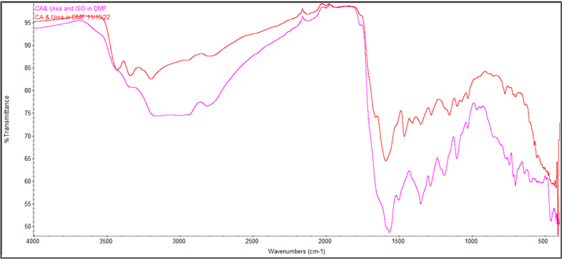
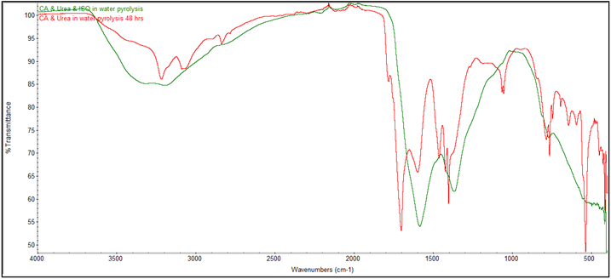


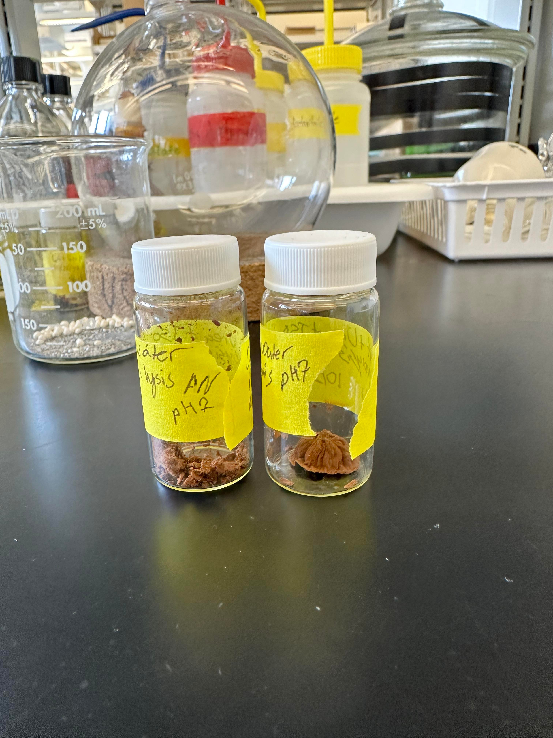
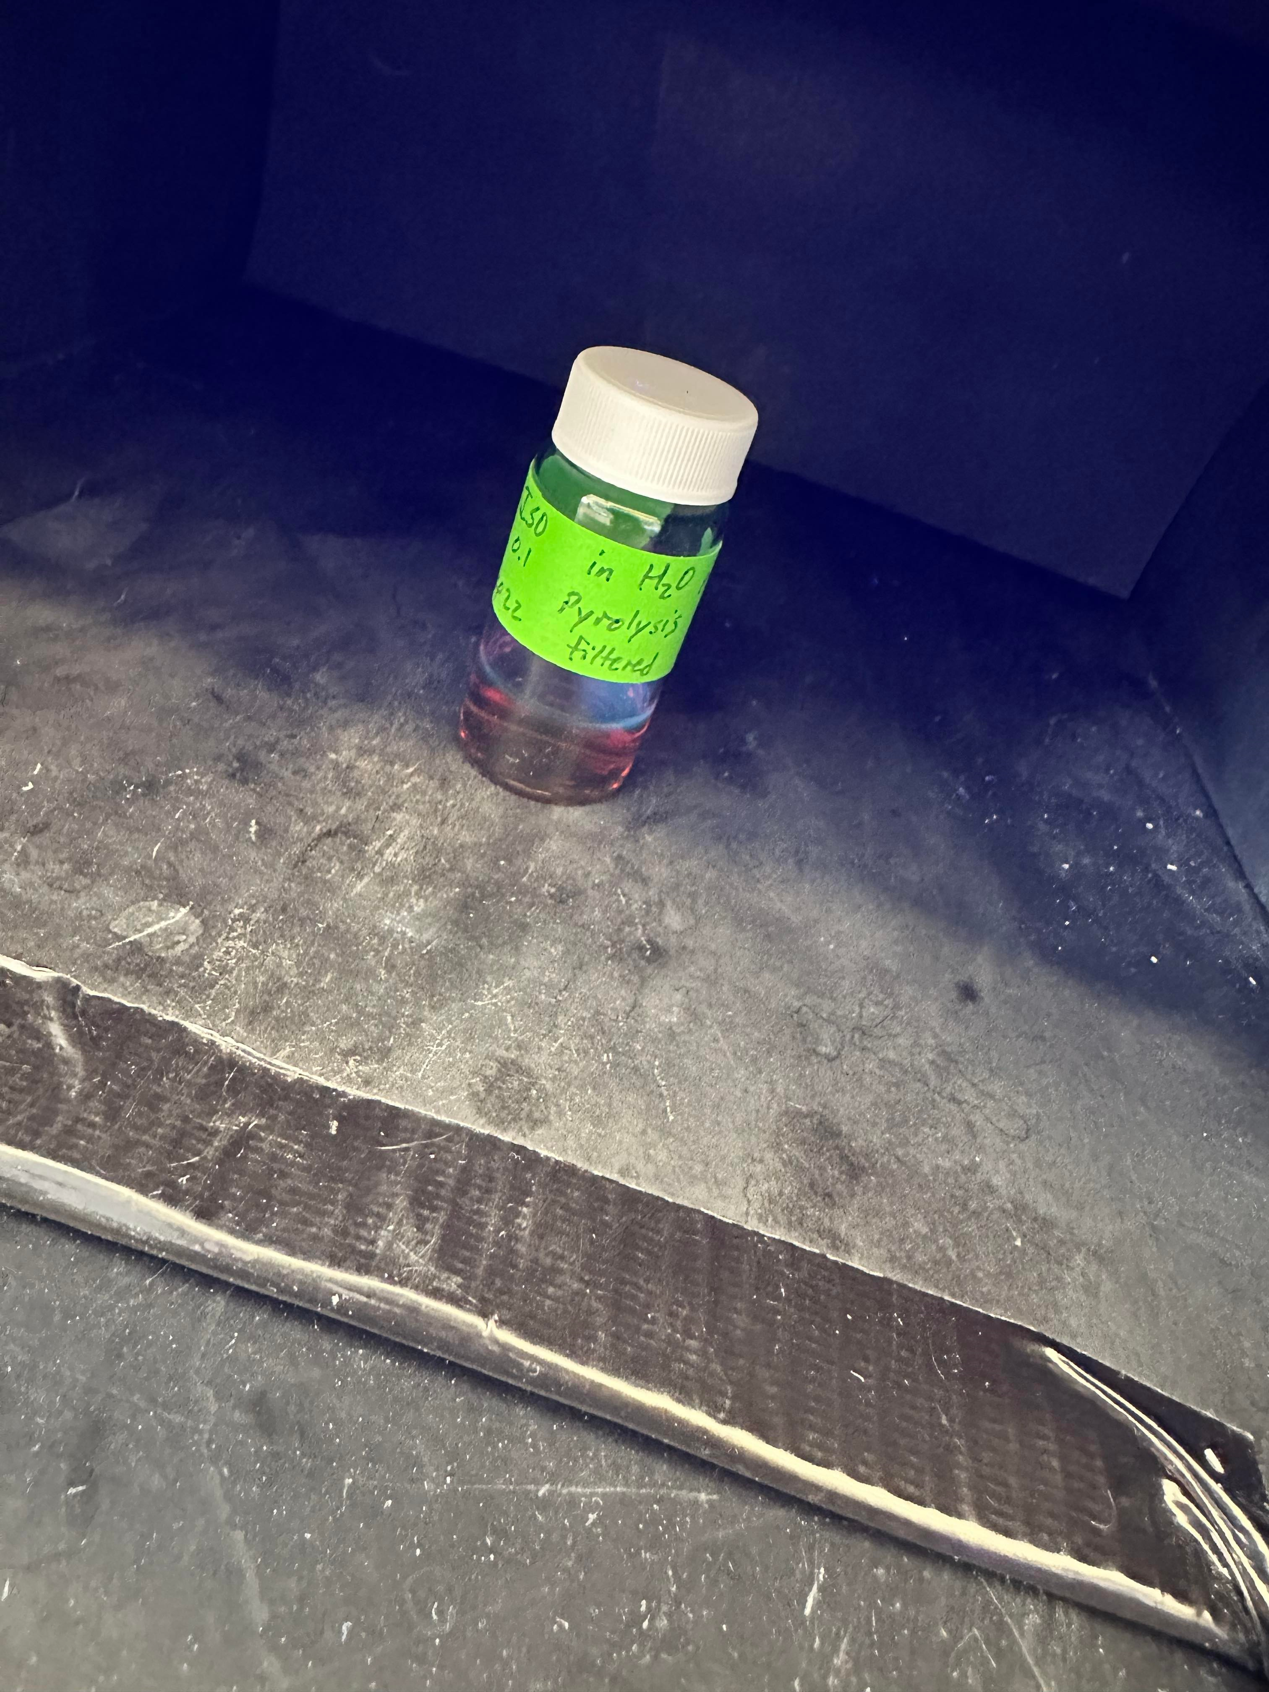
Pyridine Functionalized Carbon Dots for Photocatalysis
Adase Ntumi, Chemistry BA, Cj Wilson PhD, Caputo Group, University of New Hampshire
Introduction
Results
Energy is a valuable factor in human sustainability. As the earth's population increases, energy is in increasing demand as humanity progresses. Renewable energy is useful for maintaining sustainable energy. Further research into different ways to make renewable energy brought light to using Photocatalysts. Among different photocatalysts, carbon dots have been studied. Carbon dots have been chosen because they can be excited under light irradiation to generate charge just like photo catalysts. Carbon dots have been recently popular in research and especially in academics because of their low costs, high quantum yield, and low toxicity. This research started on the focus of building pyridine functionalized carbon dots then evolved to focusing on the synthesis of different types of carbon dots for photocatalysis that will produce hydrogen gas.
Initial Syntheses
Synthesis Process
Controls
Citric Acid and Urea in water Hydrolysis and Pyrolysis
Citric Acid and Urea in DMF for hydrolysis only
Experiments
Citric Acid, Urea, and Isonicotinic Acid in water for hydrolysis and pyrolysis
Citric Acid, Urea, Isonicotinic Acid in DMF for Hydrolysis only
Conclusion
Resources
From the IR spectra it was concluded that no pyridine functional groups were on the carbon dots. However, there was a slight shift in the IR spectra. Due to this further research is being done to create new types of carbon dots for photocatalysis using aspartic acid, nickel phthalocyanine, and cobalt phthalocyanine.
Yao, Y.; Zhang, H.; Hu, K.; Nie, G.; Yang, Y.; Wang, Y.; Duan, X.; Wang, S. Carbon Dots Based Photocatalysis for Environmental Applications. J Environ Chem Eng 2022, 10 (2), 107336. https://doi.org/10.1016/J.JECE.2022.107336.
Hersh, M. A. The Economics and Politics of Energy Generation. Improving Stability in Developing Nations through Automation 2006 2006, 77–82. https://doi.org/10.1016/B978-008045406-1/50011-2.
Panda, D.; Venkatesh, N.; Sakthivel, P. MXene-Based Materials for Remediation of Environmental Pollutants. MXenes and their Composites: Synthesis, Properties and Potential Applications 2022, 553–594. https://doi.org/10.1016/B978-0-12-823361-0.00014-9.
Tahir, M. B.; Iqbal, T.; Rafique, M.; Rafique, M. S.; Nawaz, T.; Sagir, M. Nanomaterials for Photocatalysis. Nanotechnology and Photocatalysis for Environmental Applications 2020, 65–76. https://doi.org/10.1016/B978-0-12-821192-2.00005-X.
Conduction Band – Definition, Types, Conduction Band in Semiconductor and Metals. https://www.vedantu.com/iit-jee/conduction-band (accessed 2023-02-28).

