Slide 1
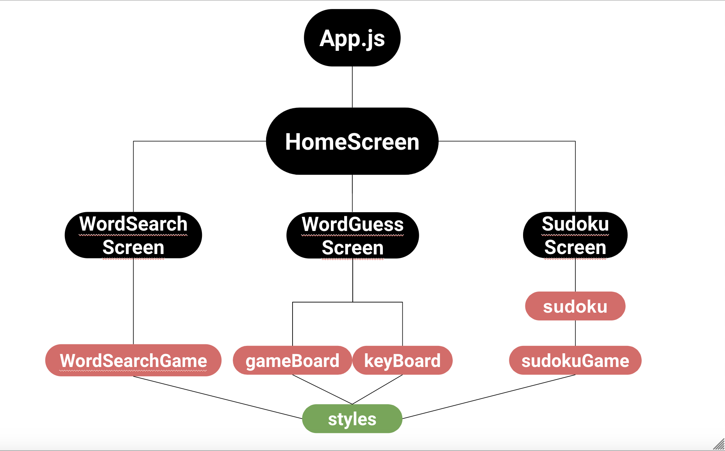
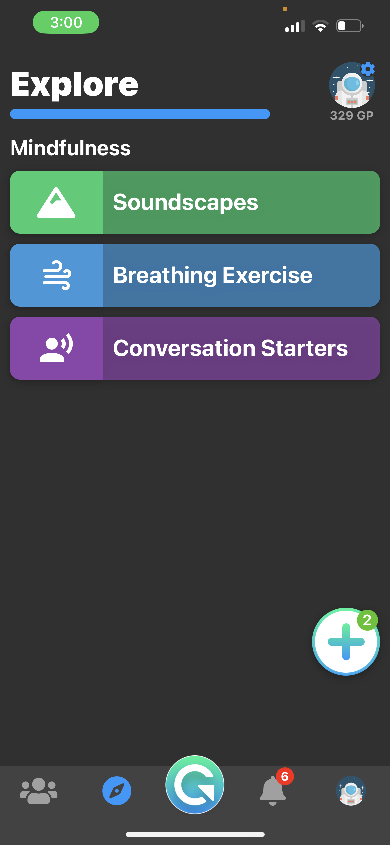
NextStep Feature Development
Kambal Vaidya, kambal.vaidya@unh.edu , University of New Hampshire
Nate Blake, nathan.blake@unh.edu ,University of New Hampshire
Gopal Timsina, gopal.timsina@unh.edu , University of New Hampshire
Introduction
Requirements
Testing
User will be able to play three puzzle mini games and will be notified when they have solved the puzzles (Sudoku, Wordsearch, Word Guess)
Application will create daily challenges for the users to complete.
Application will have “Endless” Mode for each game
User will be able to reset the progress of their game via a reset button
User will be able to earn “GoodPoints” for completion of daily challenge
Word Guess version that can be replayed indefinitely with different words
Application will be able to load each game page within 3 seconds
Games Page will be easily navigable
Games Page will not crash the application
Font, Icons, and Buttons will follow the same color palette and scheme of other NextStep Goodlife features
Each Game was tested individually on a stand-alone application. These tests consisted of manual black-box testing, with each game having specific tests based on their functionality. It was important for the team to interact with the application with no knowledge of the code in order to replicate a User Experience
NextStep GoodLife
Word Guess
Correct and incorrect inputs for words
Input words not found in the dictionary
Correct response based on the input word
Replay with a different word.
Word Search
Click and Drag correct word
Click and Drag incorrect word
Find and Highlight all correct words and press Reset button after
Sudoku
Creating the sudoku board that is visible in the View
When user input error tracking
Correct input from the user is placed on the board correctly
The NextStep Goodlife application is a mobile app for youth and adolescents. It is a social platform that encourages individuals to improve themselves and their communities through positivity and mutual support. In order to provide value to the NextStep Goodlife application, it was our group's design to create Brain Games with the goal to increase the daily use of the user and provide a fun and relaxing feature for the users. The group have developed 3 separate classic puzzle games, Word Search, Word Guess, and Sudoku for the users to use.
Designs/ Implementations
The basic design of our app is split up by a React Native Navigator. This Navigator contains three buttons that direct you to each of the individual screens for each of the distinctive games. Within the NextStep Goodlife application, there is another Navigator that contains many different existing features in the Explore View. Here, we integrated our application into the Explore Screen as show in the figure to the left. Here, the Brain Games ReactNative Button navigates to our feature's HomeScreen and from there you can navigate to the three separate games.
Results/Conclusions
Structured the application to be easy to integrate for future teams and well-documented through various documents and frequent comments
Corrected errors in the setup script for future teams to have an easier start-up.
Created a standalone mobile application using JavaScript, CSS, and React Native Components (Brain Games)
Word Search Game
Word Guess Game
Sudoku Game
Integrated the Brain Games stand-alone application into the NextStep GoodLife application
Our application uses a React Native Framework along with JavaScript and CSS to produce our product. React Native allows us to use component-based design where it can easily re-use them to implement different features in the app. For example, the basic Button components that React Native has to offer were reused for navigating between the pages. The diagram above depicts the three main types of components that we used in our application. The Screens were made up of React Views that contain the Components that are within the different Game files. Lastly, in order to create an aesthetically pleasing application, the styles of each screen and respective gameboards were contained within our styles file. These styles were meant to be dynamic, so they could be easily changeable based on the mobile device that was being used.
Brain Games
References
NextStep: https://nextstepgoodlife.com
Reactnative: https://reactnative.dev/
ExpoGO: https://docs.expo.dev/
Acknowledgements
NextStep Team: Thank you for the allowing us to work on this project and the guidance during the process.
Professor Benedetto:
Brain Games Tab in GoodLife app

