Slide 1
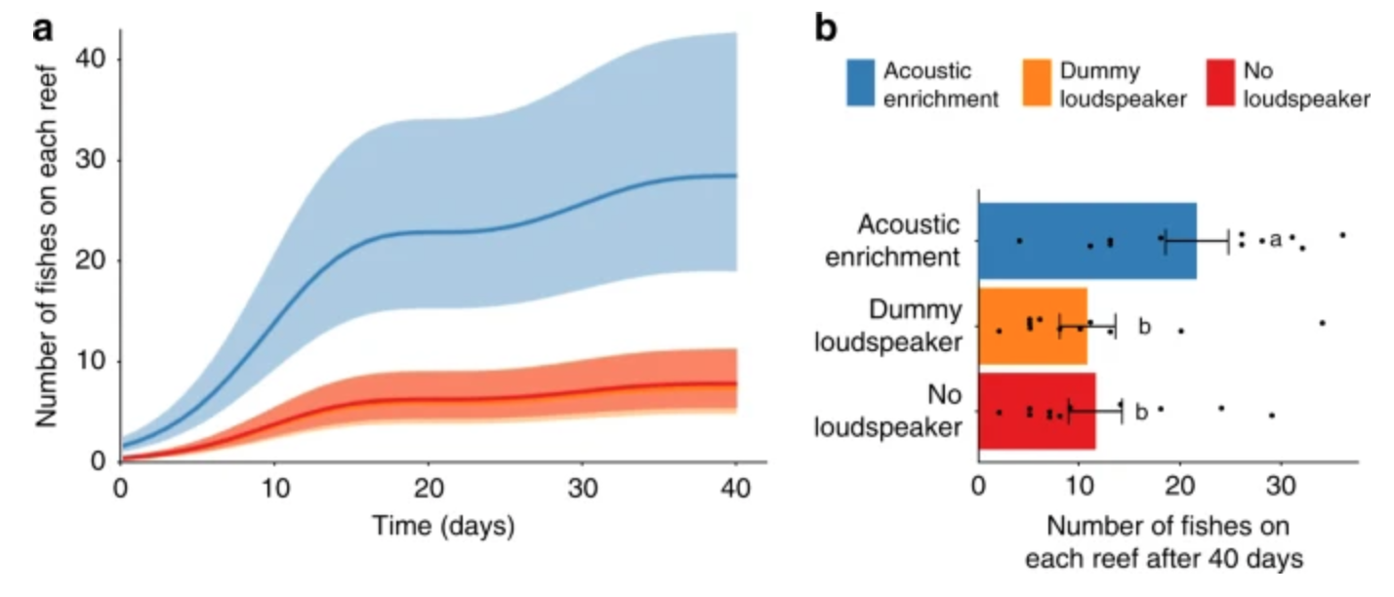
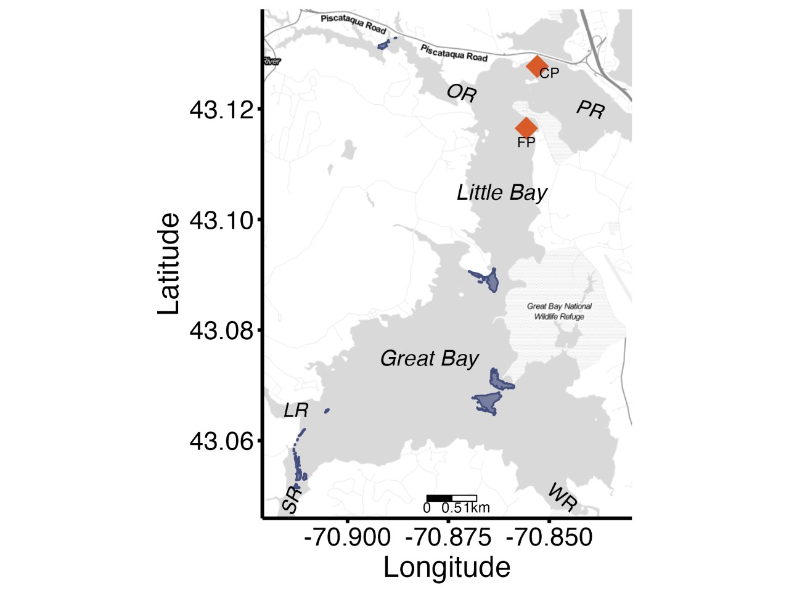
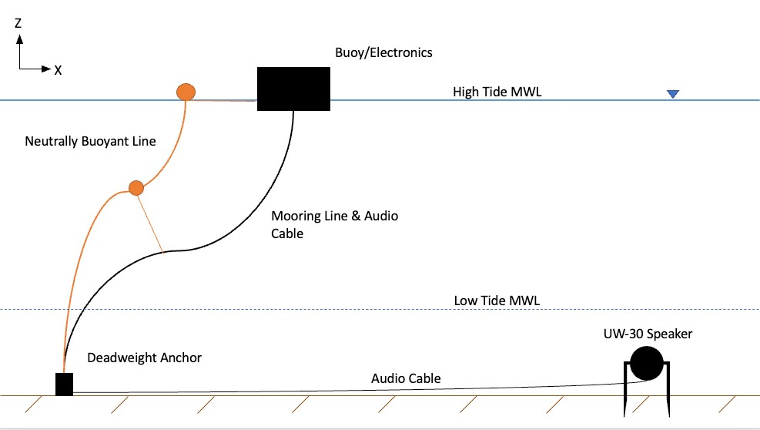
Restorative Acoustics
Phillip Cooper, Gwen Hultquist, Corey Petix
College of Life Sciences and Agriculture
College of Engineering and Physical Sciences
Faculty Advisors: Michelle Fournet, Gabriel Venegas
Background
Objective
Marine larval species largely navigate through acoustic signaling (Williams 2021). After the degradation of a reef system, the lack of healthy reef sounds will reduce the number of recruited species. The use of an underwater speaker playing the sounds of a healthy reef environment has been shown to improve the recruitment of larval reef species and assist in the restoration of the system (Gordon, 2019).
Create an underwater speaker system capable of autonomous playback for up to 12 hours of healthy reef acoustics in up to 10 ft (3 m) of water. The system will be calibrated for deployment in Great Bay for the recruitment of larval oyster species.
Method
Combine the UW30 Underwater Loudspeaker used in previous restoration research (Gordon 2019) with an amplifier and power supply within a watertight housing. The housing will be deployed at the surface on a buoy with mooring lines for stability and the speaker suspended in the water at optimal depth within Great Bay.
Observed recruitment of damselfish through research in restorative acoustics in the Great Barrier Reef (Gordon 2019).
Location of speaker deployment in Great Bay, New Hampshire
Progress
In Progress
The connections between the speaker, amplifier, and batteries have all been secured. The autonomous playback is being programmed to play through a music storage device. The housing unit is inlaid with foam inserts to hold the amplifier and batteries.
The testing the housing unit and speaker capabilities in the pool as well as the field will allow for troubleshooting before deployment. Calculations are being made for a mooring line system that accounts for tidal swell. Programming microchip for accurate playback intervals.
Future Goals
The unit is designed for future modifications to improve sustainability (i.e. solar panels, microchip control, extra battery). The goal was to be simple and cost efficient for replication to improve restoration efforts around the globe.
Diagram depicting the schematics of the mooring and deployment design.
References
Gordon, Timothy A., et al. “Acoustic Enrichment Can Enhance Fish Community Development on Degraded Coral Reef Habitat.” Nature Communications, vol. 10, no. 1, 2019, https://doi.org/10.1038/s41467-019-13186-2.
Williams, Brittany R., et al. “Repairing Recruitment Processes with Sound Technology to Accelerate Habitat Restoration.” Ecological Applications, vol. 31, no. 6, 2021, https://doi.org/10.1002/eap.2386.

