Slide 1
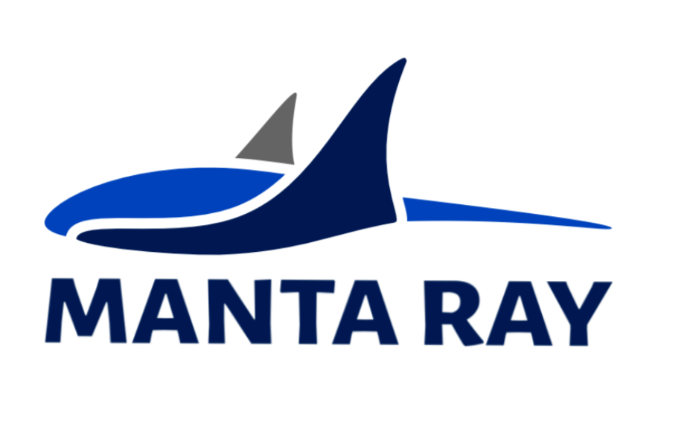
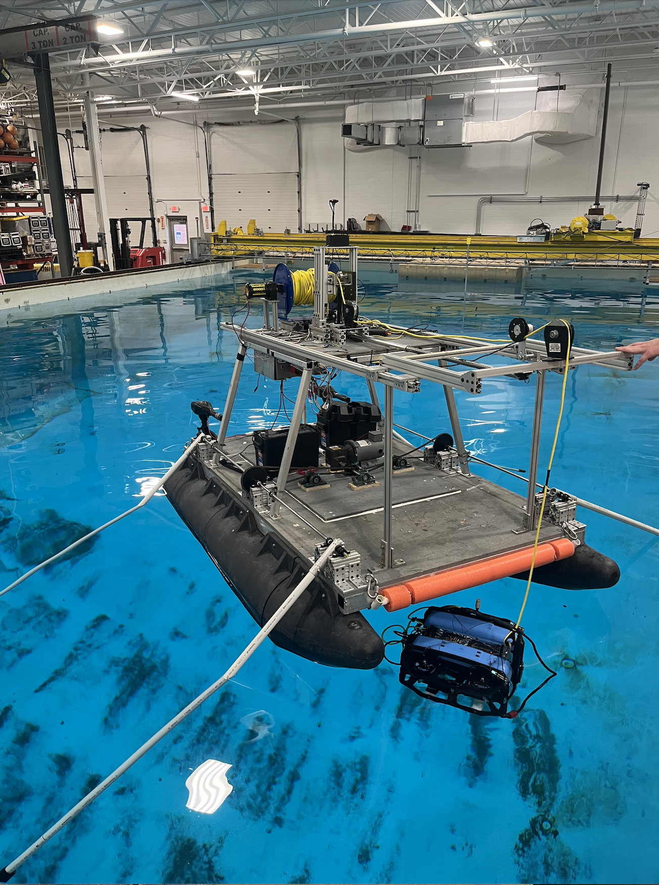
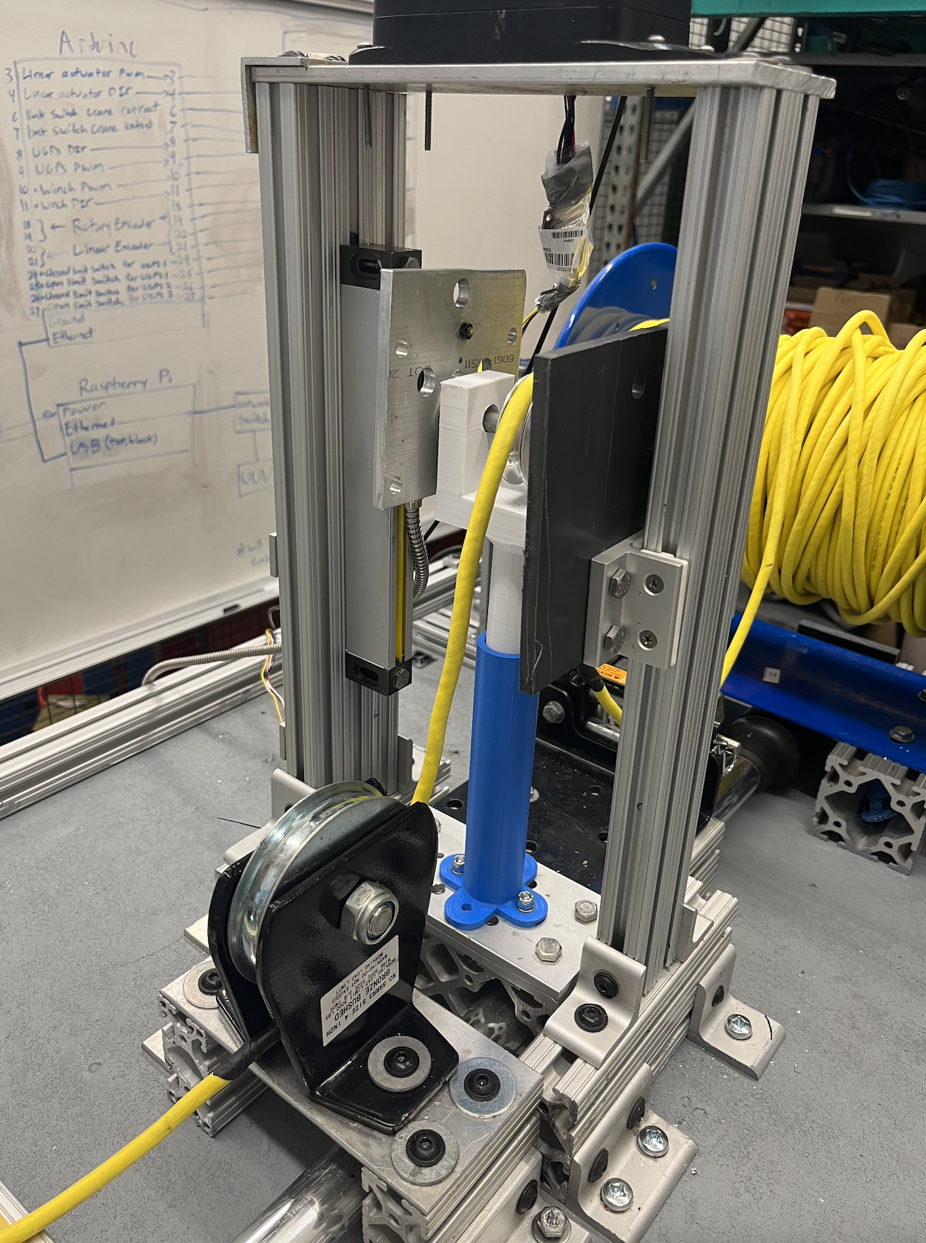
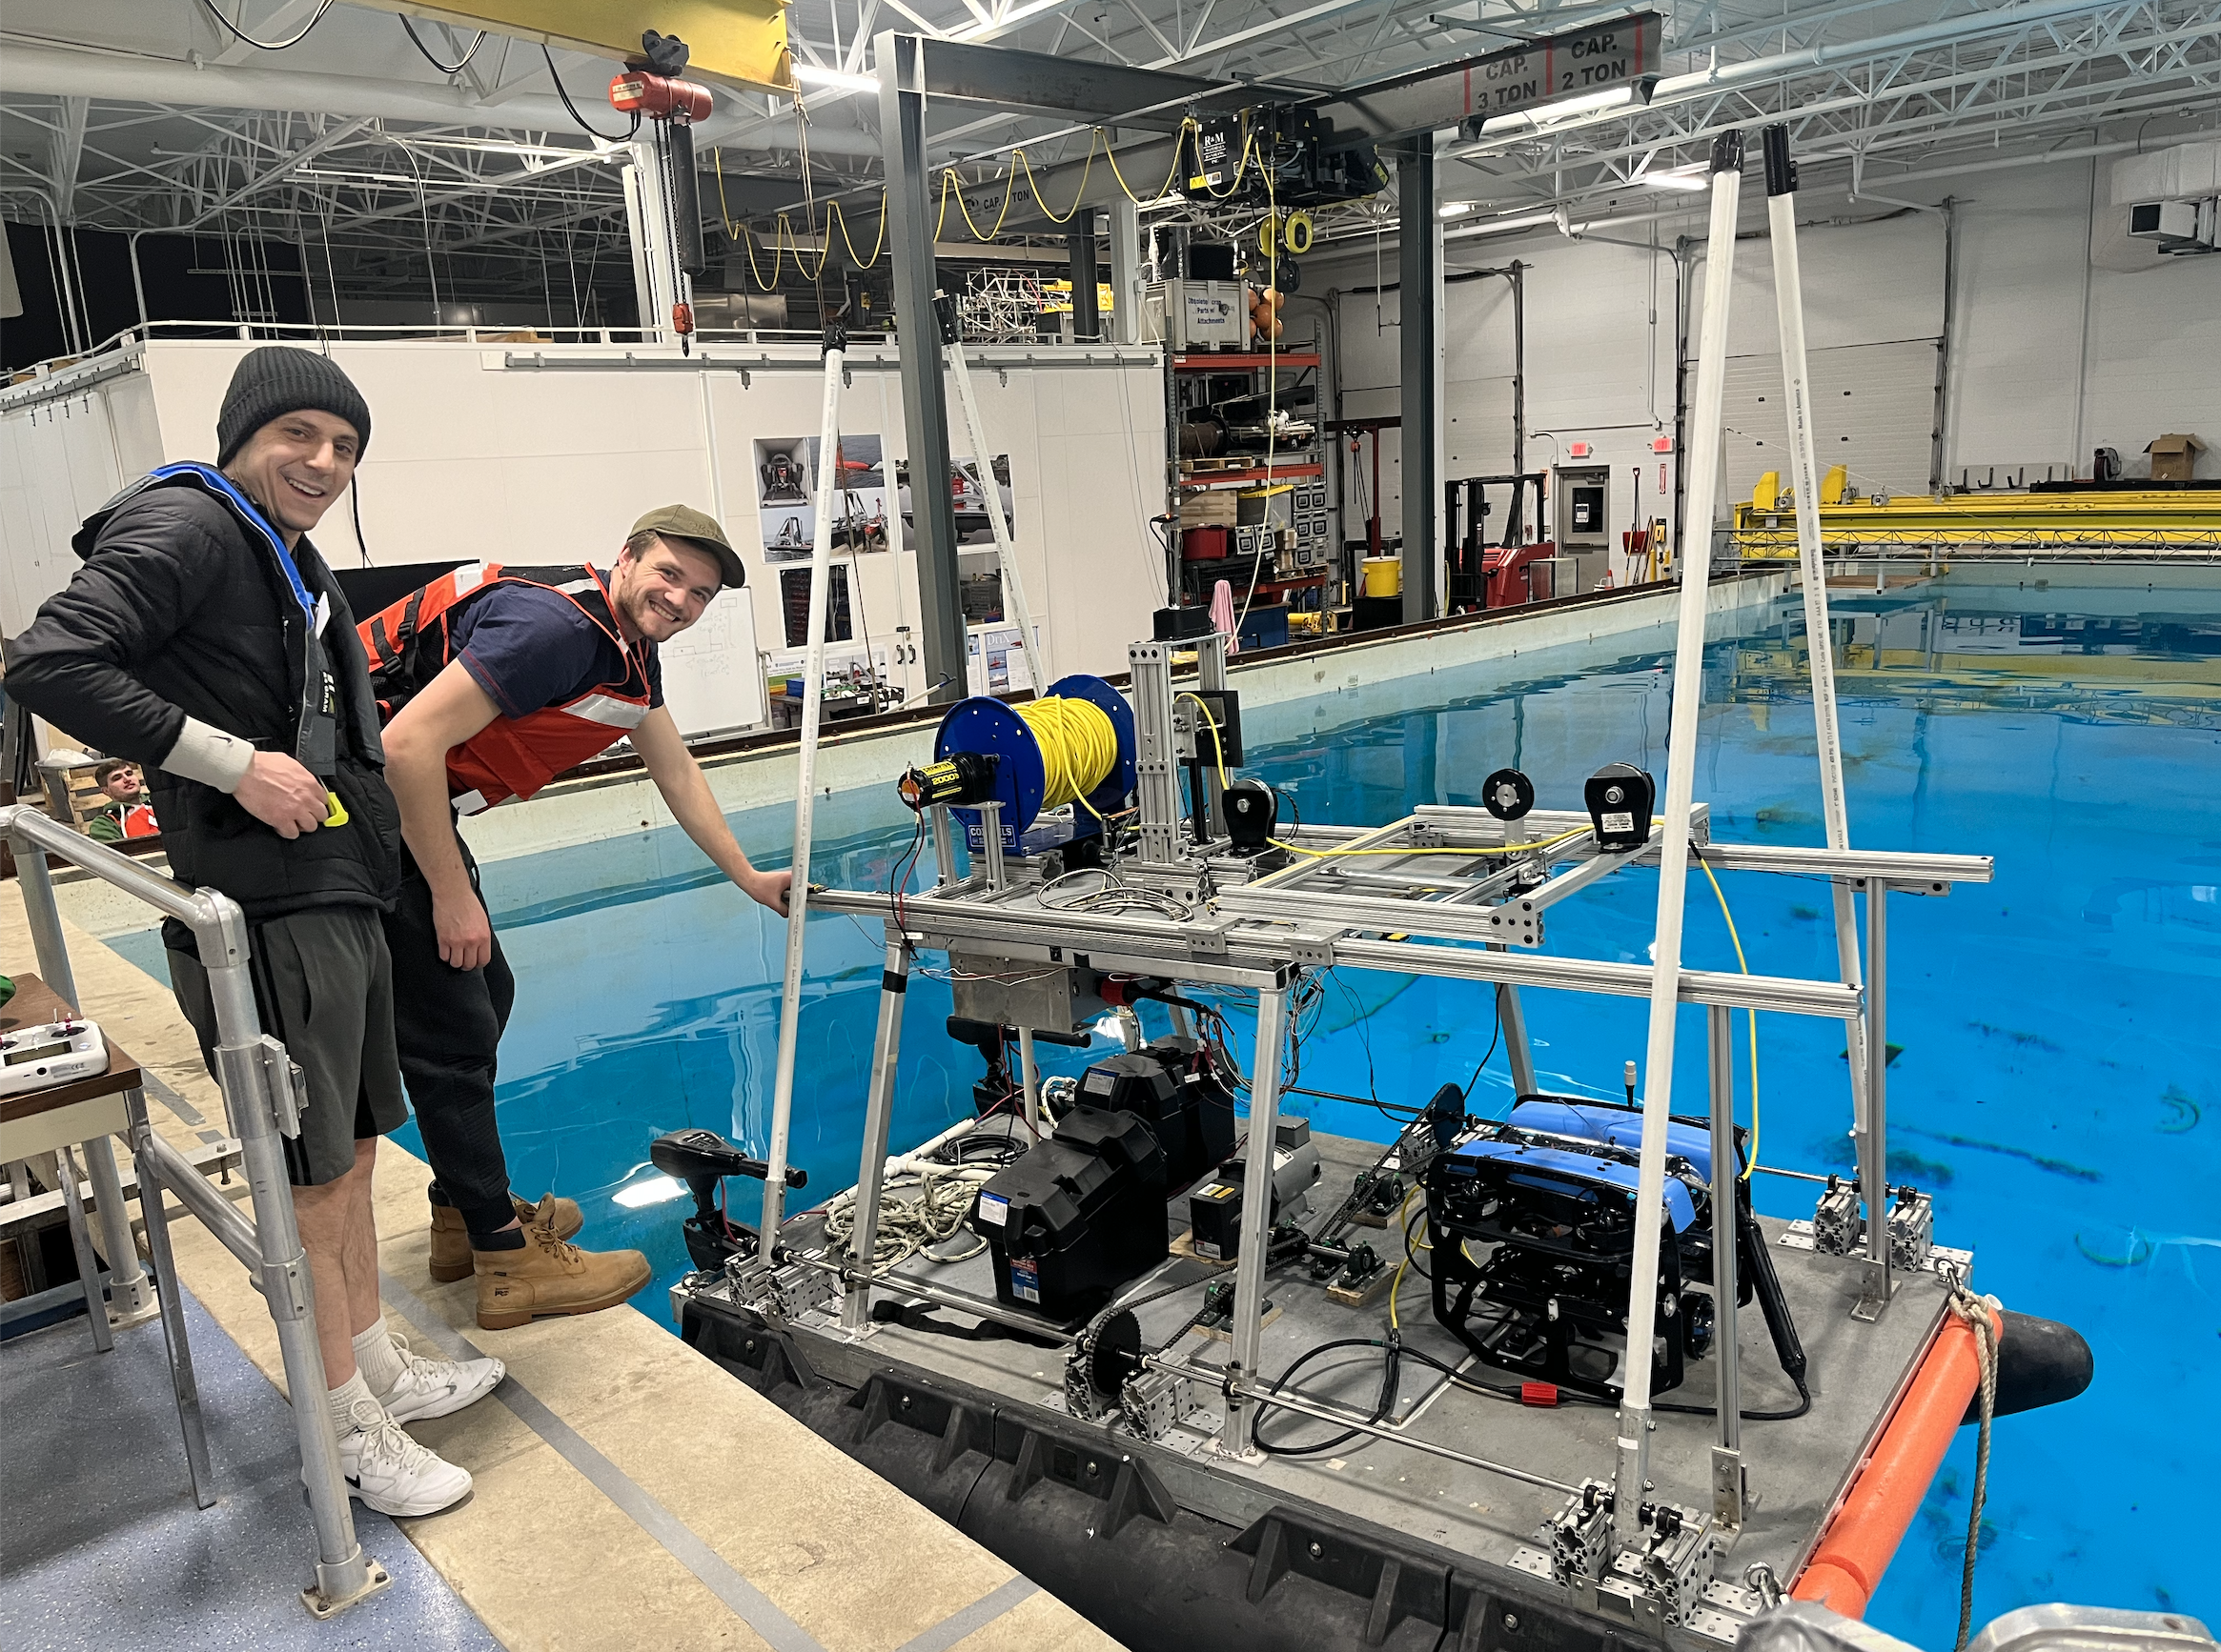
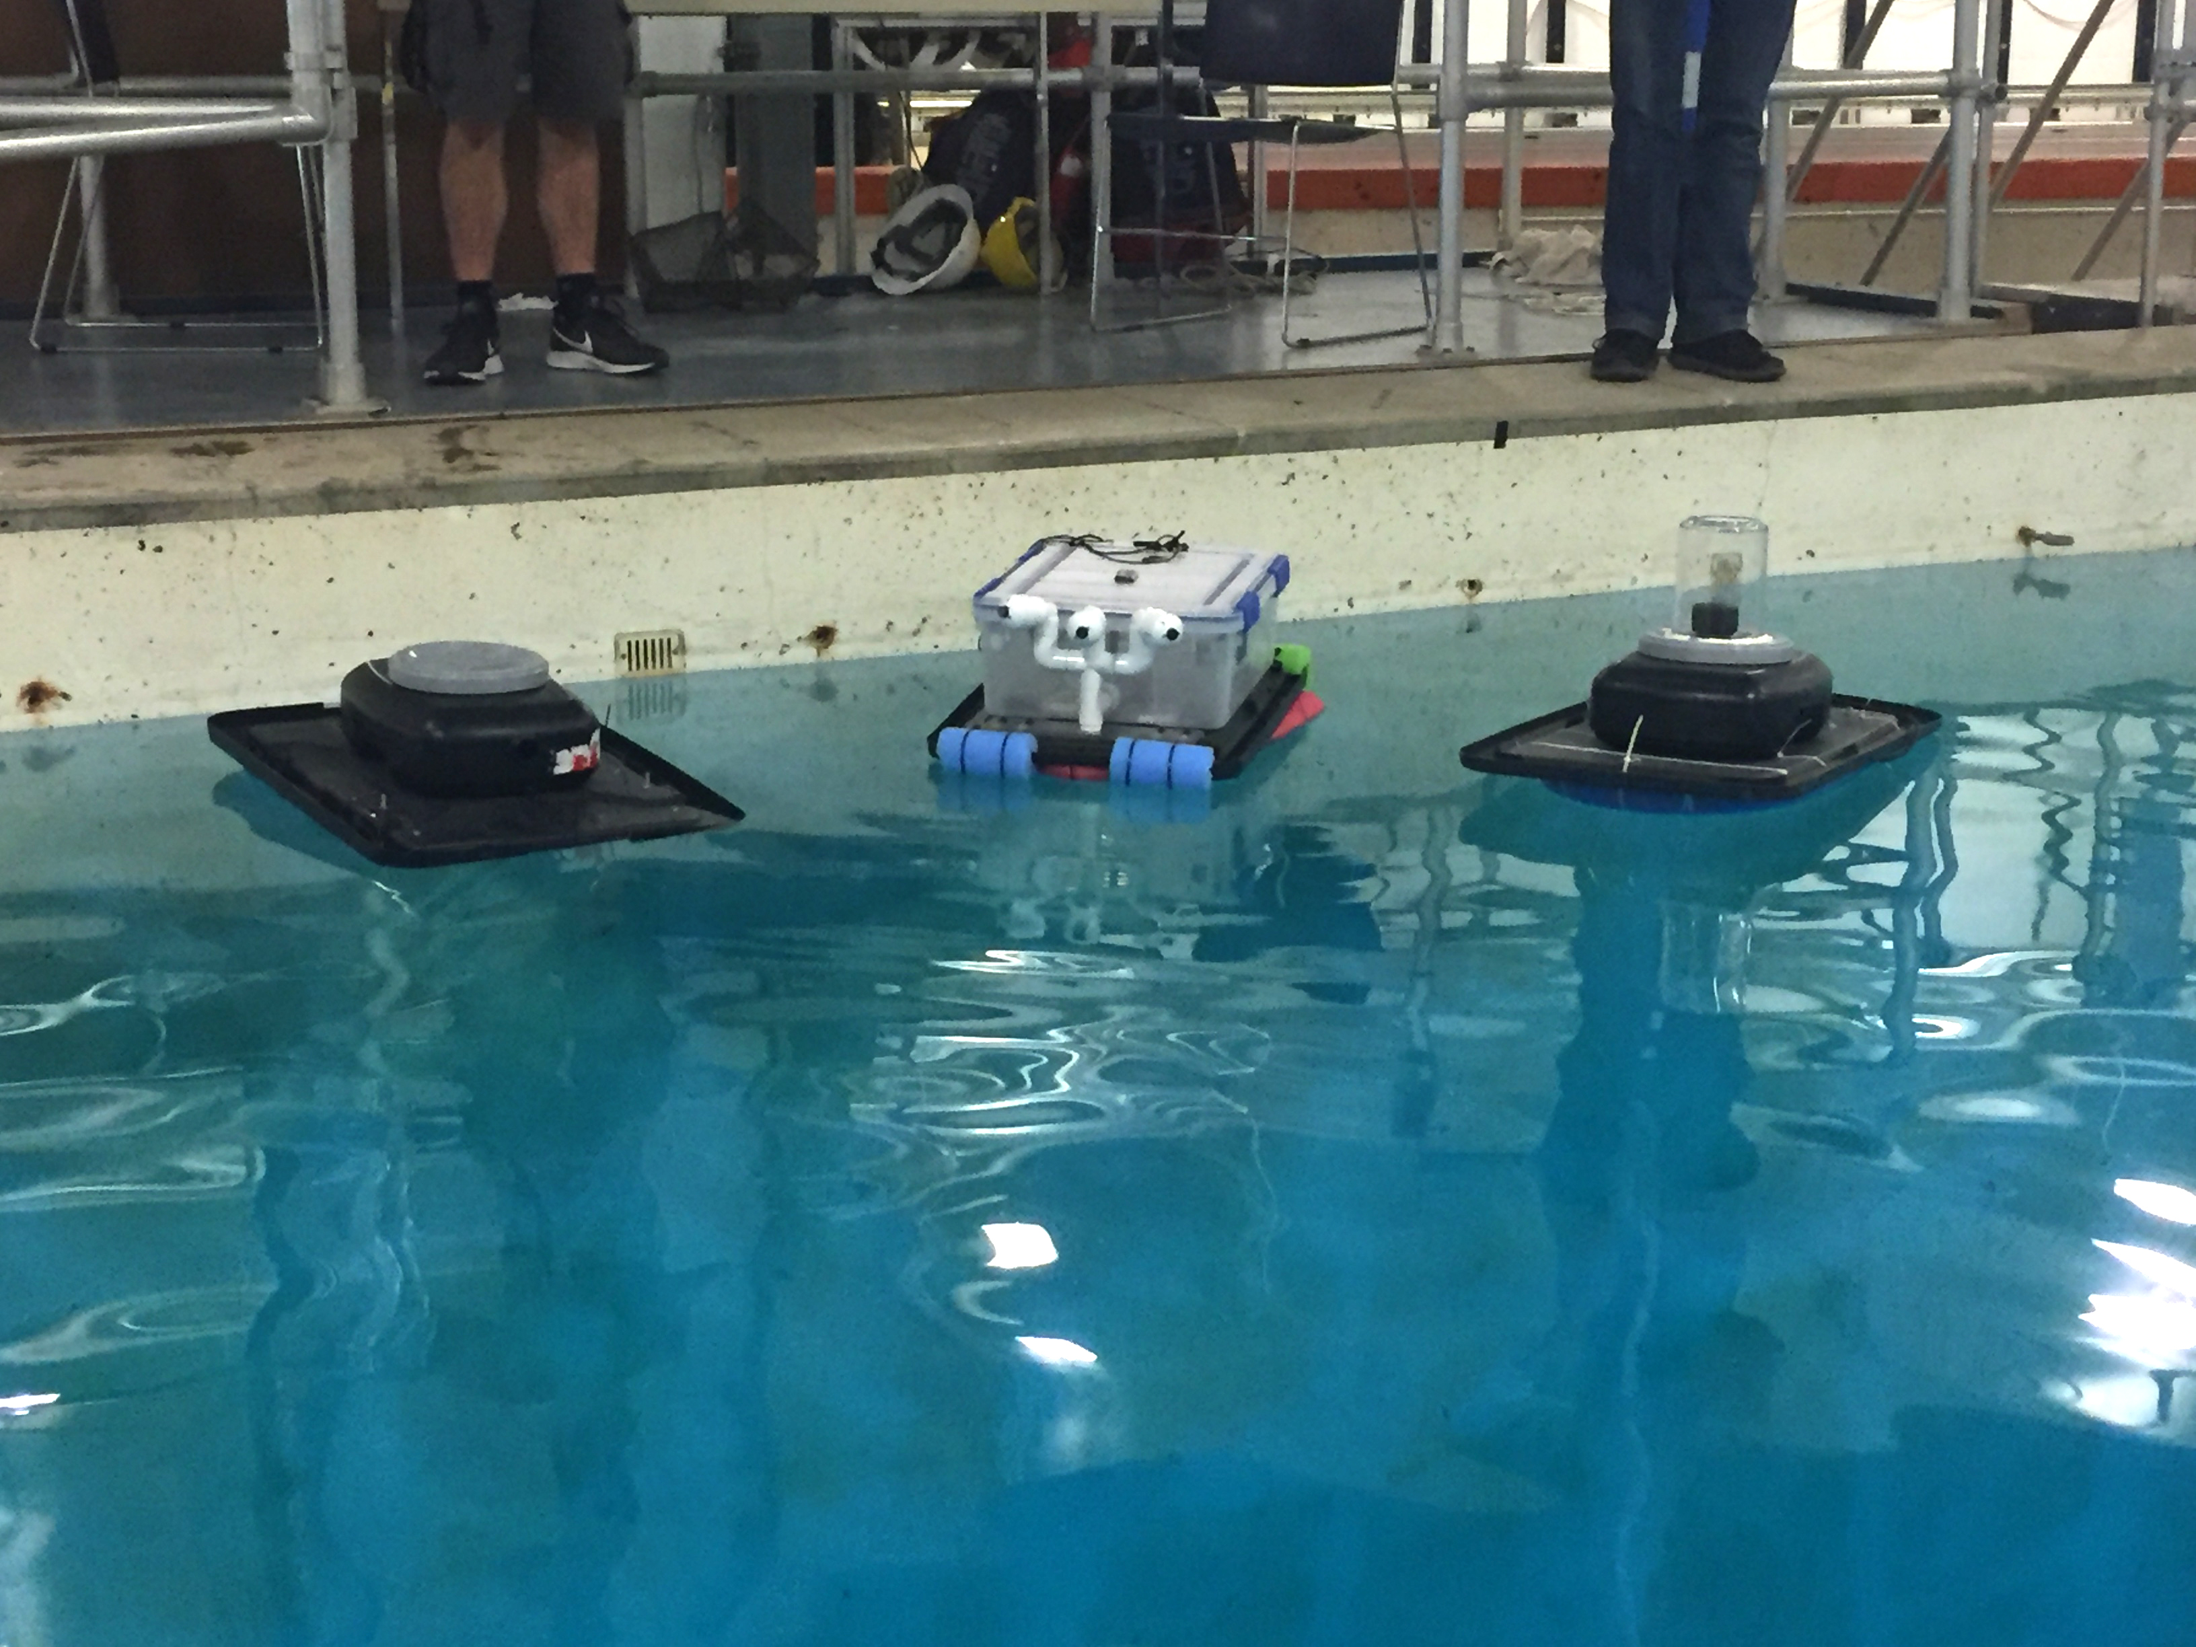
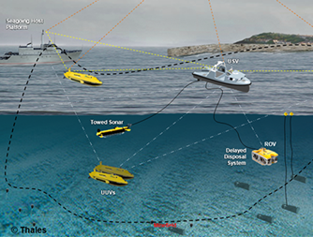
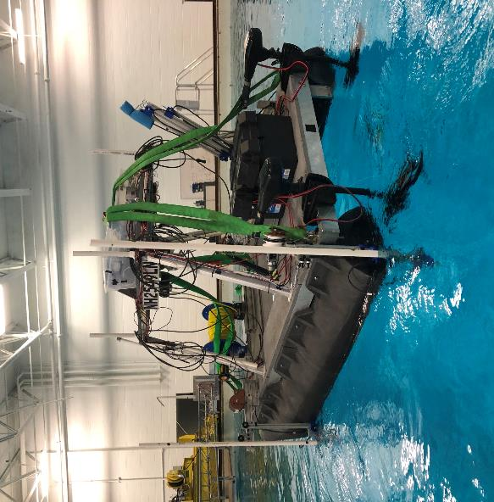
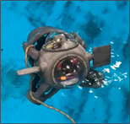
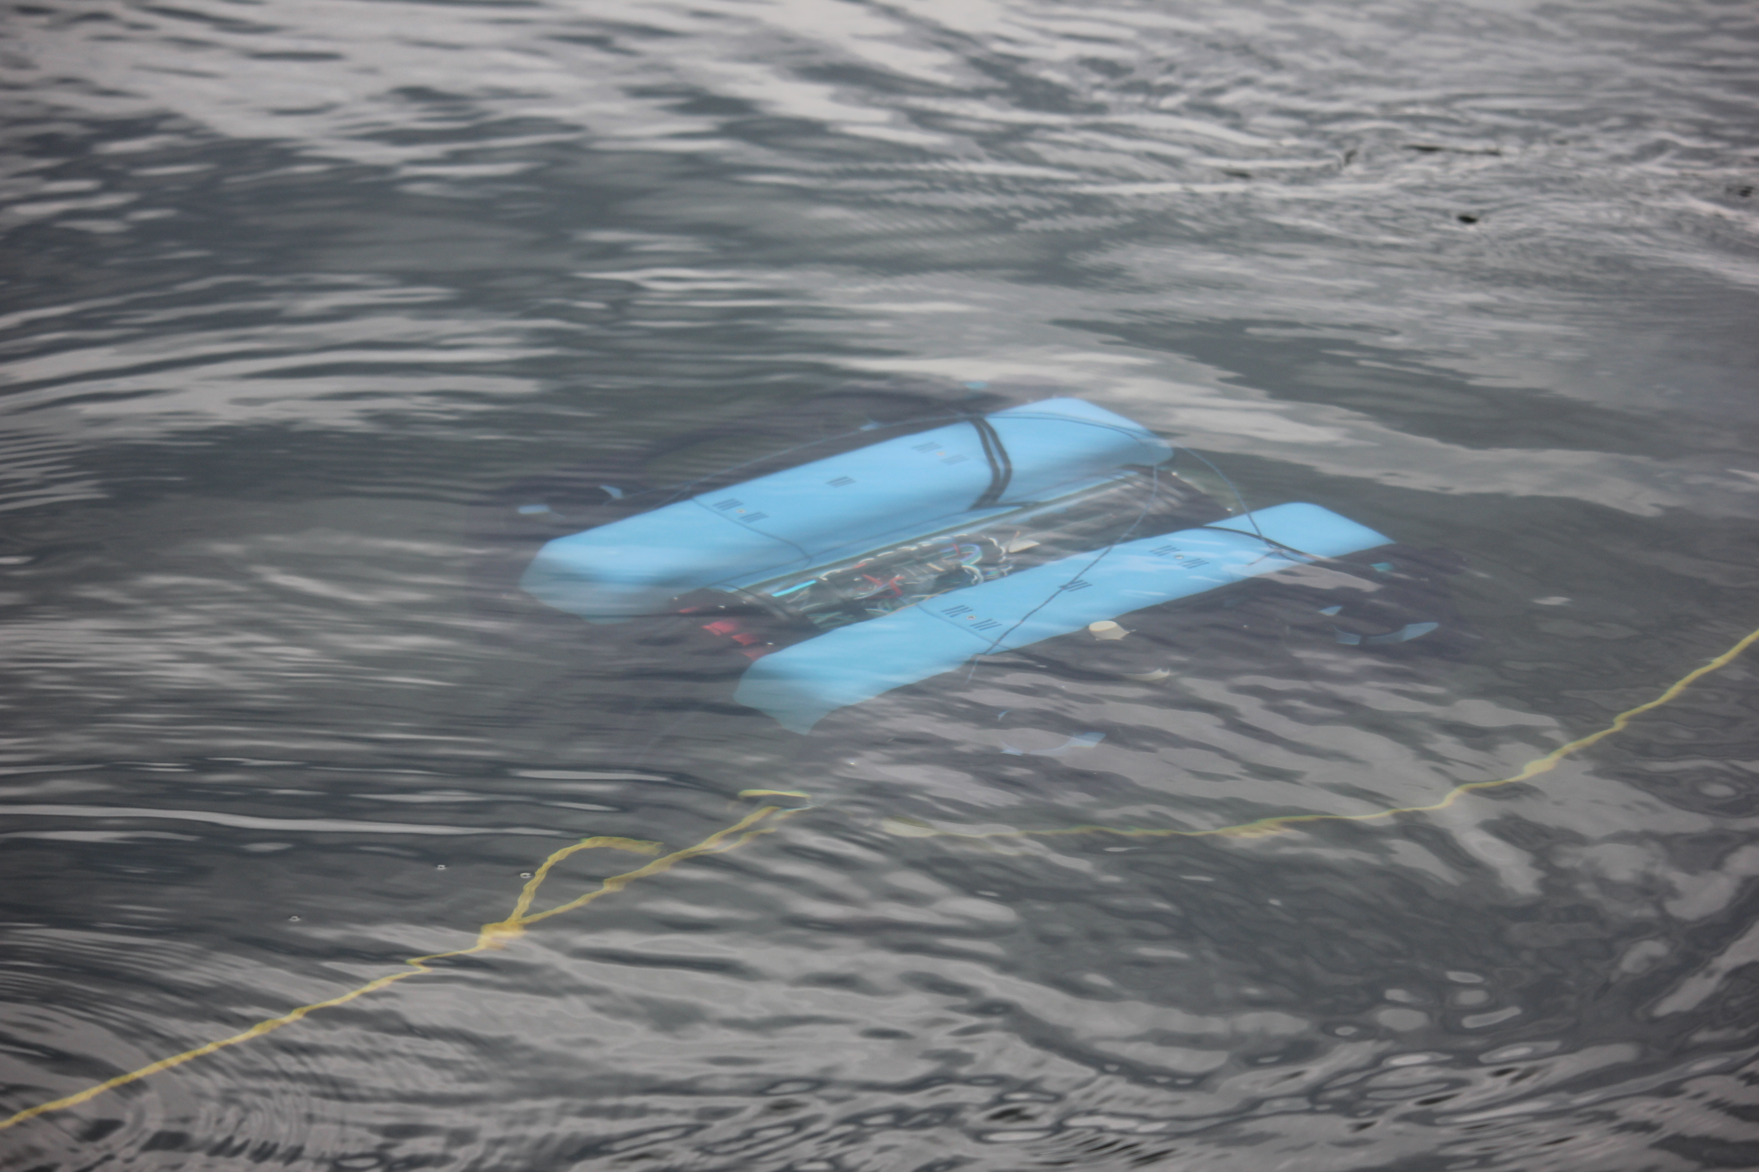
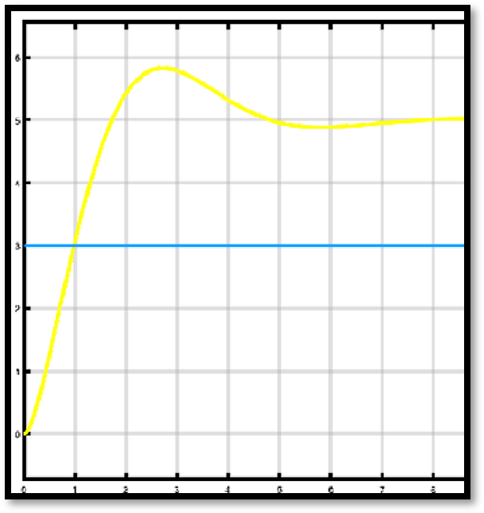
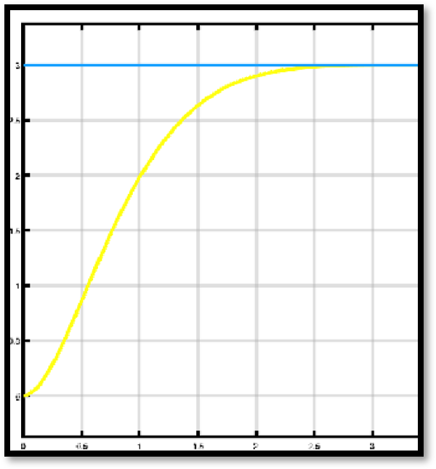
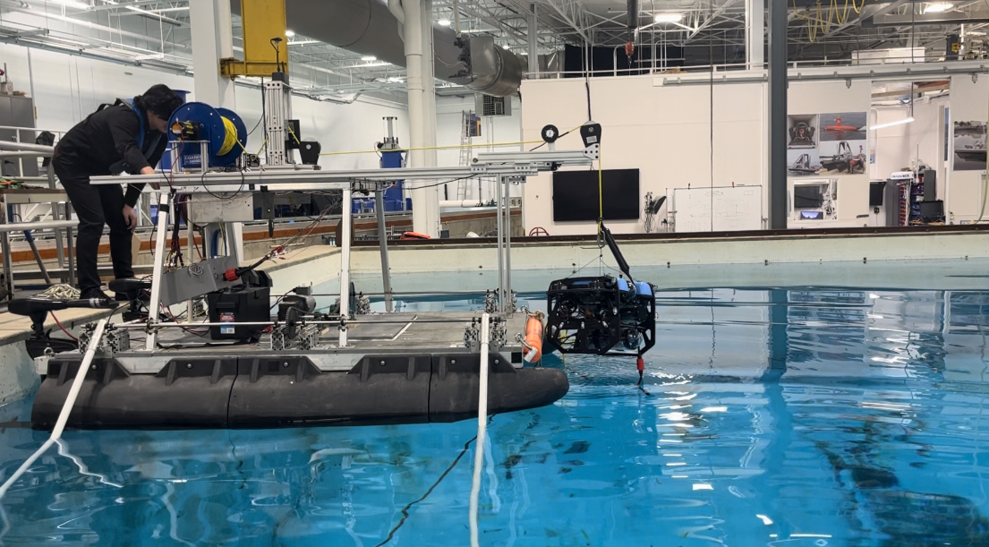
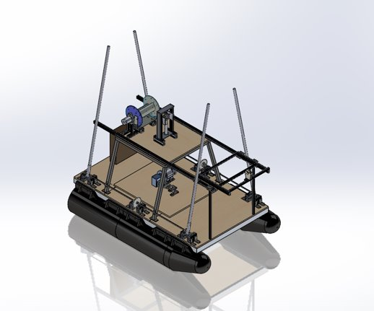
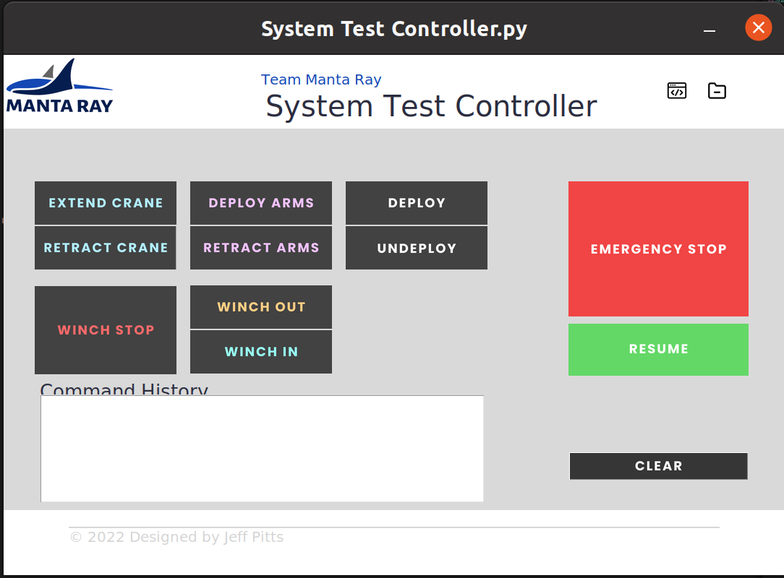
Marine and Naval Technological Advancements for Robotic AutonomY (MANTA RAY)
Autonomous Surface Vehicle (ASV) Project Advisors: Dr. May-Win Thein, Dr. Yuri Rzhanov, Dr. Elizabeth Fairchild
Graduate Advisors: Ozzy Oruc, Hannah Arnholt, Nick Custer, Igor Vladimirov, Rich Randall, Chris Van Valkenburgh, Alex Cook, Derrek Perham
Team Members: Hunter Clark, Natalie Cook, Chris Redard, Clifton Sullivan, Zachary Dicicco, Harrison Ursitti Department of Mechanical Engineering and Center for Ocean Engineering, University of New Hampshire, Durham, NH 03824
Team MANTA RAY Mission
ASV Subsystems
Results
Team MANTA RAY is an interdisciplinary project dedicated to creating, maintaining, and expanding a network of marine robots for seafloor mapping and underwater perception. The network began as just the Autonomous Surface Vehicle (ASV) and Unpiloted Underwater Vehicle (UUV) but has expanded to include a prototype of the ASV, known as TUPPS, and two kinds of remotely operated vehicles, known as GUPPS and KRILL. With these systems, students work to improve communication between vehicles, develop autonomous behaviors and algorithms, and upgrade existing mechanical systems to improve precision and performance.
Underwater GPS
Tether Tensioning System
Deployed in the Jere A. Chase Engineering Laboratory Engineering tank and enacted deployment sequence
Utilized Mavros to communicate and send missions to UUV via ethernet cable
Tested autonomy at Jackson Estuarine Lab
Deployment and retract sequences performed with active tension mode for UUV
Incorporates ultrasonic nodes that triangulate precise location of UUV
Allows for real time location tracking of UUV with respect to shore station with the ASV acting as a jump between the two
Rotates into position as part of deployment sequence
Tracks tension on tether to enable constant tension mode for UUV
Reads in values from linear encoder and communicates with rotary encoder
Winches in or out depending on needs of UUV and tension on winch cable
TUPPS
ASV
Figure 3: UGPS system deployed
Figure 4: TTS System
KRILL
UUV
Deployment Crane
Tether Tension System PID Transfer Function
GUPPS
Deploys UUV from ASV
Uses linear actuator for powerful and controlled movement
Limit switches denote the open/closed position of the crane
Allows for redundant use of system and a key element of our ASV/UUV automation
Tether is used for communication between ASV and UUV and is used to lift and lower the underwater vehicle
Figure 8: ASV during Chase tank testing
Future Plans
Figure 1: MANTARAY Mission
Convert to radio wave communication to improve range
Open ocean testing with UUV
Switched subsystems to better suited vessel
Redesign for multiple UUV deployment
ASV Mission
The ASV mission for this year was to enact a deployment sequence to launch a UUV from the platform, perform mission functions autonomously, and to follow an autonomous path determined by pre-determined waypoints.
Graph 1: Response without PID Control
Graph 2: Response with PID Control
Mechanical Design
Built by 2017-2018 ASV Team
Catamaran body: 7’9” length, 5’6” beam
Twin 55lb thrust electric trolling motors
"Penthouse" platform with electronics box mounted on stern edge
Tether winch for UUV tether management and deployment
Pixhawk 4 mounted on top of tether tensioning system
Hardware standards for open source autopilot
Enables missions uploads and performs scripted autonomous navigation between waypoints
Contains a robust sensor suit including a compass, internal IMU and GPS capability
Figure 5: UUV deployment from crane
Figure 6: Equations of motion for Multi-Input Single Output Nonlinear System
Figure 9: UNH Pier
ROS Integration
Acknowledgements
sTAMD Simulations
Autonomous Control using Arduino + ROS Commands
ASV GUI Integrated with ROS Commands
"This work was funded in part by New Hampshire Sea Grant's Workforce Development Project E/WFD-2, pursuant to National Oceanic and Atmospheric Administration Award No. NA22OAR4170124.
This work was also funded by NEEC grants no.N00174-17-1-0002 and no.N00174-20-1-0006.
Special thanks to John Ahern and Scott Campbell
Raspberry Pi (onboard computer) sends commands over ROS to the Arduino.
Arduino controls subsystems based on ROS command from the Pi.
Pixhawk 4 communicates GPS data.
All data (GPS position, operating mode, active commands, etc) published through ROS topic.
Using a local network router, this allows for reliable ROS connection between devices on the same network
Switched remote communication from Xbee wireless communication to executing ROS commands by calling functions in ROS Topics
References
Arduino. (n.d.). Home. Retrieved April 13, 2023, from https://www.arduino.cc/
Documentation. (n.d.). ROS Wiki. Retrieved April 13, 2023, from http://wiki.ros.org/
Introduction · mavlink developer guide. (n.d.). Retrieved April 13, 2023, from https://mavlink.io/en/
Linear encoders. (n.d.). HEIDENHAIN. Retrieved April 13, 2023, from https://www.heidenhain.com/products/linear-encoders
QGC. (2015, November 26). QGroundControl - Drone Control. http://qgroundcontrol.com/
Figure 2: ASV SOLIDWORKS Model
Figure 7: ROS Integrated GUI

