Slide 1


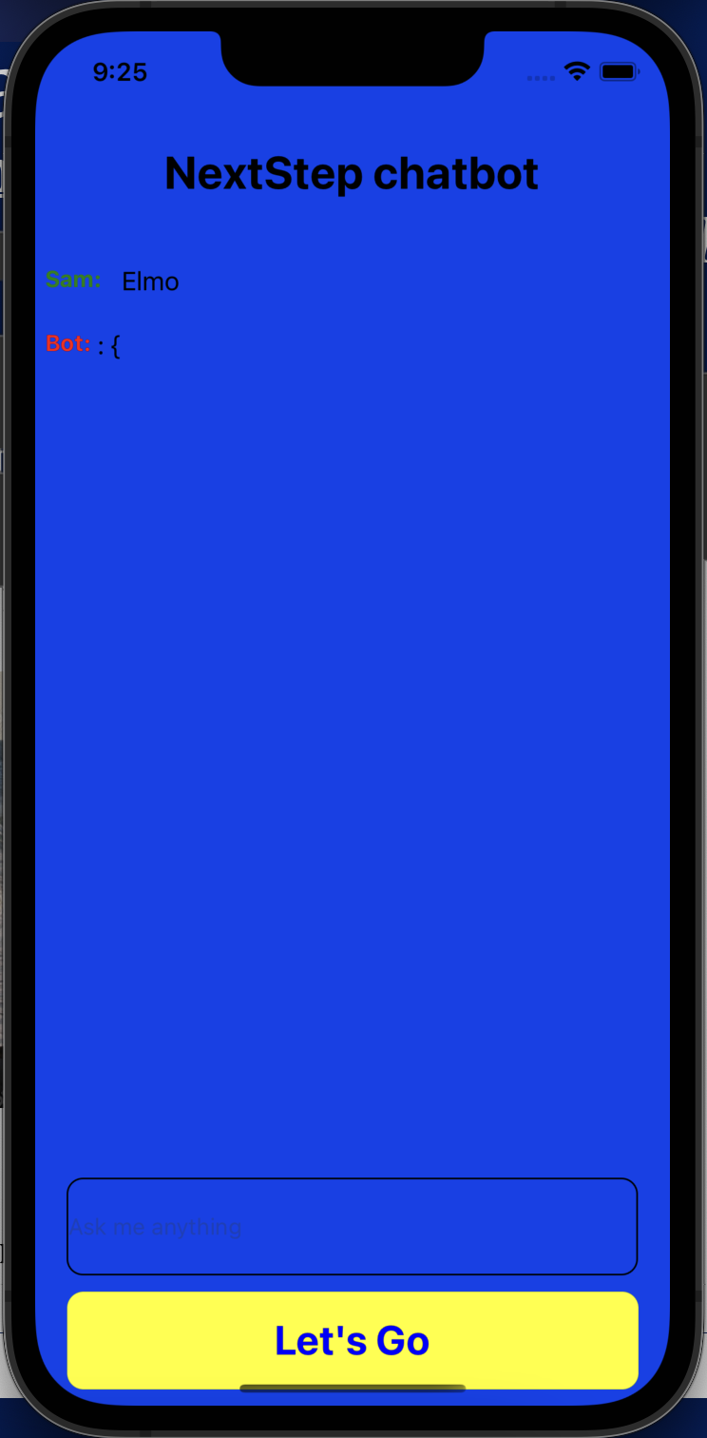
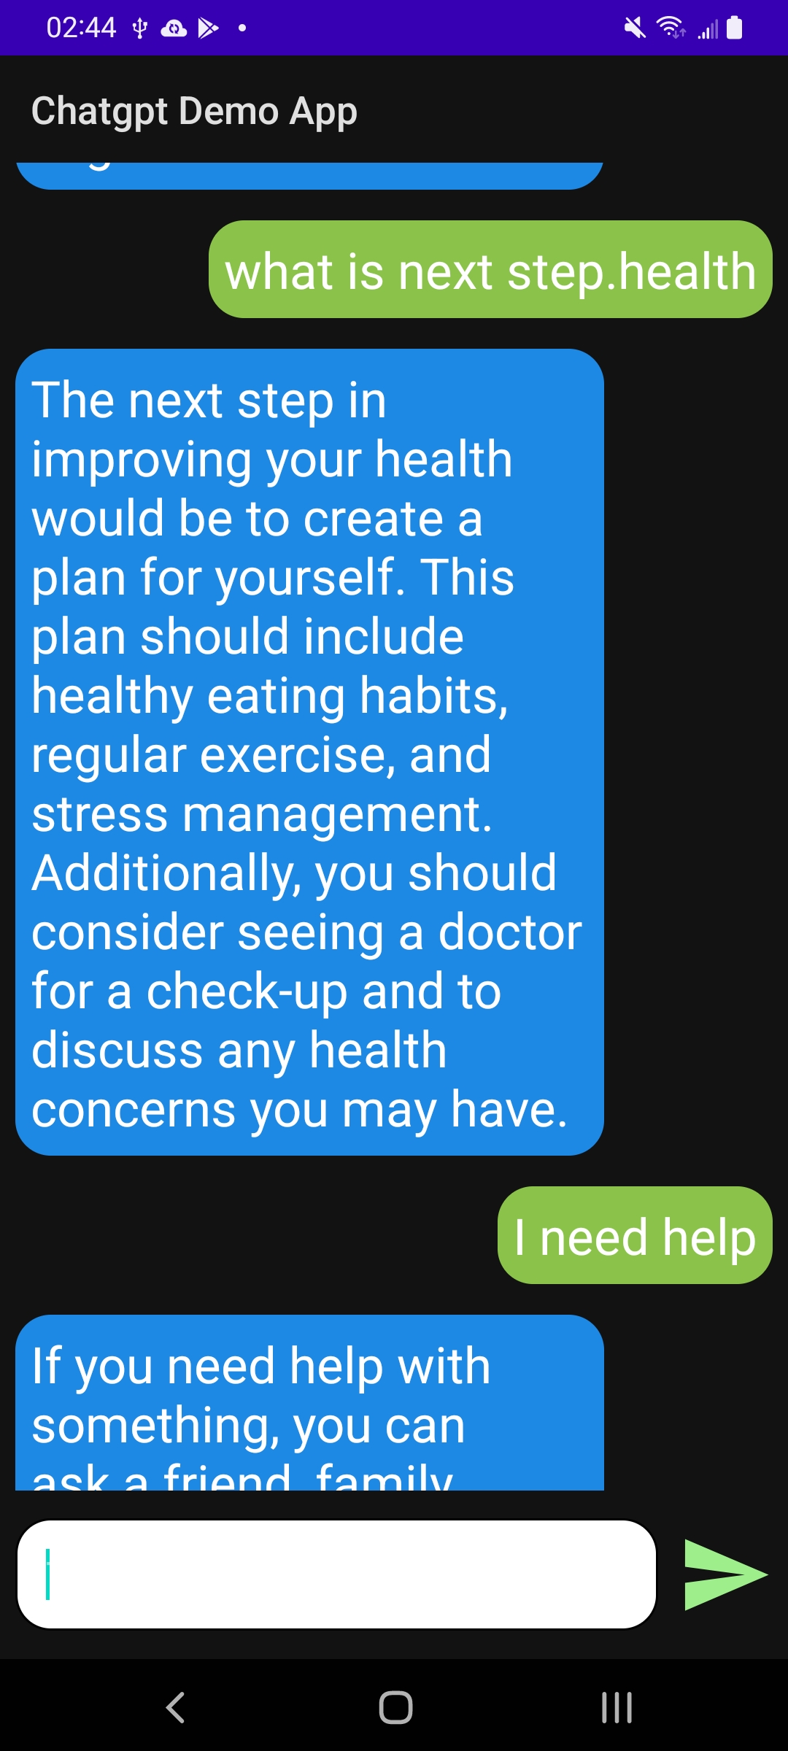
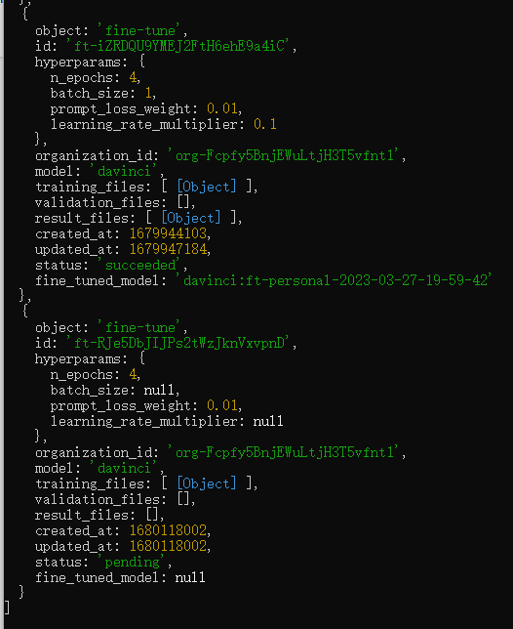
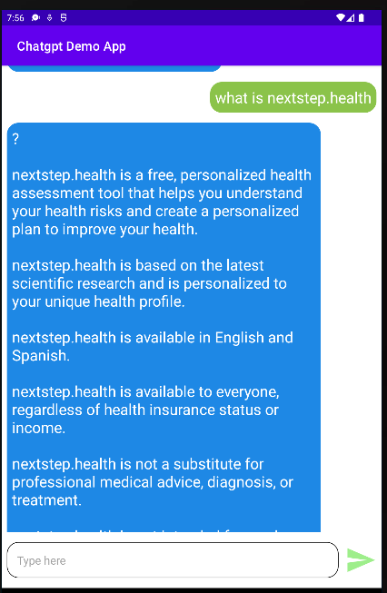
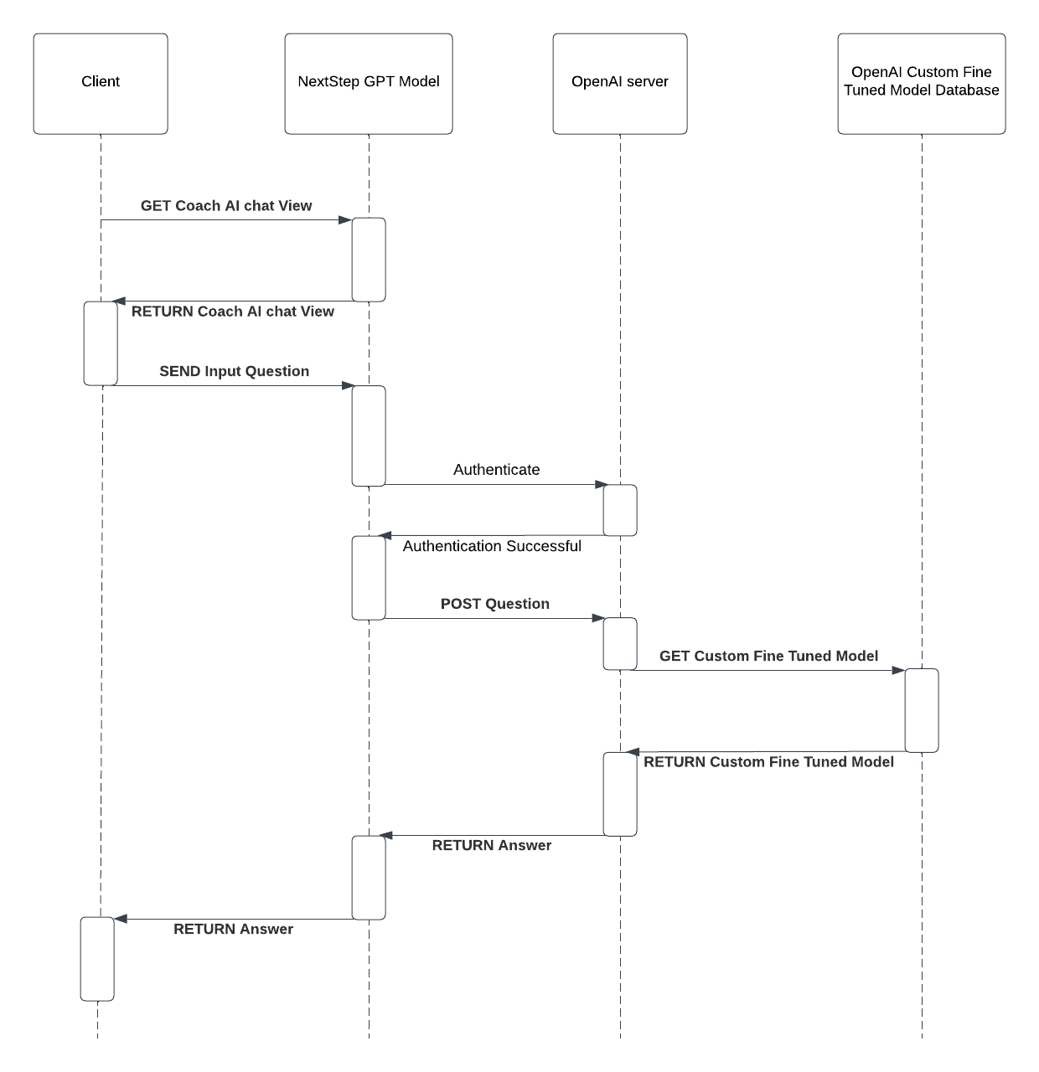
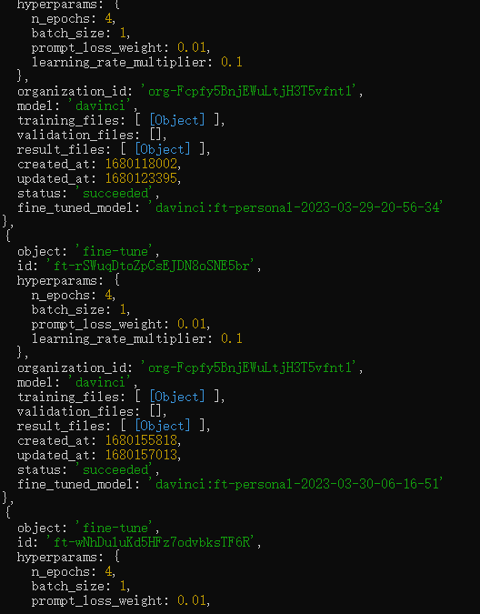
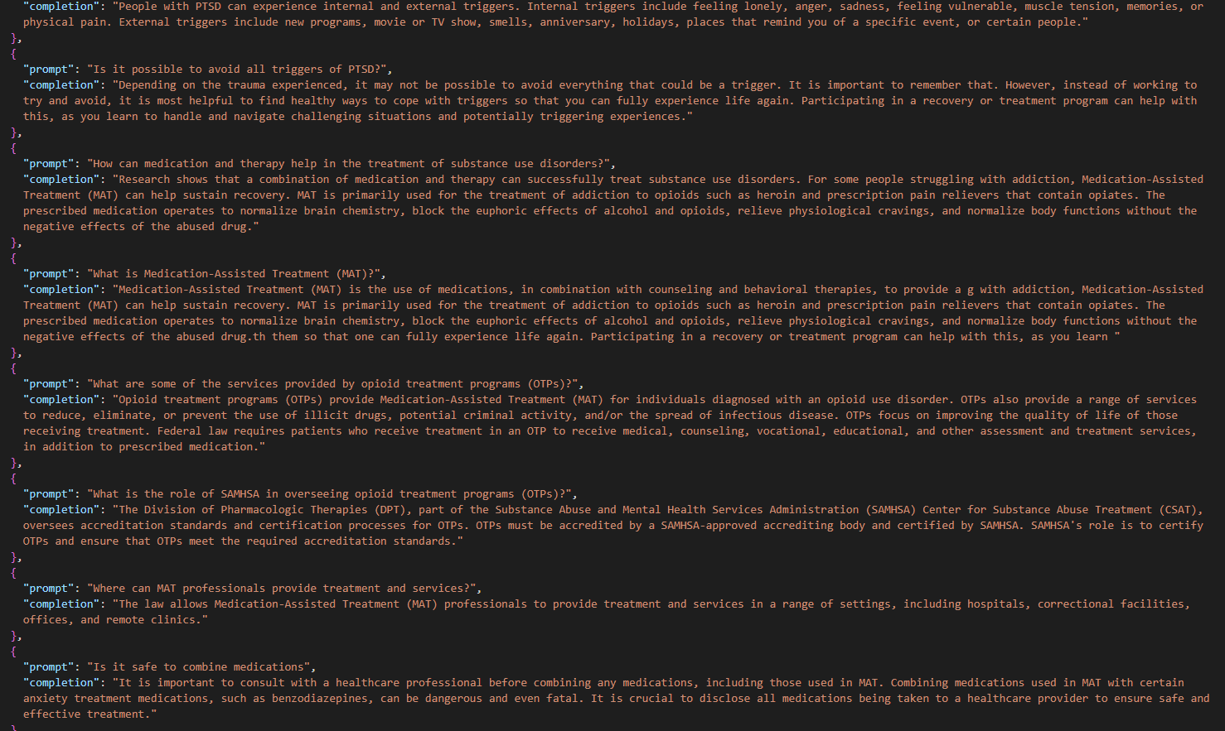
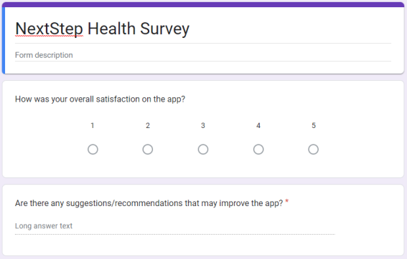
Nextstep Health Data Analysis
Anushreeya Gurung, Lingyun Chen, Benicio Liu
Department of Computer Science, University of New Hampshire, Durham, NH 03824
Place your Project Logo Here
Introduction
Design
Sequence Diagram
Mental health issues are prevalent in society, with one in four Americans experiencing a diagnosable mental disorder each year. However, many cannot afford treatment, leading to a pressing need for affordable mental healthcare solutions. NextStep HealthTech is addressing this problem by developing a mental health chatbot, Sam, which aims to serve as a cost-effective virtual life coach. Sam can act as a virtual life coach as it can help individuals access mental health support and resources which can be used as part of their holistic care approach. The primary research question guiding this project is, "Can we make a chatbot engaging?" The value of this project lies in increasing user engagement with the NextStep app, which in turn promotes the accessibility of mental health tools and improves users' overall well-being.
Dummy Chat bot
Fine tune GPT-3 model
This is the dummy chatbot that has no fine tuning done yet. We will be integrating life coach skills and prompting statements so the design is more human and enjoyable
Create custom fine tune model base on uploaded data
Testing custom fine tune model with dummy chat bot app
Methodology
Custom Fine Tuned Model
This is a sequence diagram which show how our custom fine tuned model work
Our methodology began with researching how to incorporate ChatGPT API models (Davinci and Curie) into an app and fine-tuning them to act as a life coach.
We also studied methods of measuring user satisfaction and engagement from previous case studies.
Our implementation involved integrating the chatbot into a React Native app using JavaScript and fine-tuning it with training data from our sponsor's website and other online mental health resources.
We assessed user satisfaction through qualitative research and analyzed retention and engagement rates as key performance indicators.
Objectives
Train a ChatGpt model, Sam, to be a mental health coach.
A prototype of the mental health coach AI, Sam, integrated into the NextStep app.
User surveys on Google Forms to gather qualitative feedback on users' experiences and thought processes.
Data analytics conducted on the user surveys to evaluate user engagement with the app and Sam's effectiveness in providing mental health support.
Document code for the mental health coach AI, Sam, created using OpenAI's ChatGPT API.
Recommendations for improving engagement factors and the effectiveness of the virtual life coach AI.
Multiple training models that we use
User possible question and the answer for it we used for training
Data
Data Analysis
Conclusions
Data collection occurred through network questionnaire surveys, recorded Zoom sessions, and interviews with users who provided feedback on their experience using the chatbot to open ended questions.
We analyzed the data using a Python script that identified positive and negative words, which helped determine user satisfaction scores.
Suggestions from the surveys were considered for potential implementation in future prototypes, pending sponsor approval.
Over 100 questions and answers were used to train the AI, enhancing its performance as a mental health coach.
Formulas:
Survey
Our project demonstrated that creating an engaging chatbot is possible by focusing on efficiency, safety, and relatability.
By fine-tuning the chatbot to embody a health professional coach persona, we were able to create a platform that encourages user interaction.
The success of the project was determined by the increase in user engagement and satisfaction with the chatbot.
Future work could involve further refining the chatbot's persona, incorporating additional user feedback, and expanding the scope of mental health topics covered by the AI.
Retention rate = Number of retained users/Number of active users ) * 100%
New users in a given time period = retained users
Old users in a given time period = active users
Similarly, engagement rate = (Total user actions / Total active users) * 100%
Total user actions = button clicks, opening app, any user actions that interact with the app.
Acknowledgements
Analysis on which groups are the most satisfied
Thank you, professors David Benedetto, Matthew Plumlee and Craig Smith. Thank you to our sponsor and CEO and founder of NextStep Health Sam Warach

