Slide 1

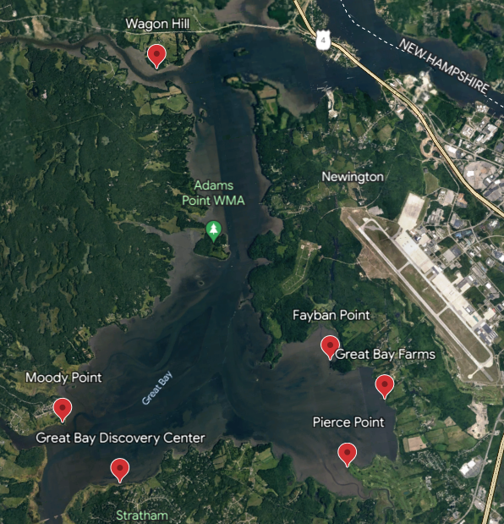
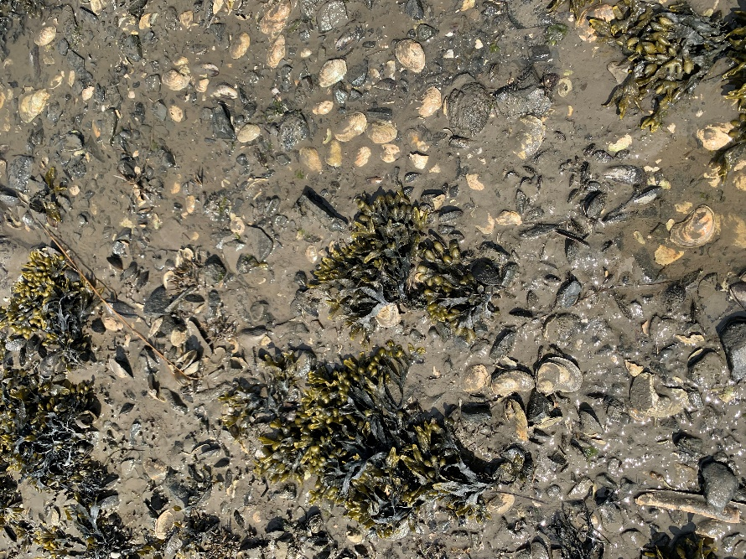
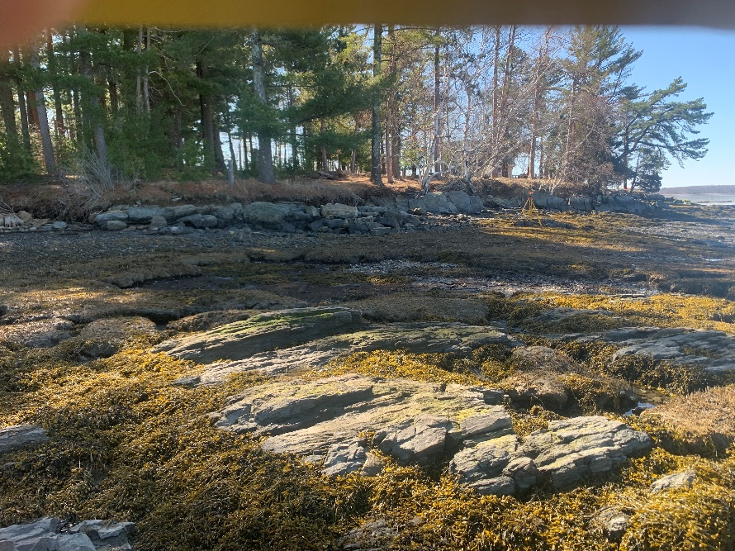
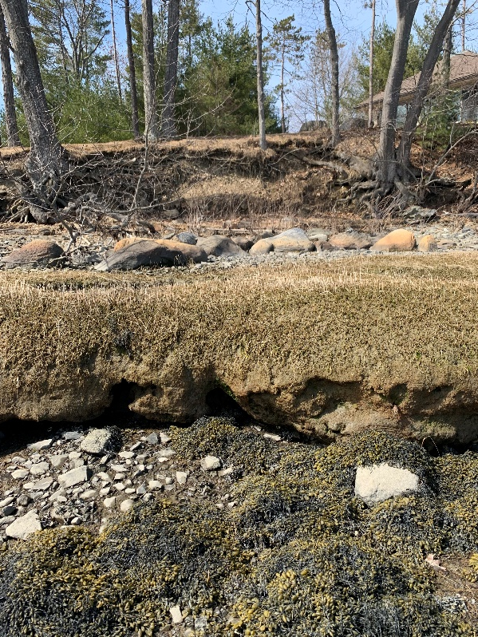
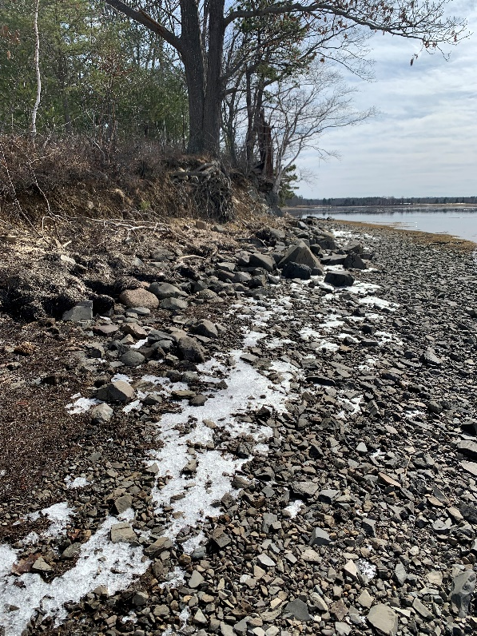
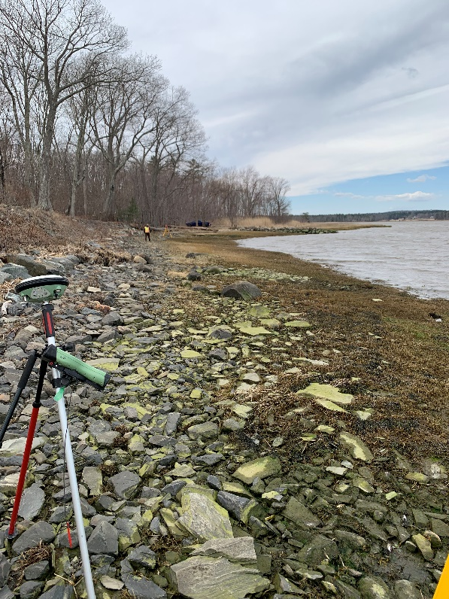
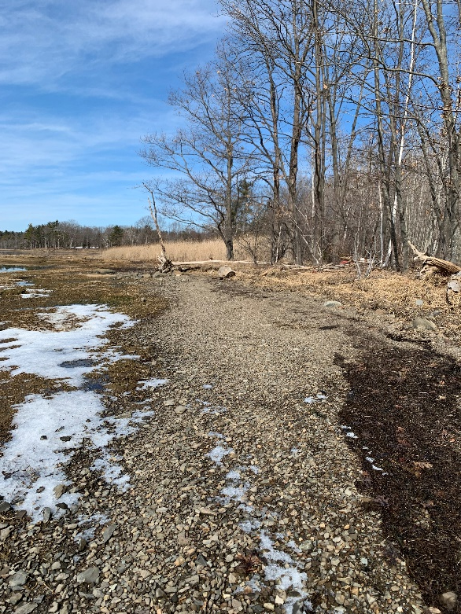
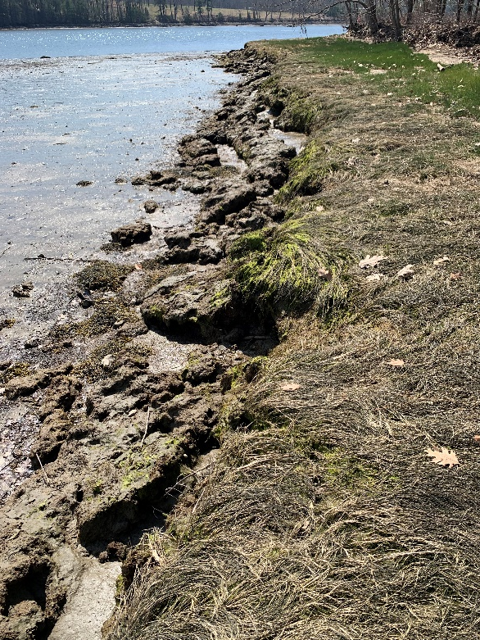
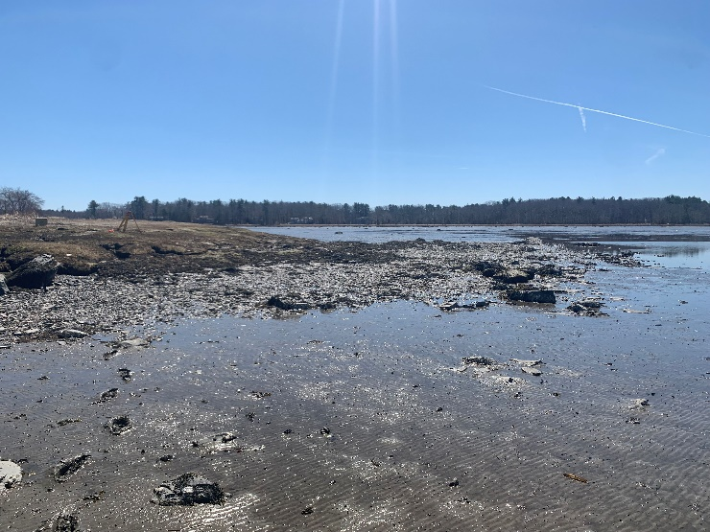
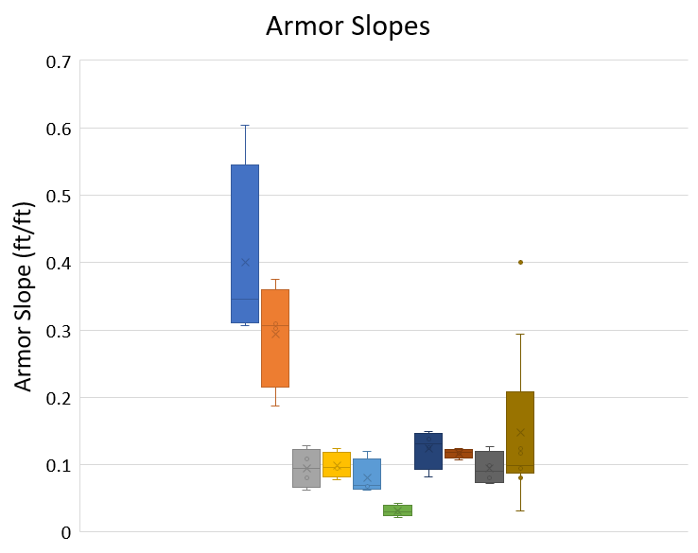
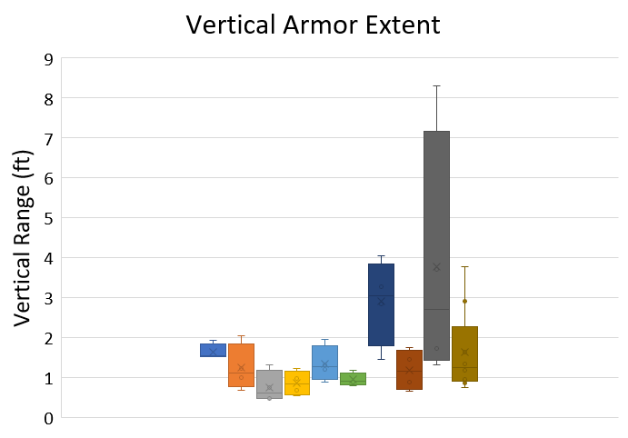
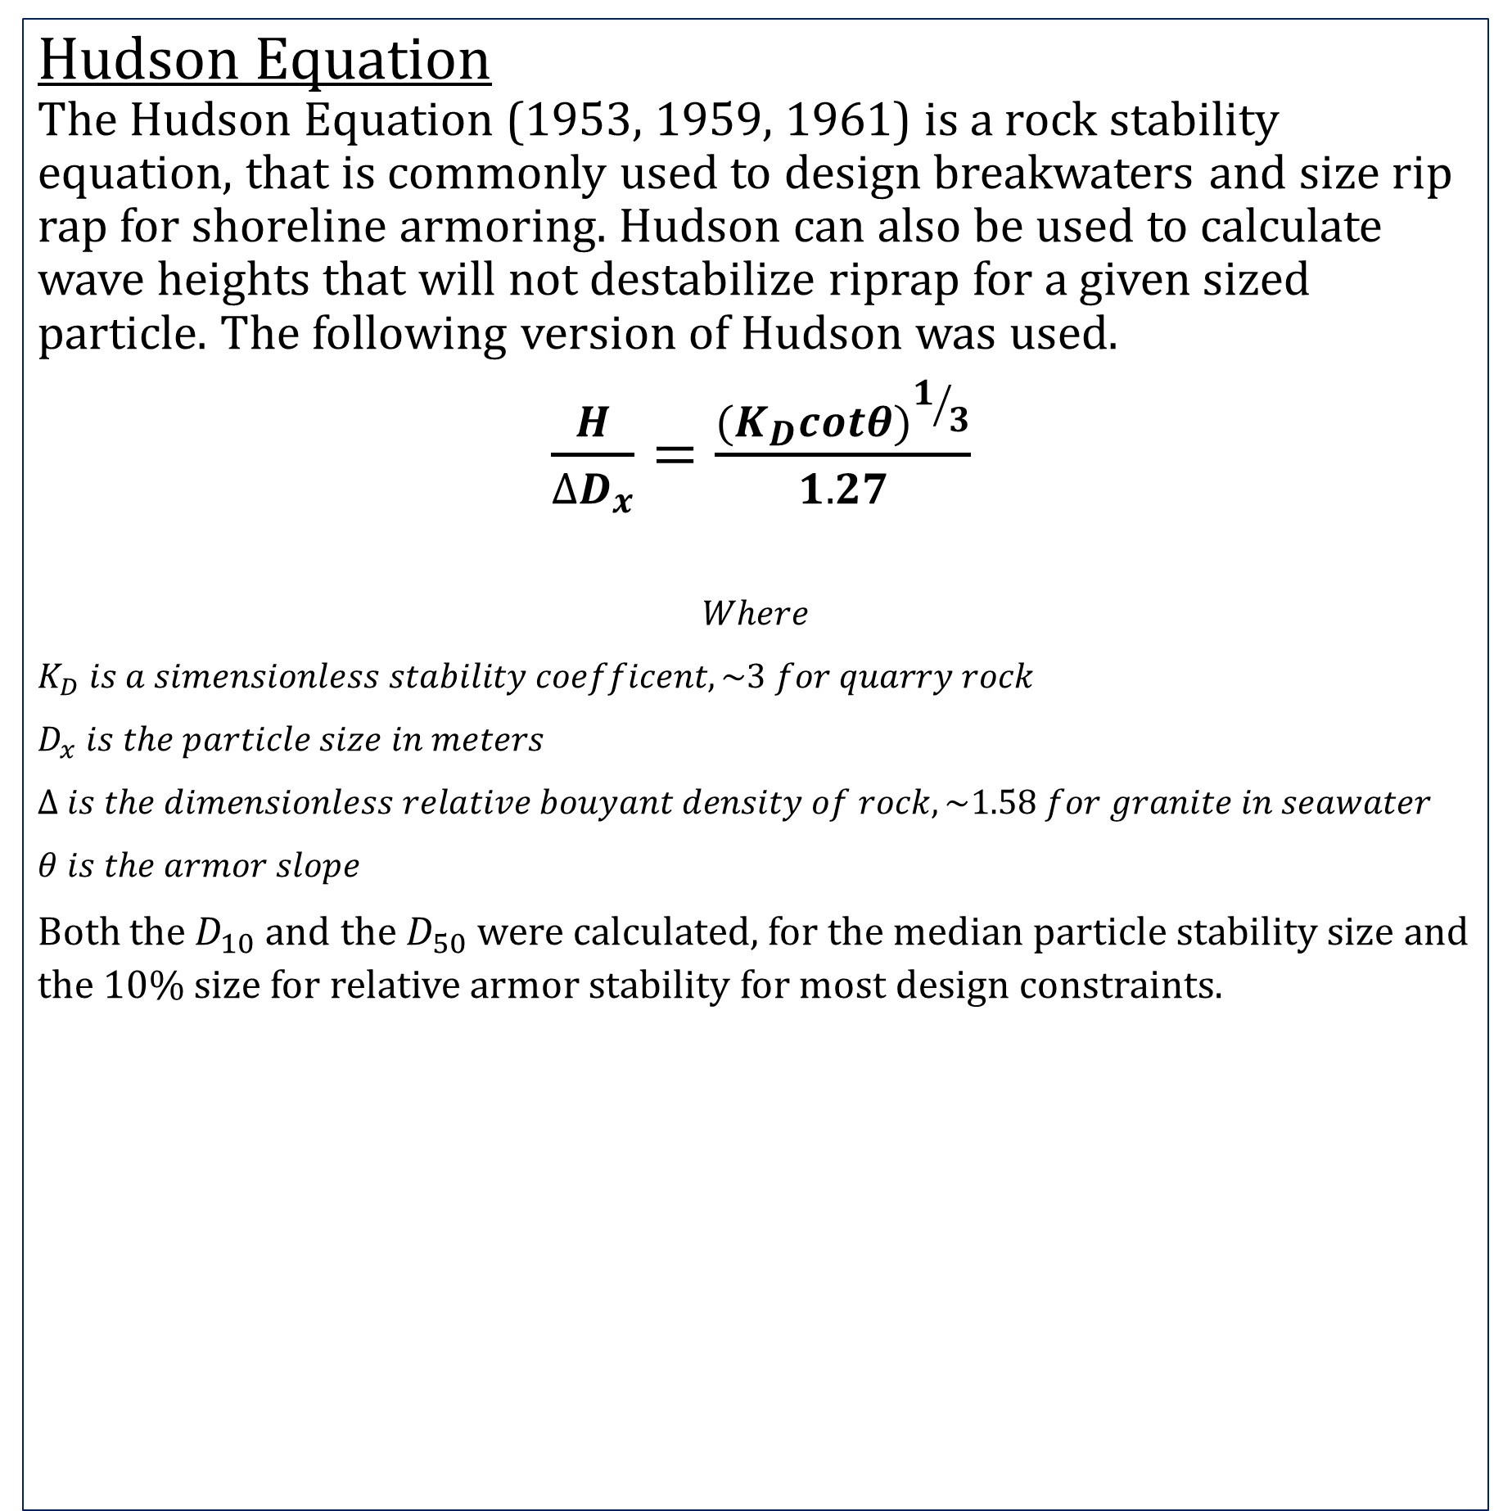

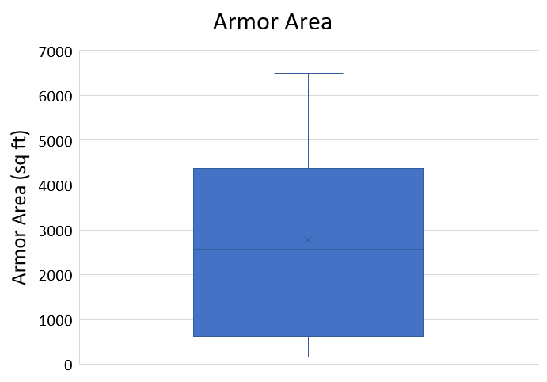
Natural Shoreline Armor Characteristics in the Great Bay
Sunjay Sood
Department of Civil and Environmental Engineering, University of New Hampshire, Durham, NH 03824
Introduction
Particle Size Distributions
Wave Effects on Critical Particle Size
The Great Bay is influenced by tidal forces and exhibits shoreline erosion, endangering saltmarshes and other estuary ecosystems. Throughout the bay, some locations exhibit “natural” armoring. This study focused on particle sampling and armor characteristics to see if any correlation between the sites exists. From the initial analysis, wind-induced wave effects were calculated and assessed against the armor to help further define the characteristics and capabilities of these armored sites. The synthesized data aims to influence future design characteristics for living shorelines in estuary systems in New England as well as identifying any potential processes on how these sites occurred.
Hudson Equation
The Hudson Equation (1953, 1959, 1961) is a rock stability equation, that is commonly used to design breakwaters and size rip rap for shoreline armoring. Hudson can also be used to calculate wave heights that will not destabilize riprap for a given sized particle. The following version of Hudson was used.
$\frac{H}{∆D_{x}}=\frac{{(K_{D}cotθ)}^{1/3}}{1.27}$
$$Where$$
$$K_{D} is a simensionless stability coefficent, \sim 3 for quarry rock$$
$$D_{x} is the particle size in meters$$
$$∆ is the dimensionless relative bouyant density of rock, \sim 1.58 for granite in seawater$$
$$θ is the armor slope$$
Both the $D_{10}$and the $D_{50}$were calculated, for the median particle stability size and the 10% size for relative armor stability for most design constraints.
Site Locations
Armor Characteristics
At all study locations, the armor thickness was a single layer, with actual thicknesses relating to the orientation and thickness of the armor particle. These characteristics differed only in the large cobble armor at the South Great Bay Farm location with a thickness ranging to about 2 times the armor thickness and in small sections at Wagon Hill. Overall armoring was a single layer with particle shape and armor slope being the main factor to dissipate wave energy and armor the shoreline. Particles ranged in size but tended to either be disk like or spherical in shape. This could be explained by the waves smoothing out the particles as particles further up the slope or under the top layer were rougher.
In addition to rock armor, many mussels and rockweed were found in the armor band on the tidal zone and may also contribute to energy dissipation. At Pierce Point, mussels made up a large portion of the armored sections, about 50%, in both discarded shells and live organisms. While differing in density, they were a similar size to the rock particles found at the site. At Wagon Hill, the armor slope and size made a very good habitat for rockweed, where the entire face was overgrown with it. A similar instance was found on the bedrock at Pierce Point.
Observations
Pierce Point Armor
Effect of discarded shells on armor stability and effectiveness, at Pierce Point
Extreme differences in armor size at Great Bay Farms, despite location proximity
Some sites have armor above the saltmarsh and others below
At Moody Point, the lower armor continues at the same size and slope under the hummock
Rockweed Growing on Bedrock, Fayban Point
Location Photos
Armor Relationships
Tidal Elevations
Tidal elevations are indicators on how the armor comes into contact with the tides and how much of the armor dissipates tidal energy.
Due to weather conditions earlier this semester, pressure transducers were unable to be deployed. The process to collect water pressure is as follows. A pressure transducer will be deployed beyond but close to the low tide line and over a 2-month period would collect pressure from water depth.
Using previously collected data at Moody Point, the collected data was converted into units of $\frac{N}{m^{2}}$. Using this pressure value, tidal elevation was calculated via $D=\frac{P}{pg}$, for the following statistics, MHHW, MHW, MLW, MLLW.
Acknowledgements
Dr. Tom Ballestero, PhD, PE
Robert Hopkinson, Streamworks
References
Double armor layer at Moody Point
Great Bay Farms North
Great Bay Discovery Center
Bunte, Kristen, and Steven R Abt. Sampling Surface and Subsurface Particle-Size Distributions in Wadable Gravel- and Cobble-Bed Streams for Analyses in Sediment Transport,
Dean, Robert George, and Robert A. Dalrymple. Water Wave Mechanics for Engineers and Scientists. World Scientific, 1995.
“Design of Coastal Revetments, Seawalls, and Bulkheads.” Army Corps of Engineers Manual , 30 June 1995, https://www.publications.usace.army.mil/Portals/76/Publications/EngineerManuals/EM_1110-2-1614.pdf.
Hydraulics, and Streambed Monitoring. US Department of Agriculture Forest Service, May 2001, https://www.fs.usda.gov/rm/pubs/rmrs_gtr074.pdf.
Shore Protection Manual, 1984.
Great Bay Farms South
Peat layer above armor level at Wagon Hill
Pierce Point

