Slide 1
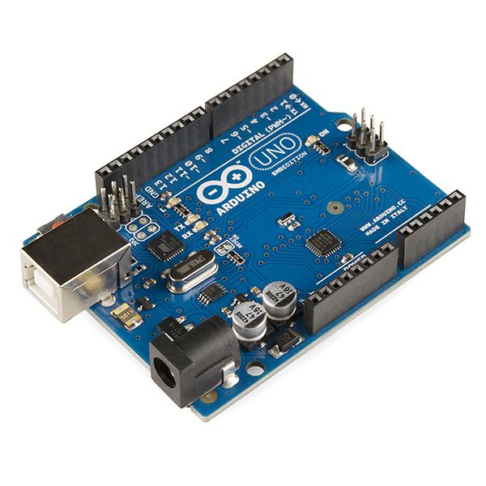
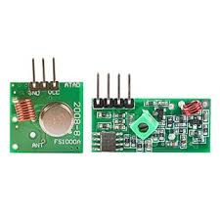
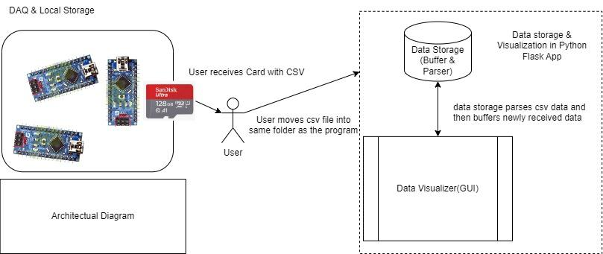
SPAITR Sports Replay Application Eli Hartin, Nick French, Dylan Terenzoni, Joey Heacock College of Engineering and Physical Sciences, University of New Hampshire, Durham, NH 03824
Introduction
Hardware
Results
When a lacrosse team is practicing out on the sports field or when they are in a real game, their coaches strongly value being able to hold players accountable for their roles and tasks on the field. For our project, we developed an app that utilizes hardware to help coaches keep those players accountable.
Arduino
Modules
So far, we have provided value related to our MOV by collecting and displaying data for two pylons so far. Our testing verified that the data being passed in from a CSV was accurate and in the proper order. These results were obtained through our app display.
Software results:
The correct distance between the pylons and player
The coordinates for the player on the field
This image shows an Arduino sensor used to get timestamps
These are RF transmitters and receiver modules. They are used to send to send radio frequencies that are used to calculate time of flight data.
Requirements
System Design Diagram
Conclusions
Functional requirements:
Calculate and display the distances between multiple pylons and transmitters
Display timestamps on an application to show change over time
Data coming in formatted at the proper intervals with no lag time
Non-functional requirements:
Watch a replay of the game through data points
Using time of flight data, we were able to visualize distances between different points. The data being displayed included all relevant points and the distances were accurate. This displayed data will help coaches know where their players are and hold them accountable on the field. For the future, we wish to have our system collect data and display two pylons and a remote.
Calculating Distance
Tools Used
Overview
For this project, we had to calculate the distance for two pylons and then calculate the distance between each pylon and the player’s sensor, with the data gathered from the field
Within the software, we find the pairs of the connections that have similar time stamps, and are both connected to the same player id
Then the distance is calculated from both connections
We use those distances to get the height and x position of the player
We then add those calculations back to the collection of datapoints
For this project, we used python to write the backend code and we used Flask to display our data on an application. Arduinos and were used to collect the data and we utilized an excel program PLX-DAQ to gather and organize the data into a CSV to be processed.
This diagram explains the relationship between the user, hardware and software. The user creates a CSV file using the collected data from hardware to then display that CSV file data on a web application. The buffer and parser organize the data. Then, the backend performs some operations to triangulate player locations.
Acknowledgements
We want to acknowledge our sponsor Joey Neleber and our advisor David Benedetto for guiding us on this project.

