Slide 1
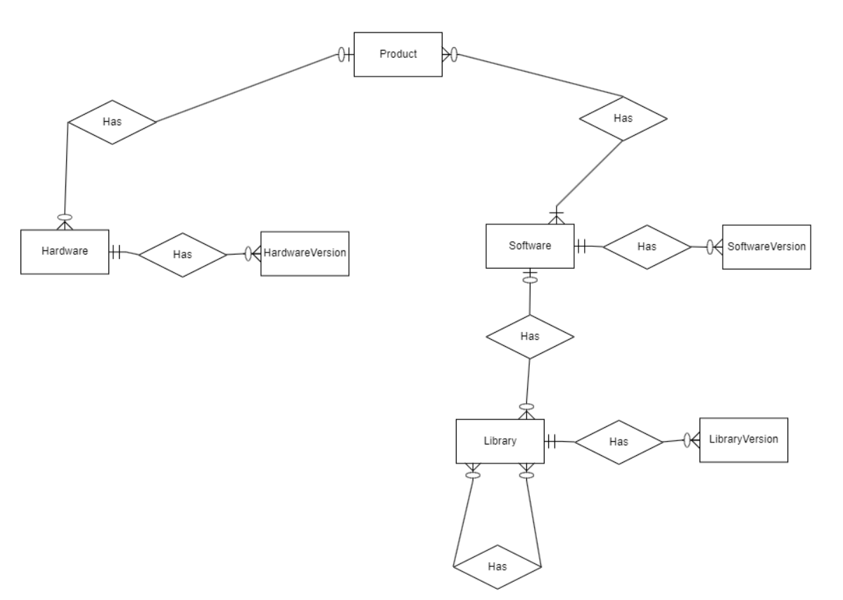
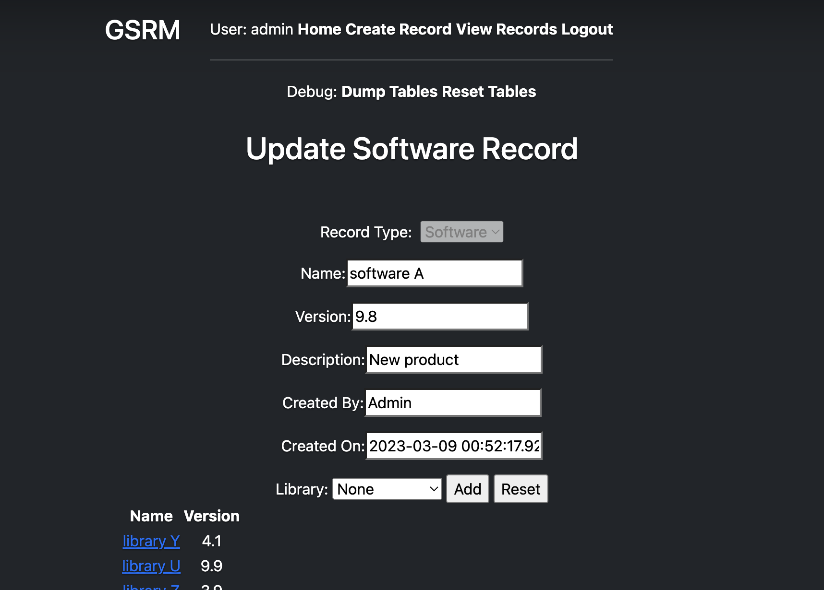
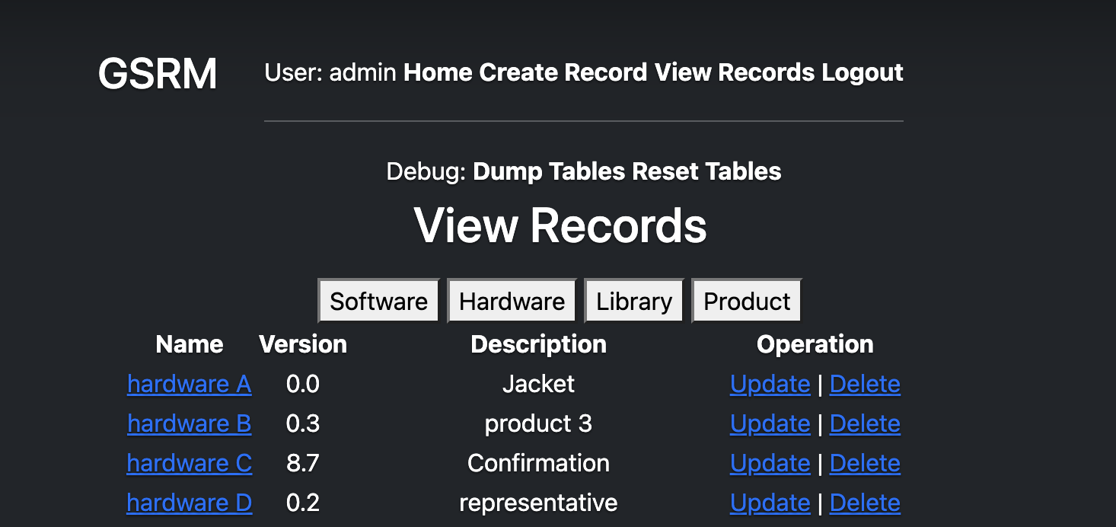
Developers: Alec Mitchell, Minhthi Detzel, and Ramya Amin Product Owner: Jonathon Andree Scrum Master: David Benedetto Department of Computer Science, University of New Hampshire
Galvion Software Release Management
Introduction
Architecture
Galvion is a company that designs, develops and delivers protective armor and helmet systems, as well as innovative power supply and management solutions for military and tactical operators.
Galvion needs a way to keep track of relationships between product dependencies. The goal of this project is to create a web application that allows users to manage their software and hardware products, relationships, and dependencies
The Entity Relationship Diagram represents how the SQL database is structured. There are 3 main parts of the database which are the product, hardware, and software tables as seen in Figure 1. Each of these tables uses a foreign key to establish a relationship with another table. For example, a software record can be related to many hardware records, product records, or library records.
Requirements
Testing
1. Entity-Relationship Diagram
Galvion Software Release Management is tested by developers through a robust quality assurance process. Developers ensure database transaction times are under a second and that user-initiated actions can be completed in the allotted numbers of clicks.
We use tools including database viewers to ensure the validity of data after insertion into the database.
The group consistently demonstrates progress on the UI to Jonathon for feedback.
Create, update, read and delete record functionality of relationships
Ability to filter records by type as seen in Figure 3.
Easy-to-use user interface
User registration for record accountability
Ability to create, read and update a record within 3 clicks
Ability to manage version increments
Implementation
2. Update Record Page
Results
The web application runs on Python and Flask to serve HTML pages to the user.
JavaScript and CSS to make the front-end visually appealing and functional.
The Python-Flask program interacts with an SQL database for persistent data storage
For example, a record request initiated by a user will propagate through the Python/Flask server which will query the database for the selected record, send it back to the server, which will send it to the browser to render the data dynamically for the user using Jinja. This is visually represented in Figure 4.
Web application is built with features being implemented with each sprint.
Users can create, read, update and delete records within 3 clicks.
Relationship management is possible when creating or updating a record which is seen in Figure 2.
User registration and login is implemented and tested. Only authenticated users can create and update records.
Managers and engineers can use the web application as a tool to assist them in updating and maintaining their current products.
3. List Records Page
.
4. Architecture Diagram

