Slide 1


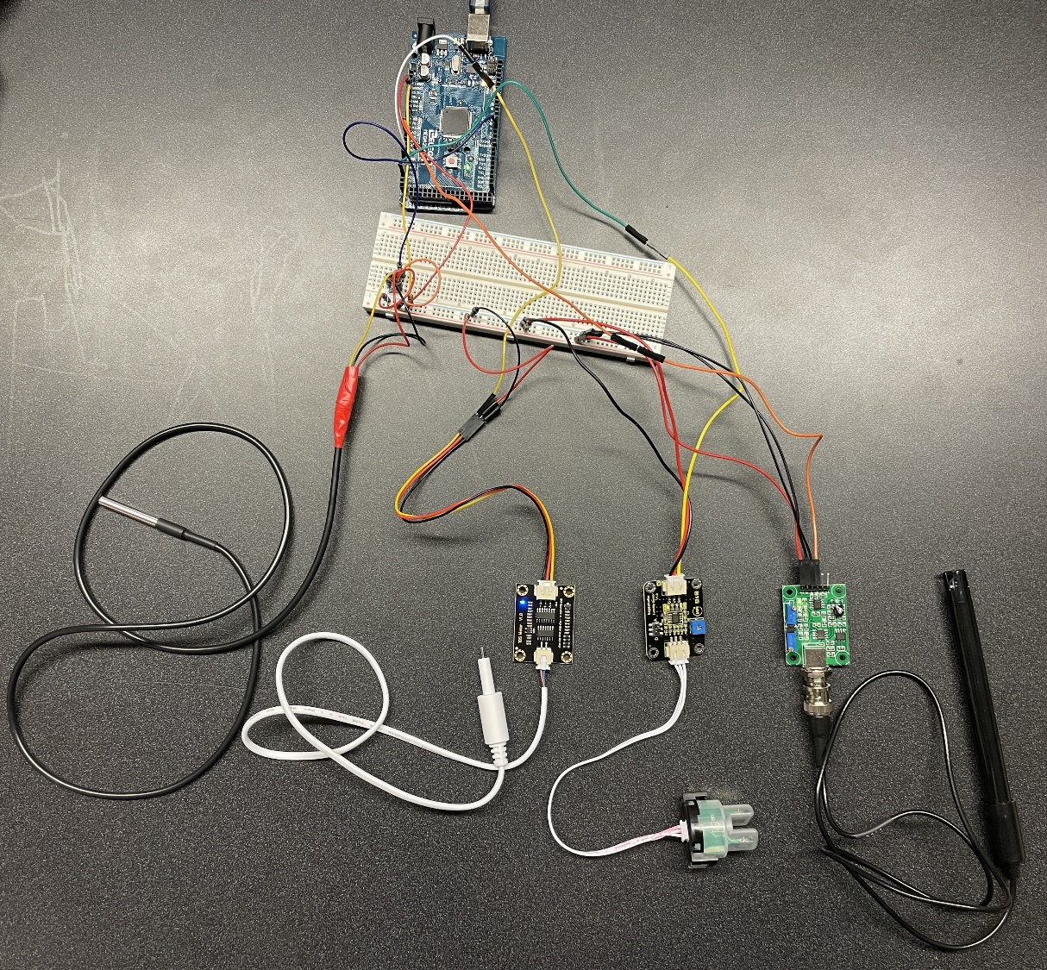
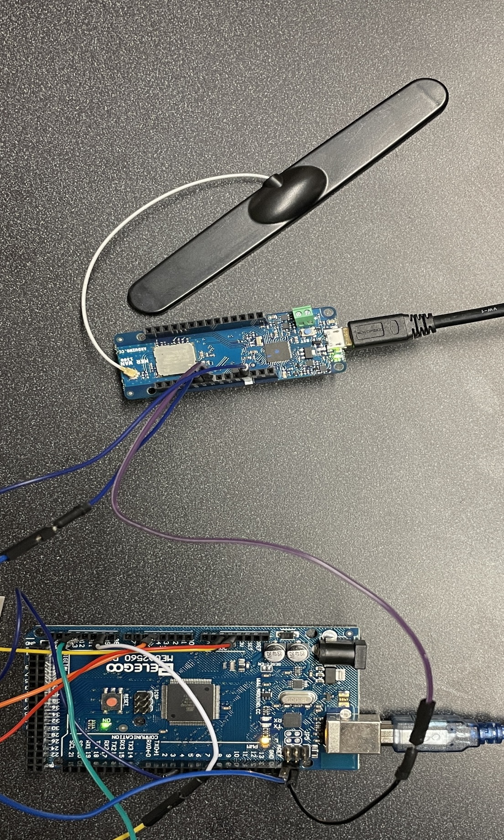
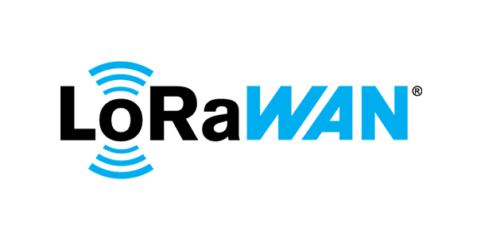






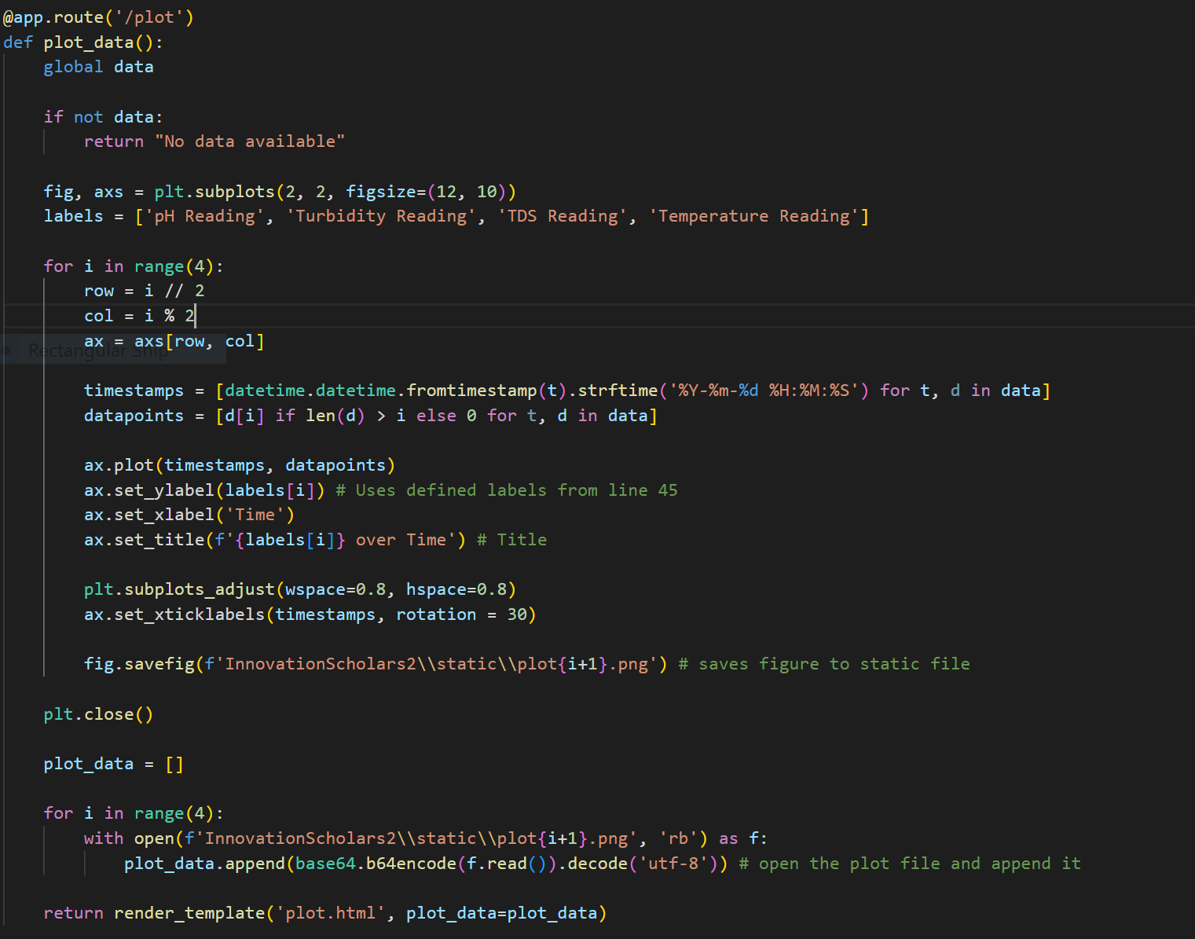


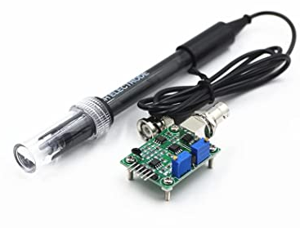
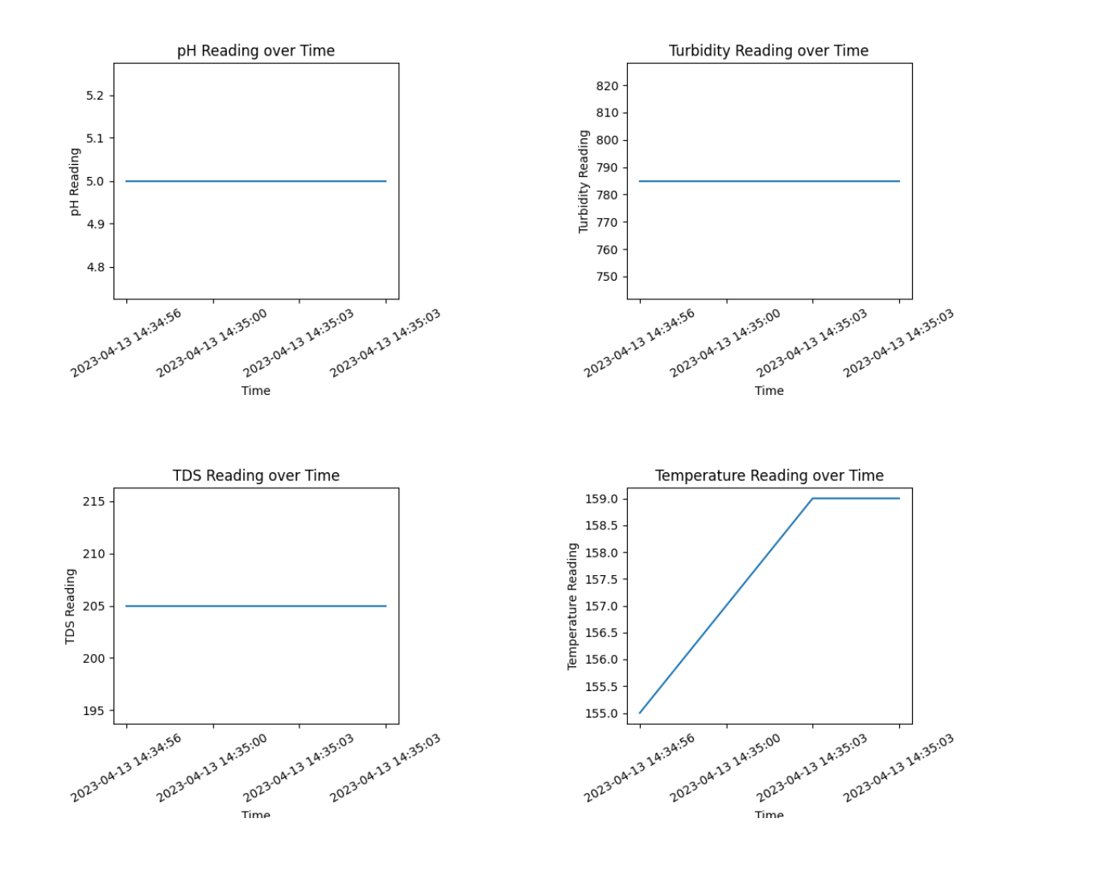
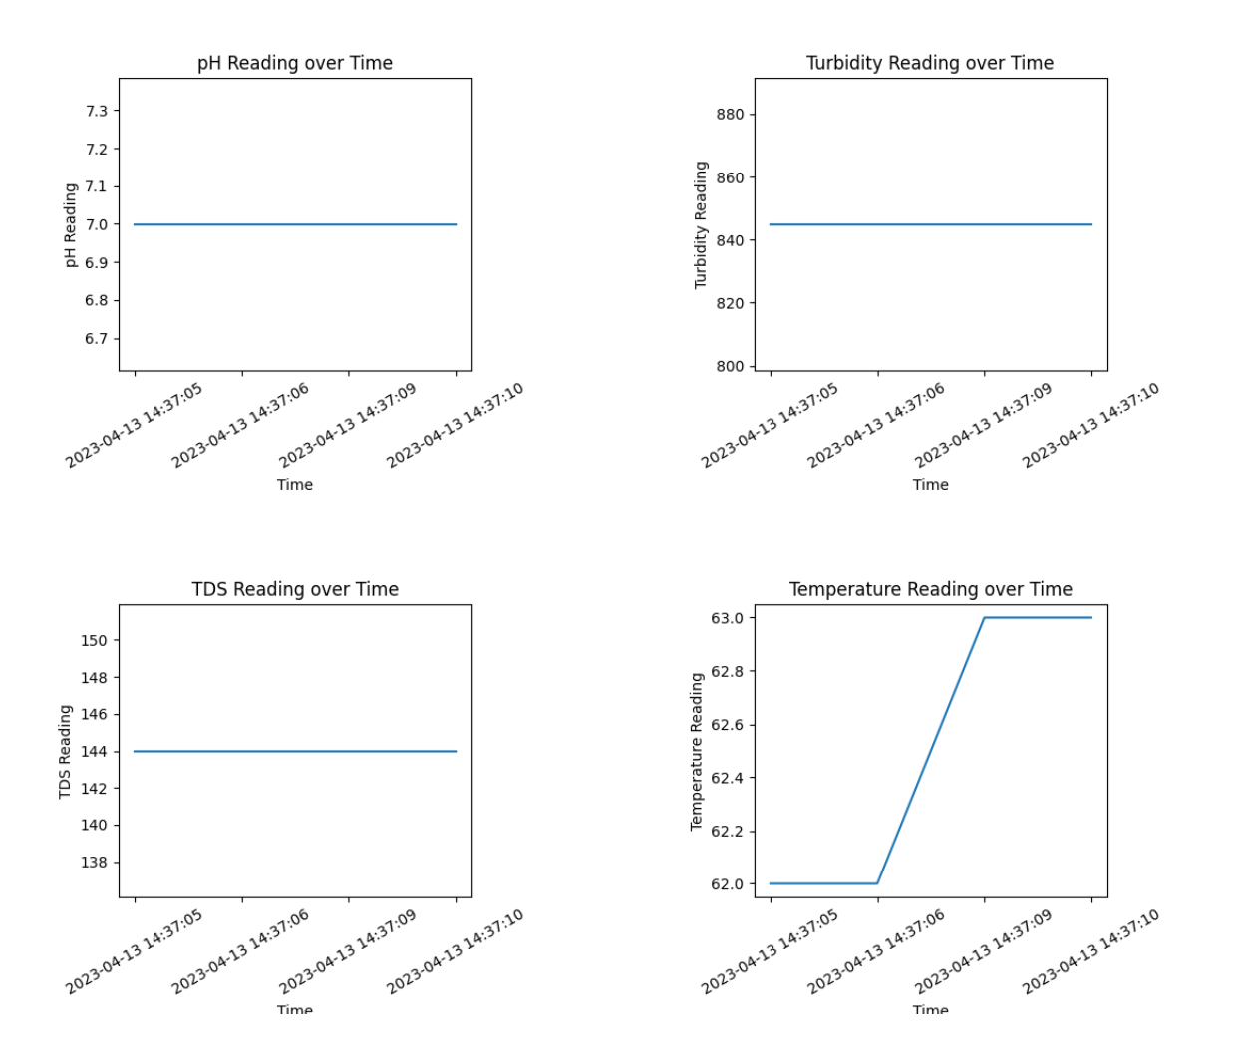
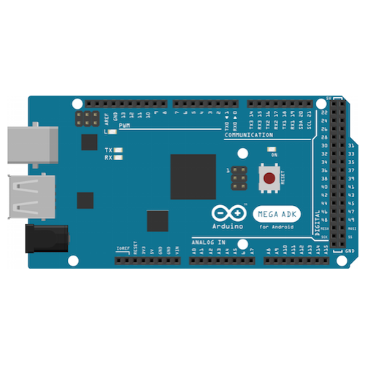
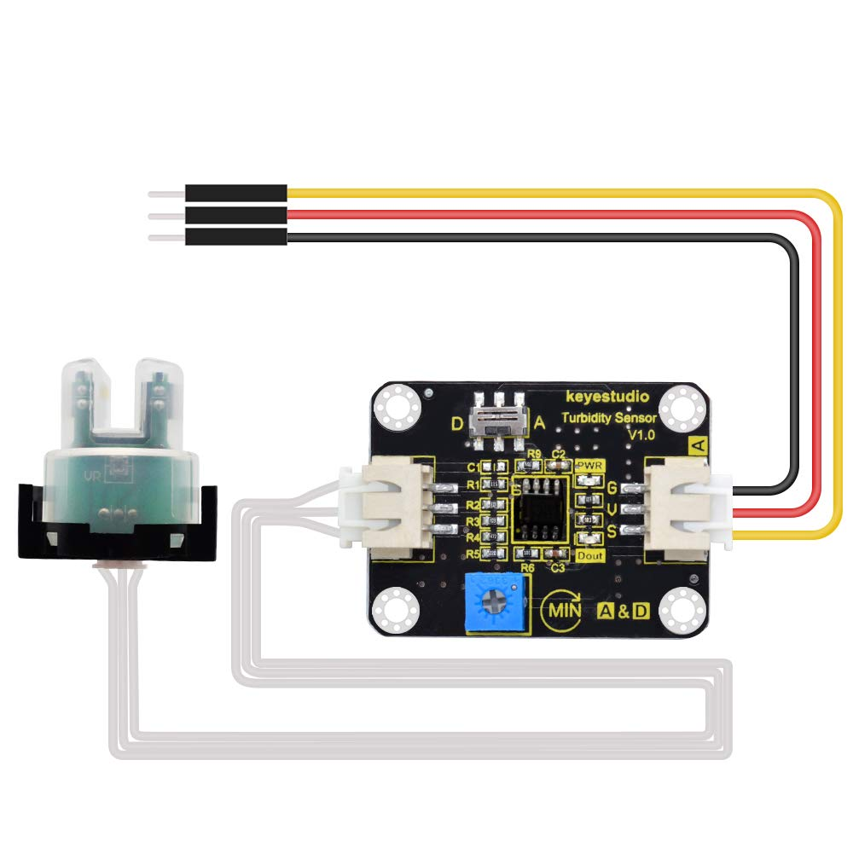
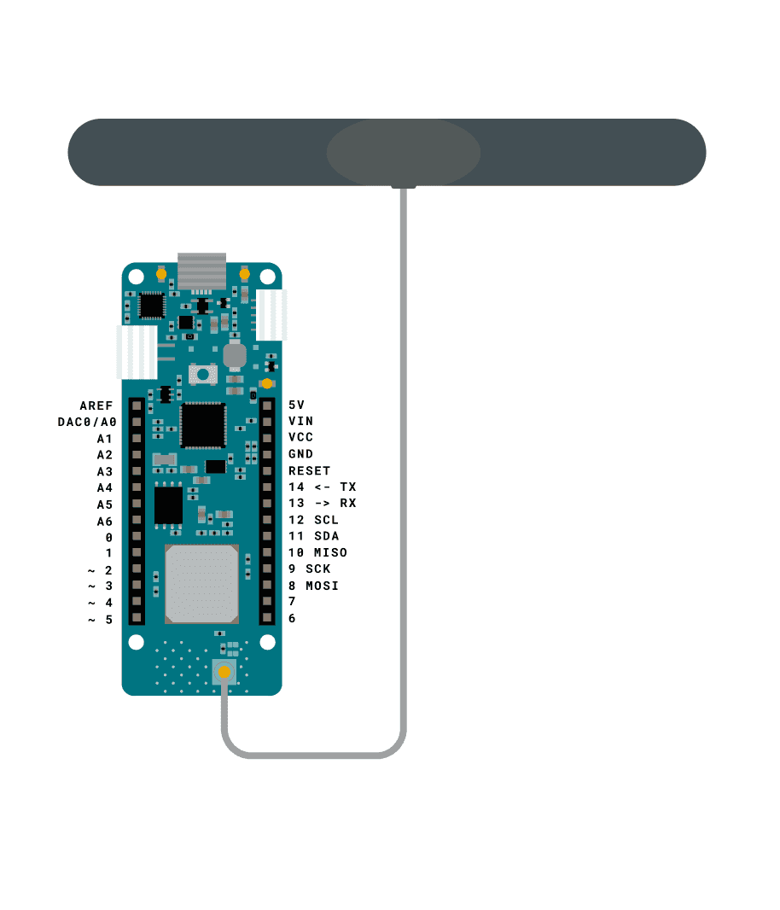
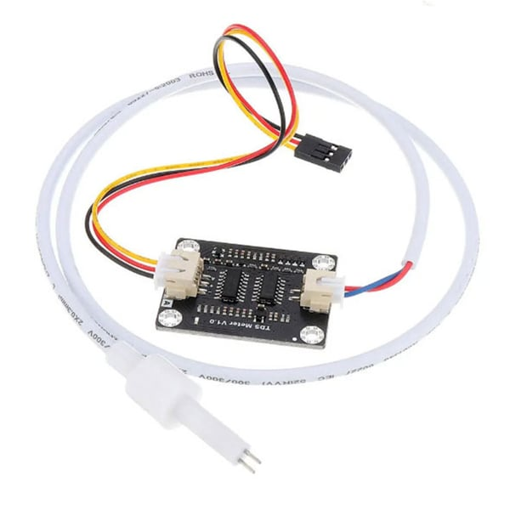
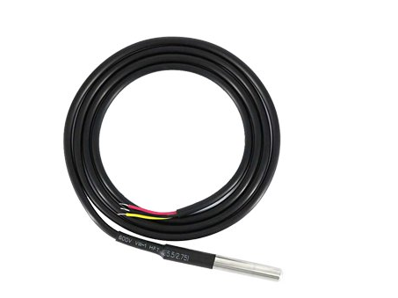
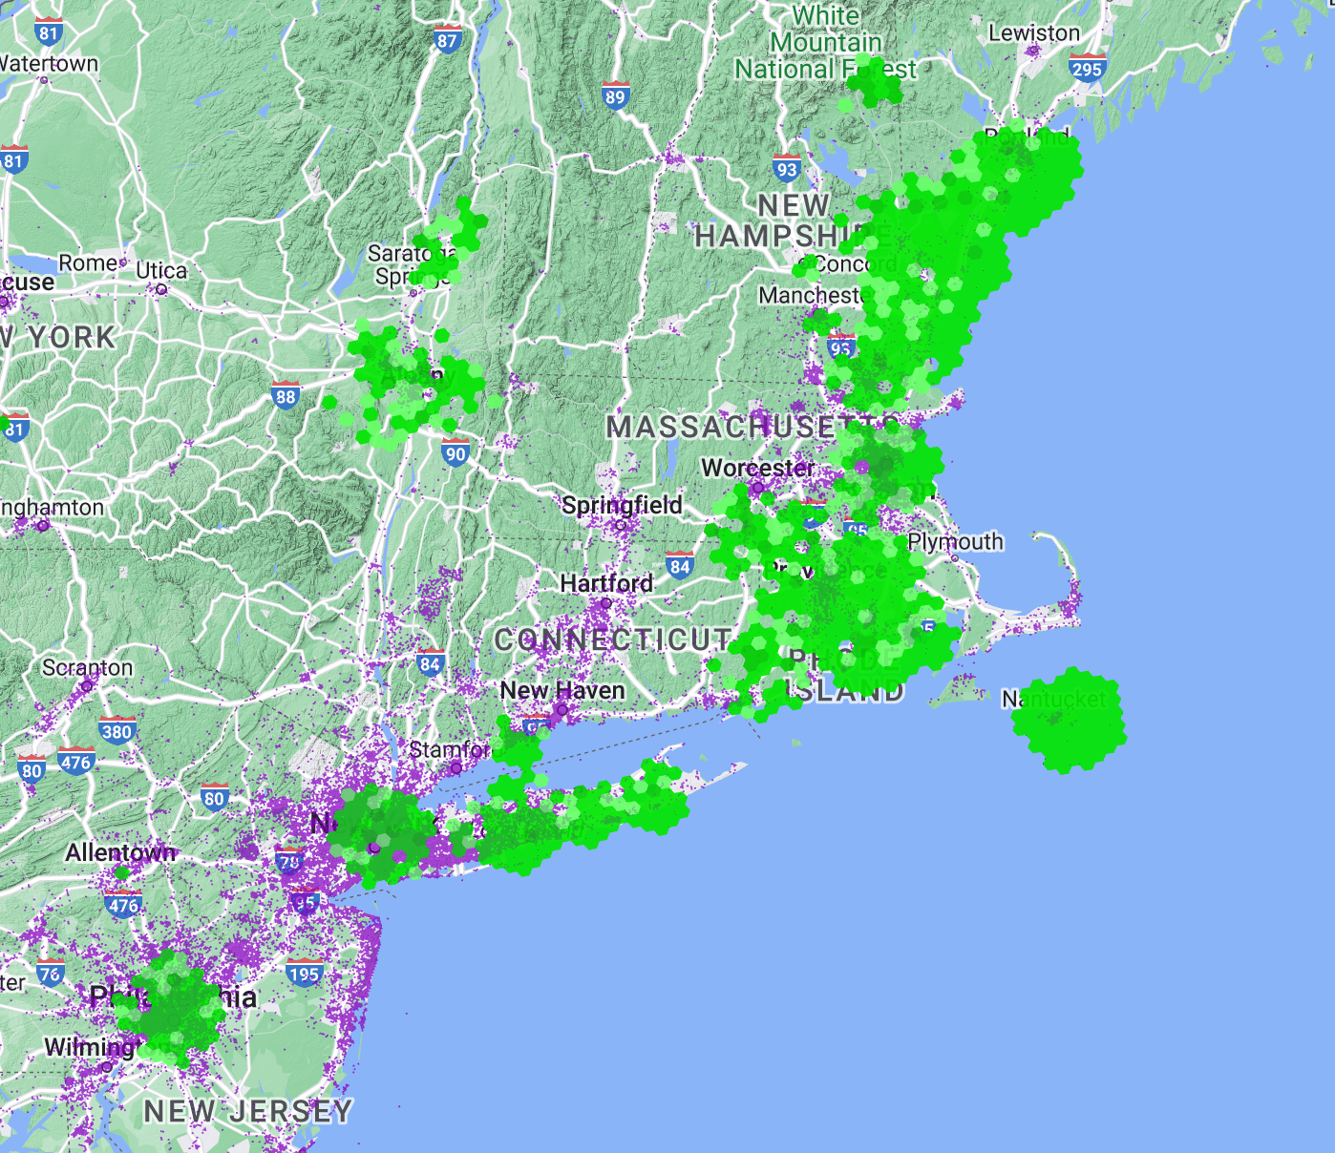

Wireless Water Quality Monitoring with IoT-enabled Devices
Alec Mercer*, Tyler Simone*, Diego Gatti*, Kyle Ouellette, Dr. Dean Sullivan
Innovation Scholars – University of New Hampshire, Durham, NH 03824
Introduction
Wireless Monitoring Process Flow
Urban runoff is a growing global issue that introduces foreign sediments and solids into stormwater systems. These types of solutes pollute waste streams that are frequently discharged to coastal environments and are a threat to clean water sources for human and wildlife populations.
This project aims to identify the presence of pollutants in stormwater streams using wireless sensor technology to track the concentration of sediments and solids that have been introduced into the stormwater system.
Collection
Transmission
Reception
Interpretation
Visualization
Critical-to-Quality Variables (C2Q)
The Arduino Mega and Sensors collect the data and communicate with the MKRWAN1300.
The MKRWAN1300 uses the LoRaWAN protocol to send the data to the Senet Gateway.
The Senet Gateway receives encrypted data and packages it in the JSON format.
The JSON data is requested by the Python Server and decodes the data to prepare for plotting.
The strings of data break into a list of four points and are plotted with matplotlib (Python library)
pH
to measure change in chemical composition
Turbidity
to monitor light intensity
Total Dissolved Solids (TDS)
to measure amount of sediment in water (ppm)
Temperature
to compensate for atmospheric/system changes
Sensor Testing and Results
Sensor Fabrication
HOT COFFEE
WATER
The wireless system was tested to compare two substrates: tap water and hot Starbucks coffee
The Arduino provides data in-real-time with accuracy
Python server successfully interfaced with the sensor, wirelessly highlighting the feasibility of LoRaWAN-Server communication and processing
Each sensor provided a consistent reading for each parameter, except for temperature due to the ambient temperature of the probe changing.
pH is consistent and had been calibrated using pH test strips
Coffee
Tap Water
The Arduino Mega was wired to a breadboard to pair with individual sensors.
Project Goals
The Arduino MKRWAN1300 was connected to the Arduino MEGA and encoded for inter-device communication.
(1) Build a wireless sensor to measure C2Q variables
(2) Transmit data using LoRaWAN over long distances
(3) Keep the sensor versatile for facile modifications
(4) Design a robust data processing server to connect with multiple sensors concurrently
Future Work
Wireless Transmission
Develop waterproof housing for the device
Deploy the device in Durham or in coastal regions in New Hampshire
Improve the server backend for autonomous deployment
The Arduino device uses the LoRaWAN protocol, a “Low Power Wide Area” protocol allowing for wireless transmission over the US915 frequency that is accessible across the Northeast.
We thank the UNH InterOperability Laboratory, Kyle Ouellette, Dr. Dean Sullivan, Jeffrey Lapak, and the Innovation Scholars Program.
[1] Coastal runoff pollution data, U.S. EPA, 2009
[2] Water quality ensor development, dfrobot Wiki
[3] Arduino design, Last Minute Engineers, 2017

