Slide 1
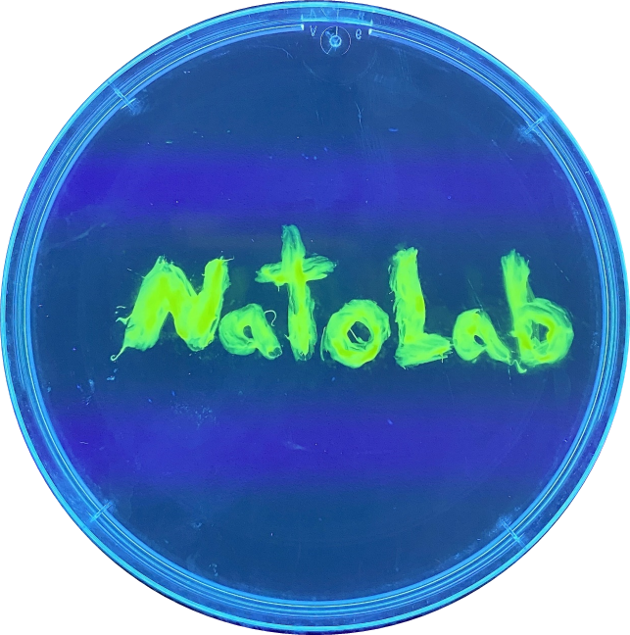


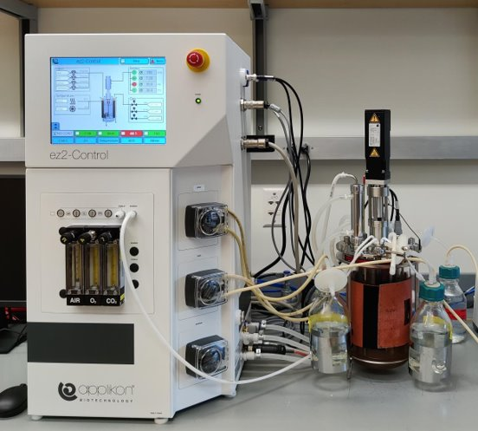
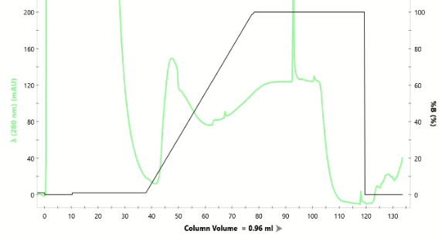
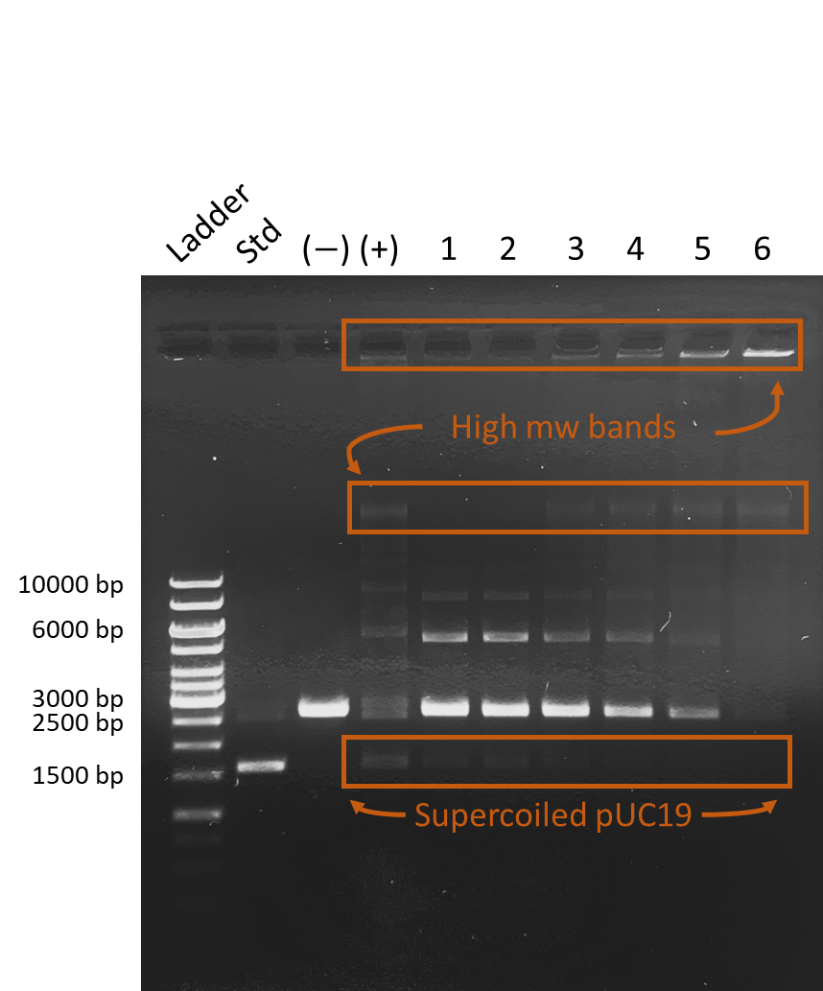
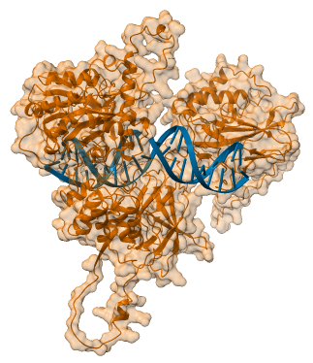
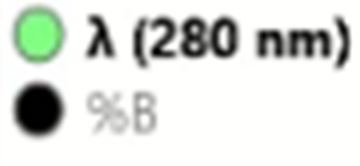
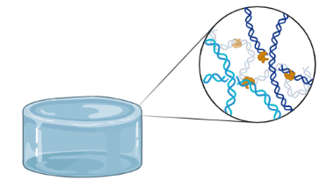
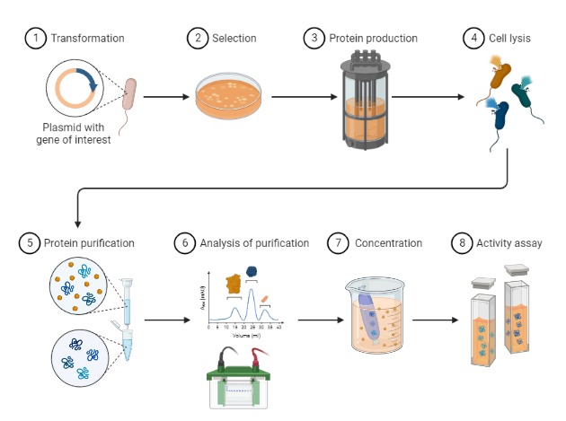
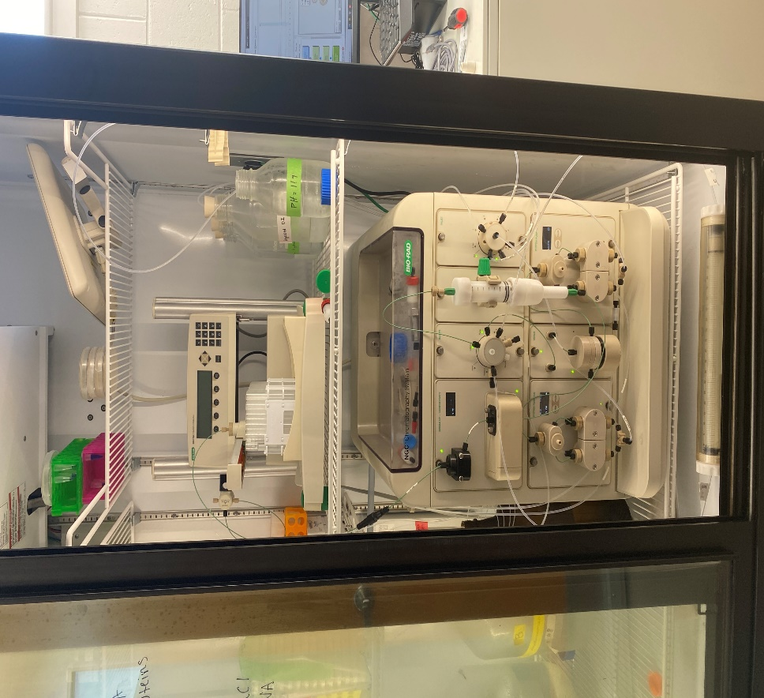

Joining Forces: Engineering a High-Efficiency DNA Ligase for Tunable Biomaterials
Somkene ‘DK’ Alakwe, Wynter Paiva, Nate Oldenhuis*
Department of Chemistry, University of New Hampshire, Durham NH, 03824, USA
dk.alakwe@unh.edu | natolab.com
BACKGROUND
METHODS
RESULTS
DNA ligase is an enzyme that plays a critical role in DNA replication and repair by joining together the ends of DNA strands.
Ligases are essential for studying topological control and properties of biomaterials (Figure 1). Our lab requires large quantities for our biomaterials and polymer research
Due to their sensitivity to temperature and freeze-thaw cycles, commercially available ligases may not always meet our specific needs and can be costly.
To address this challenge, we have developed an optimized method (Figure 2) for producing artificially engineered DNA ligase in-house.
DNA ligase was expressed from a plasmid containing a 6-His tag and a DNA binding domain (Figure 4).
BL21 Escherichia coli cells were transformed with plasmid and cultured in complex selective growth medium (Figure 3).
Unbound protein (U)
Fig 6. Chromatogram depicting the UV absorbance at 280 nm (green line) and elution profile of the home-made DNA ligase on a 0-100% linear gradient plot with a 250 mM imidazole elution buffer (black line). HiTrap TALON crude showing absorbance peaks of unbound protein impurity (U) and our ligase (L) product eluting at ~15-50% imidazole.
Ligase (L)
Wash
Figure 3. Benchtop bioreactor used in protein expression.
Figure 4. Predicted 3D structure of our engineered ligase fused with DNA binding domain..
Fig 7. Agarose gel assessing ligation efficiency using 1 µg of linearized pUC19 (2686 bp) at 16°C for 1 hour. Lanes denote GenRuler 1kb plus DNA Ladder, (Std) uncut pUC19, (-) no enzyme control, (+) commercial T4 ligase control, varying amounts of purified DNA ligase (1) 0.05 µg, (2) 0.1 µg, (3) 0.2 µg, (4) 0.4 µg, (5) 0.8 µg, (6) 2.0 µg. Successful ligation confirmed by the presence of higher molecular weight bands and/or a band at ~1700 bp resembling the uncut pUC19. Our ligase showed a higher efficiency in ligating linearized plasmid compared to the commercial ligase, as evidenced by the lower presence of linearize pUC19 on the gel with increasing ligase amount.
Figure 1. The potential use of enzymes for the topological manipulation of DNA in biomaterial design
DISCUSSION & CONCLUSIONS
METHODS OVERVIEW
We successfully expressed and purified our ‘homemade’ DNA ligase with enhanced ligation efficiency and yield compared to commercial ligase.
Our results demonstrate the feasibility of producing a cost-effective and customizable ligase for biochemical and materials science research.
We are continuing to optimize purification and ligation assays to establish a standardized unit amount of enzyme for more accurate and reproducible ligation reactions.
Purification by Immobilized Metal-Chelate Affinity Chromatography (IMAC) was performed using a Fast Protein Liquid Chromatography (FPLC) system (Figure 5) with a linear imidazole gradient (Figure 6)
Activity assays were performed and analyzed using agarose gel electrophoresis (Figure 7).
REFERENCES
1.. Rinaldi, M. et al. DNA Vaccines: Methods and Protocols. Humana Press, 2014.
2. Wilson, R. H. et al. Engineered DNA ligases with improved activities in vitro. Protein Eng. Des. Sel. 26, 471-478 (2013).
3. Sharma, J. Evolution and evaluation of engineered DNA ligases for improved blunt-end ligation. ResearchArchive Home (2020).
ACKNOWLEDGEMENTS
Figure 5. FPLC System used for IMAC.
We would like to thank the following people: Tran Truong, Shaina Hughes, Matt Currier, Dylan Finneran, Nick Pierini, Kelsey MacCallum, Sam Ashooh, Lola Fadairo, Pat Strobel, Zahraa Albeshir. This research is supported by a National Science Foundation EPSCoR award (#1757371)
Figure 2. Overview of methods for DNA ligase isolation.
Notes:
Abstract: Introduce the problem What’s your goal? How you plan on attaining it? and an overview of results.
Introduction: Background info on your
Intro:

