Slide 1

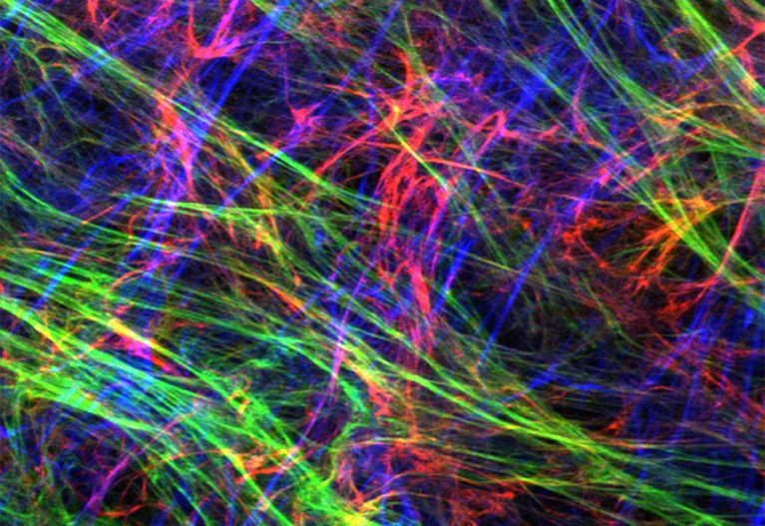
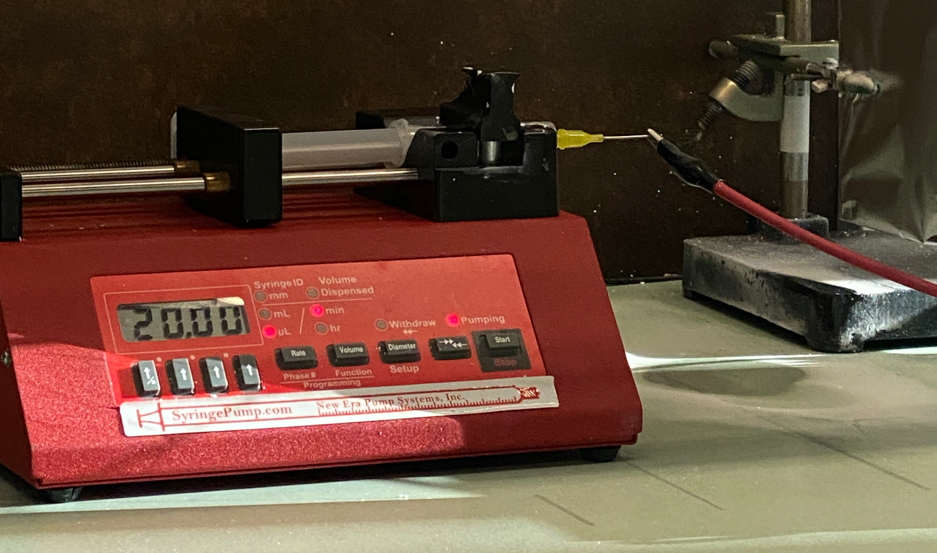
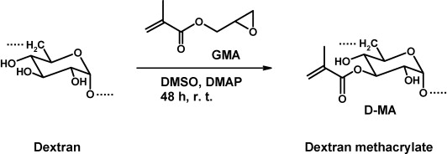
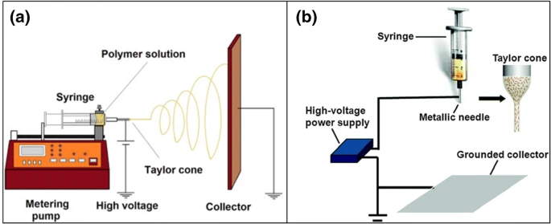
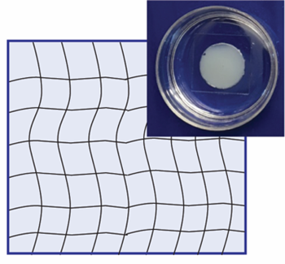
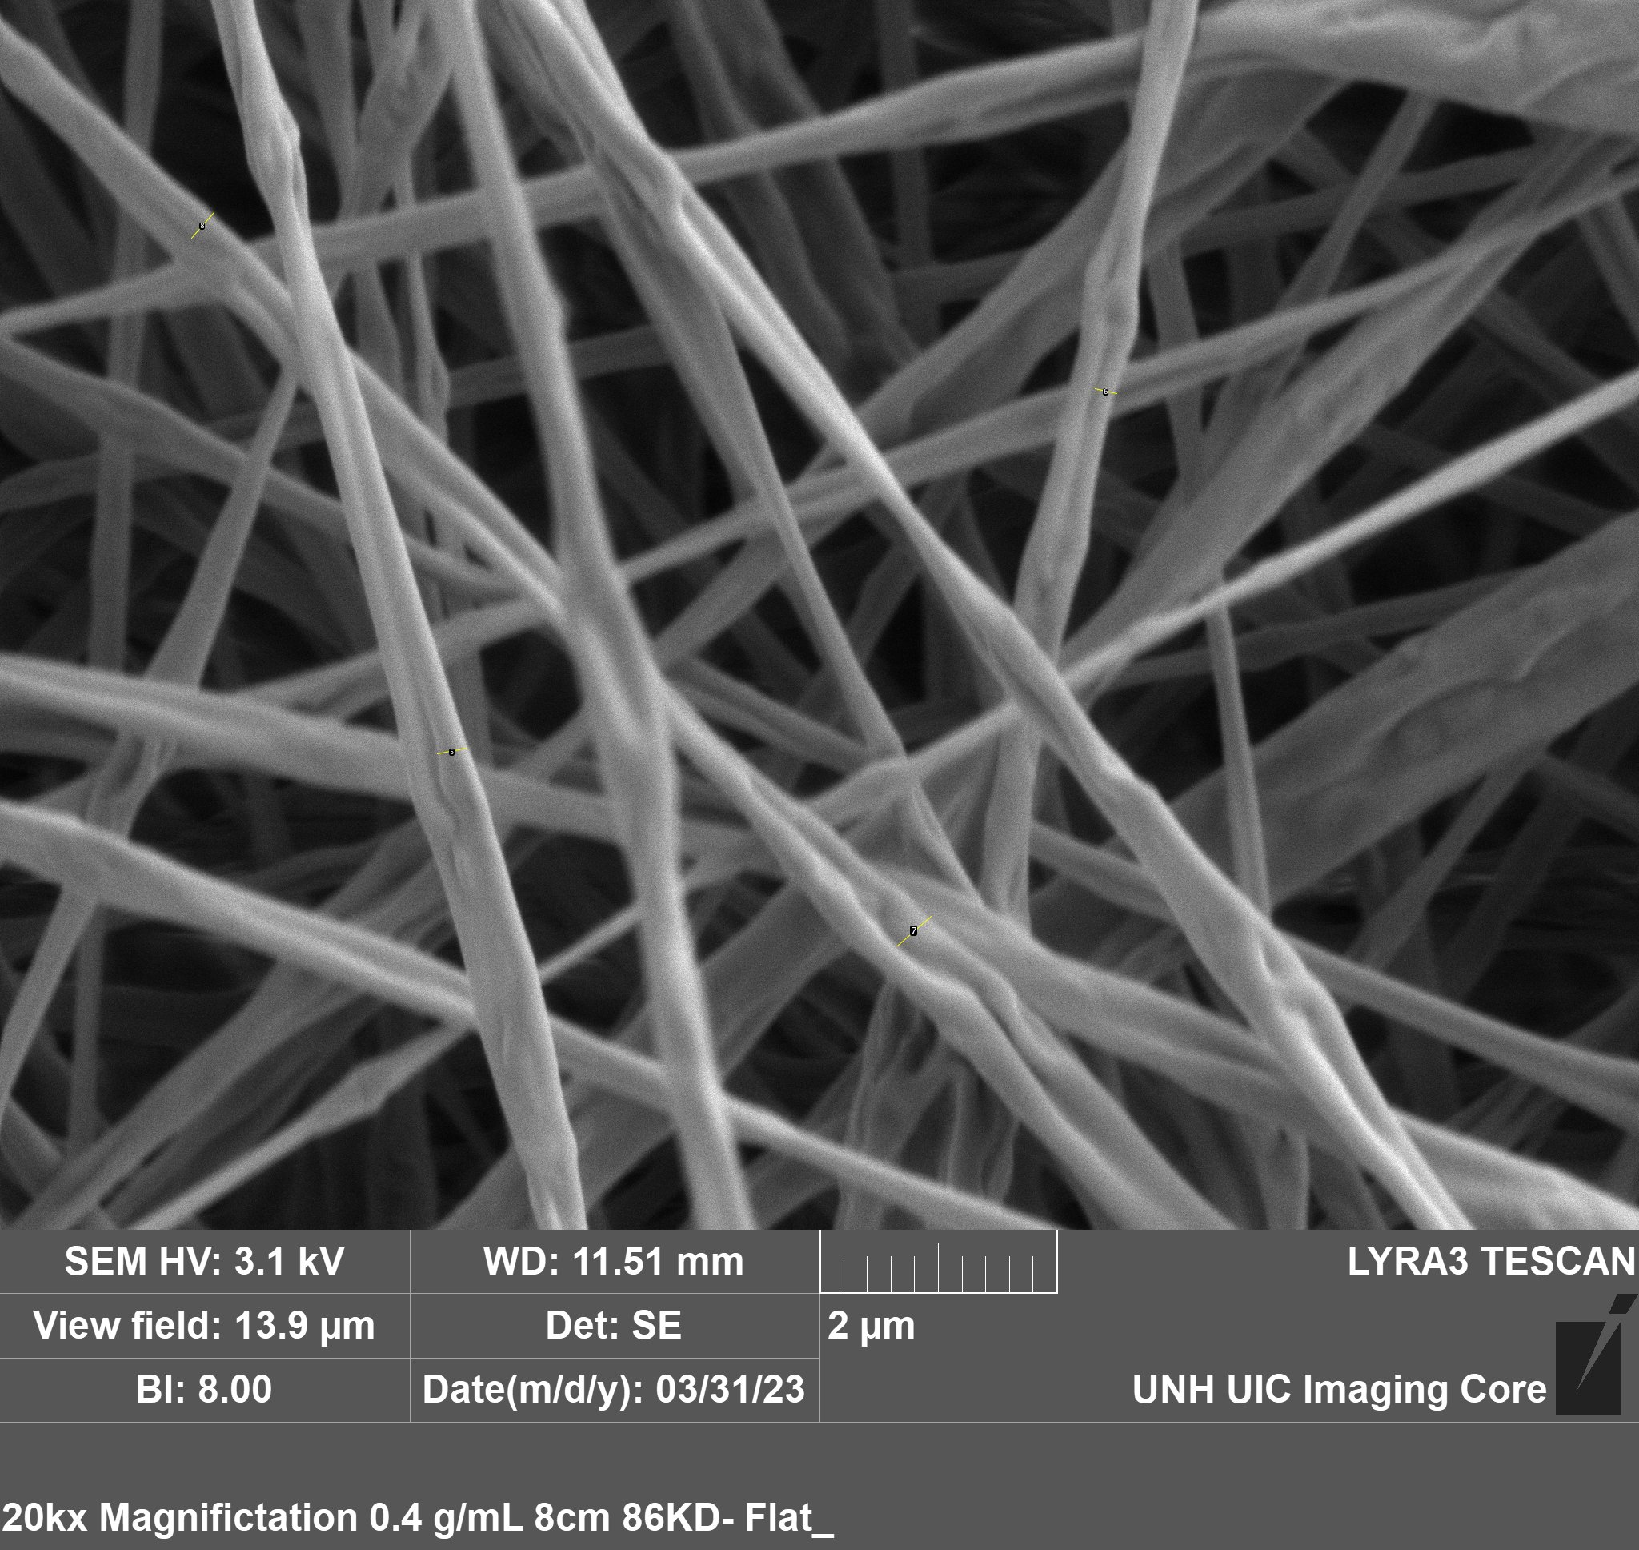
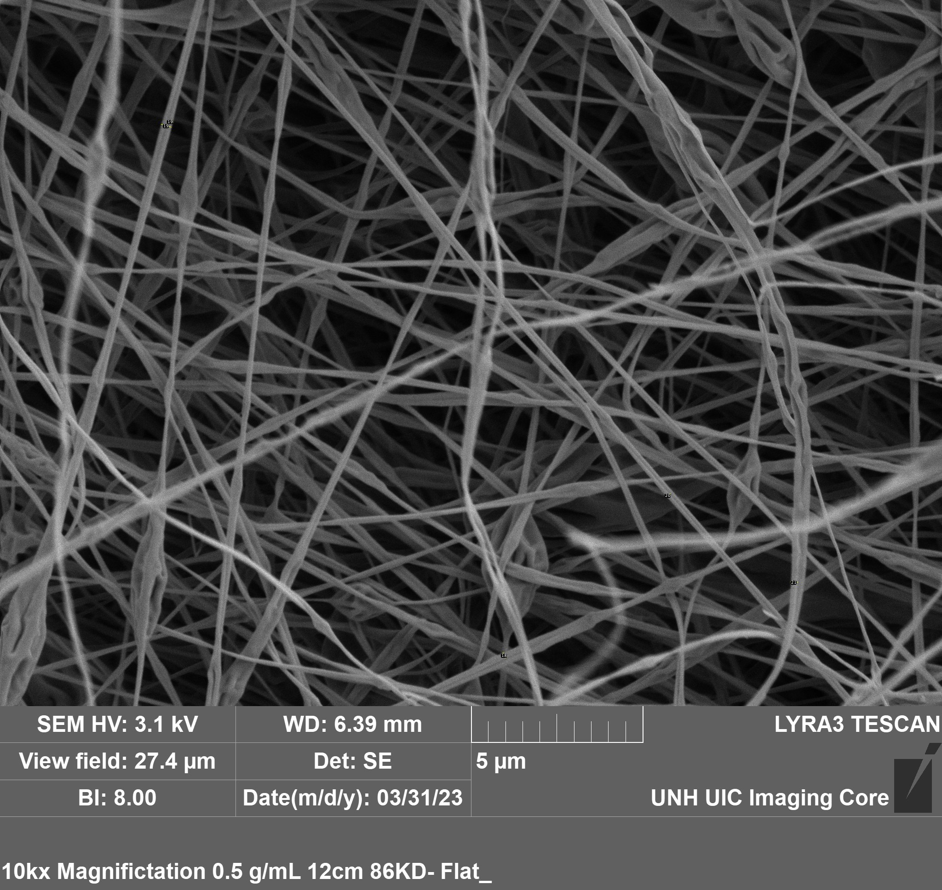
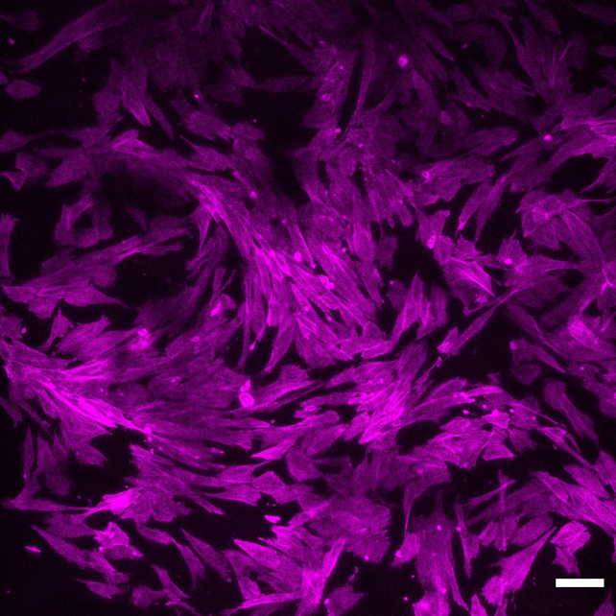
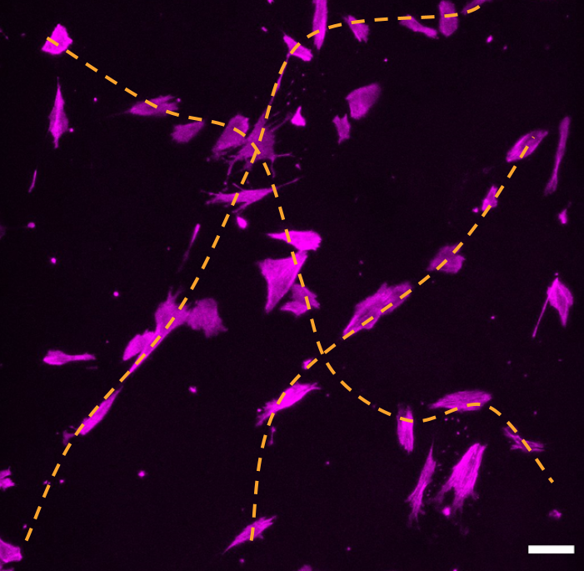
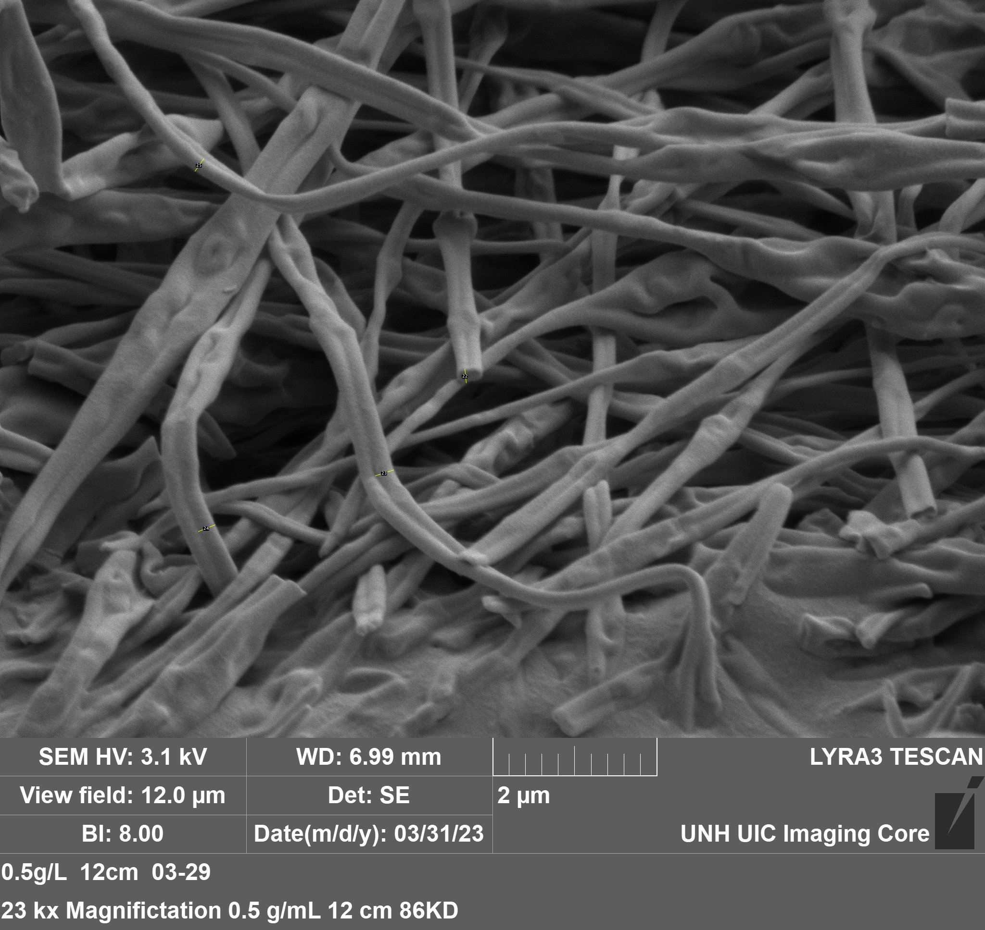
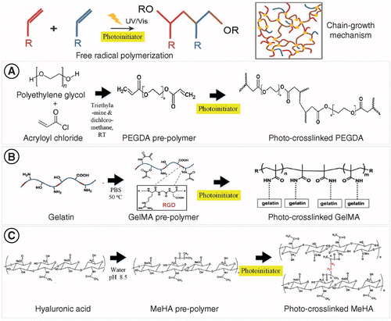
Electrospinning of Dextran-Based Polysaccharide to Fabricate Nanofibers for Cell Culture
Andrea Bartus, Sabby Clemmons, Meghan Herlihy Advisor: Linqing Li
Acknowledgements:
Saniya Yesmin Bubli, Kherlan Oyunbaatar, Nancy Cherim
Background
Research Objectives
Applications
  Electrospun nanofiber materials are used as scaffolding to culture cells and grow tissue. The scaffold produced by this process simulates the fiber networks of the extracellular matrix (ECM) which cells bind to and grow on, making it possible to grow biocompatible tissue for medical applications in the field of regenerative medicine. ECM fiber widths average 0.06-0.12 µm.
Investigating electrospinning conditions and material properties to optimize dextran-based nanofibers for dermal fibroblast cell-culture.
Regenerative Medicine
Electrospun nanofibers have versatility in the medical field, most notably as scaffolding to grow tissue. Depending on scaffold characteristics and chemical signals, cells differentiate into desired lineages of soft tissue. The cells used for this application can be extracted from the recipient to produce genetically identical tissue. This method produces implantable skin-like structures and replaces the need for skin grafts. Additionally, tissue produced utilizing this method has potential to be applied to the heart as a pericardial patch.
Drug Delivery
The large surface area and porosity of the fiber structure produces unique characteristics which make scaffolds ideal for prolonged drug delivery. The porosity of the scaffold allows for large doses to be deposited slowly in environments within the body such as for antibiotic patches to be used at surgical sites to prevent infection.
  Synthesize solutions
  Electrospin scaffolding
  Characterize nanofibers
  Crosslink to form hydrogels
  Culture dermal fibroblast cells
  Solutions of varying concentrations of dextran, a branched polymer of dextrose, formed scaffolds by electrospinning conducted at several distances, producing nanofiber structures with differing cross-sectional widths. A hydrogel was synthesized by crosslinking these nanofibers to ensure structural integrity for dermal fibroblast cell culture, and identify patterns of growth on the scaffolding.
Fig. 1: Extracellular Matrix [3]
Fig. 2: Electrospinning Setup
Materials & Methods
Nanofiber Characterization
Solution Preparation For Spinning
1. Molecular Weight Screening
86 kDa
150 kDa
250 kDa
Parameter Quantification
Images of samples were obtained via scanning electron microscopy (SEM) for nanofiber analysis. Preparation for cross-sectional imaging required processing samples in liquid nitrogen to prevent deformation of fibers. Due to the high concentrations of energy directed at the sample to image, nanofibers experienced thermal-induced morphing.
Materials for Solution Synthesis
  Dextran (86 kDa, 150 kDa, 250 kDa)
  Deionized (DI) water
  Dimethylformamide (DMF) anhydrous 99.8%
  Syringe with 23-gauge needle
  Electrospinning pump
  High voltage source
  Conductive collection plate
Molecular Weight (kDa) | 86 | 150 | 250
Spinning Compatibility | ✓ | X | X
Fig. 3: Molecular Structure of Dextran and DexMA [4]
Table 1: Tested Molecular Weights of Pure Dextran
The higher molecular weights of Dextran were too viscous to spin. 86 kDa was found to be ideal for spinning.
Fig. 7: SEM Image of 86 kDa Sample
Fig. 8: SEM Image 150 kDa Sample
Fig. 9: SEM Image 250 kDa Sample
Results
2. Concentration Screening
Negative Control
0.3 g/mL yielded thin, variable fibers with irregular shaped beads that were unsuitable for cell-culture.
0.3 g/mL
0.6 g/mL
Concentration (g/mL) | 0.3 | 0.4 | 0.5 | 0.6
Produced Defined Nanofibers | X | ✓ | ✓ | X
The cell study indicated successful growth and cell attachment to nanofiber scaffolding. Confocal microscopy results portray cells oriented in a linear pattern, along the length of a fiber. The growth and attachment of these cells to the scaffolding indicates electrospun scaffolding produced a viable environment for cell growth.
Fig. 4: Spectrum Analysis of Pure Dextran Versus Modified Dex-MA
Table 2: Tested Concentrations of Dextran Spinning Solutions
Positive Control
0.6 g/mL formed fibers averaging a width of 1.7015 µm– too wide to mimic the functional properties of ECM fibers.
  Solution Synthesis
  Scaffolds were produced by dissolving dextran powder in DI water and DMF in centrifuge tubes using a vortex mixer and ultrasonic water bath. The resulting solution is then electrospun using a 10 mL syringe with a 23-gauge needle. Dried samples were collected for SEM analysis.
The ideal spinning concentration 86 kDa dextran ranged from 0.4 g/mL to 0.5 g/mL.
Fig. 5: Electrospinning Schematic and Taylor Cone [6]
3. Spinning Distance Screening
Fig. 10: SEM Image of 0.3 g/mL Sample
Fig. 11: SEM Image of 0.6 g/mL Sample
Fig. 18: UV Crosslinked Hydrogel
Cell Culture
0.4 g/mL at 8 cm
0.4 g/mL at 12 cm
0.5 g/mL at 8 cm
Materials for Cell-Culture
  Human Dermal Fibroblasts (HDF)
  70% dextran methacrylate (Dex-MA)
  Phosphate buffered saline (PBS)
  Fibronectin coating
  Irgacure 2959 (photoinitiator)
  Trypan blue
  Phalloidin staining
Electrospinning Process
Concentration (g/mL) | Distance (cm) | Average fiber width (micron)
0.4 | 8 | 0.423
0.4 | 12 | 0.218
0.5 | 8 | 0.553
0.5 | 10 | 0.356
0.5 | 12 | 0.227
Due to issues with fiber solubility, the HDF cell study was performed using 50% of 86 kDa 70% modified Dex-MA and 50% of 86kDa pure Dextran 0.5 g/mL fibers spun at 8 cm. Fibers were dissolved in 86 kDa 70% modified Dex-MA solution with fibronectin coating for cell attachment.
Concept of Electrospinning
Electrospinning uses high-voltage to create nanofibers from polymer solutions. The solution is extruded out of a needle tip as the syringe plunger is depressed at a constant rate supplied by a metering pump. High-voltage charges the stream of solution, creating a conical shape, known as a Taylor cone, to be collected on a grounded conductive surface forming nanofibers [2].
Table 3: Average Widths of Fibers Derived from SEM Imaging Analysis
Fig. 19.1: HDF in Cultured in Gel
Scale bar 100 µm
Hydrogel Formulation
Due to the high solubility of dextran scaffolding, the scaffold was dissolved in a solution of Dex-MA dissolved in PBS with a photoinitiator to maintain structural integrity for cell culture. UV light was used to activate the photoinitiator to crosslink the nanofibers, forming a hydrogel on which dermal fibroblasts were cultured. To promote attachment of cells to the scaffold, fibronectin coating was performed on the gels [1].
An inverse relationship was found between distance and nanofiber width, such that as distance increased, nanofiber width decreased.
Fig. 12: SEM Image of 0.4 g/mL 8 cm Sample
Fig. 13: SEM Image of 0.4 g/mL 12 cm Sample
Fig. 14: SEM Image of 0.5 g/mL 8 cm Sample
Screening Electrospinning Parameters
Distance, voltage, and extrusion rate are parameters which influence the physical characteristics of fiber width and fiber density in scaffold. Distance was the primary parameter screened at a constant voltage of 15 kilovolts and flow rate of 0.5 mL/hr. Primary analysis of all concentrations was performed at a distance of 8 cm from needle tip to collector plate. Viable samples were spun at additional distances of 10 cm and 12 cm in attempt to produce thinner fibers.
For future studies, cell culture on gels consisting of higher concentrations of Dex-MA fibers should be investigated as gels produced with low concentrations were brittle due to limited crosslinking of nanofibers.
0.5 g/mL at 10 cm
0.5 g/mL at 12 cm
Fig. 19.2: HDF in Cultured in Gel
Scale bar 100 µm
Cell Seeding and Culturing
Trypan blue was used to determine cell seeding density using the Countess digital counting system. After 24 hours, cells were fixed and stained with phalloidin to reveal the actin cytoskeleton of the cells and cell morphology.
References
Fig. 15: SEM Image of 0.5 g/mL 8 cm Sample
Fig. 16: SEM Image of 0.5 g/mL 12 cm Sample
  [1]Akiyama, S. K., Yamada, K. M., & Hayashi, M. (1981). The structure of fibronectin and its role in cellular adhesion. Journal of supramolecular structure and cellular biochemistry, 16(4), 345-358.
  [2]Agrahari, V., Agrahari, V., Meng, J., & Mitra, A. K. (2017). Electrospun nanofibers in drug delivery: fabrication, advances, and biomedical applications. In Emerging nanotechnologies for diagnostics, drug delivery and medical devices (pp. 189-215). Elsevier.
  [3]Madhusoodanan, J. (2019). Matrix mimics shape cell studies. Nature, 566(7745), 563-565.
  [4] Möller, S., Weisser, J., Bischoff, S., & Schnabelrauch, M. (2007). Dextran and hyaluronan methacrylate based hydrogels as matrices for soft tissue reconstruction. Biomolecular Engineering, 24(5), 496-504.
  [5] Pereira, R. F., & Bártolo, P. J. (2015). 3D photo-fabrication for tissue engineering and drug delivery. Engineering, 1(1), 090-112.
  [6]Riazi K, Kübel J, Abbasi M, Bachtin K, Indris S, Ehrenberg H, Kádár R, Wilhelm M (2016) Polystyrene comb architectures as model systems for the optimized solution electrospinning of branched polymers. Polymer 104:240–250
Fig. 6: UV Crosslinking of Nanofibers [5]
Fig. 17: Nanofiber Widths at Spinning Distances

