Slide 1
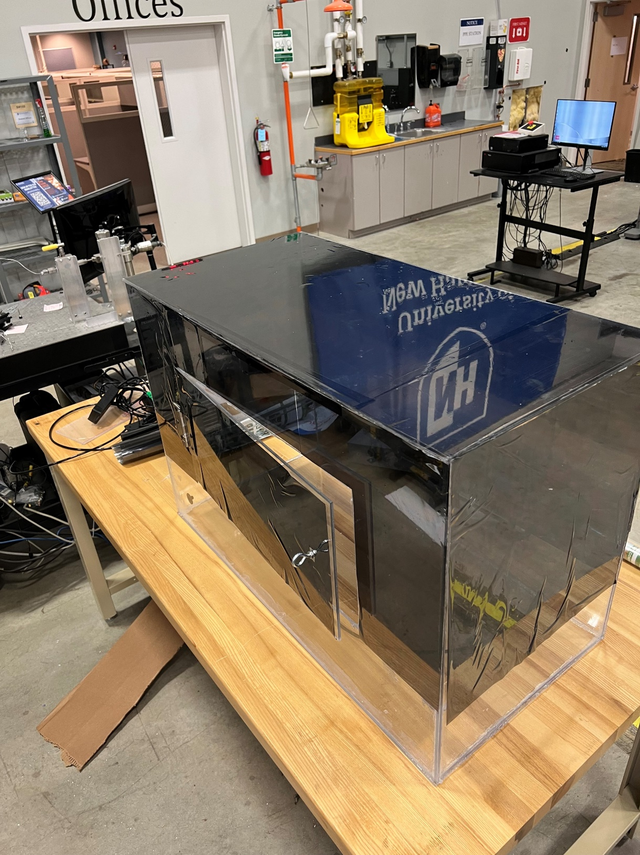
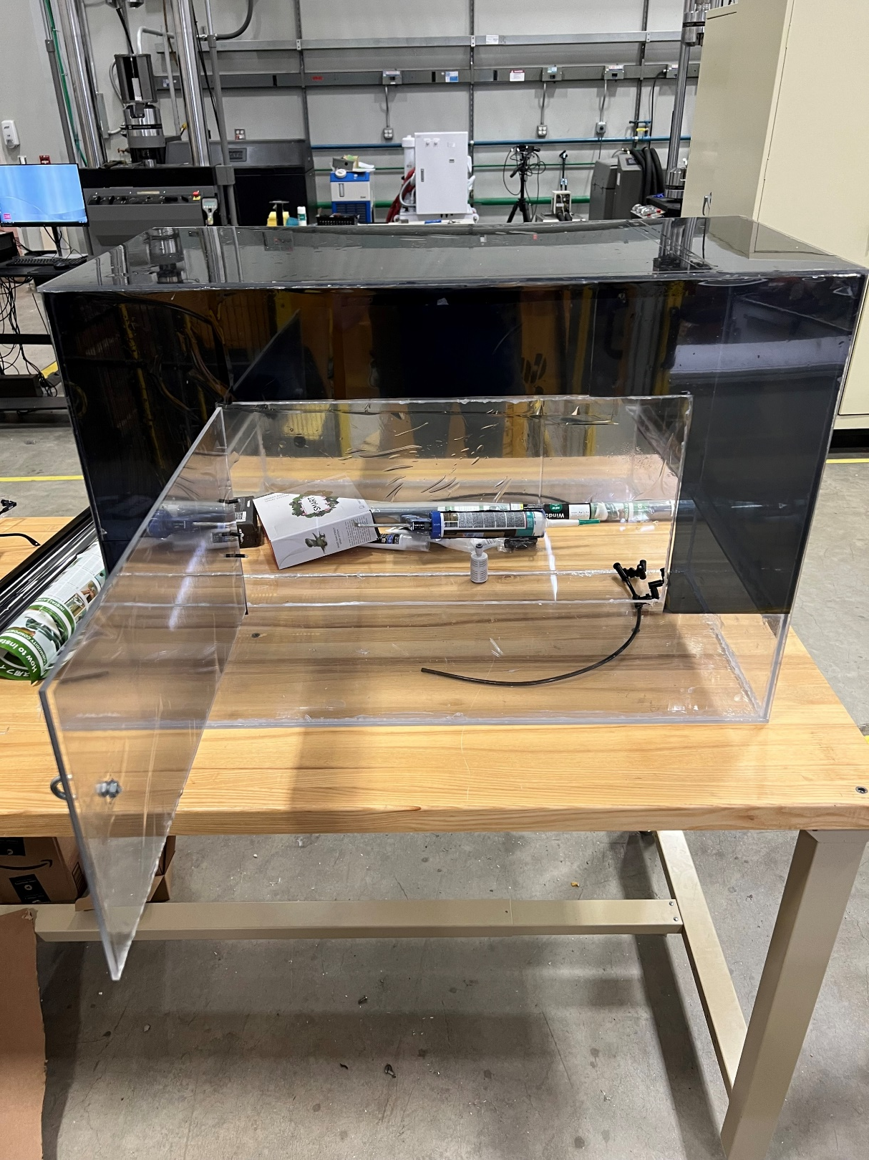
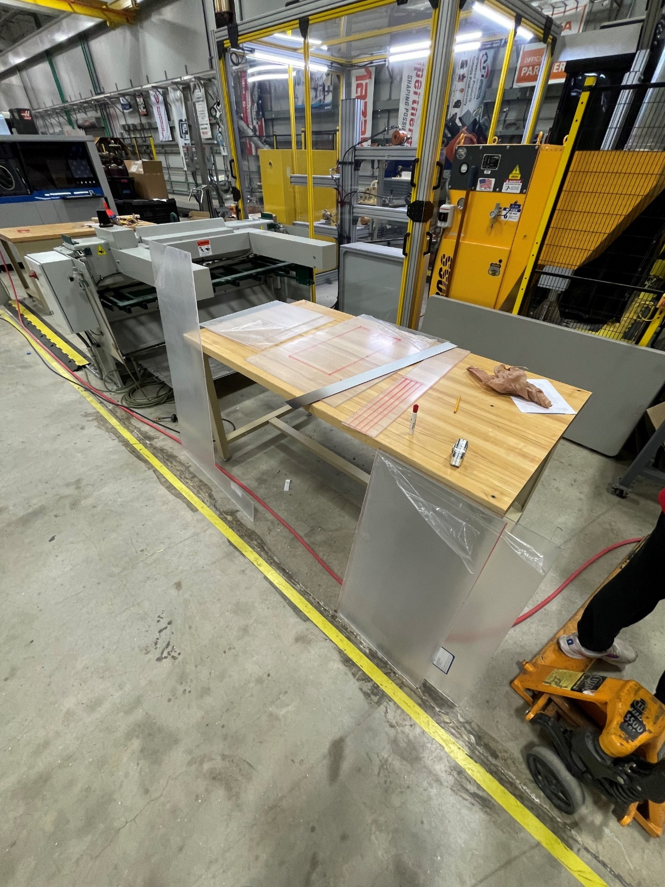
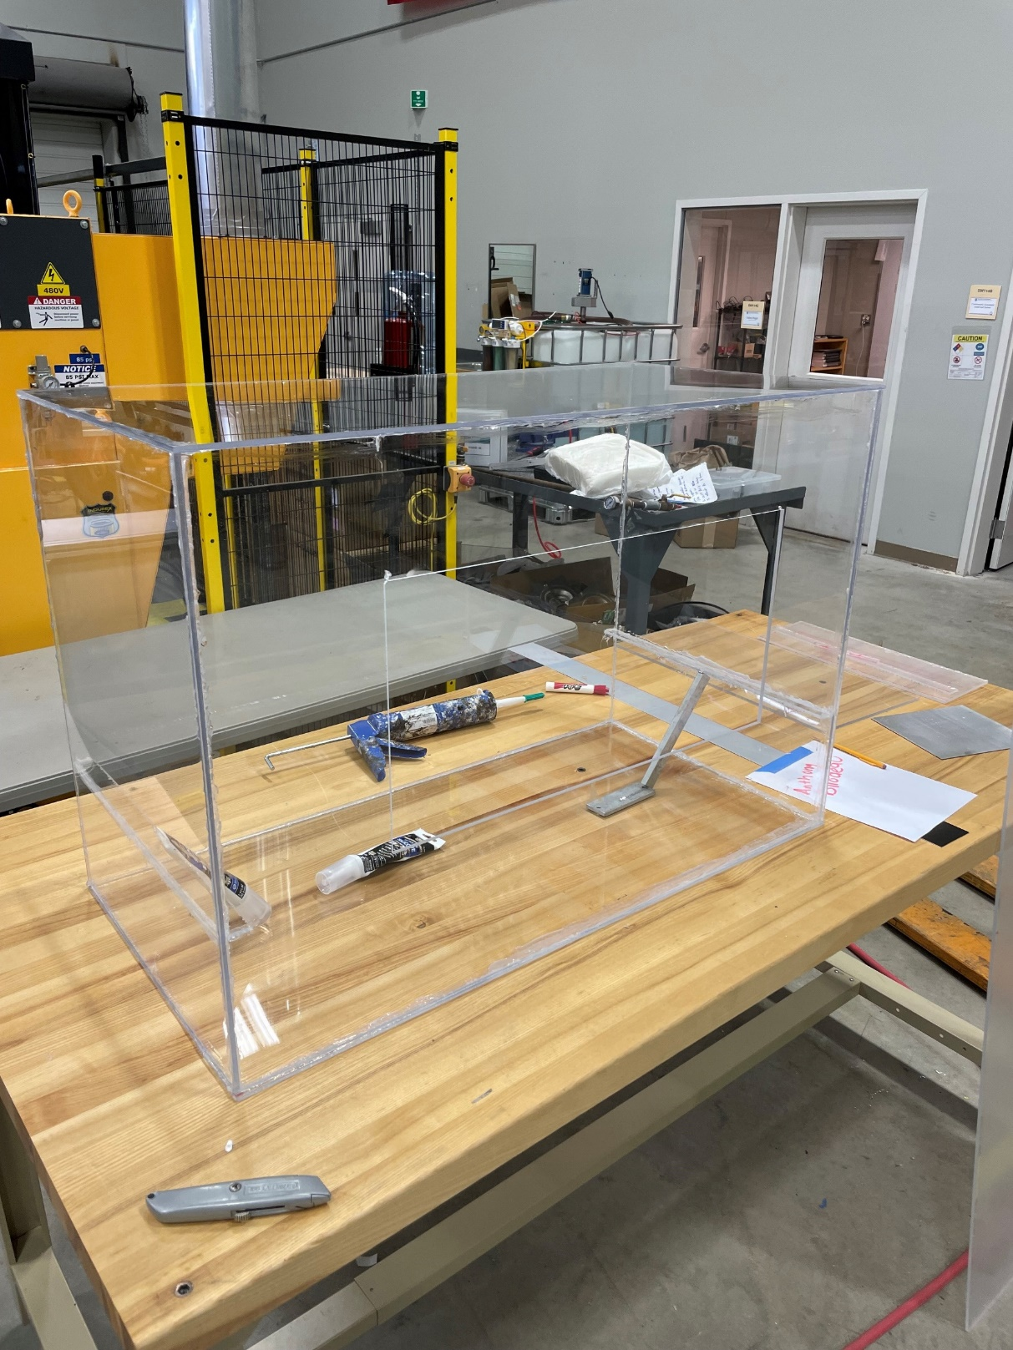
Hydroponic Bay Anthony Bilodeau Innovation Scholars, University of New Hampshire
Project Overview
Media
Polls
Issue
Gardening is hard, animals do not make it easier, and they are hard to carry on year after year.
Resolution
Hydroponics
Indoor, soil-free plant growth that can be done with little to no previous gardening.
Has the possibility of being self sustaining.
Goals
Create a hydroponic bay for home use, whilst being sustainable and financially conscious.
Methods
Research
How to fit inside of a conventional home?
Space optimization, tall vs long, shallow vs deep.
How will it grow?
Soil vs no soil, water oxidization, plant nutrients.
How will it be sustainable?
Recycle water and timers on equipment.
Decisions
What materials to use?
Plexiglass, aquarium sealant, silicone sealant.
Off the shelf parts.
Save design time and overall complexity.
Space optimization
3 feet wide x 2 feet tall x 1.5 feet deep.
Growth
No soil, pump water around internally to oxidize, insertion of generic plant nutrients into water.
Sustainability
Low power usage, timers on all equipment, water recycles through pump with filter.
Conclusions
Ongoing project, looking for more data to reinforce field estimates of hydroponic growth.
Bay itself could be improved.
How so?
Financial goal failed, was not inexpensive, looking for ways to make it more cost efficient.
Results
Building
Plexiglass cut with waterjet, used sealants to seal edges and make watertight.
Built door to fit snugly with layer of sealant to create internal climate
Added two-way mirror film to eliminate light pollution from internal light source.
Installed pump, misters to regulate water flow and oxidization.
Temperature sensors, and water temperature sensors to analyze climate inside of bay.
Acknowledgments
Thank Dr. Benjamin Mitchell and Elizabeth Mamros for their continued support during the duration of the project.

