Slide 1
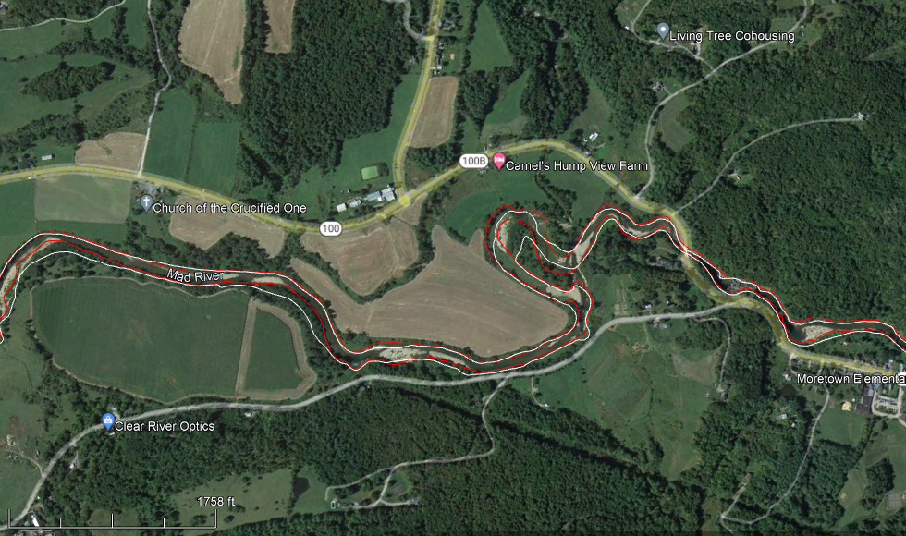
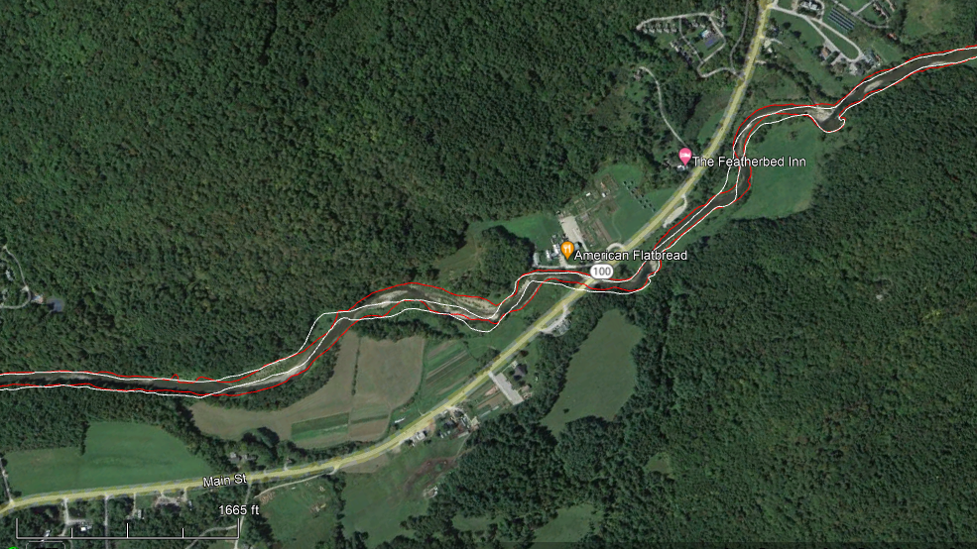
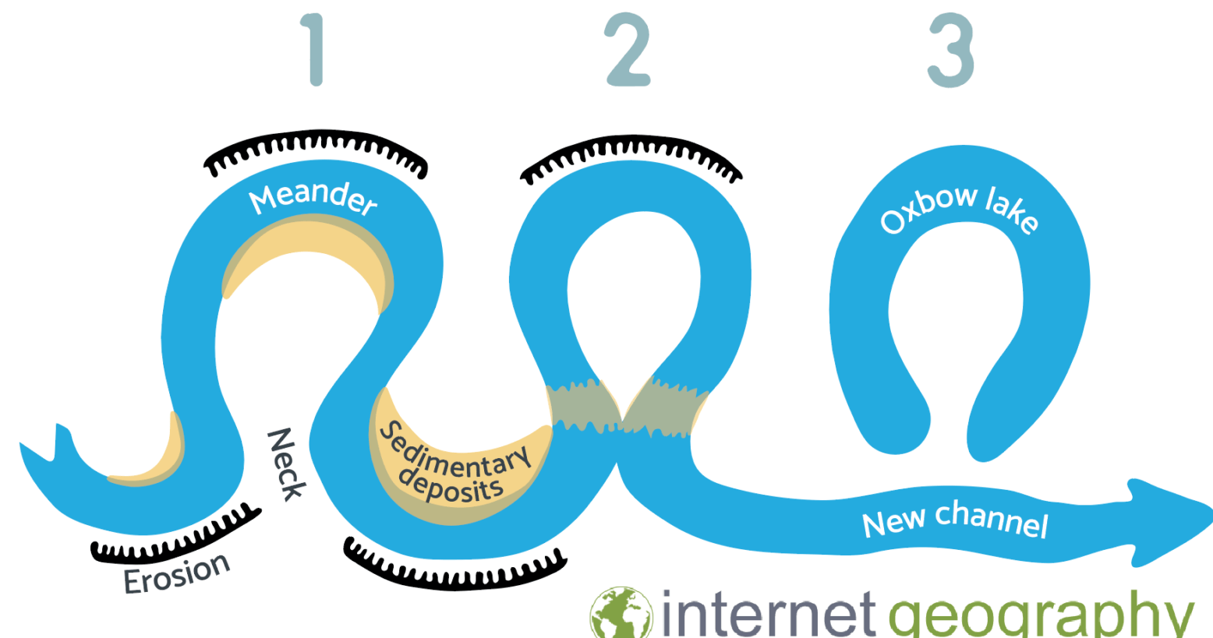
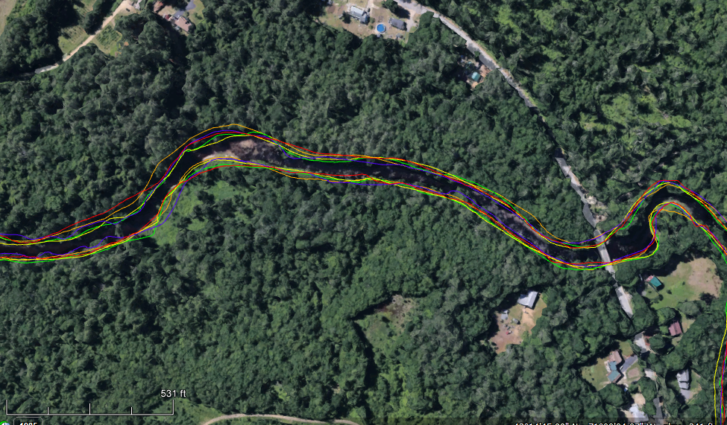
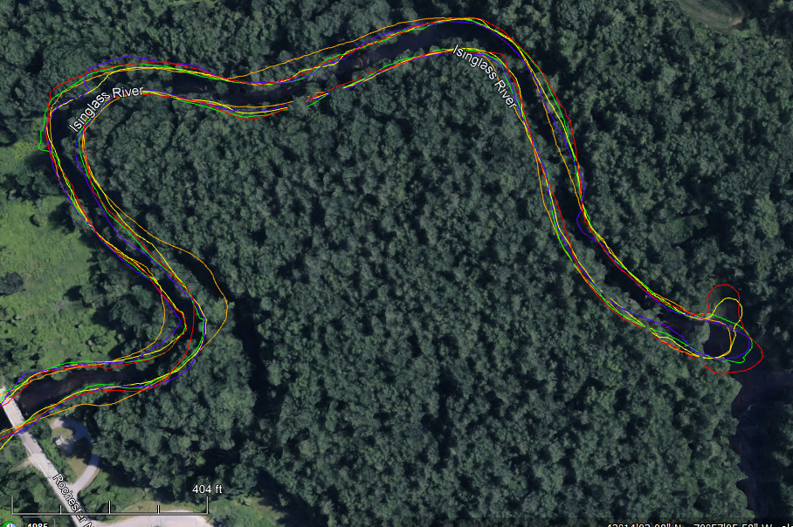
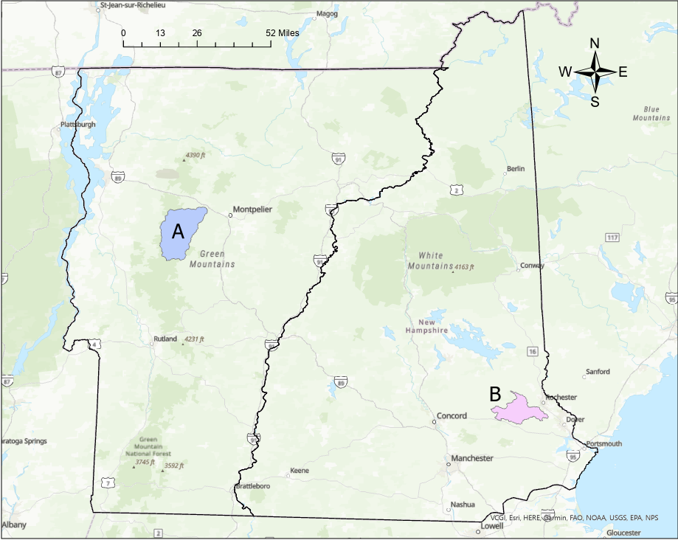
Estimating River Change In New England Using Past Aerial Photography
Gavin Drake
Advisor: Anne Lightbody
Department of Earth Sciences, University of New Hampshire
Introduction
Delineations
Spatial Variation in Erosion Rates
Flooding events can cause substantial damage to any infrastructure that is within the flood plain. High flow events erode cut banks and build point bars, which lead to river migration and river channel change. Knowing the historical location of rapid channel change can provide valuable information for where to build infrastructure to mitigate future erosional damage. The main goal of this study was to quantify spatial differences in the erosion rate by delineating stream channels and comparing them in detail to see how they have changed over time.
Mad River
Mad River
(a)
(b)
Figure 3: Comparison of the bank full channel of the Mad River in 1993 (white) and 2015 (red). Differences between the delineations reveal point bars and cut banks forming over time.
Isinglass River
Isinglass River
Figure 1: The ideal point bar, cut bank, and avulsion of riverbanks as they erode over time. 1 is the formation of the cutbanks on the outside of the meander bend and point bars on the inner banks, 2 is the beginning stages of avulsion, and 3 is the avulsion event. Image modified from Internet Geography.
(a)
(b)
Study Area
Figure 5: Rate of erosion at different locations of the study rivers showing areas of high and low erosion.
Figure 4: Comparison of the bank full channel of the Isinglass River in
2011 2013 2015 2016 and 2018
Conclusion
Rates of Erosion and Deposition
There were multiple areas of major erosion within both rivers. If these areas are not reenforced with concrete or other materials, they will likely continue to erode and potentially cause damage to major infrastructure.
The Mad River was more mobile (experienced more erosion and deposition) than the Isinglass River. This could be due to the more urbanized Mad River watershed, which could increase runoff by increasing impervious area and reduce bank stability by reducing bank vegetation. It is also possible that geomorphological differences, including the higher bed slope of the Mad River, led to increased mobility.
 | Mad River | Isinglass River
Erosion (m/yr) | 15 ± 17 | 8 ± 7
Deposition (m/yr) | 5 ± 7 | 2 ± 4
Area (mi²) | 144 | 74
Channel slope | 5.0% | 1.4%
Table 1: Average erosion and deposition rates of the riverbanks between 1993 and 2012 for the Mad River and 2011 and 2018 for the Isinglass River. Rates of erosion and deposition were significantly different between the two rivers (p < 0.001 using Student t-test).
Acknowledgements
Figure 2: Locations of the watersheds of the (A) Mad River in Vermont and the (B) Isinglass River in New Hampshire. These rivers were chosen for analysis because they offered substantially contrasting land uses in the watershed.
I would like to thank Anne Lightbody for the guidance and support during this research. I would also like to thank Trevor Fenoff for assisting me and using his python program to convert delineations to estimates of channel change

