Slide 1
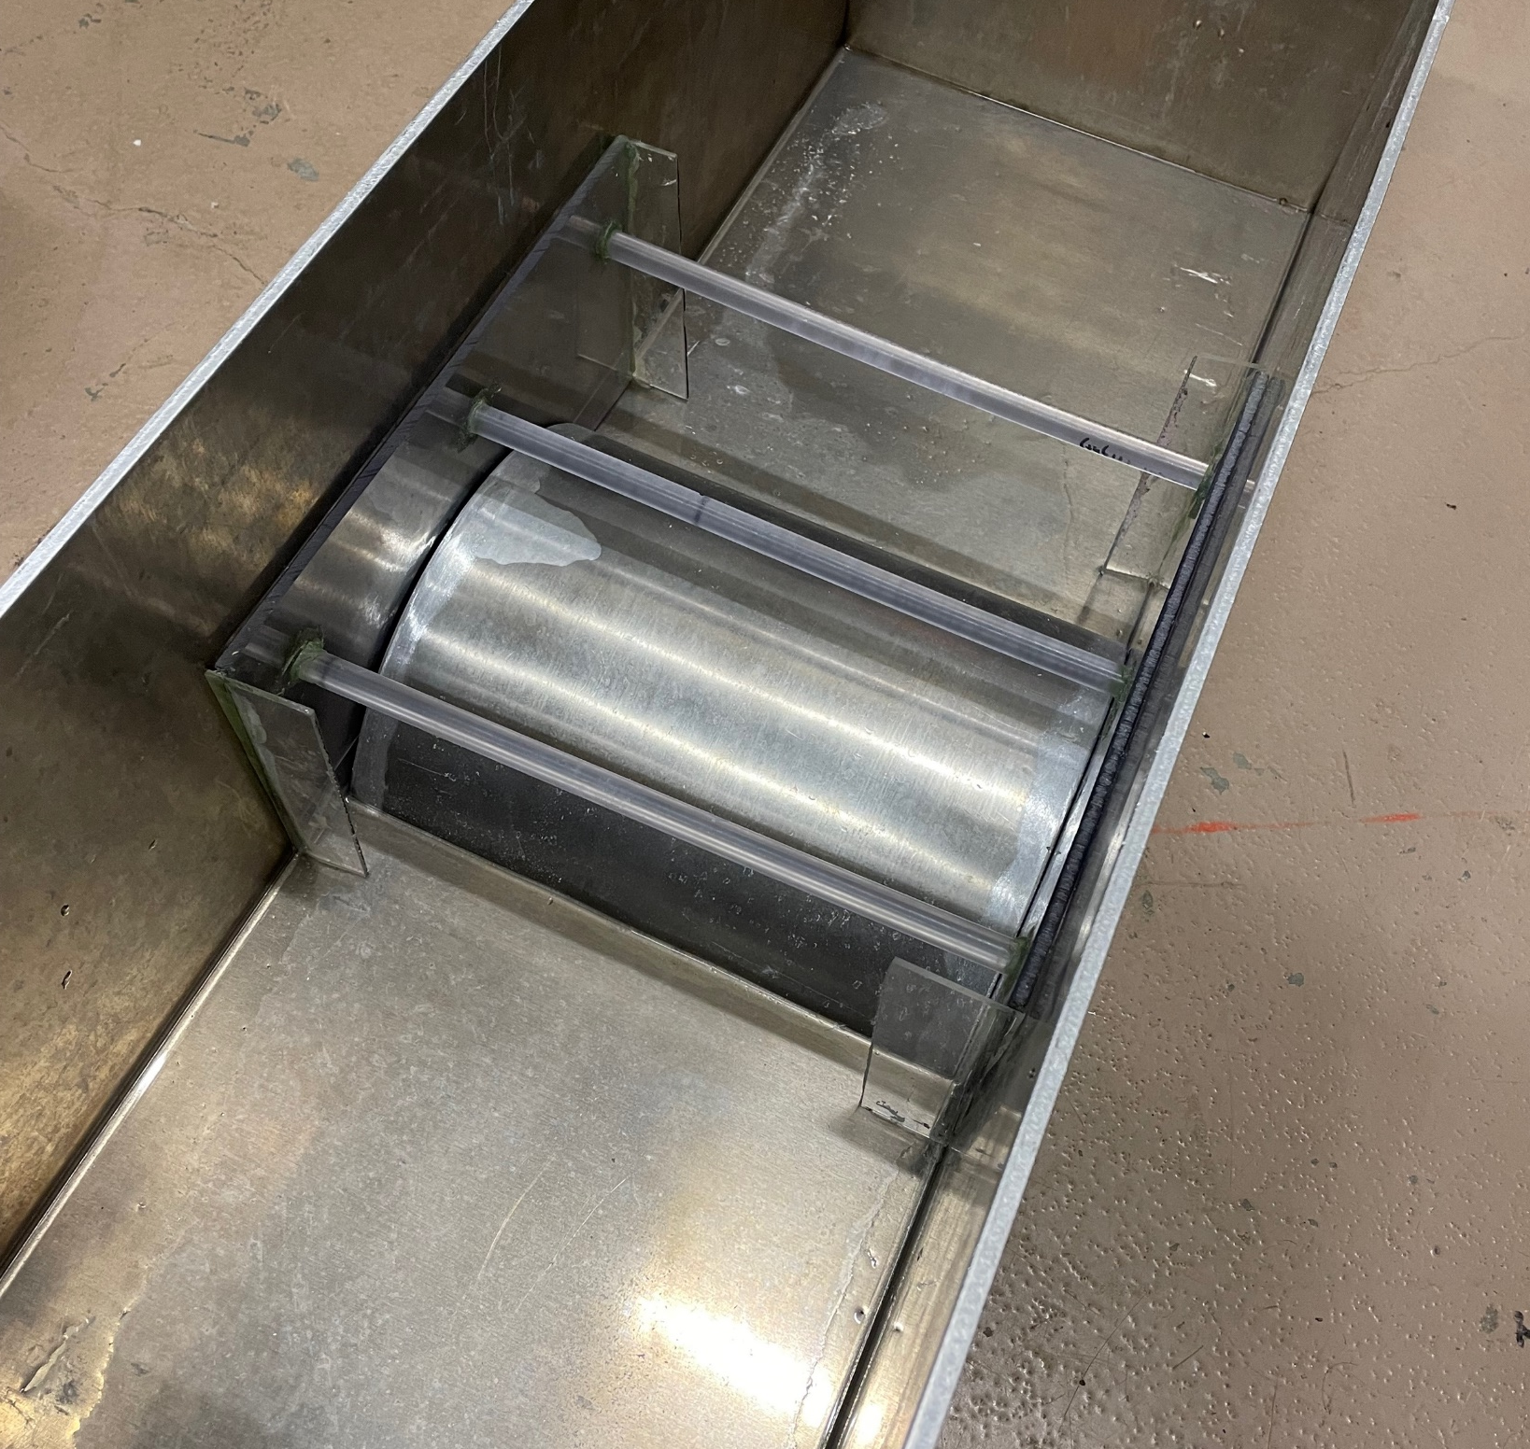
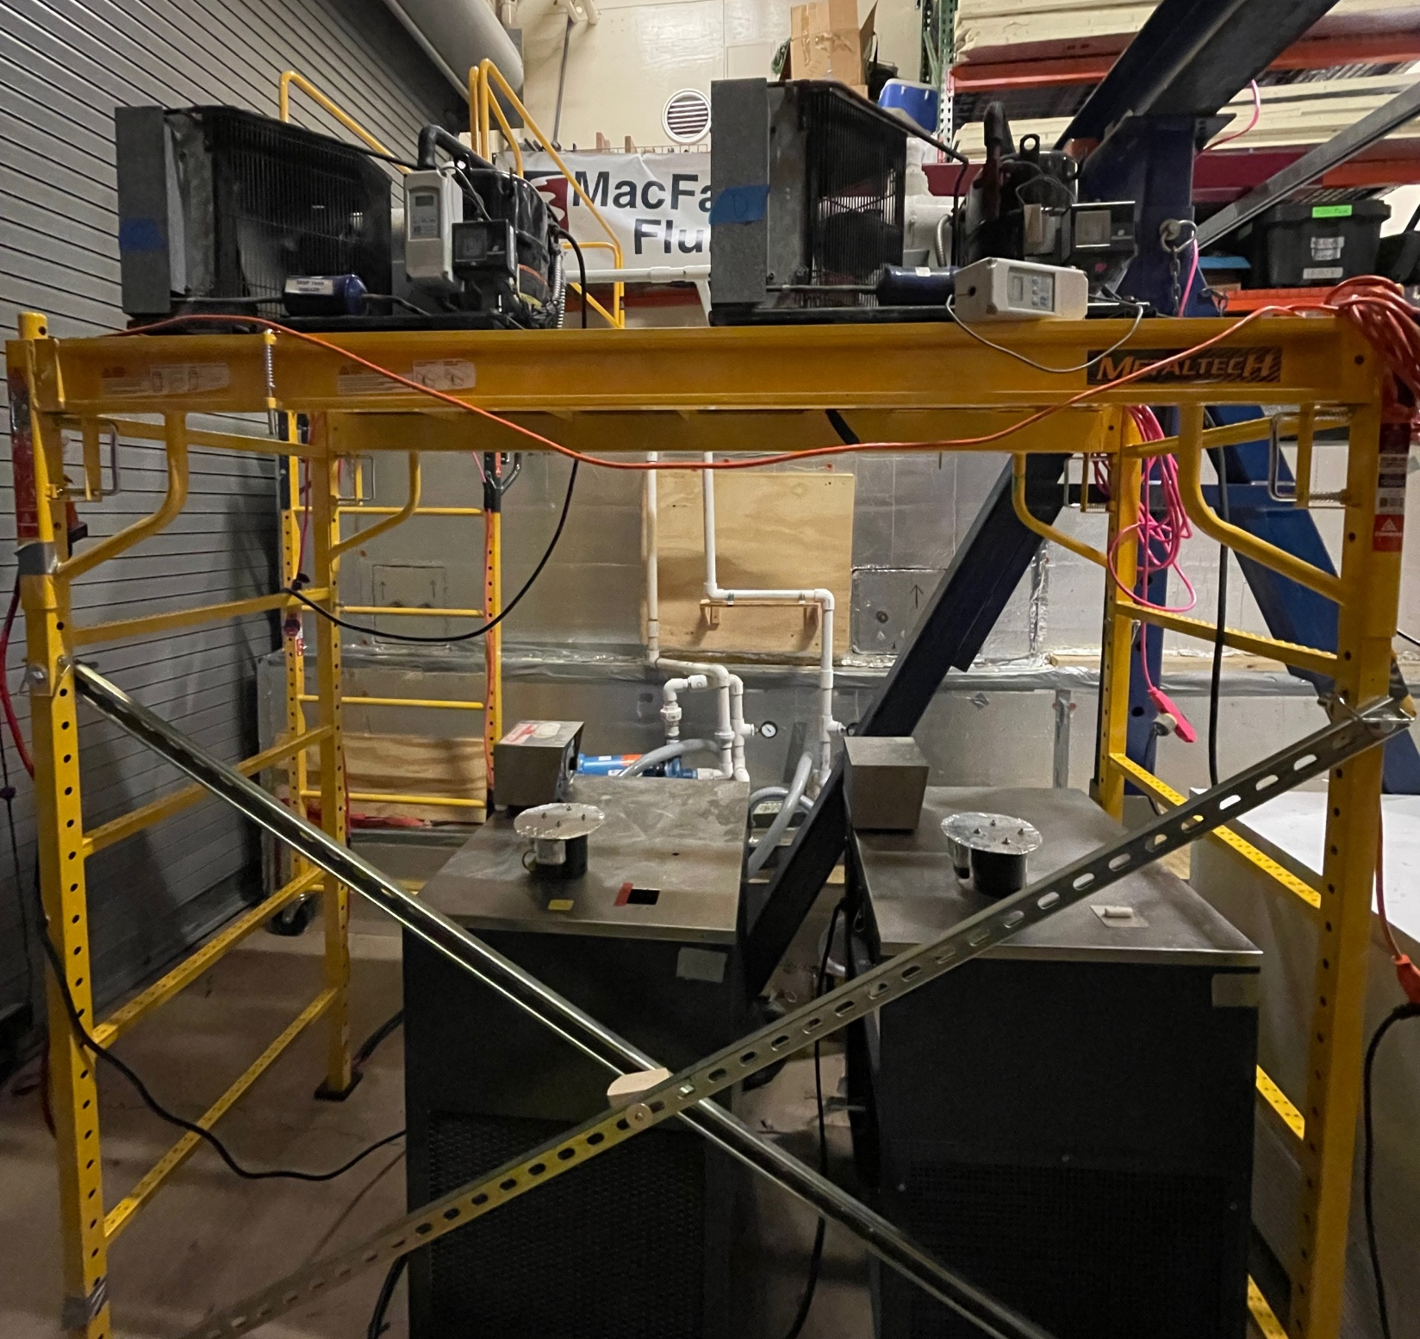
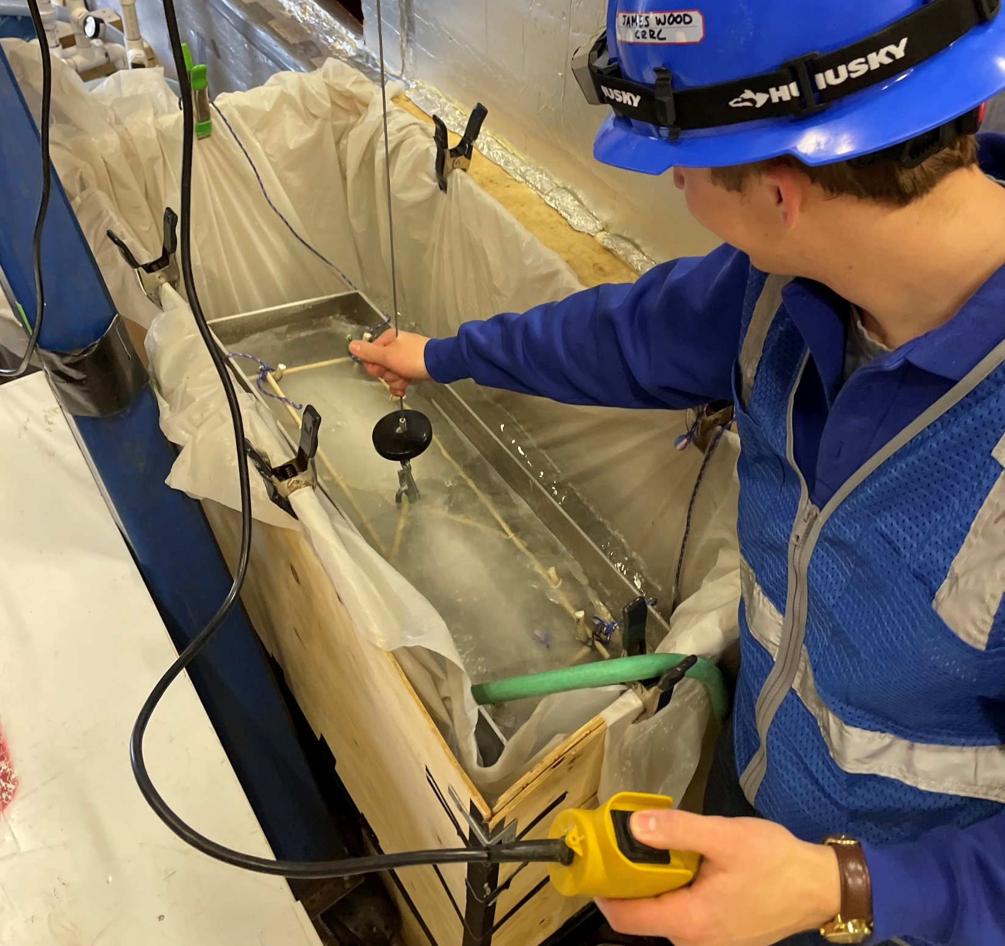
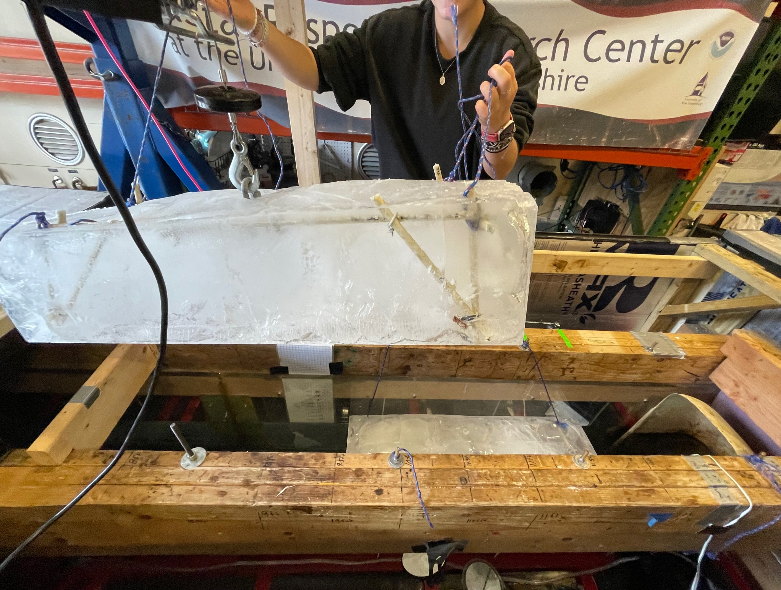
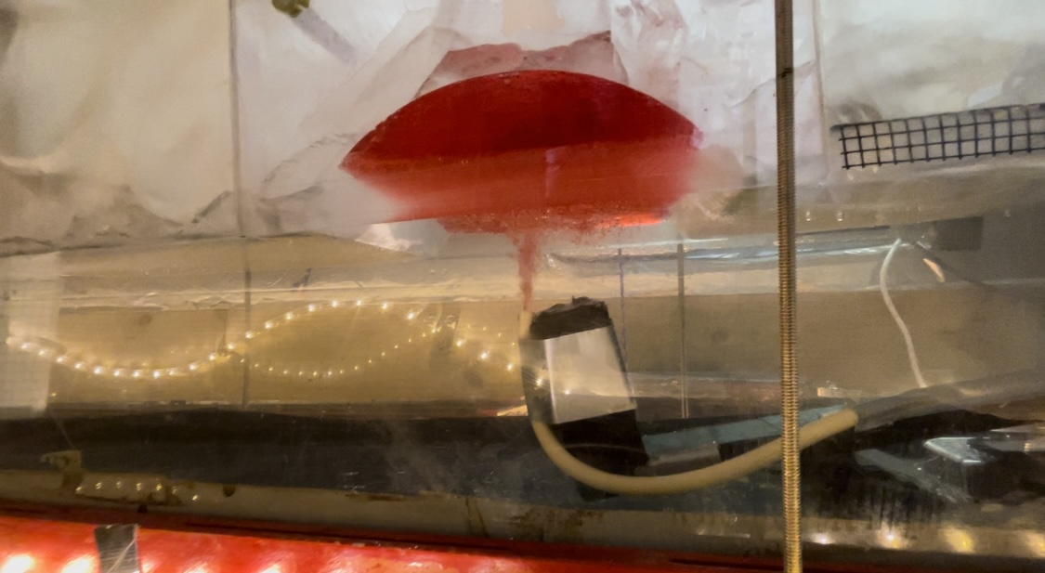
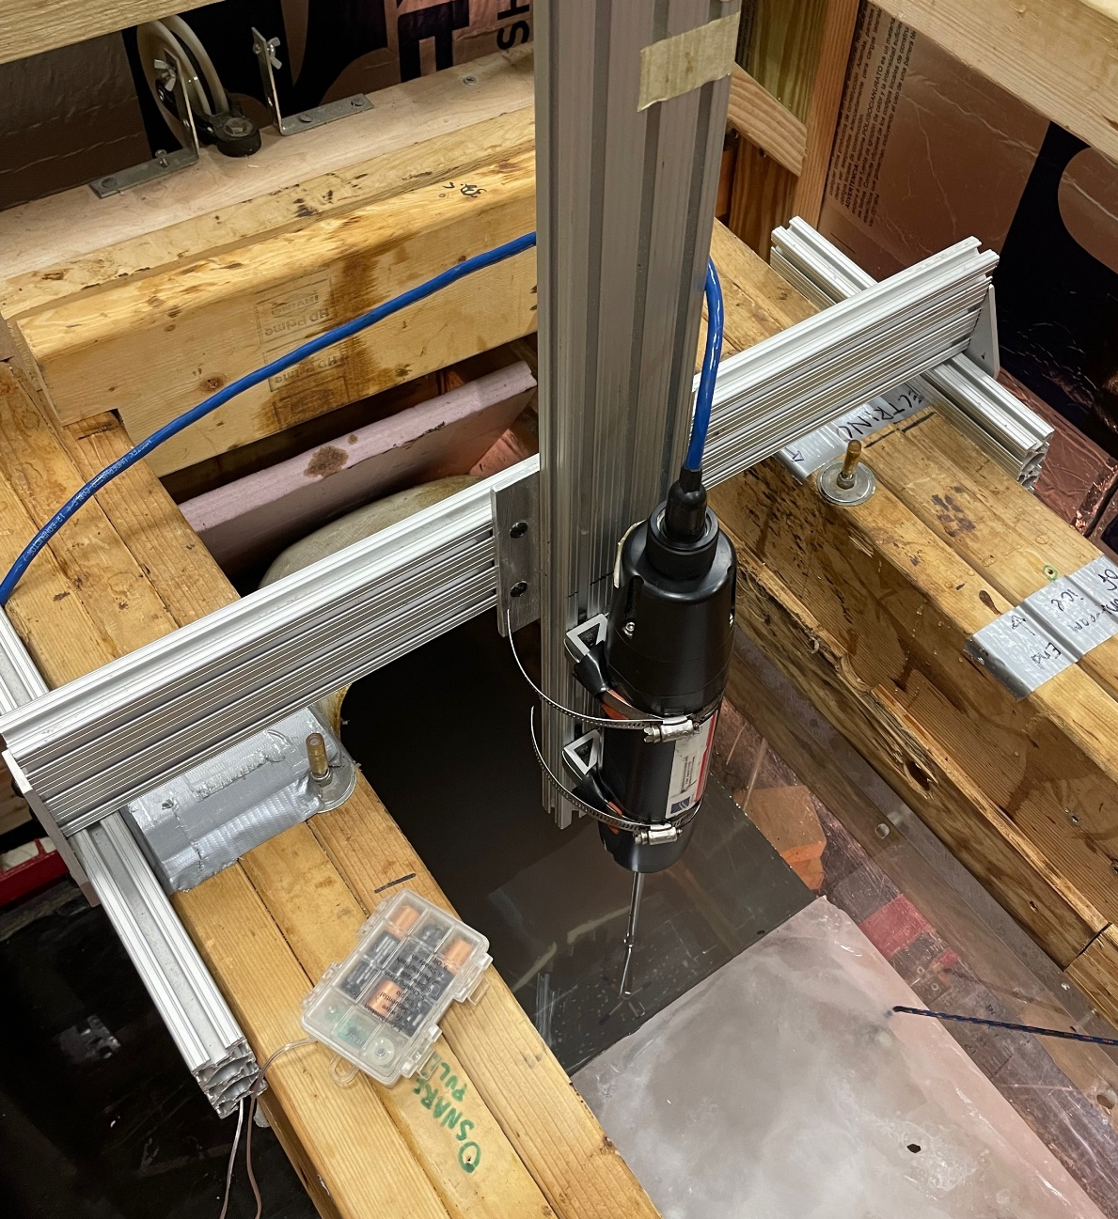
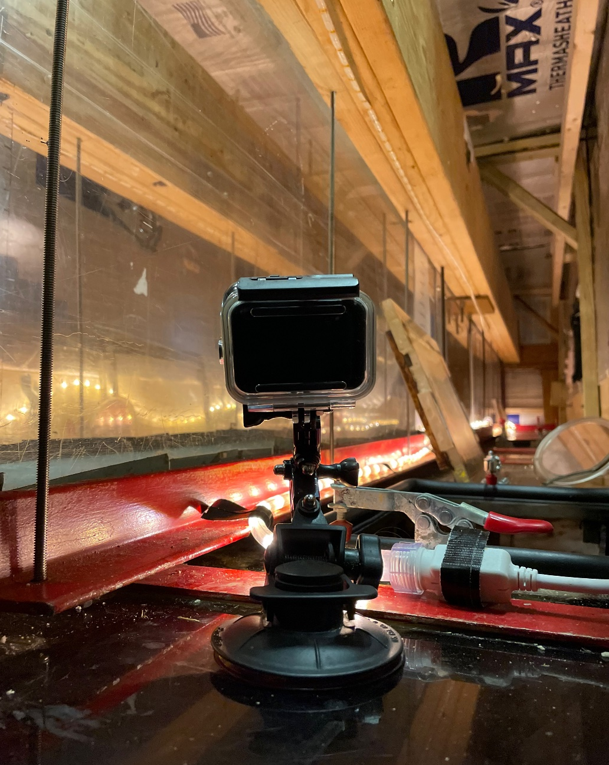
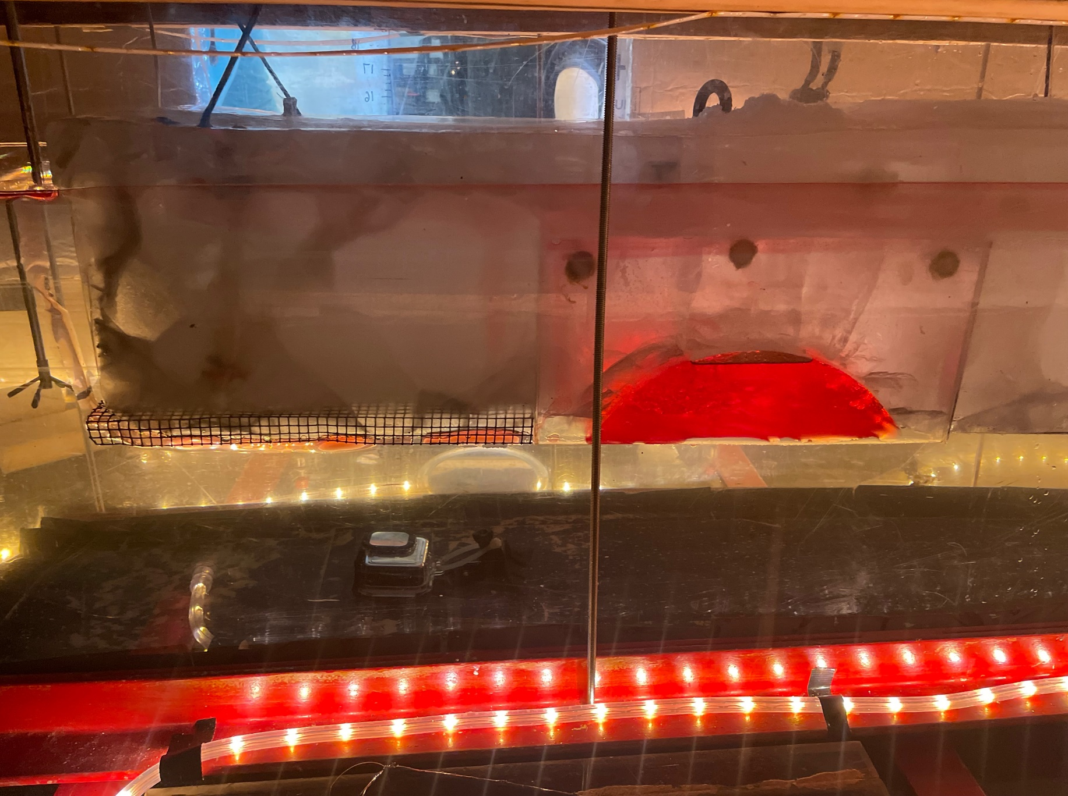
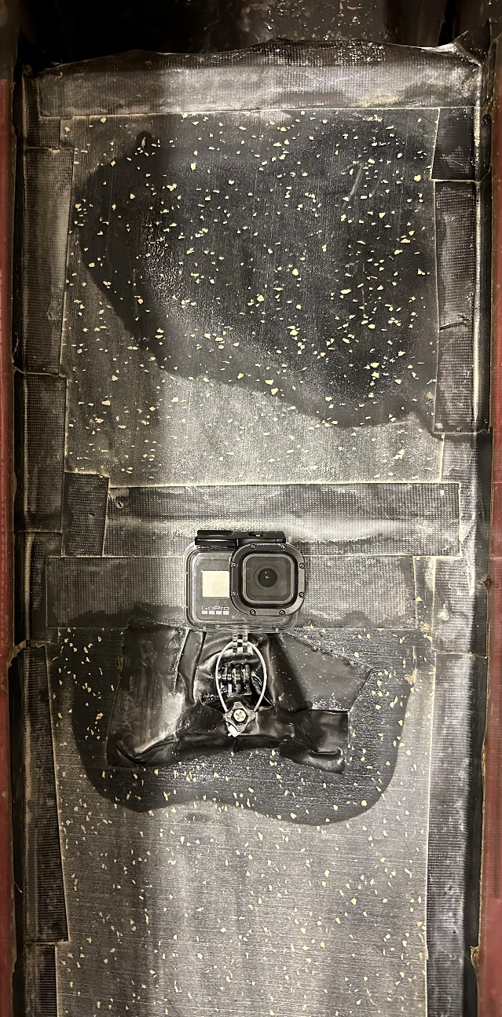
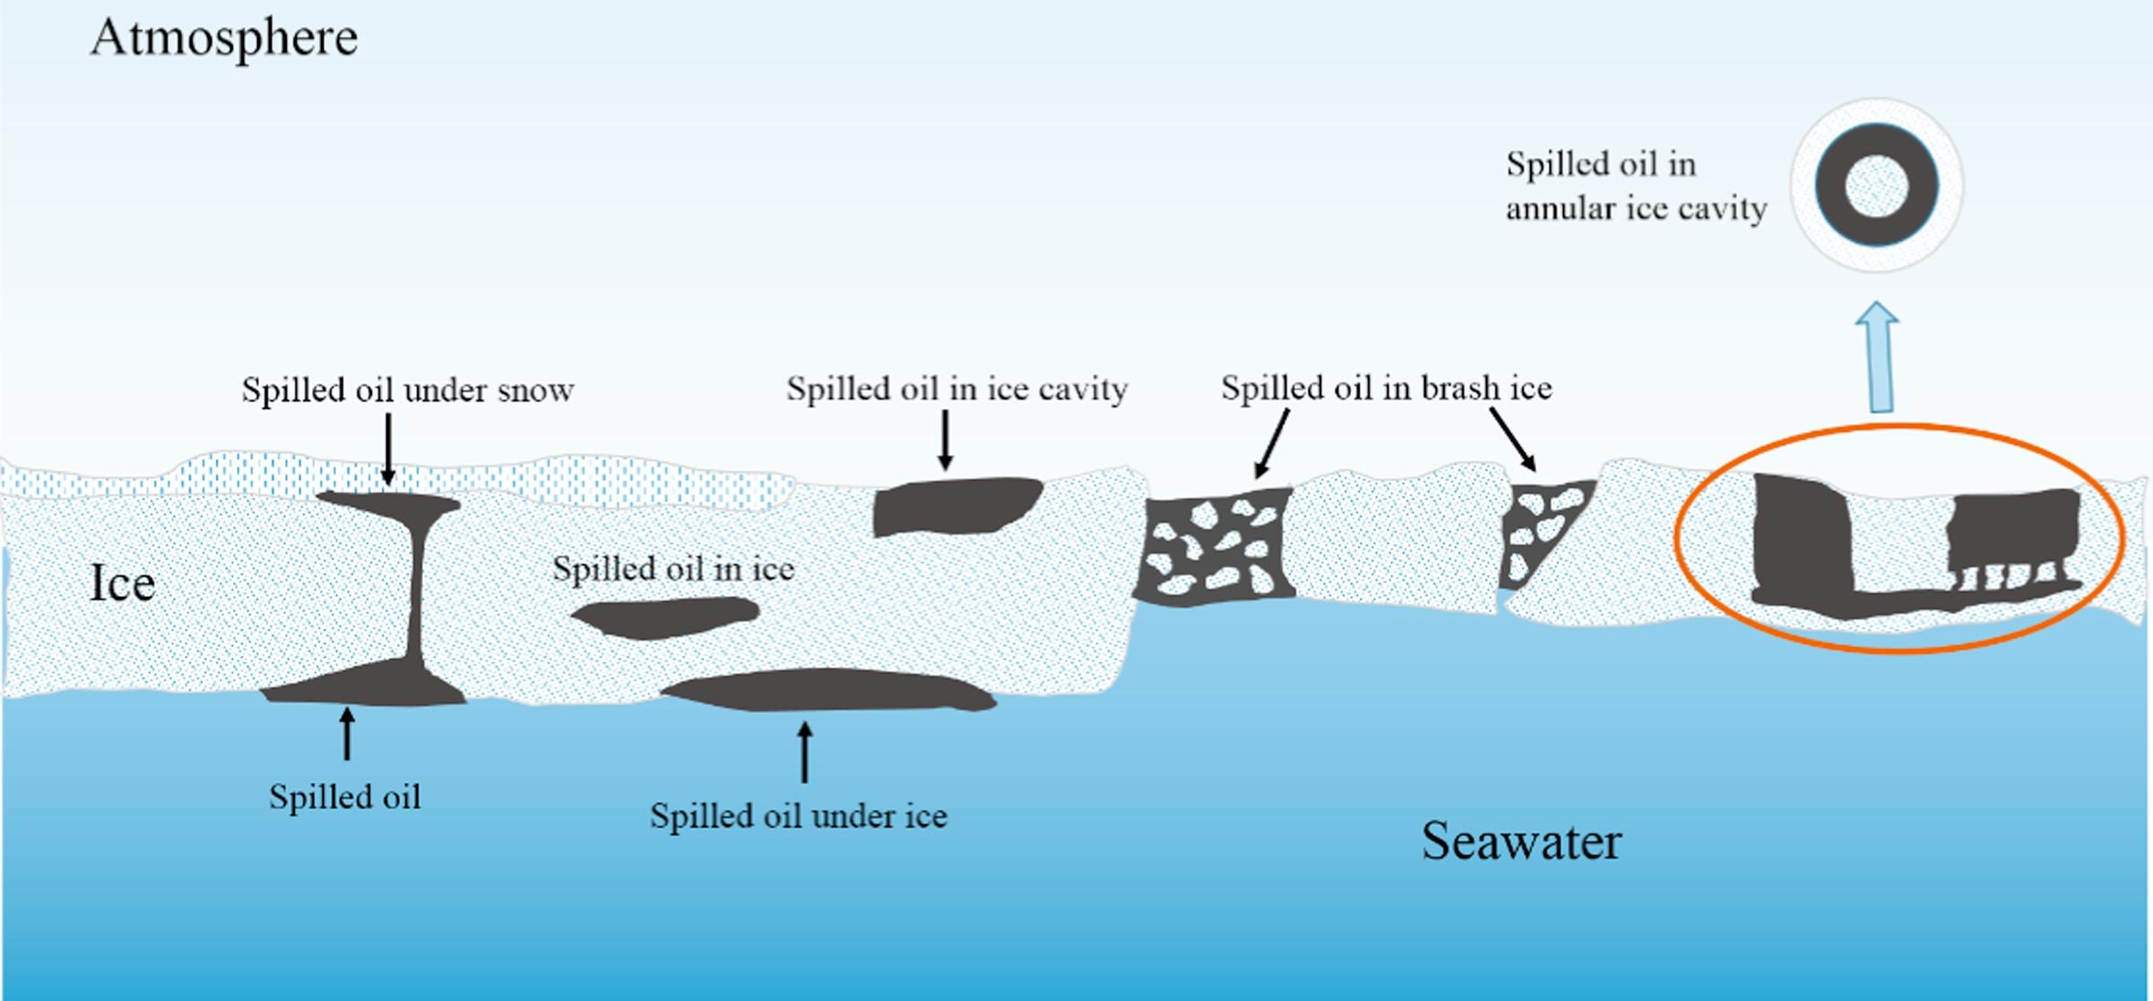
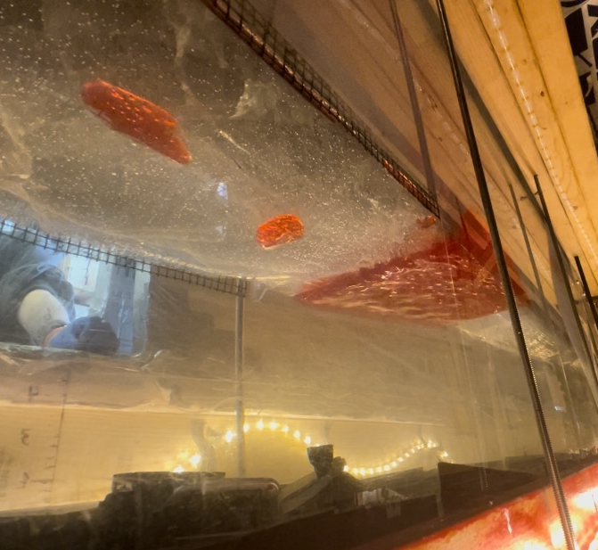
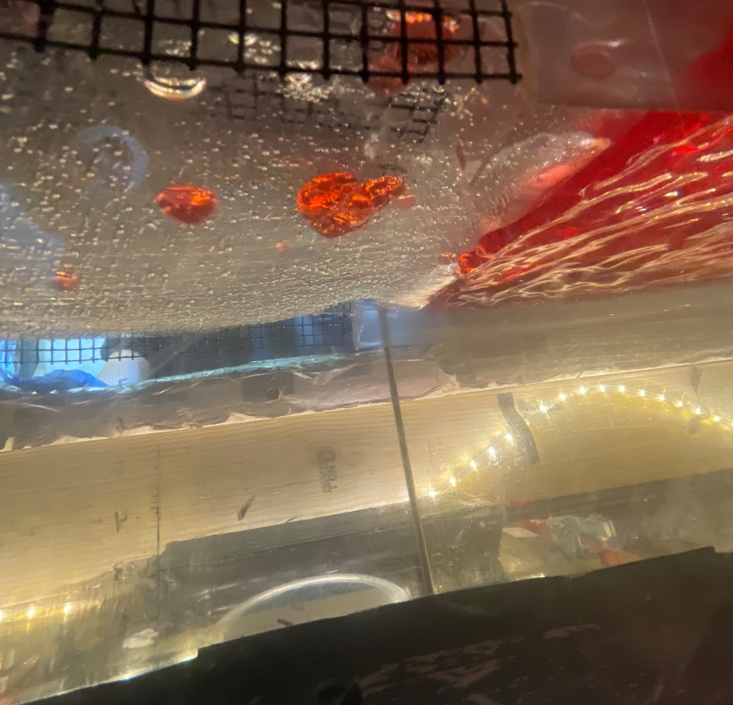
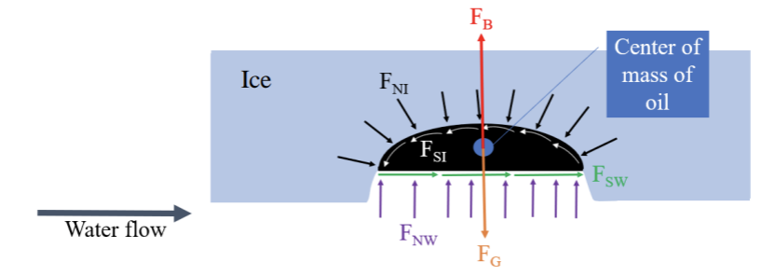
Prediction of Movement of Spilled Oil under Ice James Wood, Jessica Manning, Nancy Kinner Civil and Environmental Engineering, Coastal Response Research Center, University of New Hampshire, Durham NH
Background
Experimental Design
Melting sea ice has resulted in an increase in shipping vessel traffic in Arctic sea routes. Increased shipping activity is linked to increased occurrences of oil spills. Cavities are formed on the underside of sea ice. These formations have the potential to store large volumes of spilled oil whose movement can be influenced by water currents. Characterizing the mobility of oil trapped in these sea ice cavities is needed to refine Arctic fate and transport modeling, including the General NOAA Operational Modeling Environment (GNOME) used to advise the U.S. Coast Guard during spill response.
1. Make ice blocks
2. Fill and chill flume
3. Remove ice molds
4. Position ice blocks in flume
Fig. 2
Photo by James Wood
Fig. 3
Photo by James Wood
Fig. 4
Photo by James Wood
Fig. 5
Photo by James Wood
5. Inject oil
6. Install Vectrino
7. Begin GoPro recording
8. Start water flow
Fig. 6
Photo by James Wood
Fig. 7 & 8
Photos by James Wood
Fig. 9 & 10
Photos by James Wood
Fig. 11
Photo by James Wood
Experiment Results
References
Initial change in velocity of flow was tested within a range of 0 m/s to 0.3 m/s. Observed impacts included different oil formations developing and some oil leaving the cavity. ImageJ software will be used to measure size and conformation of the moving oil at each velocity.
Type of oil was tested using fresh HOOPS crude oil (0.881 g/mL at -2 $°C$) and diesel no. 2 (0.851 g/mL at -3 $°C$). Different under ice water velocities initiated movement for each oil type.
Change in volume of the cavity over time was observed over periods of prolonged flow with little variation in temperature. Movement from the cavity was influenced by the proximity of oil to the flow plane of the ice. Changes in volumetric capacity will be determined using MeshLab modeling pre and post run.
Kong, Depeng, et al. (2018). Center for Offshore Engineering and
Safety Technology. Experimental study on burning behavior of crude oil pool fire in annular ice cavities. https://doi.org/10.1016/j.fuel.2018.07.049.
Barker, C. et. al. (2021). Journal of Marine Science and Engineering 9, no. 2: 201. Responder Needs Addressed by Arctic Maritime Oil Spill Modeling. https://doi.org/10.3390/jmse9020201.
Rodrigue, J-P. (2017). New York, USA: Dept. of Global Studies & Geography, Hofstra University. The Geography of Transport Systems. Polar Shipping Routes. https://transportgeography.org/contents/chapter1/transportation-and-space/polarshipping-routes/.
Fig. 1
Source: Kong, 2018
Objective
Test and apply a novel design for visualizing the movement of oil under ice to characterize the impact of changes in:
(1) Velocity of under ice water currents,
(2) Oil type,
(3) Cavity volume.
Acknowledgements
Academic Advisor: Dr. Nancy Kinner
Special thank you to Kathy Mandsager, Tori Sweet and the CRRC team for their continued help and support with this project.
Fig. 12 Fig. 13
Photos by James Wood
Fig. 14
Drawing by Jessica Manning

