Slide 1
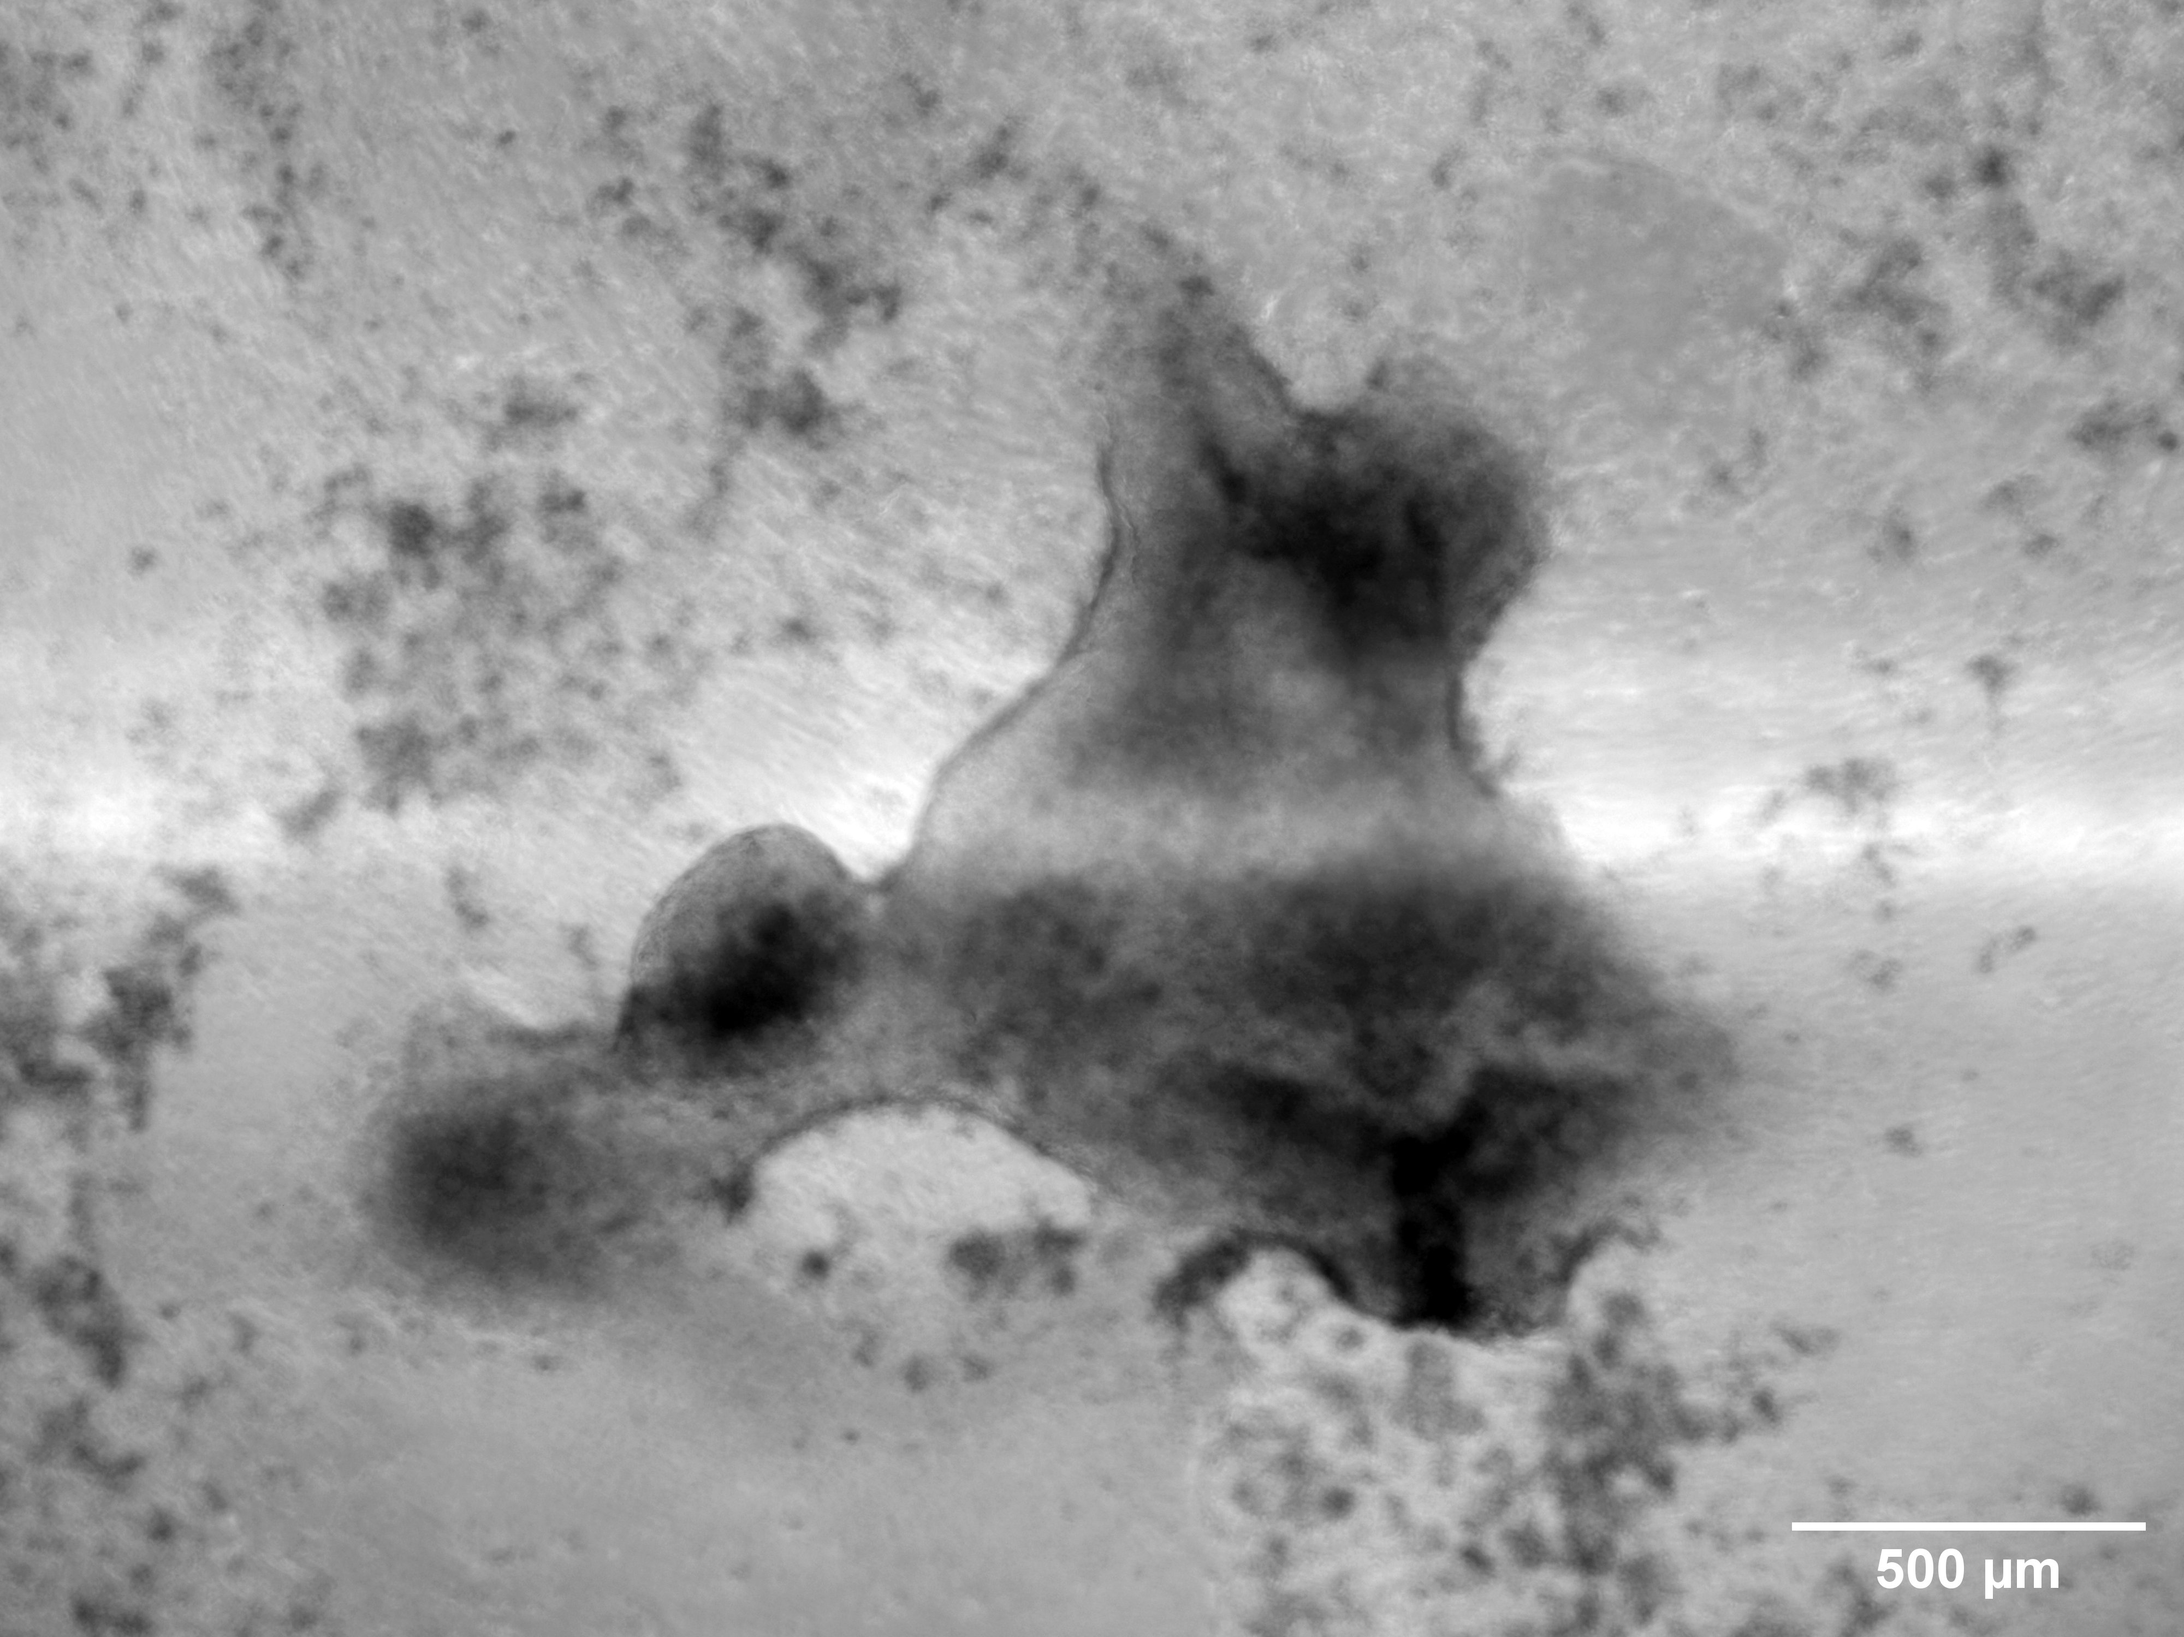
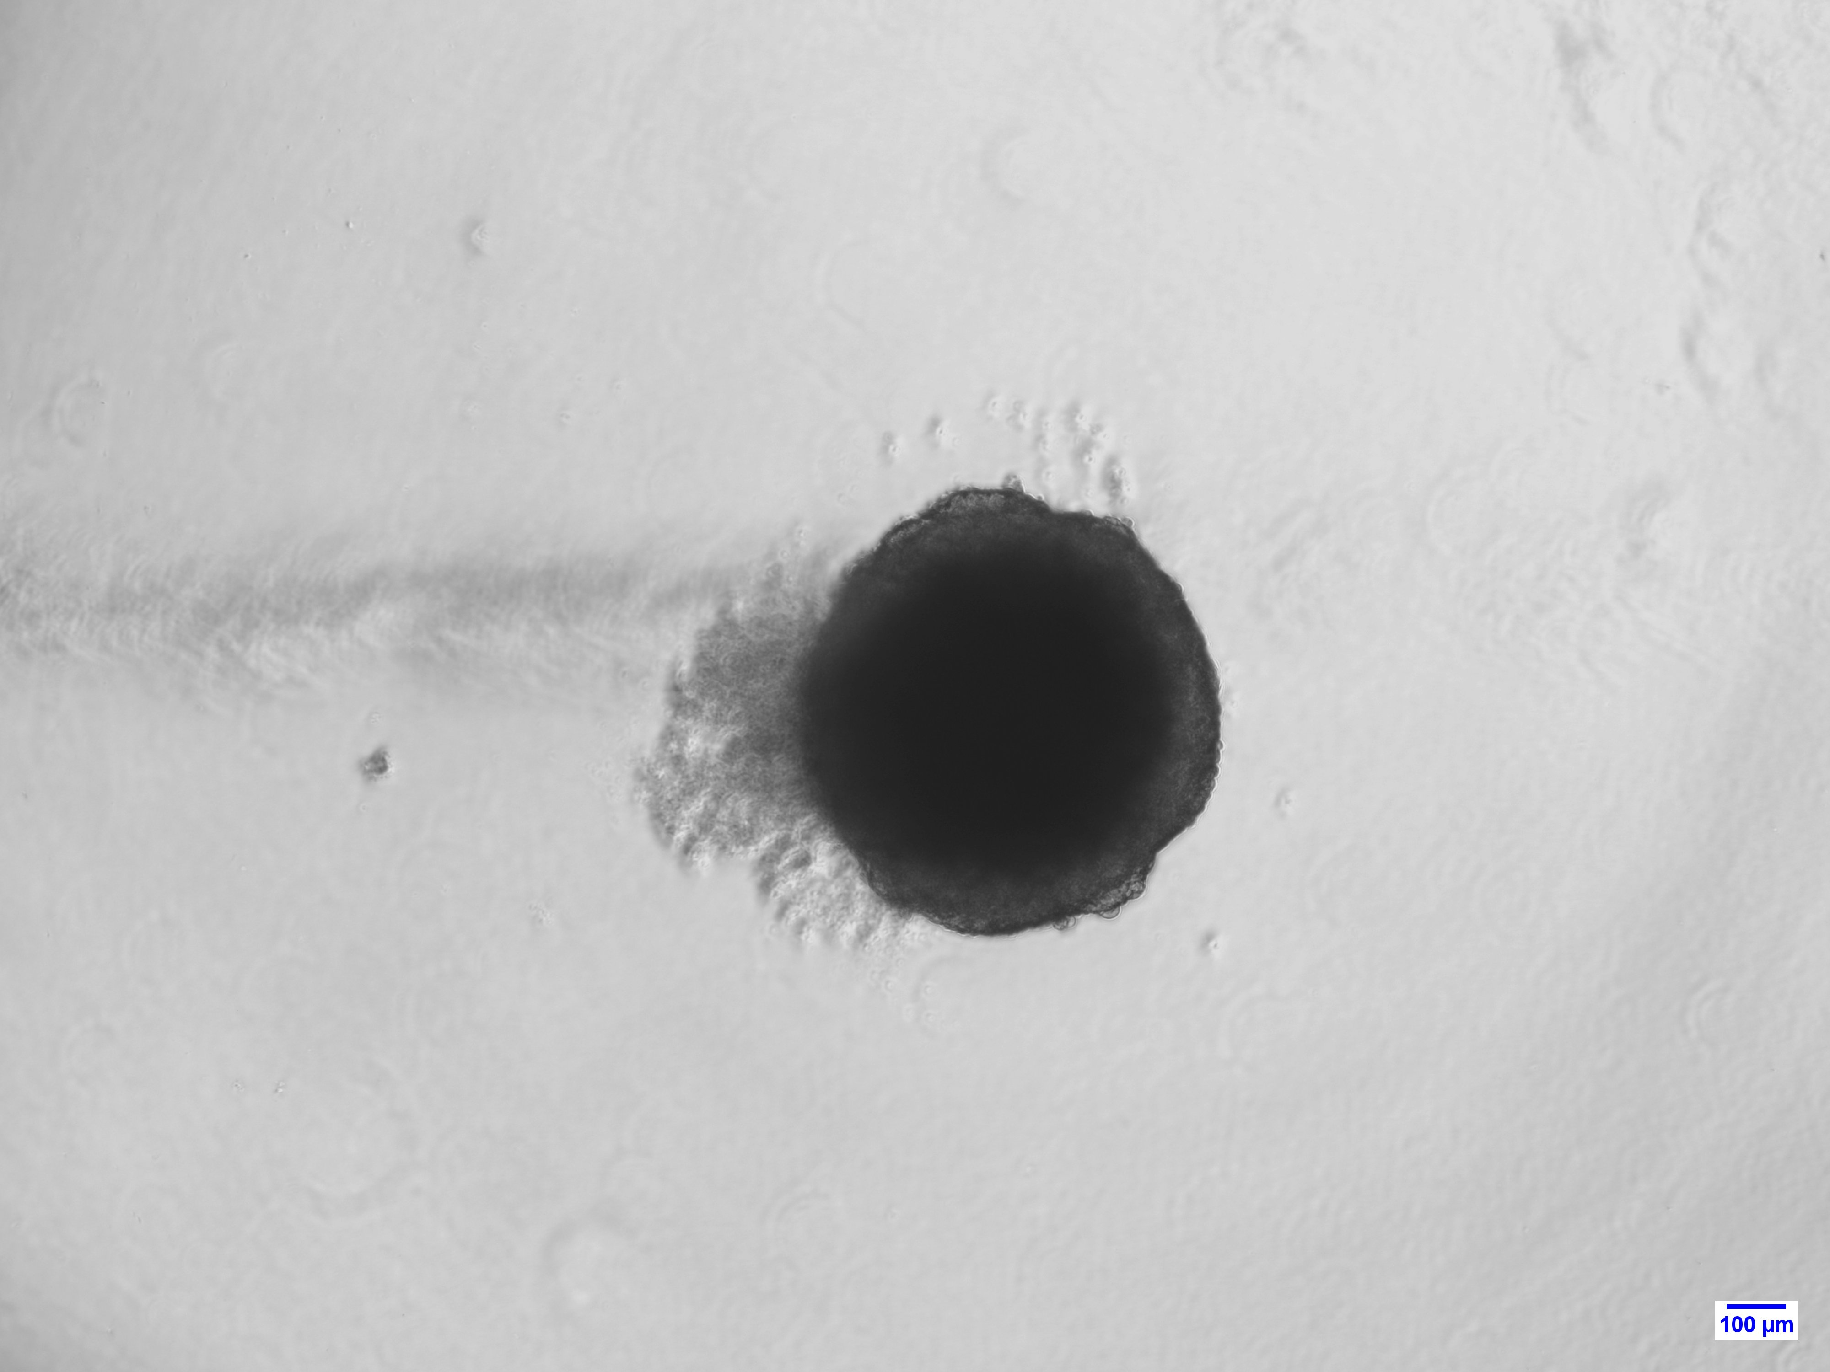
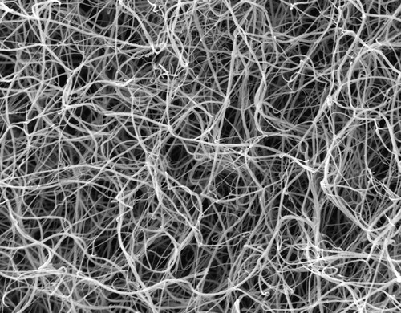
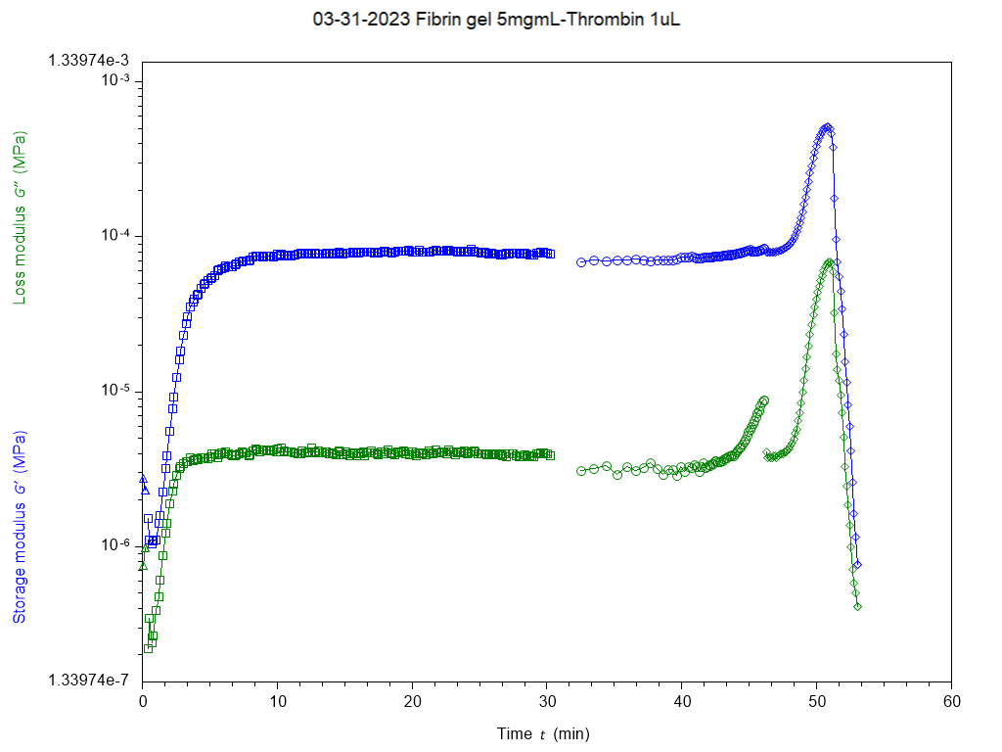
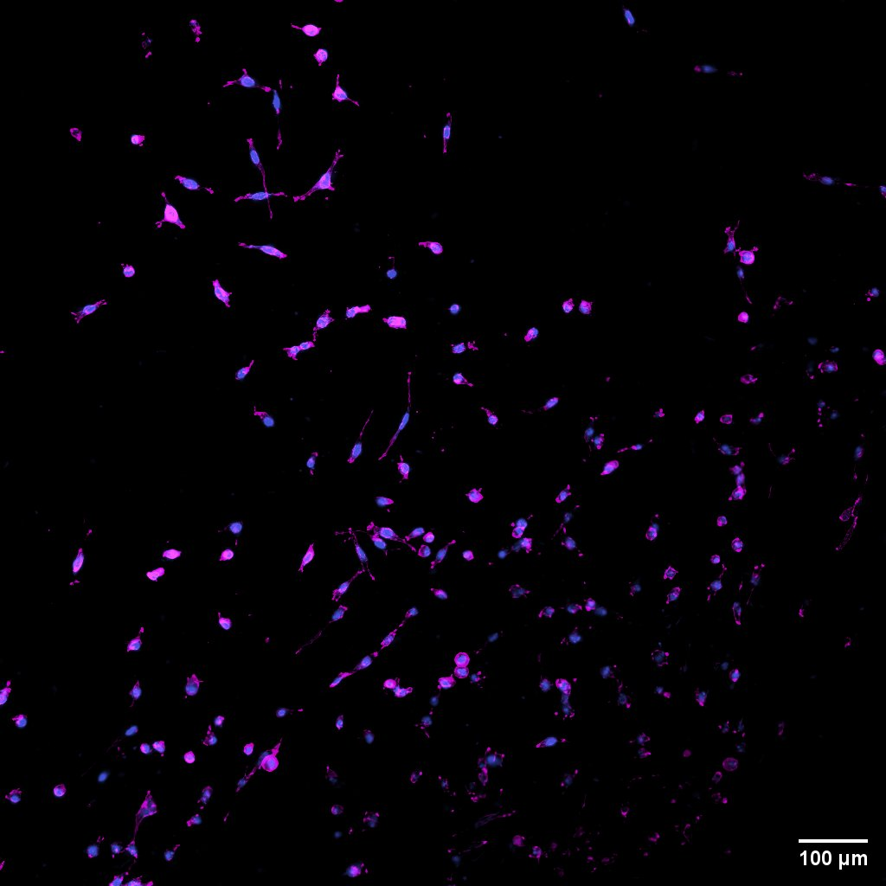
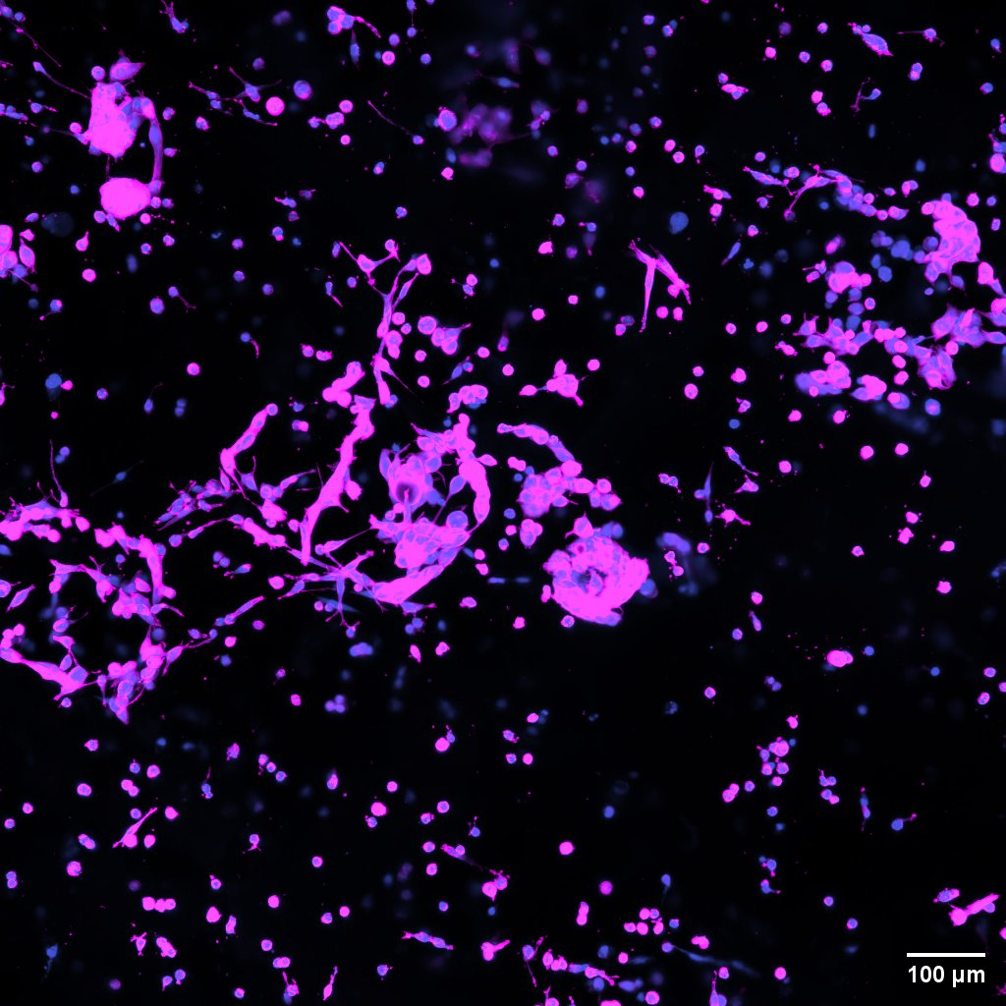
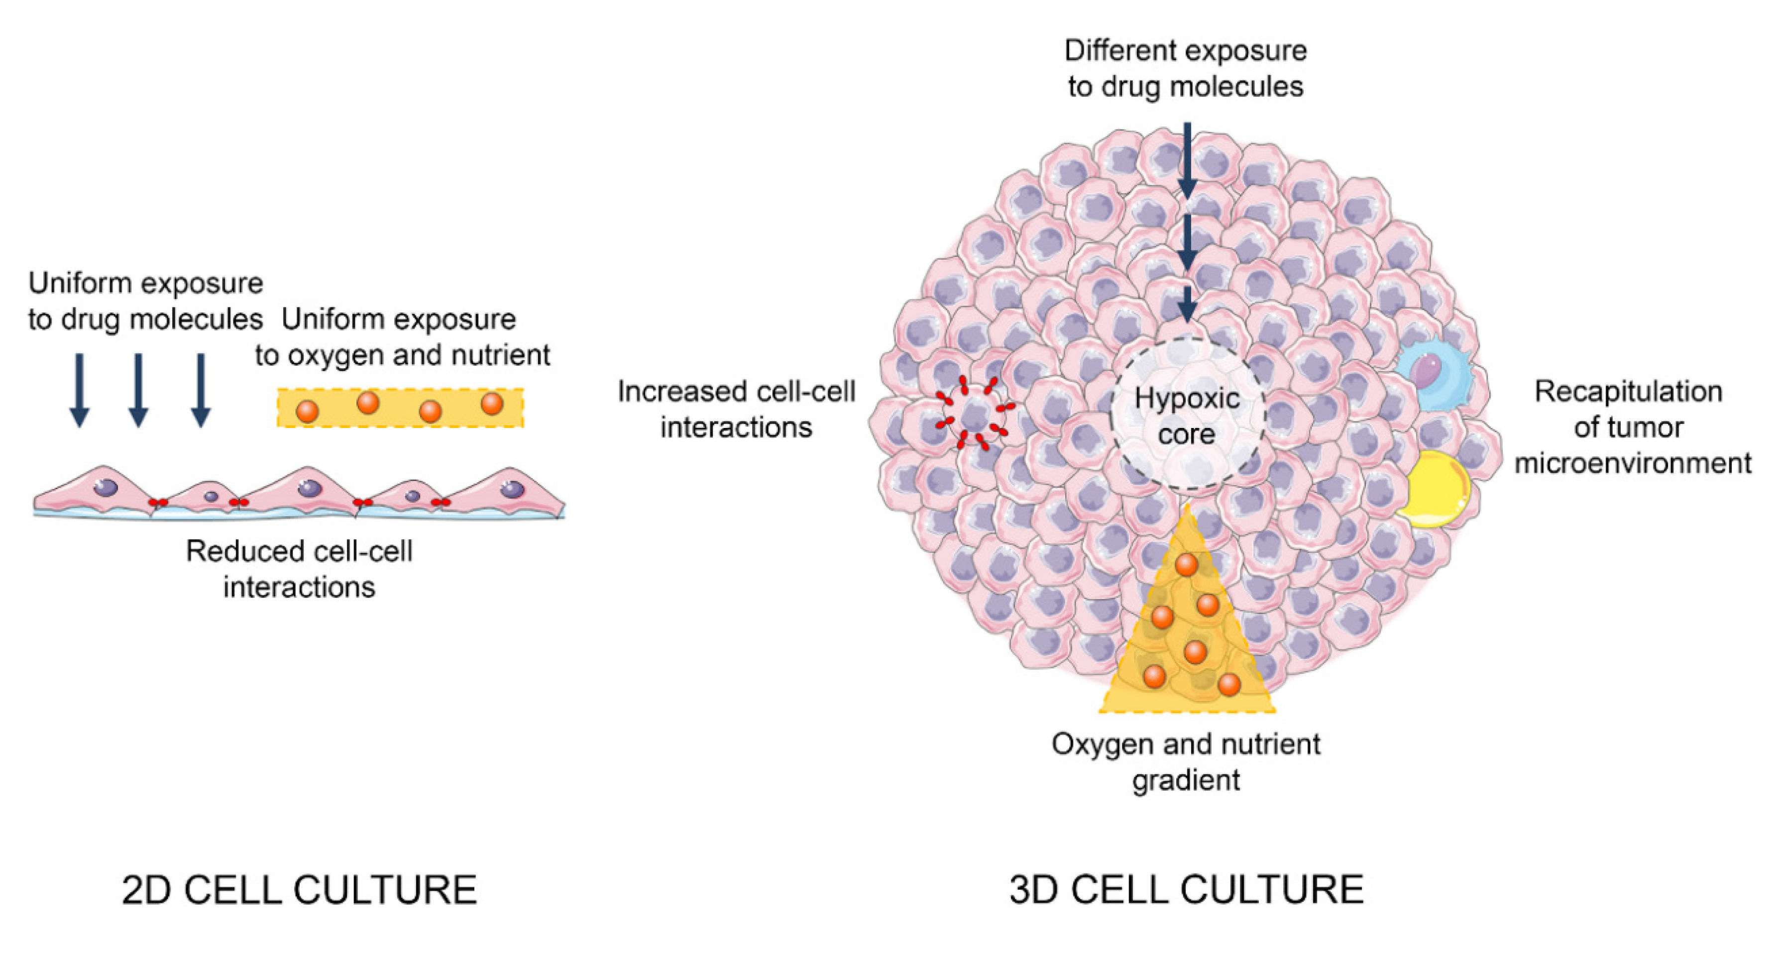
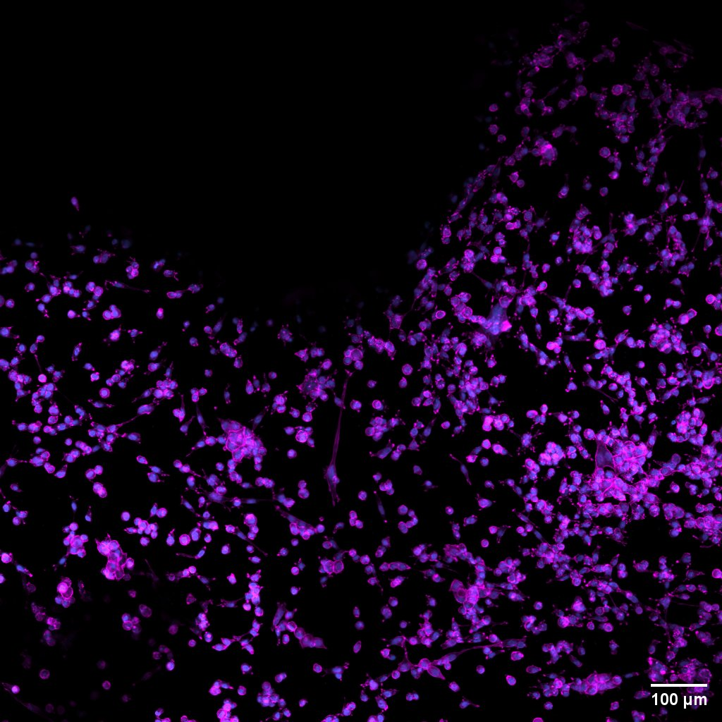
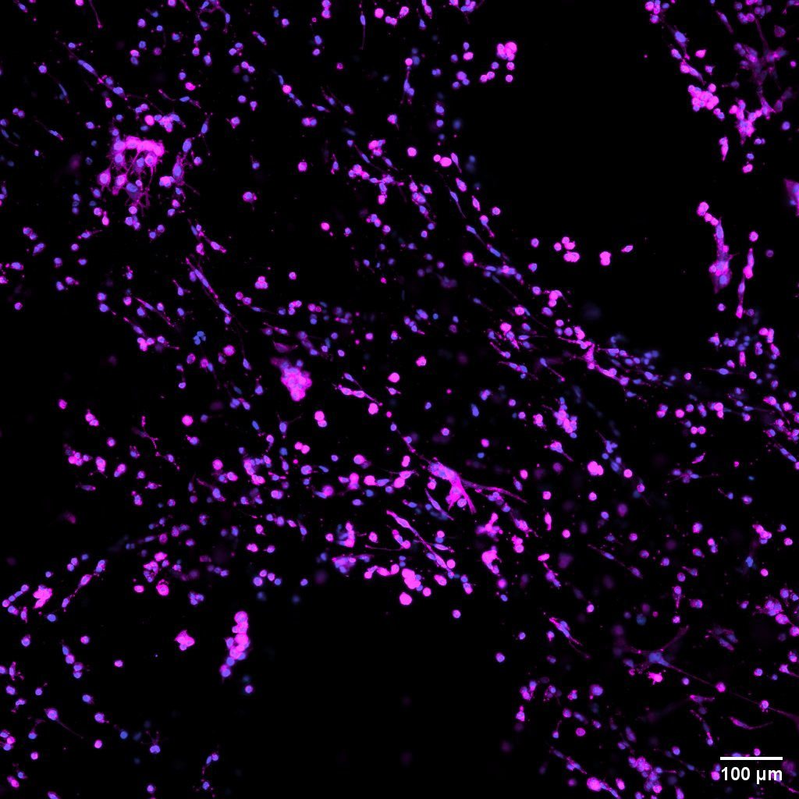
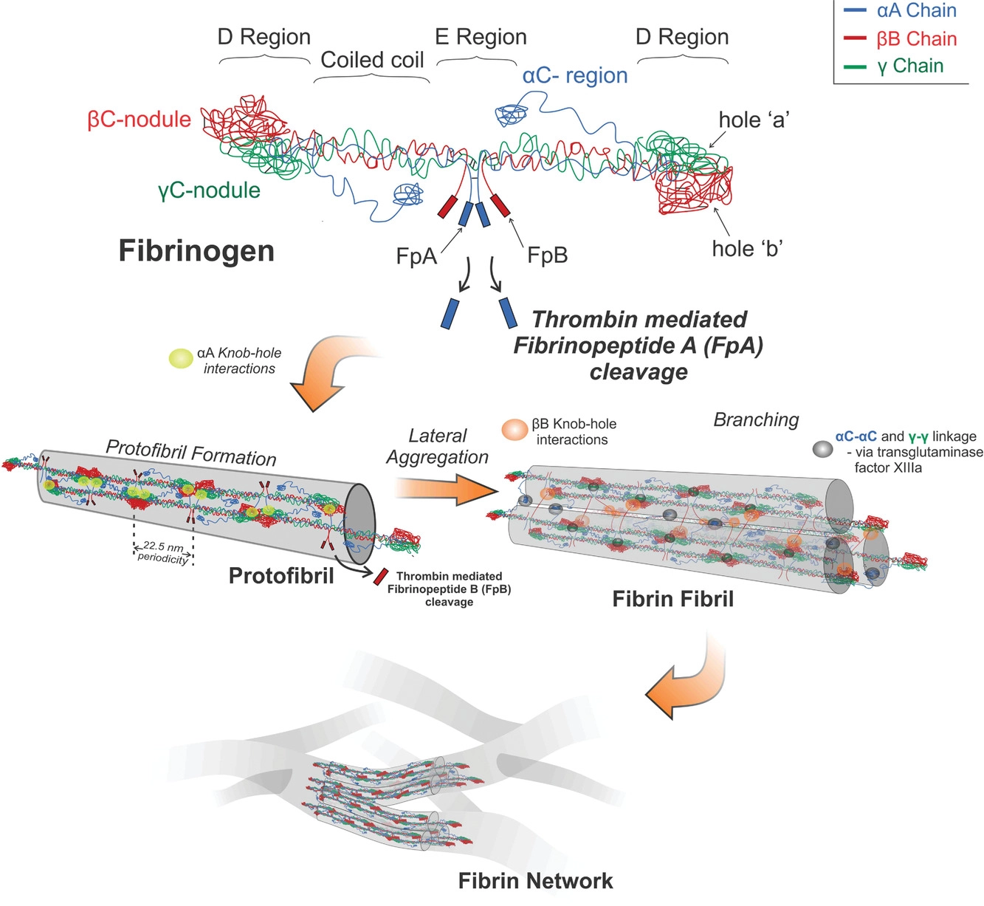
Fibrin Hydrogels with SKBR
Matthew Breton, Naya Leslie, Ronan Fleming, Jaxson Libby, Linqing Li
Department of Chemical Engineering University of New Hampshire
Introduction
40,000 people died from breast cancer in 2015 (4)
SKBR3 is a form of breast cancer
Hydrogels are water insoluble networks of polymer chains that can hold large amounts of fluids or cells (3)
Fibrinogen is a glycoprotein that when mixed with thrombin forms complex linkages seen in hydrogels (5)
The goal is to create an accurate model for in vivo environments found in natural human breast tissue
Results
Discussion
Three-dimensional testing was done to show its resemblance to in vivo
Two-dimensional testing was done to see the efficacy of present models
Fibrinogen hydrogels were created due to their biocompatibility and natural use in the body
SKBR3 cells need to be manipulated to form steroids in 2D but not in 3D
Spheroids formed give an accurate representation of tumor biology
SKBR3 cells ate away soft gels
Multiple concentrations of fibrinogen to thrombin were tested to see what concentrations best represent human breast tissue
2D Phase contrast microscope images
2D fibrinogen gel with SKBR3 that ate through it
2D fibrinogen microscope image using centrifuged SKBR3 spheroids
Graph of storage modulus (blue) and loss modulus (green) of fibrin hydrogel related to time after 60 minutes of oscillatory shear
Figure 1: fibrin hydrogel linking
3D Confocal microscope images
Innovation Scholars
Methods
Cells grown on a 2-dimensional and 3-dimensional matrix
Typical normal breast tissue stiffness is 42.11N/cm (6)
Master mix was created using PBS, sodium chloride, & DI water
Trypsin was used to “unstick” the cells from the grow plate
Fibrinogen gel recipe: Fibrinogen, Saline to dilute, Thrombin
Various concentrations of fibrinogen to thrombin activator were tested
Cell counts were taken using a hemocytometer
Cells were put through a centrifuge in a 96 well plate to create spheroids for the 2D plates
Conclusions
Our research found that 3 dimensional models were a better representation of the human body
Tissue stiffness determines how quickly cancer deteriorates the surrounding environment
5mg/mL 3D fibrinogen confocal image using red cap bovine fibrinogen
5mg/mL 3D fibrinogen confocal image using red cap bovine fibrinogen
Future Work
Further research in hydrogels for in vivo models of cancer will lead to increased information as to how cancer works and how the ECM impacts cells.
Create a tensile and stiffness index for all body tissues to modulate appropriate tissue hardness
How does changing the stiffness of the tissue over time cause normal cells to transform into cancer cells in 3D matrices
Test common cancer treatments on cancer cells grown in the 3d fibrin hydrogel
Acknowledgements
Innovation scholars
University instrumentation Center
CEPS
Everyone at the URC
Figure 2: 2D vs. 3D
10 mg/mL 3D fibrinogen confocal image using Sigma fibrin powder
5 mg/mL 3D fibrinogen confocal image using Sigma fibrin powder
References
(1) Dietmar W. Hutmacher Biomaterials offer cancer research the third dimension
(2) Yunfeng Li and Eugenia Kumacheva Hydrogel microenvironments for cancer spheroid growth and drug screening
(3) Carol E. DeSantis, et. Al. Breast cancer statistics, 2015: Convergence of incidence rates between black and white women
(4) Lini V. Korah, et. Al. Hydrogels, DNA, and RNA polypeptides for the preparation of biomaterials
(5) Paul A Janmey, Jessamine P Winer, and John W Weisel Fibrin gels and their clinical and bioengineering applications
(6) Norman F. Boyd, et. Al. Evidence That Breast Tissue Stiffness is Associated with Risk of Breast Cancer
Figure 3: fibrin clot formation
Notes:
In 2015 alone 8.8 million people died from cancer (2). 40,290 of those deaths were from breast cancer (3). SKBR3 is a form of breast cancer that was isolated in 1970, with an epithelial morphology. Fibrinogen is a glycoprotein that when the enzyme Thrombin is added complex linkages form creating a clot which is used to form a bio-hydrogel ( a water insoluble 3-dimensional network of polymer chains that hold large amounts of liquids). The protein is commonly found in the liver. Finding an appropriate way to test chemotherapy drugs has been an issue for years. The goal has been to simulate natural human breast tissue to create a more accurate environment to study the development of tumors and to see drug interactions before animal testing
Three-dimensional testing was done to follow along with the present hypothesis that cancer cells cultured in these 3D layers parallel in vivo tumors. These 3D models are used to simulate the extracellular matrix(ECM) of the human body. Two-dimensional models like petri dishes are the main form of cancer cell culture today. Leading to the desire to test its efficacy The SKBR cells ate away the soft gels because normal breast tissue is typically soft. Stiffer hydrogels led to malignant mammary cells (2). The reason fibrin hydrogels were used is because the typical ECM of the human body is made of proteins, glycoproteins, proteoglycans and polysaccharides. Fibrin is one of these glycoproteins that are used as a filamentous structure in the ECM. Multiple concentrations of thrombin to fibrinogen were tested to see what combination creates the most accurate representation for the human breast tissue while not degrading rapidly.
Further research in hydrogels for in vivo models of cancer will lead to increased information as to how cancer works and how the ECM impacts cells.

