Slide 1
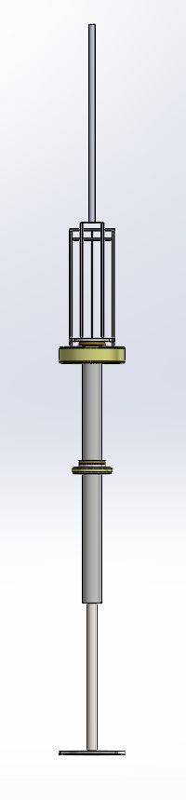
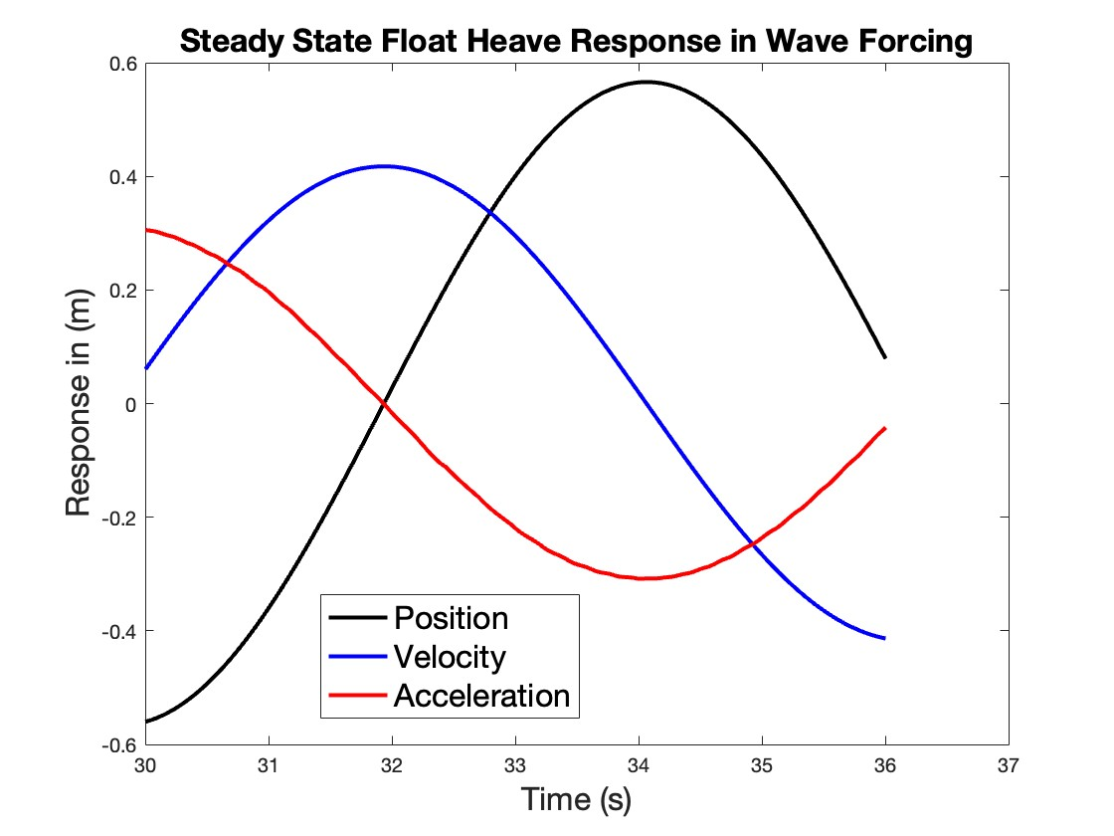
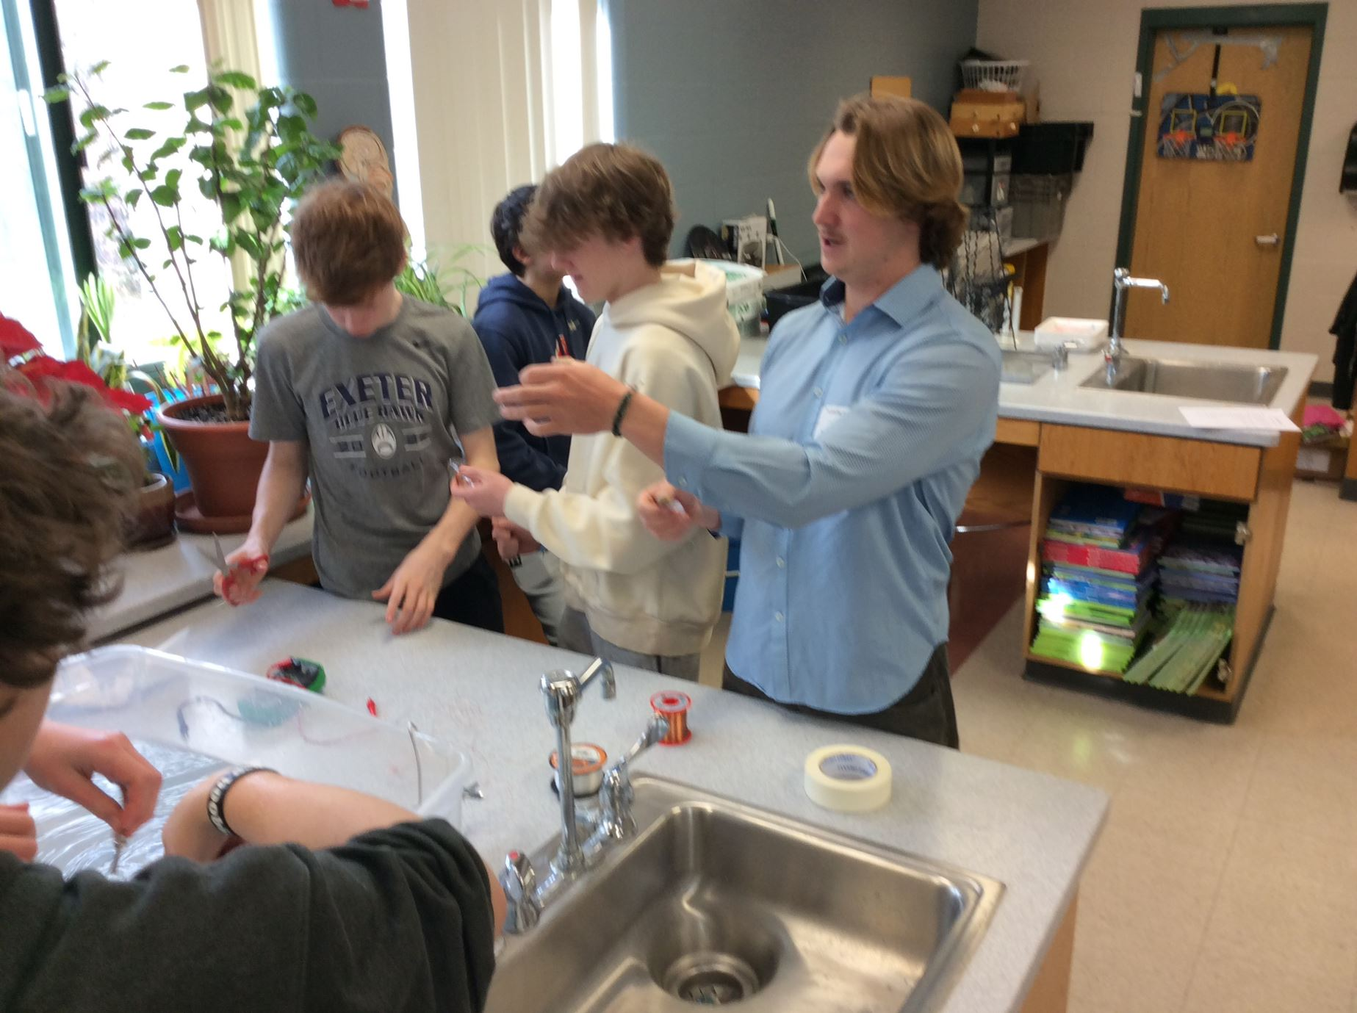
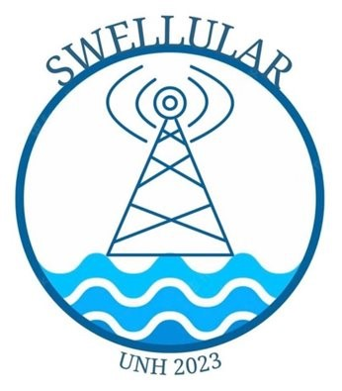
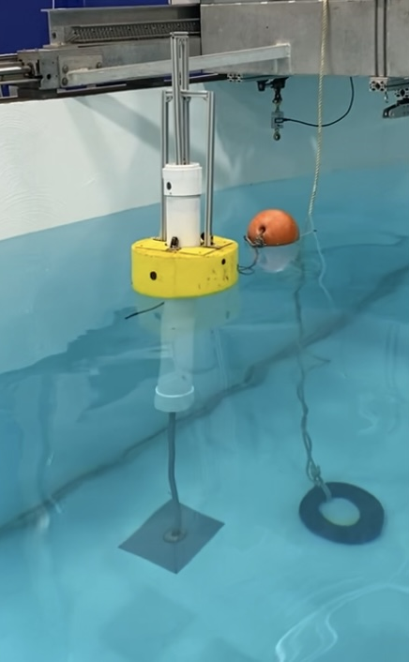
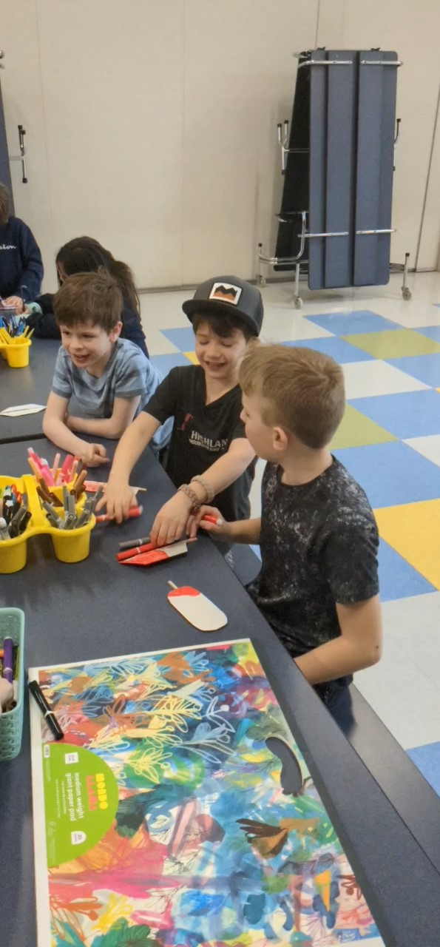
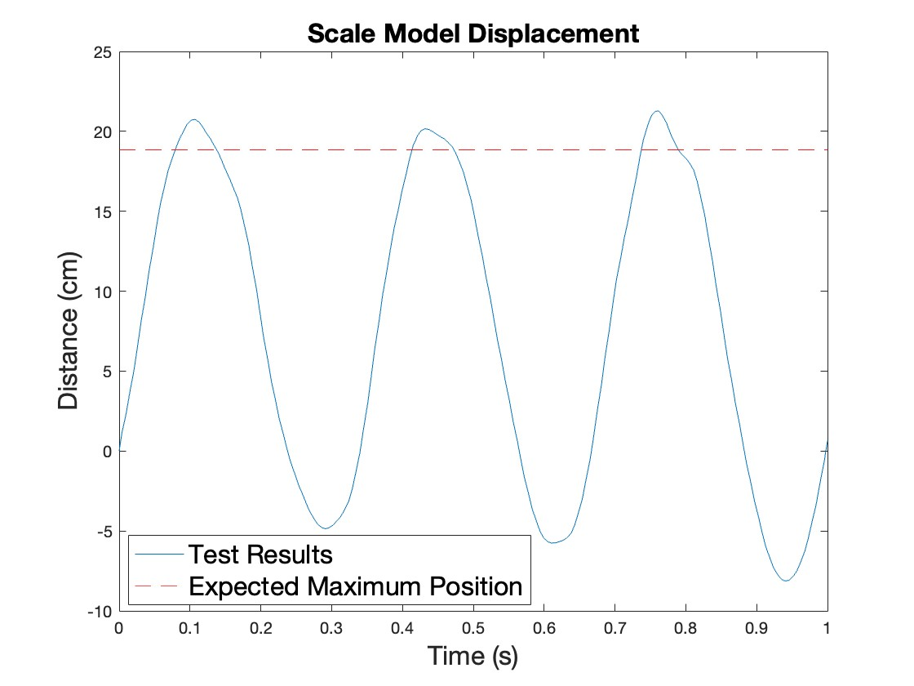
Swellular - Wave Powered Communications System for First Responders - MECC Competition Luke Conroy, Allison Childs, Maddie Strange, Aidan Cadogan, Teddy Evans, Danny Sheehan, Katie Dold, Raeanne Breton Advisors: Dr. Martin Wosnik, Dr. Erin Bell Center for Ocean Engineering, University of New Hampshire
Motivation / Need
Device Design
Co-Design
Customer Discovery
The Marine Energy Collegiate Competition (MECC) works to support and develop:
Powering the Blue Economy
Clean and renewable marine energy
The resilience of isolated and coastal communities
Project Objectives
Communication system powered by marine energy
Easily deployable and retrievable
Provide communication relief following natural disasters
Less carbon emissions compared to alternatives
Puerto Rico & The Caribbean
Frequent natural disasters
Manageable wave energy
Opportunity for infrastructure improvement
SolidWorks
Power take-off/generator design
Stands 7.24m tall
Total weight of 159.39 kg
Calculations
Hydrostatic analysis
$W_{total}$ = 𝜌𝑔$V_{submerged}$
Hydrodynamic analysis (metacentric height, degrees of tipping in wind and wave field)
Power Needs
10 - 250W power required for HAM radio
500W feasible to extract
Assuming 10% overall efficiency
Financials
Sales Price: $25,000+ shipping and maintenance
Cost of Sales: $14,508
Gross Profit Margin: 46.2%
Break Even Point: 93 units sold (year 4)
Deployment and Retrieval
The product can be easily deployed from an inflatable raft towed behind a small boat or off a larger vessel, by an independent contractor or member of the community
With the product sitting offshore, it will not be in the way of any disaster relief cleanup efforts
GPS allows for easy retrieval
Device can be towed once communication infrastructure has been restored
The product targets small island communities in the Caribbean and other locations with similar weather/wave conditions. The team conducted the following interviews to understand the customer base:
John Robinson Jr., Disaster Communications Specialist in FEMA Region 1
Brian Teague, Branch Chief in FEMA Region 4
Customer's Cost of Ownership ($25,000 purchase price)
 | Year 1 | Year 2 | Year 3 | Year 4 | Year 5 | Total
O&M | $800 | $744 | $692 | $599 | $449 | $3,284
Today's Dollars $28,284
* Assumes 7.5% interest rate
Community Outreach
Outreach conducted to educate the community on marine renewable energy so they can better understand it's benefits and potential.
8th Grade Science Classes
Led lessons on wave energy, renewable energy, electromagnetism, and buoyancy
Students created small prototypes of our model and measured electricity
Students explored various designs and compared output values
Held fieldtrips for students at UNH to showcase the wave tank, Swellular's model, and conducted buoyancy activity in miniature wave flume
Proposed Solution
Design
Wave energy converter
2-body point absorber
Direct drive linear generator
Electricity stored in batteries
Radio repeater extends range of HAM Radios to help first responders communicate
Characteristics
Easy to deploy and maintain
Usable in remote locations
Simple mechanics
Multiuse
Lightweight
Durable
3D model created in SolidWorks
Environmental Impact
Calculated heave response
Environmental Risks
Wildlife entanglement
Disturbing noise to aquatic life
Chemical leakage
Lost product pollution
Solutions
Single mooring line
Noise insulating casing
Nontoxic paint and totally enclosed spar
GPS to track in case of damage
K-5 Program
Reviewed concept of electricity
Taught importance of renewables
Led a wind turbine activity
Validation: Scale Modeling
Froude Scaling
Built to maintain hydrodynamic similarities
1:3 scaled model
Based on original design's size, weight and power capabilities
Our team and product logo: Swellular
Model Testing
Tested in UNH Wave Tank
Heave analyzed using Kinovea motion software
Durability tested in extreme wave field
Prototyped generator
Tested to have 25.9% efficiency
Device Modeling
Stakeholders
Preliminary Design
Used for basic calculations
Used to estimate costs
WEC-Sim
Model's geometry and direct linear power take off in wave conditions
Estimates power, current, and voltage outputs
The key objectives in conducting stakeholder research were to analyze the market’s need for our product and adapt based on feedback.
Top: 8th-grade building mini prototypes, Left: Students making small wind turbine blades,
Right: Fieldtrip at UNH’s Chase Ocean Engineering Laboratory
Reached out to communication professionals to refine product
Initially conducted market research to find need for the product without a large financial investment, reducing the risk of failure
Essential to engage with stakeholders throughout the project's lifecycle to address concerns and build support for the project's success
Future Work
Scale model being tested in wave tank
WEC-Sim Validation
Finalize model parameters to obtain accurate output predictions
Scale Model Validation
Currently waiting on materials to arrive to continue model power testing
 | Wave Height (cm) | Wave Period (s)
Wave 1 | 10 | 2
Wave 2 | 30 | 1.5
Wave 3 | 27 | 2
Simple model in WEC-Sim
Scale model heave response results for Wave 3
Tested wave states
Team Swellular would like to thank UNH's College of Engineering and Physical Sciences, United States Department of Energy, Dr. Rob Swift, Dr. Tom Lippmann, and Chelsea Kimball for their guidance and support.

